Slide 1

UNIT 3:
DATING
Teacher’s name:
Vuong Thanh Thuy

Slide 2
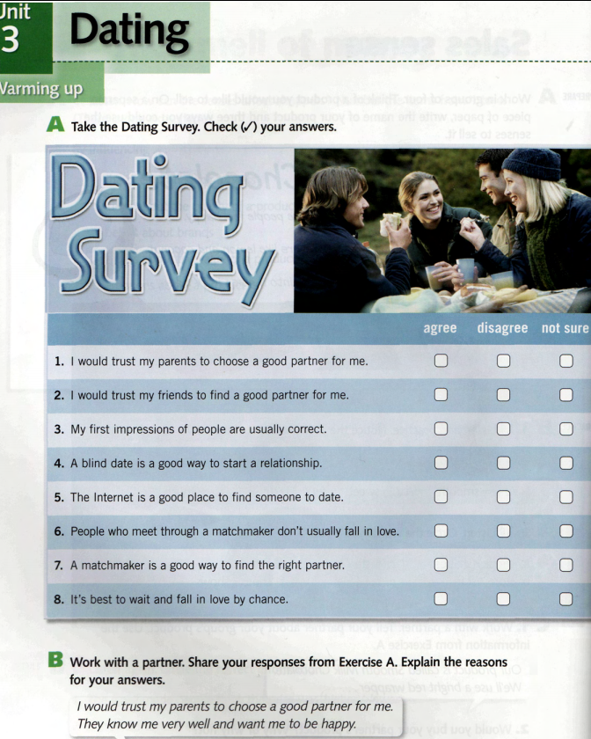

Slide 3
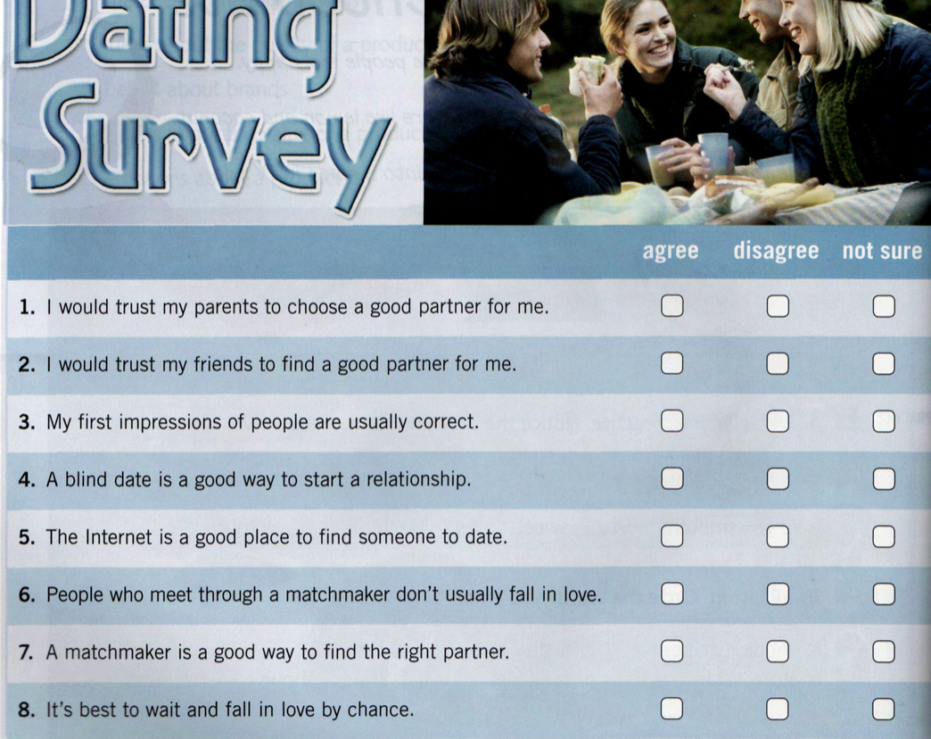
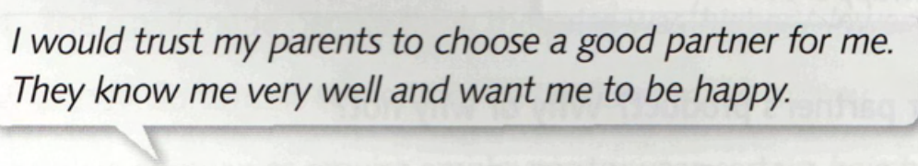
√

Slide 4
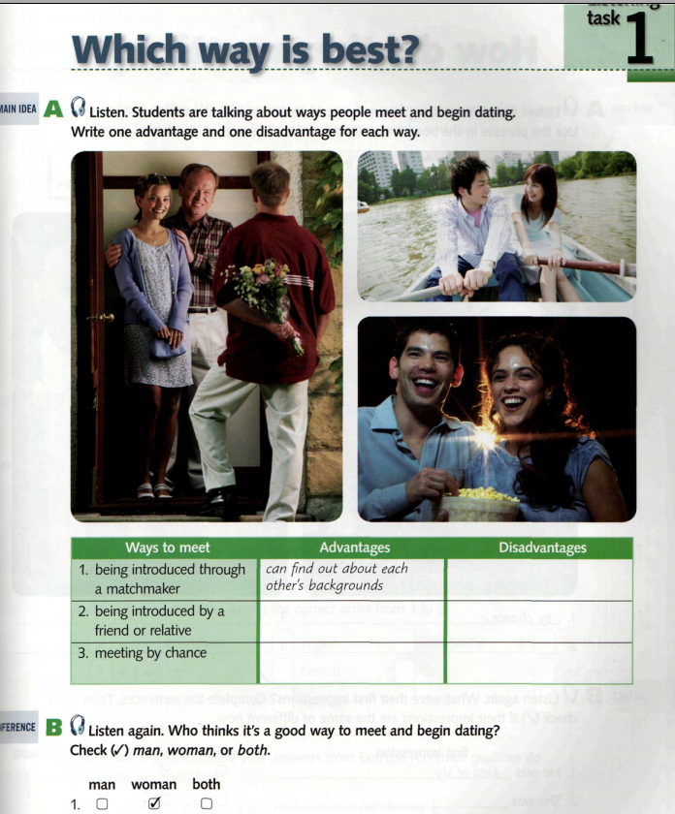

Slide 5
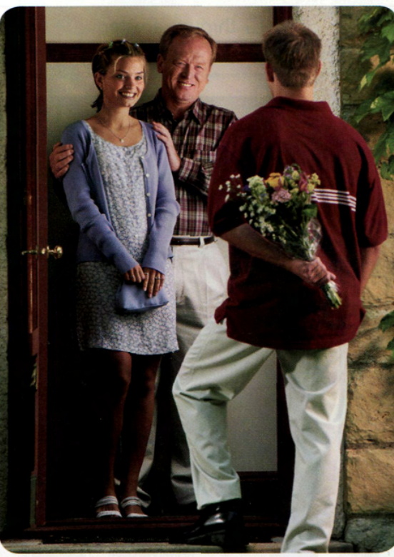
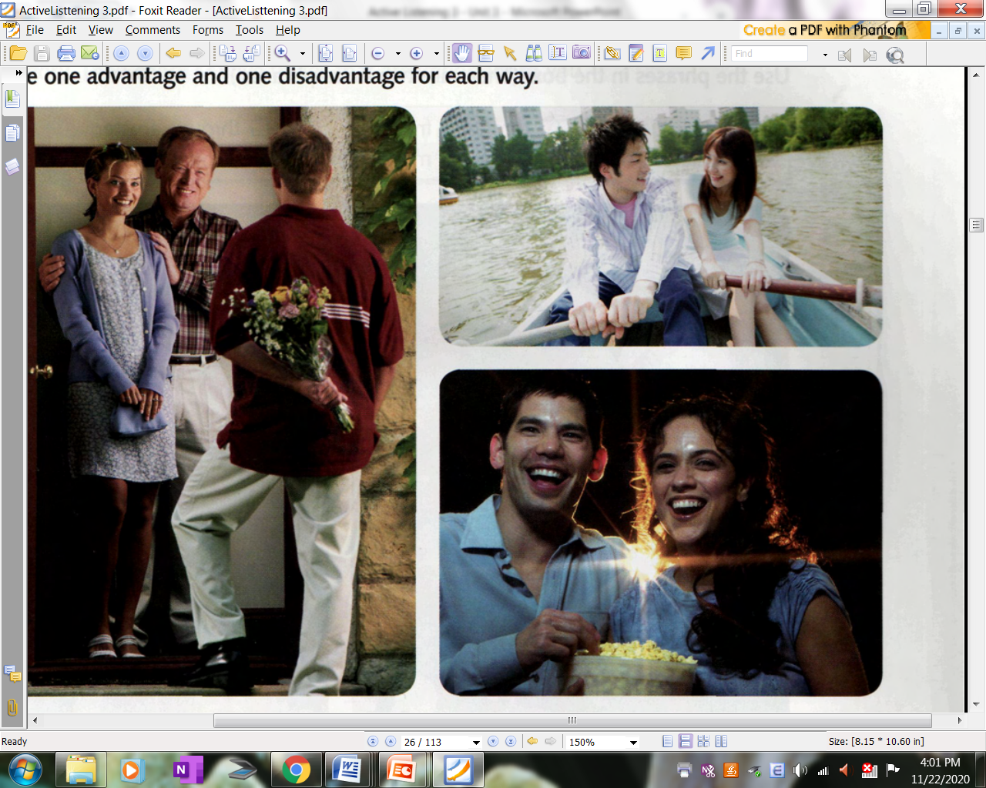
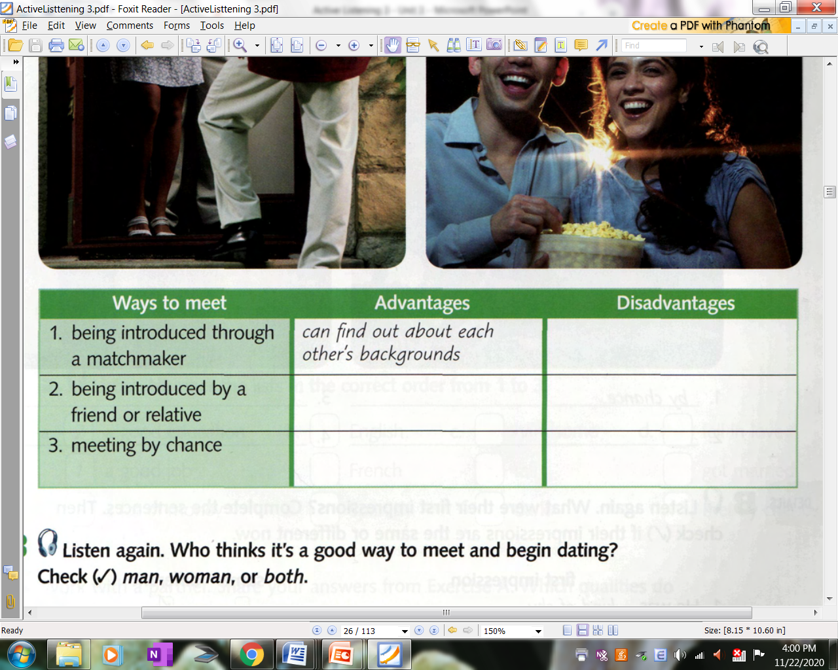
1.13
may never fall in love
They know you & your interests
Pressure;
have to date
may really fall in (true) love
may never find the right person or get married

Slide 6
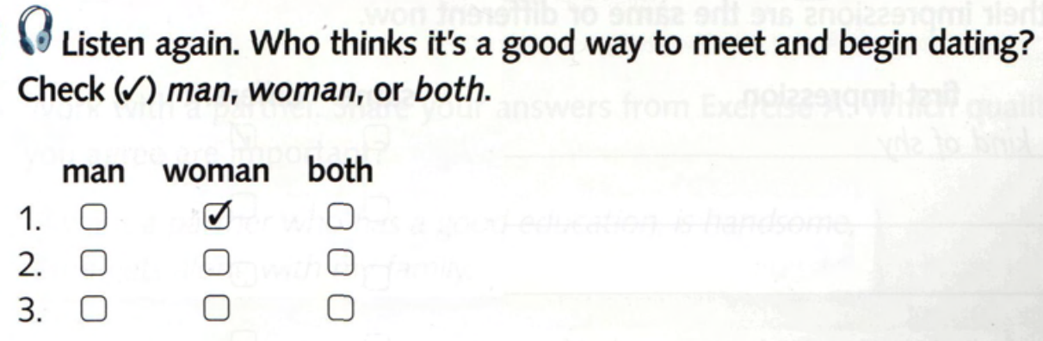
√
√

Slide 7
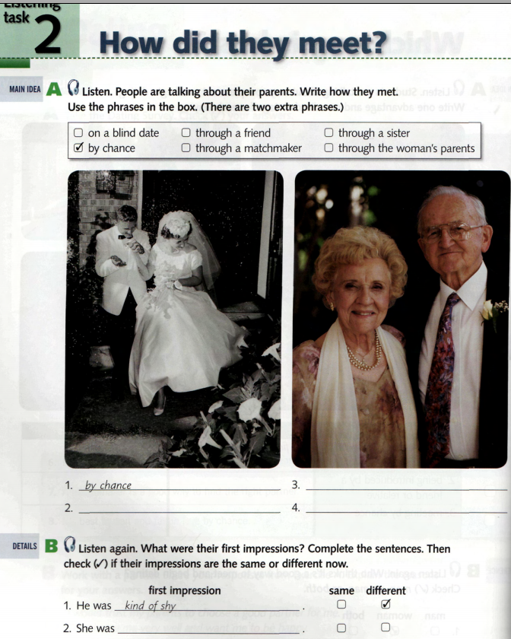

Slide 8
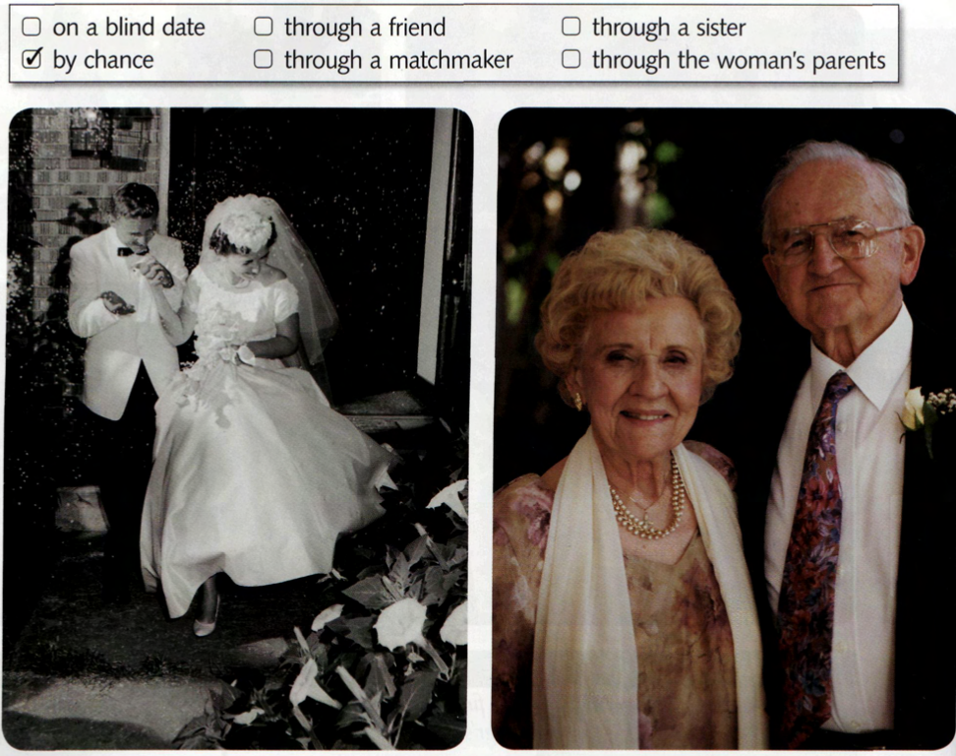
2
1.14
4
3

Slide 9
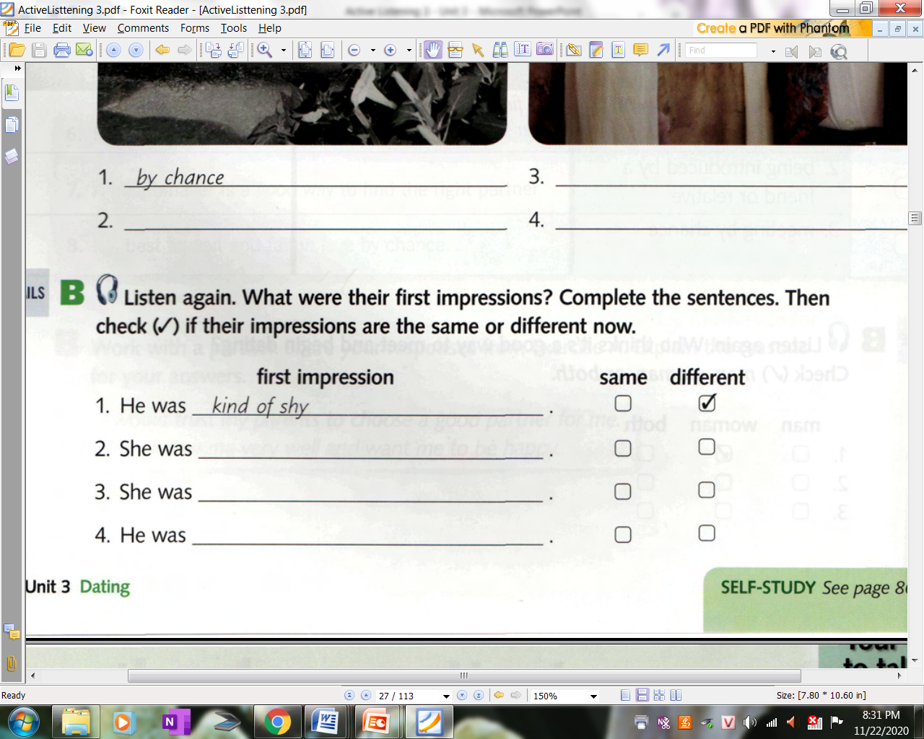
1.14
really funny
√
talkative
√
too old
√

Slide 10
1.
Where did they start dating?
Why didn’t he know anybody?
By chance, what happened to them?
What did mom think about him at first?
What did they do together once in a while?
1.14
high school
just move to town
They sat next to each other.
A kind of shy
Speak French

Slide 11
2.
Why does he feel funny?
How can they call that date?
Who introduced her to him?
When did they go out?
What did she do?
1.14
Bc his parents had never seen each other before their first date.
A blind date
His father’s boss
that night
Telling stories, making his father laugh

Slide 12
3.
What did she have?
What did her parents do?
What did dad think about her at first?
Is she really like that?
Why did she do like that?
1.14
Many friends
introduce partners
Talkative/ talking a lot
No
nervous

Slide 13
4.
Where did they meet?
When did he want to get married?
What was the problem?
Who did his parents call?
How old was she?
1.14
South Korea
30
He didn’t know any women his age who weren’t already married.
A matchmaker
22

Slide 14
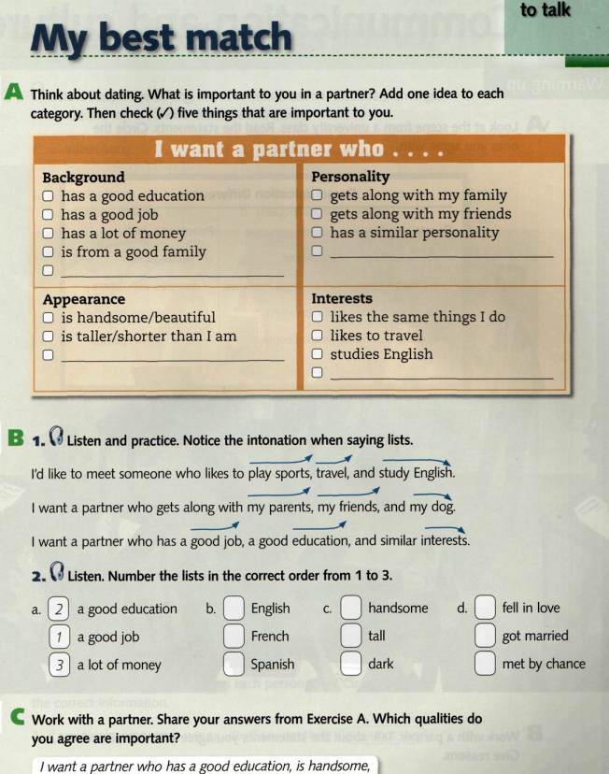

Slide 15
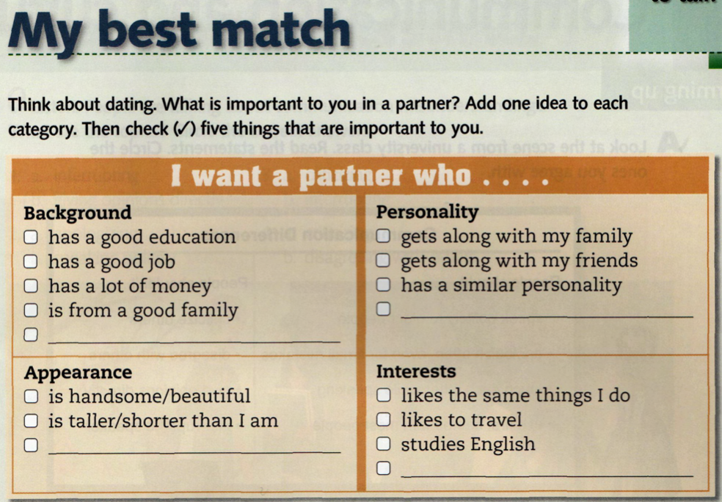

Slide 16
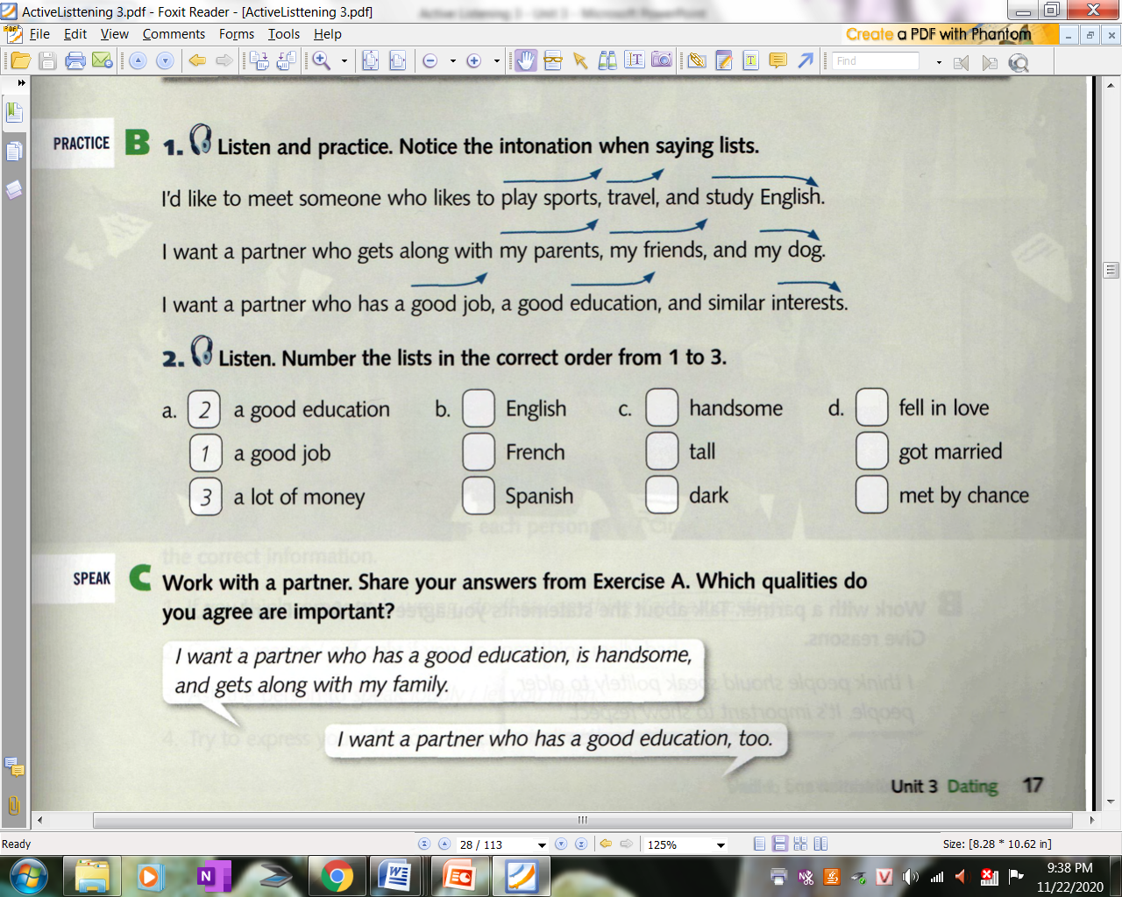
1.15
3
3
2
2
1
3
1
2
1
1.16

Slide 17
DICTATION
I just met my perfect match! He has a good job, good education, and a lot of money.
My sister’s new boyfriend speaks Spanish, French and English.
My ideal man would be tall, dark, and handsome.
My parents’ story is really romantic. They met by chance, fell in love, and got married.
1.16

Slide 19
4
____1____
√
1.08
planning to do

