Slide 1

Adaptive Learning Systems
Overview
DRAFT
Dale P. Johnson
Director
Adaptive Learning Initiatives

Slide 2

What are we trying to accomplish?
MISSION: Enable Student Success
OBJECTIVES:
Improve critical thinking & problem solving
Increase student subject mastery
Increase student retention
Improve instructor insight
Achieve 90% freshman retention
Do active learning in every class
Help 90% of students get C or better
Reduce withdrawal rate to under 5%
Identify struggling students by week 2

Slide 3






What subjects are we working on at ASU?
2011 2019
    Biology
    Chemistry
    College Algebra
    College Math
    Economics
    General Science
    History
    Physics
    Psychology
Adaptive software is necessary
but not sufficient to enable student success.

Slide 4
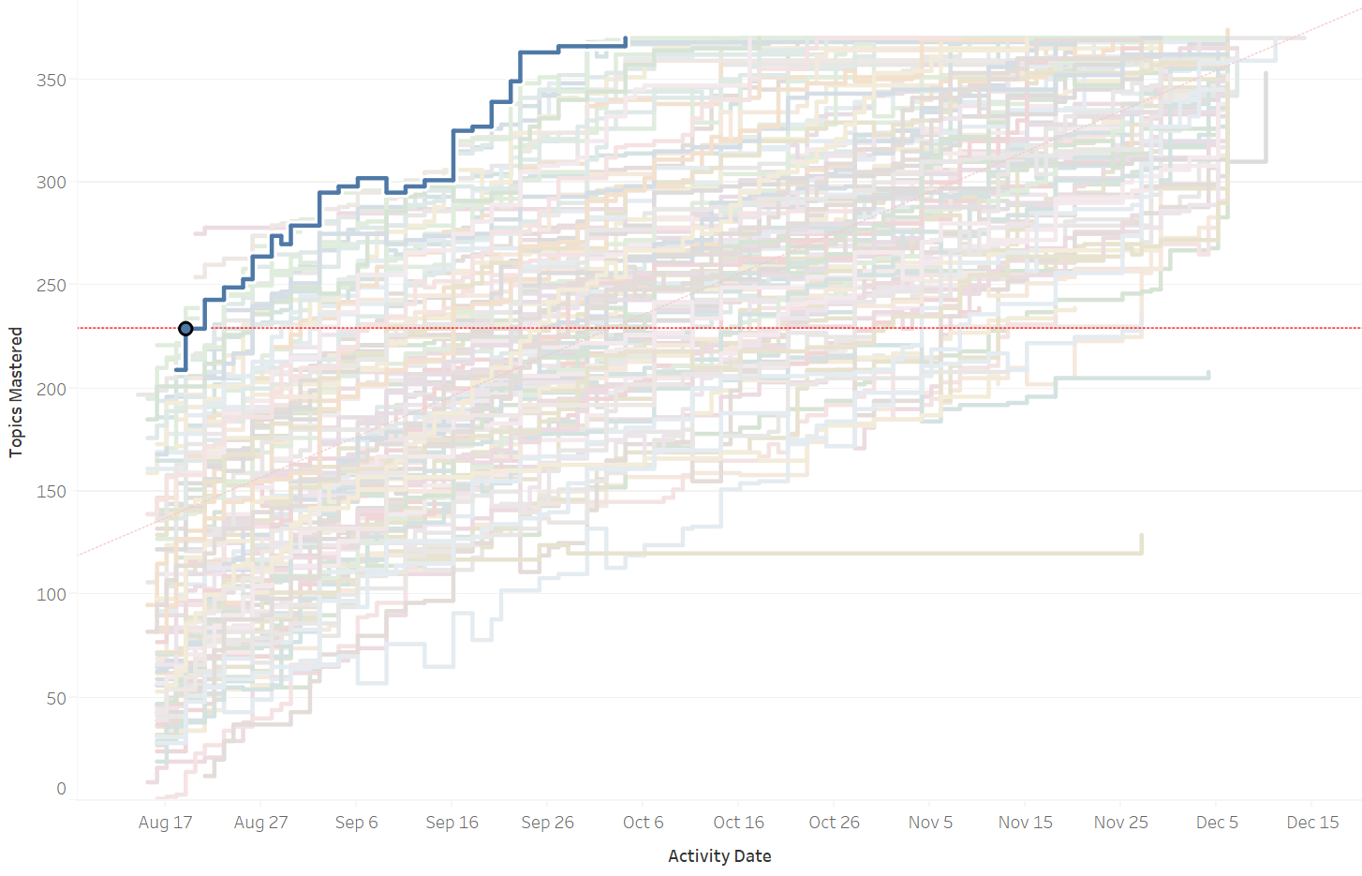
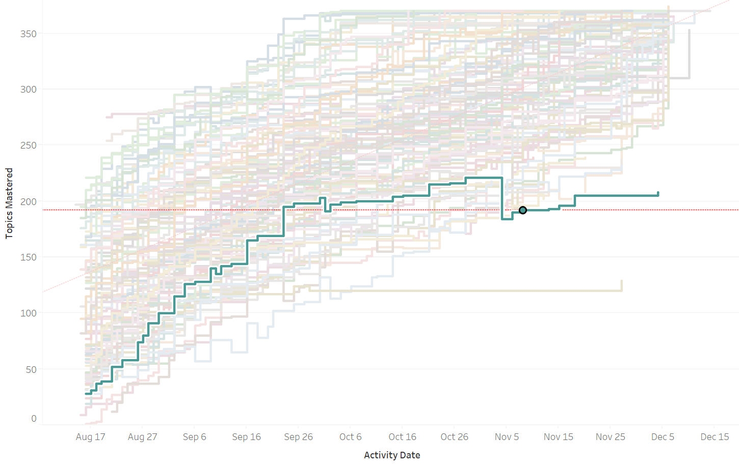
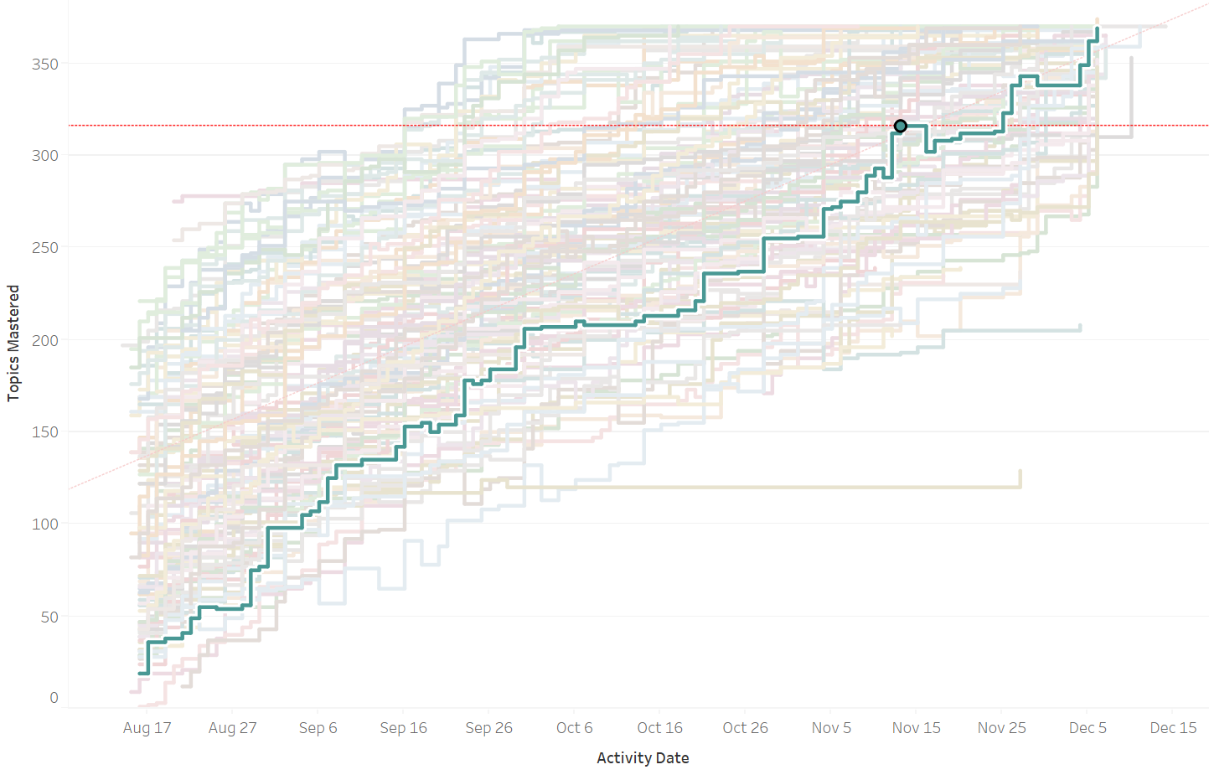
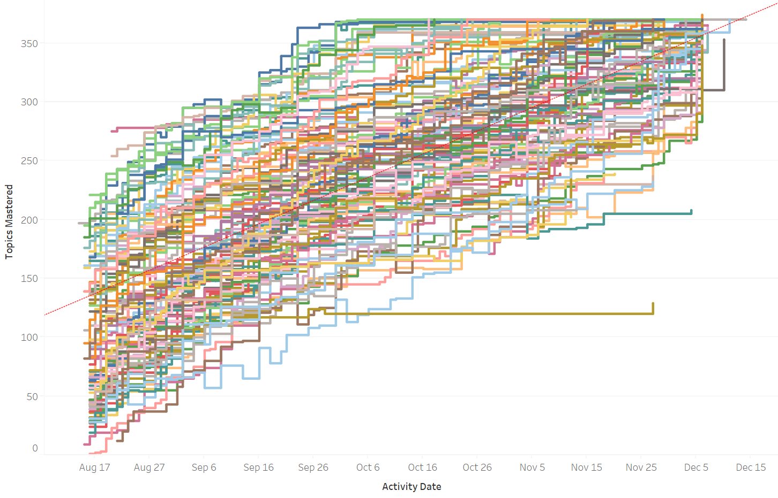
Why are adaptive instructional systems needed?
INSIGHT
Who needs help?
What do they need help with?
What’s the best way to help?
Notes:
Students start with different levels of knowledge.
This is reality!
Our old (current?) view was blinded by lack of data.
Personalization is possible at scale.
Professors can now closely monitor performance.

Slide 5
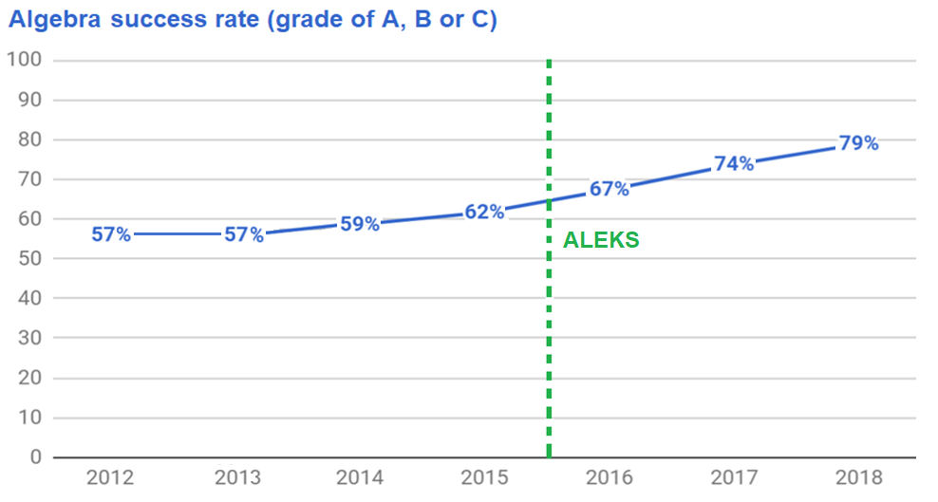
How have they helped students at ASU?
+ 17%

Slide 6

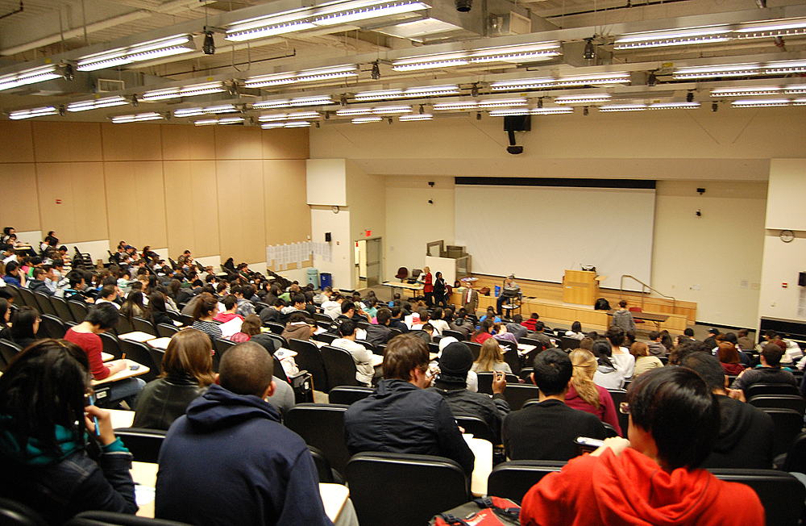
What do we mean by adaptive courseware?
Right Student
All Students
Same Time
Right Lesson
Same Lesson
Right Time
Notes:
Key goals of redesign

Slide 7
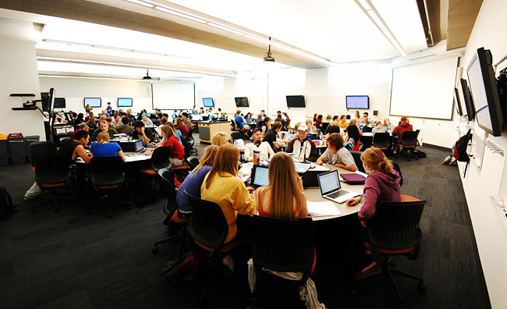

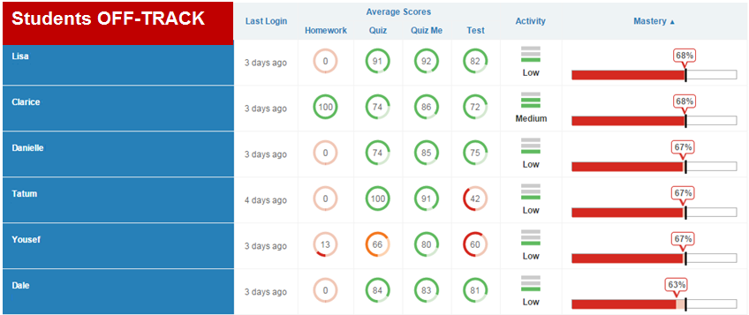
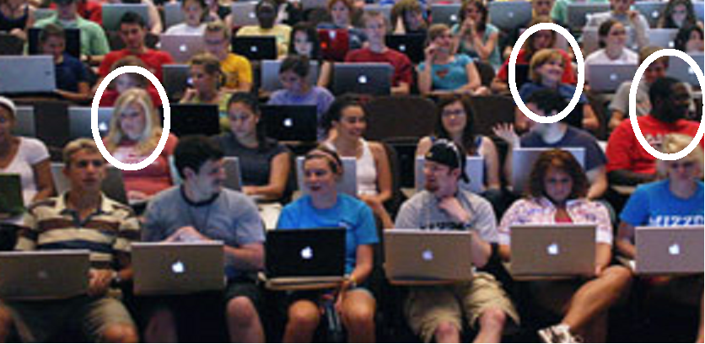
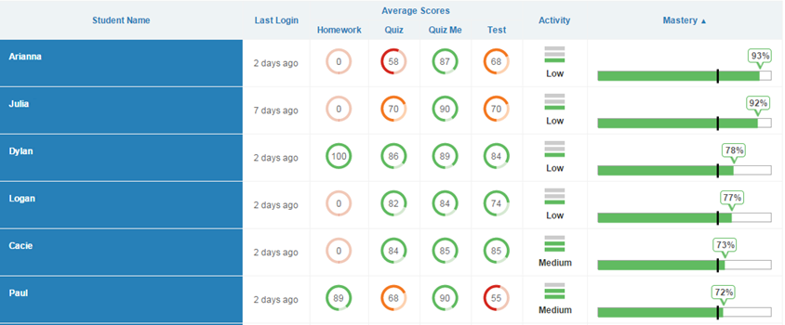

What is the promise of adaptive courseware?
Mass Production
Mass Personalization
Students ON-Track
Notes:
Key goals of redesign

Slide 8
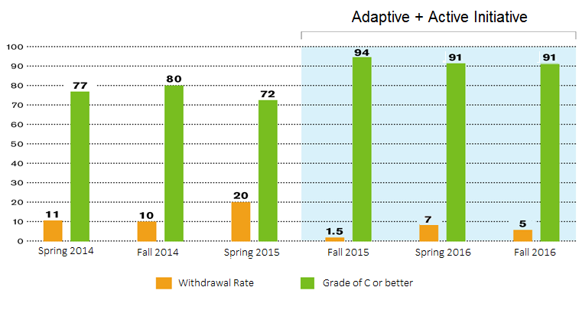
How has it worked at ASU?
Introduction to Biology ~ 1200 students
Fall 2015 implemented CogBooks
Same instructor, curriculum and assessments

Slide 9
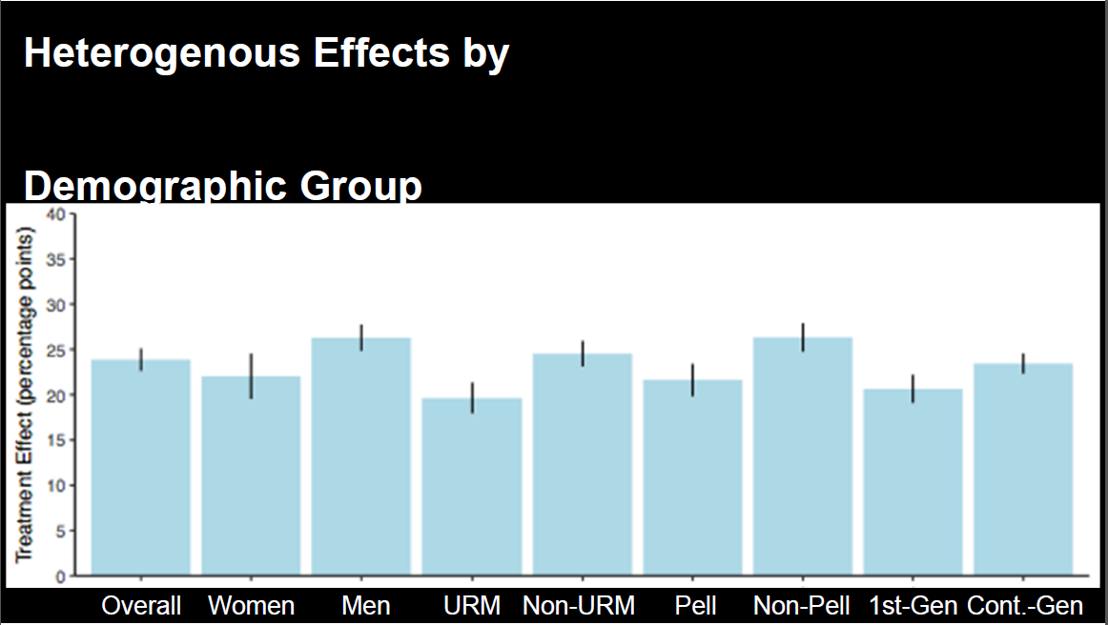
What about different demographic groups?
College Algebra
AY 2016-17 increases in success rates among all groups

Slide 10
How has it worked at ASU?
Microeconomics (~ 2,000 students per year) with Cengage Learning Objects
Same instructor, curriculum and assessment

Slide 11
How are the adaptive systems different?
Static
Dynamic
LMS ADAPTIVE
Variable
- Lesson Plan Fixed
Individual
- Presentation Group
Personalized
- Content Common

Slide 12
What is adapting to the student?
  Lesson sequence
  Content selection
  Algorithm (analytics) – recommendations
  Assessment – rapid remediation
  Association – knowledge network
  Agency – student chooses
What is guiding the adaptation?

Slide 13

What makes up a measurable Lesson?
  (or Competency, Skill, Topic, Unit, Module, etc.)
  Components form an “Ed Molecule”
Objective
Assessment
Content

Slide 14
How are the Lessons sequenced?
Lesson Chart
  (or Knowledge Map, Skill Graph, etc.)
Basic Math
Algebra
Calculus
Lesson 1
Course Configuration
L-2
L-5
L-4
L-7
L-x
L-3
L-6

Slide 15
How do students experience Lesson adaptivity?
Lesson Library
Lesson
Student
Lesson
Instructional Materials
Lesson
Practice Problems
  Algorithm Assessment
  Association
  Agency
Instructional Materials
Lesson
Assessment Instruments
Objective
Practice Problems
Assessments
Objective
Assessments
Content
Assessment Instruments
Content
Content
Content

Slide 16
How is Content adapting to the student?
    (or Resource, Material, Text, Video, Exercise, Problem, etc.)
Learning Loop
Lesson #1
Lesson X
Pre-Assessment
Algorithm
Assessment
Association
Agency
Content
Content
Algorithm
Assessment
Association
Agency
Algorithm
Assessment
Association
Agency

Slide 17
How are these techniques implemented?
Personalized Lesson Sequence
Personalized Lesson Sequence (Algorithm, Association, Agency)
Personalized Lesson Sequence
Content Customization
Rapid Remediation
Personalized Review
Lesson 1
Lesson 1
L-2
L-2
L-5
L-5
L-7
L-7
L-x
L-4
L-x
L-4
L-3
L-3
L-6
L-6

Slide 18
How are these techniques implemented?
Rapid Remediation (Assessment)
Lesson 1
L-2
L-5
L-4
L-7
L-x
L-3
L-6

Slide 19
How are these techniques implemented?
Content Selection (Algorithm, Assessment, Agency)
Lesson #5
Lesson 1
L-2
Content Library
Content
Video A
L-3
Content
Video B
Algorithm
Assessment
Agency

Slide 20
How are these techniques implemented?
Personalized Review (Algorithm, Assessment)
Adaptive Test Prep
Review materials in:
Lesson 3 (quiz score 69%)
Lesson 4 (quiz score 58%)
Lesson 7 (quiz score 72%)
Lesson 1
L-2
Lesson 1
L-1
L-2
L-2
L-5
L-5
L-5
L-7
L-x
L-7
L-x
L-4
L-4
L-7
L-x
L-3
L-3
L-4
L-3
L-6
L-6
L-6

Slide 21
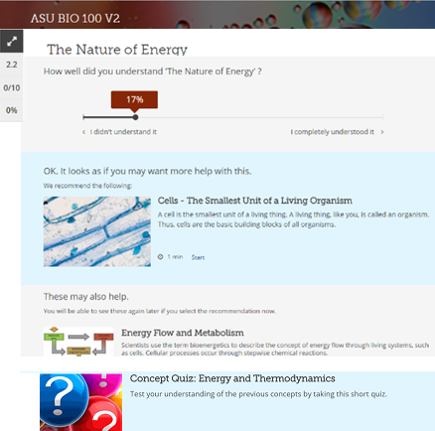
What is an example of a vendor?
  Vendors use a mix of the different techniques:
  Algorithm
  Assessment
  Association
  Agency
Agency
How well did you understand The Nature of Energy?
I didn’t understand
I completely understood
Algorithm
We recommend the following content:
Association
These may also help:
Assessment

Slide 22
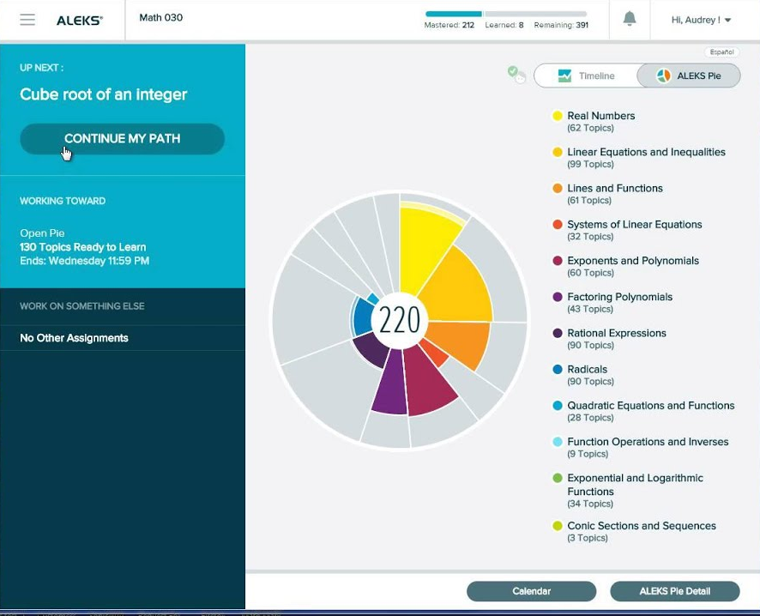
How do the systems help students?
    Respect their prior knowledge
    Respond to their learning needs
    Reduce gaps in their understanding
3 Rs
Personalized learning path

Slide 23
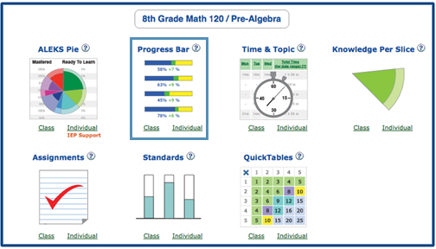
How do the systems help faculty?
    Monitor which students need assistance
    Measure curriculum performance
    Maximize course outcomes
3 Ms
Student Reports

Slide 24
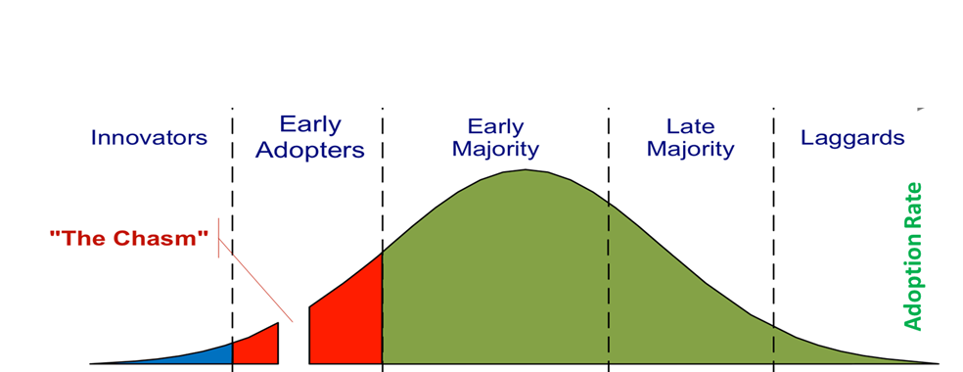
Where are we in the technology cycle?
WE ARE HERE!
Adaptive courseware is scaling up rapidly.
Notes:
Where are we in the personalization process?
The systems are scaling up rapidly.

Slide 25
What are the major challenges and decisions?
Pedagogy
System
Course Development
Faculty
Facilities
Evaluation

Slide 26
How can the system support your Pedagogy?
Lecture
Flipped
Online
Other?
- homework and assessment
- information delivery and assessment
- information, homework and assessment

Slide 27
What other Pedagogical decisions matter?
  Student learning
  Self-paced or Synced
  Complex tracking Lesson alignment
  Flexible exam dates Fixed exam dates
  Independent Interactive
  Competency Completion
Faculty need to make these decisions first.

Slide 28
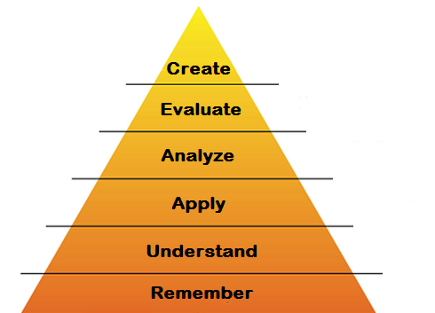
What Pedagogy did ASU decide to use?
Best results with “Adaptive and Active” approach
We’ve tried:
Adaptive and Self-paced online
Adaptive and Supervised in class
Adaptive and Active in class
Active Learning in class
Adaptive Learning
before class
Bloom’s Taxonomy
Optimize high-tech (adaptive) and high-touch (active) learning

Slide 29
How does this process work in practice?
1. ACQUIRE INFO
Read textbook,
watch video,
do simulation, etc.
2. ASSESS
Do practice problems, take quiz before class
Prove
Participate
Prove
Prepare
ADAPTIVE SYSTEM
ACTIVE CLASS
4. ASSIMILATE
Write essay, solve problems, take quiz, etc.
3. APPLY
Solve an applied problem (case study) with classmates.

Slide 30
What does a course design look like?
Biology and Society
Genetics
Biomes
Evolution
Human Body
Photosynthesis
Ecology
Scientific Method
Cells
Prove
Participate
Prove
Prepare
Prove
Participate
Prove
Prepare
Prove
Participate
Prove
Prepare
Prove
Participate
Prove
Prepare
Prove
Participate
Prove
Prepare
Prove
Participate
Prove
Prepare
Prove
Participate
Prove
Prepare
Prove
Participate
Prove
Prepare
Prove
Participate
Prove
Prepare
Lab
Lab
Lab
Lab
Lab
Lab
Exam
Exam
Exam
Adaptive and Active learning are symbiotic in the educational ecosystem.

Slide 31
What are the major System components?
Student UX
Instructor UX
Lesson
Reporting
Reporting
Grouping
Adaptive
Content
Database
Information
Architecture
Analytics
Content Curation
Course Creation
Edit
Associate
Edit
Sequence

Slide 32
What are some key System selection issues?
  Course Creation
  Construct or Configure
  Time consuming Quick
  Flexible Constrained
  Costly Cheap
  Riskier Safer
Consider the commitment before committing.

Slide 33
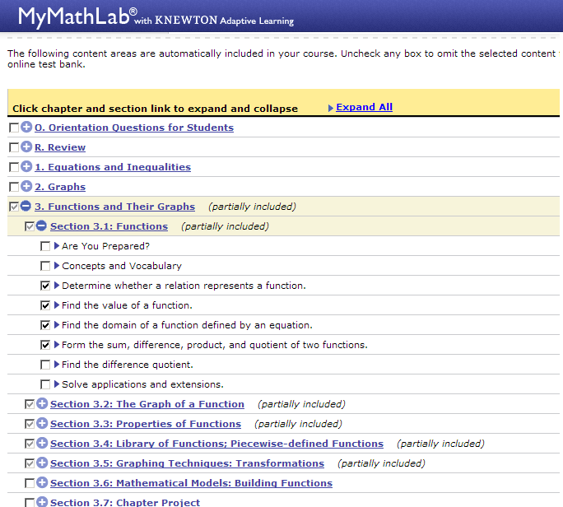
How are different Systems implemented?
  Course Creation – Construct
Configure
Knowledge Graph
L2
L5
L8
Lesson 1
L4
Lx
L3
L7
L6
The market is moving toward modularity.

Slide 34
How does the System handle different subjects?
  Course Creation – Subject Matter
    Math Model
        Assess, learn, assess
        Predicated on 12 years of prior math education
    Other Disciplines
      More traditional presentation
        Learn, assess, remediate, assess
Adaptive logic may not be the same for all subjects.

Slide 35
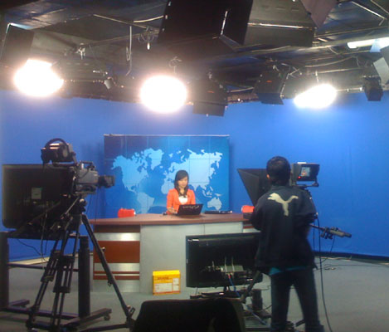
How can you manage content in the System?
  Content Curation
    Vendor Resources
        Prebuilt courses
        Library of materials
    Your Resources
        Teacher produced content
        Open Educational Resources (OER)
Will the vendor allow locally produced content in their system?

Slide 36
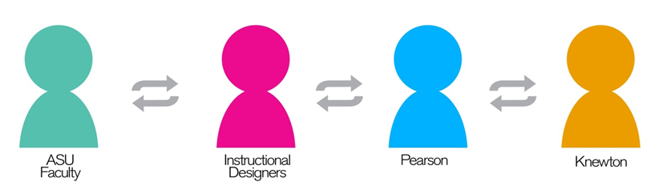
How can you manage Course Development?
Instructional Designers
Instructional Designers
Faculty
Instructional Designers
Instructional Designers
Technologists
Vendor
Personnel
Vendor
Personnel
Vendor
Personnel
Faculty
Vendor
Personnel
Faculty
Faculty
Technologists
Technologists
Technologists
Video Producers
Video Producers
Others?
Graphic
Designers
Video Producers
Librarians
Others?
Graphic
Designers
Video Producers
Librarians
Leaders
Graphic
Designers
Librarians
Others?
Graphic
Designers
Librarians
Adaptive tech is a team sport, so plan accordingly.

Slide 37
What can help Faculty succeed with AL?
  Strong provost and departmental support (and $)
  Faculty leadership for each course
  Instructor peer mentoring for training
  “Guide on the Side” is not for everyone
  Be patient, it’s a learning process
The technology success depends on the teacher!

Slide 38
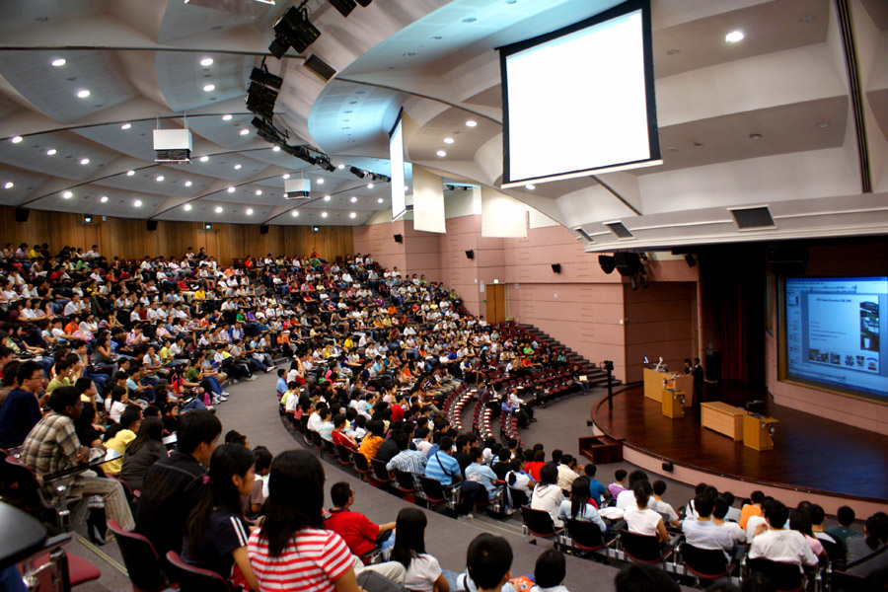
What types of classroom Facilities will you need?
  How many rooms?
  How big do they need to be?
  How long will they take to build?
  How much will they cost?
  Who is going to pay for them?
  How will you support them?
Think the project all the way through.

Slide 39
What factors could you Evaluate?
Macro indicators
    Persistence (lower student withdraw rate)
    Performance (higher student pass rate)
    Satisfaction
      Student
      Instructor
      Administrator
    Financials
      Money saved or spent
Micro indicators
  Assessment results (lesson or exam level)

Slide 40
How does ASU Evaluate our efforts?
MISSION: Enable Student Success
OBJECTIVES:
Improve critical thinking & problem solving
Increase student subject mastery
Increase student retention
Improve instructor insight
Achieve 90% freshman retention
Do Applied Concept Exercise every class
Help 90% of students get C or better
Re-enroll 90% of students next semester
Identify struggling students by week 2

Slide 41
What is this going to cost?
Implementation
    Construct
    Configure
Operation
Implementation
    Construct ~ $50,000
      Faculty time ~ 9 months
      Staff time ~ 12 months
      Systems integration ~ 1 month
      Content development and licensing
    Configure ~ $5,000
      Faculty time ~ 1 month
      Staff time ~ 3 months
Operation
  Student license $35 - $100
  Faculty training – every semester

Slide 42
For More Information
Dale Johnson
Dale.Johnson@asu.edu
480-884-1927

