Slide 1
Unit 3: GERUNDS

Slide 2
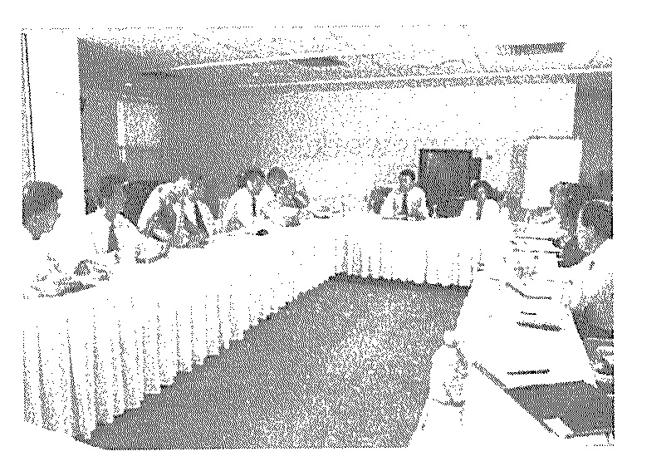
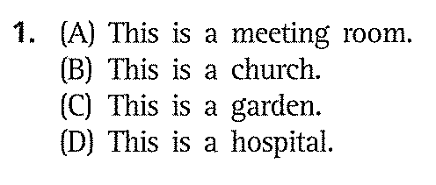
MINI TEST

Slide 3
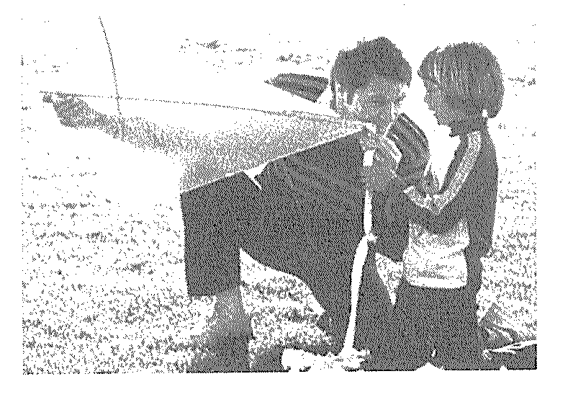
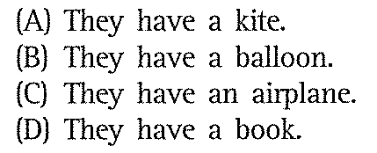

Slide 4
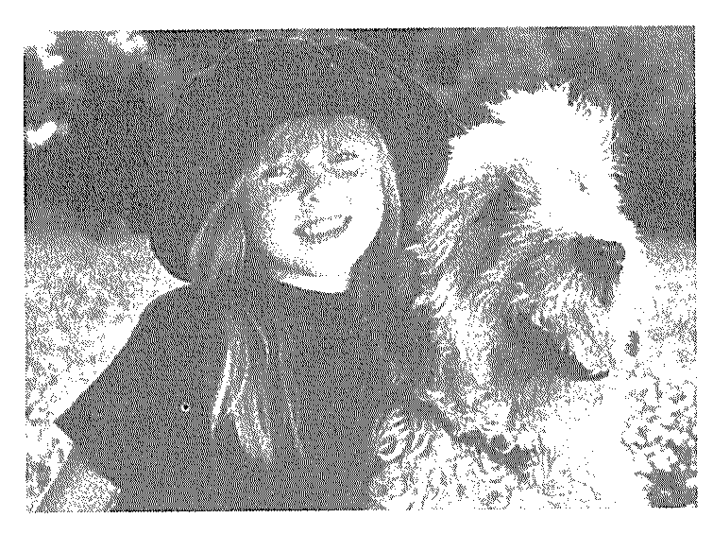
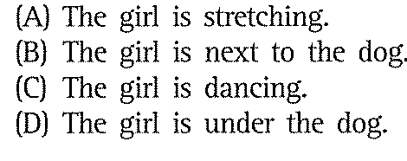

Slide 5
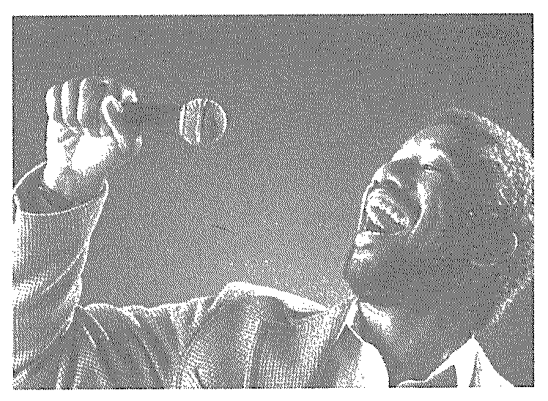
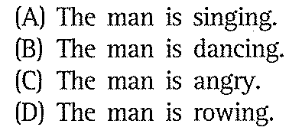

Slide 6
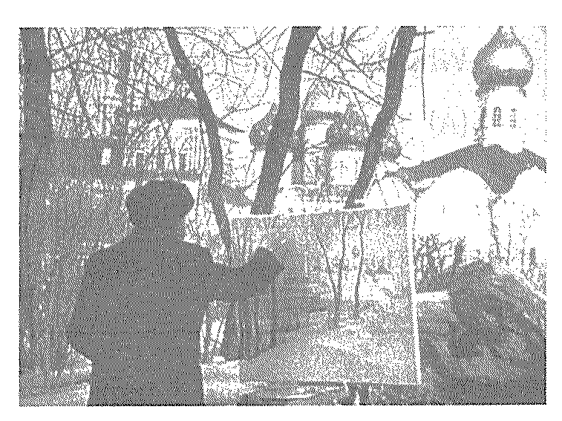
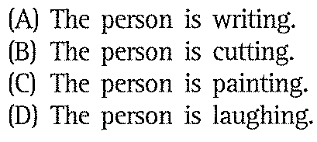

Slide 7
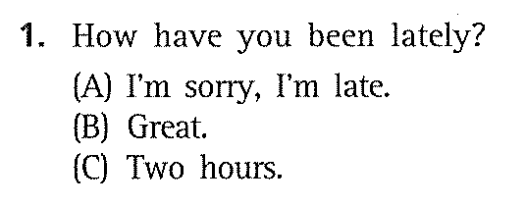
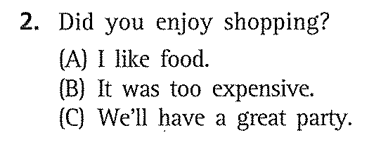
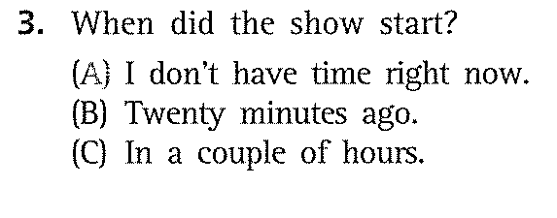
PART 2

Slide 8
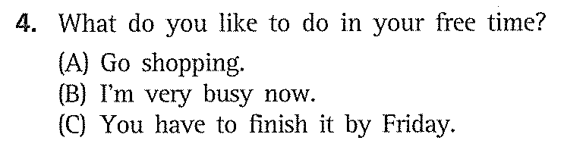
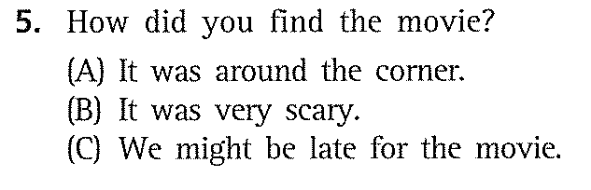

Slide 9
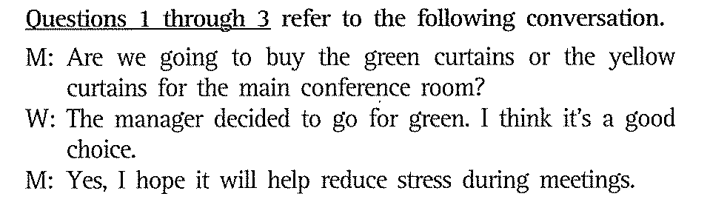
PART 3

Slide 10
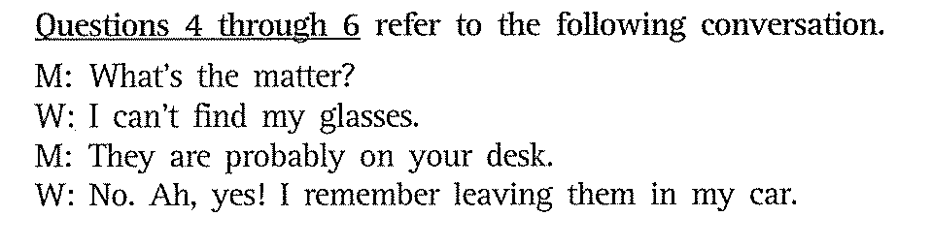

Slide 11
GERUNDS
V-ING

Slide 12
As the subject of a verb
When a gerund (v-ing) is used as the subject of a verb,
it is placed at the beginning of a sentence.
Reading romantic novels is my favourite pastime.
Climbing mountains can be dangerous if we are not careful.
A baby’s crying woke me up last.
Walking from here to the local supermarket takes only five minutes.

Slide 13
Notes: The gerund is also used in the following
construction:
Go+ V-ING
E.g. Did you go shopping yesterday ?
How often do you go swimming in the
summer ?

Slide 14
As the object of a verb
When a gerund (V-ING)is used as the object of a verb in a sentence, it is placed after the verb.
She tried to avoid getting involved in their quarrels.
He enjoys acting.
Mary disliked listening to pop music.
They hate eating fatty foods.
We all enjoy reading a good book.

Slide 15
The gerund (-ing) is often used after certain verbs: avoid, deny, enjoy, finish, give up, mind, spend, keep, etc.
Examples:
I dislike working after 5 pm.
We enjoy hiking.
She stopped working at 6 o’clock.
She suggested going for a movie.
Use gerund (-ing) after the following verb phrases: look forward to, get used to, object to, can’t help, can’t stand
Examples:
I look forward to hearing from you soon.
We can’t help having more cookies. They’re delicious.

Slide 16
As a object of a preposition
The gerund follows the preposition.
My brother is thinking of changing his job.
She is fed up with teaching English.
I look forward to seeing you in the summer.
I was interested in painting.
He persisted in carrying out the plan.

Slide 17
to - infinitives.

Slide 18
to - inf.
Verb + to + inf.
agree decide ask tell want would like expect hope like love need fail
Examples:
1.
2.
3.

Slide 19
Gerunds and Infinitives
Some verbs (e.g. love, hate, start, prefer) can take gerund or infinitive, with similar meanings.
Examples:
I love to eat chocolates.
I love eating chocolates.
I started to polish the car, but then decided not to.
I started polishing the car, but then decided not to.

Slide 20
Gerunds and Infinitives
BE CAREFUL!
A few verbs (such as ‘stop’, ‘remember’ and ‘forget’) can be followed by either the gerund or the infinitive but the meanings are different.
Examples:
They stopped having lunch at the restaurant.
(They don’t eat at the restaurant anymore)
They stopped to have lunch at the restaurant.
(They stopped another activity in order to have lunch at the restaurant)

Slide 21
Gerunds and Infinitives
Examples:
Remember/ forget + V-ing: means remember something you did in the past – an event or an activity.
He remembered putting his keys on the table.
Remember/forget + to + infinitive means that you remember something you have to do – a duty or a chore.
He remembers to put his keys on the table.

Slide 22
TRY
+ Ving : nghĩa là thử
I try eating the cake he makes ( tôi thử ăn cái bánh anh ta làm )
+ To inf : cố gắng để ...
I try to avoid meeting him (tôi cố gắng tránh gặp anh ta )

Slide 23
Gerunds and Infinitives
Put the verbs in brackets into the gerund or the infinitive.
I want _____ (finish) work early tonight.
I hate ______ (wait) for buses in the rain.
I’m going to the café _____ (meet) Anna.
Sam is really good at _____ (climb).
Thank you for ____ (be) so helpful.
I enjoy _____ (listen) to the radio while cooking.
Let’s go now. I’m worried about _____ (miss) the train.
He refused _____ (help) me.

Slide 24
Gerunds and Infinitives
Put the verbs in brackets into the gerund or the infinitive.
9. There’s a lot of work ______ (do) in the new building.
10. ‘What’s this for?’
‘It’s for _______ (cook) the vegetables.’
11. I really love _____ (play) with the children.
12. ______ (swim) is a good form of exercise.
13. I can’t stand _____ (do) the washing-up.
14. We managed ______ (pass) the exam by _____ (test) each other every evening.
15. We were getting tired, so we stopped _____ (have) lunch.
16. I was surprised _______ (not hear) about the new baby.

Slide 25
WHEEL GAME

Slide 26
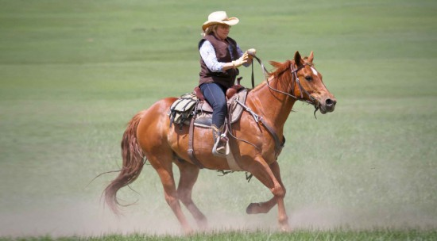
VOCABULARY
HORSEBACK (N)

Slide 27
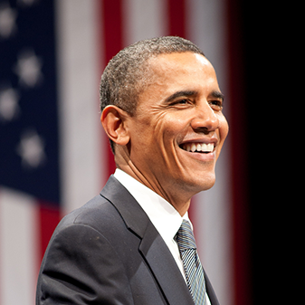
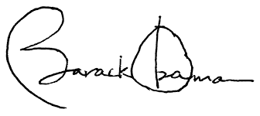

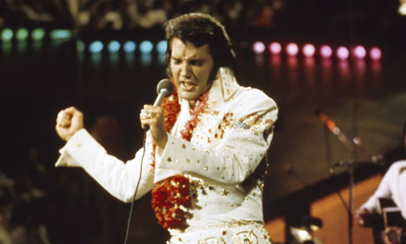
AUTOGRAPH (N)

Slide 28
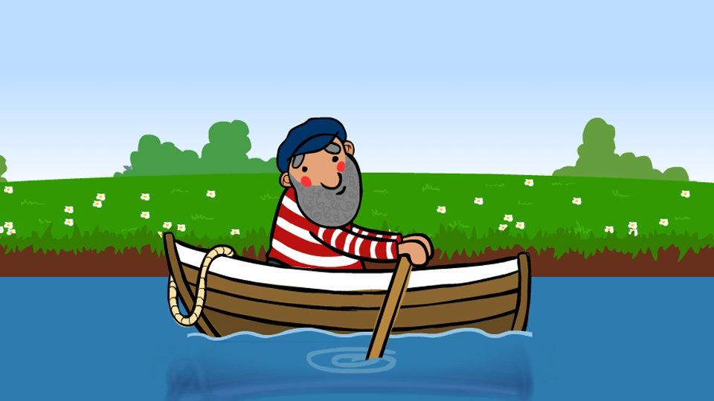
ROW (V)

Slide 29
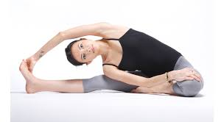
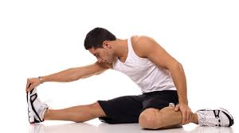
STRETCH (V)

Slide 30
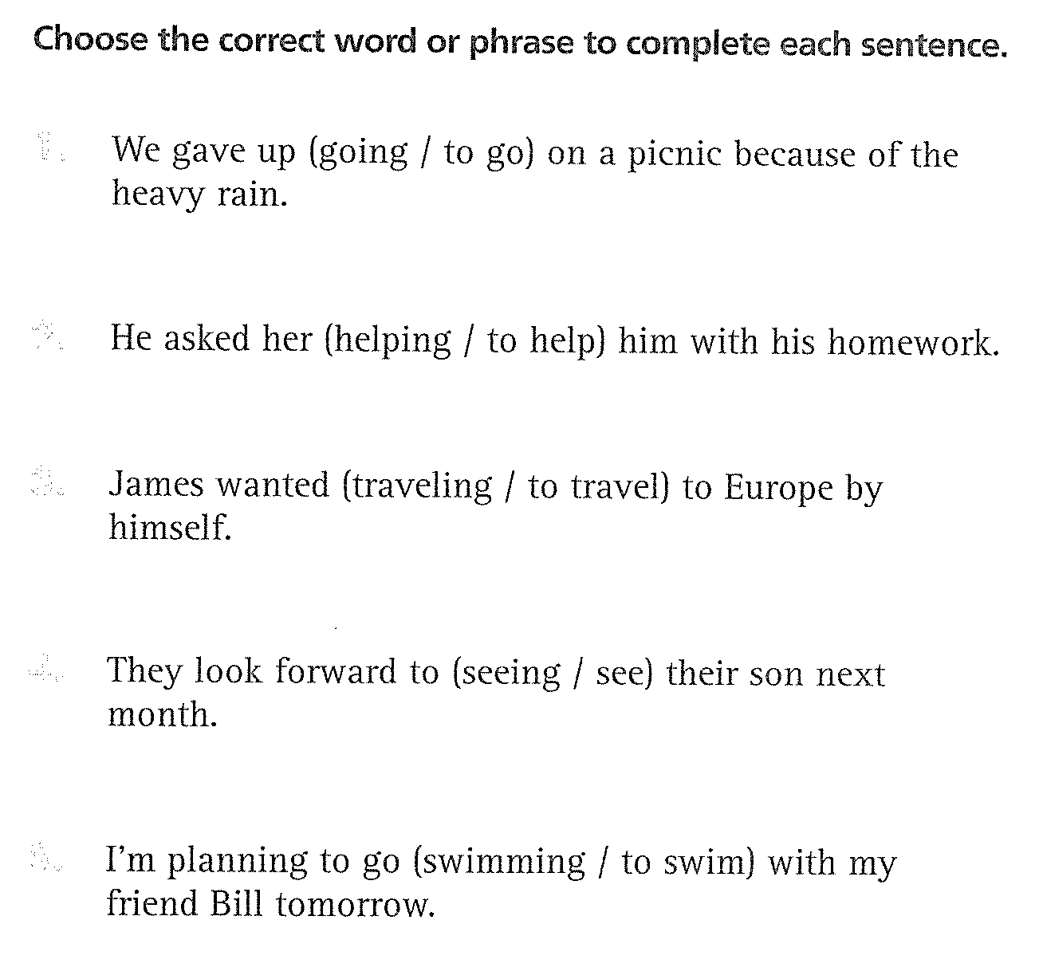
Grammar Exercise /page 45

Slide 31
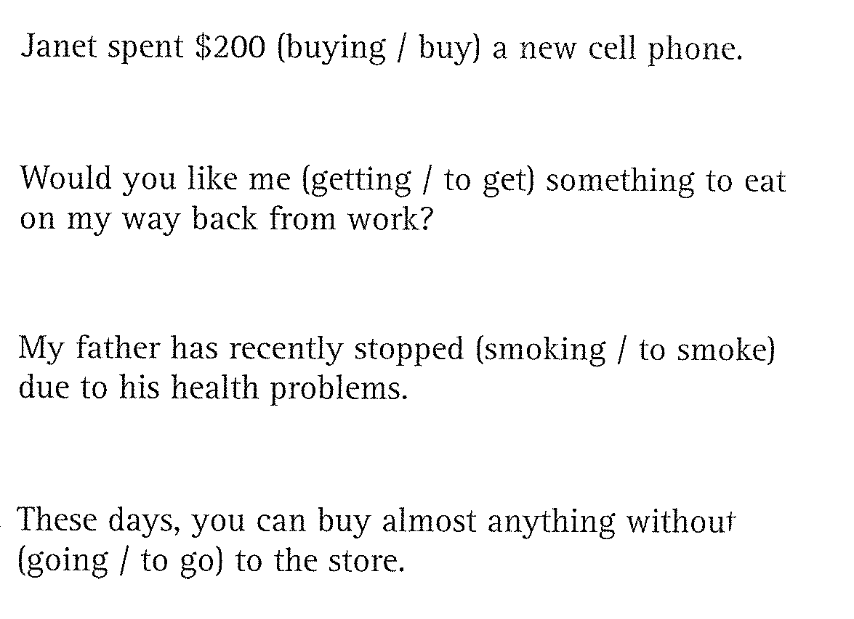

Slide 32
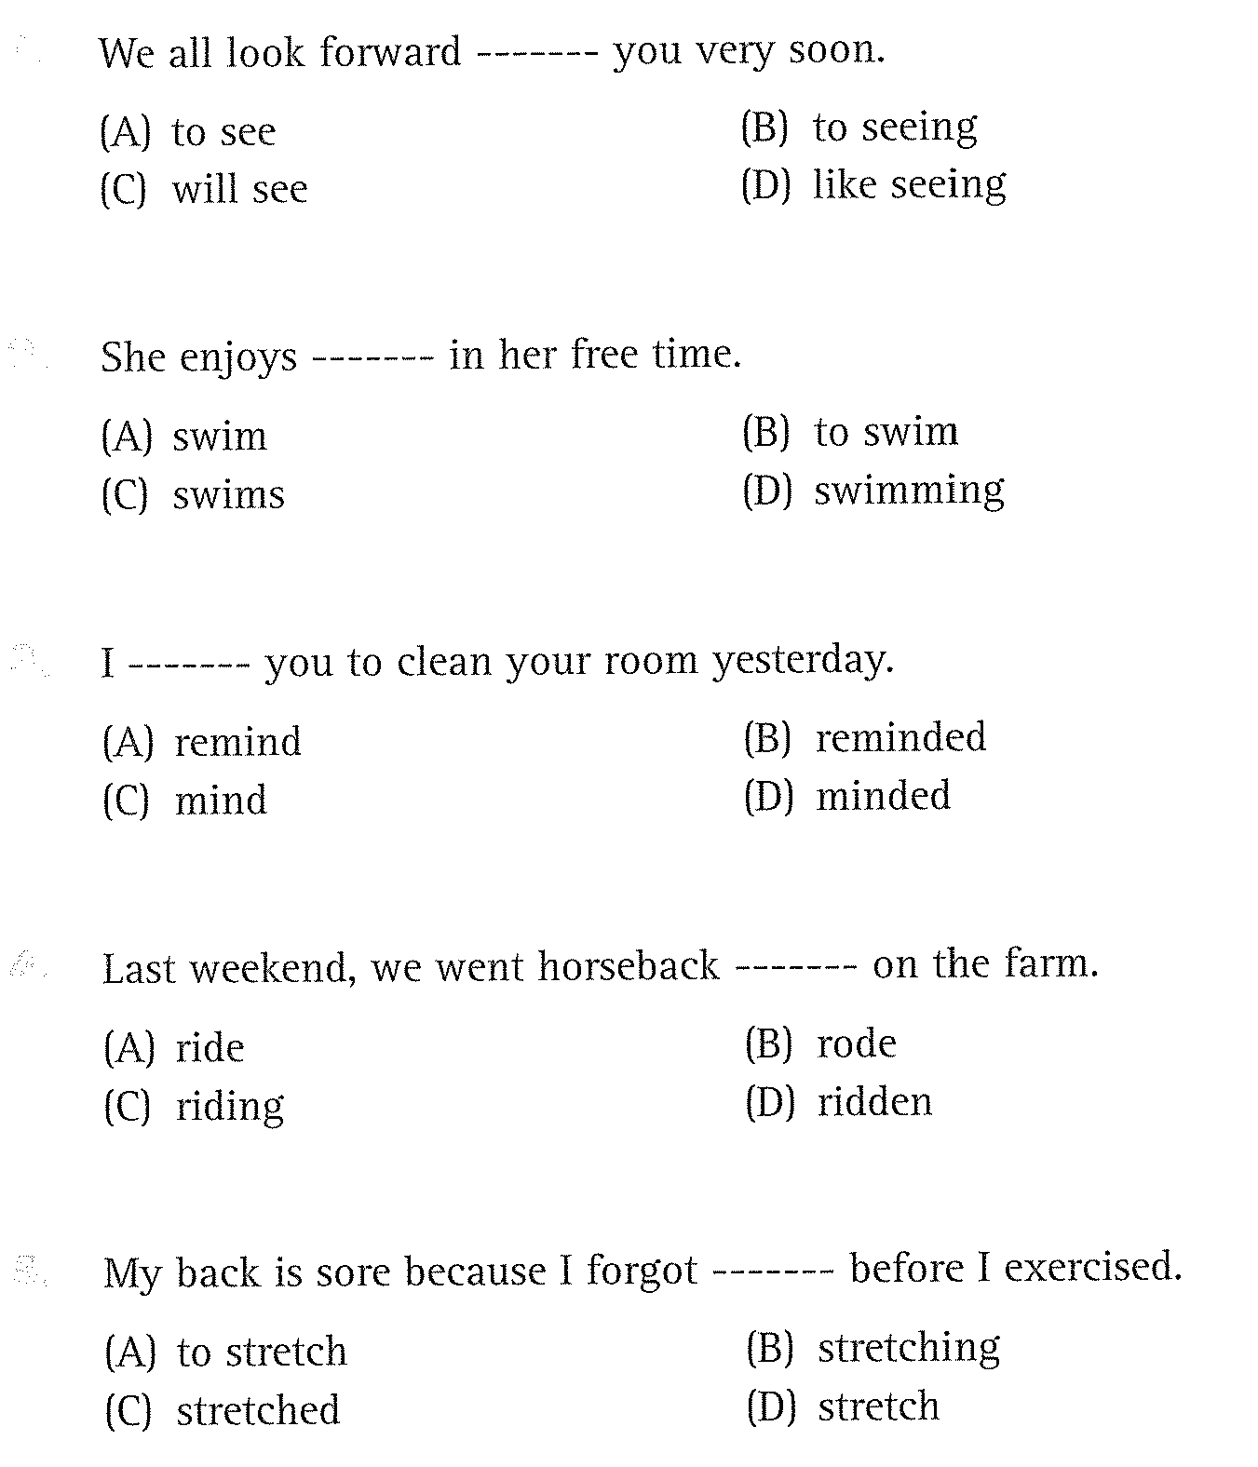
Part 5: incomplete sentences/ page 50
1.
2.
3
4
5

Slide 33
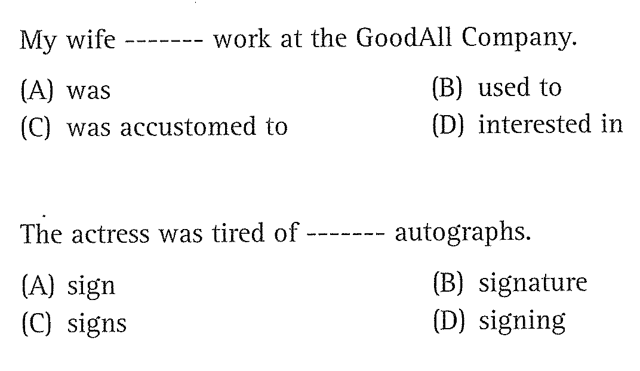
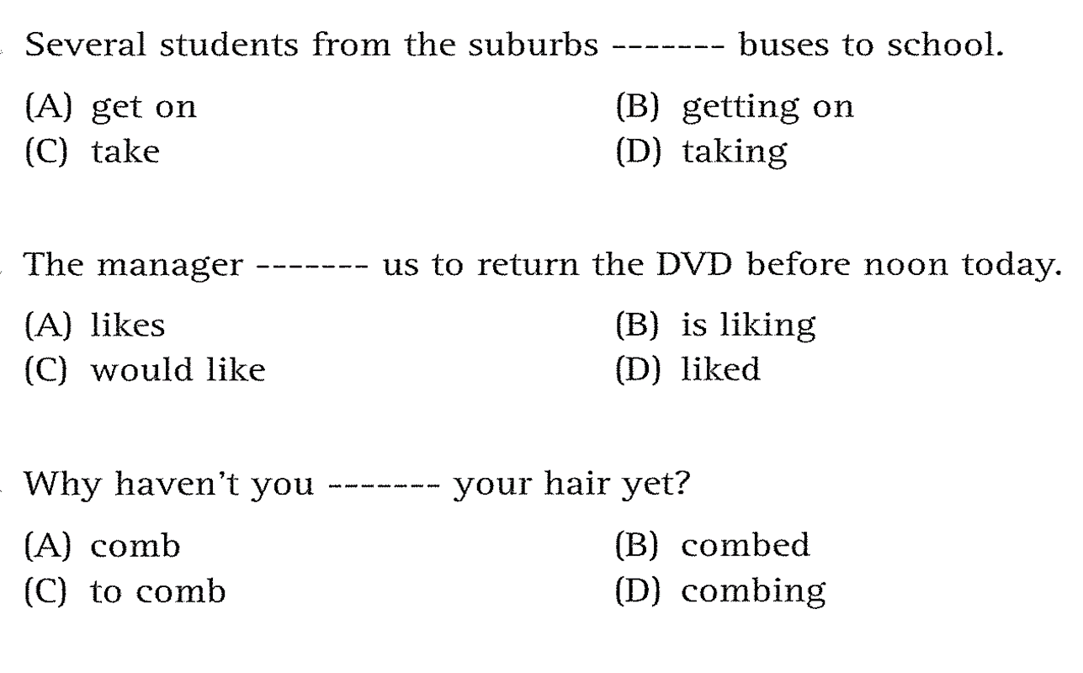
6
7
8
9
10

Slide 34
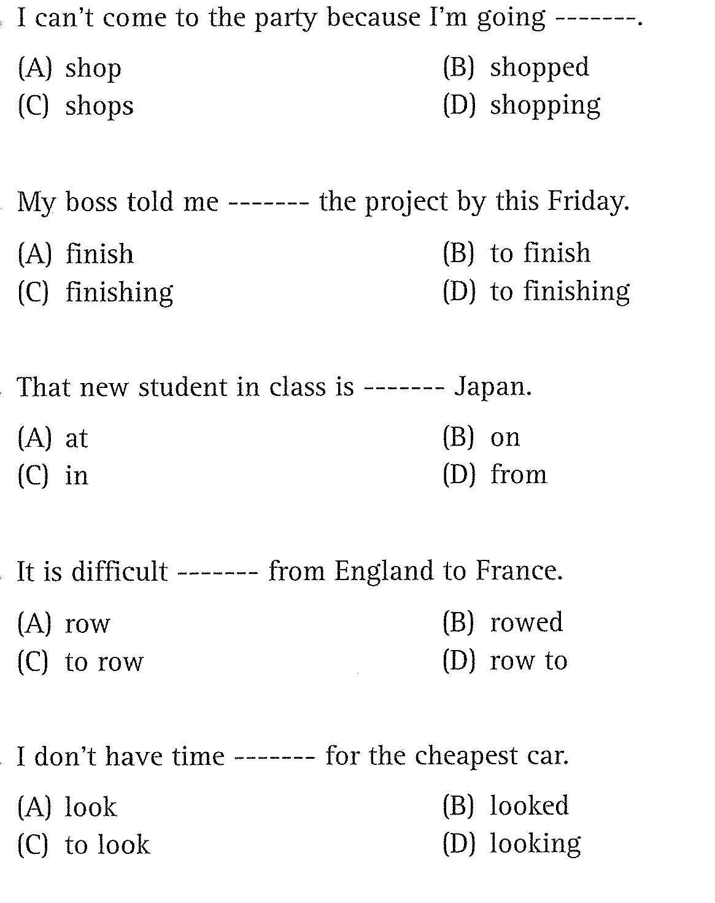
11
12
13
14
15

Slide 35



Slide 36

Question 1 : CAN YOU HELP ME ……………..(CARRY) THESE
BAGS?
00:30
00:29
00:28
00:27
00:26
00:25
00:24
00:23
00:22
00:21
00:20
00:19
00:18
00:17
00:16
00:15
00:14
00:13
00:12
00:11
00:10
00:09
00:08
00:07
00:06
00:05
00:04
00:03
00:02
00:01
00:00
A. TO CARRY
B. CARRYING
C. CARRIES
D. TO BE CARRYING

Slide 37
Question 2: DO YOU MIND ……..THE WINDOW? IT’S TOO HOT HERE.
00:30
00:29
00:28
00:27
00:26
00:25
00:24
00:23
00:22
00:21
00:20
00:19
00:18
00:17
00:16
00:15
00:14
00:13
00:12
00:11
00:10
00:09
00:08
00:07
00:06
00:05
00:04
00:03
00:02
00:01
00:00
A. OPEN
B. OPENING
C. TO OPEN
D. CLOSING

Slide 38
Question 3 : SHE ENJOYS ……..BADMINTON.
00:30
00:29
00:28
00:27
00:26
00:25
00:24
00:23
00:22
00:21
00:20
00:19
00:18
00:17
00:16
00:15
00:14
00:13
00:12
00:11
00:10
00:09
00:08
00:07
00:06
00:05
00:04
00:03
00:02
00:01
00:00
A. PLAYING
B. PLAY
C. DOING
D. DO

Slide 39
Question 4 : HE AGREES …….. THE GUITAR AT PARTY.
00:30
00:29
00:28
00:27
00:26
00:25
00:24
00:23
00:22
00:21
00:20
00:19
00:18
00:17
00:16
00:15
00:14
00:13
00:12
00:11
00:10
00:09
00:08
00:07
00:06
00:05
00:04
00:03
00:02
00:01
00:00
A. TO PLAY
B. PLAY
C. TO LEARN
D. LEARNING

Slide 40
Question 5 : I PROMISE ……..
00:30
00:29
00:28
00:27
00:26
00:25
00:24
00:23
00:22
00:21
00:20
00:19
00:18
00:17
00:16
00:15
00:14
00:13
00:12
00:11
00:10
00:09
00:08
00:07
00:06
00:05
00:04
00:03
00:02
00:01
00:00
A. NOT LATE
B. NOT BEING LATE
C. NOT TO BE LATE
D. NOT TO LATE

Slide 41
Question 6 : WE DECIDE …….. BY CAR.
00:30
00:29
00:28
00:27
00:26
00:25
00:24
00:23
00:22
00:21
00:20
00:19
00:18
00:17
00:16
00:15
00:14
00:13
00:12
00:11
00:10
00:09
00:08
00:07
00:06
00:05
00:04
00:03
00:02
00:01
00:00
A. TO TRAVEL
B. TRAVELLING
C. TRAVEL
D. BEING TRAVEL

Slide 42
Question 7 :YOU CAN’T STOP ME ……..WHAT I WANT
00:30
00:29
00:28
00:27
00:26
00:25
00:24
00:23
00:22
00:21
00:20
00:19
00:18
00:17
00:16
00:15
00:14
00:13
00:12
00:11
00:10
00:09
00:08
00:07
00:06
00:05
00:04
00:03
00:02
00:01
00:00
A. DO
B. DOING
C. TO DO
D. THAT I DO

Slide 43
Question 8: SHE TRIED TO LOOK SERIOUS BUT SHE CAN’T HELP ……..
00:30
00:29
00:28
00:27
00:26
00:25
00:24
00:23
00:22
00:21
00:20
00:19
00:18
00:17
00:16
00:15
00:14
00:13
00:12
00:11
00:10
00:09
00:08
00:07
00:06
00:05
00:04
00:03
00:02
00:01
00:00
A. LAUGHING
B. TO LAUGH
C. LAUGH
D. BE LAUGHING

Slide 44
Question 9: THE ROAD WAS ICY, SO WE DROVE CAREFULLY. WE WERE AFRAID ……..
00:30
00:29
00:28
00:27
00:26
00:25
00:24
00:23
00:22
00:21
00:20
00:19
00:18
00:17
00:16
00:15
00:14
00:13
00:12
00:11
00:10
00:09
00:08
00:07
00:06
00:05
00:04
00:03
00:02
00:01
00:00
A. OF CRASHING INTO OTHER CARS.
B. FROM CRASHING INTO OTHER CARS.
C. TO CRASH FROM OTHER CARS
D. IN CRASHING INTO OTHER CARS

Slide 45
Question 10: MY PARENTS ARE THINKING ……A HOUSE. DO YOU THINK THAT’S A GOOD IDEA?
00:30
00:29
00:28
00:27
00:26
00:25
00:24
00:23
00:22
00:21
00:20
00:19
00:18
00:17
00:16
00:15
00:14
00:13
00:12
00:11
00:10
00:09
00:08
00:07
00:06
00:05
00:04
00:03
00:02
00:01
00:00
A. TO BUY
B. OF BUYING
C. OF TO BUY
D. BUY

Slide 46
THANK YOU!

