Slide 1

WRITING I
Lecturer: Nguyen Thien Binh

Slide 2

Supporting sentences:

Slide 4
PUNCTUATION
and
CAPITALIZATION

Slide 5


(Page 21)

Slide 6
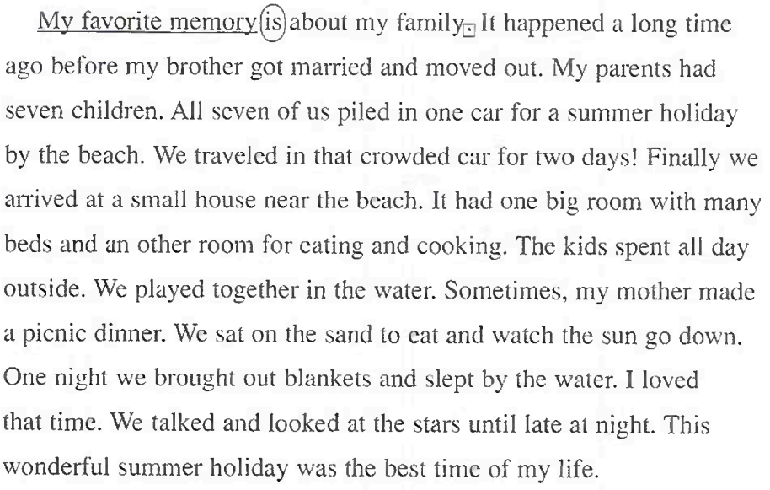
,

Slide 7
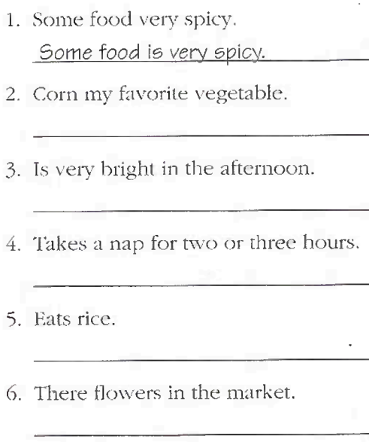
(Page 22)

Slide 8
Run-on sentences:
Connecting words:

Slide 9

(Page 23)

Slide 10


Slide 11

(Page 23)

Slide 12
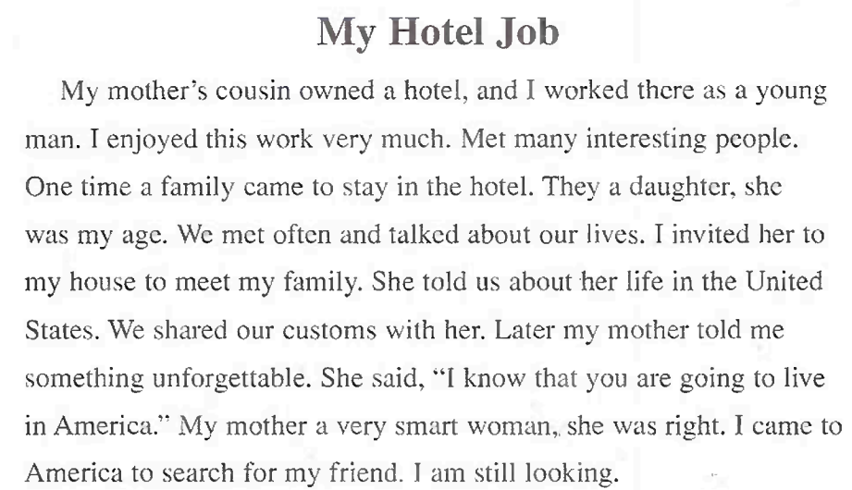

Slide 13


Slide 14
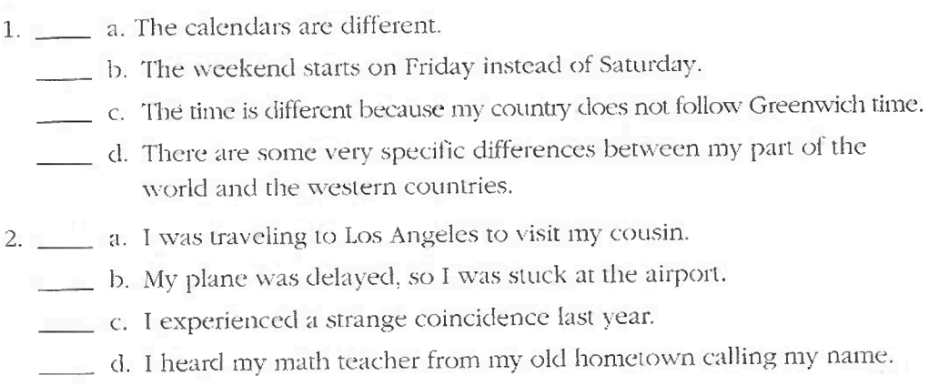
TS
TS

Slide 15
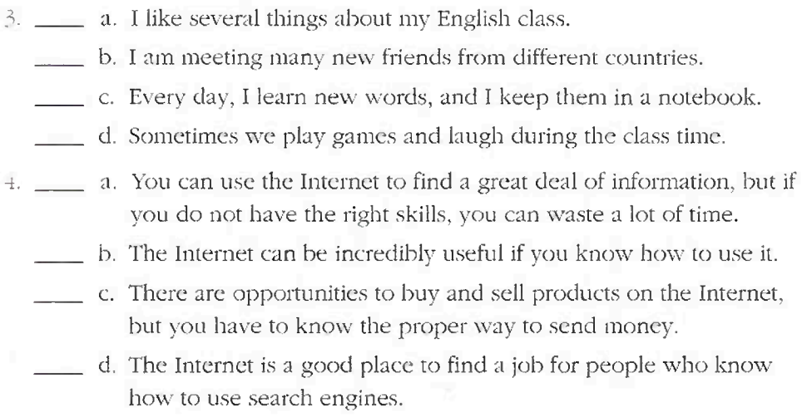
TS
TS

Slide 16

(Page 25)

Slide 17
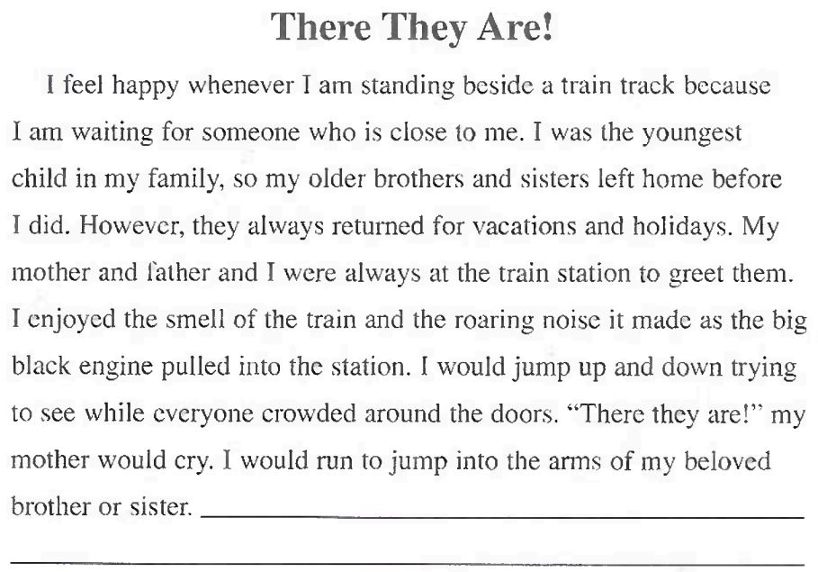

Slide 18
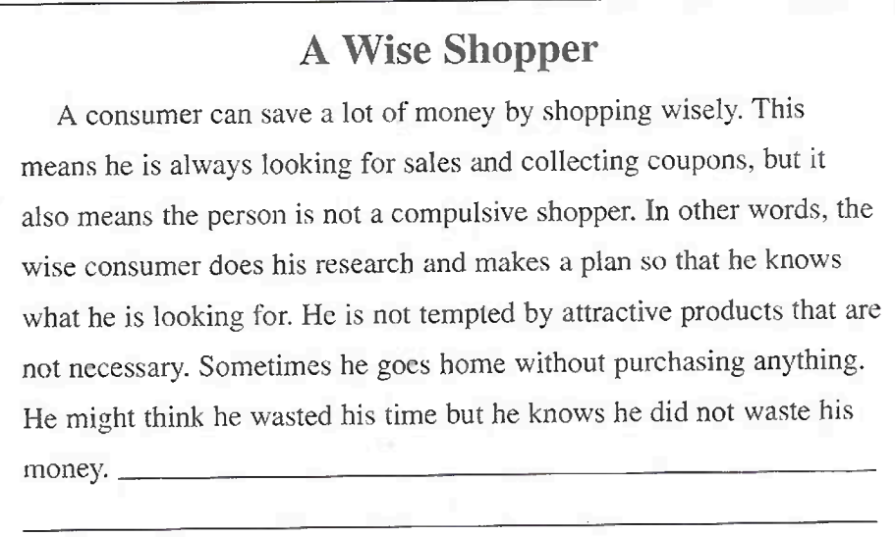

Slide 19

(Page 26)

Slide 20
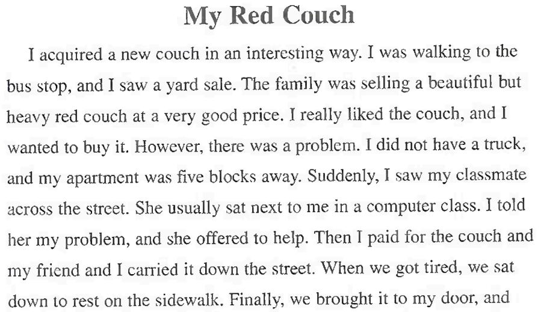

Slide 21


Slide 22
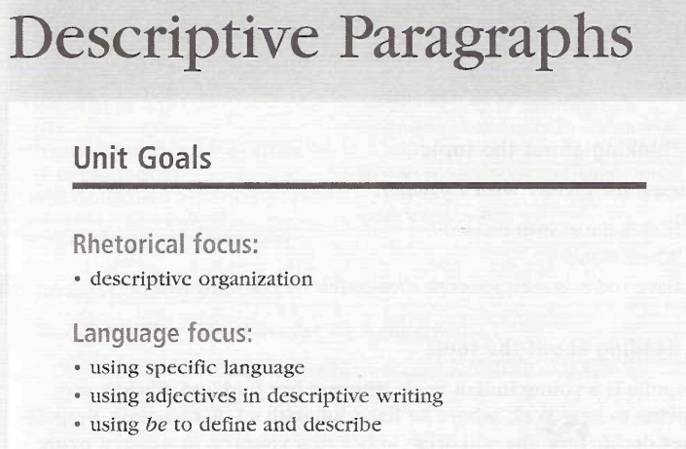

Slide 23
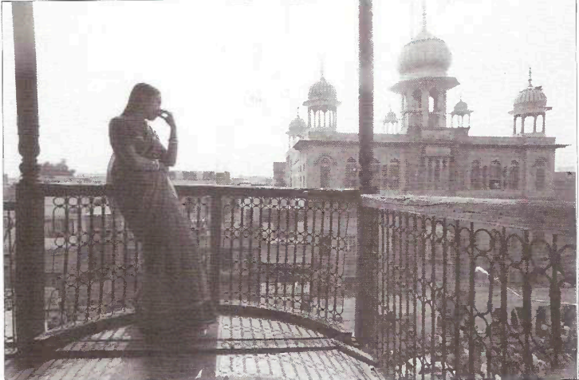


Slide 24
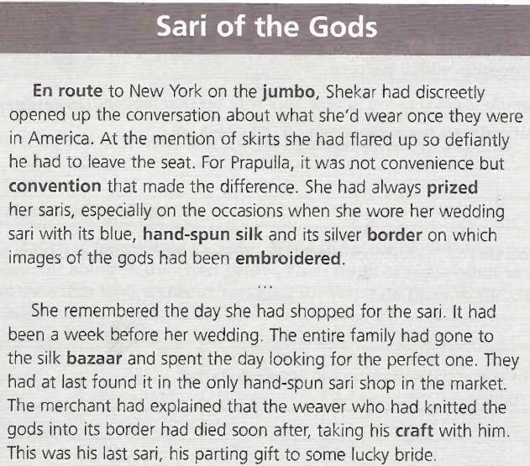

Slide 25


Slide 26
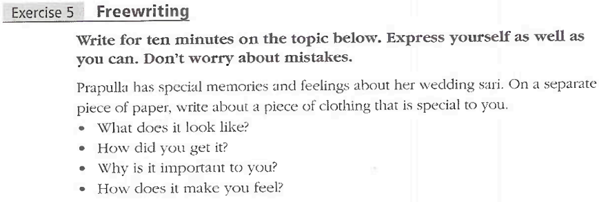

Slide 27

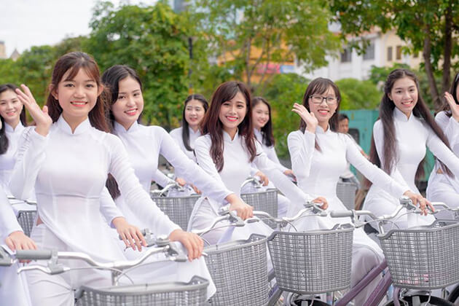

Slide 28
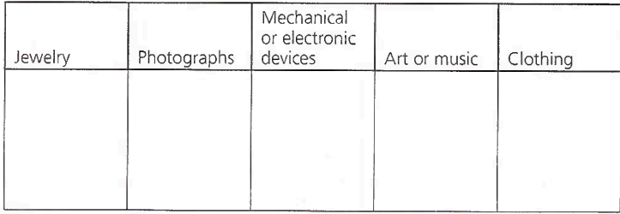
Possessions

Slide 29
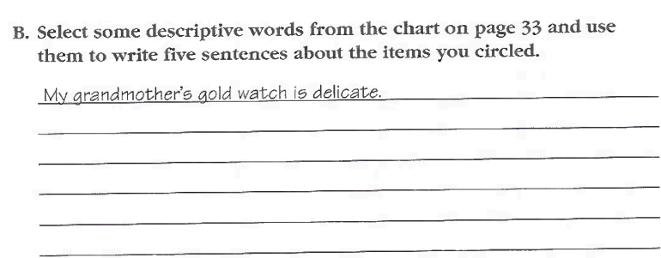

Slide 30
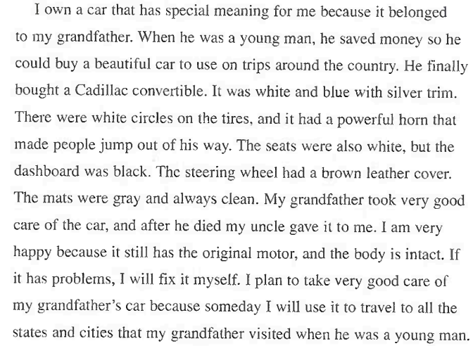
Page 35

Slide 31
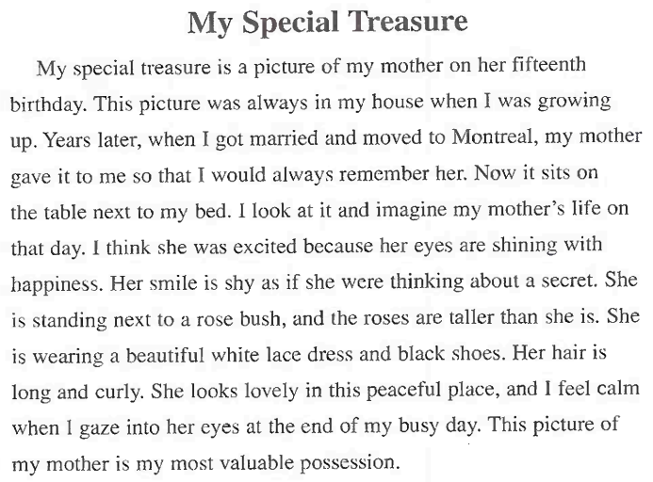
Page 38

Slide 32


General sentences vs Specific sentences

Slide 33


Page 40

Slide 34
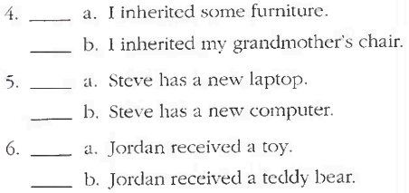

Slide 35


Page 40

Slide 36
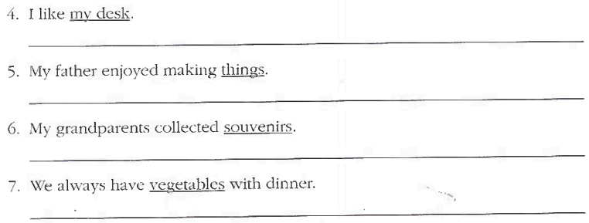

Slide 37

Page 41

Slide 38


