Slide 1
UNIT 3
Writing about the present

Slide 2
OBJECTIVES
To learn the simple present tense
To study simple and compound sentences
To practice the article A/AN

Slide 3
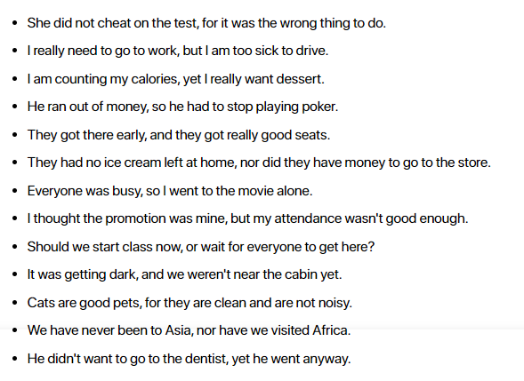
PAGE 85: SIMPLE SENTENCES AND COMPOUND SENTENCES
Các liên từ thường được sử dụng để nối trong câu ghép bao gồm: for, and, nor, but, or, yet, so (hay còn gọi tắt là FANBOYS).

Slide 4
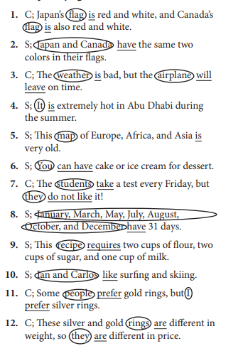
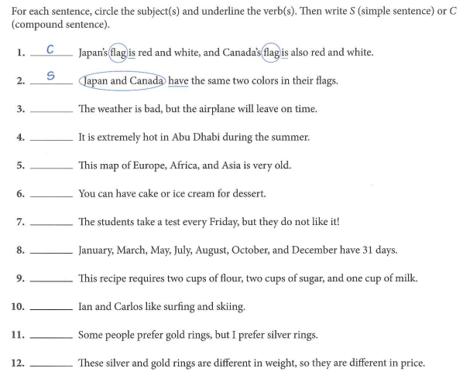
PAGE 86

Slide 5
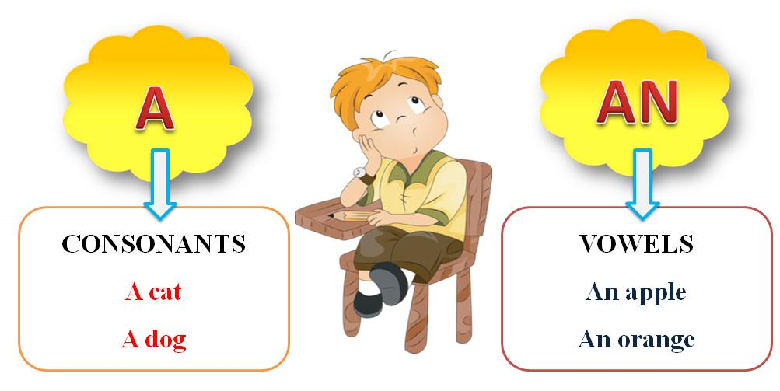
THE ARTICLE A or AN

Slide 6
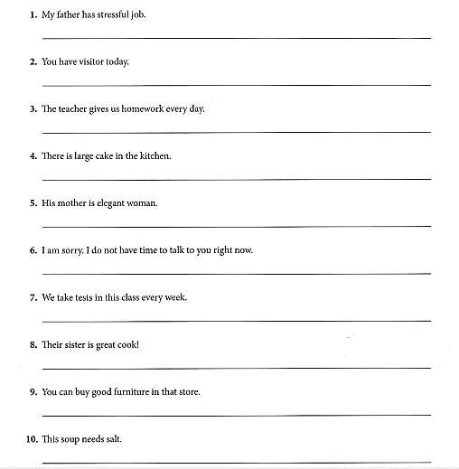
PAGE 91
My father has a stressful job.
You have a visitor today.
(No change.)
There is a large cake in the kitchen
His mother is an elegant woman
(No change.)
(No change.)
Their sister is a great cook!
(No change.)
(No change.)

Slide 7
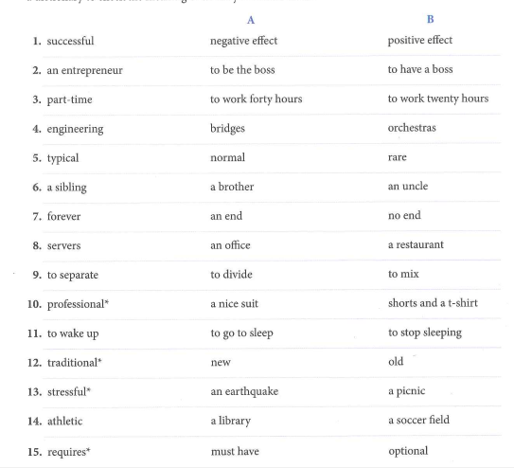
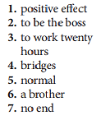
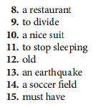
PAGE 93

Slide 8
UNIT 4
WRITING ABOUT THE PAST
OBJECTIVES:
To learn the simple past tense of be and regular verbs
To learn about the simple past tense of irregular verbs
To study the negative form of the simple past tense
To practice compound sentences with but
To study complex sentences to show time

Slide 9
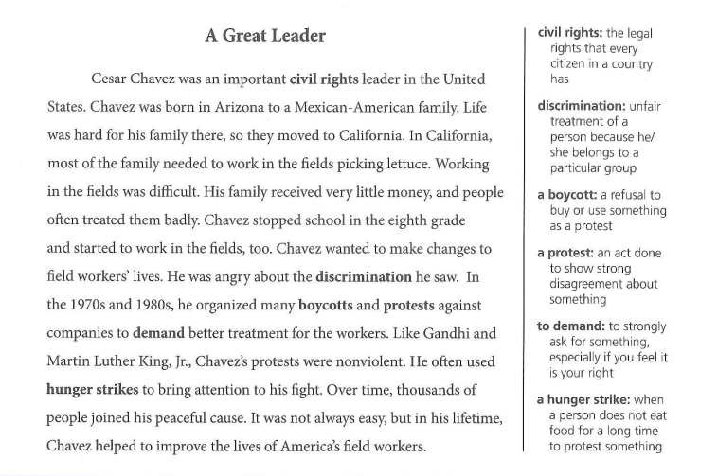
Read the article and answer the questions using complete sentences (p.101)

Slide 10
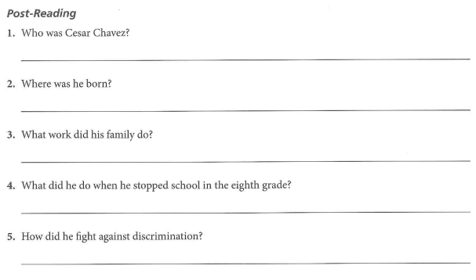
p. 102
Cesar Chavez was an important civil rights leader in the United States.
He was born in Arizona
His family worked in the fields picking lettuce.
He started working in the fields
He organized many boycotts and protests, and he used hunger strikes.

Slide 11
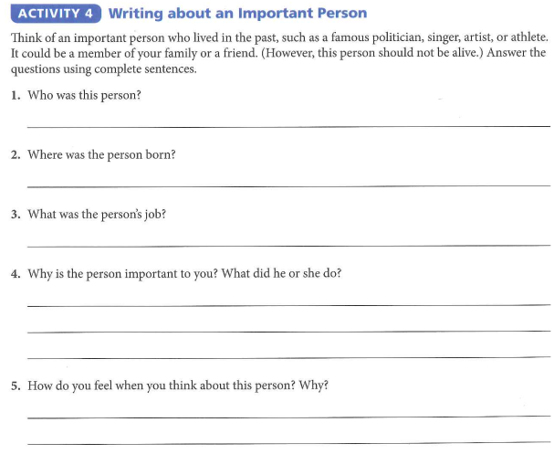
Page 105

Slide 12
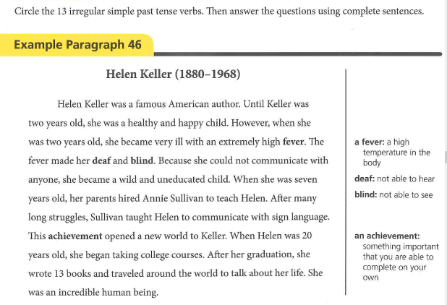
Page 106

Slide 13
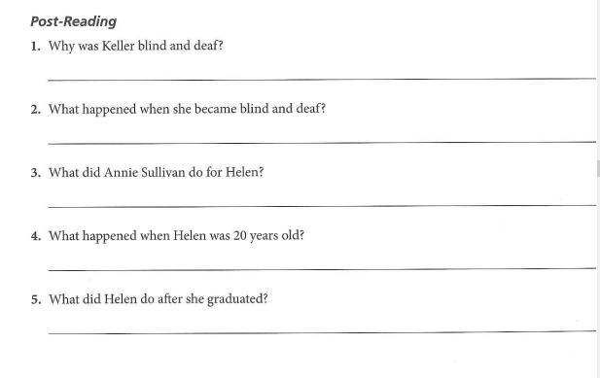
She had a fever when she was two years old.
Helen could not communicate with anyone and became wild and uneducated.
Annie Sullivan taught Helen sign language.
Helen began taking college courses.
Helen wrote thirteen books and traveled around the world to talk about her life.

