Slide 1

COMMUNICATION SPOTLIGHT
Speaking strategies & Listening Skills
Teacher: Ms Quyen
Class: 19T4 – NNA3
Subject: Speaking 2

Slide 2
UNIT 12
HOW MANY ARE THERE ?

Slide 3
Now work with a partner. Look at the numbers below. Student A, choose a number and say it to your partner. Student B, listen and shadow your partner.
35 49 55 67 88 92 84 73 12 38 77
456 778 653 785 961 854 632 451 398 734 523
5678 7789 2254 4763 6834 8724
56,253 98,354 78,602 65,338 41,654 25,987
325,963 254,635 687,621 228,229 665,447 757,578
495,654,321 584,697,621 213,854,931 673,918,656

Slide 4
Work with a partner. Ask and answer questions about Cedar City Airport
Student A: How many + Ns + are there?
Student B: There are + Numbers + Ns.
Cedar City Airport Information:
Number of runways:
Number of terminals:
Number of restaurants:
Number of rooms in the hotel:
Number of workers:
Number of stores:
Number of fire trucks:
Number of flights per day:

Slide 5
Cedar City Airport Information: ( Cont )
Number of bags and suitcases handled every day:
Number of restrooms:
Number of parking spaces in the car parks:
Number of gates:
Number of cups of coffee sold each day:
Number of meals made for the people on the planes:
Number of passengers each day:
Look below. Which is more? Draw “ > “ or “ < “
Number of terminals ___________ Number of runways.
Number of workers ___________ Number of parking spaces
Number of rooms in the hotel ___________ Number of flights per day
Number of fire trucks ___________ Number of gates

Slide 6
Spotlight on Vocabulary
Do you know and understand these words and expressions?
Check ( x ) the boxes
No | VOCABULARY | YES | NO
1 | Grid
2 | Call out
3 | Mall
4 | Write down
5 | Around
6 | Take turns
7 | Diagonal ( a, n ) ( across, down, diagonal )
8 | Point ( v )
9 | Choose – chose - chosen
10 | Cross out

Slide 7
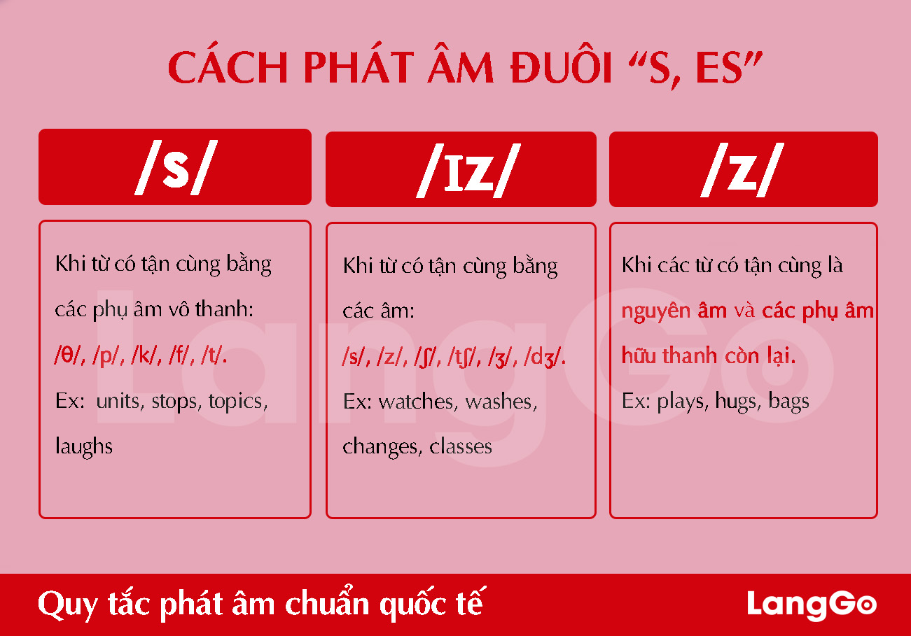
HOW TO PRONOUNCE S , ES

Slide 8
Look at the example below. Complete the sentences
No | TIME | ACTIVITIES | SENTENCES
1 | 7.00 am | get up
2 | 8.00 am | Have breakfast
3 | 8.30 am | Go to school
4 | 9.00 am | Get to school
5 | 12.15 pm | Have lunch
6 | 3.15 pm | Study
7 | 4.30 pm | Get home
8 | 8.00 pm | Watch TV
9 | 10.00 pm | Have a bath
10 | 11.00 pm | Go to bed

Slide 9
MIDTERM TEST 1 ( cont )
  Q: Where is the bank ?
  A:
  Ngân hàng thì ở kế bên bưu điện bên tay trái.
  Ngân hàng thì ở giữa nhà hàng và bưu điện.
  Ngân hàng thì đối diện thư viện
  Q: What time do you … ?
  A:
  Tôi thức dậy vào lúc 4h05.
  Tôi ăn sáng vào lúc 5h15.
  Tôi đi học vào lúc 6h30.
  Tôi làm bài tập về nhà của tôi vào lúc 4h45.
  Tôi đi ngủ vào lúc 11h55.

Slide 10


