Slide 1
WELCOME TO OUR CLASS

Slide 2


Slide 3

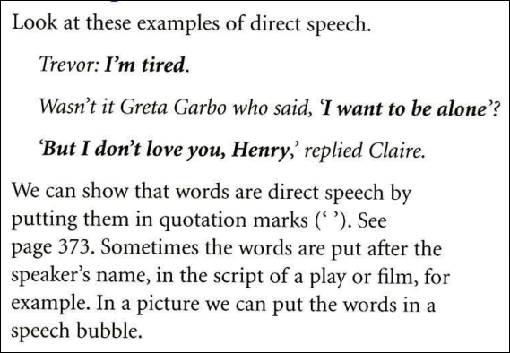

Slide 4

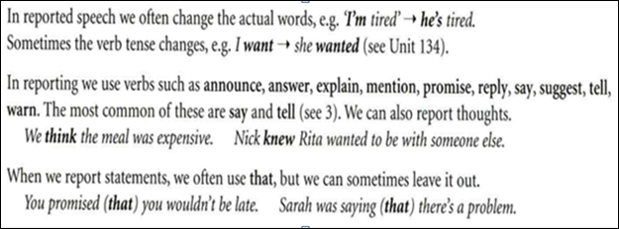

Slide 5

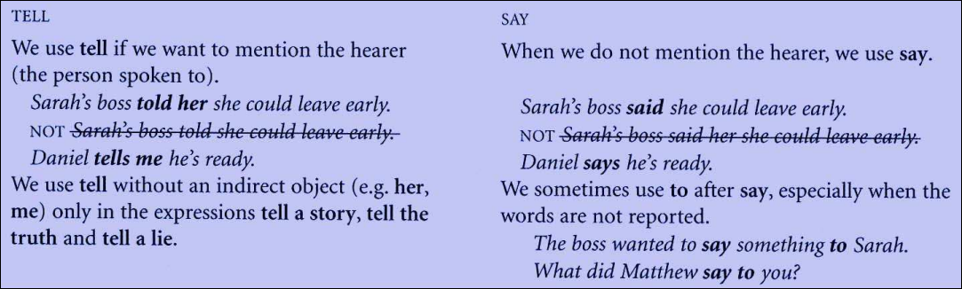

Slide 6
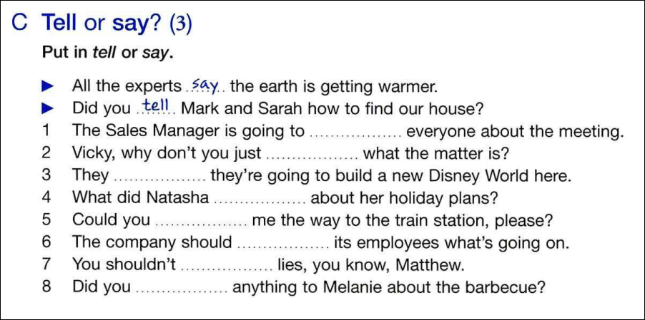
tell
say
say
say
tell
tell
tell
say

Slide 7
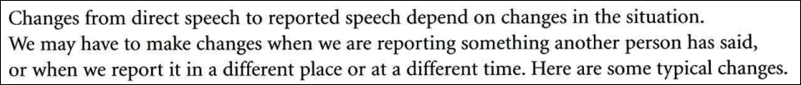

Slide 8
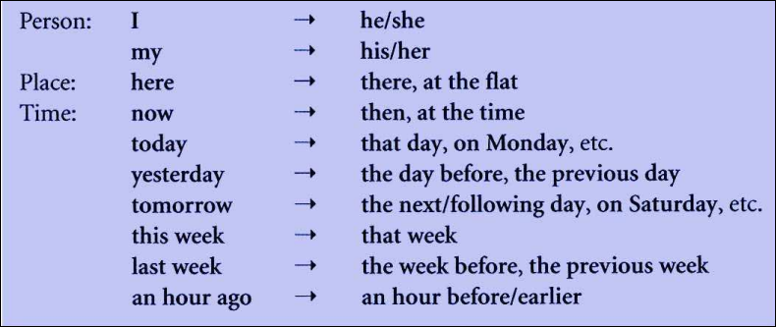

Slide 9
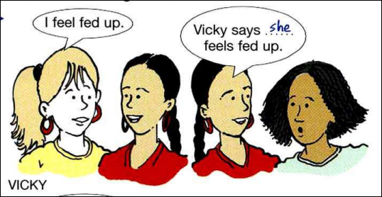

Slide 10



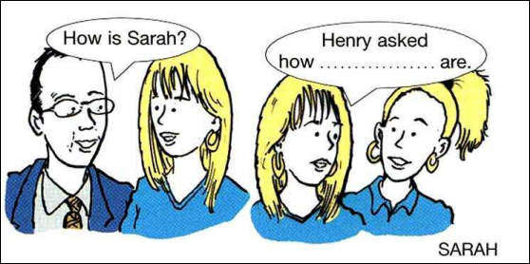
you

Slide 11
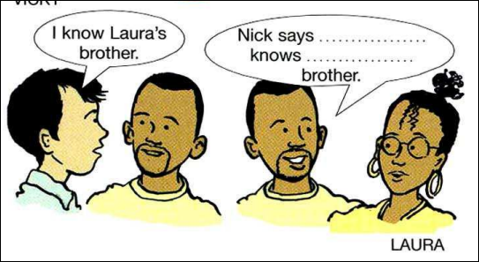
he
your

Slide 12
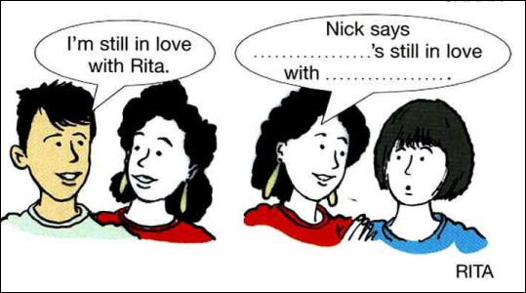
he
you

Slide 13
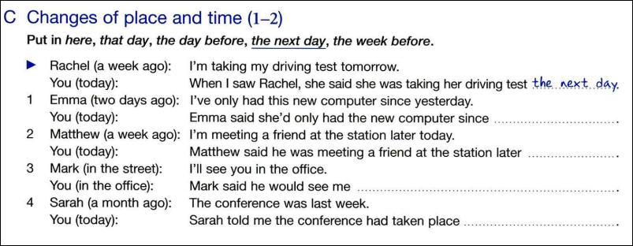
the day
before
the previous day
that day
here
the week
before
the previous week

Slide 14


Slide 15


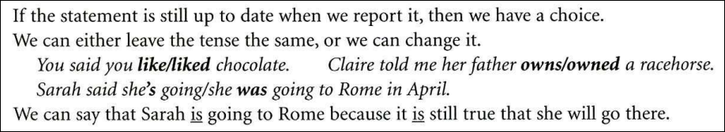

Slide 16
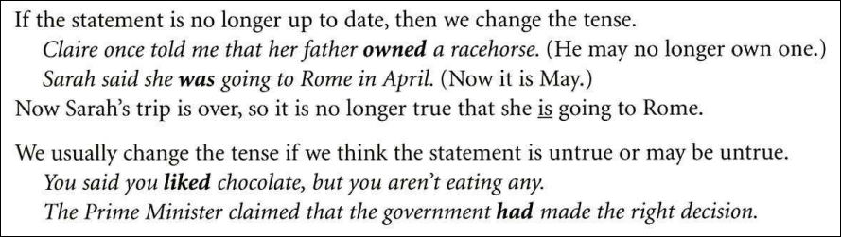

Slide 17


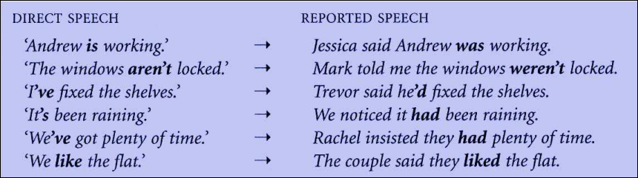

Slide 18
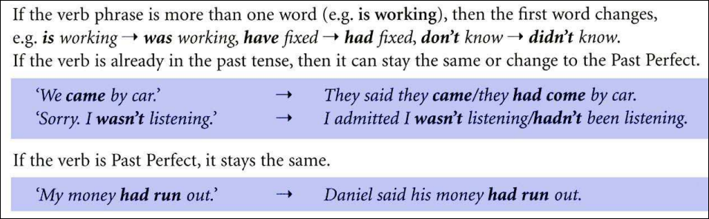

Slide 19
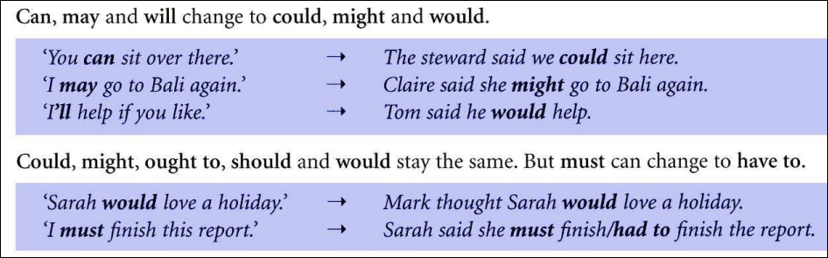

Slide 20


Slide 21
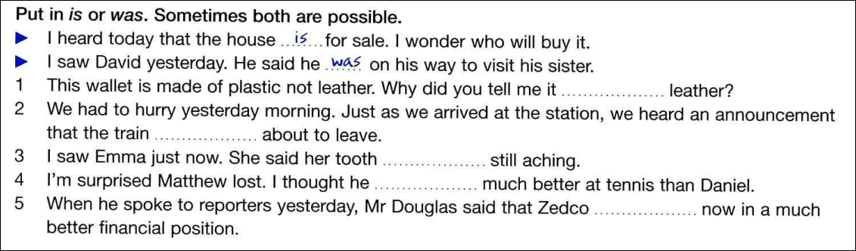
was
was
is
or was
was
was
or is

Slide 22

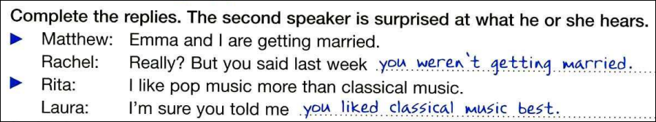

Slide 23
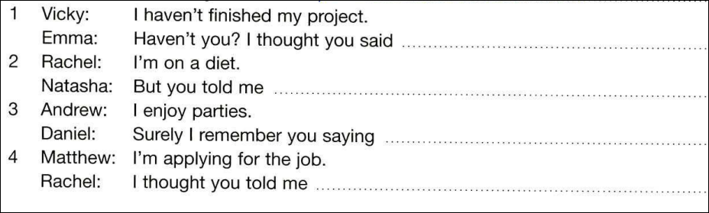
you had finished it
/your project
you weren’t on a diet
you didn’t enjoy
them/parties
you weren’t applying for it/ the job

Slide 24

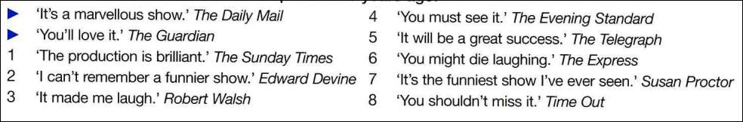

Slide 25

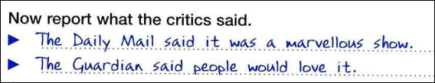

Slide 26

1. The Sunday Times said the production was brilliant.
2. Edward Devine said he couldn’t remember a funnier show.
3. Robert Walsh said it (had) made him laugh.

Slide 27

4. The Evening Standard said you/people had to see it
or The Evening Standard said you/people must see it.
5. The Telegraph said it would be a great success.

Slide 28
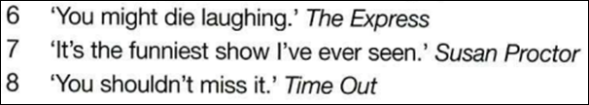
6. The express said you/people might die laughing.
7. Susan Proctor said it was the funniest show she’d/had ever seen
8. Time out said you/people shouldn’t miss it.

Slide 29


Slide 30

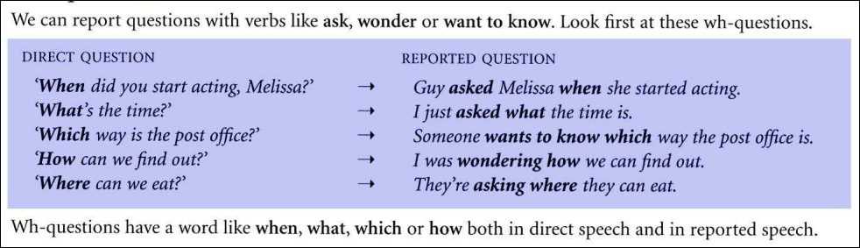

Slide 31

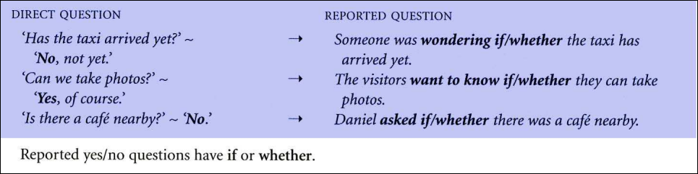

Slide 32

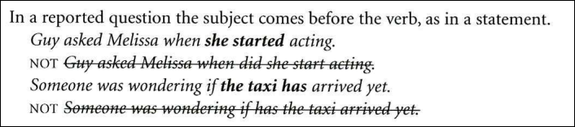

Slide 33

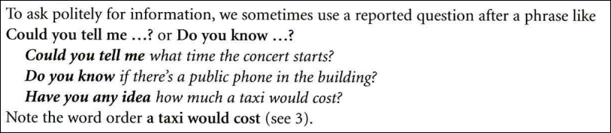

Slide 34

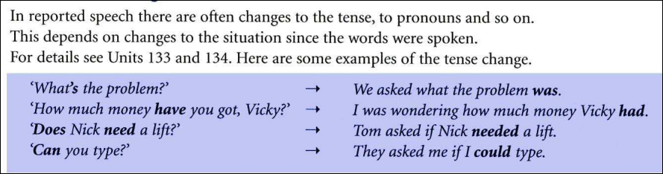

Slide 35



Slide 36
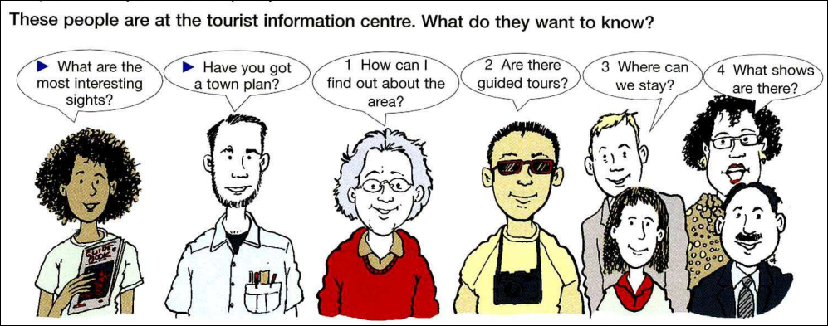

Slide 37
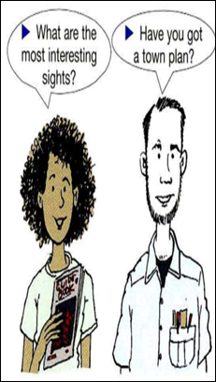


Slide 38
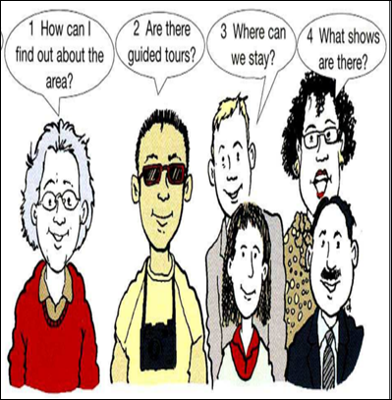



Slide 39

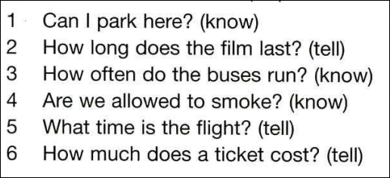

Slide 40
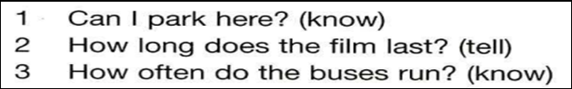


Slide 41
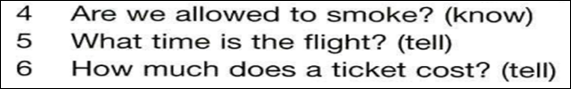

Slide 42

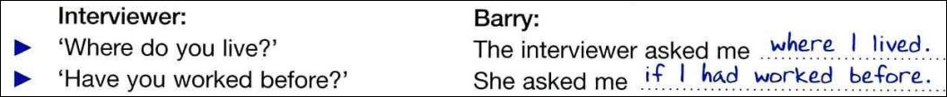

Slide 43
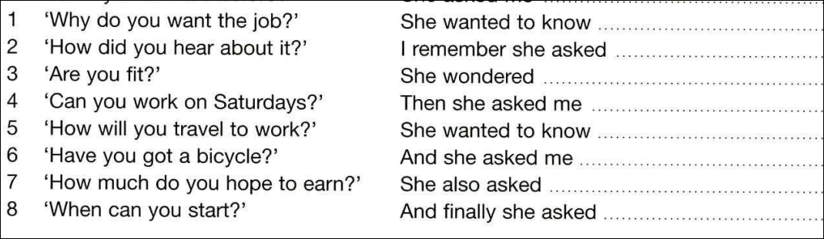

Slide 44
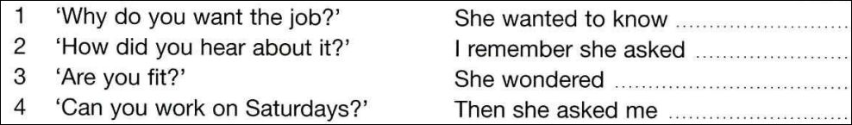



Slide 45
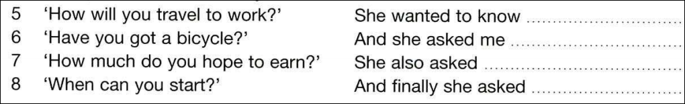


Slide 46
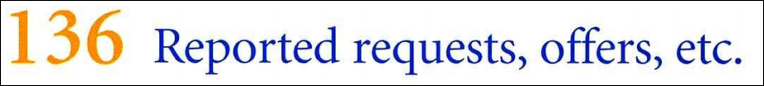


Slide 47
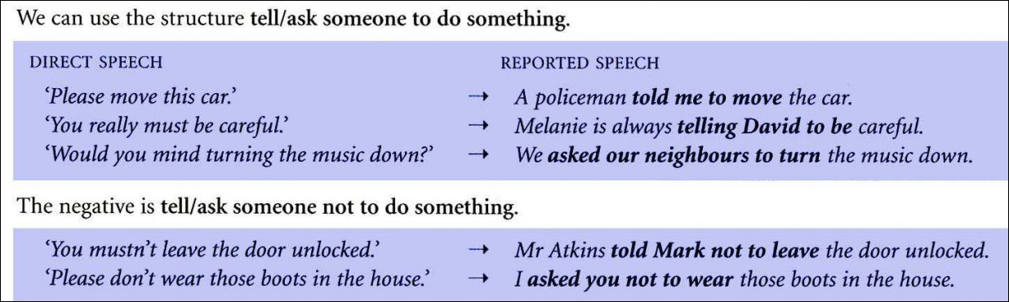

Slide 48
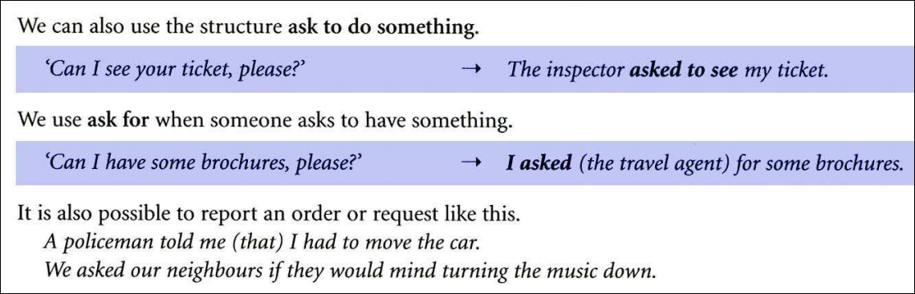

Slide 49
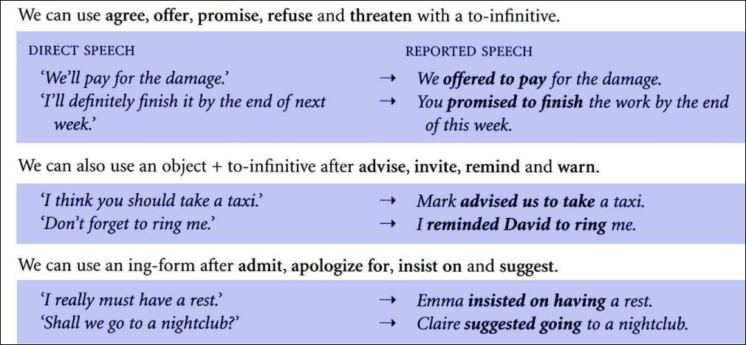

Slide 50

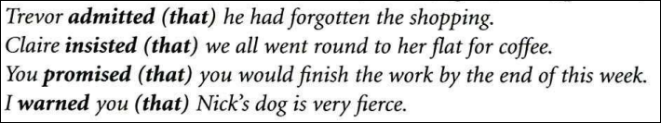

Slide 51

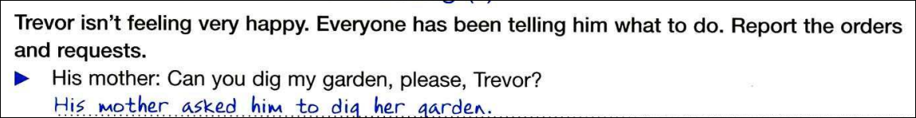

Slide 52
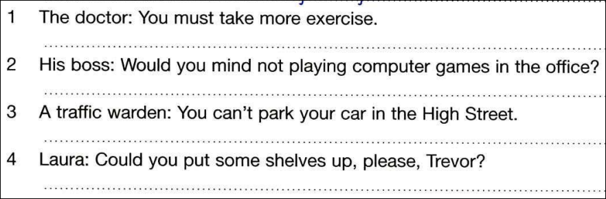
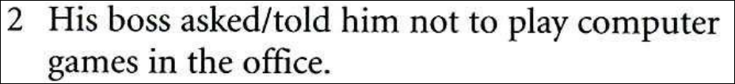
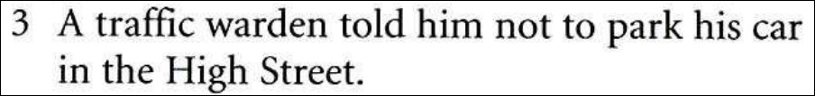

Slide 53
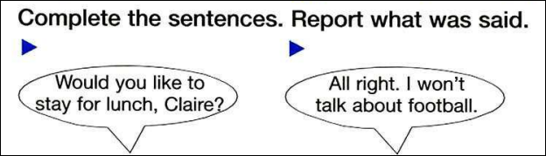


Slide 54
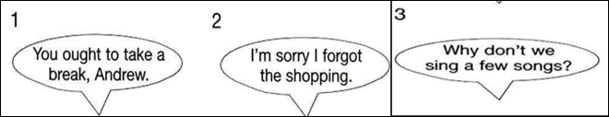
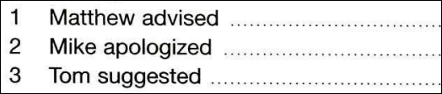


for getting
the shopping

Slide 55
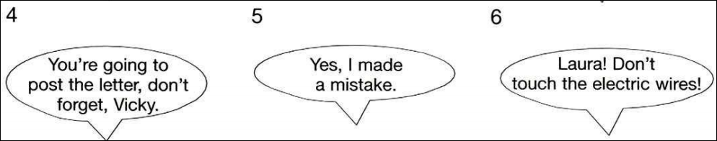



Laura not to touch
the electric wires

Slide 56


Slide 57




Slide 58



Slide 59

me
did
√
that
√
me
did
for

Slide 60


Slide 61

1. C
2. D
3. D
4. C
5. D
6. A
7. B
8. D

Slide 62



they
that
/whether
she
/if
to
didn’t
had
wouldn’t
/didn’t
/had
if
/ whether
wanted
/needed
next
/ following
same

Slide 63





Slide 64


Slide 65

A policeman told Christopher to stop shouting.
Tessa admitted eating all the cake/having eaten all the cake
the day before/the previous day
Adrian apologized for being rude/for having been rude.
Simon invited Susan to join him for lunch.
Martin asked Nancy if/whether someone rang her/
someone had rung her an hour before.
Peter insisted on leaving.

