Slide 2

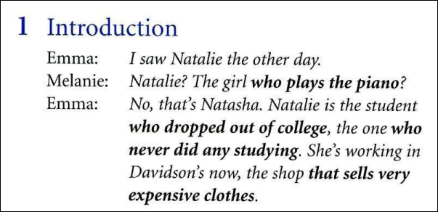
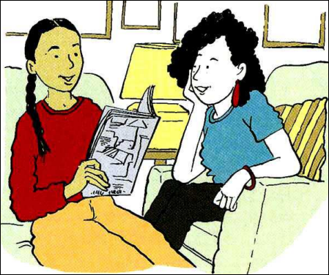

Slide 3
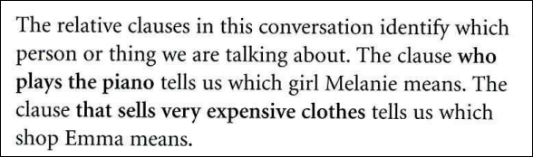
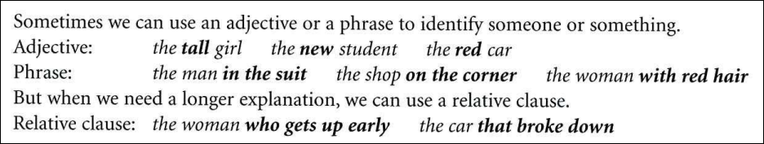

Slide 4
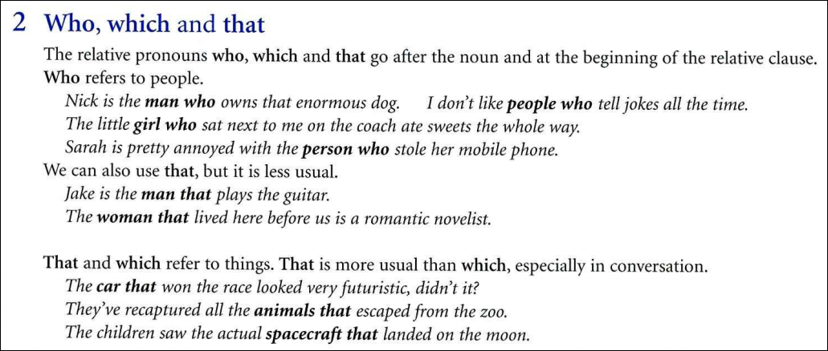

Slide 5

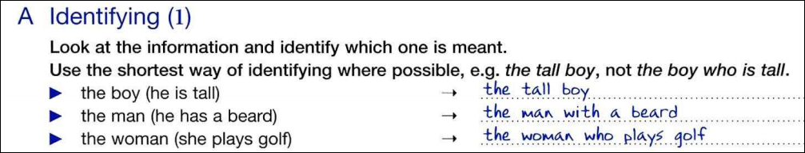

Slide 6
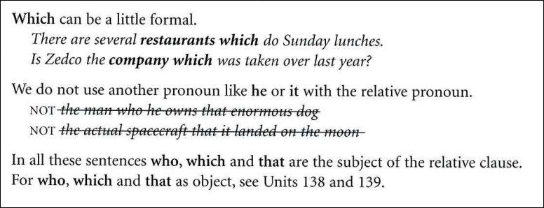

Slide 7
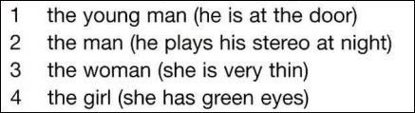
1. the young man at the door
2. the man who plays his stereo at night
3. the very thin woman
4. the girl with green eyes
or the green-eyed girl

Slide 8
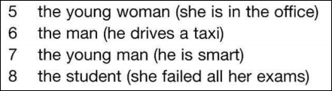
5. the young woman in the office
6. the man who drives a taxi
7. the smart young man
8. the student who failed all her exam

Slide 9
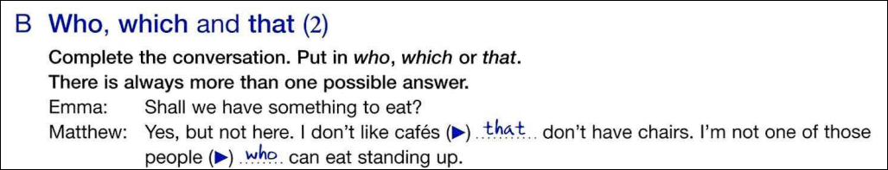
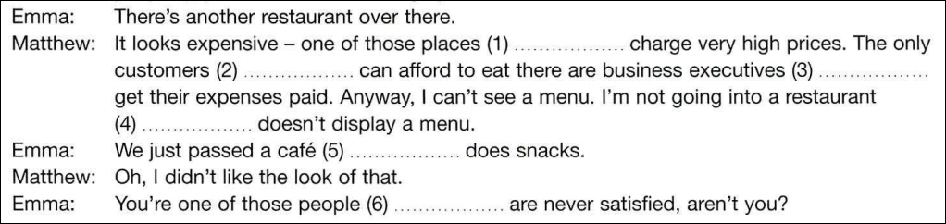

Slide 10
which
that
who
that
who
that
which
that
that
which
that
who

Slide 11
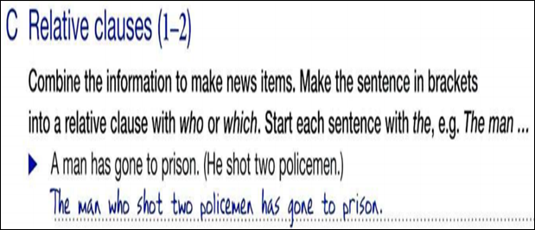


The bomb which went off this morning caused a lot of damage
The scientist who discovered a new planet has won the Nobel Prize.

Slide 12





Slide 13




Slide 14

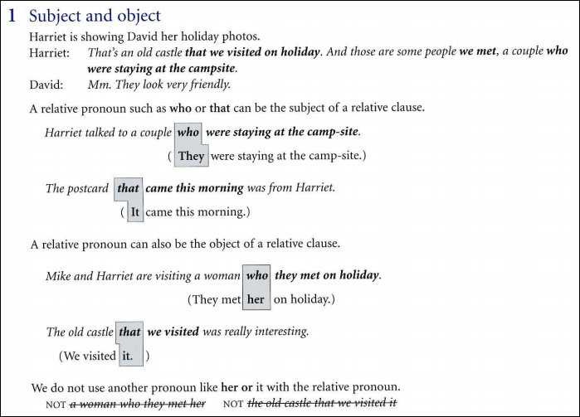

Slide 15
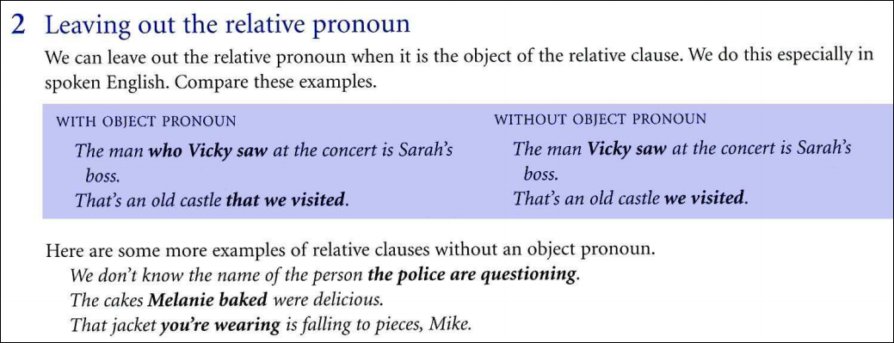

Slide 16
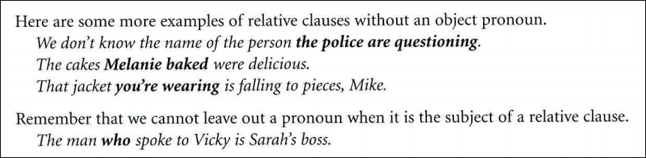

Slide 17
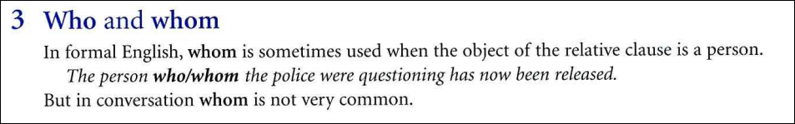
WHO + V + O
WHOM + (S) + V + O

Slide 18

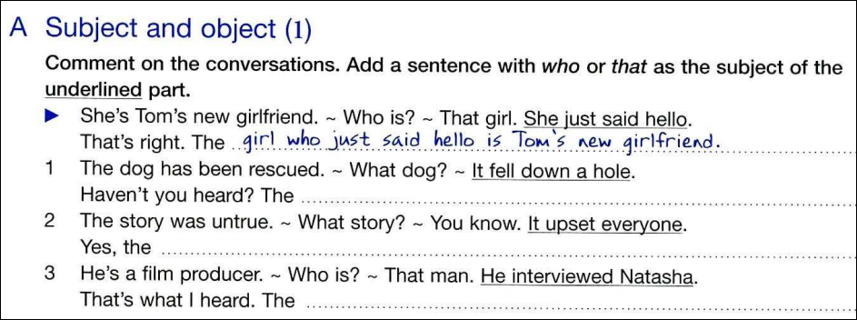


Slide 19
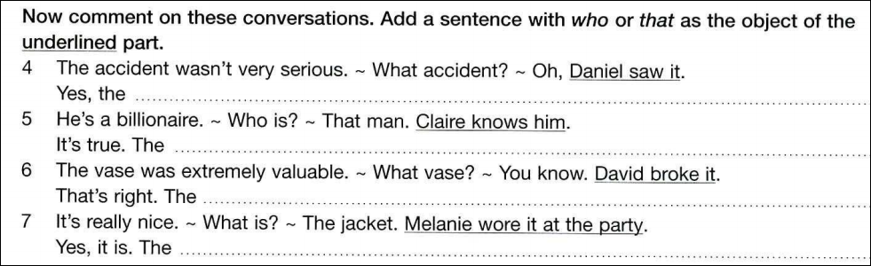

Slide 20
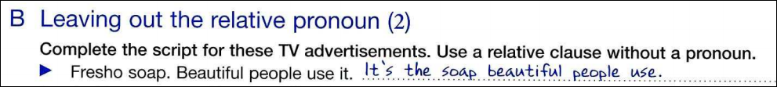



Slide 22
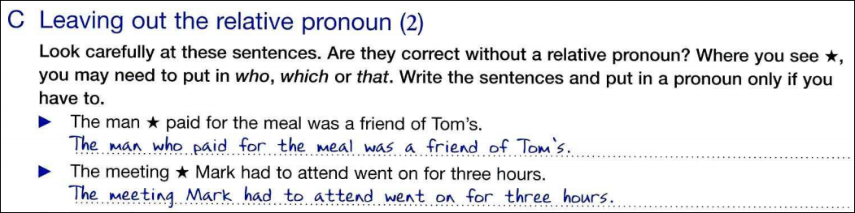

Slide 23
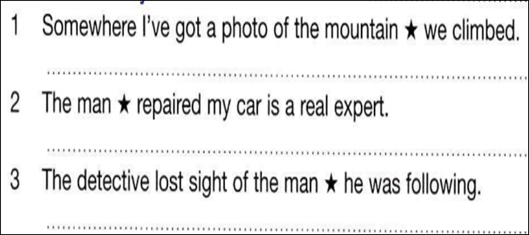
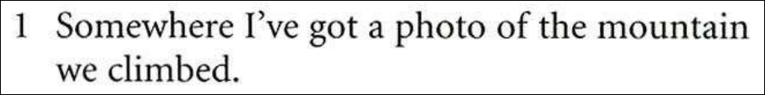
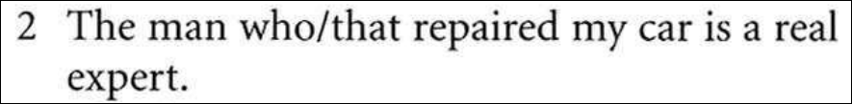
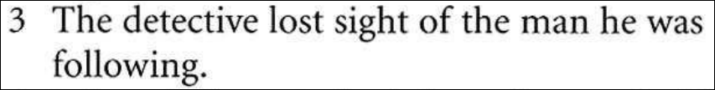

Slide 24
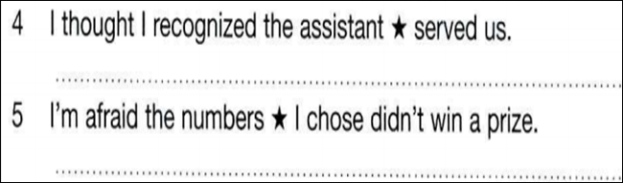
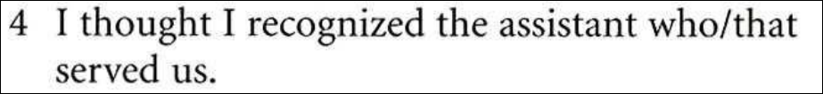
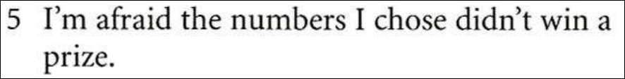

Slide 25

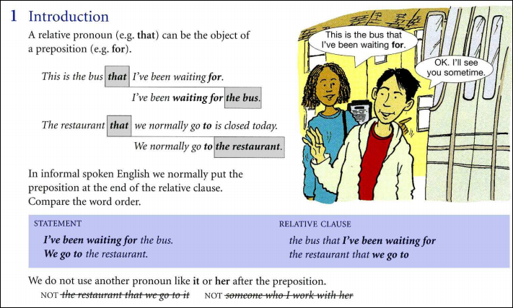

Slide 26
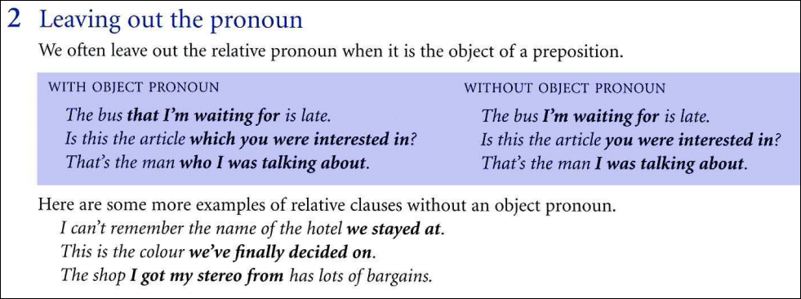

Slide 27

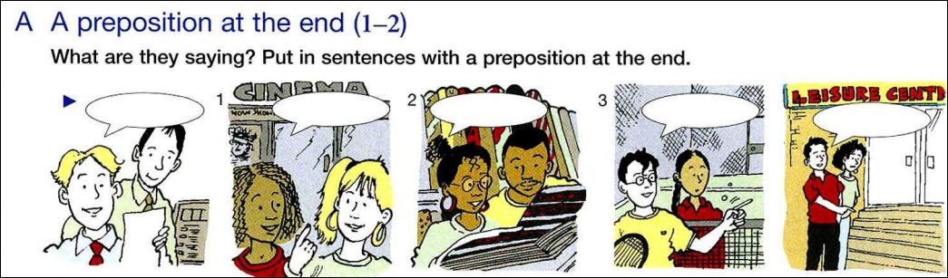

Slide 28
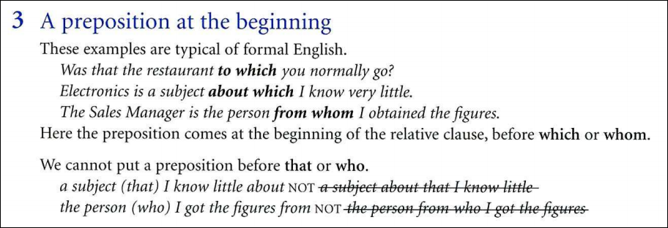

Slide 29
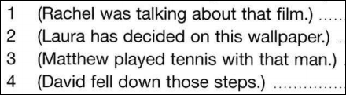




Slide 30
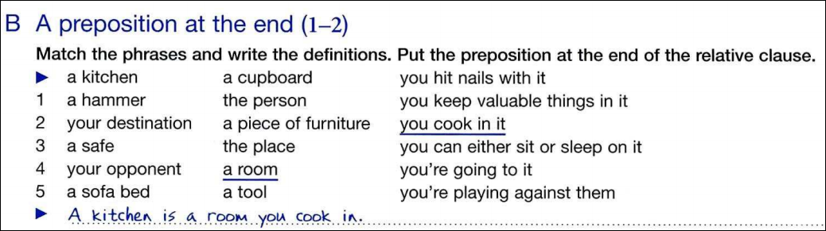

Slide 31






Slide 32
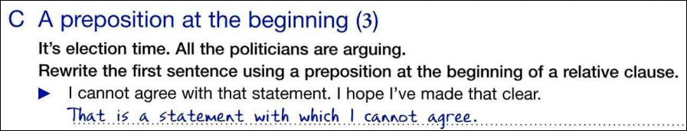


Slide 33
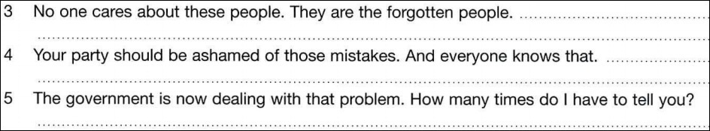



Slide 34
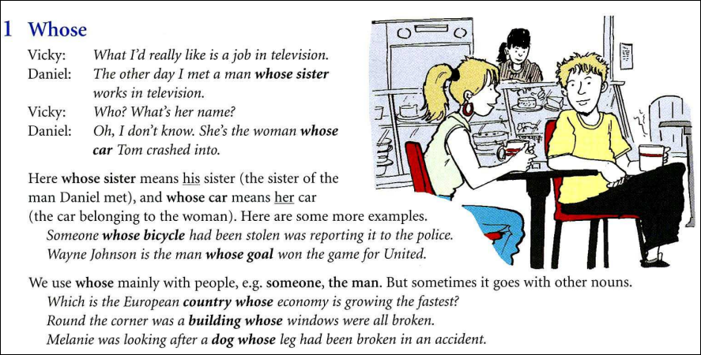

Slide 35
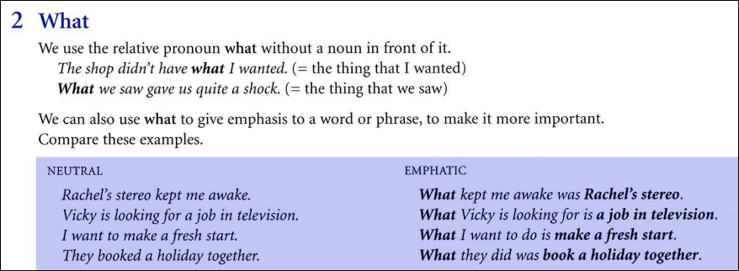

Slide 36
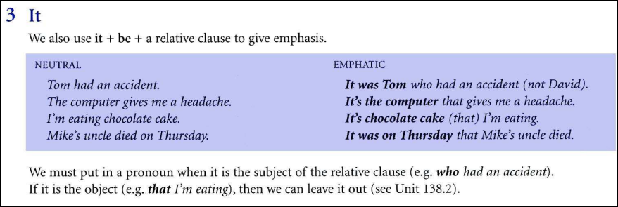

Slide 37
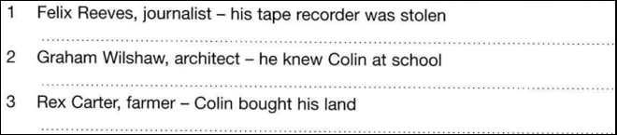




Slide 38

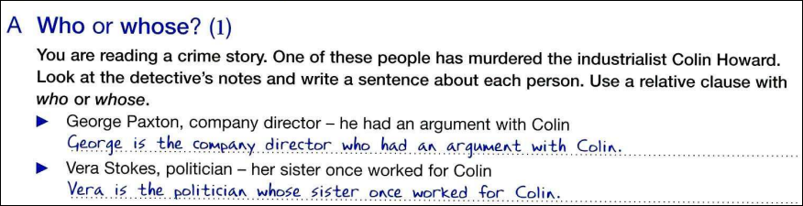

Slide 39
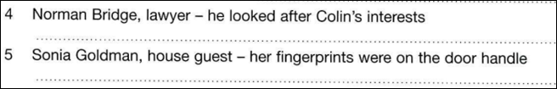



Slide 40
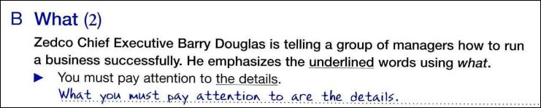

Slide 41
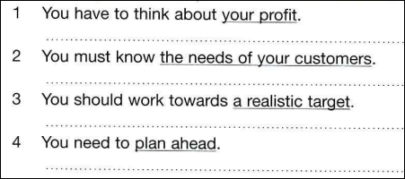



Slide 42
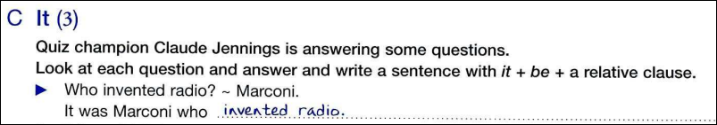
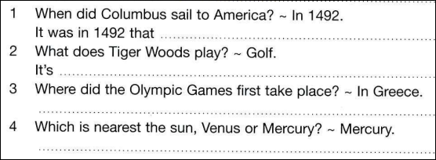




Slide 43

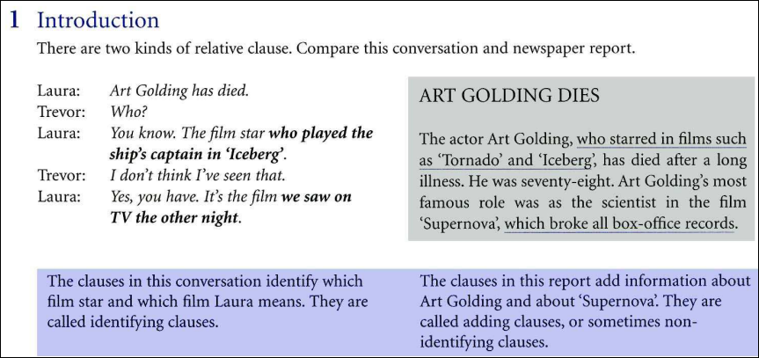

Slide 44
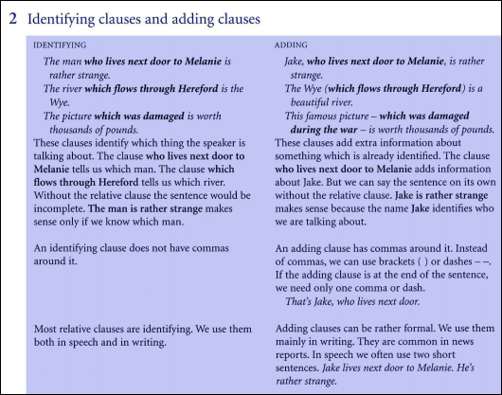

Slide 45

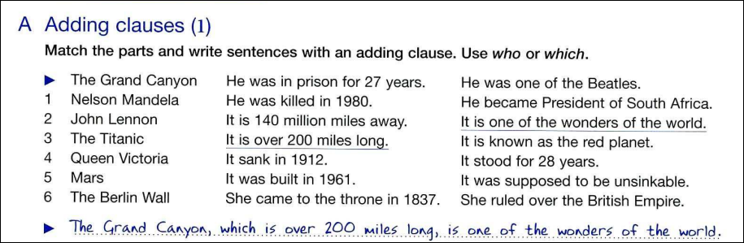

Slide 46







Slide 47
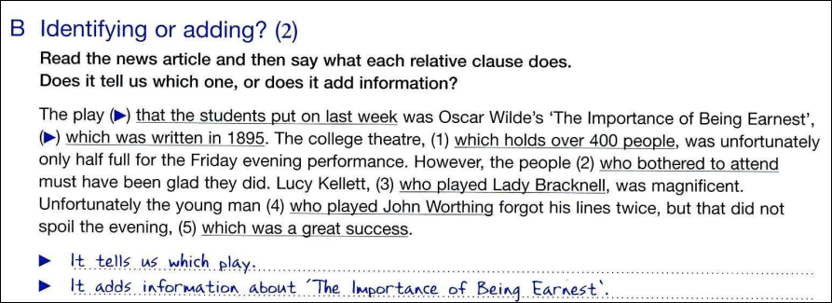



Slide 48
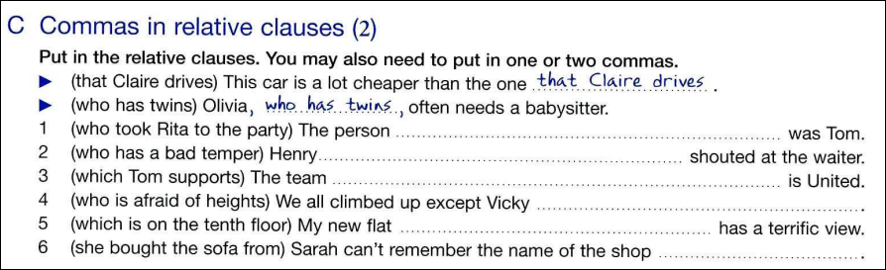







Slide 49



Slide 50


Slide 51


Slide 52


Slide 53


which
who
whose
why
who
whom
who
which
where

Slide 54

Rachel’s mother paid for the meal, whicjh was very kind of her.
My brother is disabled, which means he can’t get about very easily
You left the keys in the car, which was rather careless of you.
Vicky didn’t get the job, which has made her very depressed.
The police blocked off the road, which cuased a traffic jam.

Slide 55







