Slide 1
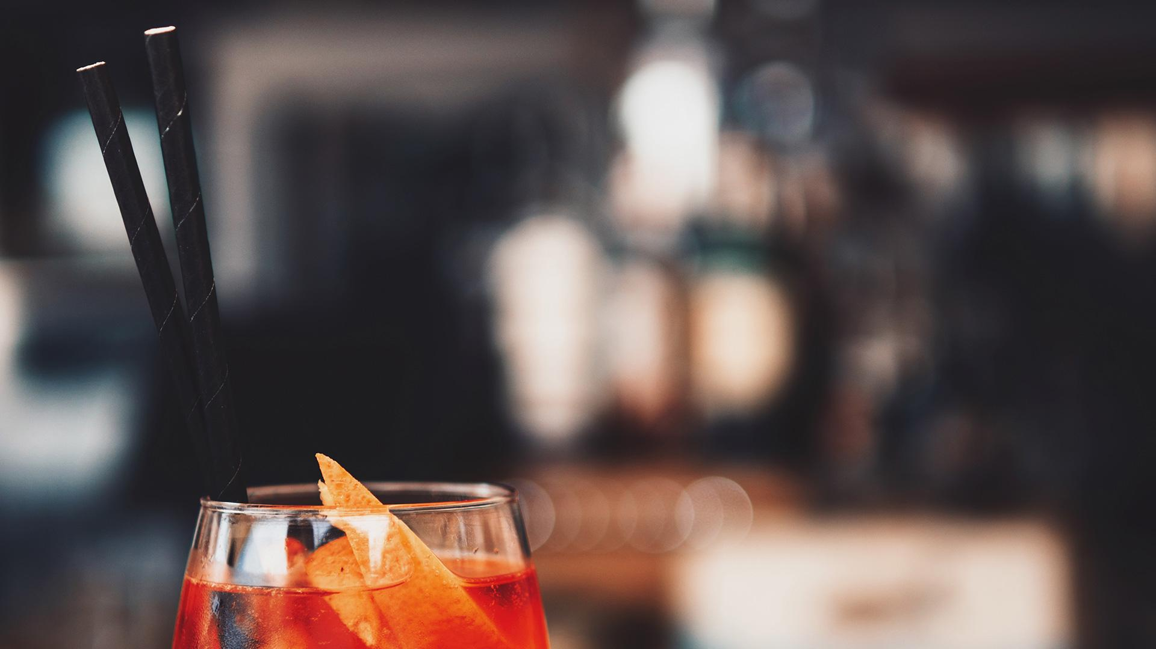
LISTENING PRACTICE 1
Unit 7: International Food
Lecturer: Nguyen Thien Binh

Slide 2
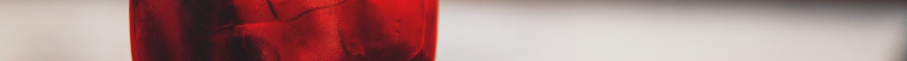
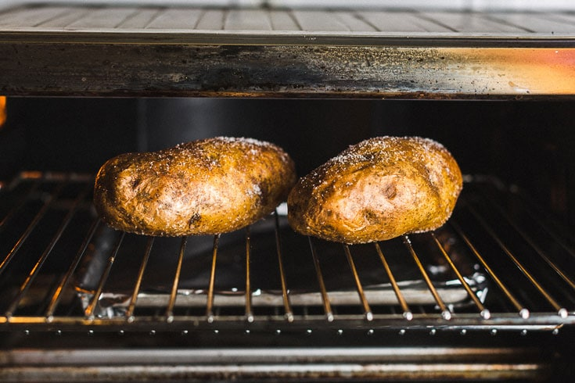
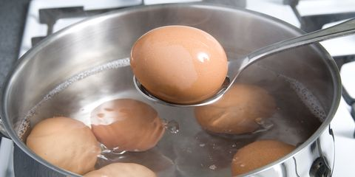
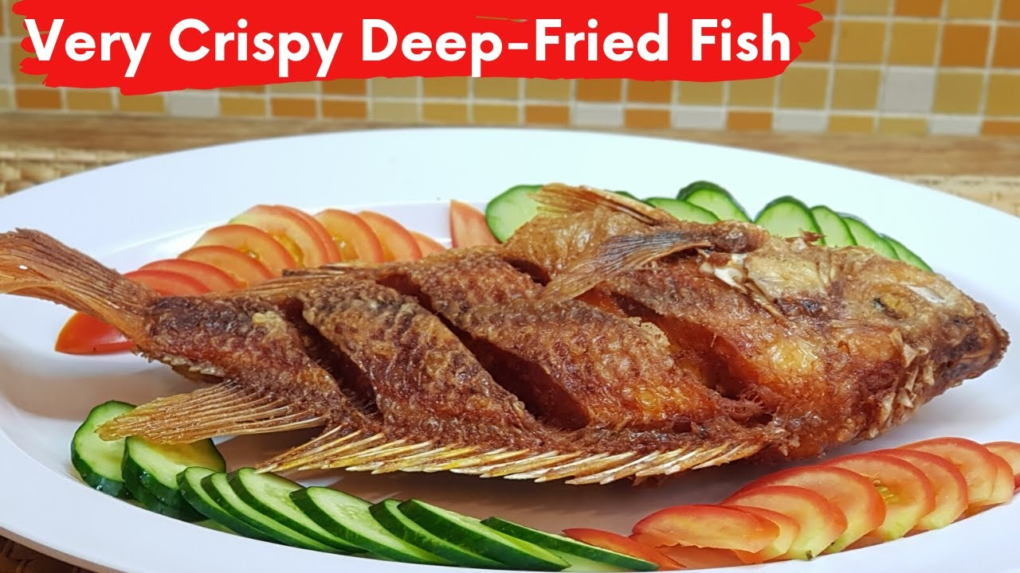
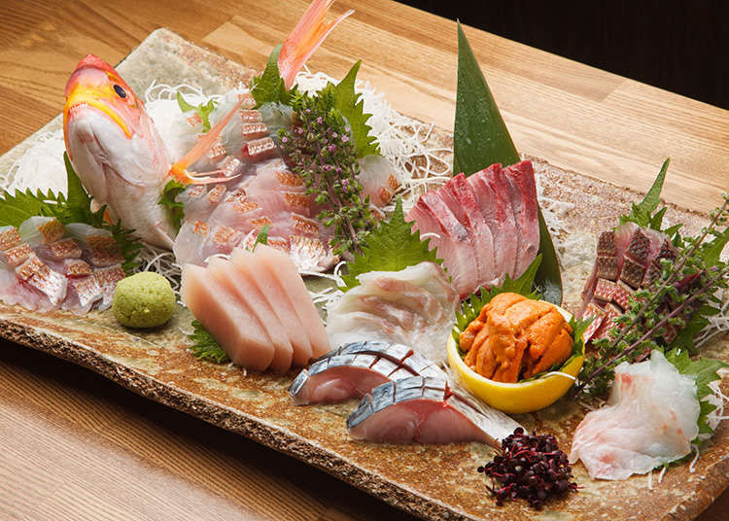
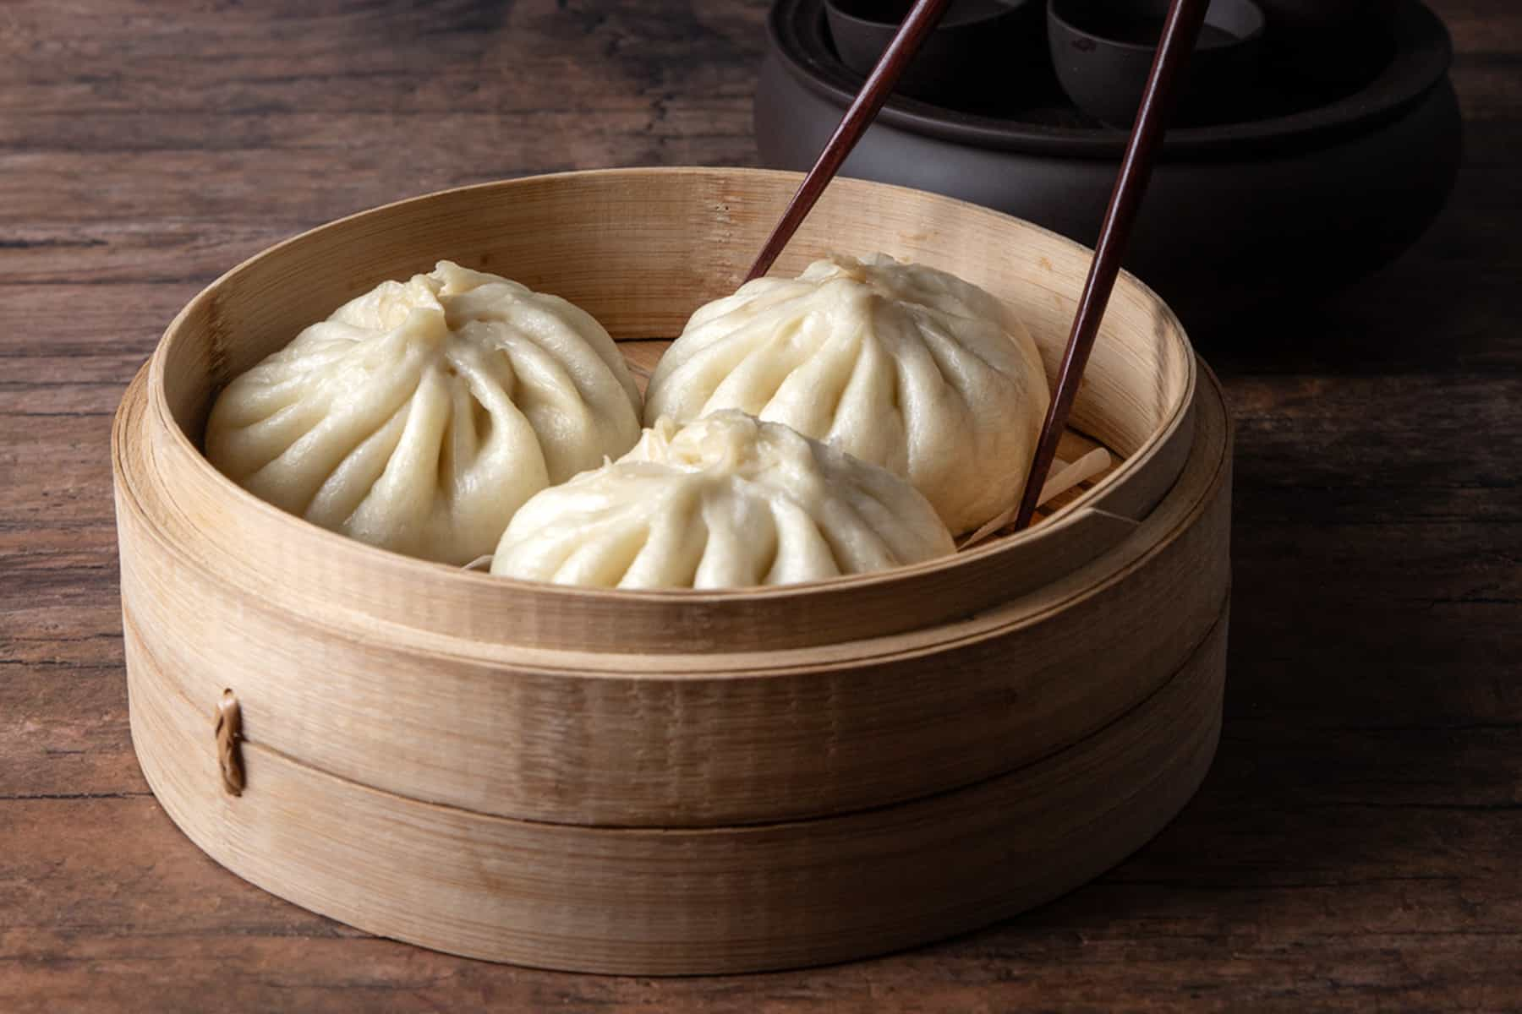
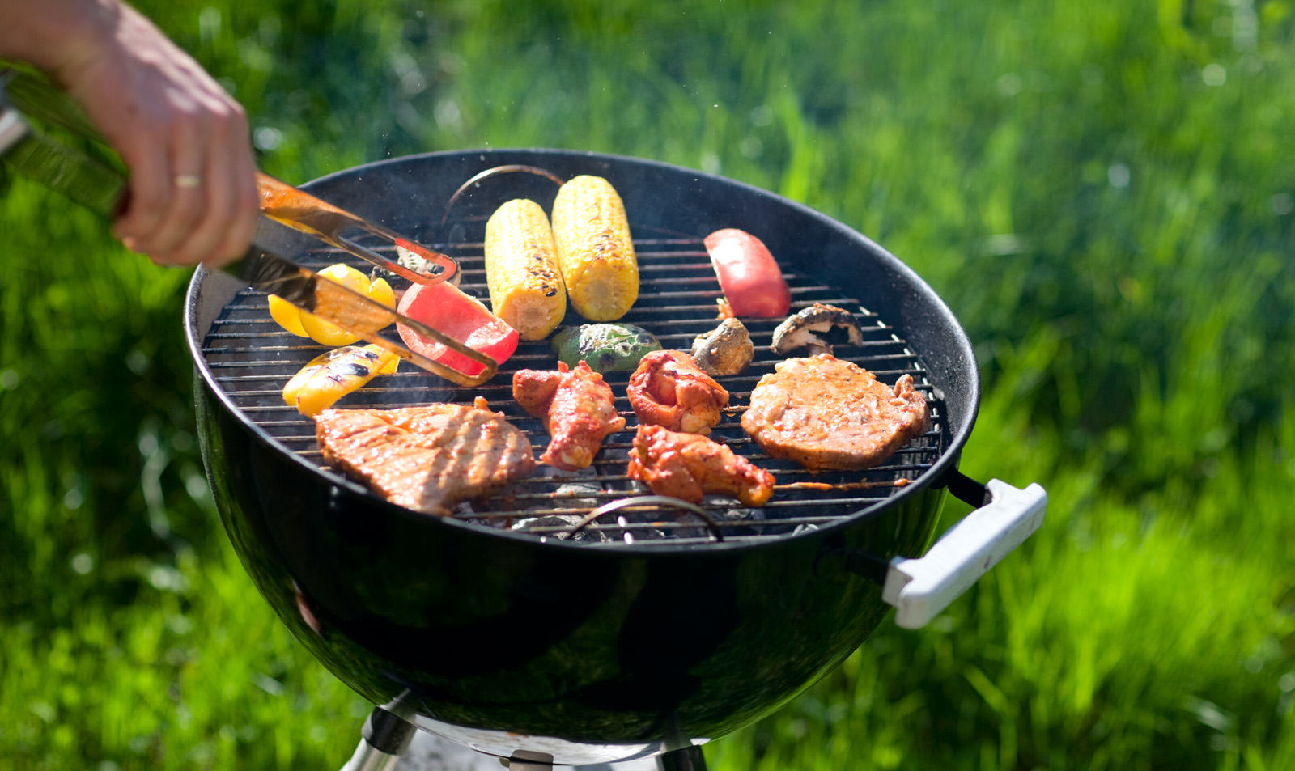
Ways of cooking
boiled
baked
raw
fried
steamed
grilled

Slide 3
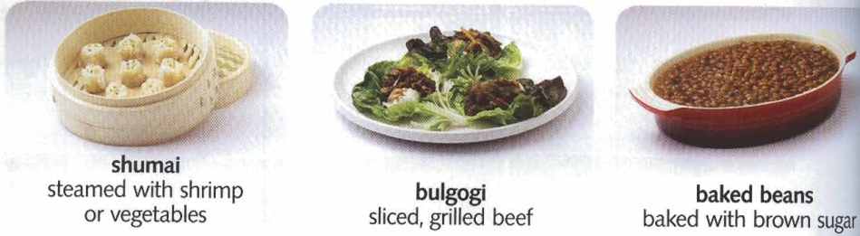
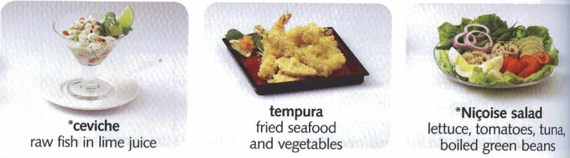
China
Korea
the U.S
Japan
France
Peru / Ecuador

Slide 4
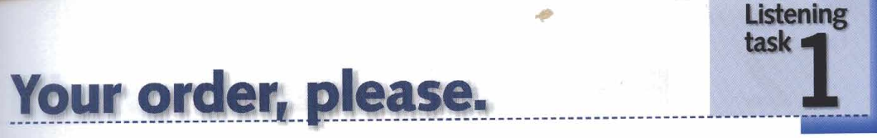
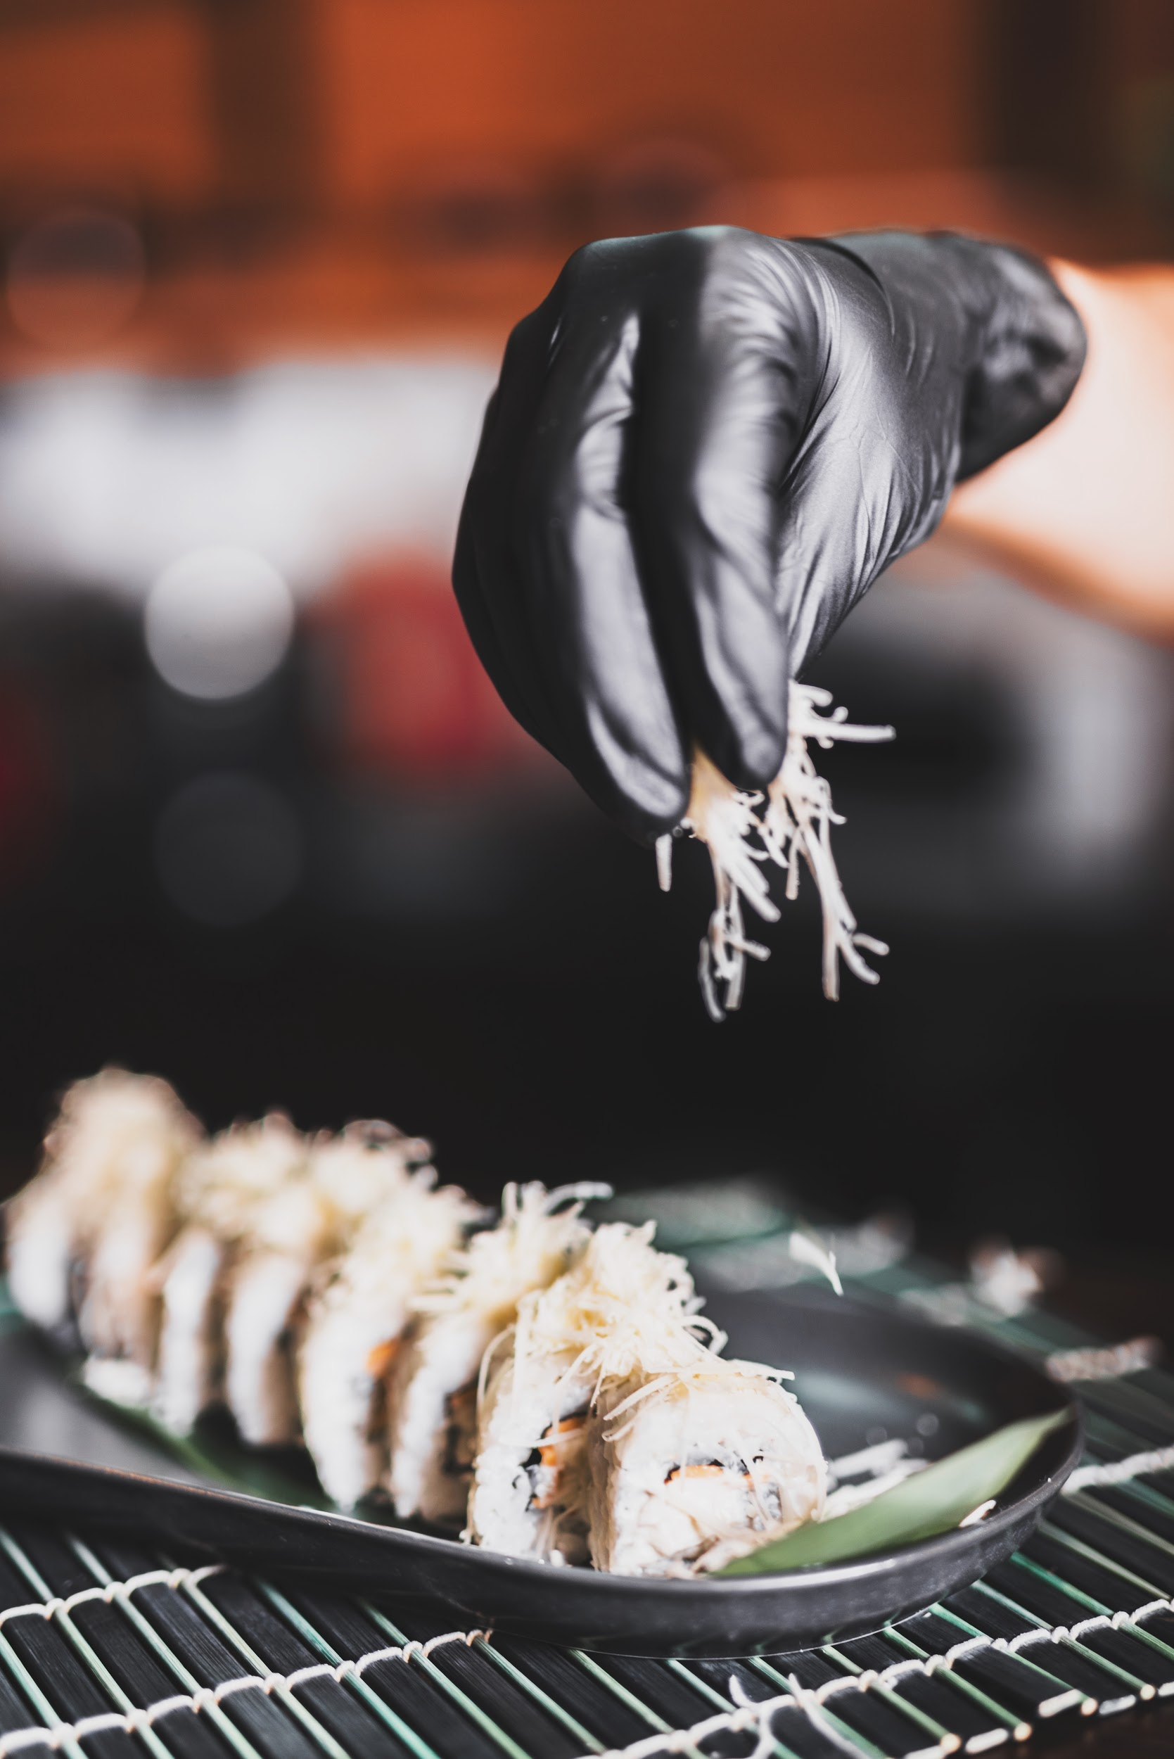
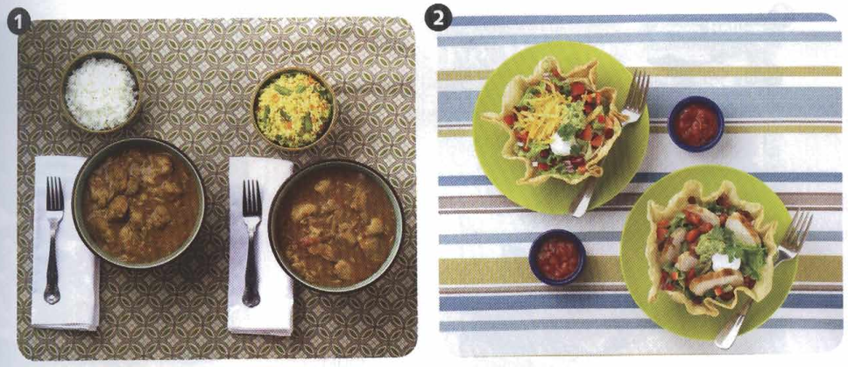
01
PROJECT SCHEDULE
02
PROJECT TIMELINE
04
UPCOMING REPORT
white rice
cheese
fried rice
Here you could describe the topic of the section
Here you could describe the topic of the section
Here you could describe the topic of the section
Here you could describe the topic of the section
sliced, grilled chicken
curry
Tacos

Slide 5
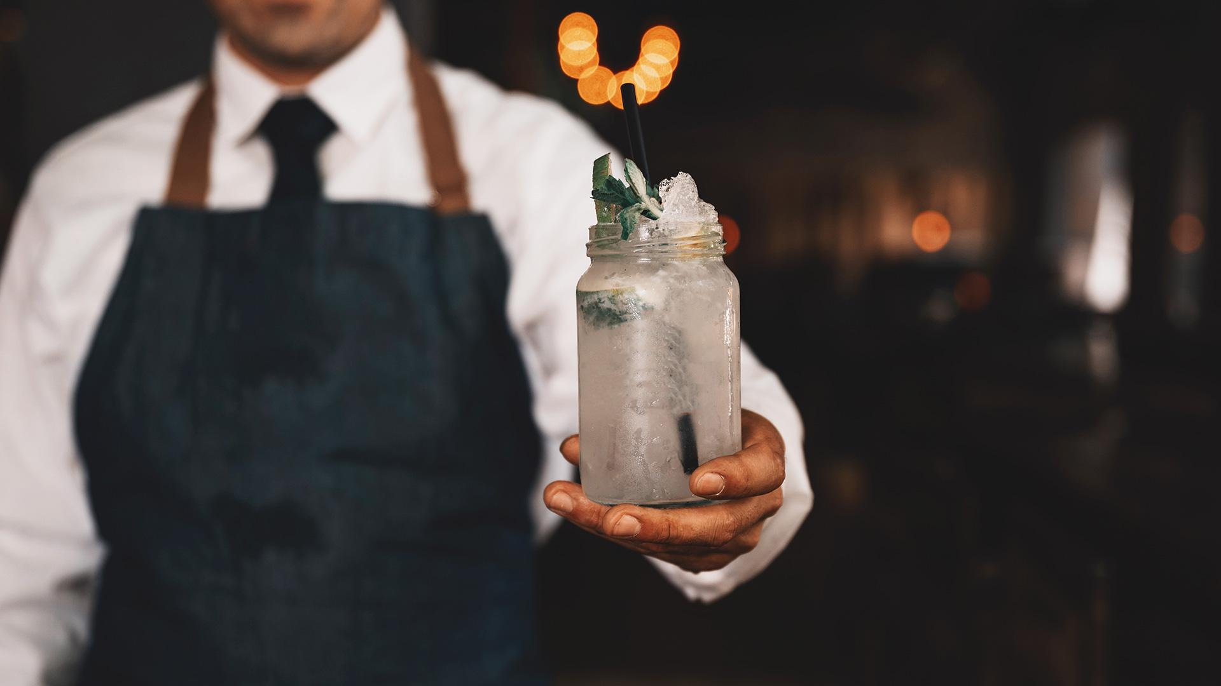
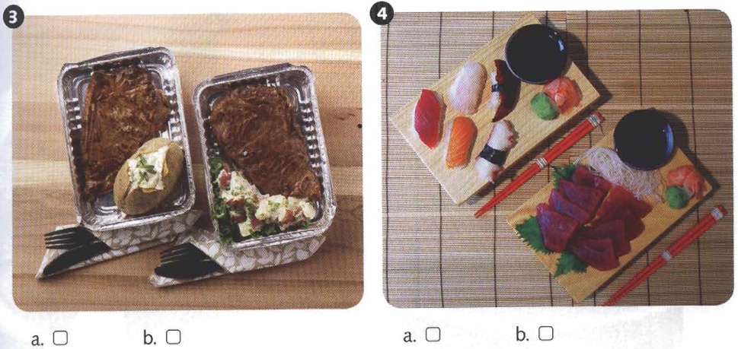
01
COMPANY
grilled beef
Sushi
baked potato
You could enter a subtitle here if you need it
potato
salad
Sashimi

Slide 6
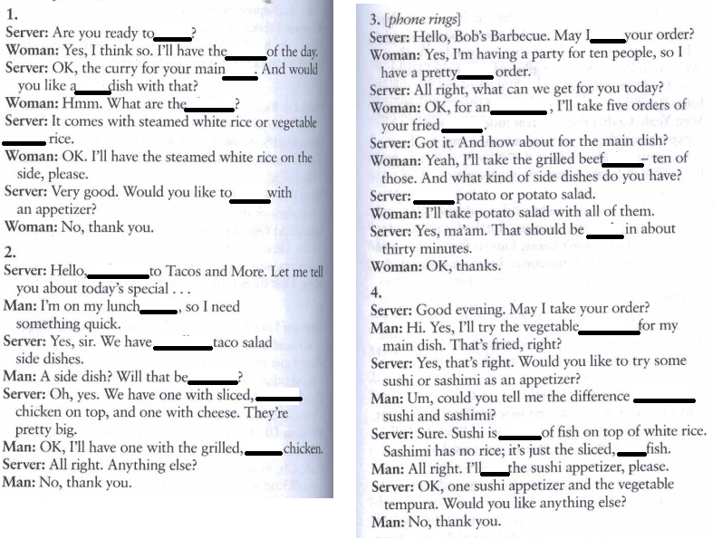
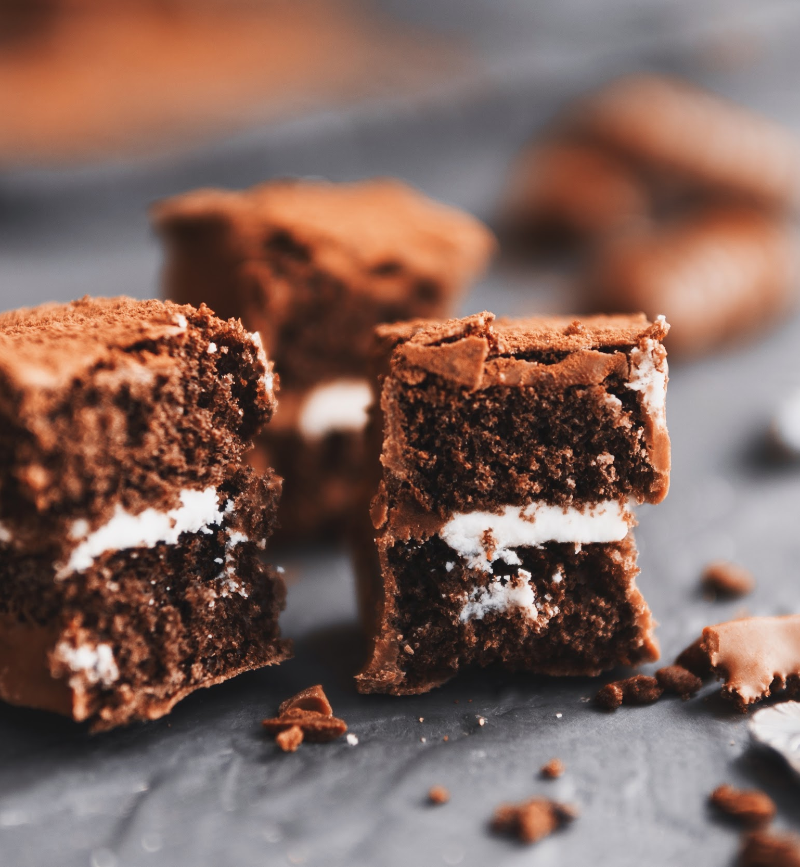
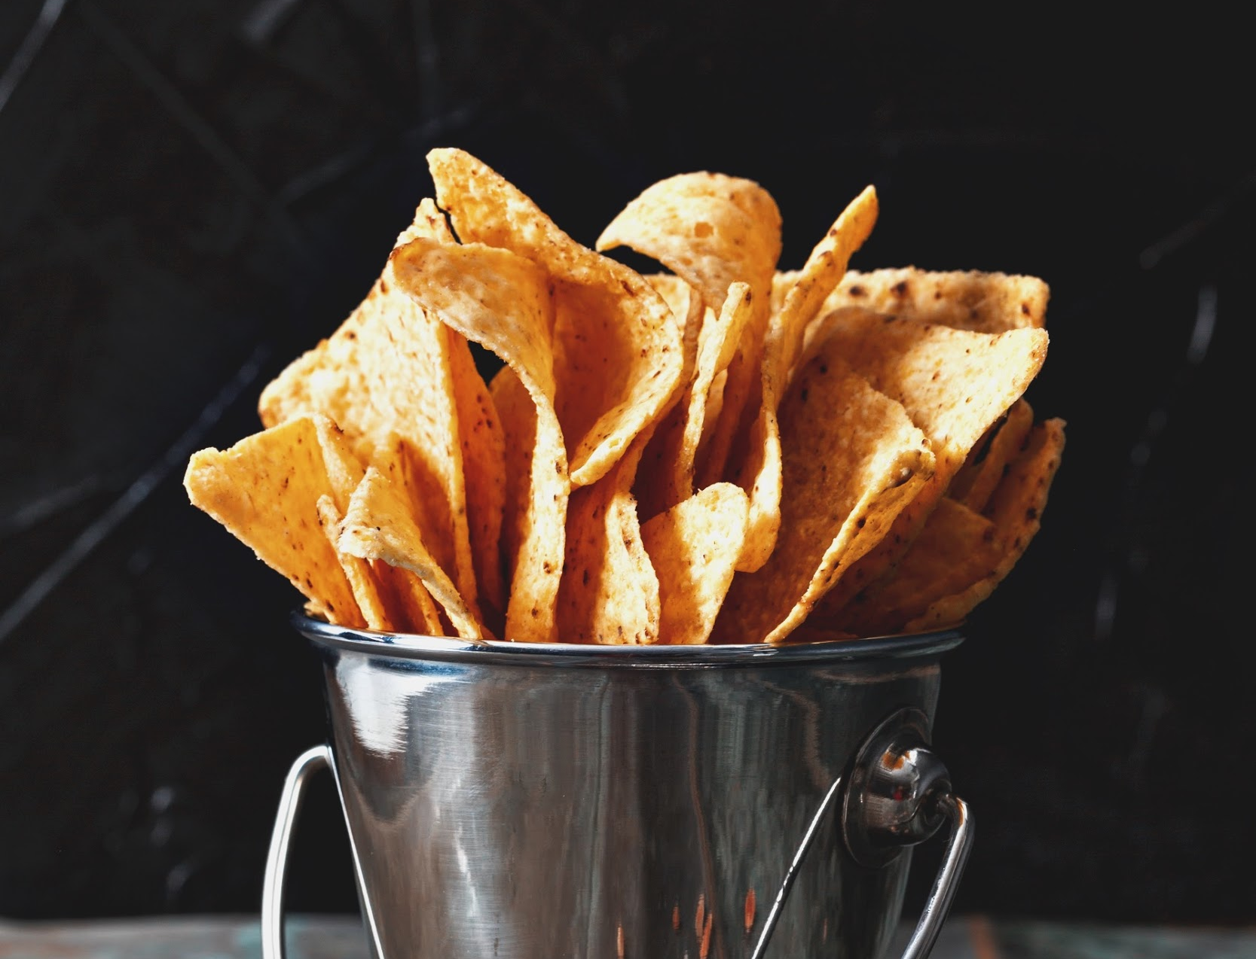
ABOUT THE PROJECT
Mercury is the closest planet to the Sun and the smallest one in the Solar System—it’s only a bit larger than our Moon. The planet’s name has nothing to do with the liquid metal, since it was named after the Roman messenger god, Mercury

Slide 7
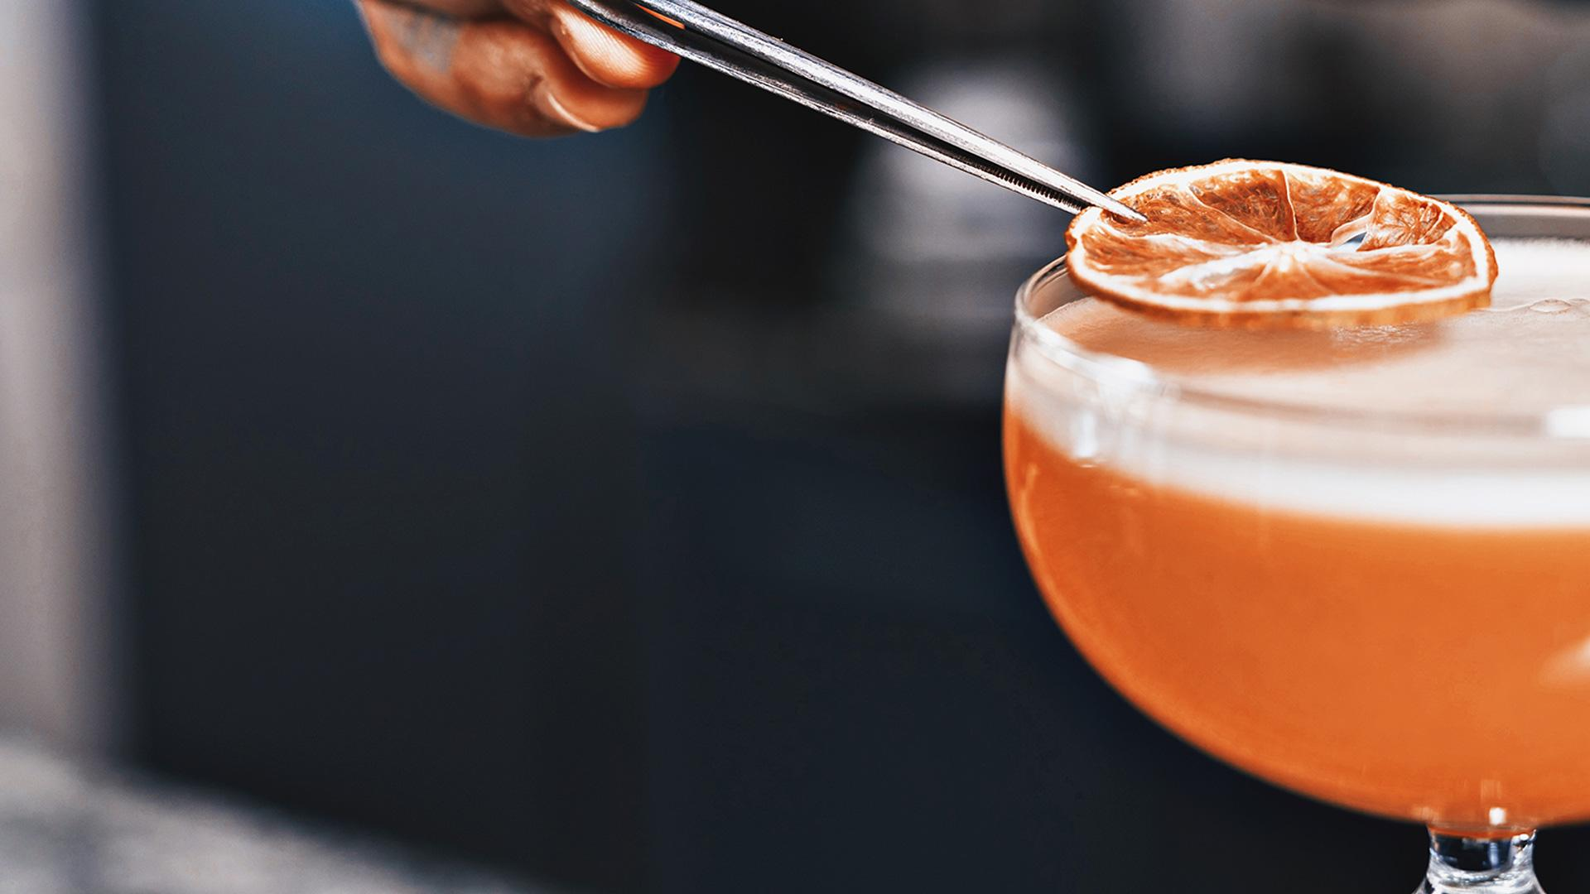
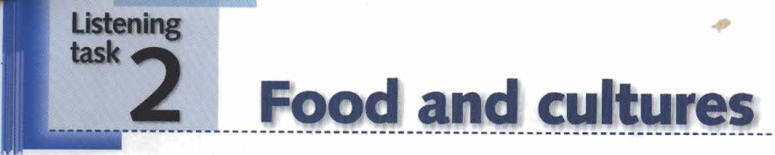
“This is a quote. Words full of wisdom that someone important said and can make the reader get inspired.”
—SOMEONE FAMOUS

Slide 8
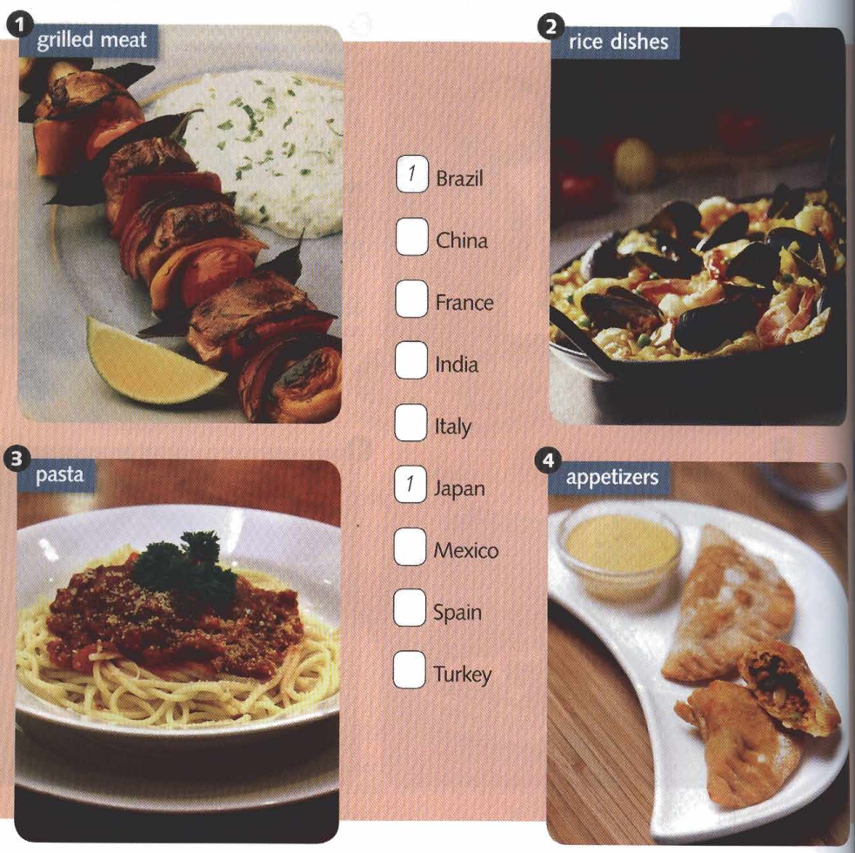
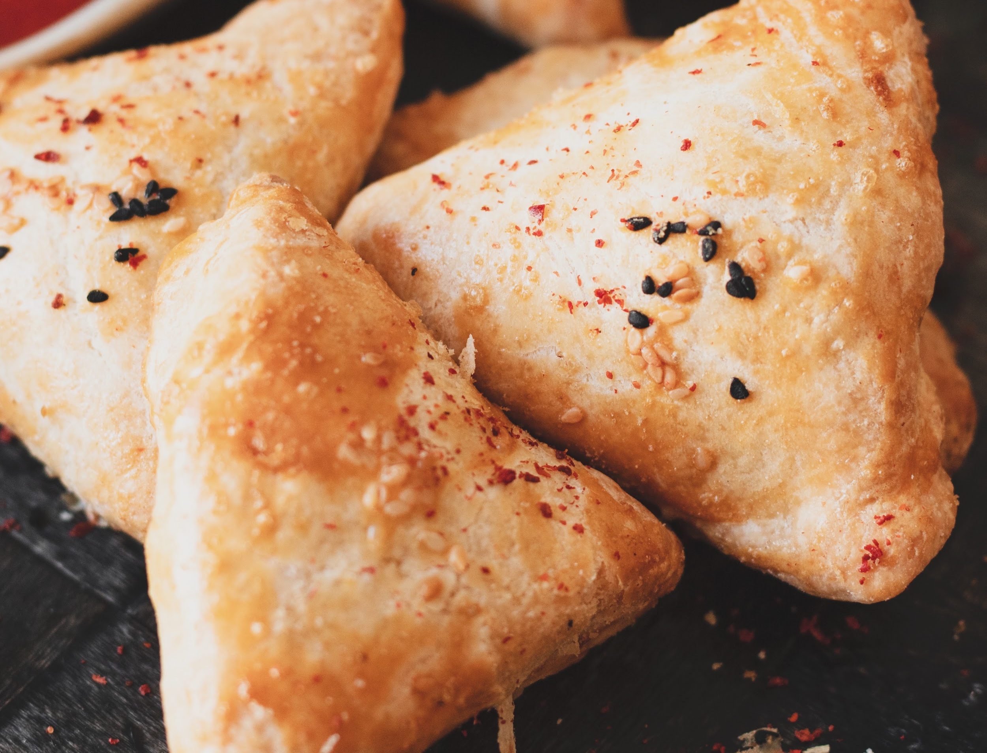
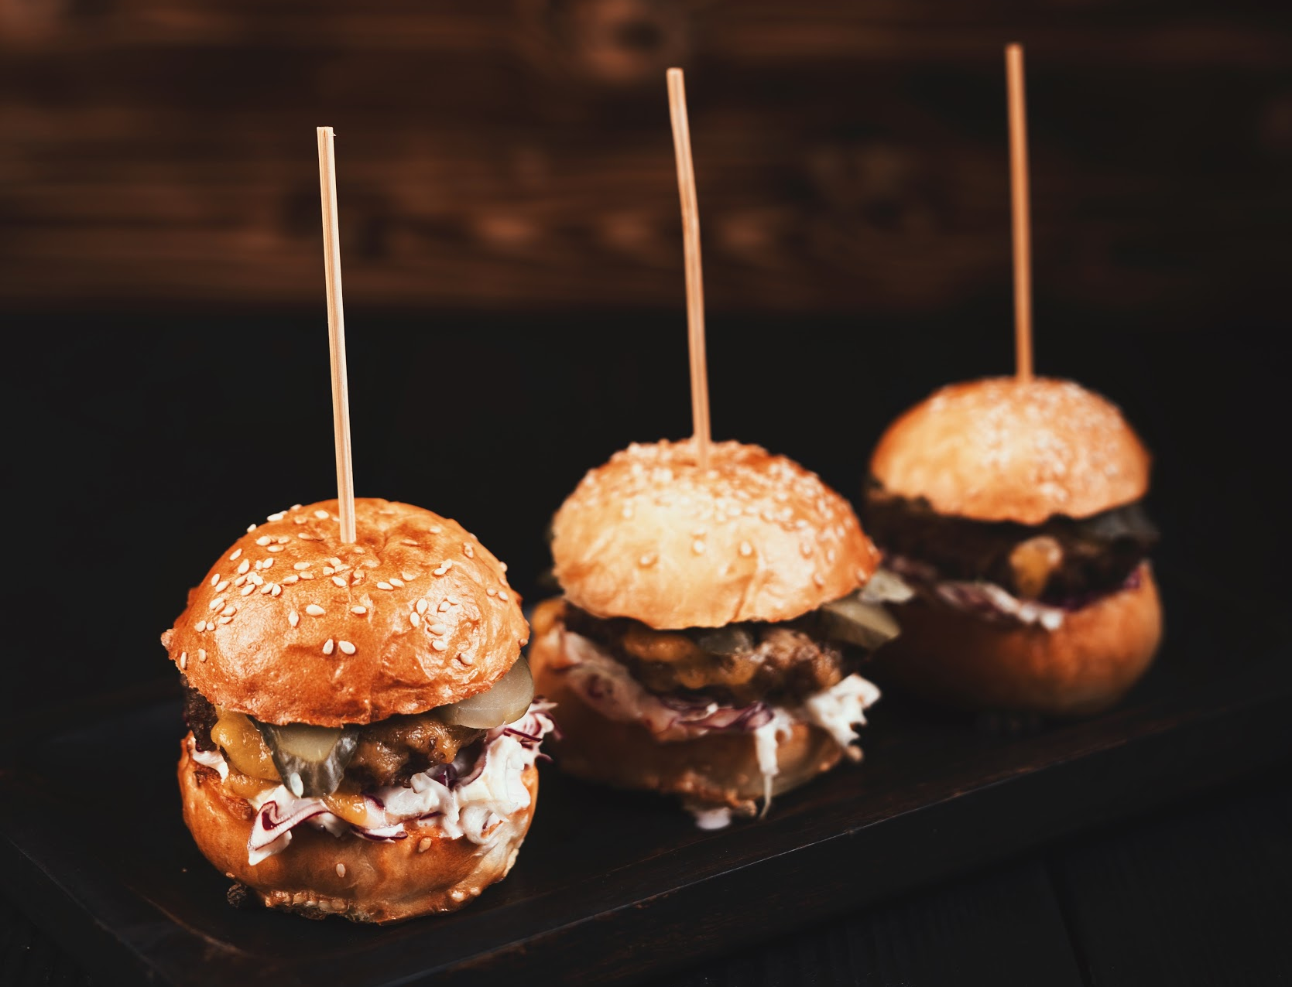
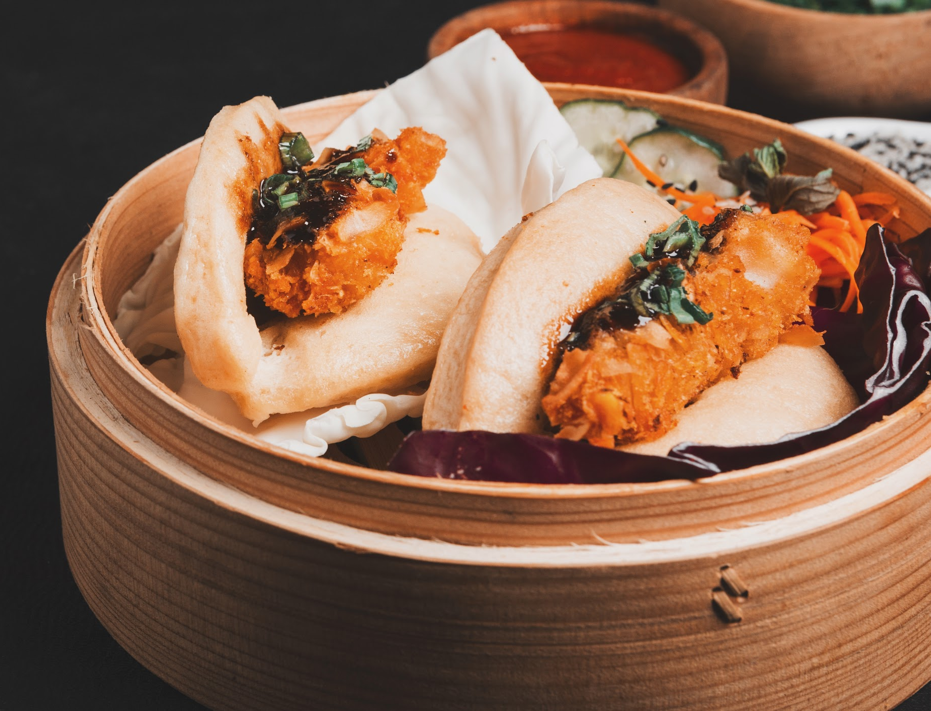
PROJECT PROPOSAL
Neptune
Mars
Jupiter
Neptune is the farthest planet from the Sun and the fourth-largest by diameter
Despite being red, Mars is actually a cold place. It’s full of iron oxide dust
Jupiter is a gas giant and the biggest planet in our Solar System

Slide 9
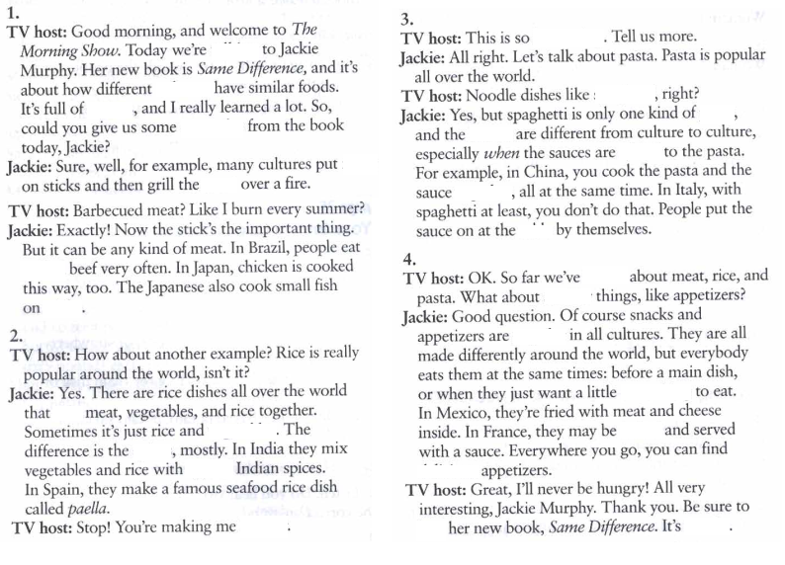
PROJECT SCHEDULE
Jupiter
Venus
14:00 | Title Here you can write your description
16:00 | Title Here you can write your description
18:00 | Title Here you can write your description
20:00 | Title Here you can write your description
22:00 | Title Here you can write your description
00:00 | Title Here you can write your description

Slide 10
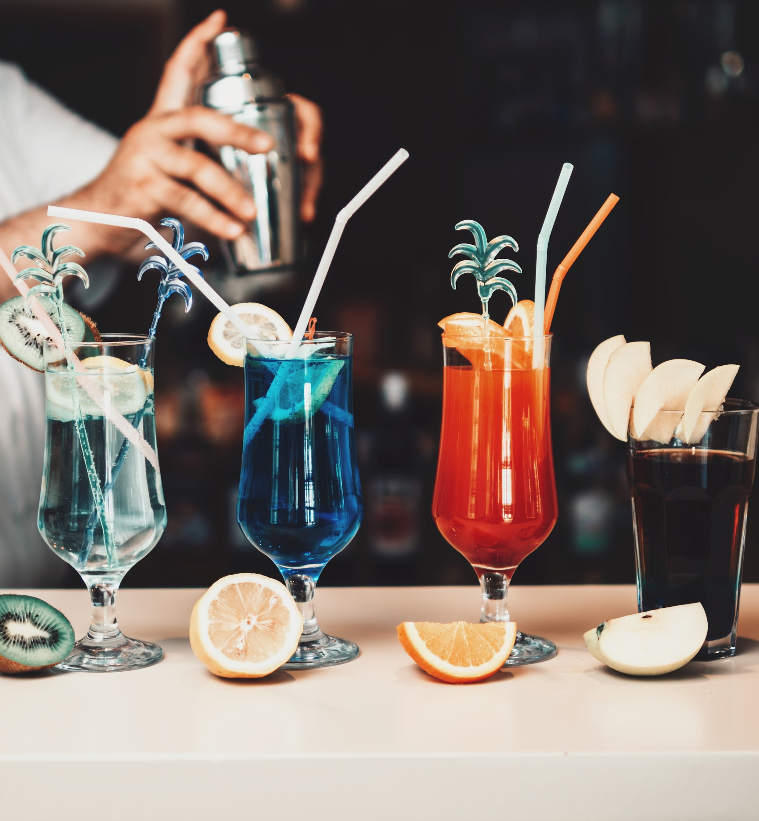
FUTURE PROJECTS
Mars
Venus
Mercury
Jupiter
Saturn
Neptune
Despite being red, Mars is actually a cold place
Venus has a beautiful name and is the second planet from the Sun
Mercury is the smallest planet in our Solar System
Jupiter is a gas giant and the biggest planet in our Solar System
Saturn is a gas giant, composed mostly of hydrogen and helium
Neptune is the fourth-largest planet in our Solar System

Slide 11
CHECKLIST
01 PROJECT
02 PROJECT
Here you can write your description
Here you can write your description
Here you can write your description
Here you can write your description
Here you can write your description
Here you can write your description
Here you can write your description
Here you can write your description

Slide 12
RAID SUMMARY
Risks
Assumptions
Issues
Dependencies
Neptune is the farthest planet from the Sun and the fourth-largest in our Solar System
Despite being red, Mars is actually a cold place. It’s full of iron oxide dust
Jupiter is a gas giant and the biggest planet in our Solar System
Mercury is the closest planet to the Sun and the smallest one in our Solar System

Slide 13
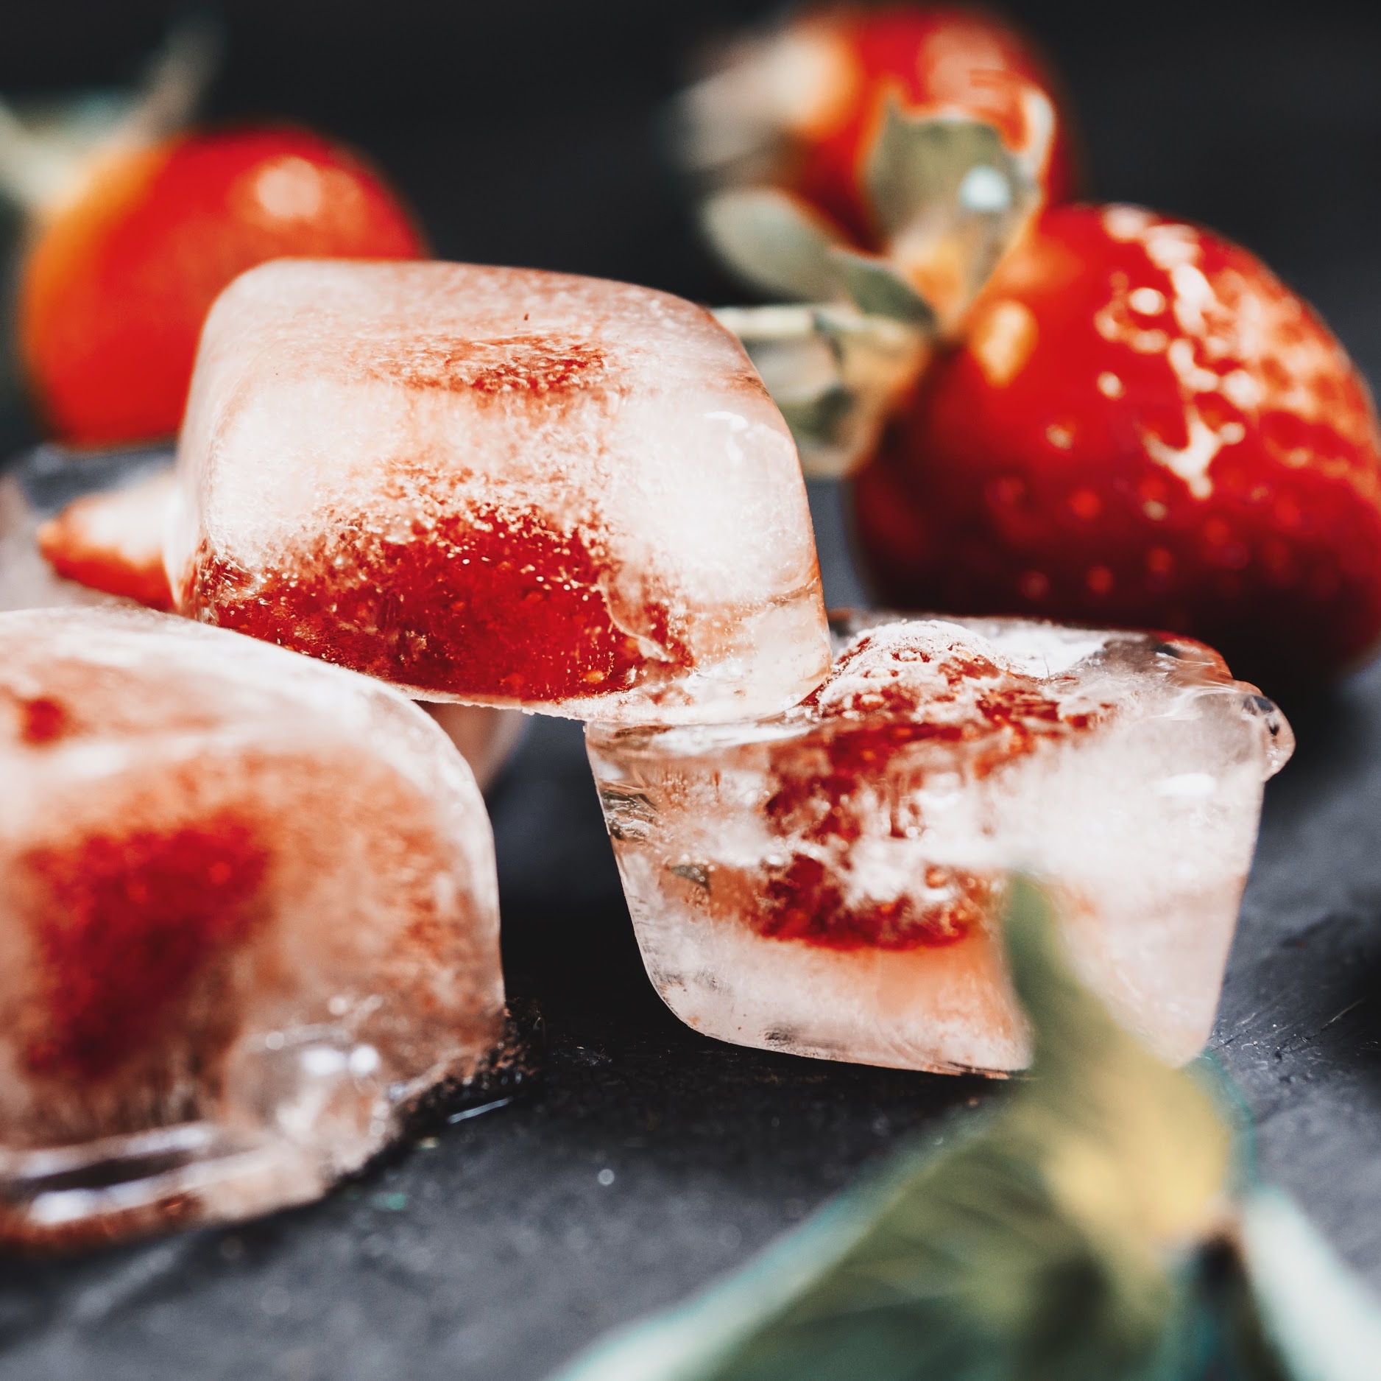
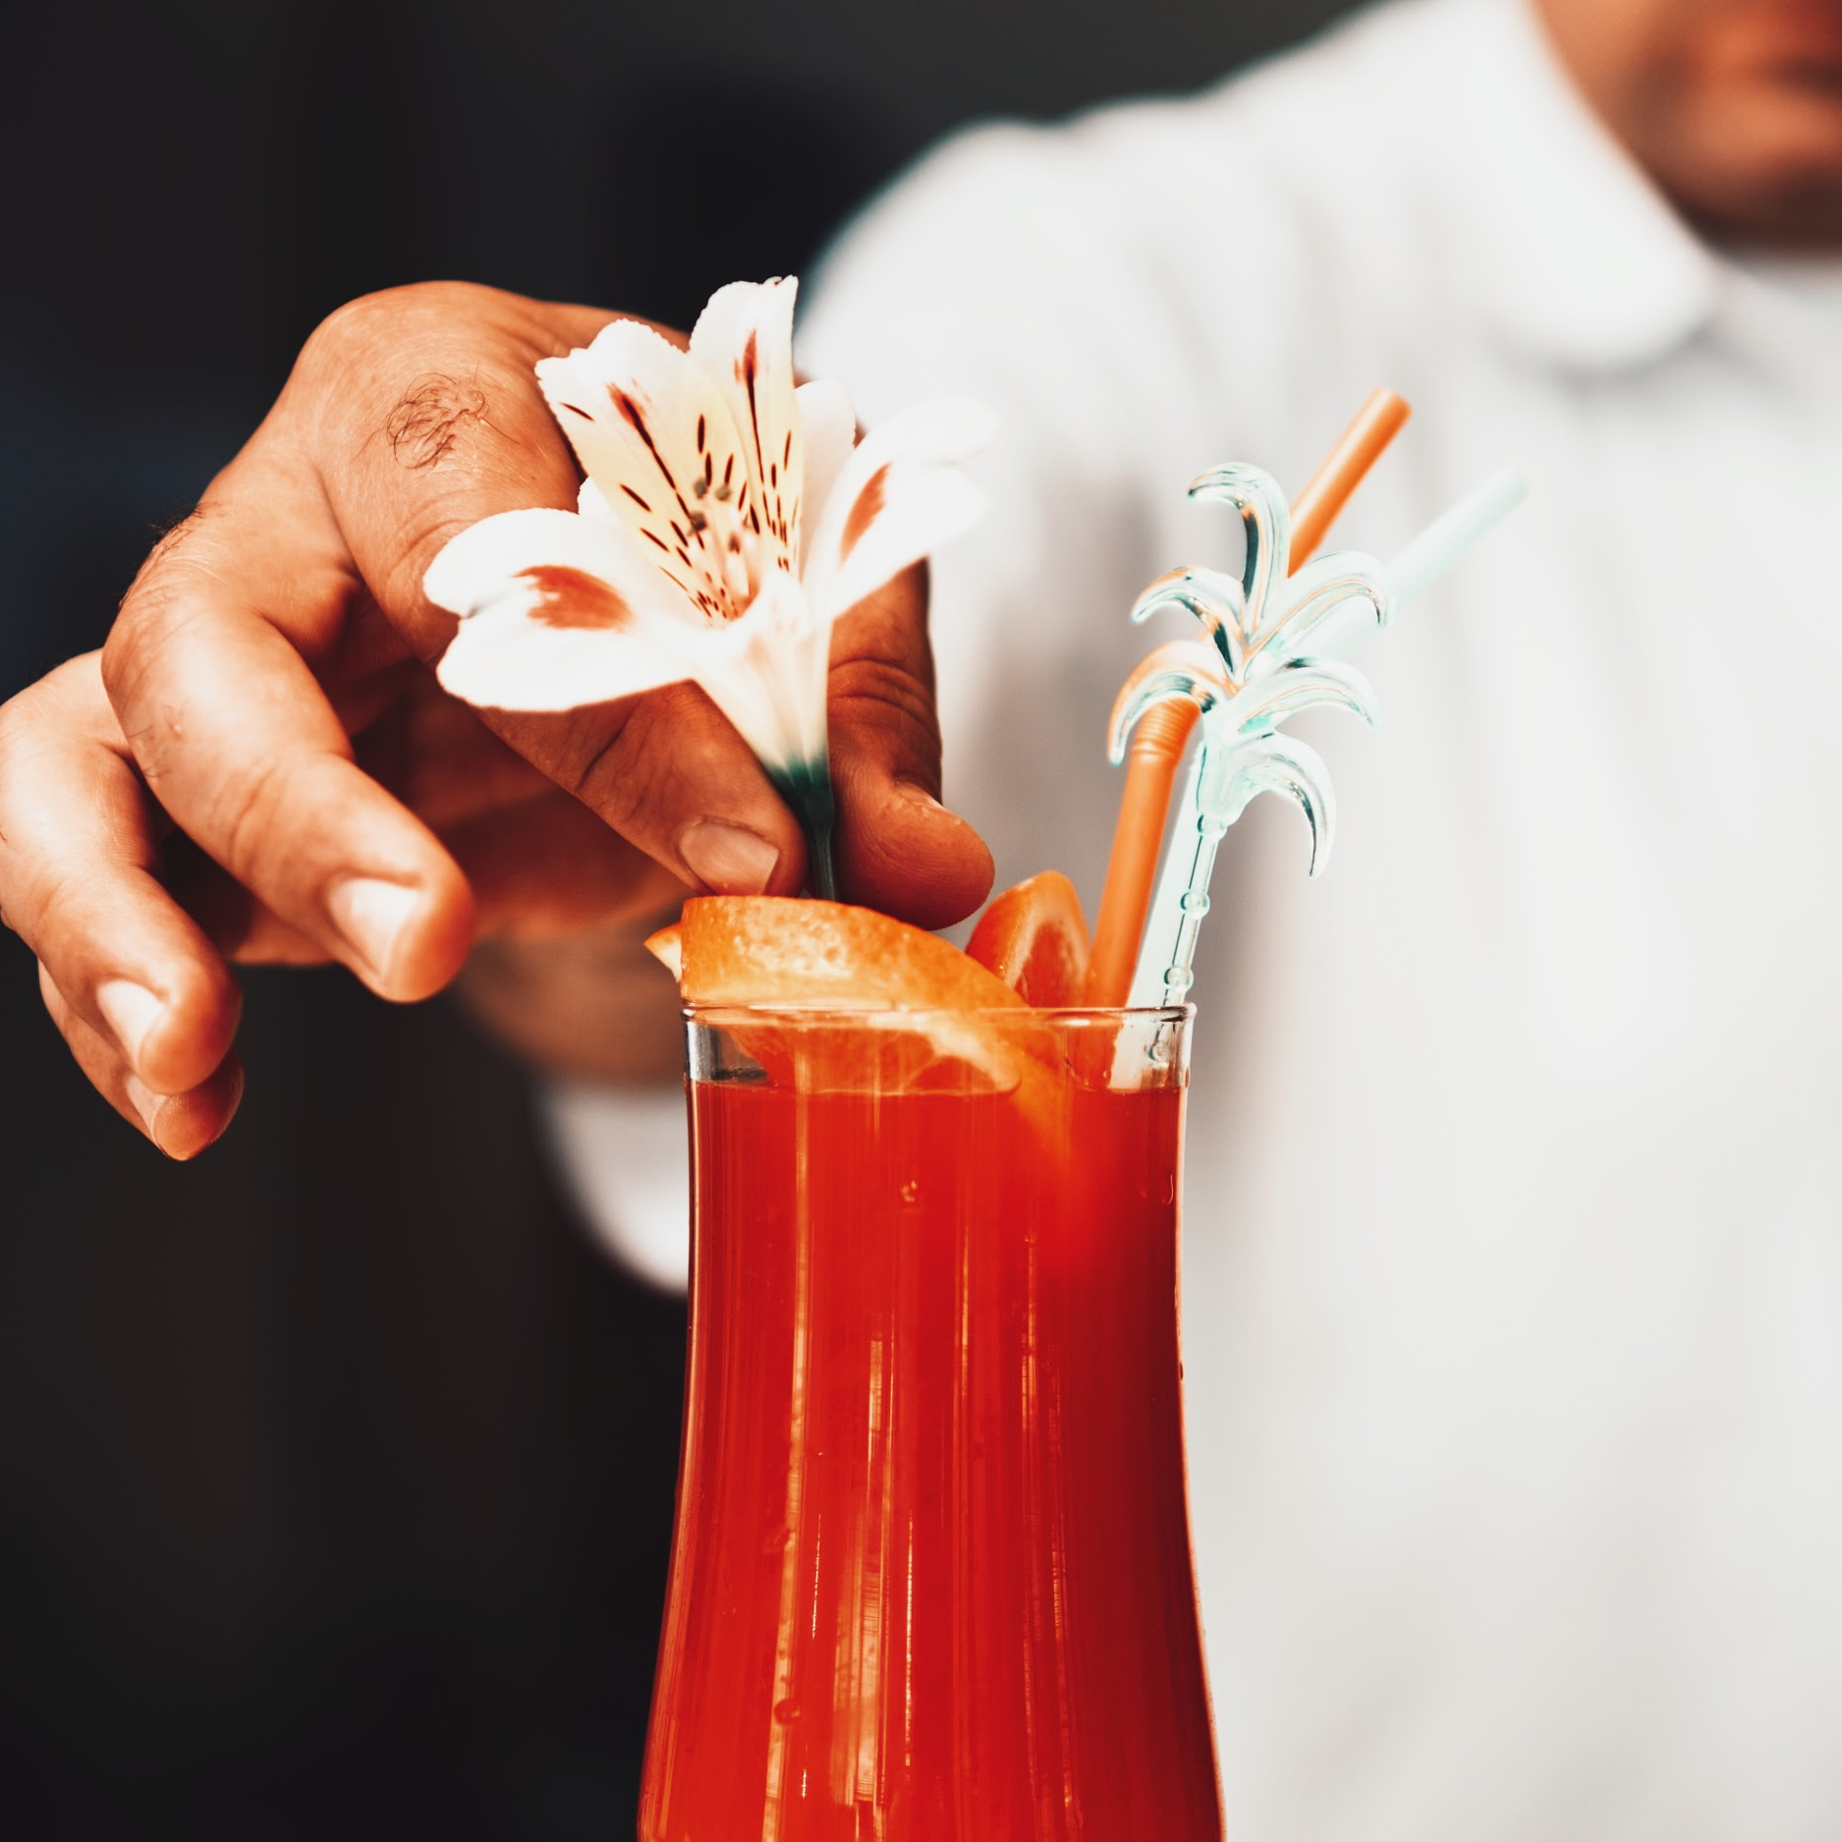
WHERE WE ARE
WHERE WE WANT TO BE
Mercury is the closest planet to the Sun and the smallest one in the Solar System. The planet’s name has nothing to do with the liquid metal
Venus has a beautiful name and is the second planet from the Sun. It’s terribly hot—even hotter than Mercury—and its atmosphere is extremely poisonous

Slide 14
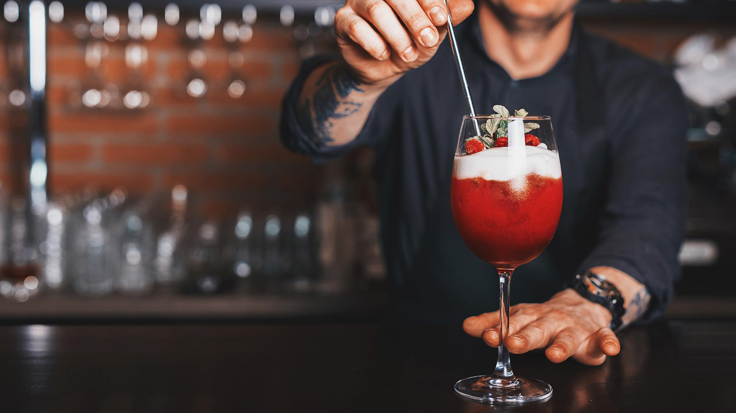
AWESOME WORDS

Slide 15
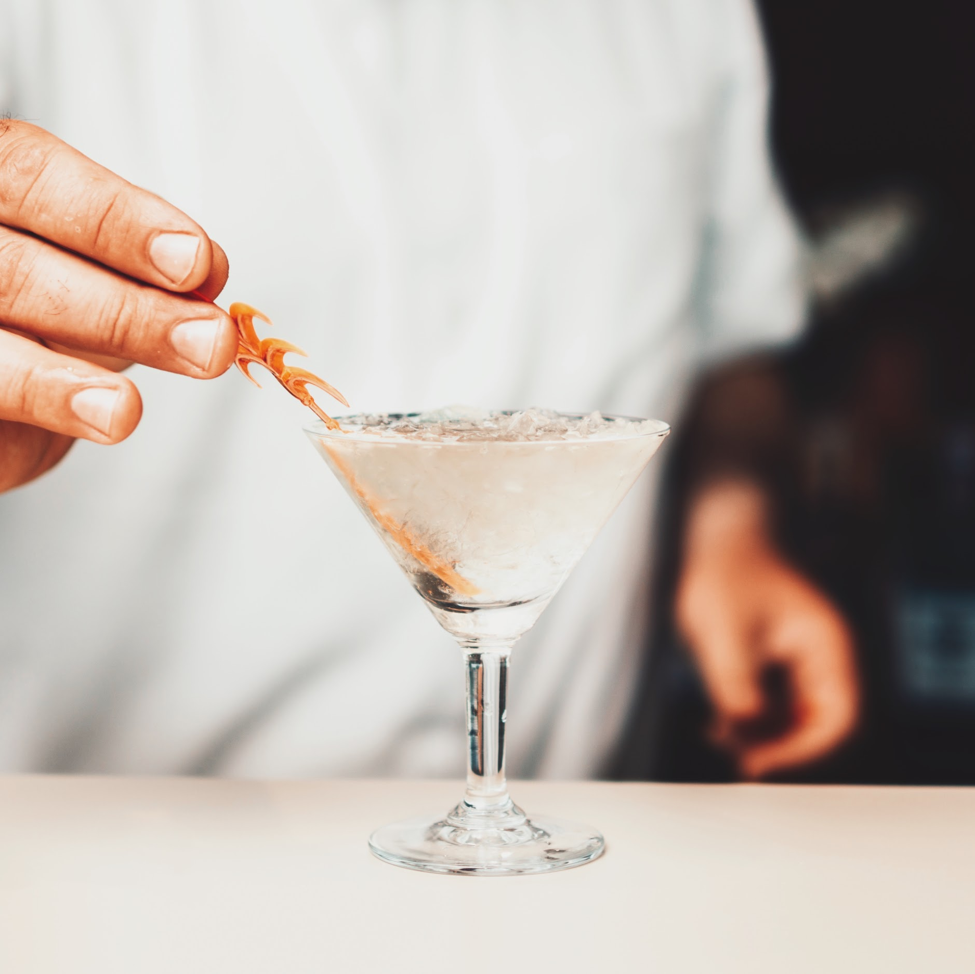
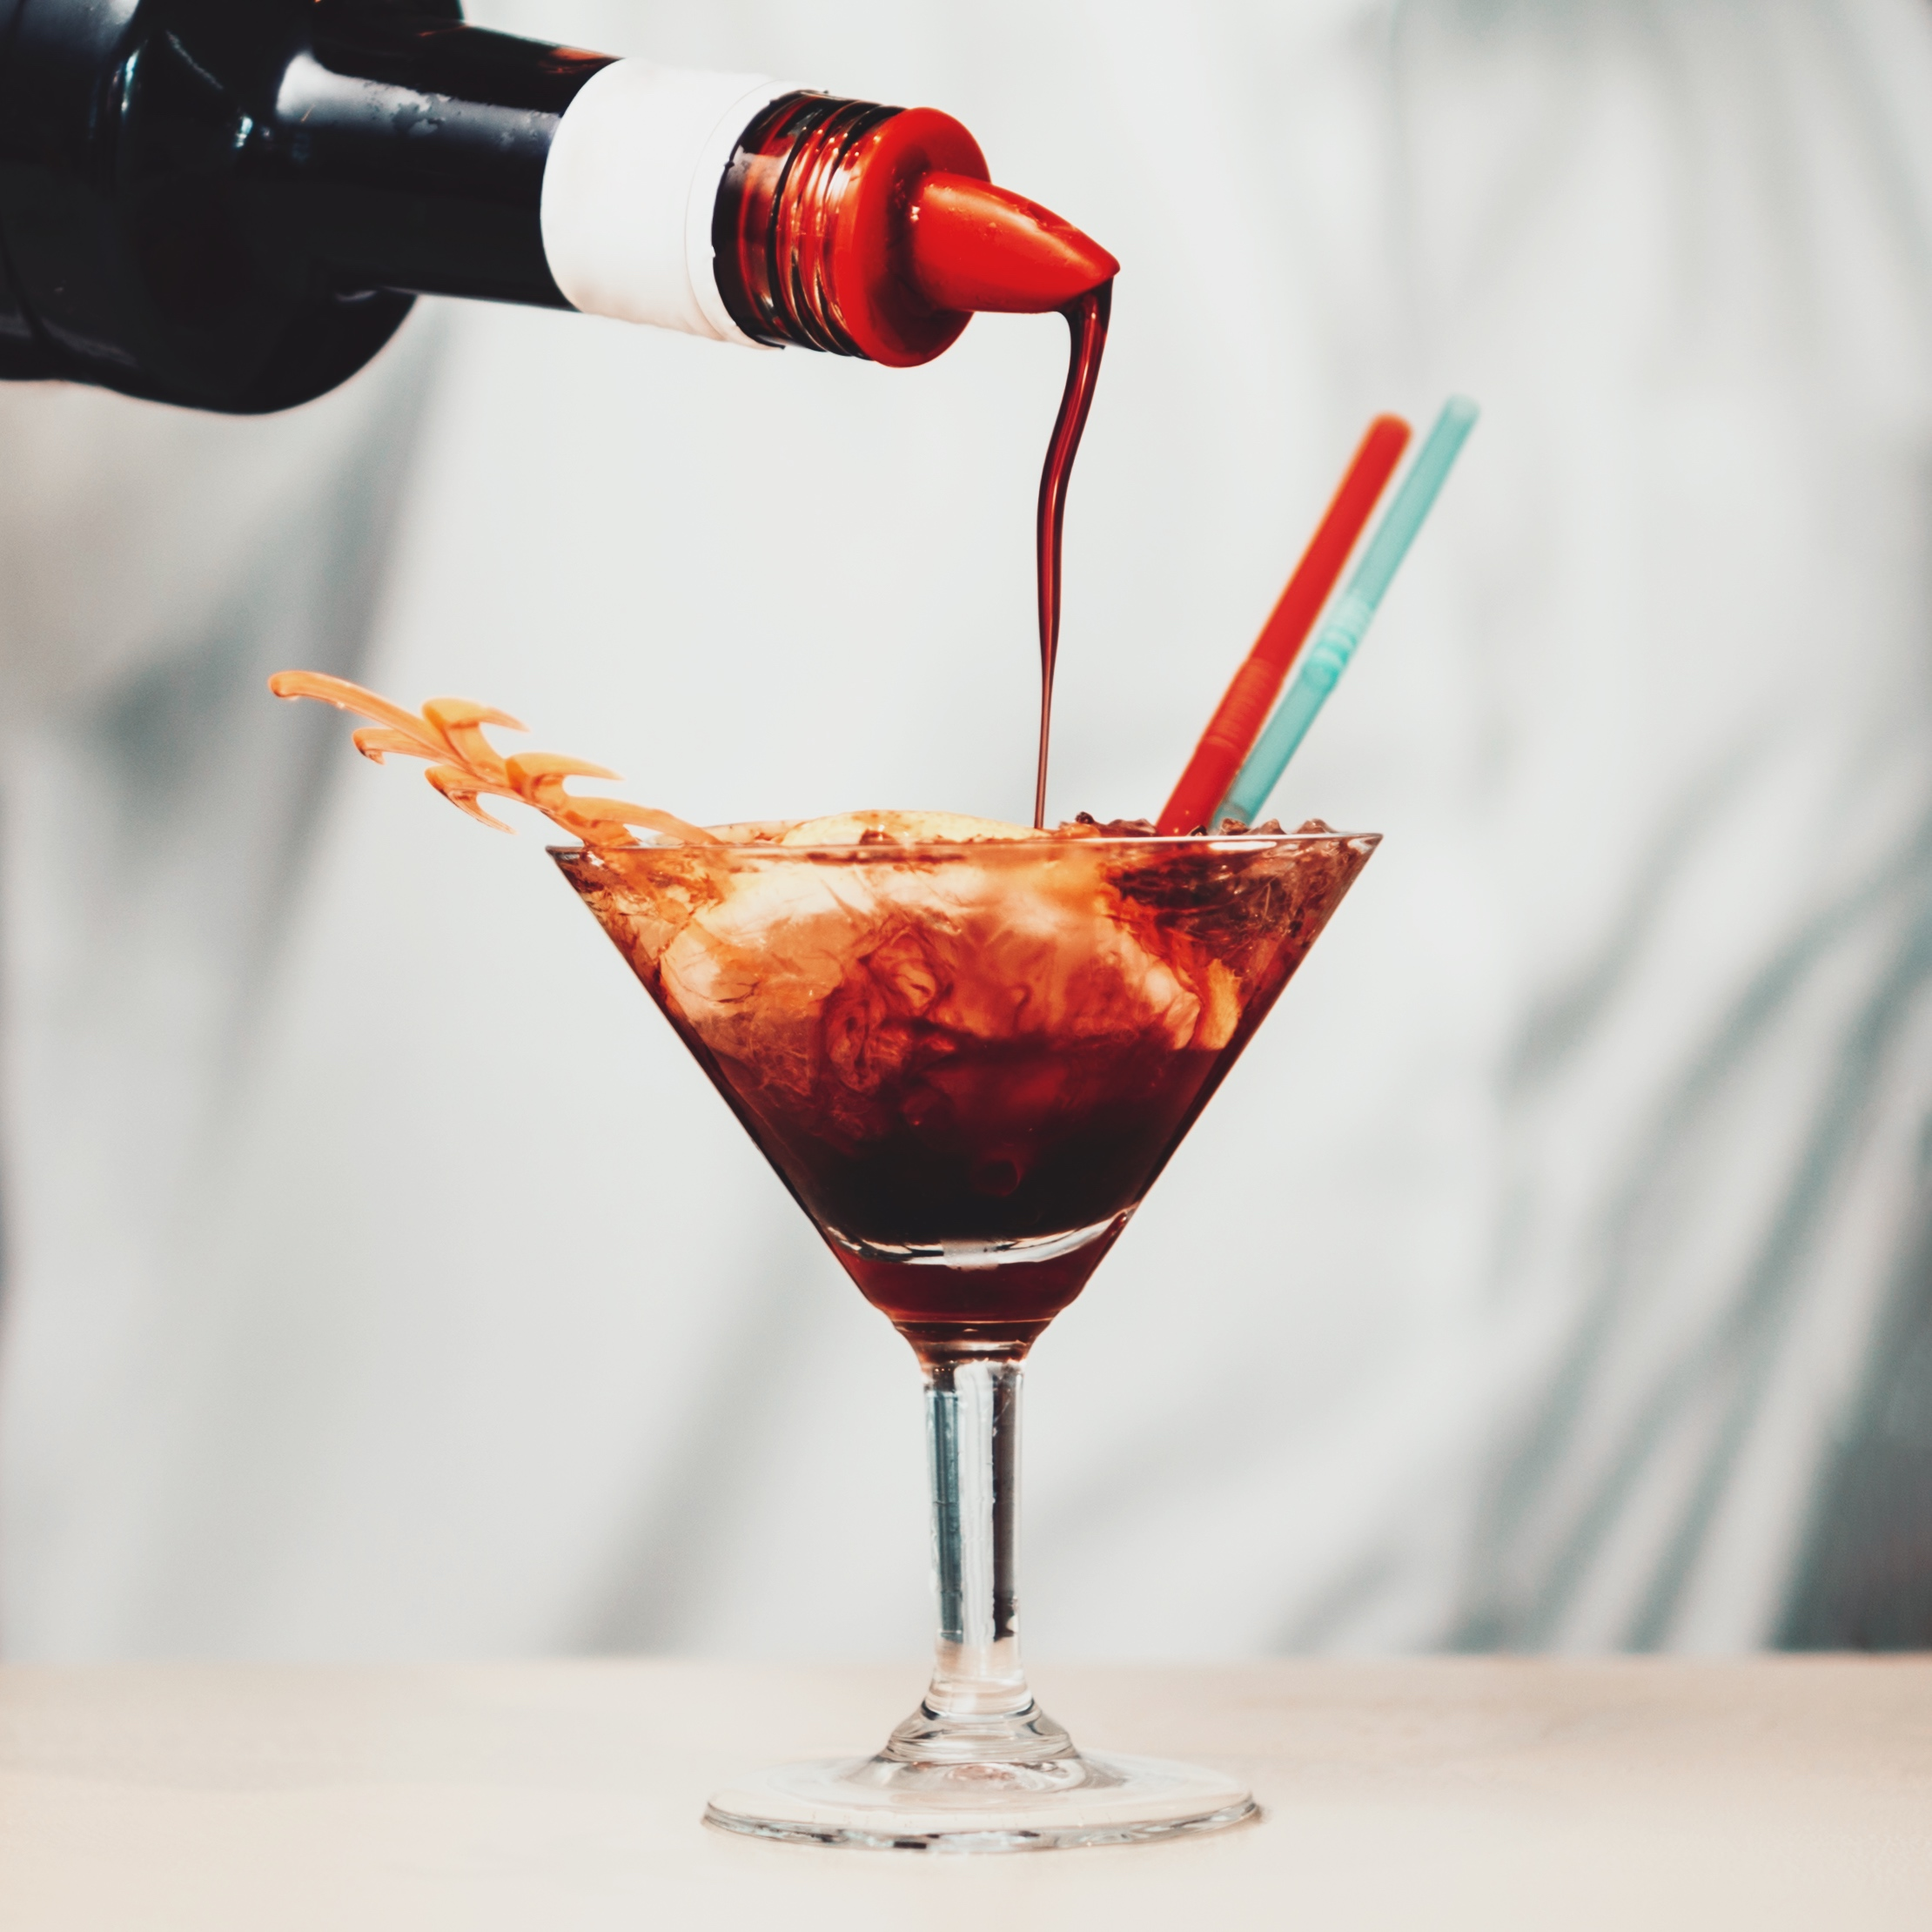
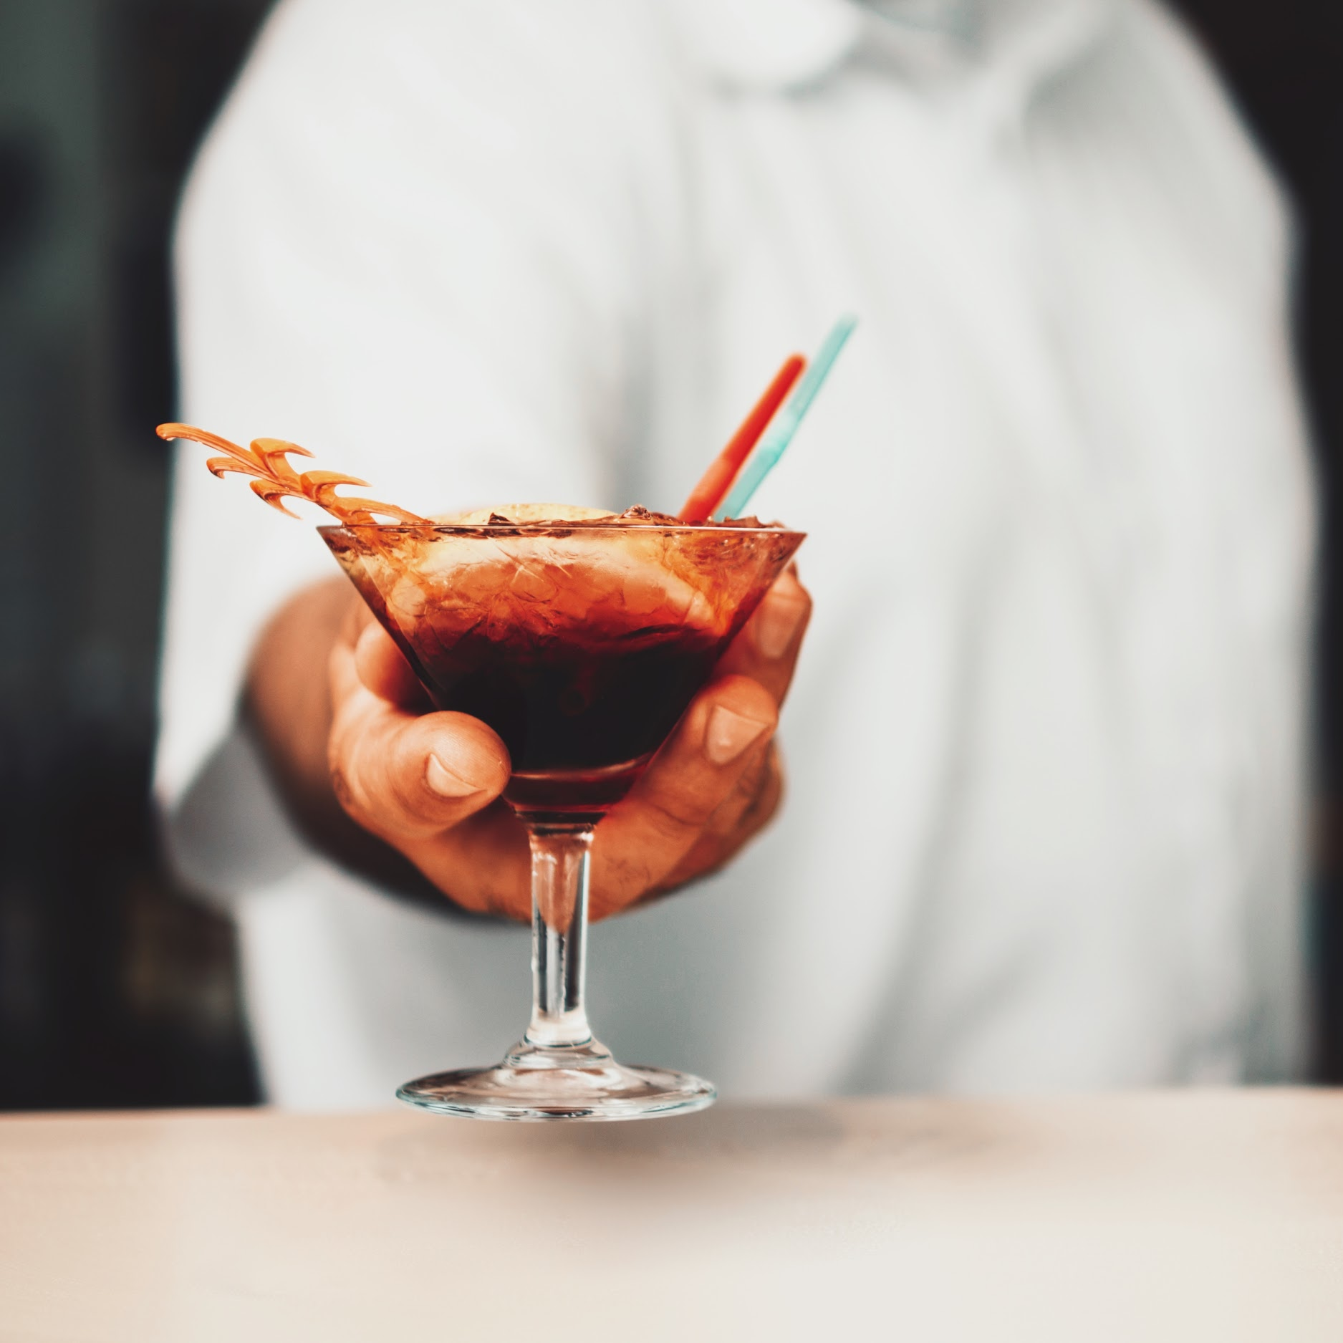
PROJECT TIMELINE
01
02
03
Neptune is the farthest planet from the Sun and the fourth-largest by diameter
Despite being red, Mars is actually a cold place. It’s full of iron oxide dust
Jupiter is a gas giant and the biggest planet in our Solar System

Slide 16
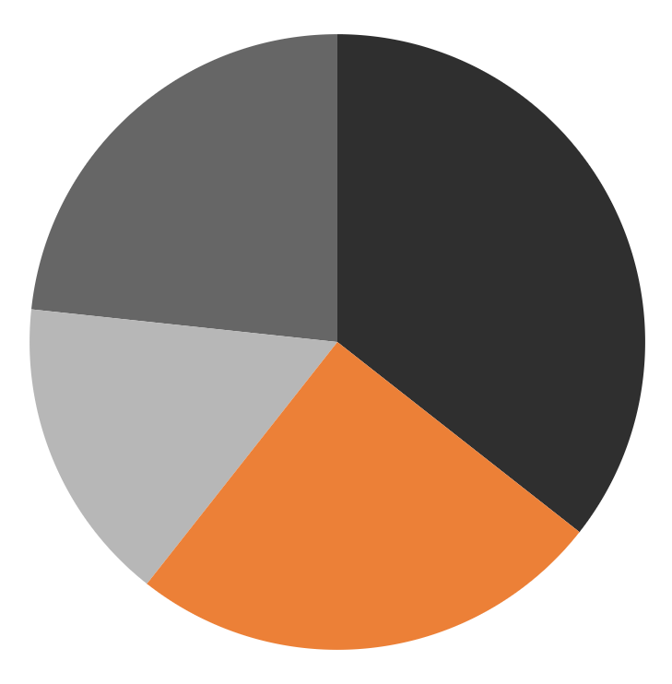
KPI DASHBOARD
EARNINGS
Mercury
Mars
25%
35%
Neptune
Jupiter
15%
25%
Mercury is the closest planet to the Sun and the smallest one in our Solar System
Despite being red, Mars is actually a cold place. It’s full of iron oxide dust
Neptune is the farthest planet from the Sun and the fourth-largest by diameter
Jupiter is a gas giant and the biggest planet in our Solar System
If you want to modify this graph, click on it, follow the link, change the data and replace it

Slide 17
KPI DASHBOARD
Profits
Trending items
Jupiter
Mars
Venus
Mercury
$50,000
Neptune
$2M
Venus

Slide 18
STATUS REPORT
Resources
Issues
Critical: 3
Total: 15
Risks
85%
Critical: 3
Total: 15
Quality
Critical: 1
Total: 11

Slide 19
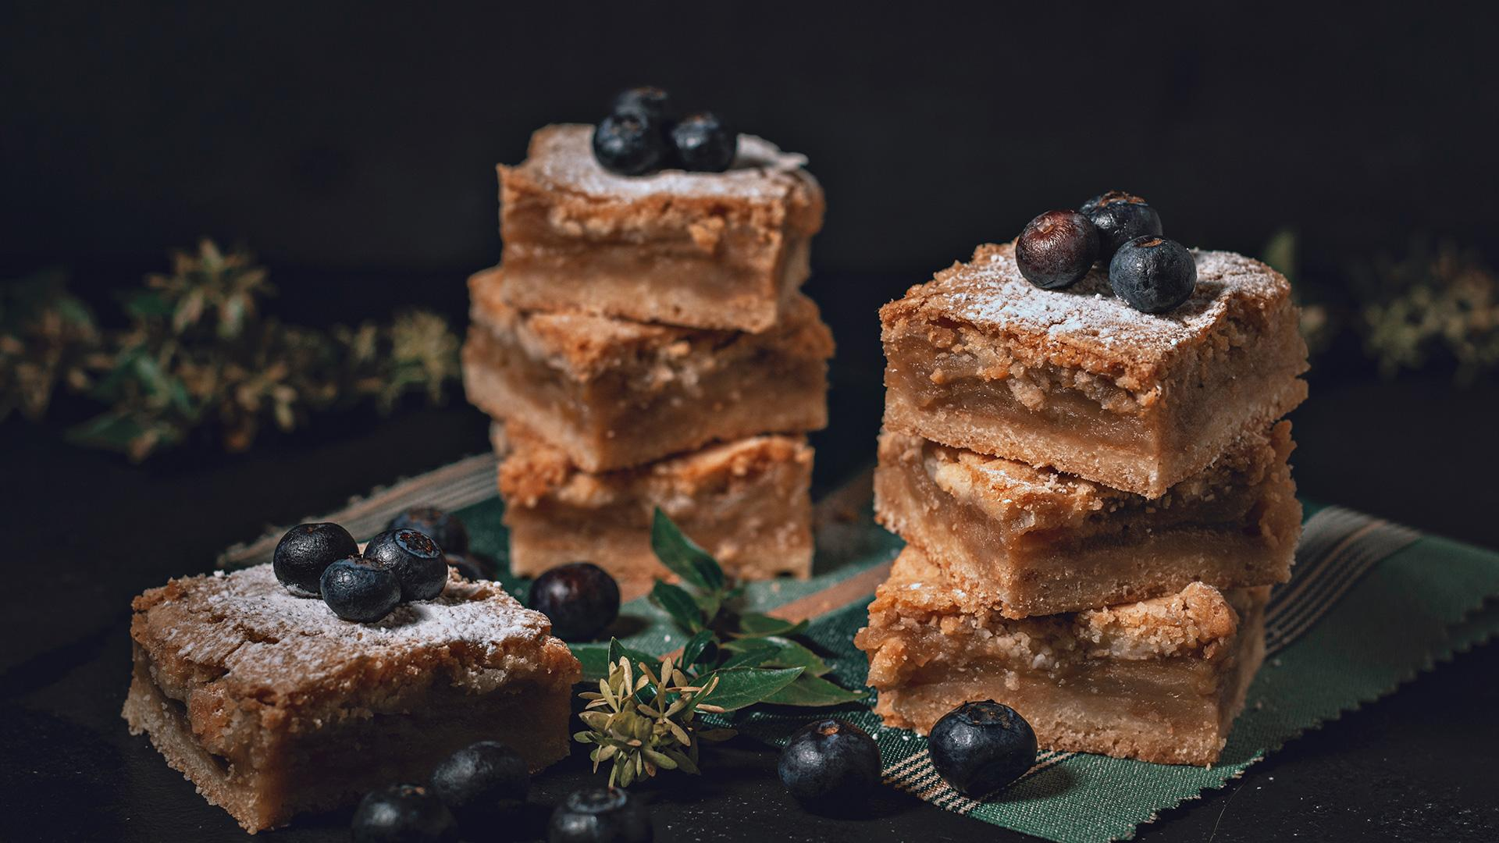
333,000.00
earths is the Sun’s mass

Slide 20
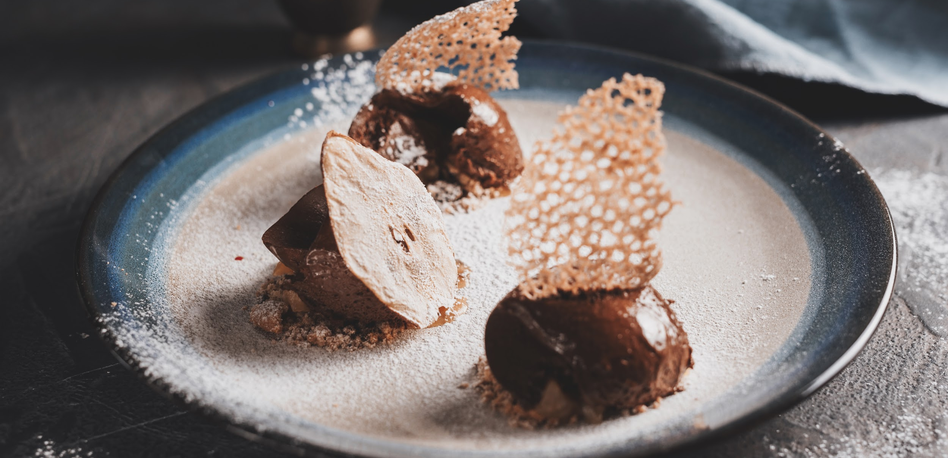
333,000.00
24h 37m 23s
386,000 km
earths is the Sun’s mass
is Jupiter’s rotation period
is the distance between the Earth and the Moon

Slide 21
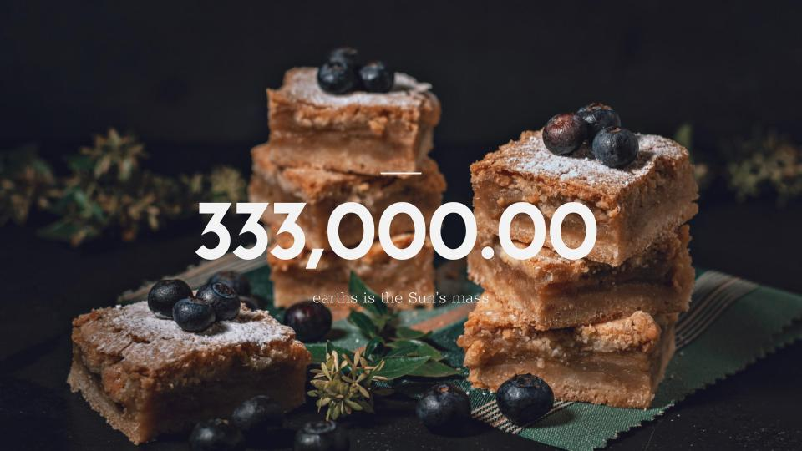


SNEAK PEEK
Desktop software
You can replace the image on the screen with your own work. Just delete this one, add yours and send it to the back
Tablet app
Mobile web
You can replace the image on the screen with your own work. Just delete this one, add yours and send it to the back
You can replace the image on the screen with your own work. Just delete this one, add yours and send it to the back

Slide 22
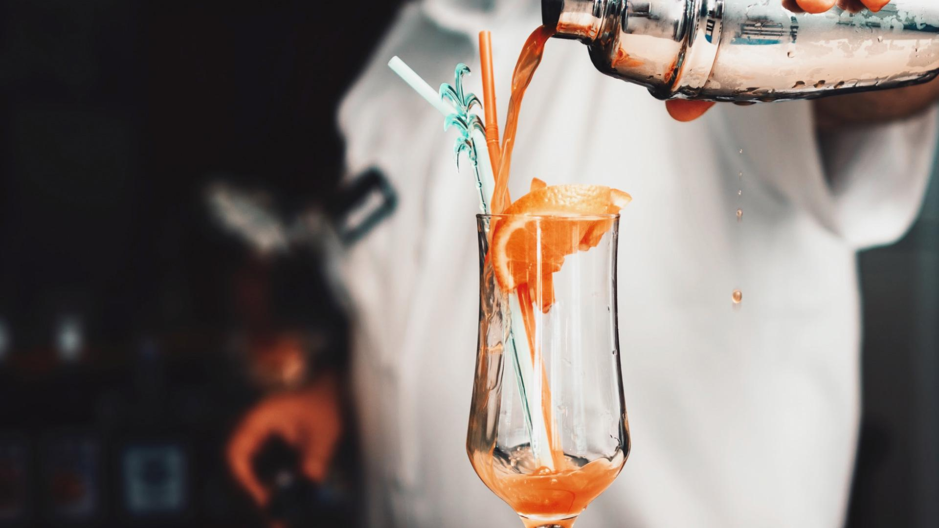
THANKS
Does anyone have any questions?
youremail@freepik.com
+91 620 421 838
yourcompany.com
Please keep this slide for attribution.

