Slide 1

TRƯỜNG CAO ĐẲNG LÝ TỰ TRỌNG TP. HỒ CHÍ MINH

Slide 2
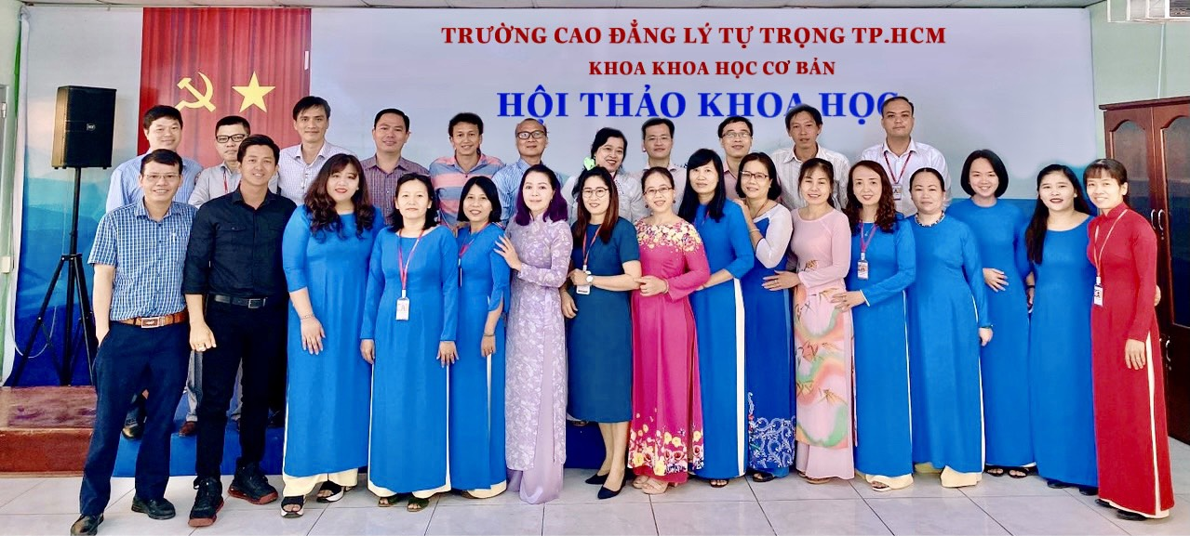
KHOA KHOA HỌC CƠ BẢN

Slide 3

ỦY BAN NHÂN DÂN THÀNH PHỐ HỒ CHÍ MINH
TRƯỜNG CAO ĐẲNG LÝ TỰ TRỌNG TP. HỒ CHÍ MINH
Bậc đào tạo: CAO ĐẲNG CHUYÊN NGHIỆP
Tên giảng viên: TỔ ANH VĂN

Slide 4

Good afternoon class.

Slide 5


Slide 6
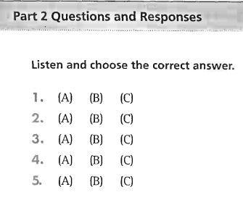

UNIT 7: NOUNS / PRONOUNS

Slide 7
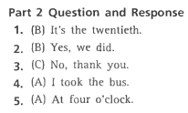
UNIT 7: NOUNS / PRONOUNS
Part 2 Questions and Responses
Answer Key

Slide 8
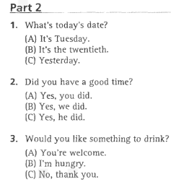
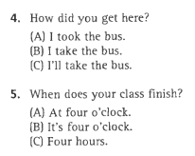
UNIT 7: NOUNS / PRONOUNS
PART 2 Questions and Responses
Transcripts

Slide 9
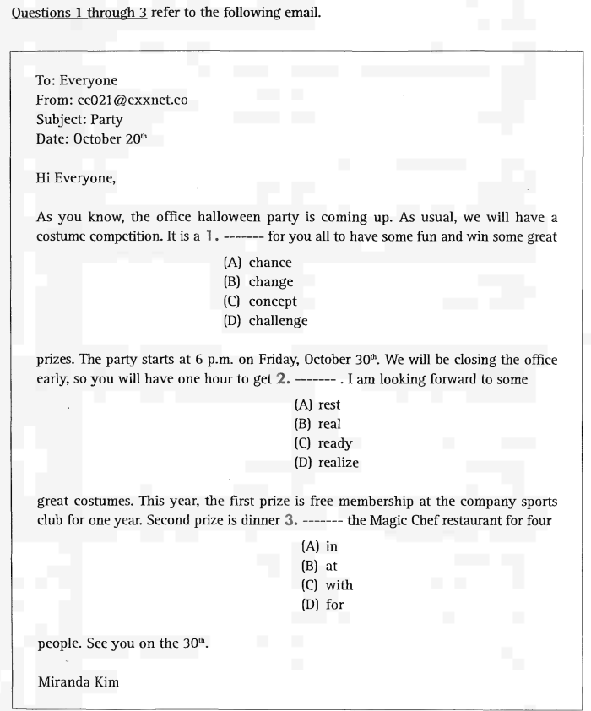
UNIT 7: NOUNS / PRONOUNS
Part 6 Incomplete Texts

Slide 10
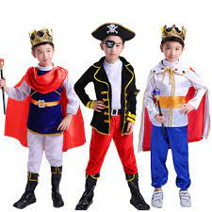
UNIT 7: NOUNS / PRONOUNS
Part 6 Incomplete Texts
New words:
1. costume

Slide 11

UNIT 7: NOUNS / PRONOUNS
Part 6 Incomplete Texts
New words:
2. competition

Slide 12

UNIT 7: NOUNS / PRONOUNS
Part 6 Incomplete Texts
New words:
3. prize

Slide 13
UNIT 7: NOUNS / PRONOUNS
Part 6 Incomplete Texts

Slide 14

UNIT 7: NOUNS / PRONOUNS
Part 6 Incomplete Texts

Slide 15
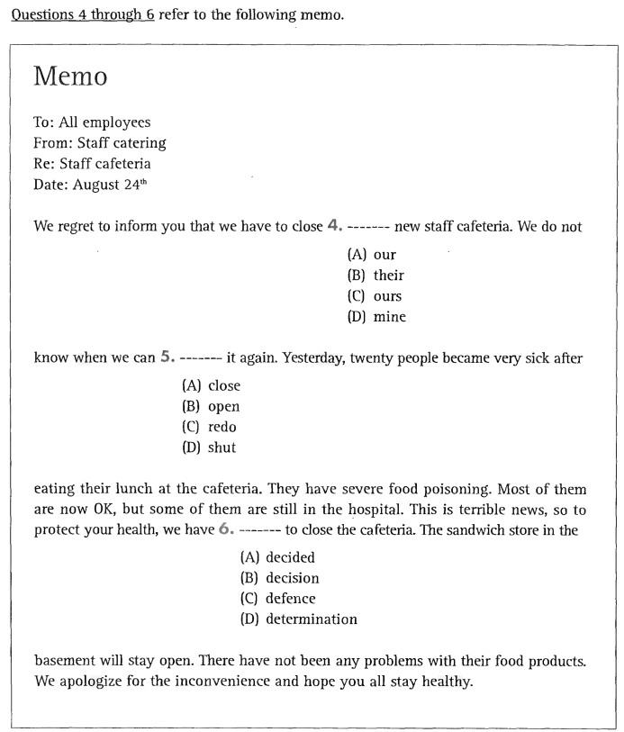
UNIT 7: NOUNS / PRONOUNS
Part 6 Incomplete Texts

Slide 16
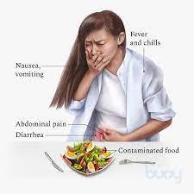
UNIT 7: NOUNS / PRONOUNS
Part 6 Incomplete Texts
New words:
1. severe food poisoning

Slide 17
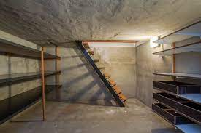
UNIT 7: NOUNS / PRONOUNS
Part 6 Incomplete Texts
New words:
2. basement

Slide 18
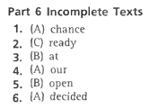
UNIT 7: NOUNS / PRONOUNS
Part 6 Incomplete Texts

Slide 19
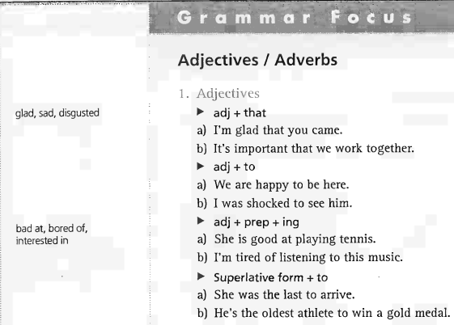
UNIT 8: Adjectives / Adverbs
Grammar Focus

Slide 20
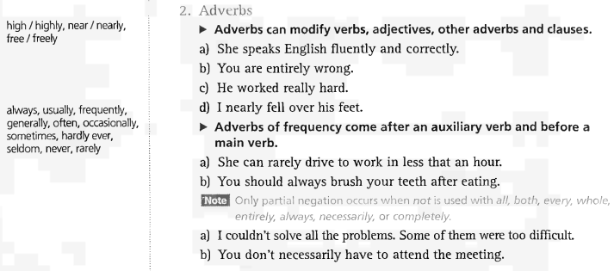
UNIT 8: Adjectives / Adverbs
Grammar Focus

Slide 21
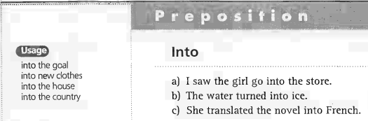
UNIT 8: Adjectives / Adverbs
Grammar Focus

Slide 22
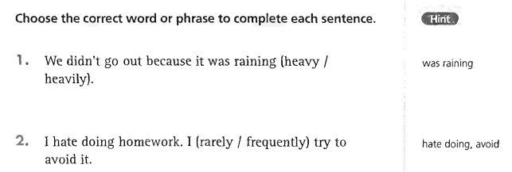
UNIT 8: Adjectives / Adverbs
Grammar Exercises
-> 1. heavily
-> 2. frequently

Slide 23
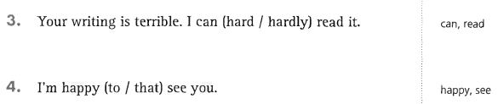
UNIT 8: Adjectives / Adverbs
Grammar Exercises
-> 3. hardly
-> 4. to

Slide 24
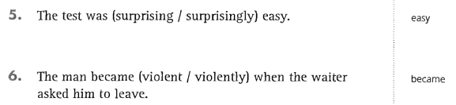
UNIT 8: Adjectives / Adverbs
Grammar Exercises
-> 5. surprisingly
-> 6. violent

Slide 25
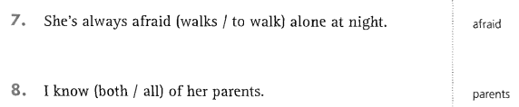
UNIT 8: Adjectives / Adverbs
Grammar Exercises
-> 7. to walk
-> 8. both

Slide 26
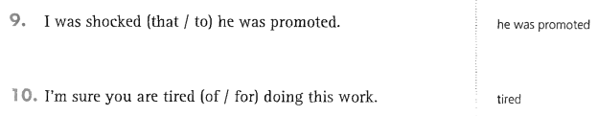
UNIT 8: Adjectives / Adverbs
Grammar Exercises
-> 9. that
-> 10. of

Slide 27
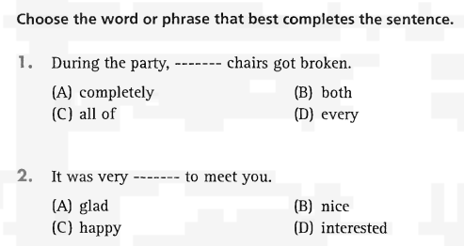
UNIT 8: Adjectives / Adverbs
Part 5 Incomplete Sentences
-> 1. both
-> 2. nice

Slide 28
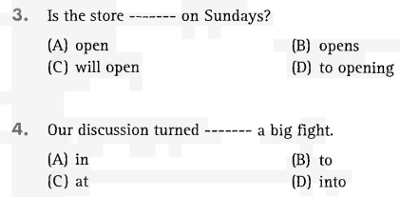
UNIT 8: Adjectives / Adverbs
Part 5 Incomplete Sentences
-> 3. open
-> 4. into

Slide 29
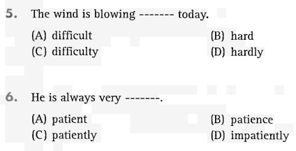
UNIT 8: Adjectives / Adverbs
Part 5 Incomplete Sentences
-> 5. hard
-> 6. patient

Slide 30
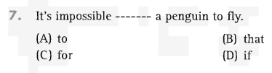
UNIT 8: Adjectives / Adverbs
Part 5 Incomplete Sentences
-> 7. for

Slide 31
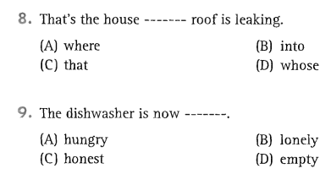
UNIT 8: Adjectives / Adverbs
Part 5 Incomplete Sentences
-> 8. whose
-> 9. empty

Slide 32
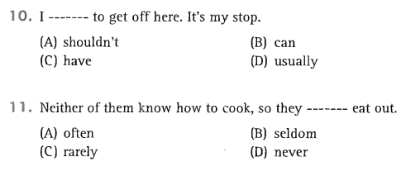
UNIT 8: Adjectives / Adverbs
Part 5 Incomplete Sentences
-> 10. have
-> 11. often

Slide 33
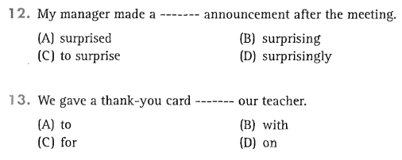
UNIT 8: Adjectives / Adverbs
Part 5 Incomplete Sentences
-> 12. surprising
-> 13. to

Slide 34
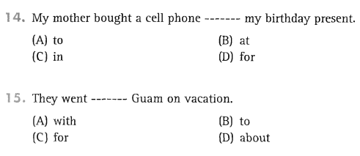
UNIT 8: Adjectives / Adverbs
Part 5 Incomplete Sentences
-> 14. for
-> 15. to

Slide 35

Thank you very much
for your cooperation.

