Slide 1

TRƯỜNG CAO ĐẲNG LÝ TỰ TRỌNG TP. HỒ CHÍ MINH

Slide 2

KHOA KHOA HỌC CƠ BẢN

Slide 3

ỦY BAN NHÂN DÂN THÀNH PHỐ HỒ CHÍ MINH
TRƯỜNG CAO ĐẲNG LÝ TỰ TRỌNG TP. HỒ CHÍ MINH
Bậc đào tạo: CAO ĐẲNG CHUYÊN NGHIỆP
Tên giảng viên: LÊ NGUYỄN MỸ TRÂM

Slide 4

Good morning class.

Slide 5
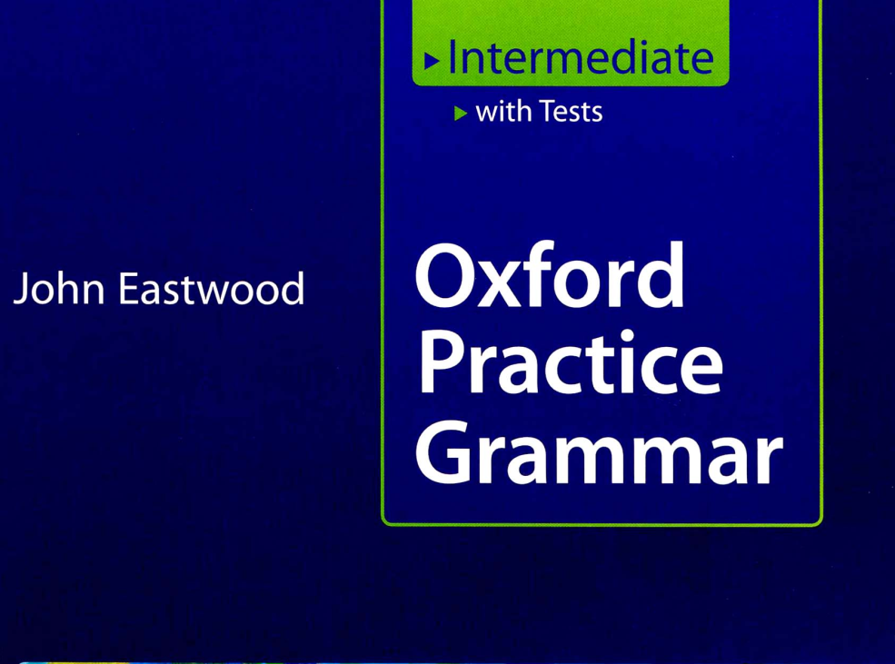

Slide 6
Part 4 Prepositions and
Part 5 Verbs with prepositions and Adverbs

Slide 7
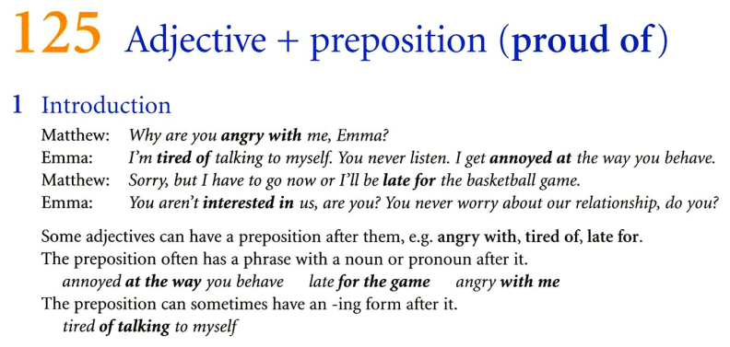
Part 4 Prepositions (Continued)

Slide 8
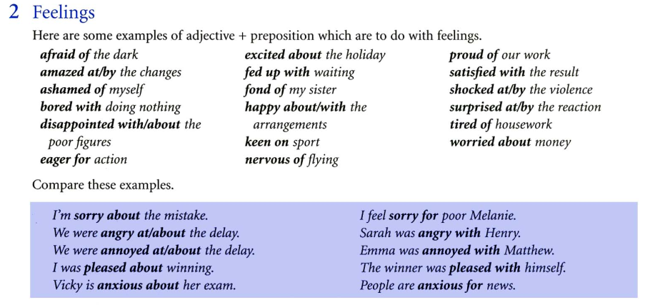
Part 4 Prepositions (Continued)
125 Adjective + preposition (proud of)

Slide 9
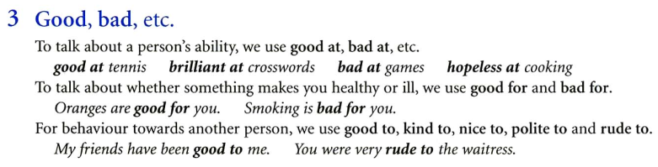
Part 4 Prepositions (Continued)
125 Adjective + preposition (proud of)

Slide 10
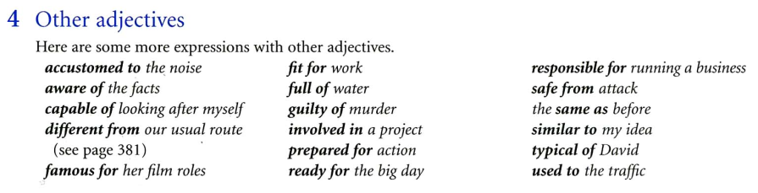
Part 4 Prepositions (Continued)
125 Adjective + preposition (proud of)

Slide 11
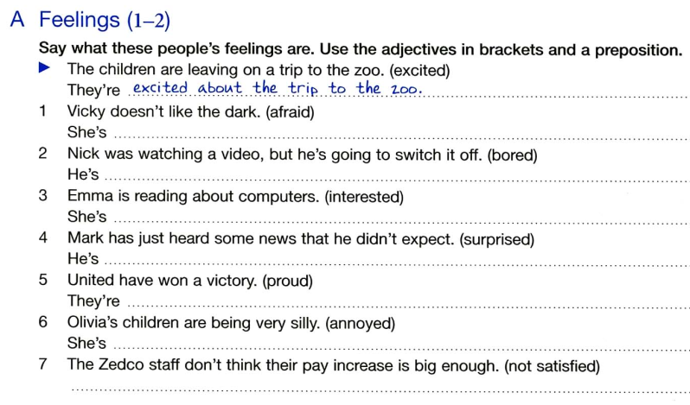
Part 4 Prepositions (Continued)
125 Adjective + preposition (proud of)
Practice

Slide 12
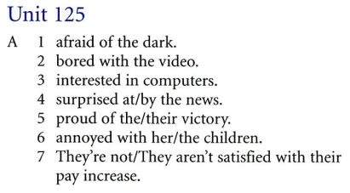
Part 4 Prepositions (Continued)
125 Adjective + preposition (proud of)
Key (Practice)

Slide 13
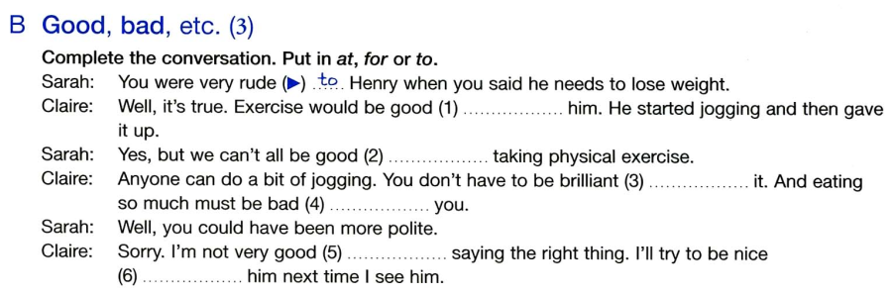
Part 4 Prepositions (Continued)
125 Adjective + preposition (proud of)
Practice

Slide 14
Part 4 Prepositions (Continued)
125 Adjective + preposition (proud of)
Key (Practice)

Slide 15
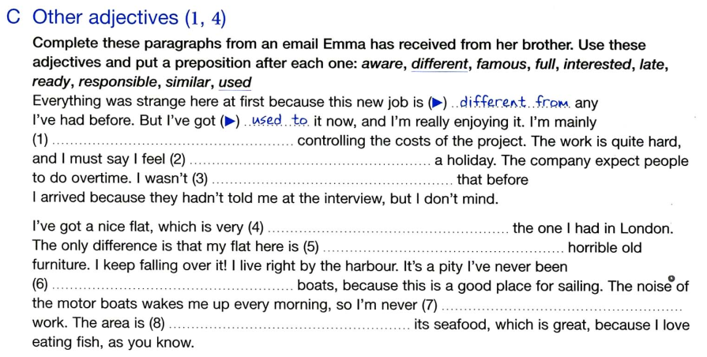
Part 4 Prepositions (Continued)
125 Adjective + preposition (proud of)
Practice

Slide 16
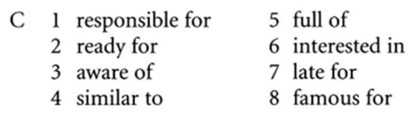
Part 4 Prepositions (Continued)
125 Adjective + preposition (proud of)
Key (Practice)

Slide 17
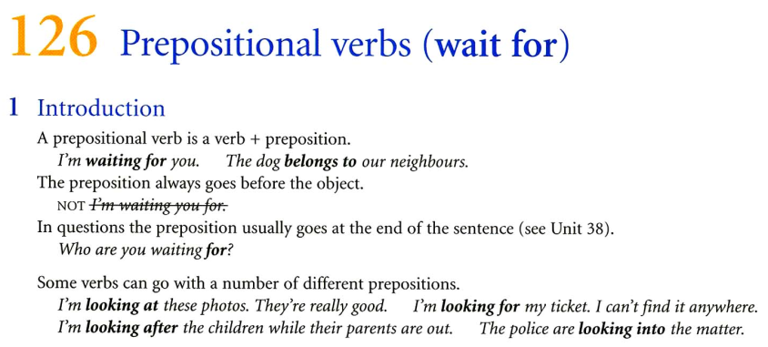
Part 5 Verbs with prepositions and Adverbs
126 Prepositional verbs (wait for)

Slide 18
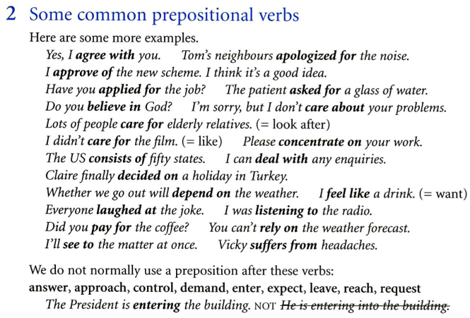
Part 5 Verbs with prepositions and Adverbs
126 Prepositional verbs (wait for)

Slide 19
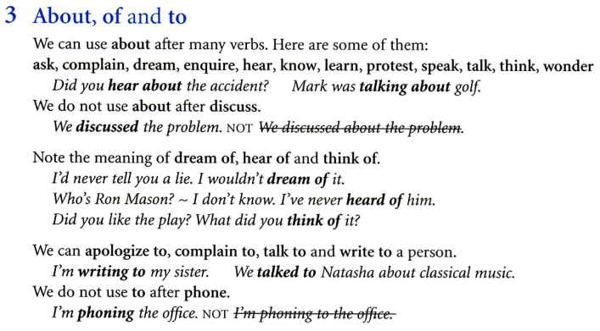
Part 5 Verbs with prepositions and Adverbs
126 Prepositional verbs (wait for)

Slide 20
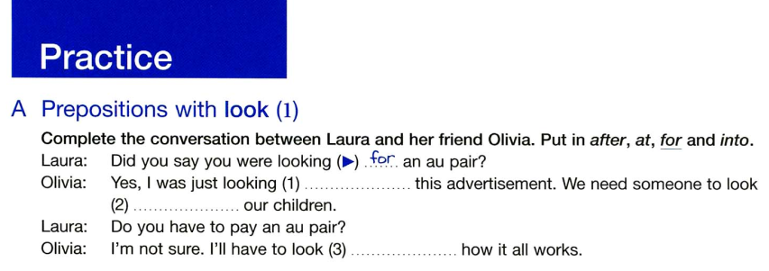
Part 5 Verbs with prepositions and Adverbs
126 Prepositional verbs (wait for)
Practice
1. at
2. after
3. into

Slide 21
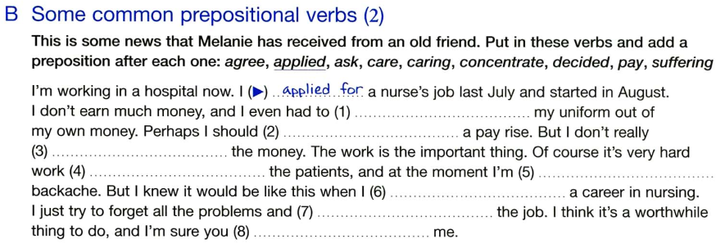
Part 5 Verbs with prepositions and Adverbs
126 Prepositional verbs (wait for)
Practice

Slide 22

Part 5 Verbs with prepositions and Adverbs
126 Prepositional verbs (wait for)
Key (Practice)

Slide 23
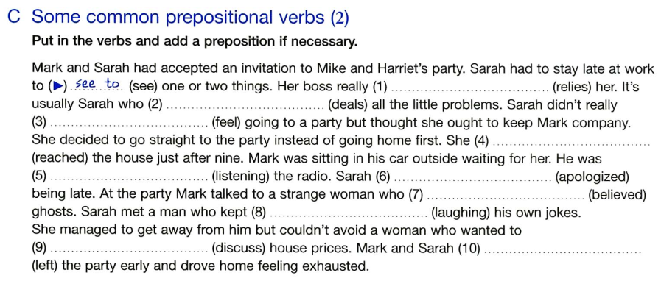
Part 5 Verbs with prepositions and Adverbs
126 Prepositional verbs (wait for)
Practice

Slide 24
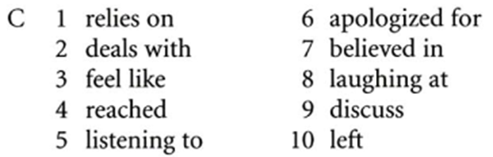
Part 5 Verbs with prepositions and Adverbs
126 Prepositional verbs (wait for)
Key (Practice)

Slide 25
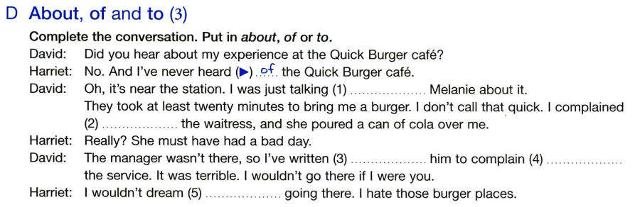
Part 5 Verbs with prepositions and Adverbs
126 Prepositional verbs (wait for)
Practice

Slide 26
Part 5 Verbs with prepositions and Adverbs
126 Prepositional verbs (wait for)
Key (Practice)
D.
1. to
2. to
3. to
4. about
5. of

Slide 27
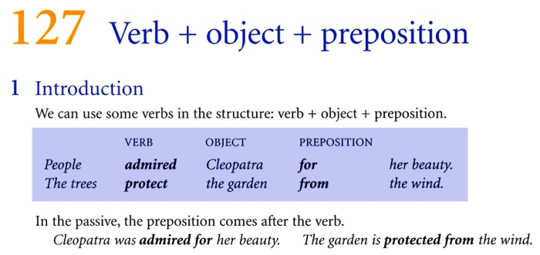
Part 5 Verbs with prepositions and Adverbs
127 Verb + object + preposition

Slide 28
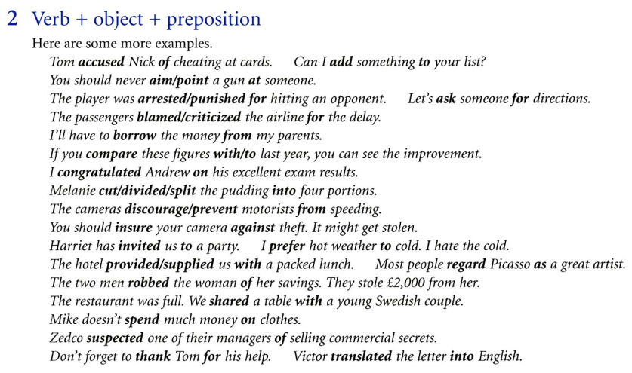
Part 5 Verbs with prepositions and Adverbs
127 Verb + object + preposition

Slide 29
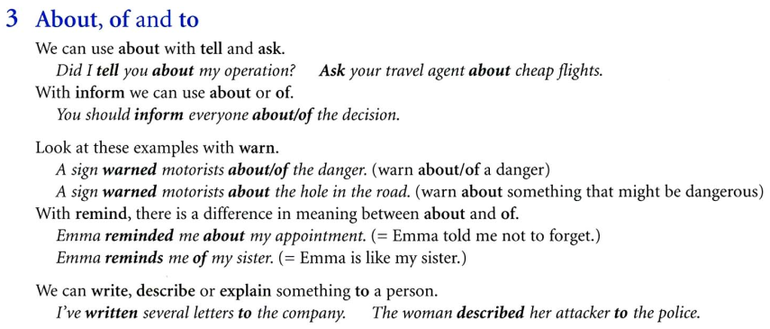
Part 5 Verbs with prepositions and Adverbs
127 Verb + object + preposition

Slide 30
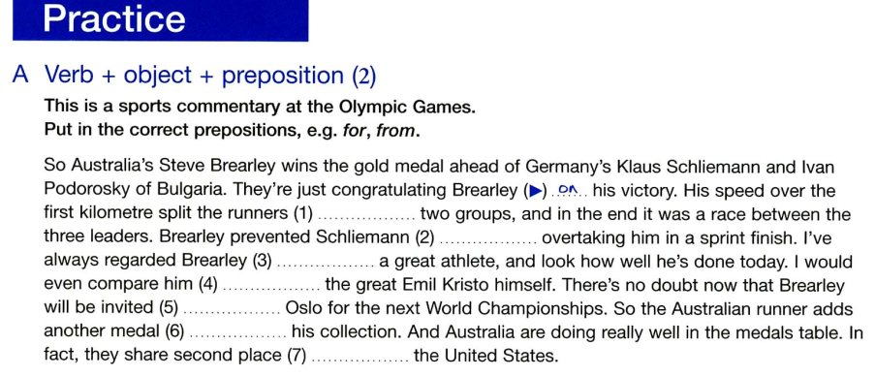
Part 5 Verbs with prepositions and Adverbs
127 Verb + object + preposition
Practice

Slide 31
Part 5 Verbs with prepositions and Adverbs
127 Verb + object + preposition
Key (Practice)
A.
1. into
2. from
3. as
4. with / to
5. to
6. to
7. with

Slide 32
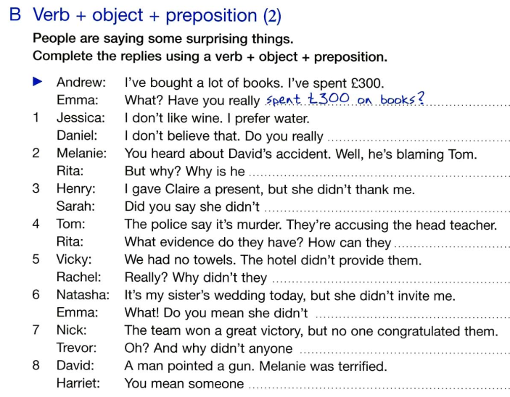
Part 5 Verbs with prepositions and Adverbs
127 Verb + object + preposition
Practice

Slide 33
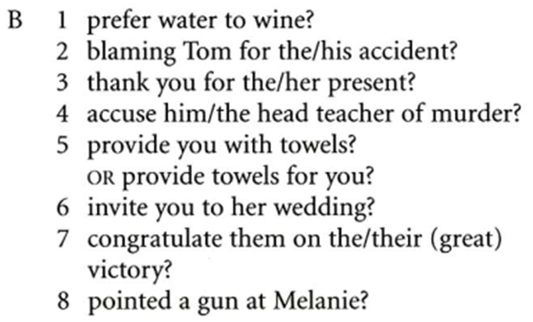
Part 5 Verbs with prepositions and Adverbs
127 Verb + object + preposition
Key (Practice)

Slide 34
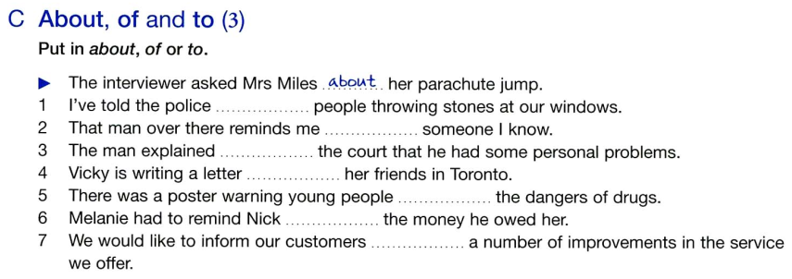
Part 5 Verbs with prepositions and Adverbs
127 Verb + object + preposition
Practice

Slide 35
Part 5 Verbs with prepositions and Adverbs
127 Verb + object + preposition
Key (Practice)
C.
1. about
2. of
3. to
4. to
5. about / of
6. about
7. about / of

Slide 36

Thank you very much
for your cooperation.

