Slide 1

ENGLISH 3
Lecturer: Nguyen Thien Binh

Slide 2
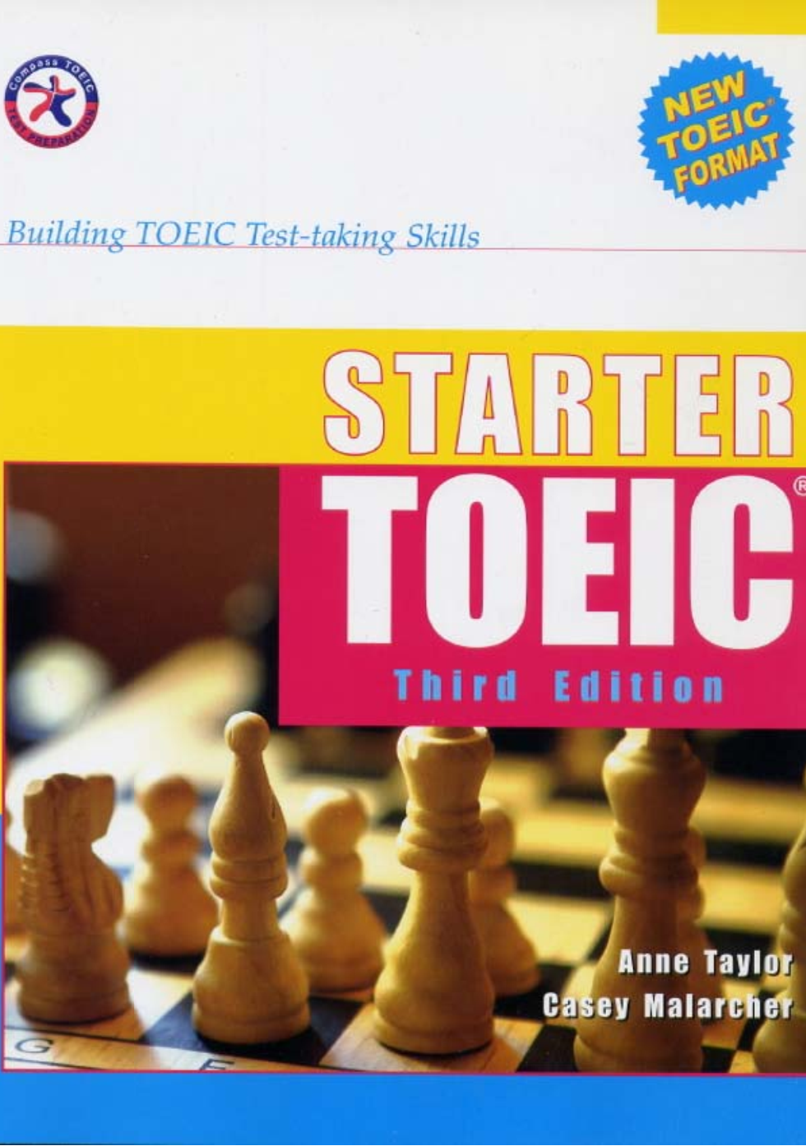

Slide 3
UNIT 10
INDEFINITE PRONOUNS

Slide 4
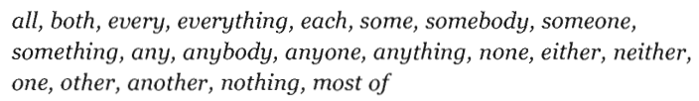

Slide 5


Both/all/some/most + N (plural)
→ main V (plural)
Both sisters are 24 years old
of
+ the / possessive adjective + N (plural)
(my/your/his/her…)
Both of his sisters are 24 years old

Slide 6
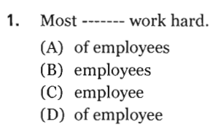
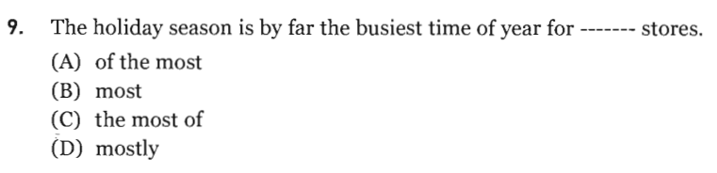
Page 197

Slide 7
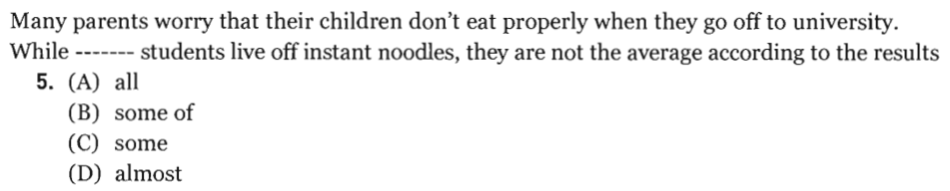
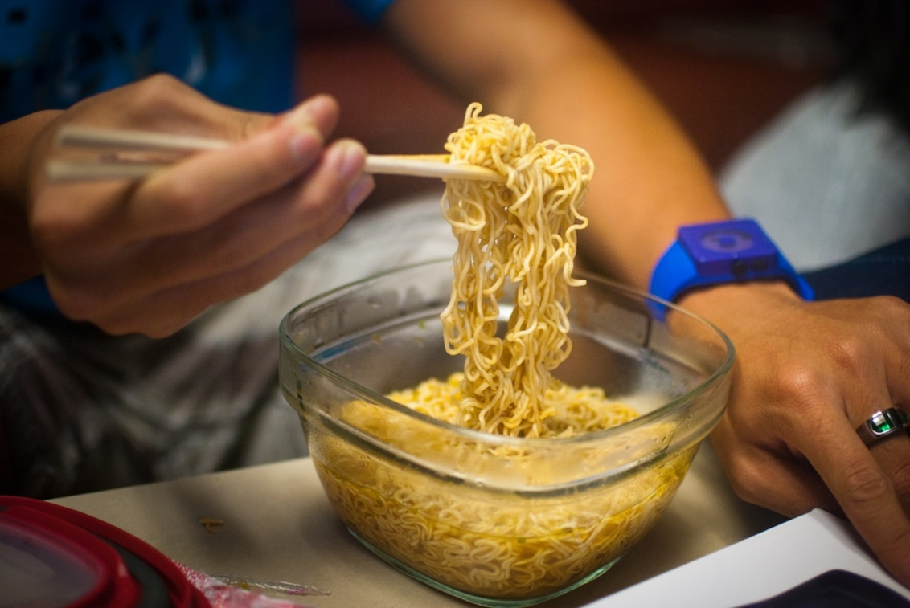
Page 200
Vài sinh viên sống nhờ vào mì ăn liền
(thường xuyên ăn)

Slide 8
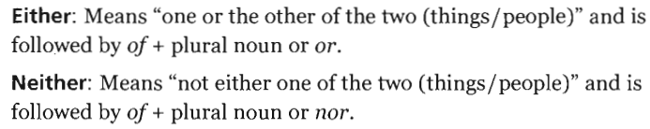
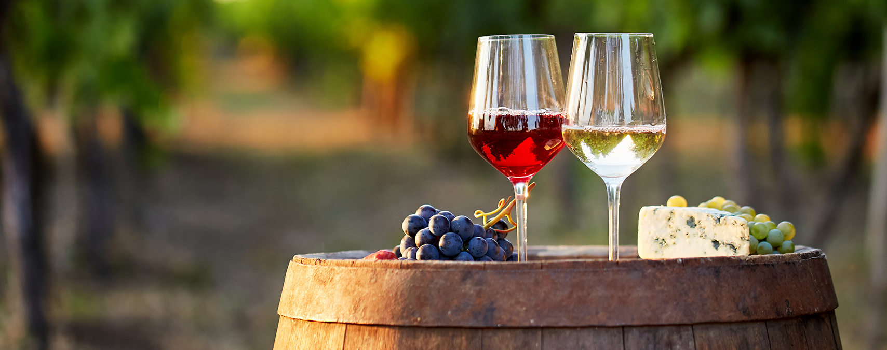
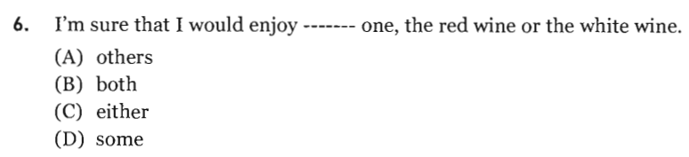
either…….or……….
neither……nor……..
Page 198

Slide 9
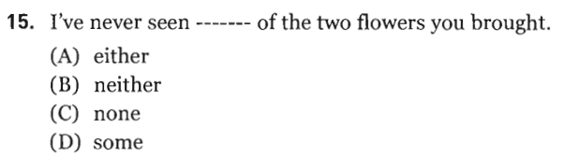

Slide 10
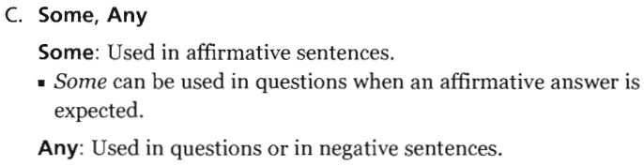
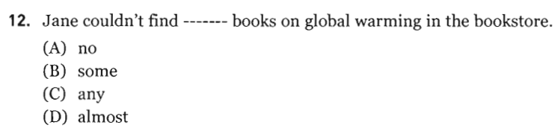
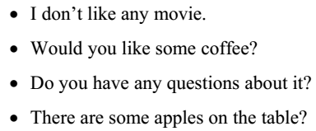
Page 199

Slide 11


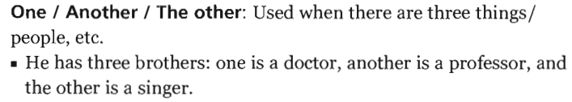
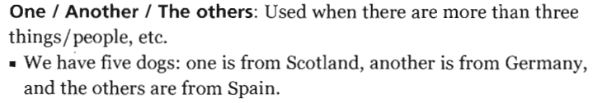
1
2
3

Slide 12
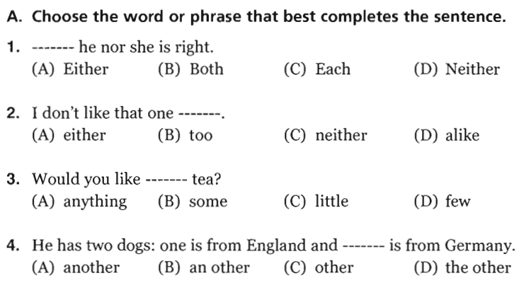

Slide 13
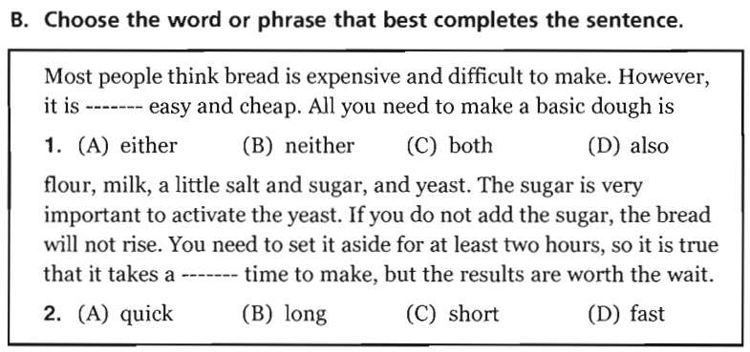

Slide 14
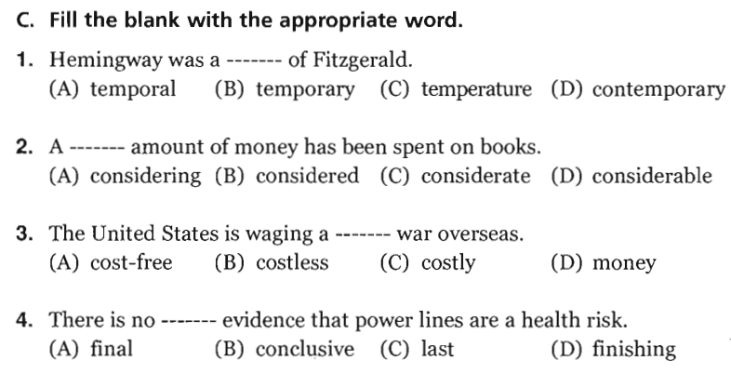
Cùng thời
Đáng kể, lớn
expensive
decisive, crucial, certain

Slide 15
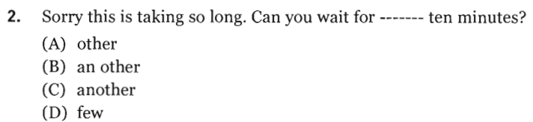
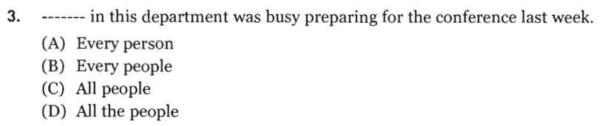
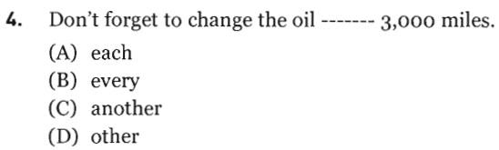
Page 197
Đợi thêm 10 phút nữa
Each / every + N (singular) + V (singular)
Cứ mỗi 3000 dặm

Slide 16
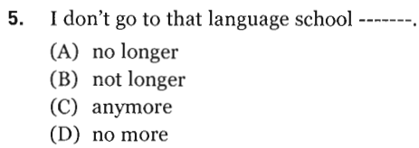
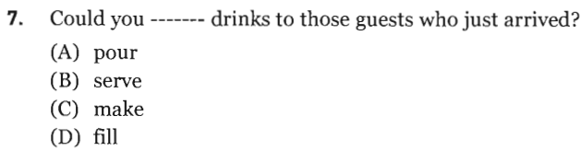
Không còn nữa

Slide 17
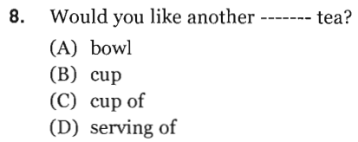
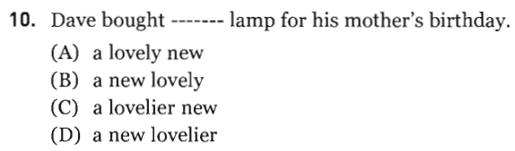
O – S – A – S– C – O – M – P
( Opinion – Size – Age – Shape – Color – Origin – Material – Purpose)

Slide 18
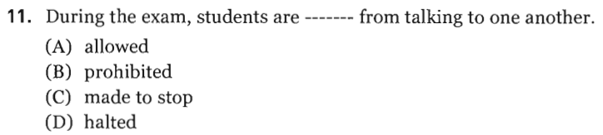
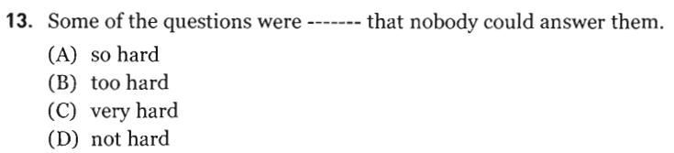
Bị cấm

Slide 19
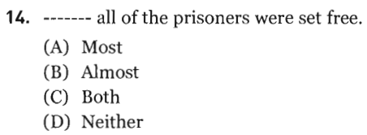
Almost + all / every / no

Slide 20
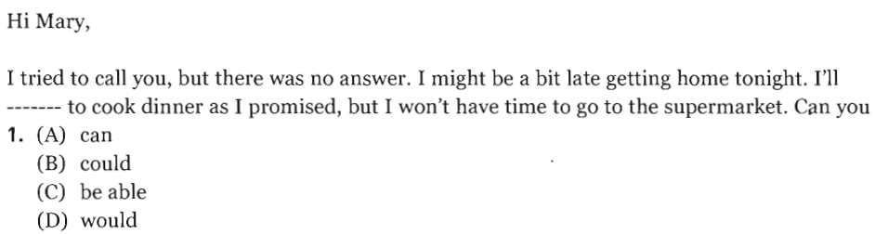
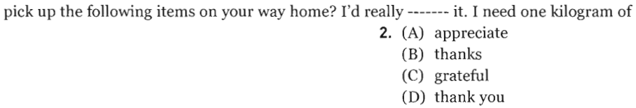

Slide 21
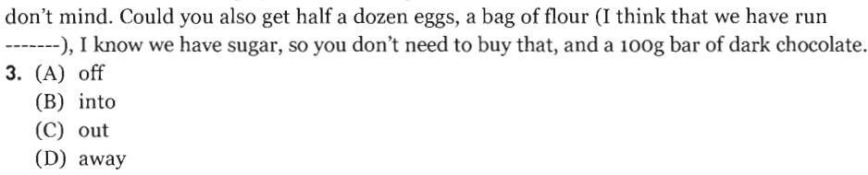
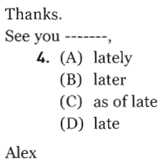

Slide 22
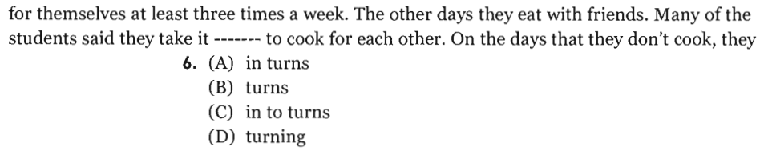
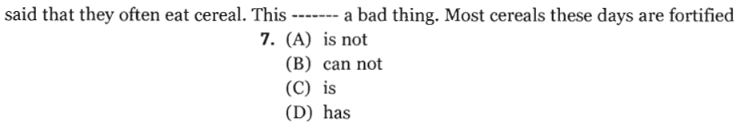

Slide 23
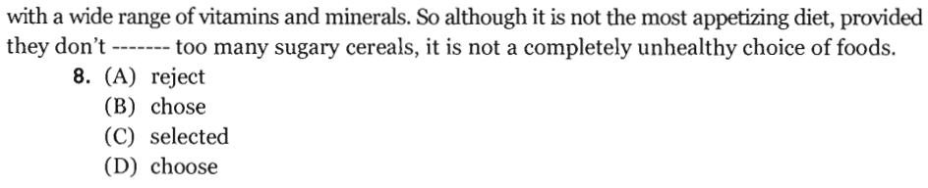
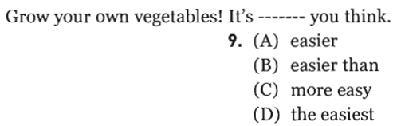
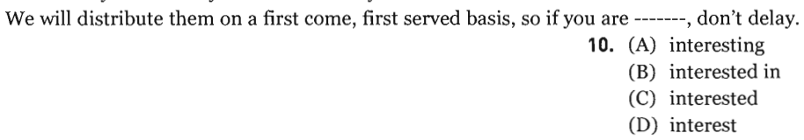

Slide 24
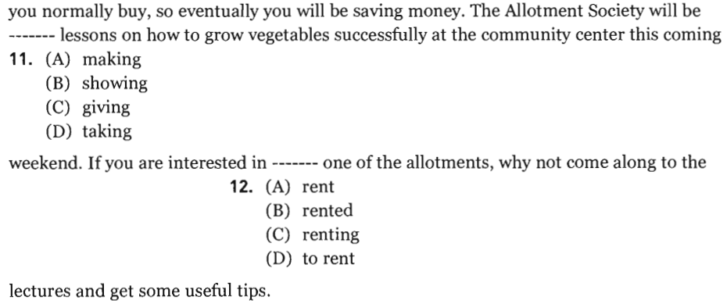

Slide 25
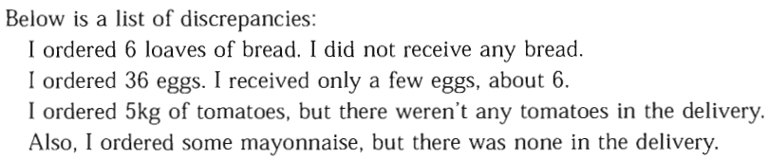
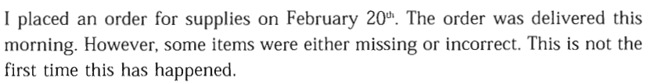
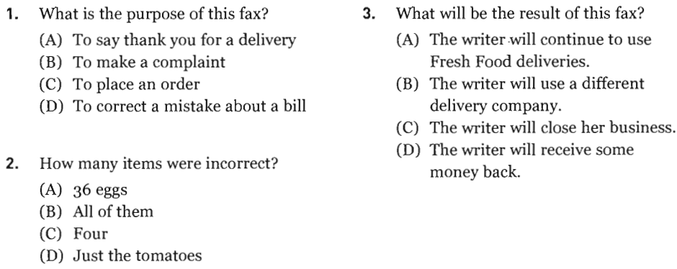

Slide 26



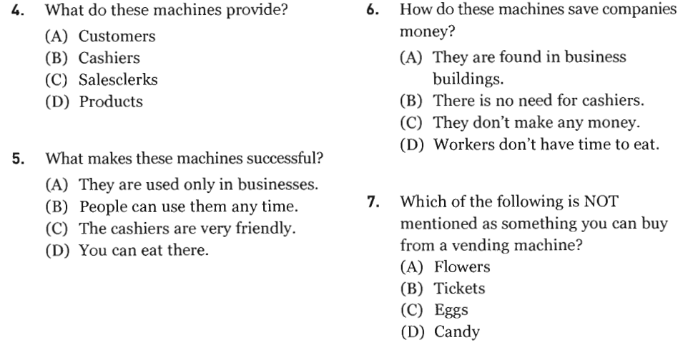

Slide 27

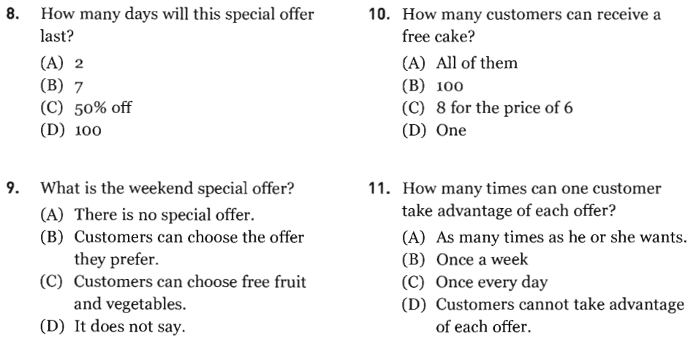

Slide 28
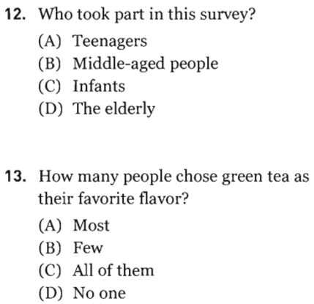
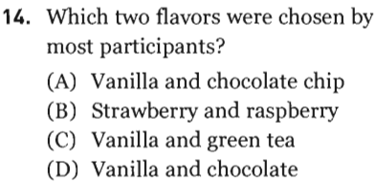

Slide 29
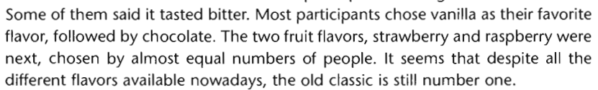
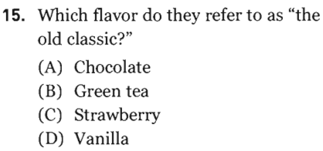
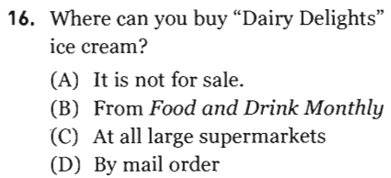

Slide 30
LISTENING PRACTICE

Slide 31
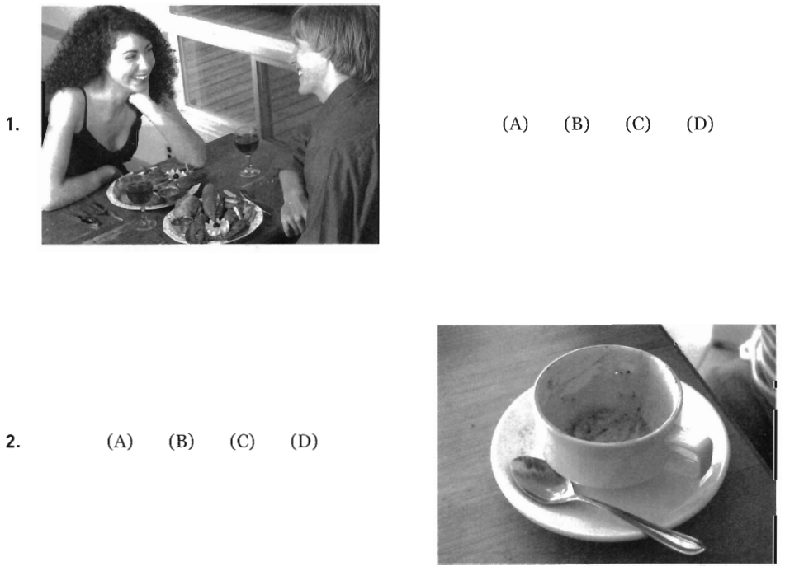
A. The plates are full of food
Page 193
B. The coffee cup is empty

Slide 32
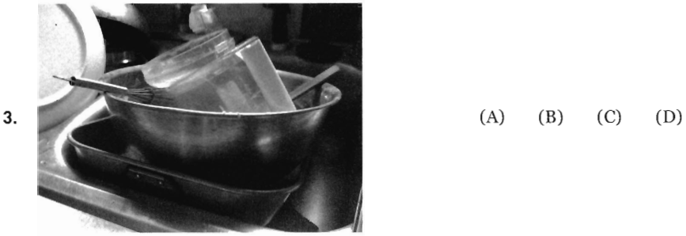
B. The sink is full of dishes

Slide 33

The man is preparing
food
D. The woman is holding a fork

Slide 34


Slide 35



Không lặp lại

Slide 36



Slide 37





Slide 38





Slide 39





Slide 40





Slide 41

Thank you very much
for your cooperation.

