Slide 1
UNIT 10
INDEFINITE PRONOUNS

Slide 2
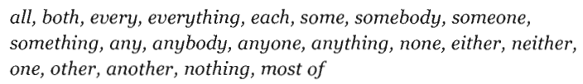

Slide 3


Both/all/some/most + N (plural)
→ main V (plural)
Both sisters are 24 years old
of
+ the / possessive adjective + N (plural)
(my/your/his/her…)
Both of his sisters are 24 years old

Slide 4
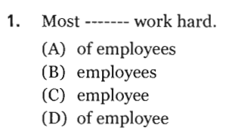
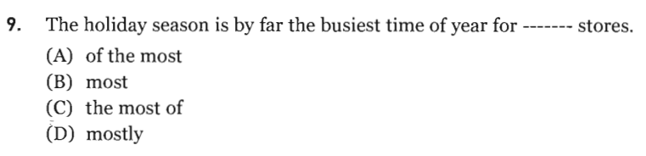
Page 197

Slide 5
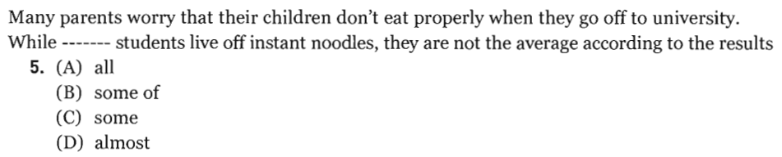
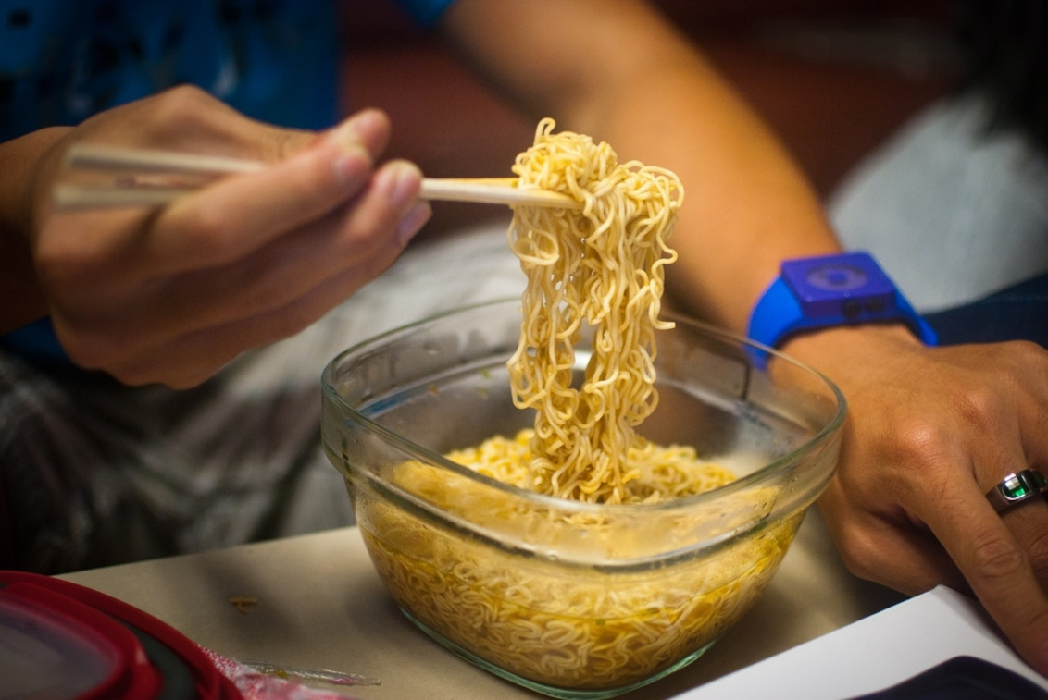
Page 200
Vài sinh viên sống nhờ vào mì ăn liền
(thường xuyên ăn)

Slide 6
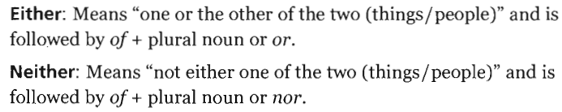
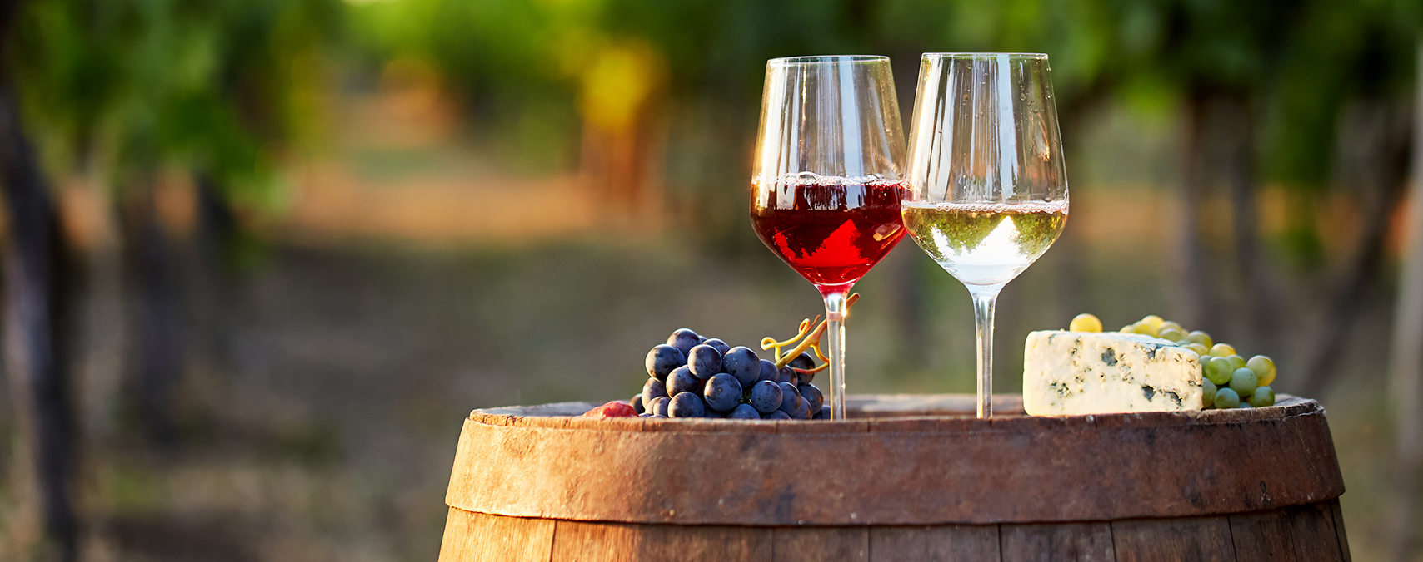
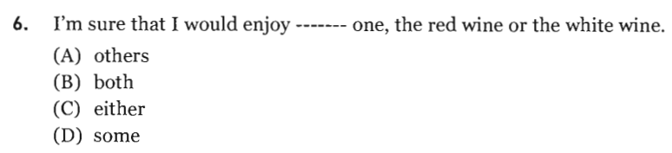
either…….or……….
neither……nor……..
Page 198

Slide 7
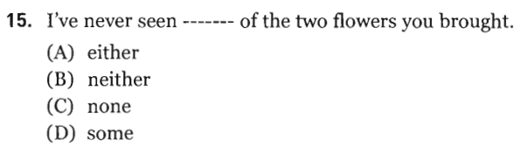

Slide 8
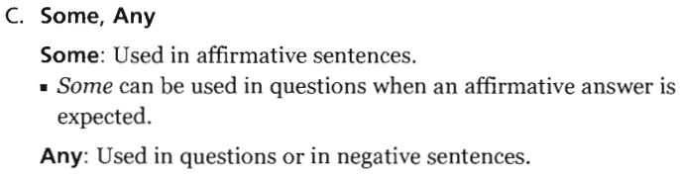
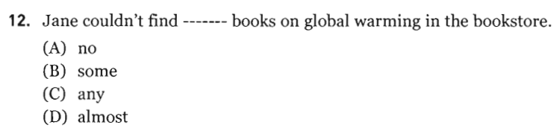
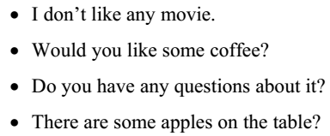
Page 199

Slide 9

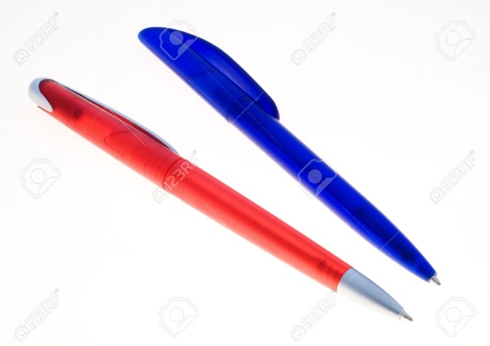
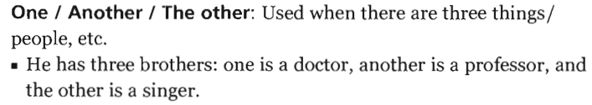
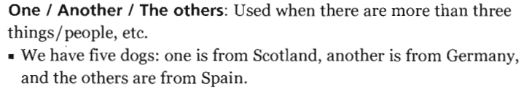
1
2
3

Slide 10
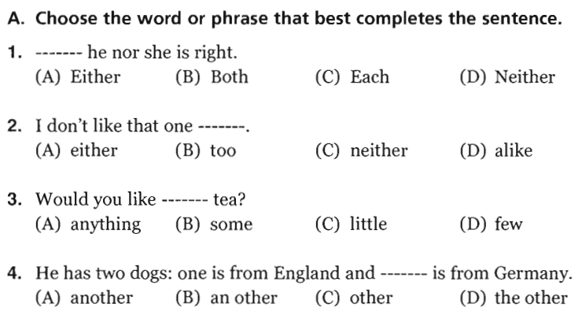

Slide 11
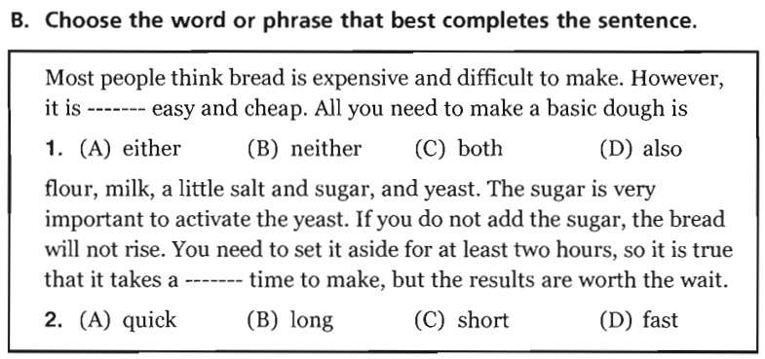

Slide 12
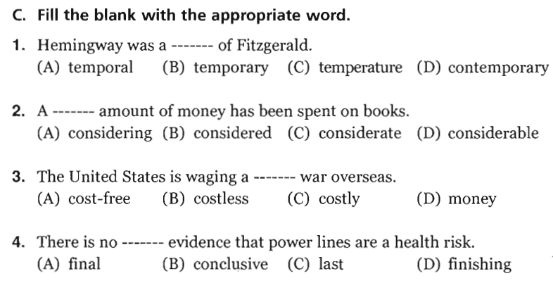
Cùng thời
Đáng kể, lớn
expensive
decisive, crucial, certain

Slide 13
PART VI
INCOMPLETE SENTENCES

Slide 14
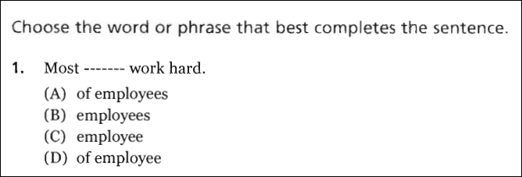
1. B

Slide 15
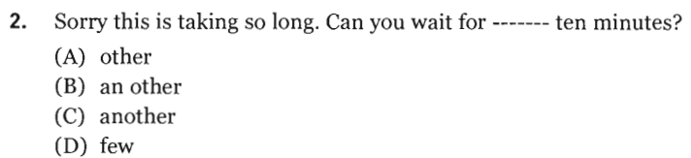
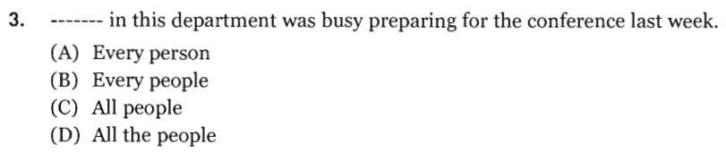
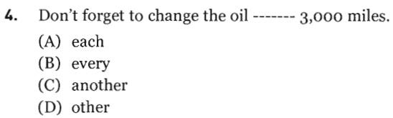
Page 197
Đợi thêm 10 phút nữa
Each / every + N (singular) + V (singular)
Cứ mỗi 3000 dặm

Slide 16
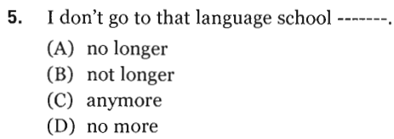
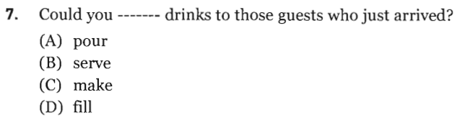
Không còn nữa

Slide 17
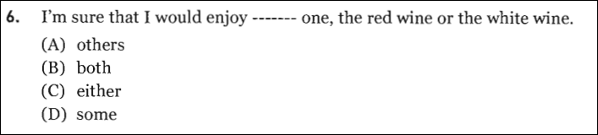
6. C

Slide 18
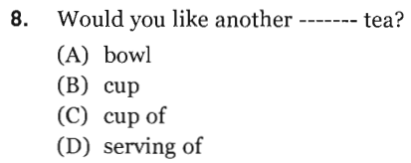
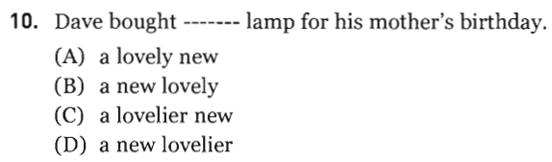
O – S – A – S– C – O – M – P
( Opinion – Size – Age – Shape – Color – Origin – Material – Purpose)

Slide 19
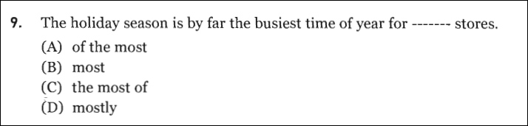
9. B

Slide 20
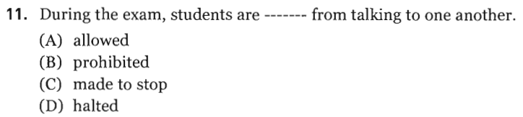
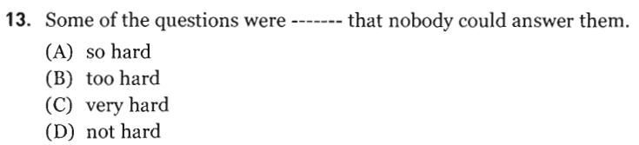
Bị cấm

Slide 21
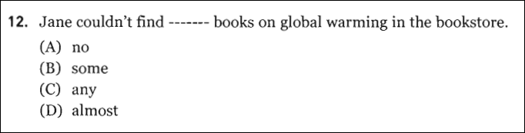
12. C

Slide 22
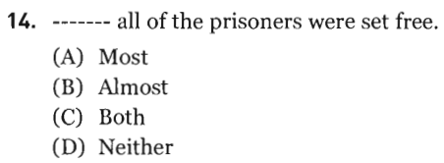
Almost + all / every / no

Slide 23
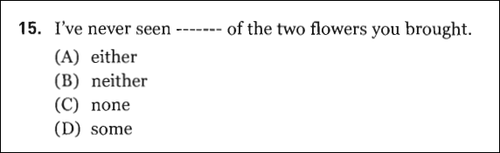
15. A

Slide 24
PART VI
INCOMPLETE TEXTS

Slide 25
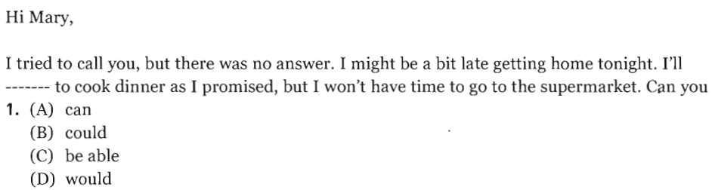
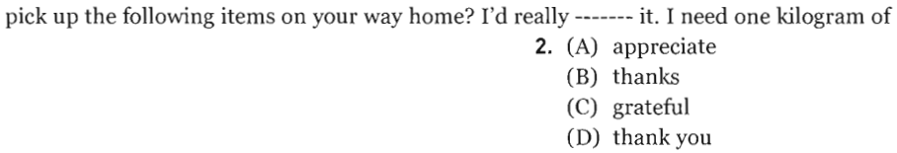

Slide 26
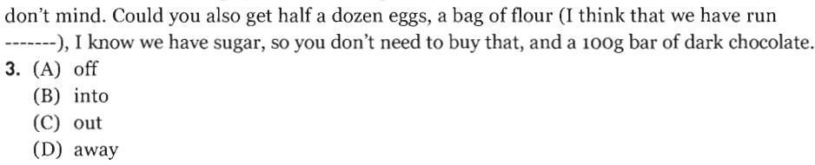
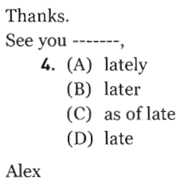

Slide 27
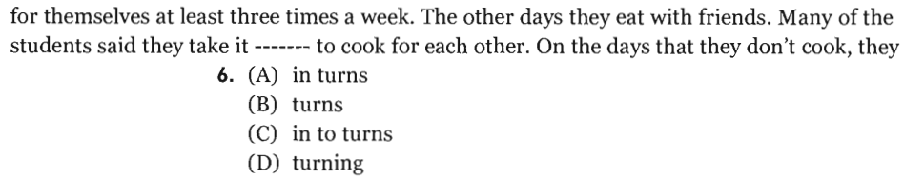
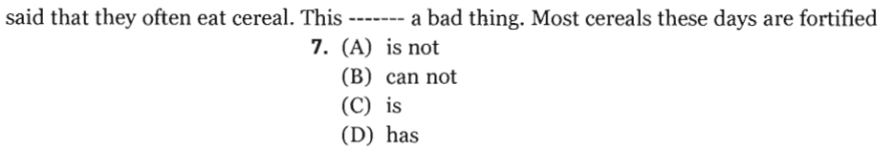

Slide 28
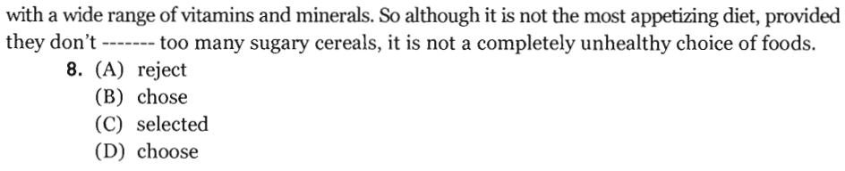
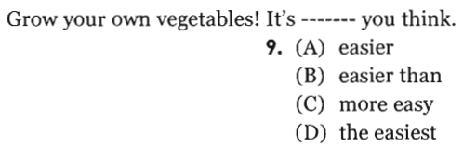
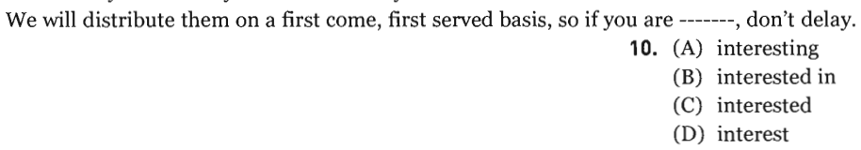

Slide 29
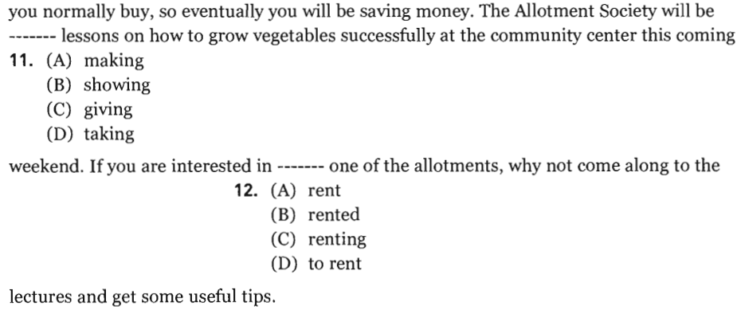

Slide 30
PART VII
READING COMPREHENSION

Slide 31
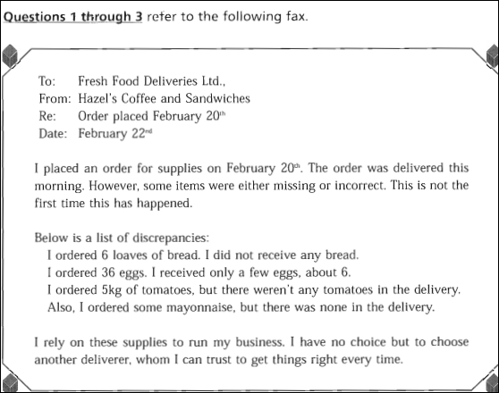

Slide 32
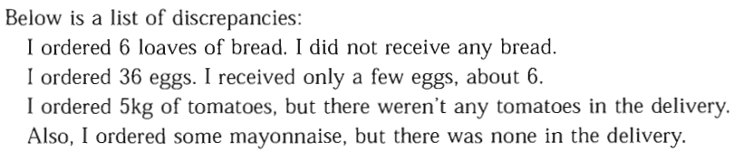
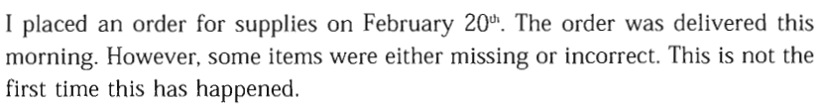
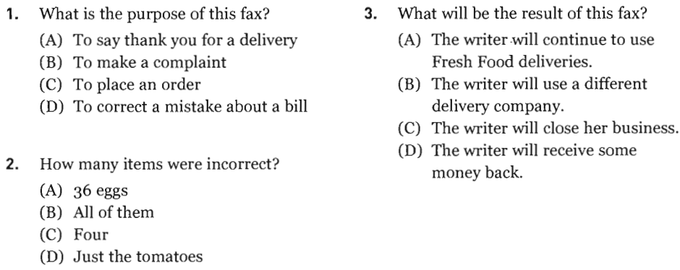

Slide 33



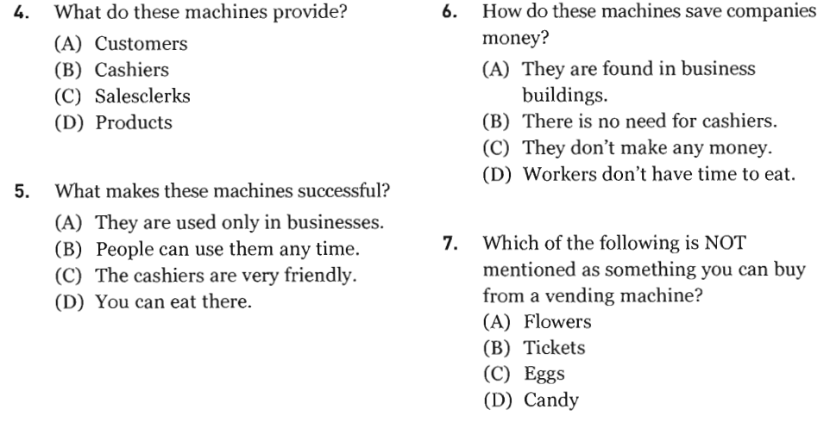

Slide 36

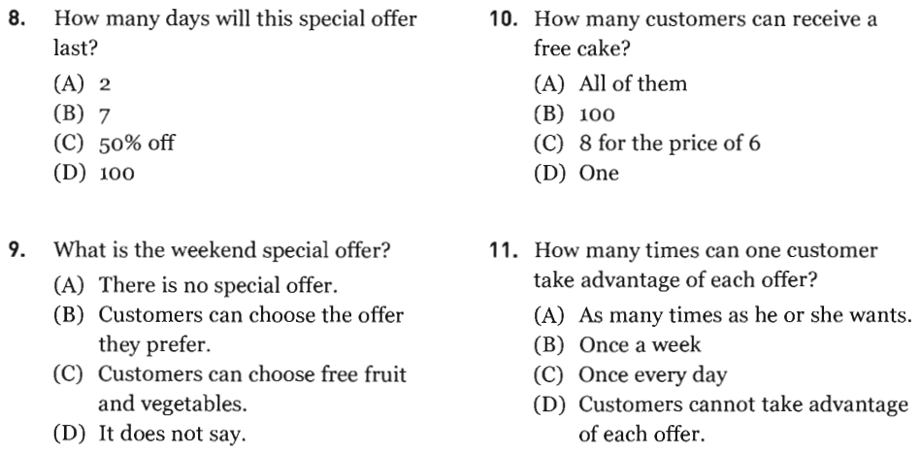

Slide 37
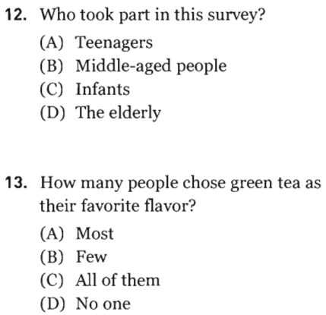


Slide 38




Slide 39
PART VII
READING COMPREHENSION

Slide 40

1. B
2. C
3. B

Slide 41


Slide 42

4. D
5. B
6. B
7. C

Slide 44
LISTENING PRACTICE

Slide 45

A. The plates are full of food
Page 193
B. The coffee cup is empty

Slide 46

B. The sink is full of dishes

Slide 47

The man is preparing
food
D. The woman is holding a fork

Slide 48


Slide 49



Không lặp lại

Slide 50



Slide 51





Slide 52





Slide 53





Slide 54





Slide 55

Thank you very much
for your cooperation.

