Slide 1
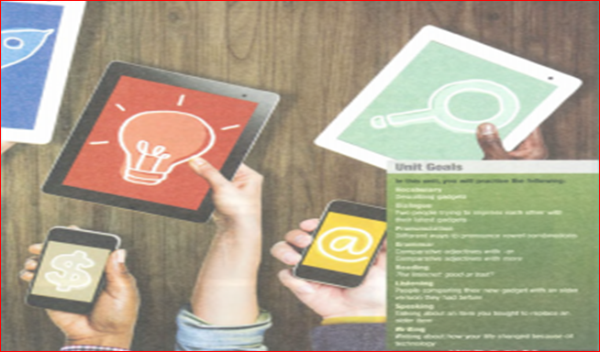
UNIT 11: TECHNOLOGY

Slide 2


1. VOCABULARY

Slide 3
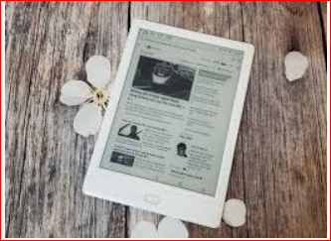

Slide 4
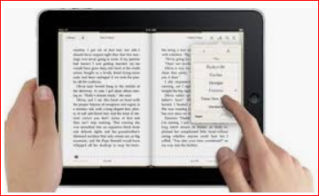

Slide 5


Slide 6
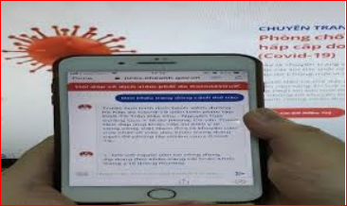
e-reader /ˈiː.riː.dər/ (c)
a small electronic device with a screen that allows you to read books in an electronic form

Slide 7
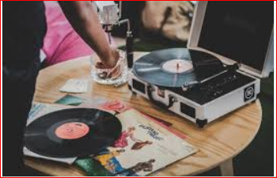

Slide 8
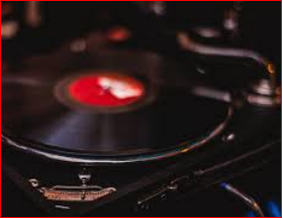

Slide 9
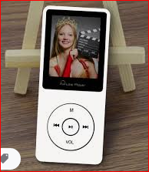

Slide 10
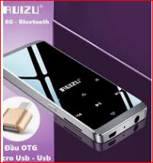
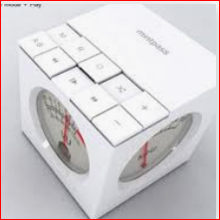
music player (n)
an electronic device for playing music, especially music as MP3 files

Slide 11
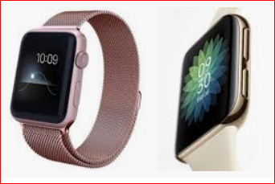

Slide 12
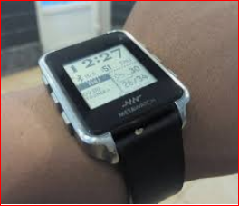
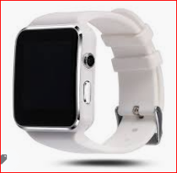

Slide 13
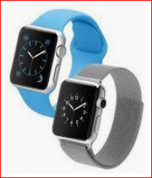
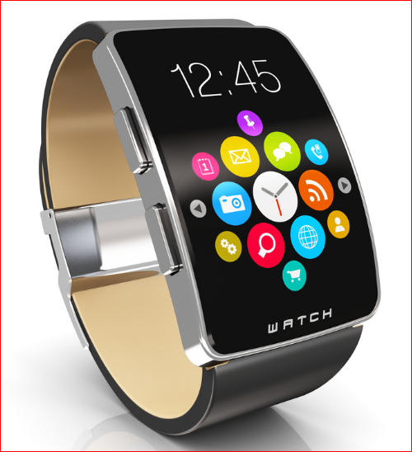

Slide 14
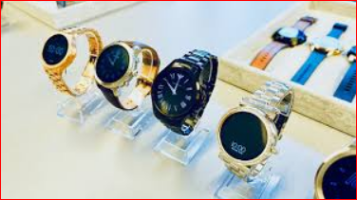
smartwatch /ˈsmɑ:rt.wɑ:tʃ/ (n)
a watch that has many of the feature of a smartphone or a computer

Slide 15
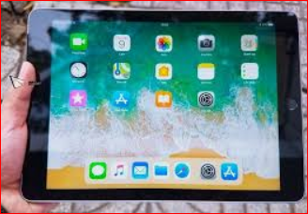

Slide 16
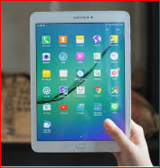

Slide 17


Slide 18

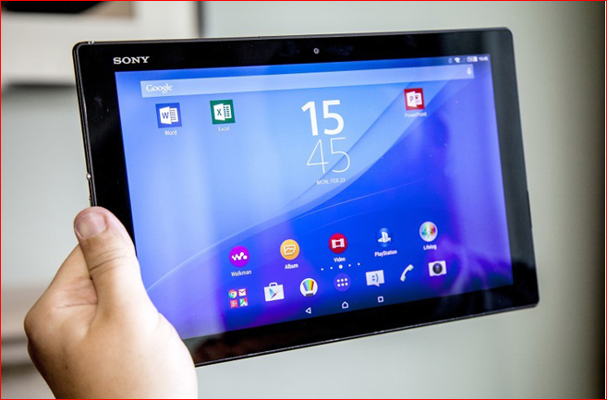
tablet /ˈtӕblit/ (n)
(also tablet computer) (computing) a small one-piece portal computer which the user operates by a touchscreen

Slide 19
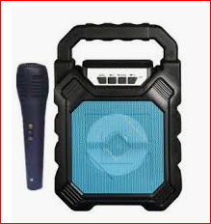
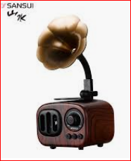

Slide 20
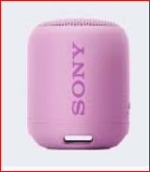
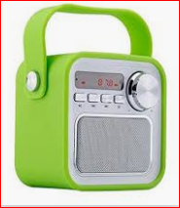
portable speaker

Slide 21
powerful (a)
having great strength influence etc
→ a powerful engine
Eg: He’s powerful in local politics.

Slide 22
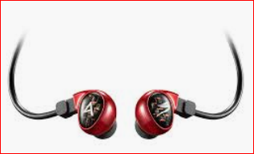
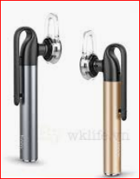
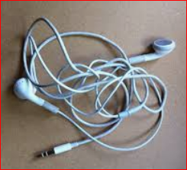

Slide 23
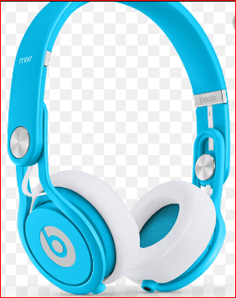
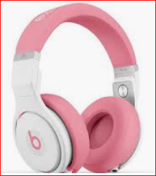

Slide 24
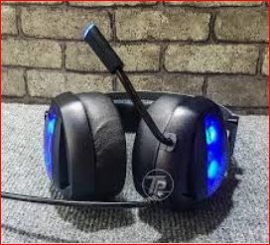

Slide 25
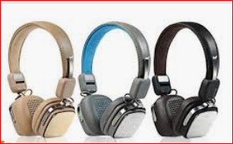
earbuds /’ɪr.bʌdz/ (plurar N)
very small headphones that you wear in your ears

Slide 26
VOCABULARY 2

Slide 27
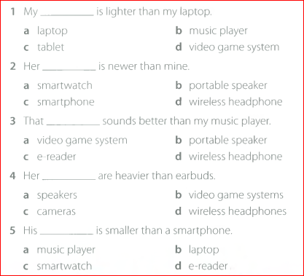
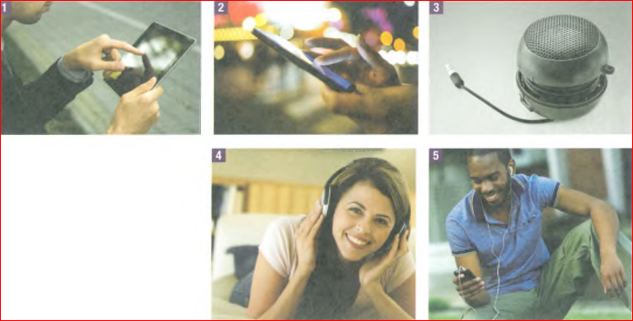

Slide 28
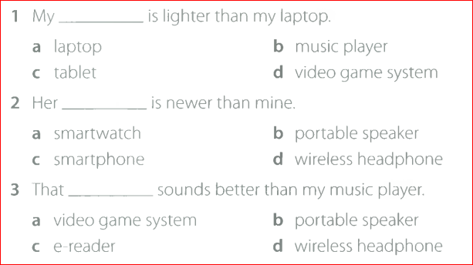
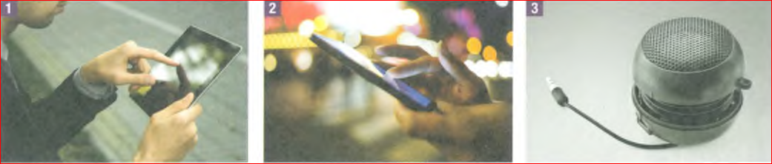

Slide 29
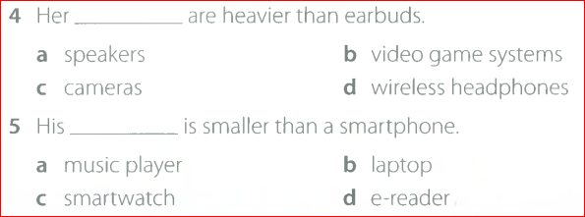
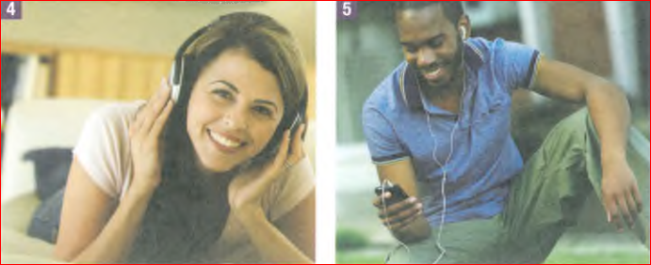

Slide 30
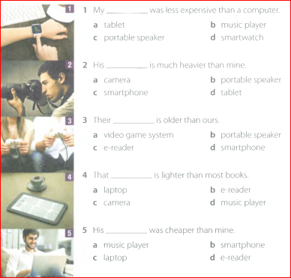
VOCABULARY 3

Slide 31
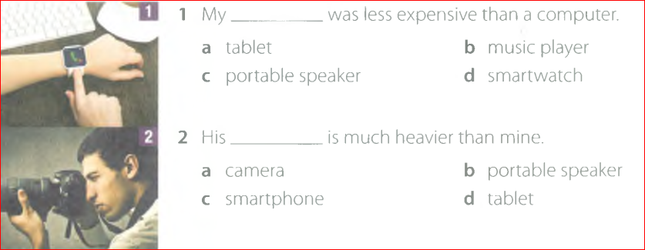

Slide 32
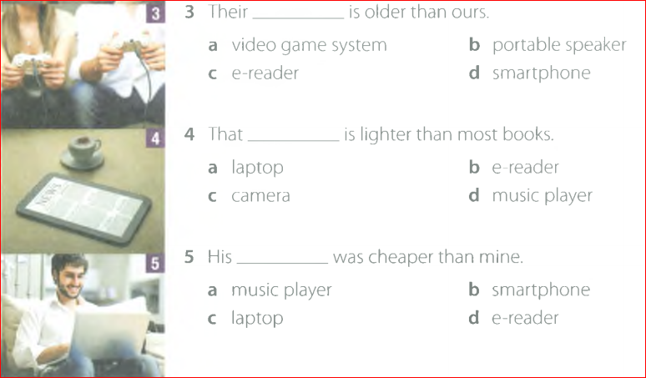

Slide 33
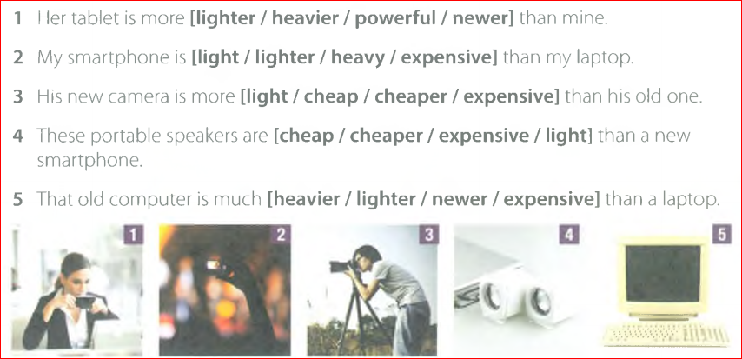
VOCABULARY 4

Slide 34

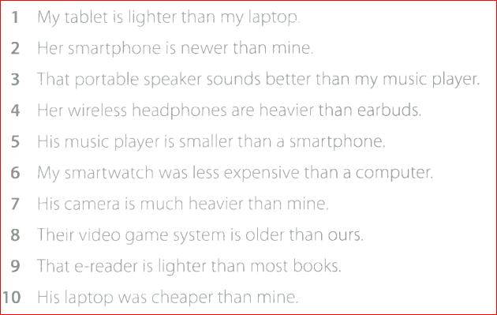
VOCABULARY 5

Slide 35

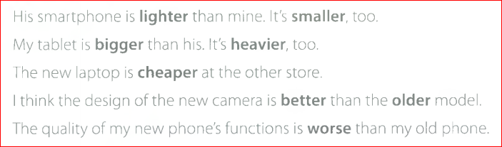
2. GRAMMAR
GRAMMAR 1

Slide 36
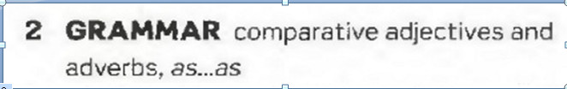
1. Equality
S + Be + As + ADJ + As + S (N/PRO) + (V)
Ex : Tom is as tall as Jerry.
S + V + As + ADV + As + S + (V)
Ex : Peter dances as well as Mary.

Slide 37
2. Comparative
a. Short Adjective
S + Be/ V + ADJ/ADV + er + than + …
Ex : Tom is taller than Mary.
b. Long Adjective
S + Be/ V + more + ADJ/ADV + than +…
Ex : Peter dances more beautifully than Mary.

Slide 38
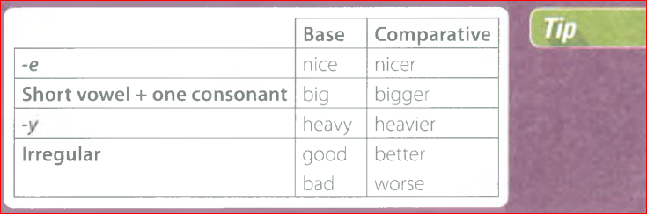

Slide 39
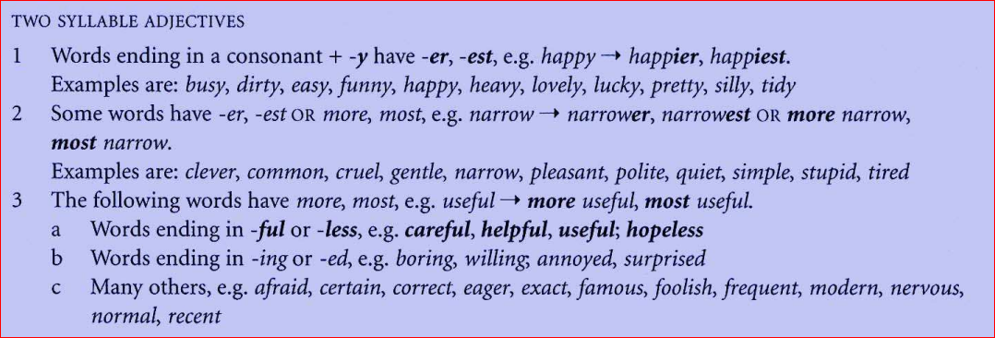

Slide 40
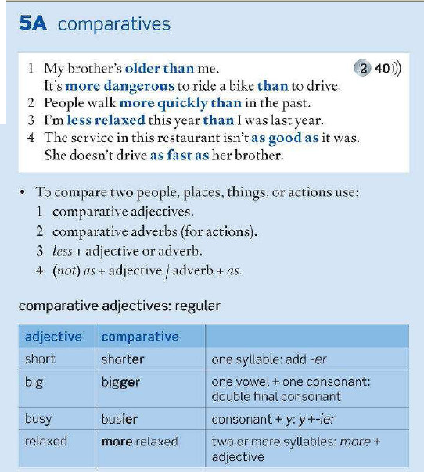

Slide 41
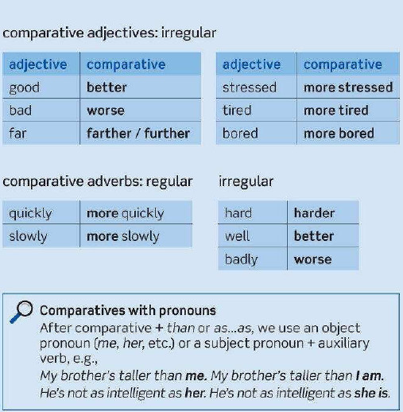

Slide 42
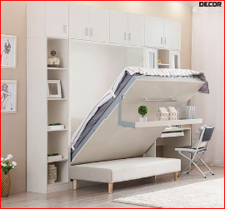

Slide 43
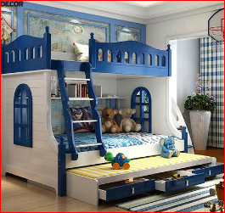

Slide 44
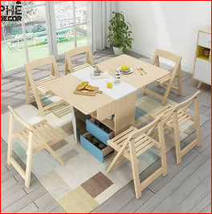

Slide 45
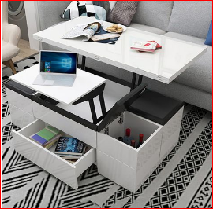

Slide 46


Slide 47

convenient /kən’vi:niənt/ (a)
suitable for your purposes and needs and causing
Our local shop has very convenient opening hours.

Slide 48


Slide 49


Slide 50


Slide 51

excited /ɪk’saitid/ (a)
feeling very happy and enthusiastic
Tim was very excited about going to Bangkok.

Slide 52


Slide 53


Slide 54


Slide 55

LCD /el.si:’di:/ (n)
abbreviation for liquid crystal display

Slide 56

GRAMMAR 2

Slide 57


GRAMMAR 3

Slide 58


Slide 59

GRAMMAR 4

Slide 60

GRAMMAR 5

Slide 61
3. Superlative
a. Short Adjective
S + Be/ V + the + ADJ/ADV + est + N ..
Ex : Tom is the tallest boy in his class.
b. Long Adjective
S + Be/ V + the most + ADJ/ADV + N …
Ex : Peter draws the most beautifully in his family.

Slide 62

EXERCISE

Slide 63





Slide 64

3. READING

Slide 65


Slide 66


Slide 67


Slide 68


Slide 69
Internet /’ɪntənet/ (n)
(computing) a worldwide computer network that provides information on very many subjects and enables users to exchange messages

Slide 70


Slide 71


Slide 72



Slide 73

technology /tek’nolədʒi/ (n)
(the study of) science applied to practical, ( especially industrial) purposes
(plural) technologies

Slide 74
local /ˈləukəl/ (n):
belonging to a certain place or district
→ local residents
Eg: The local shops are very good.

Slide 75


PARAGRAPH 2

Slide 76


Slide 77


Slide 78



Slide 79


rule /ru:l/ (n)
a regulation or order
→ school rules
He make it a rule never to be late
for appointments.

Slide 80


Slide 81


Slide 82


Slide 83
leave /li:v/ (v)
to go without taking
Eg: She left her gloves in the car.
He left his children behind
when he went to France.

Slide 84


Slide 85


Slide 86



Slide 87

allow /ə’lau/ (v)
not to forbid or prevent
Eg: He allowed me to enter.
Smoking is not allowed inside the restaurant.

Slide 88


PARAGRAPH 3

Slide 89


Slide 90


Slide 91




Slide 92

chat /tʃӕt/ (v) (chatted)
to talk in a friendly and informal way
They chatted about the weather.

Slide 93


Slide 94


Slide 95


Slide 96


Slide 97


stay off (v)

Slide 98


Slide 99


Slide 100


Slide 101

limit (v)
to set a restriction on
We must limit the amount of time we spend on this work.

Slide 102


Slide 103


Slide 104


Slide 105
get out of (phrasal verb)
to (help a person etc to) avoid doing st
How can I get him out of
going to the party?
I wonder how I can get out of washing the dishes.

Slide 106


Slide 107
barely /ˈber.li/ (adv)
to have barely enough time
to catch the train
She was barely (= only just) 15 when she won her first championship.

Slide 108


Slide 109


Slide 110


Slide 111

keep from phrasal verb
to stop oneself from (doing st)
I could hardly keep from hitting him.

Slide 112


Slide 113


Slide 114


Slide 115


Slide 116


Slide 117


Slide 118


Slide 119



Slide 120


Slide 121

drop a call (phrasal verb)

Slide 122


Slide 123


Slide 124


Slide 125
complicated (v)
difficult to understand or explain
→ complicated instructions.

Slide 126


Slide 127


Slide 128


Slide 129
chore /tʃo:/ (n)
a piece of housework or other hard or dull job
Eg: I’ve got a load of household
chores to do.

