Slide 1
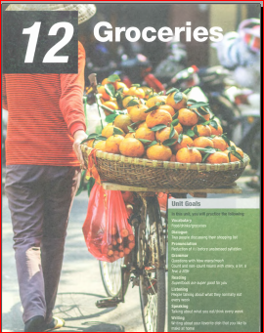
UNIT 8

Slide 2
1. VOCABULARY
  VOCABULARY 1

Slide 3
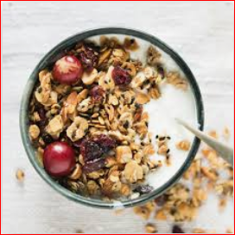

Slide 4
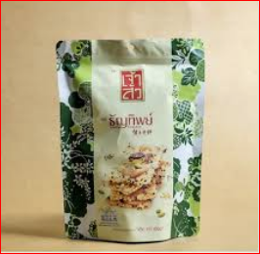
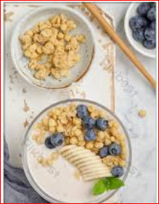

Slide 5
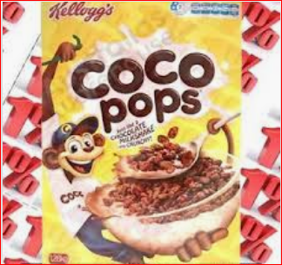

Slide 6
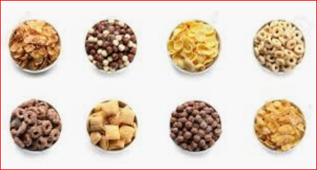
cereal /ˈsiəriəl/ (n)
a kind of grain used as food
→ wheat, barley, and other cereals
(also adjective) cereal crops.

Slide 7
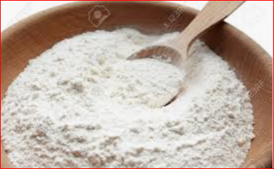

Slide 8
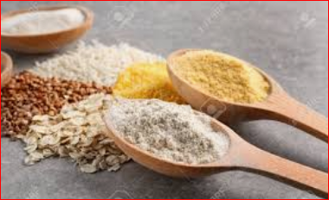

Slide 9
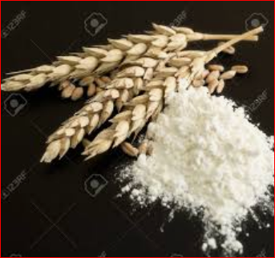

Slide 10
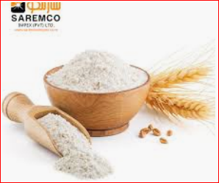
flour /ˈflauə/ (n)
wheat, or other cereal, ground into a powder and used for cooking, baking etc

Slide 11
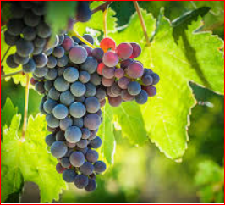

Slide 12
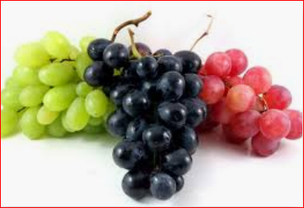

Slide 13
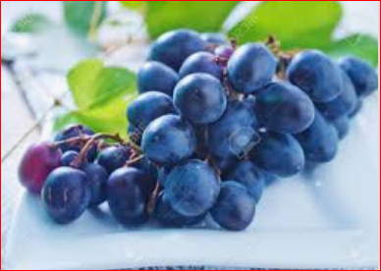

Slide 14
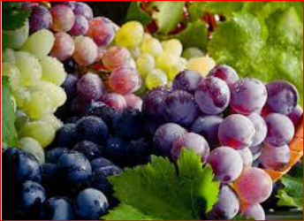
grape /ɡreip/ (n)
a green or black smooth-skinned eatable berry from which wine is made
→ seedless grapes

Slide 15
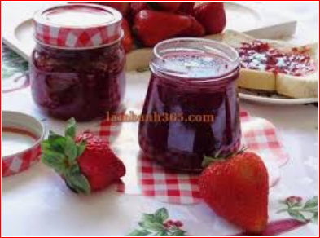
jam /dʒӕm/ (n)
a thick sticky substance made of fruit etc preserved by being boiled with sugar
→ raspberry jam

Slide 16
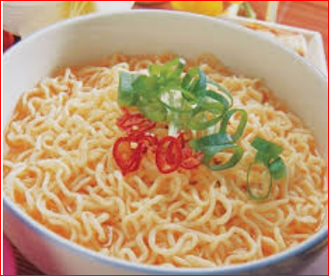

Slide 17
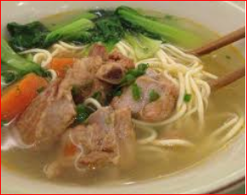

Slide 18
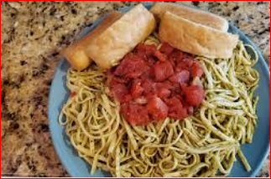

Slide 19
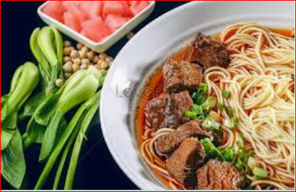
noodle /ˈnuːdl/ (n)
a strip of paste usually made with water, flour and egg
→ fried noodles

Slide 20
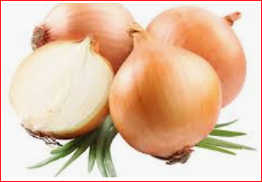

Slide 21
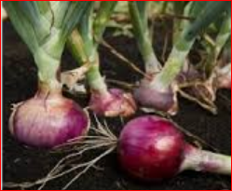

Slide 22
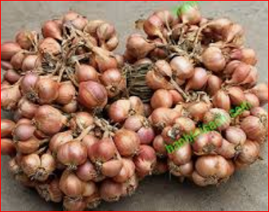

Slide 23
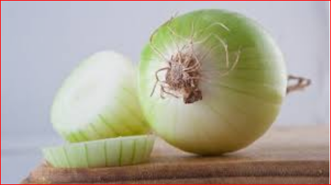
onion /ˈanjən/ (n)
a type of vegetable with an eatable bulb which has a strong taste and smell
→ pickled onions

Slide 24
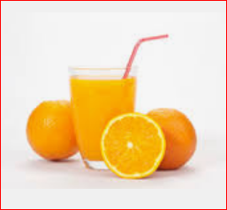

Slide 25
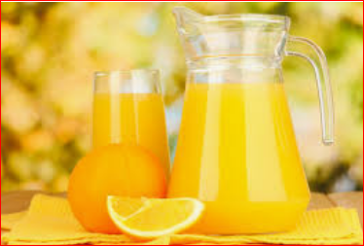

Slide 26
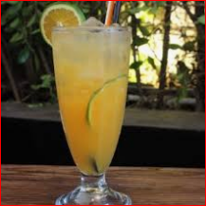
orange juice /’ɔ:r.ɪndʒ dʒu:s/ (U)N
drink consisting of the juice from oranges
For breakfast, I have toast and
a glass of orange juice.

Slide 27
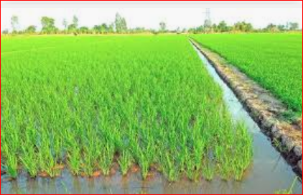

Slide 28
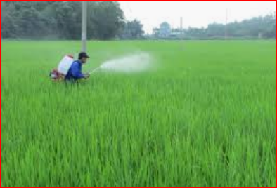

Slide 29
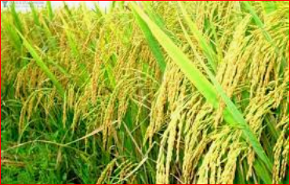

Slide 30
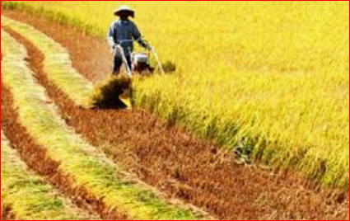
rice /rais/ (n)
→ fried rice
a plant, grown in well-watered ground in tropical countries,
whose seeds are used as food

Slide 31

  VOCABULARY 2

Slide 32
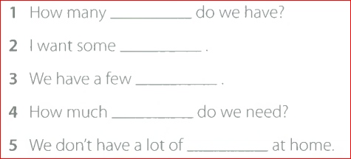
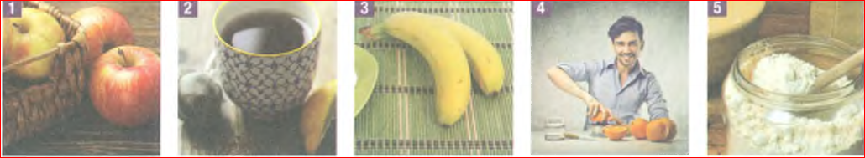

Slide 33
  VOCABULARY 3

Slide 34
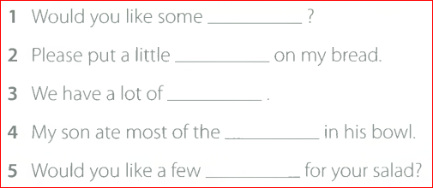
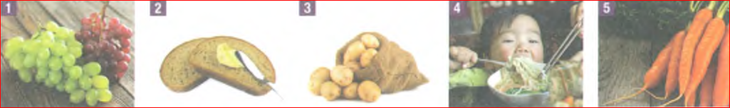

Slide 35
  VOCABULARY 4

Slide 36
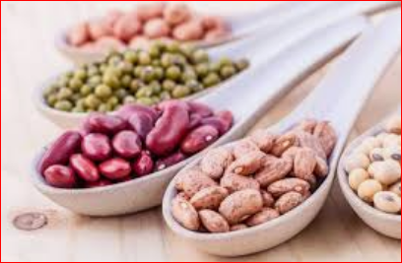

Slide 37
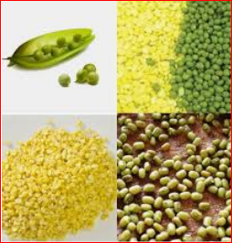

Slide 38
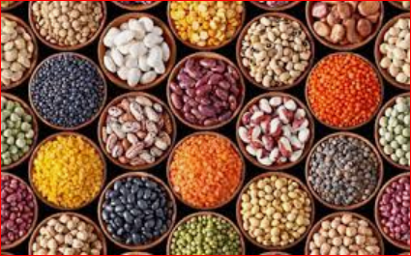

Slide 39
bean /bi:n/ (n)
any one of several kinds of
pod-bearing plant or its seed
→ broad beans, green beans

Slide 40
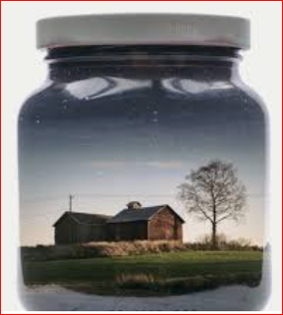
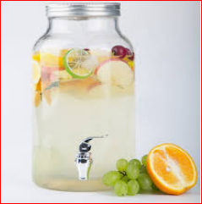

Slide 41
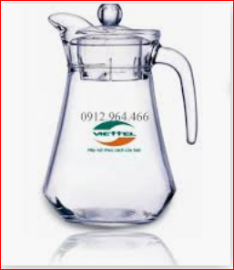
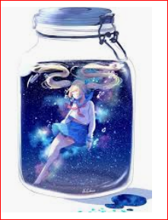

Slide 42
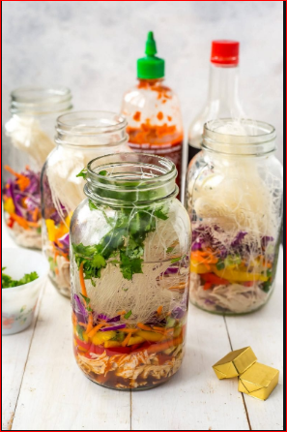


Slide 43
jar /dʒa:/ (n)
a kind of bottle made of glass or pottery, with a wide mouth
→ a jam jar
She poured the jam into large jars.

Slide 44
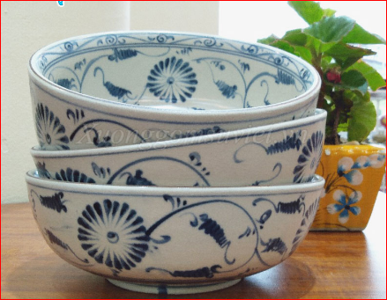

Slide 45
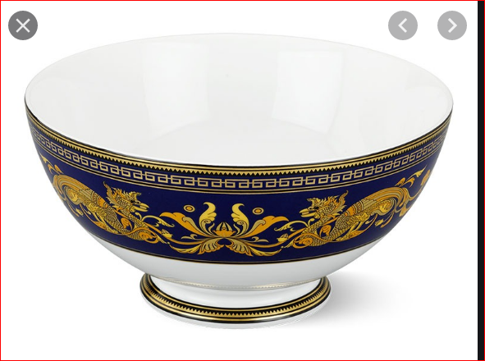

Slide 46
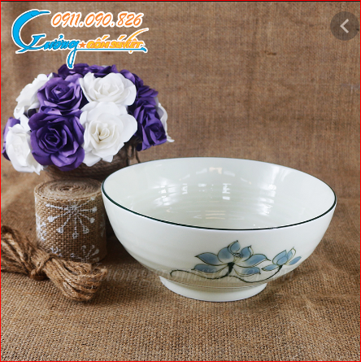

Slide 47
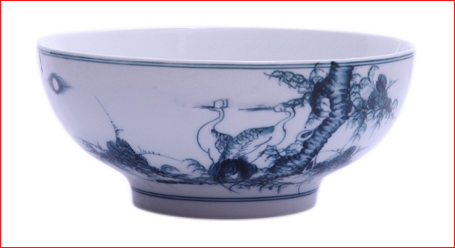
bowl /bəul/ (n)
a round, deep dish eg for mixing or serving food etc:
→ a baking bowl, a soup bowl

Slide 48
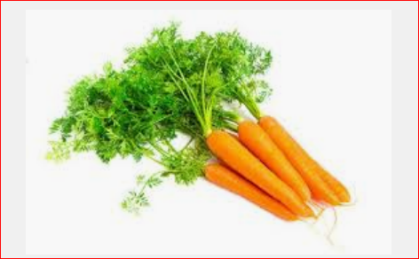

Slide 49
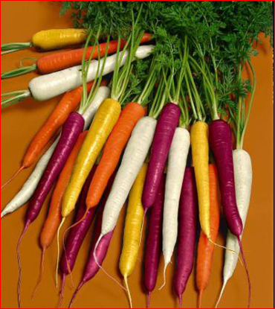

Slide 50
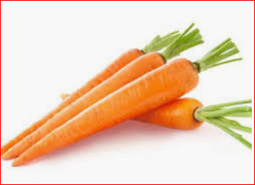
carrot /ˈkӕrət/ (n)
(a vegetable with)an edible,
orange, pointed root
→ a bunch of carrots.

Slide 51
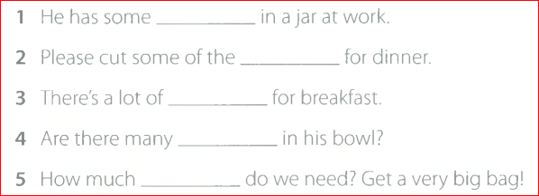


Slide 52

VOCABULARY 5

Slide 53
2. GRAMMAR
GRAMMAR 1
Question with
How many/ How much

Slide 54

GRAMMAR 1

Slide 55
GRAMMAR 1
  HOW MANY, HOW MUCH
How many + Count. Noun + Auxiliary Verb + S + V ?
How many eggs does she have ? - 20
How many carrots do you have?- 10
 Count. Ns: egg, carrot, potato

Slide 56
How much + UnCount. Noun + Auxiliary Verb + S + V ?
How much rice do we need ?
How much water do they have ?
 UnCount Ns: water, rice, oil

Slide 57
GRAMMAR 1
stew /stju:/ (v)
to cook (meat, fruit etc) by slowly boiling and simmering
Eg: She stewed steak.
The meat was stewing in the pan.

Slide 58
gallon /’ɡӕlən/ (n)
a measure for liquids, eight pints
(in Britain, 4.546 litres; in the United States, 3.785 litres)

Slide 59

GRAMMAR 2

Slide 60


Slide 61




Slide 62
recipe /’resəpi/ (n)
set of instructions on
how to prepare and cook something
→ a recipe for curry
(also adjective) a recipe book

Slide 63

  GRAMMAR 3

Slide 64
  GRAMMAR 3
  MANY, A LOT,
  A FEW, A LITTLE

Slide 65
MANY + Count. Noun FEW / A FEW
I don't have many clothes.
Were there many cars on the road?
Our costs have climbed rapidly
in the last few years.
Very few people can afford to pay
those prices.

Slide 66
A LOT OF + Coun/ UnCount. N A LITTLE/ LITTLE + UnCount.N
There is a lot of salt in this soup.
There are a lot of people in the hall.
There is a little money in the purse.

Slide 67

GRAMMAR 3

Slide 68

GRAMMAR 4

Slide 69

GRAMMAR 5

Slide 70
pick up (phrasal verb)
to collect (st) from somewere
I ordered some meat from the butcher
– I’ll pick it up on my way
home tonight.

Slide 71
left (n)
Eg: He has five francs left.
How much milk is left ?

Slide 72
quiche /kiːʃ/ (n)
a pie without a top that has a base made of pastry and is filled with a mixture of cheese, eggs, vegetables
→ a vegetarian quiche

Slide 73
sound (v)

Slide 74
silly /ˈsili/ (a)
comparative sillier superlative silliest foolish; not sensible
Eg: Don’t be so silly!

Slide 75
dessert /diˈzə:t/ (n)
the sweet course in a meal; pudding
Eg: We had ice cream for dessert.

Slide 76
peanut /ˈpiːnat/ (n)
an oval-shaped nut that grows underground in pairs inside
a thin brown shell
→ roast peanuts

Slide 77

READING

Slide 78
superfood ˈsuː.pə.fuːd/ (n): a food
that is considered to be very good for your health

Slide 79
PARAGRAPH 1
hard (a): not easy to do, learn,
slove etc:
Eg: Is Finnish a hard language to
learn?

Slide 80
He is a hard man to please.
taste (v): to teast or find out the flavour/flavor or quality of (food etc) by eating or drinking a little of it:

Slide 81
Eg: Please taste this and tell me if it is too sweet.
fast food (n): food that can be quickly prepared, eg hamburgers etc
(also adjective) a fast food restaurant.

Slide 82
make /meik/ (v): past tense, past participle made /meid/: to creat, form or produce:
Eg: I’m going to make lunch/coffee

Slide 83
PARAGRAPH 2
so-called (a): wrongly described or
named in such a way :

Slide 84
Eg: Your so-called friends have gone without you!
kale /keɪl/ (n): [ U ]: a type of
cabbage with green or purple tighly curled leaves:

Slide 85
- blueberry /ˈbluːˌbər.i/ (n) [ C ] : the dark blue fruit of a bush that is grown in North Americas in similar to a bilberry:

Slide 86
-salmon/ˈsӕmən/ (n), plural salmon: a type of large fish with orange-pink
flesh:
- nut /nat/ (n): a fruit consisting of a single seed in a hard shell:

Slide 87
→ a hazelnut, a walnut.
nutrition (n): (the act of giving or getting) nourishment, or the scientific study of this:
Eg: Eggs are a source of nutrition.

Slide 88
condition /kənˈdiʃən/ (n): state or circumstances in which a person or thing is:
Eg: The house is not in good
condition

Slide 89
blood pressure(n): (medical) the (amount of) pressure of the blood on the walls of the blood-vessels:
Eg: The excitement will raise his
blood pressure

Slide 90
The nurse measured his blood
pressure.

Slide 91
cholesterol /(British) kəˈlestəˌrol;
(American) kəˈlestəˌroːl, kəˈlestəˌ
roul/: a chemical subtance found in
animal tissues and in certain foods.
Too much cholesterol in the blood can cause diseases of the heart
cholesterol

Slide 92
Eg: A common cause of high blood cholesterol levels is eating too much saturated fat
dish /diʃ/ (n): food mixed and prepared for the table:

Slide 93
Eg: She served us an interesting dish containing chicken and almonds.
main /mein/ (a):chief, principal or most important :
the main purpose, the main
character in the story.

