Slide 1

TRƯỜNG CAO ĐẲNG LÝ TỰ TRỌNG TP. HỒ CHÍ MINH

Slide 2
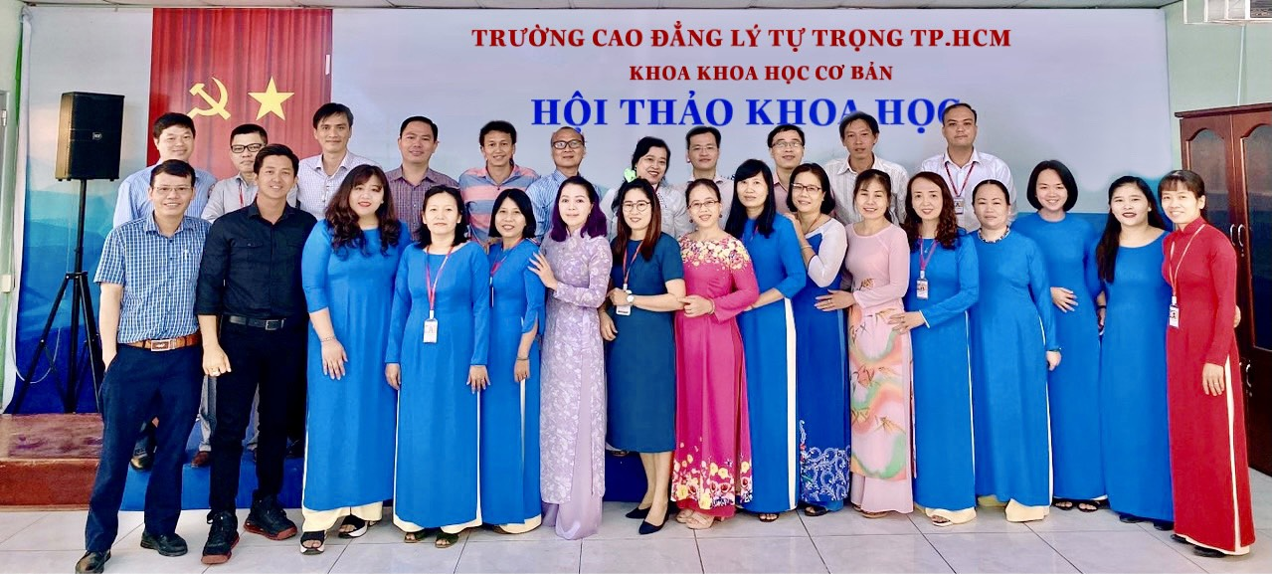
KHOA KHOA HỌC CƠ BẢN

Slide 3

ỦY BAN NHÂN DÂN THÀNH PHỐ HỒ CHÍ MINH
TRƯỜNG CAO ĐẲNG LÝ TỰ TRỌNG TP. HỒ CHÍ MINH
Bậc đào tạo: CAO ĐẲNG CHUYÊN NGHIỆP
Tên giảng viên: TỔ ANH VĂN

Slide 4

Good afternoon everybody

Slide 5
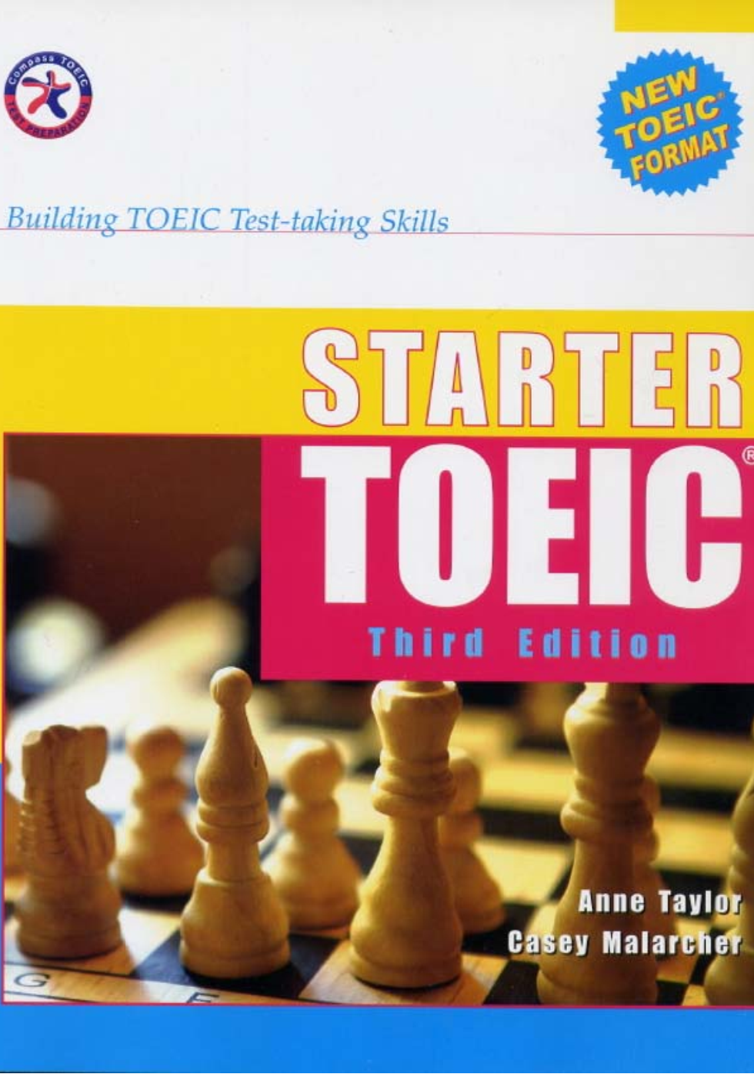

Slide 6
UNIT 6
COMPARISIONS

Slide 7
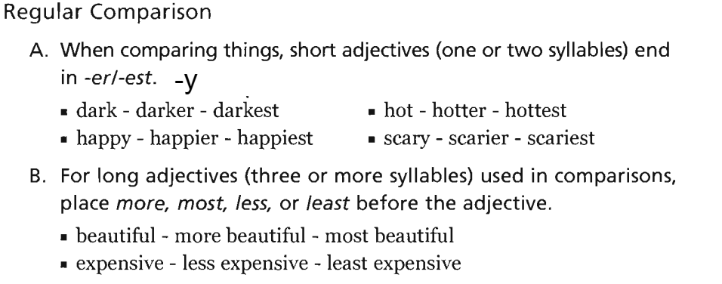
UNIT 6: Comparisions

Slide 8
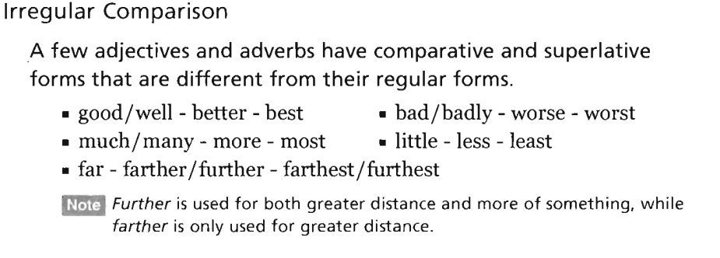
UNIT 6: Comparisions

Slide 9
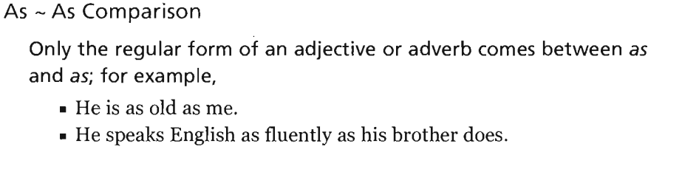
UNIT 6: Comparisions

Slide 10
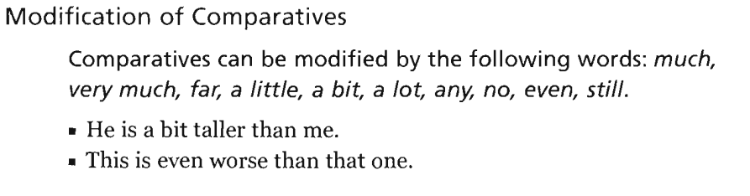
UNIT 6: Comparisions

Slide 11
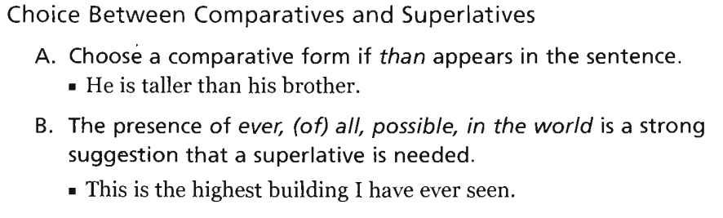
UNIT 6: Comparisions

Slide 12
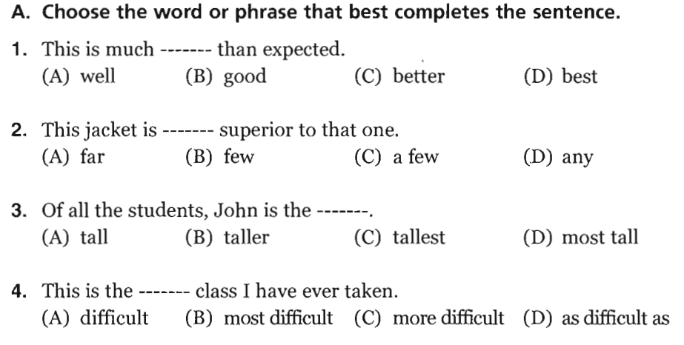
UNIT 6: Comparisions - Execises

Slide 13
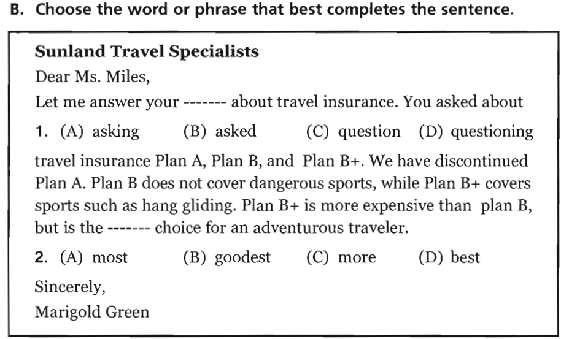
Unit 6: Exercise:
C. question
D. best

Slide 14
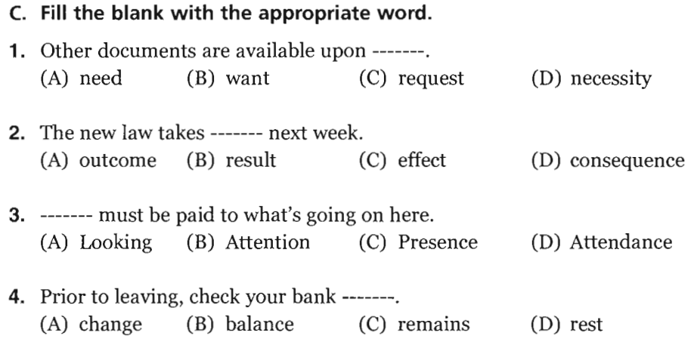
Unit 6: Exercise
C/ request
C/ upon request = when asked for
C/ effect
Take effect = be effective; begin
B/ attention
Pay attention to = look at carefully
B/ balance
Bank balance = money left over in one’s bank account

Slide 15

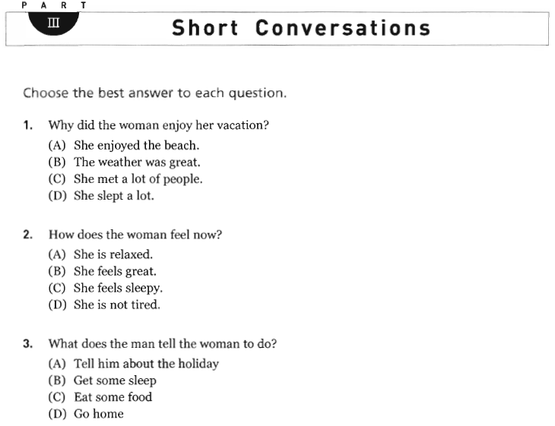

Slide 16


Slide 17
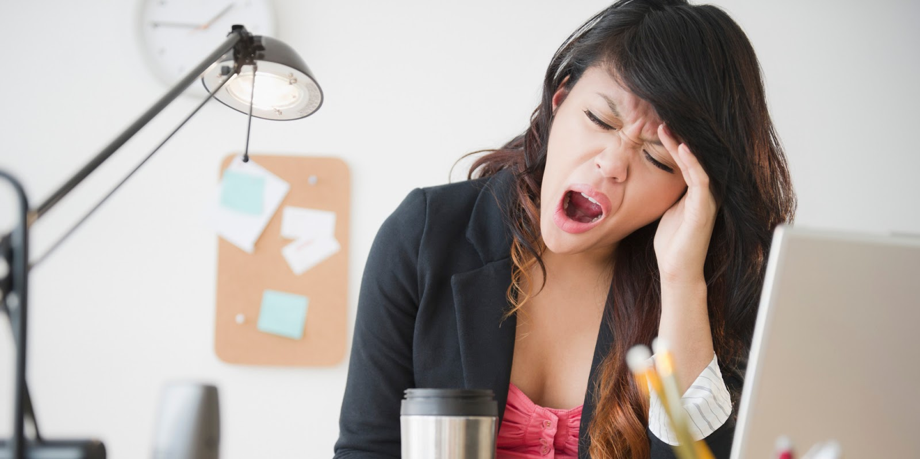
Vocabulary:
Sleepy (adj): needing sleep; ready to go to sleep

Slide 18
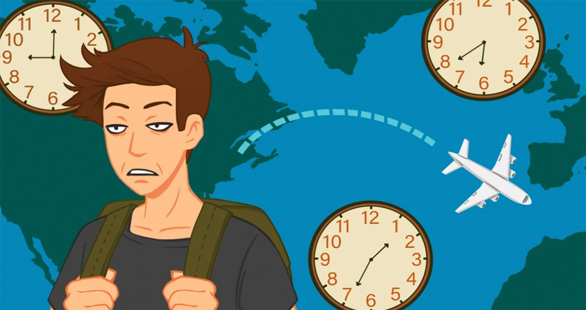
VOCABULARY
jeg lag (n): the feeling of being tired and slightly confused after a long plane journey, especially when there is a big difference in the time at the place you leave and that at the place you arrive inI’m still suffering from jet lag after my trip to Australia.

Slide 19
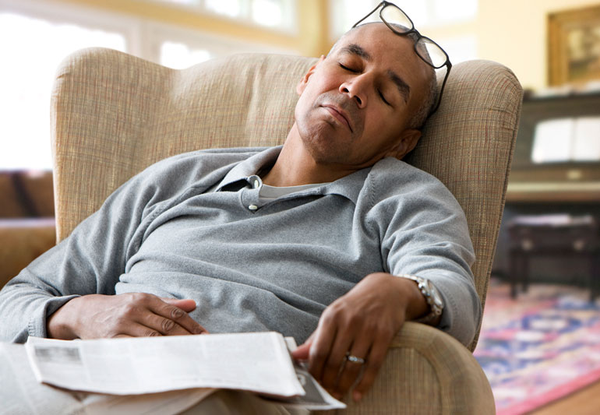
VOCABULARY
Asleep (adj): ngủ ngục
He was so exhausted that he fell asleep at his desk.

Slide 20
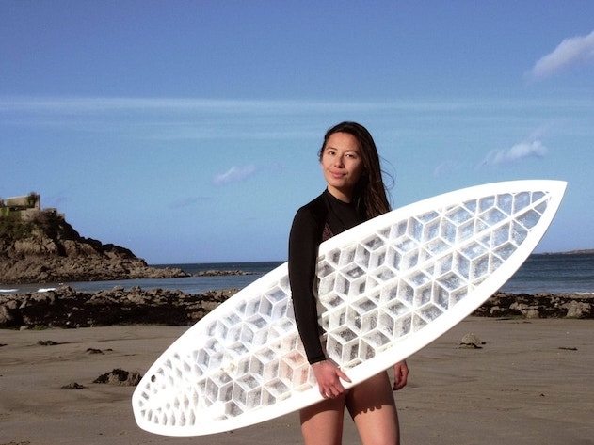
VOCABULARY
A surf board (n): a long narrow board used for surfing → ván lướt sóng

Slide 21
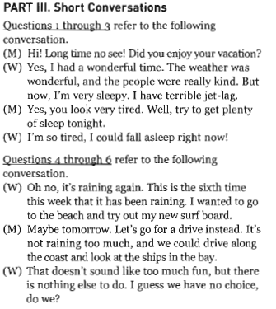
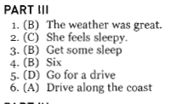
Answer:

Slide 22
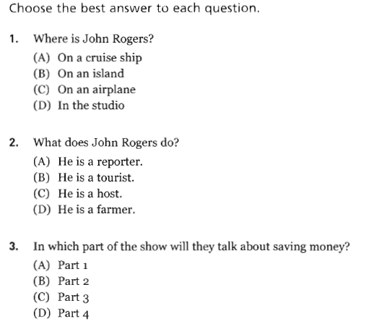
Part IV: Short talks – p. 132

Slide 23
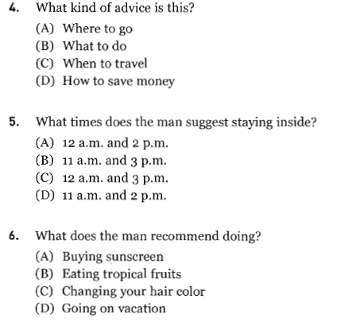
Part IV: Short talks – p. 132

Slide 24
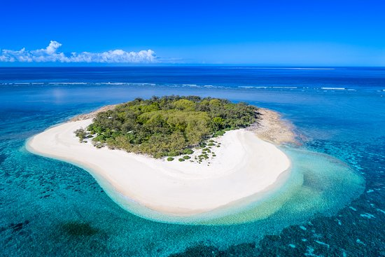
VOCABULARY
island /ˈaɪlənd/ (n) : a piece of land that is completely surrounded by water

Slide 25
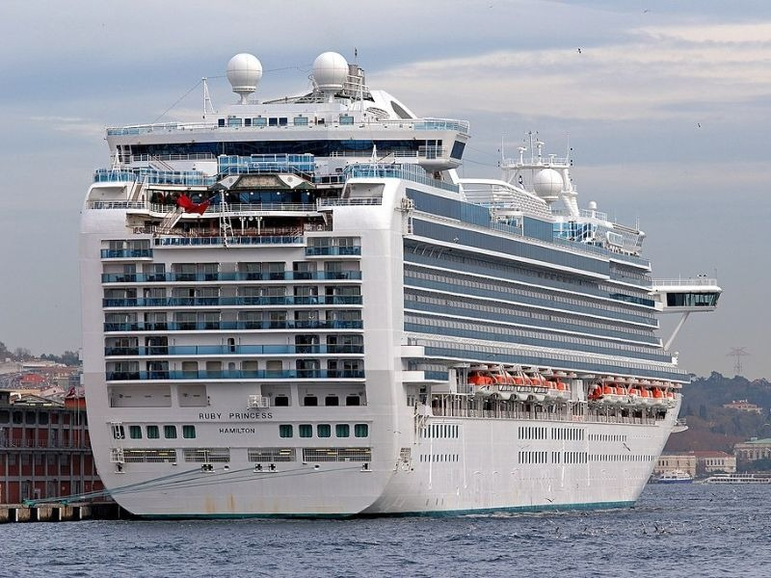
VOCABULARY
A CRUISE SHIP

Slide 26
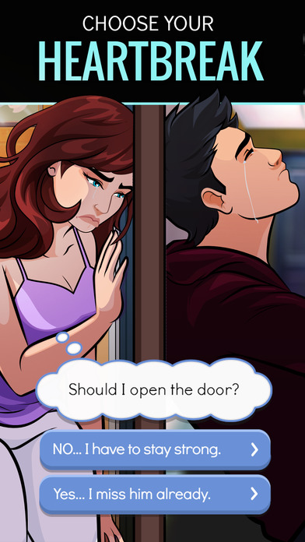
VOCABULARY
Episode (N): one part of a story that is broadcast on television or radio in several parts: TẬP PHIM

Slide 27
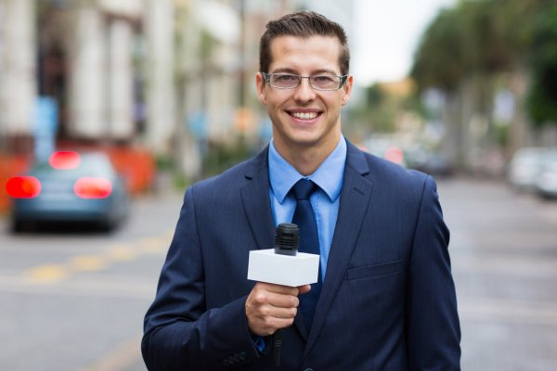

VOCABULARY
Reporter /rɪˈpɔːrtər/ (n): ​a person who collects and reports news for newspapers, radio or television

Slide 28
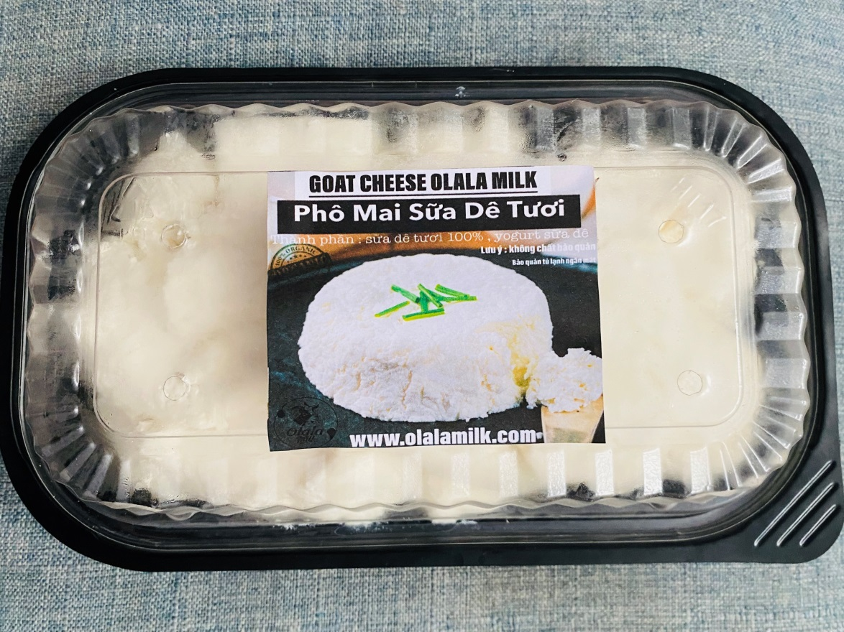
VOCABULARY
GOAT-MILK CHEESE

Slide 29
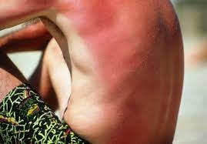
VOCABULARY
Sunburn /ˈsʌnbɜːn/ (n):the condition of having painful red skin because you have spent too much time in the sun

Slide 30
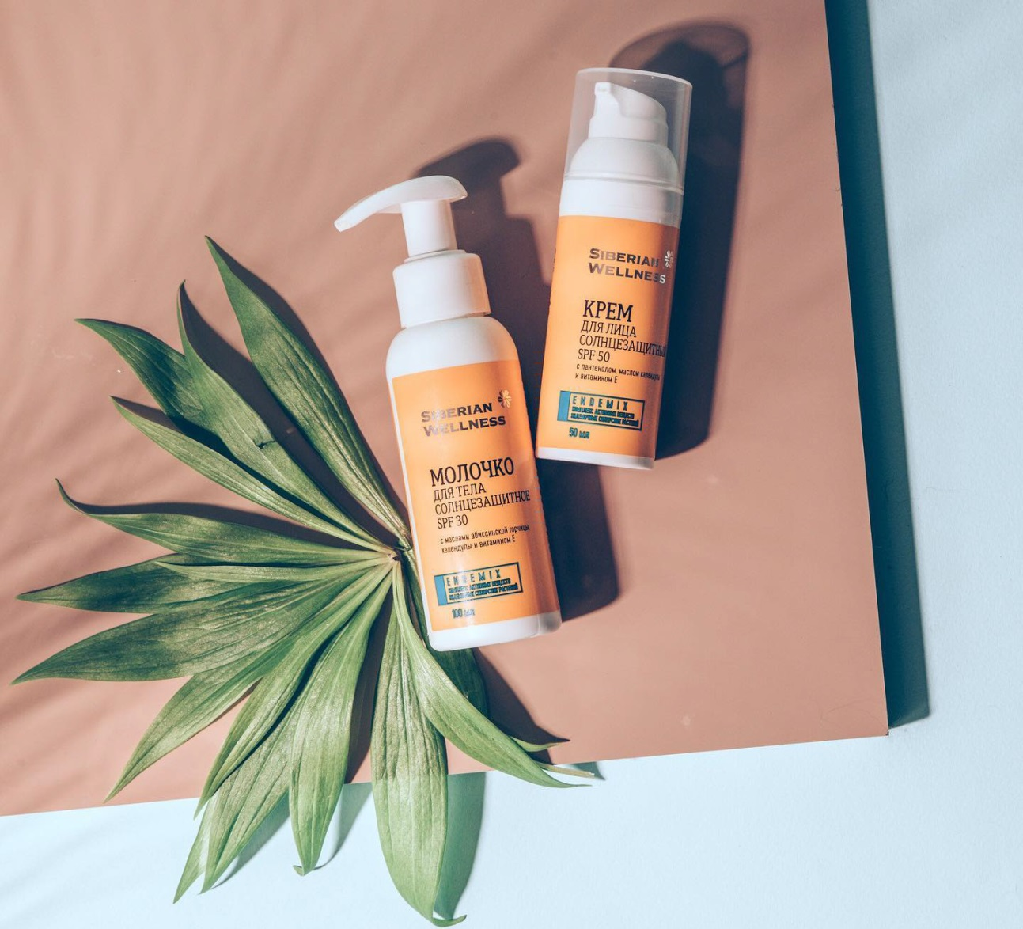
VOCABULARY
Sunscreen /ˈsʌnskriːn/
[countable, uncountable]
​a cream or liquid that you put on your skin to protect it from the harmful effects of the sun

Slide 31
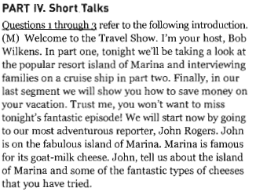
ANSWER: PART IV: SHORT TALKS
1/ (B)
On an island
2/ (A)
He is a reporter.
3/ (C)
Part 3

Slide 32
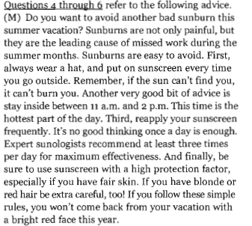
ANSWER: PART IV: SHORT TALKS
4/ (B) what to do
5/ (D) 11 a.m and 2 p.m
6/ (A) buying sunscreen

Slide 33
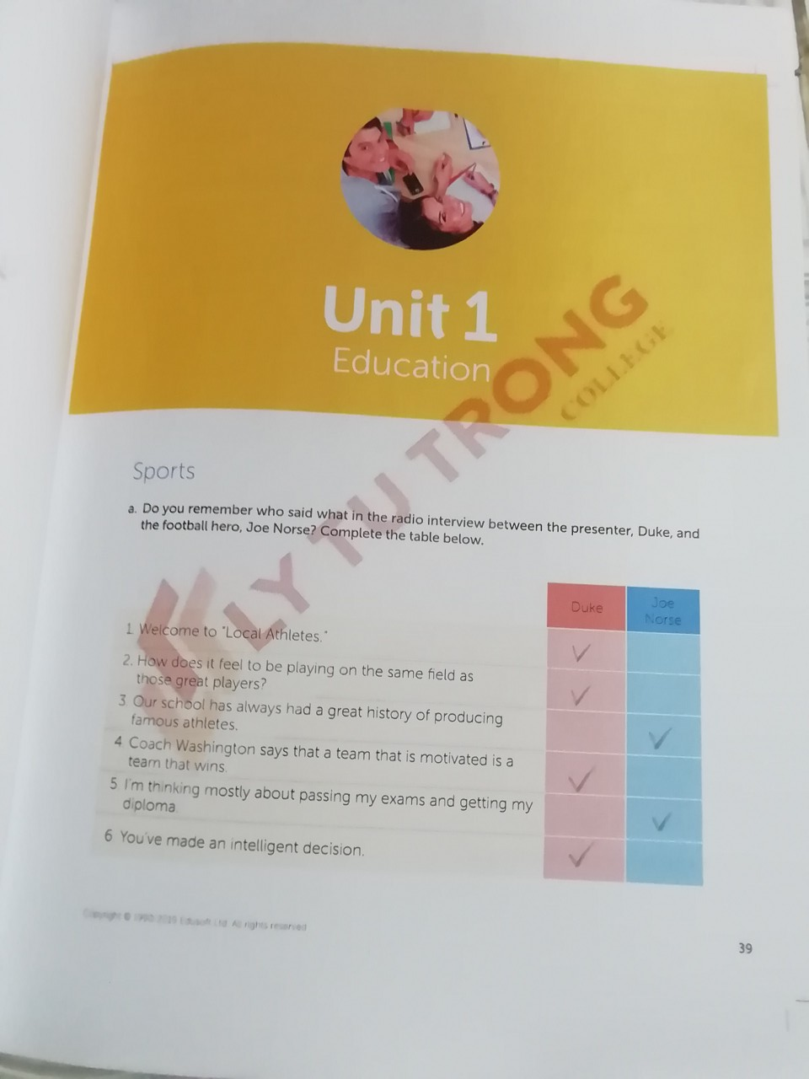
English Discoveries
Intermediate 1 Unit 1 Education
– Page 39

Slide 34
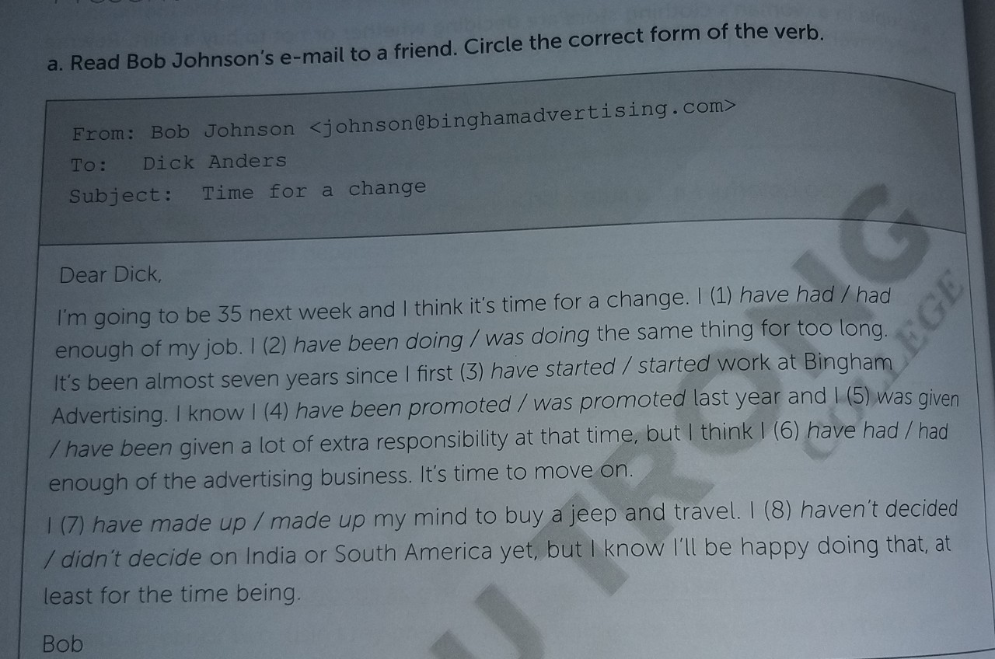
English Discoveries
Intermediate 1 Unit 6 At Work

Slide 35
English Discoveries
Intermediate 1 Unit 6 At Work
Answer Key a
Duke
Duke
Joe
Duke
Joe
Duke

Slide 36
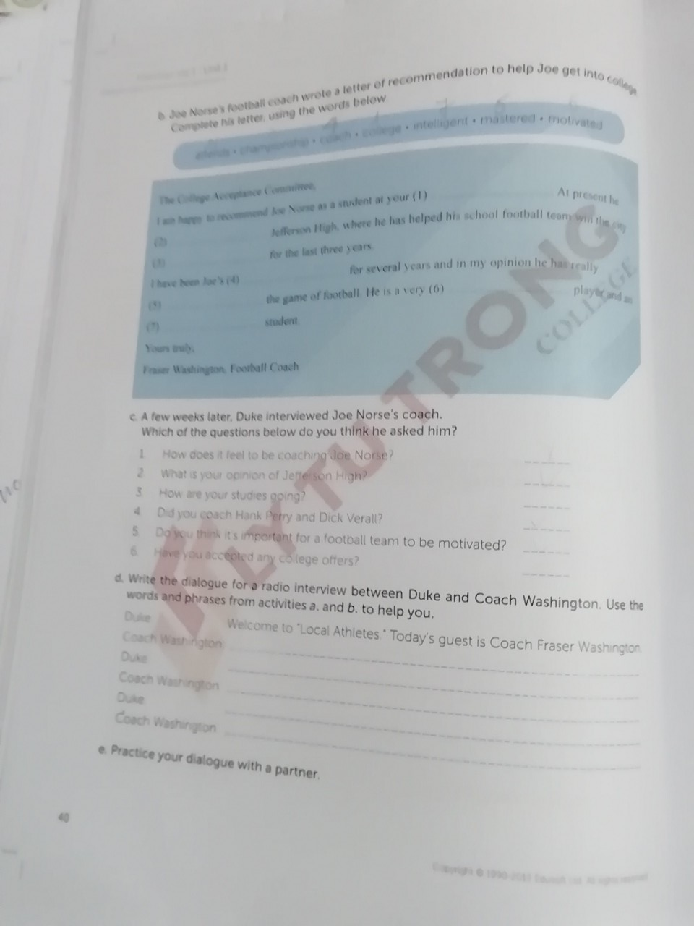
English Discoveries
Unit 1: Education page 40
Answer b:
1. college
2. attends
3. championship
4. coach
5. mastered
6. Motivated
7. Intelligent
Answer c:
1, 2,4,5

Slide 37
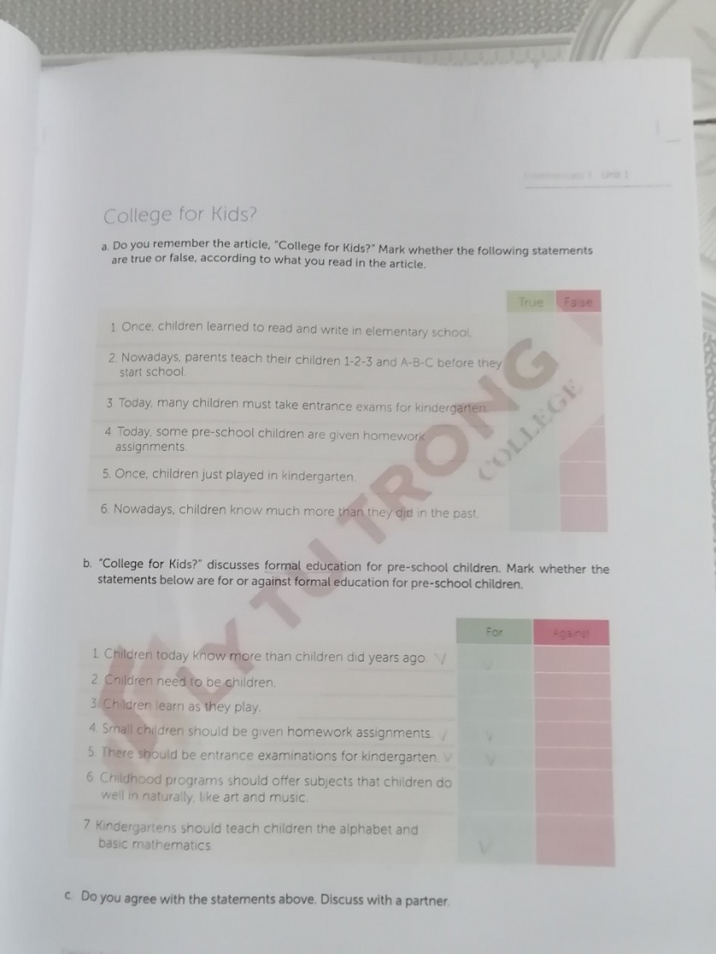
English Discoveries
Unit 1: Education page 41
Answer a:
True
True
False
True
True
True
Answer b:
For
Against
Against
For
For
Against
For

Slide 38
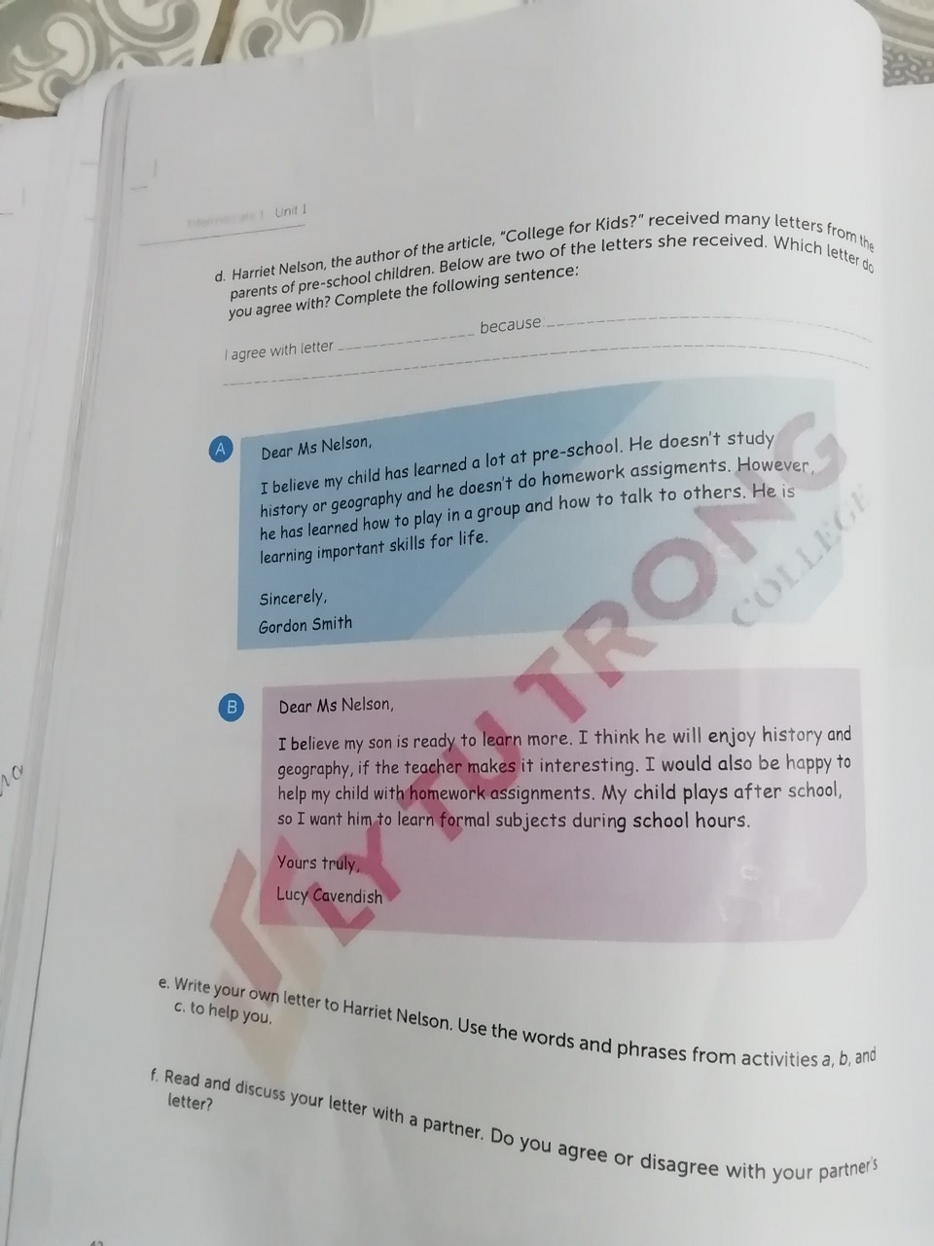
English Discoveries
Unit 1: Education page 42
Write a letter and then hand in

Slide 39
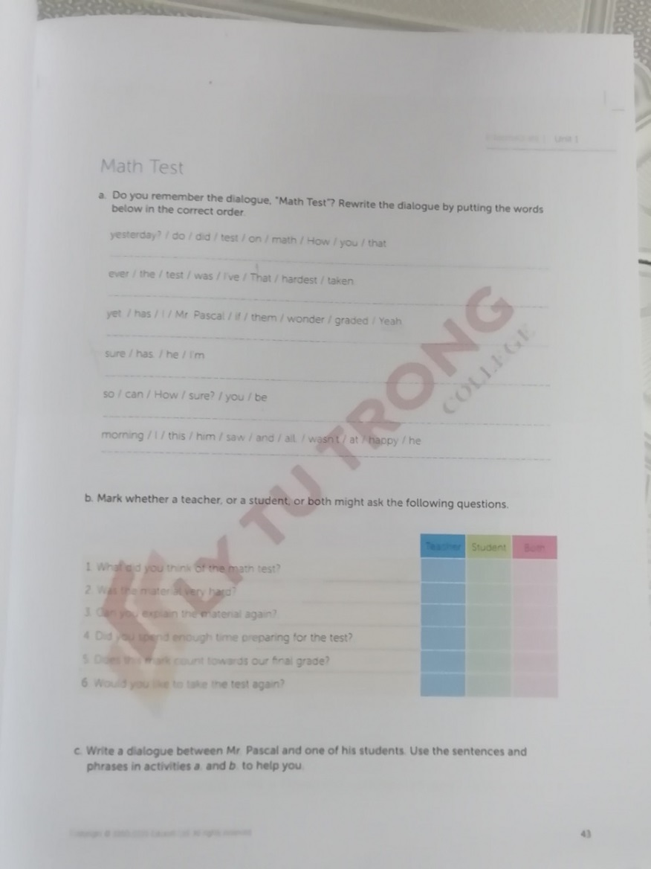
Unit 1: Education page 43
Answer a:
How did you do on that math test yesterday?
That was the hardest test I’ve ever taken.
Yeah. I wonder if Mr. Pascal has graded them yet.
I’m sure he has.
How can you be sure?
I saw him this morning and he wasn’t happy at all.

Slide 40
English Discoveries
Intermediate 1 Unit 1: Education
Answer Key b
both
Teacher
Student
Teacher
Student
Teacher

Slide 41
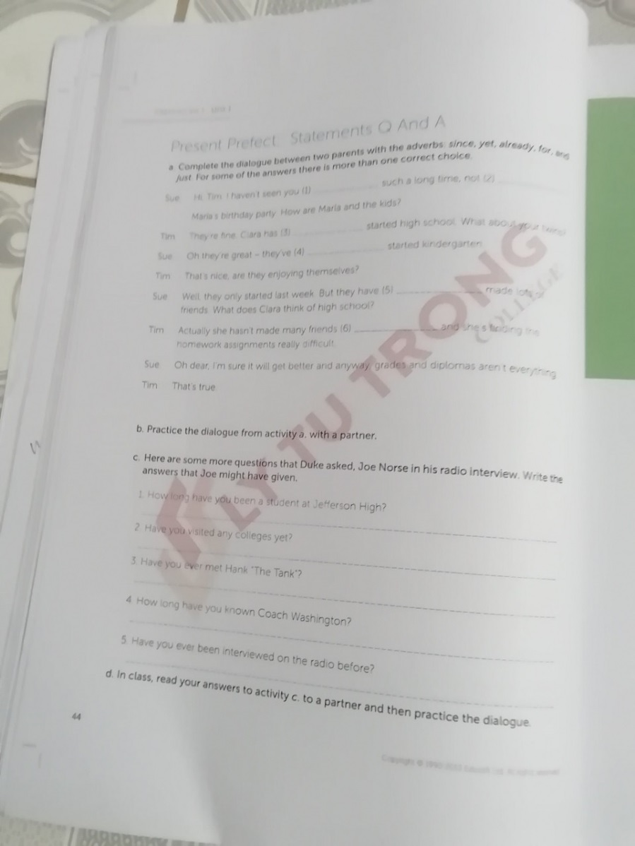
Unit 1: Education page 44
Answer a:
For
Since
Just/ already
Already/ just
Already
yet

Slide 42
Unit 1: Education page 44
Answer c:
I have been a student at Jefferson High for three years.
No, I’m concentrating on my exams.
Yes, I met him once at school reunion.
I have known Coach Washington for three years.
No, I have never been interviewed before.

Slide 43

Thank you very much
for your cooperation.

