Slide 1


Slide 2


Slide 3
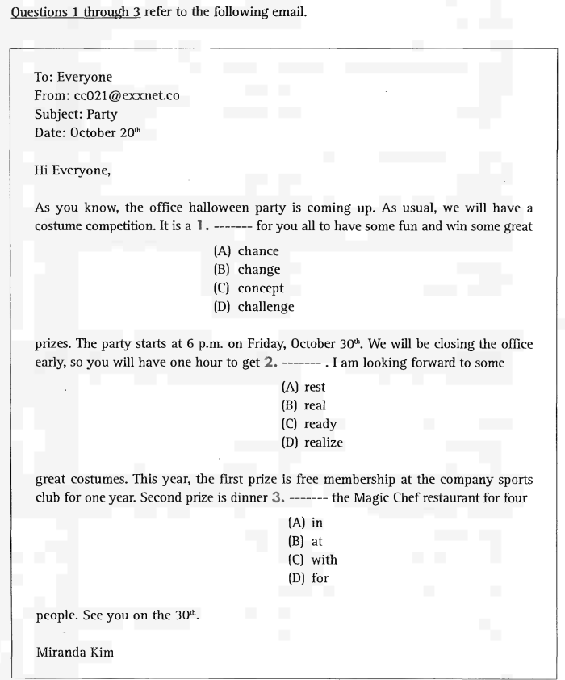
UNIT 7: NOUNS / PRONOUNS
Part 6 Incomplete Texts

Slide 4
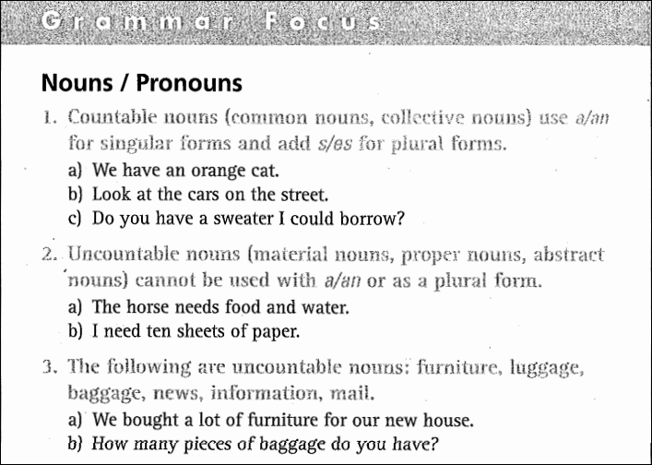

Slide 5
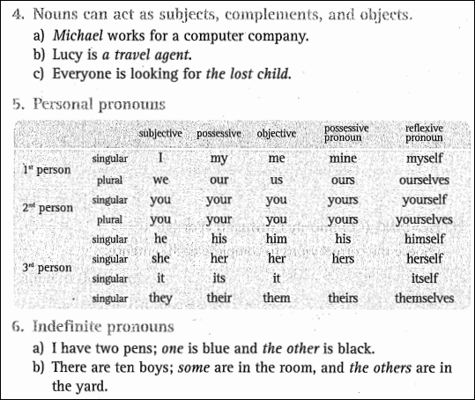

Slide 6
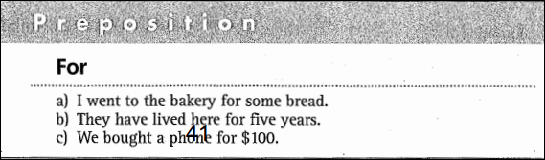

Slide 7
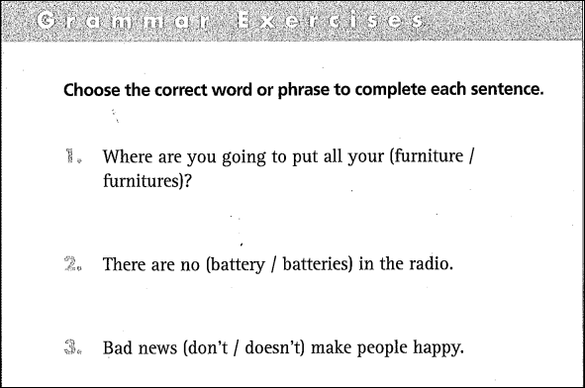
furniture
batteries
doesn’t

Slide 8
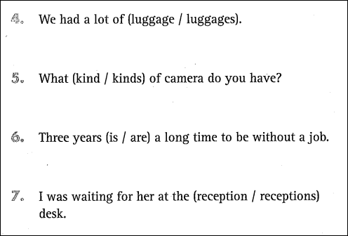
luggage
kind
is
reception

Slide 9
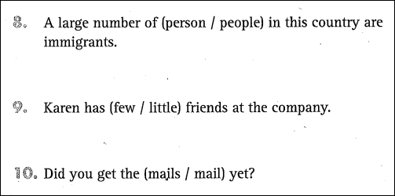
people
few
mail

Slide 10
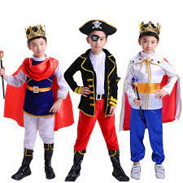
Part 6 Incomplete Texts
New words:
‘costume
quần áo, y phục, trang phục

Slide 11

Part 6 Incomplete Texts
New words:
competition
cuộc thi

Slide 12

Part 6 Incomplete Texts
New words
prize (n)

Slide 13
Part 6 Incomplete Texts
1. A. chance
2. C. ready
3. B. at

Slide 14
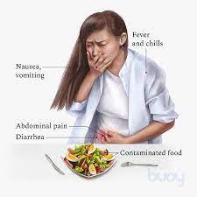
Part 6 Incomplete Texts
New words:
severe food
poisoning

Slide 15
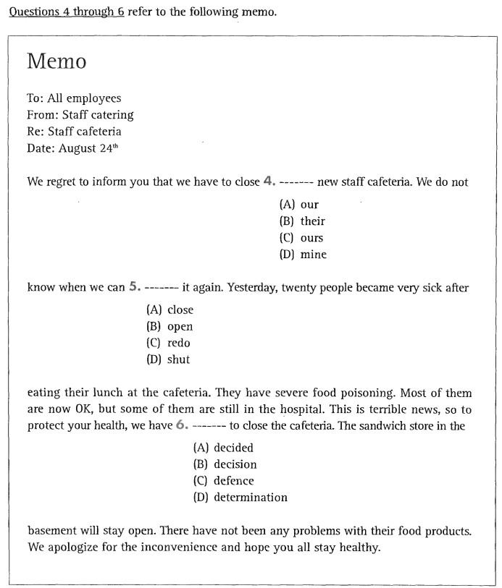
Part 6 Incomplete Texts
4. A. our
5. B. open
6. A. decided

Slide 16
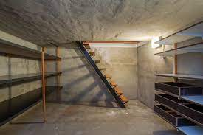
Part 6 Incomplete Texts
New words:
basement

Slide 17
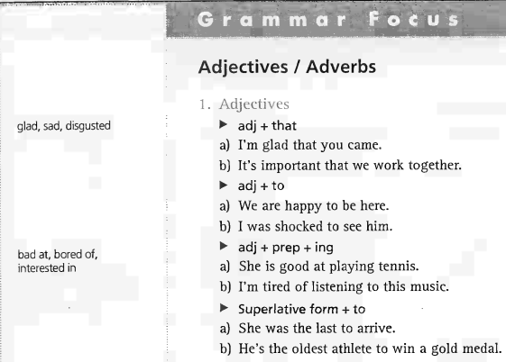
UNIT 8: Adjectives / Adverbs

Slide 18
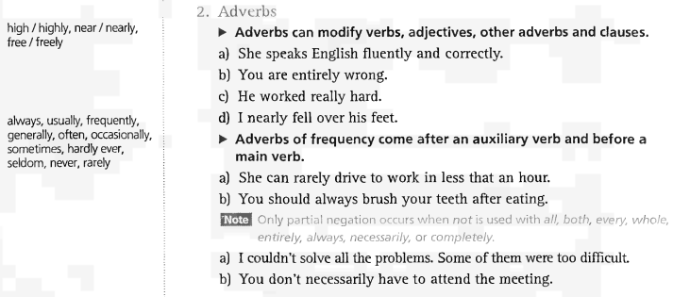

Slide 19
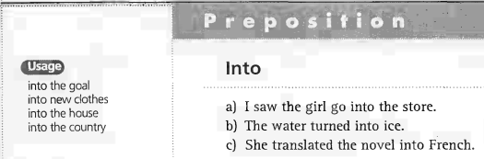

Slide 20
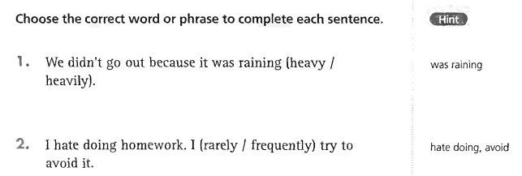
UNIT 8: Adjectives / Adverbs
Grammar Exercises
-> 1. heavily
-> 2. frequently

Slide 21
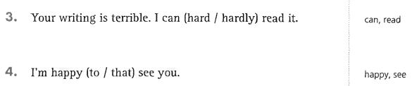
UNIT 8: Adjectives / Adverbs
Grammar Exercises
-> 3. hardly
-> 4. to

Slide 22
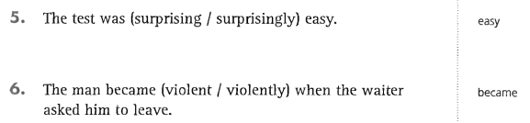
UNIT 8: Adjectives / Adverbs
Grammar Exercises
-> 5. surprisingly
-> 6. violent

Slide 23
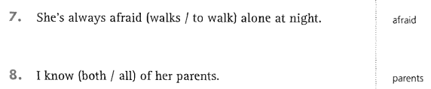
UNIT 8: Adjectives / Adverbs
Grammar Exercises
-> 7. to walk
-> 8. both

Slide 24
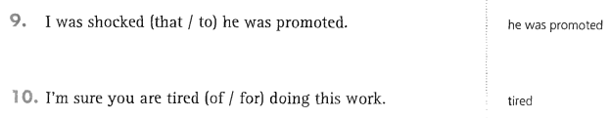
UNIT 8: Adjectives / Adverbs
Grammar Exercises
-> 9. that
-> 10. of

Slide 25
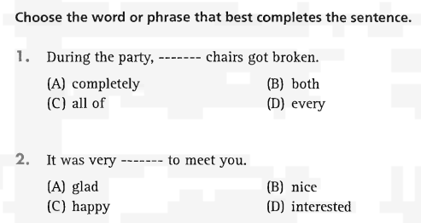
Part 5 Incomplete Sentences
-> 1. both
-> 2. nice

Slide 26
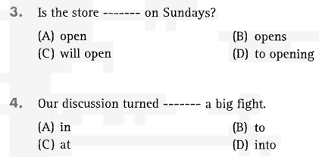
-> 3. open
-> 4. into

Slide 27
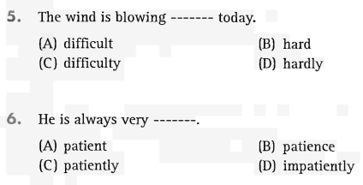
-> 5. hard
-> 6. patient

Slide 28
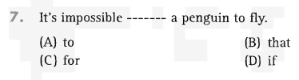
-> 7. for

Slide 29
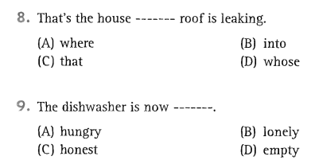
-> 8. whose
-> 9. empty

Slide 30
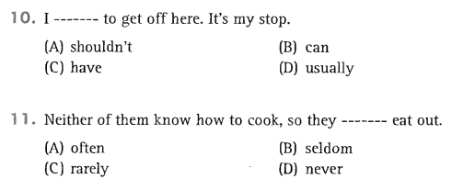
-> 10. have
-> 11. often

Slide 31
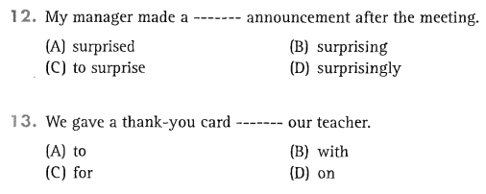
-> 12. surprising
-> 13. to

Slide 32
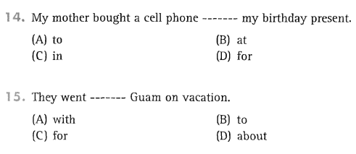
-> 14. for
-> 15. to

