Slide 1


Slide 2


Slide 3
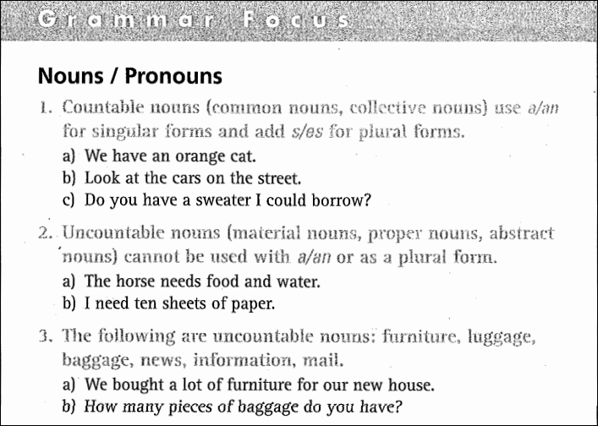

Slide 4
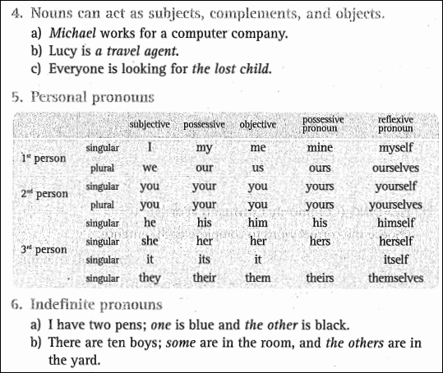

Slide 5
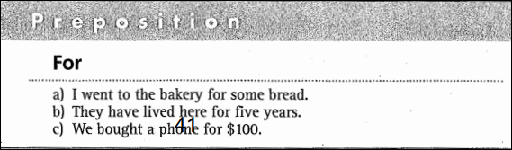

Slide 6
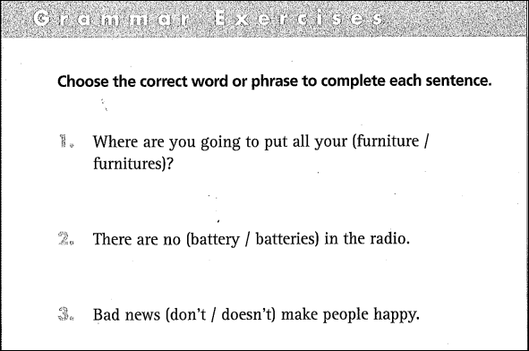
furniture
batteries
doesn’t

Slide 7
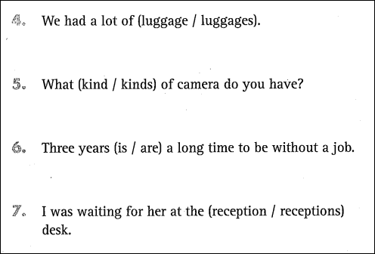
luggage
kind
is
reception

Slide 8
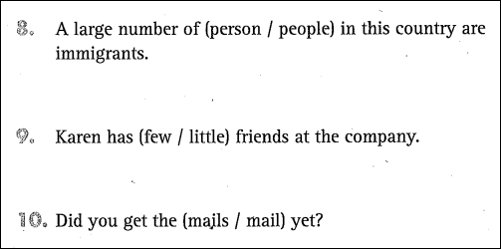
people
few
mail

Slide 9
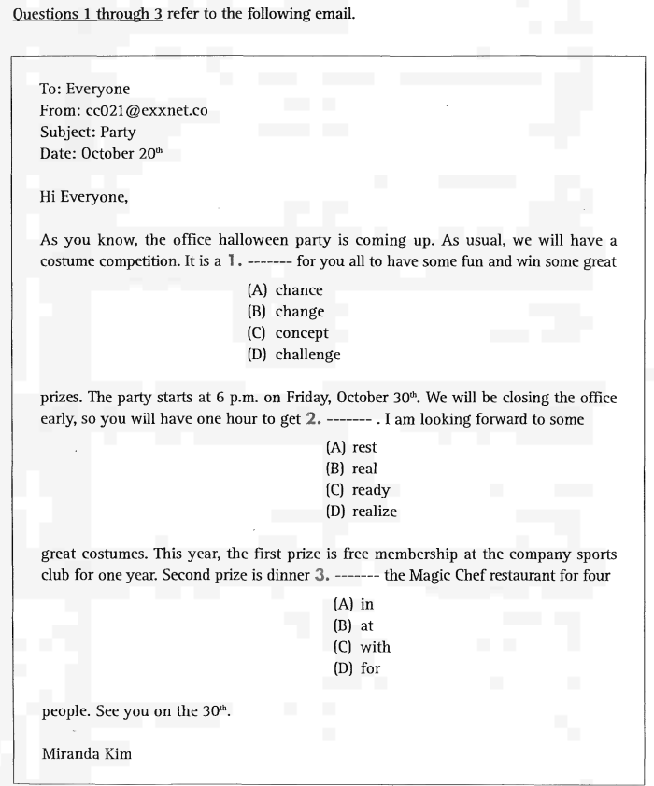
UNIT 7: NOUNS / PRONOUNS
Part 6 Incomplete Texts

Slide 10
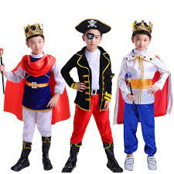
New words:
‘costume
quần áo, y phục, trang phục

Slide 11

Part 6 Incomplete Texts
New words:
competition
cuộc thi

Slide 12

Part 6 Incomplete Texts
New words
prize (n)

Slide 13
Part 6 Incomplete Texts
1. A. chance
2. C. ready
3. B. at

Slide 14
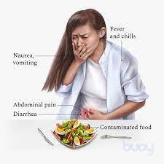
Part 6 Incomplete Texts
New words:
severe food
poisoning

Slide 15
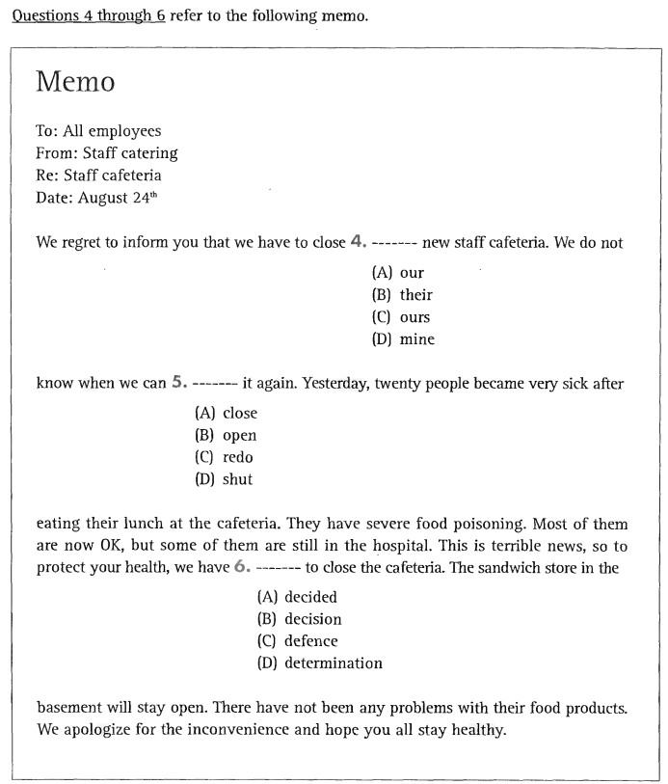
Part 6 Incomplete Texts
4. A. our
5. B. open
6. A. decided

Slide 16
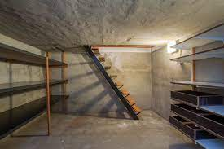
Part 6 Incomplete Texts
New words:
basement

