Slide 1
UNIT 8
Adjectives / Adverbs

Slide 2
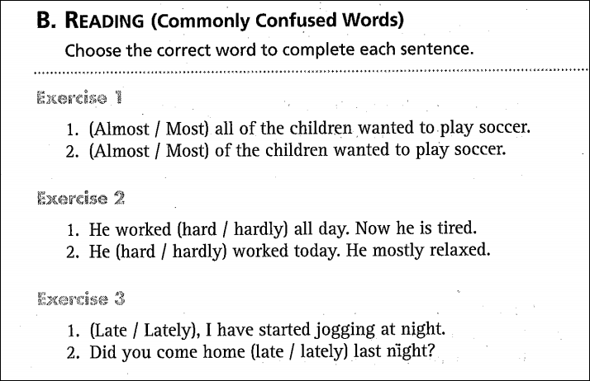
1. Almost
2. Most
1. hard
2. hardly
1. Lately
2. late

Slide 3
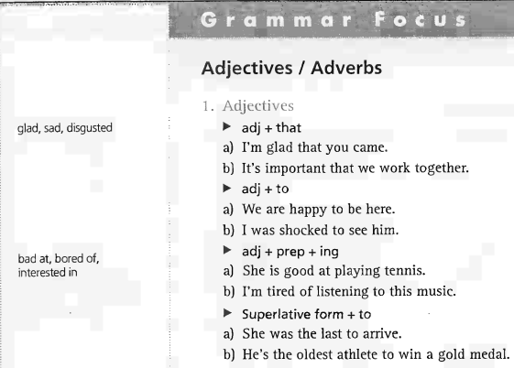
UNIT 8: Adjectives / Adverbs

Slide 4
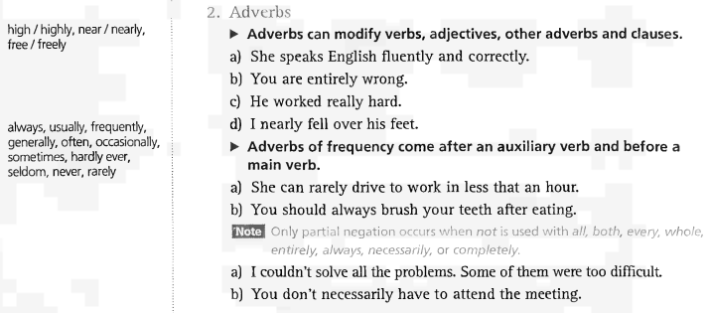

Slide 5
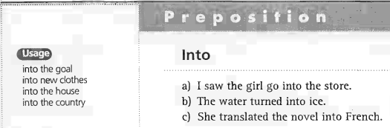

Slide 6
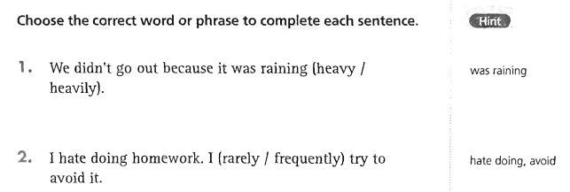
UNIT 8: Adjectives / Adverbs
Grammar Exercises
-> 1. heavily
-> 2. frequently

Slide 7
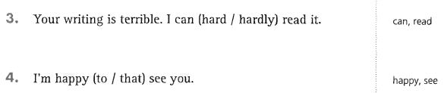
UNIT 8: Adjectives / Adverbs
Grammar Exercises
-> 3. hardly
-> 4. to

Slide 8
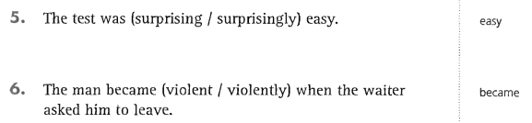
UNIT 8: Adjectives / Adverbs
Grammar Exercises
-> 5. surprisingly
-> 6. violent

Slide 9
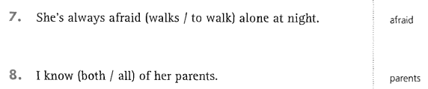
UNIT 8: Adjectives / Adverbs
Grammar Exercises
-> 7. to walk
-> 8. both

Slide 10
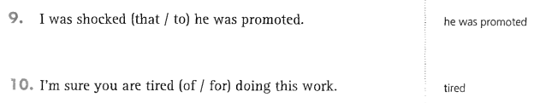
UNIT 8: Adjectives / Adverbs
Grammar Exercises
-> 9. that
-> 10. of

Slide 11
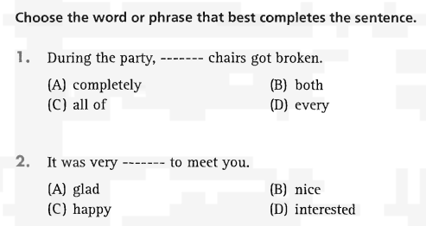
Part 5 Incomplete Sentences
-> 1. both
-> 2. nice

Slide 12
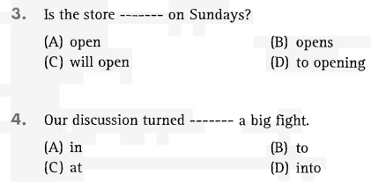
-> 3. open
-> 4. into

Slide 13
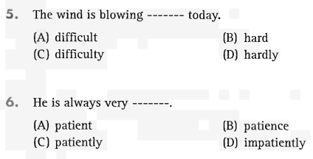
-> 5. hard
-> 6. patient

Slide 14
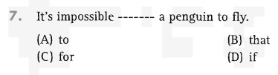
-> 7. for

Slide 15
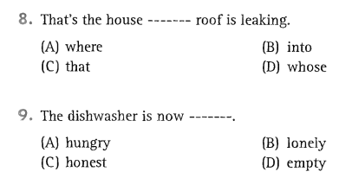
-> 8. whose
-> 9. empty

Slide 16
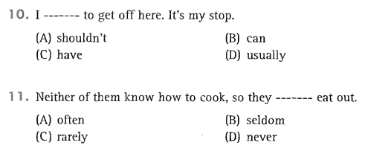
-> 10. have
-> 11. often

Slide 17
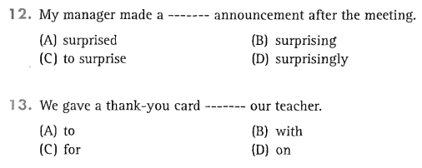
-> 12. surprising
-> 13. to

Slide 18
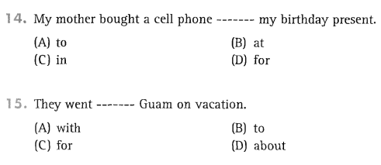
-> 14. for
-> 15. to

Slide 19
PART 6
INCOMPLETE TEXTS

Slide 20
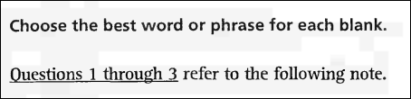
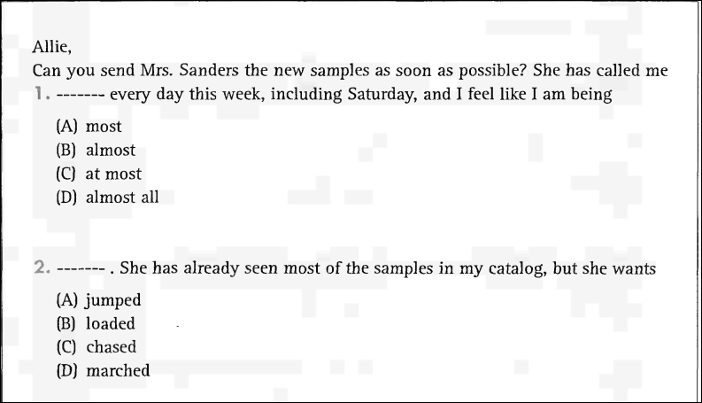

Slide 21
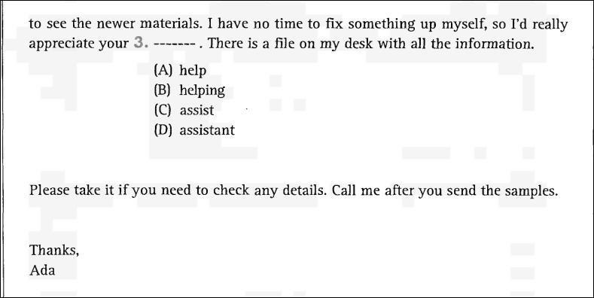

Slide 22

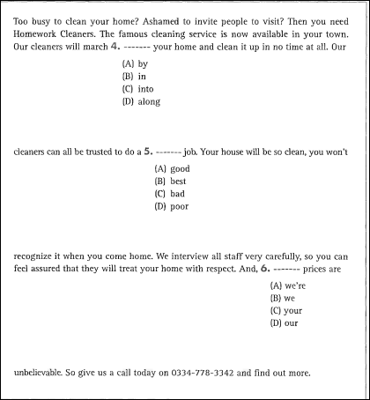

Slide 23
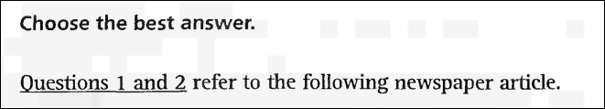
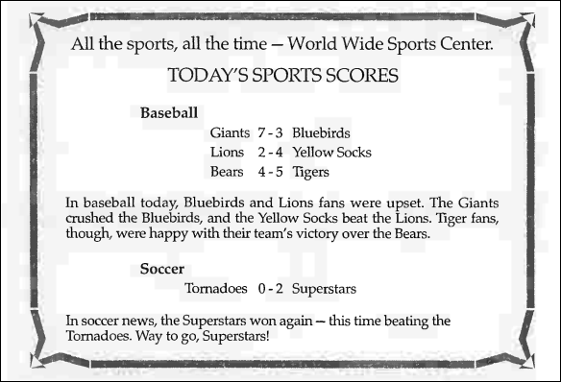
PART 7 : READING COMPREHENSION

Slide 24
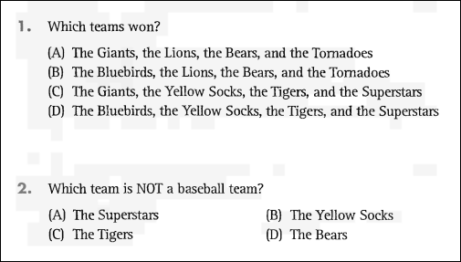
1. C
2. A

Slide 25
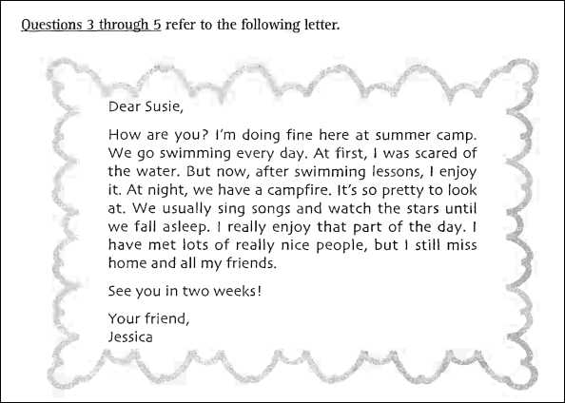

Slide 26
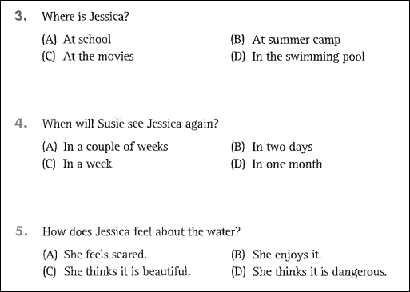
3. B
4. A
5. B

