Slide 1
UNIT 9
COMPARISON

Slide 2
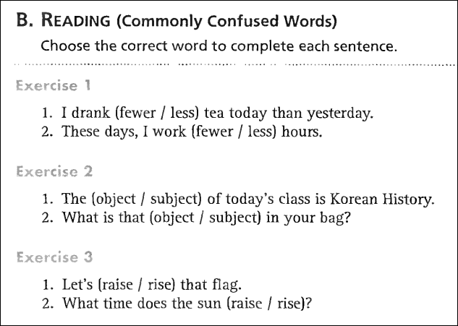
1. less
2. fewer
1. subject
2. obbject

Slide 3
Grammar Focus
Comparison

Slide 4
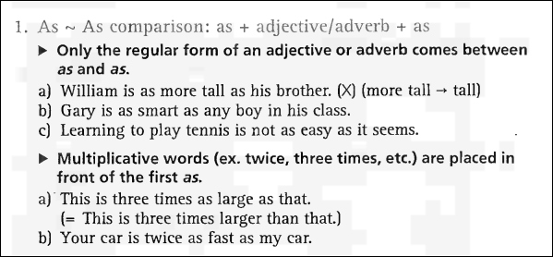

Slide 5
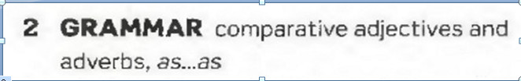
1. Equality
S + Be + As + ADJ + As + S (N/PRO) + (V)
Ex : Tom is as tall as Jerry.
S + V + As + ADV + As + S + (V)
Ex : Peter dances as well as Mary.

Slide 6
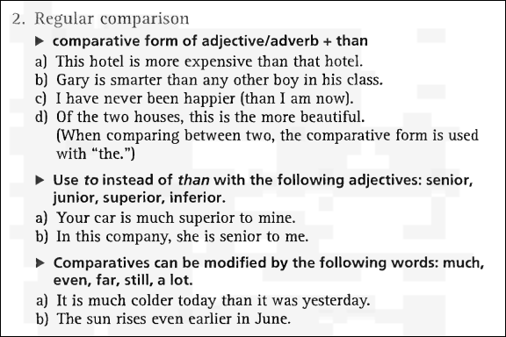

Slide 7
2. Comparative
a. Short Adjective
S + Be/ V + ADJ/ADV + er + than + …
Ex : Tom is taller than Mary.
b. Long Adjective
S + Be/ V + more + ADJ/ADV + than +…
Ex : Peter dances more beautifully than Mary.

Slide 8
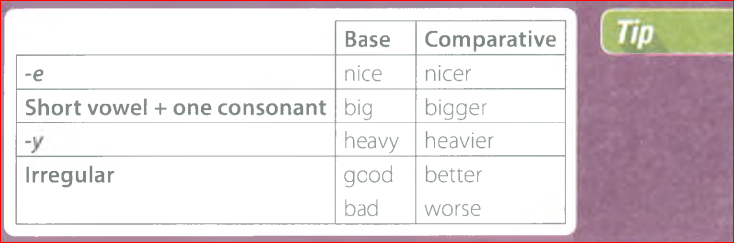

Slide 9
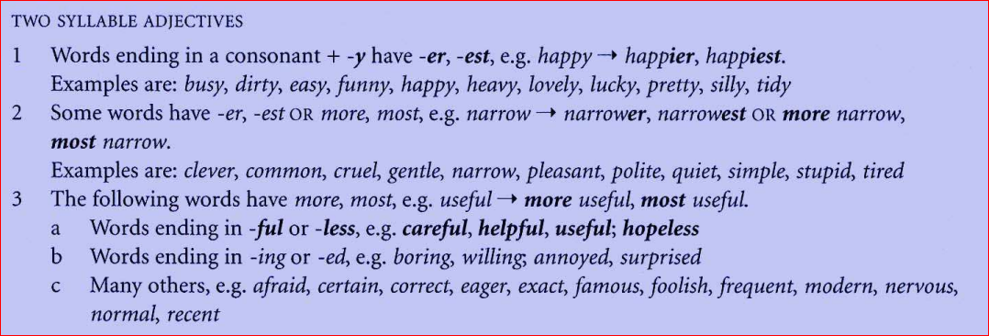

Slide 10
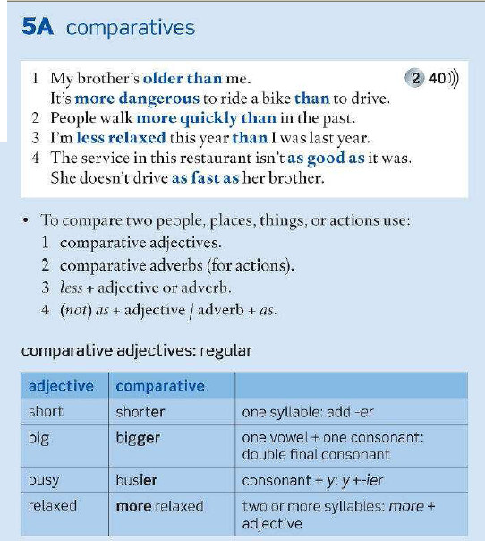

Slide 11
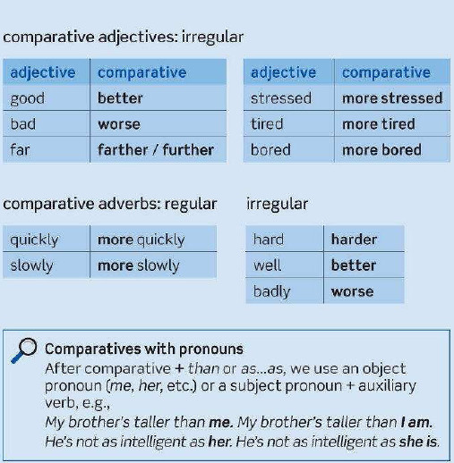

Slide 12
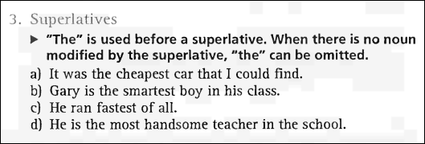

Slide 13
3. Superlative
a. Short Adjective
S + Be/ V + the + ADJ/ADV + est + N ..
Ex : Tom is the tallest boy in his class.
b. Long Adjective
S + Be/ V + the most + ADJ/ADV + N …
Ex : Peter draws the most beautifully in his family.

Slide 14


Slide 15

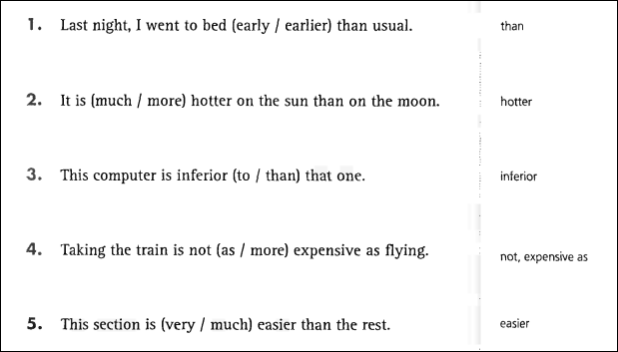
Grammar Exercises
1. earlier
2. much
3. to
4. as
5. much

Slide 16
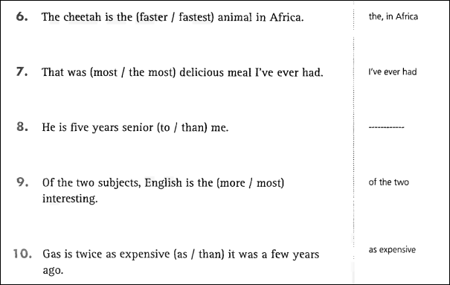
6. fastest
7. the most
8. to
9. more
10. as

Slide 17
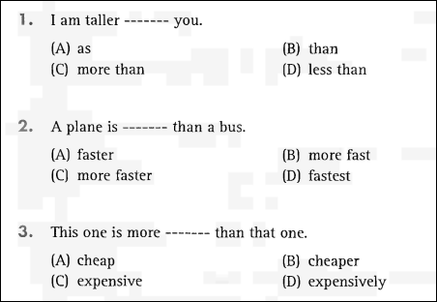
Part 5: INCOMPLETE SENTENCES
1. B
2. A
3. C

Slide 18
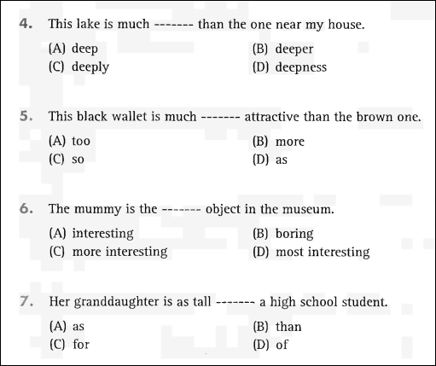
4. B
5. B
6. D
7. A

Slide 19
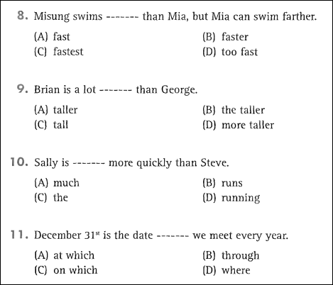
8. B
9. A
10. D
11. C

Slide 20
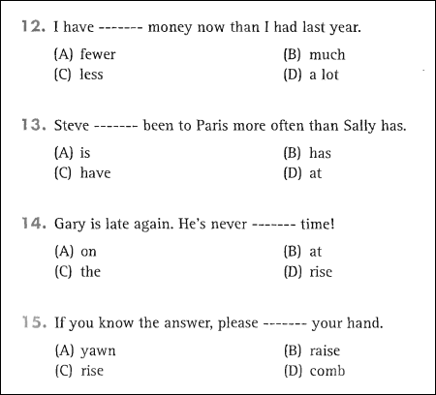
12. C
13. B
14. A
15. B

Slide 21

EXERCISE

Slide 22





Slide 23
PART 6: INCOMPLETE TEXTS

Slide 24

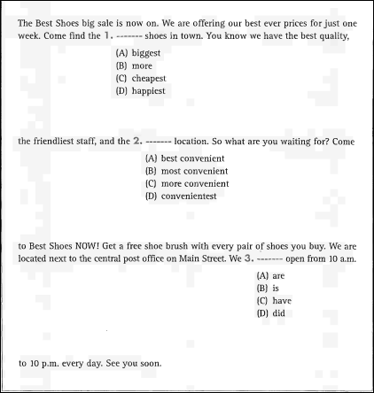
1. C
2. B
3. A

Slide 25
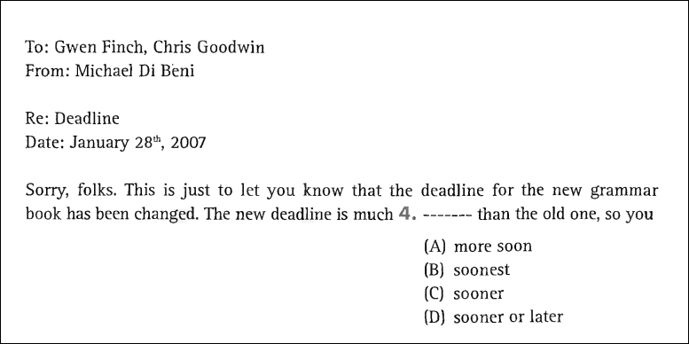
4. C

Slide 26
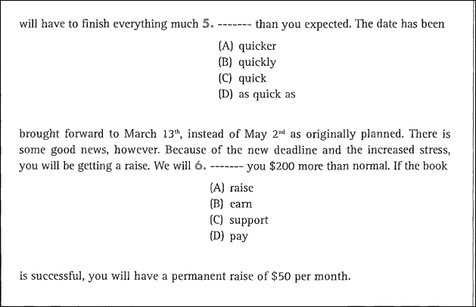
5. A
6. D

Slide 27

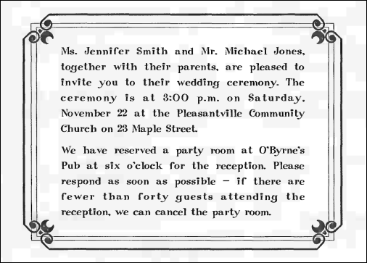
PART 7: READING COMPREHENSION

Slide 28
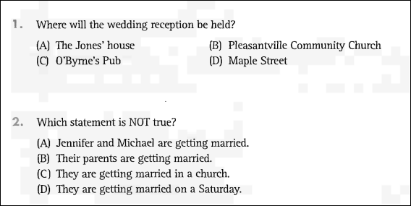
1. C
2. B

Slide 29
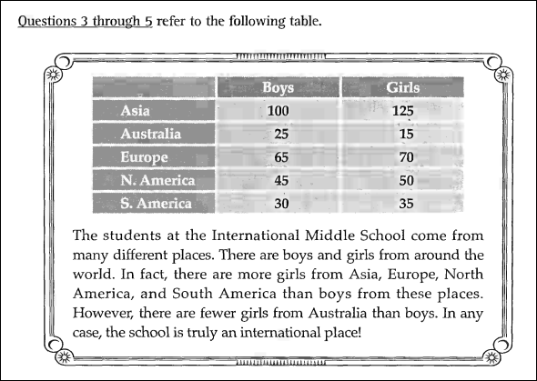

Slide 30
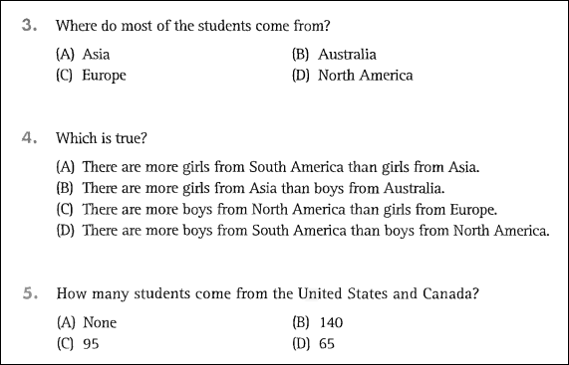
3. A
4. B
5. C

