Slide 1
UNIT 9
Modification and Word Order

Slide 2
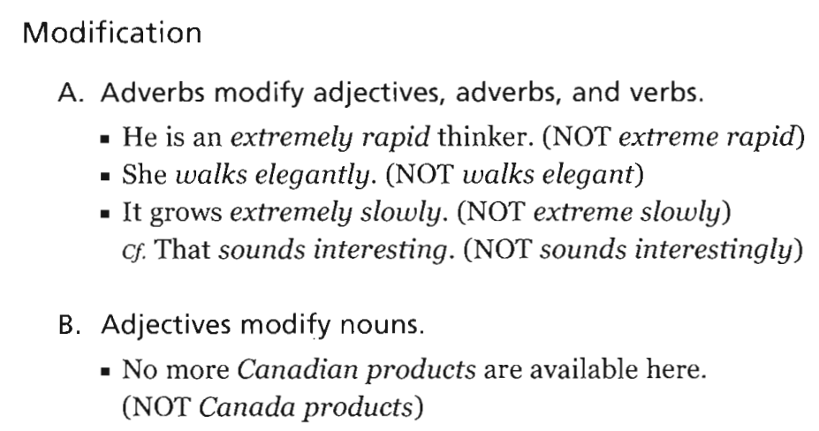
UNIT 9: Modification and Word Order

Slide 3
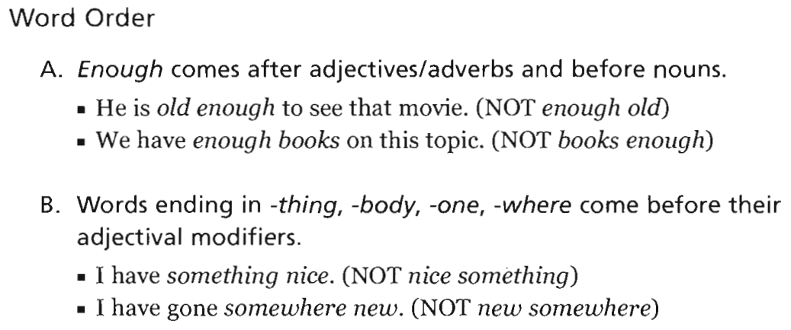
UNIT 9: Modification and Word Order

Slide 4
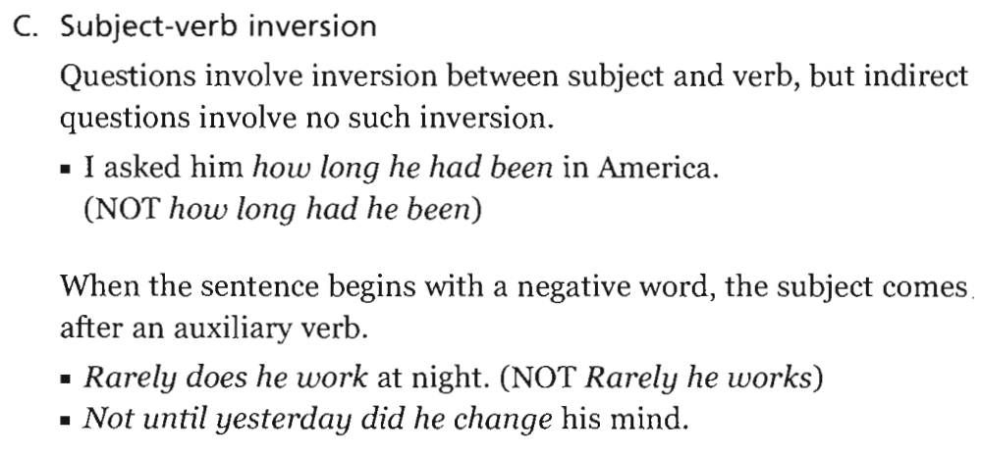
UNIT 9: Modification and Word Order

Slide 5
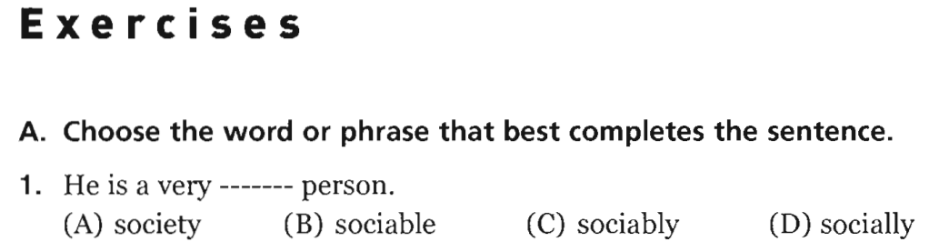
UNIT 9: Modification and Word Order
-> sociable

Slide 6
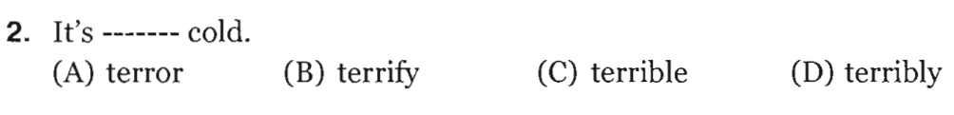
UNIT 9: Modification and Word Order
Exercises
-> terribly

Slide 7
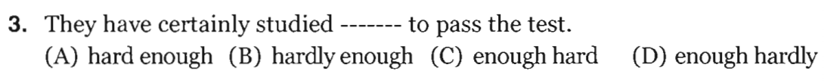
UNIT 9: Modification and Word Order
Exercises
-> hard enough

Slide 8
UNIT 9: Modification and Word Order
Exercises
-> anything new

Slide 9
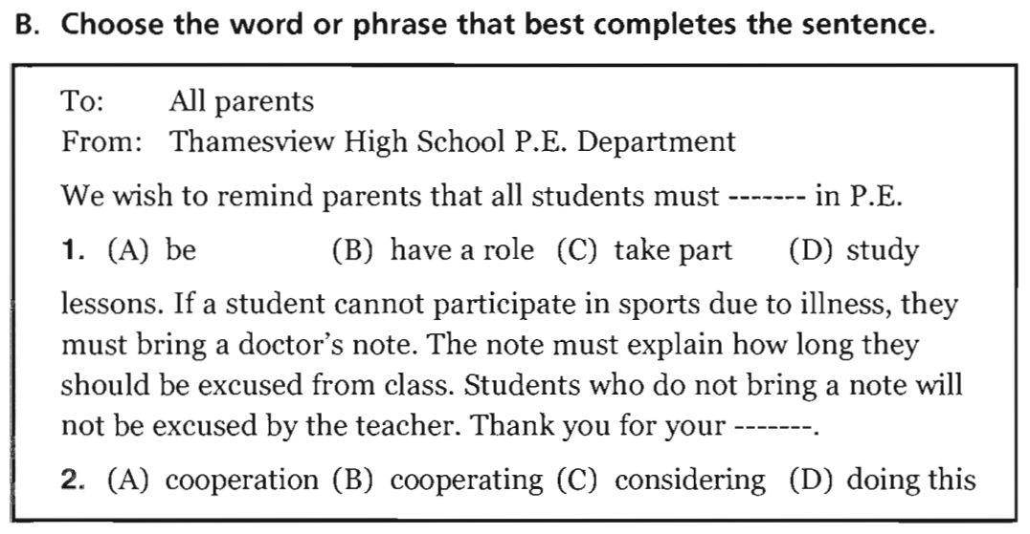
UNIT 9: Modification and Word Order
Exercises

Slide 10
-> 1. take part
-> 2. cooperation

Slide 11
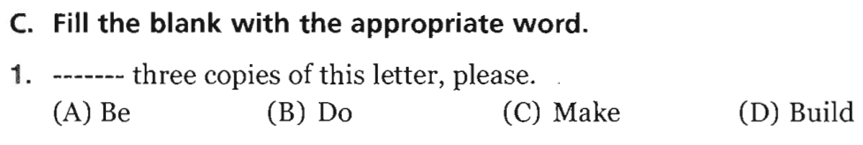
UNIT 9: Modification and Word Order
Exercises
-> Make

Slide 12
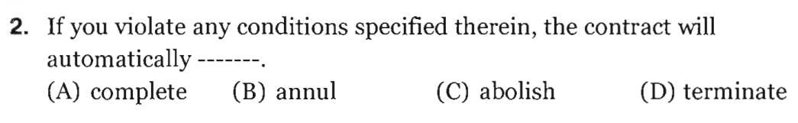
UNIT 9: Modification and Word Order
Exercises
-> terminate

Slide 13
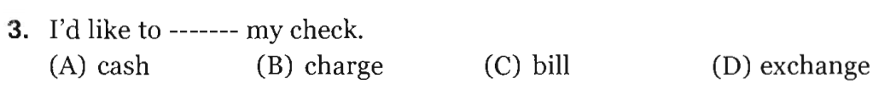
UNIT 9: Modification and Word Order
Exercises
-> cash

Slide 14
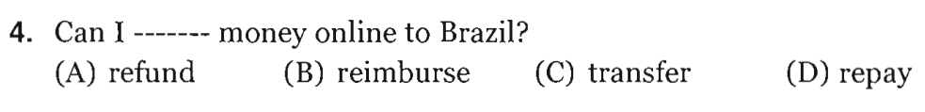
UNIT 9: Modification and Word Order
Exercises
-> transfer

Slide 15
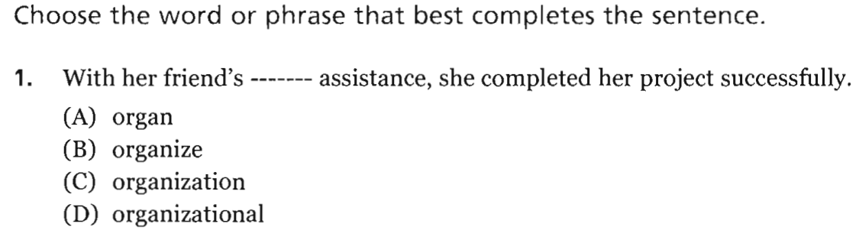
UNIT 9: Modification and Word Order
PART V Incomplete Sentences
-> organizational

Slide 16
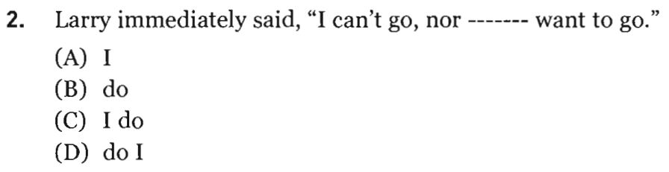
UNIT 9: Modification and Word Order
PART V Incomplete Sentences
-> do I

Slide 17
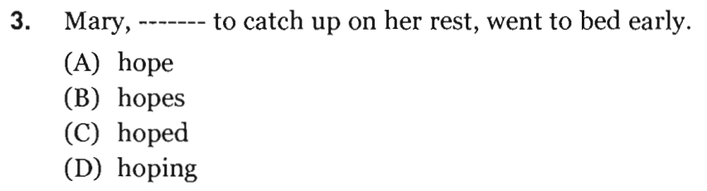
UNIT 9: Modification and Word Order
PART V Incomplete Sentences
-> hoping

Slide 18
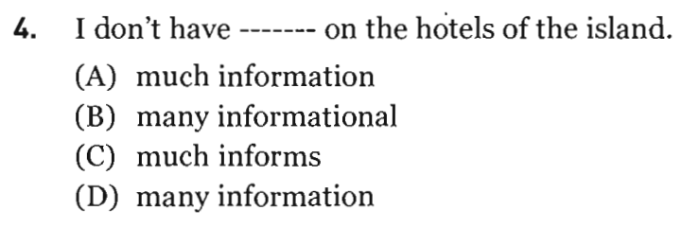
UNIT 9: Modification and Word Order
PART V Incomplete Sentences
-> much information

Slide 19
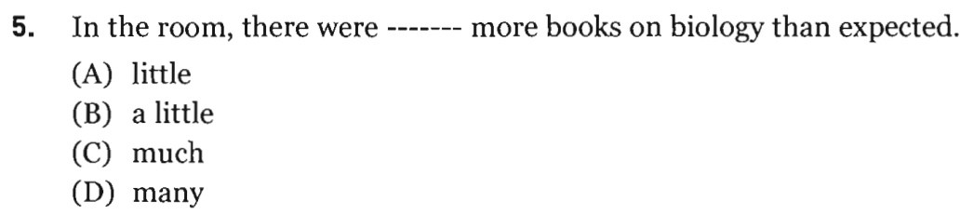
UNIT 9: Modification and Word Order
PART V Incomplete Sentences
-> many

Slide 20
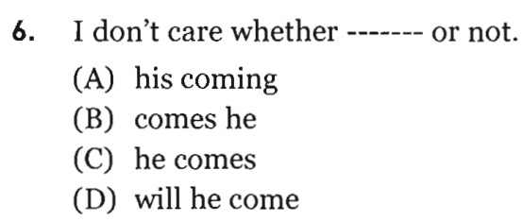
UNIT 9: Modification and Word Order
PART V Incomplete Sentences
-> he comes

Slide 21
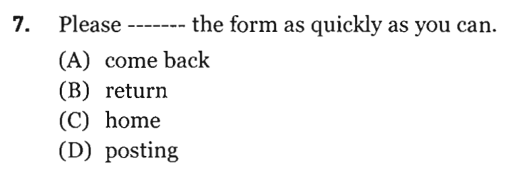
UNIT 9: Modification and Word Order
PART V Incomplete Sentences
-> return

Slide 22
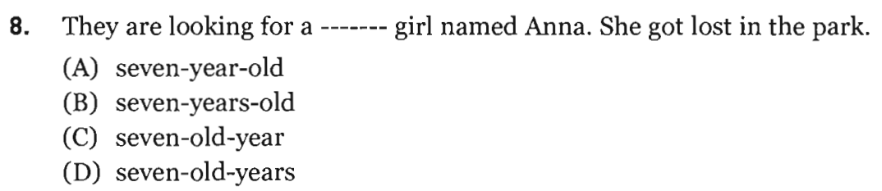
UNIT 9: Modification and Word Order
PART V Incomplete Sentences
-> seven-year-old

Slide 23
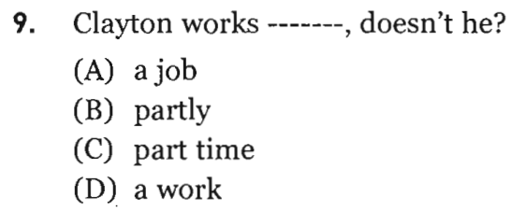
UNIT 9: Modification and Word Order
PART V Incomplete Sentences
-> part time

Slide 24
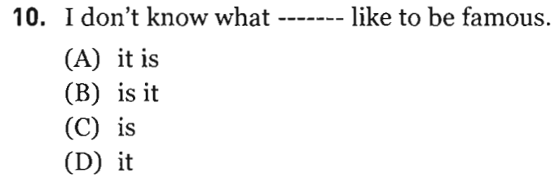
UNIT 9: Modification and Word Order
PART V Incomplete Sentences
-> it is

Slide 25
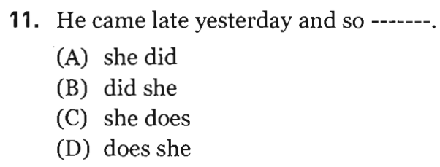
UNIT 9: Modification and Word Order
PART V Incomplete Sentences
-> did she

Slide 26
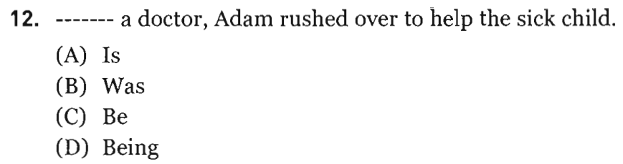
UNIT 9: Modification and Word Order
PART V Incomplete Sentences
-> Being

Slide 27
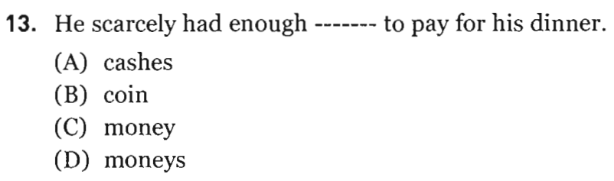
UNIT 9: Modification and Word Order
PART V Incomplete Sentences
-> money

Slide 28
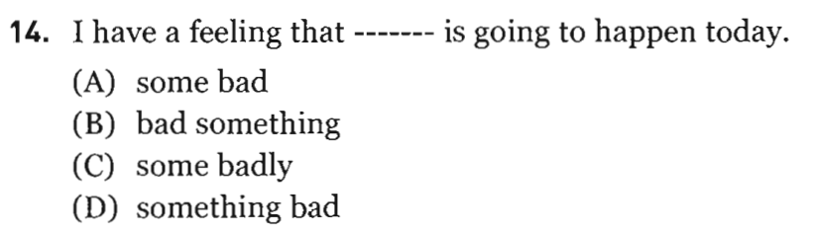
UNIT 9: Modification and Word Order
PART V Incomplete Sentences
-> something bad

Slide 29
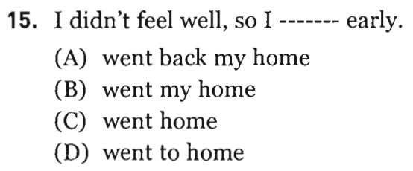
UNIT 9: Modification and Word Order
PART V Incomplete Sentences
-> went home

Slide 30
PART VI
INCOMPLETE TEXTS

Slide 31
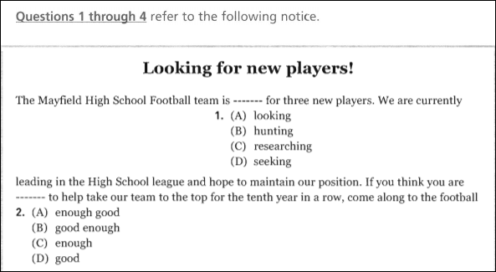
1. A
2. B

Slide 32
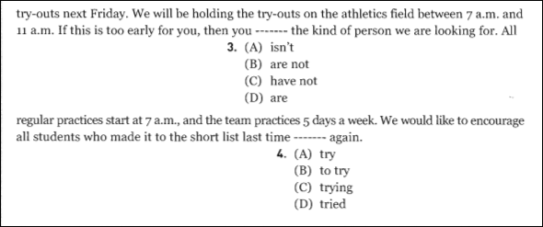
3. B
4. A

Slide 33
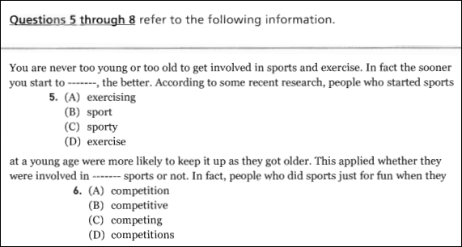
5. D
6. B

Slide 34
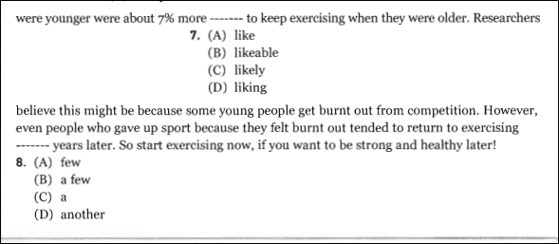
7. C
8. B

Slide 35
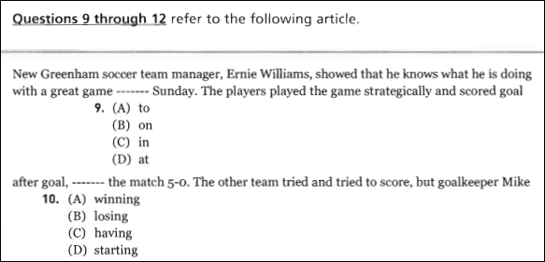
9. B
10. A

Slide 36
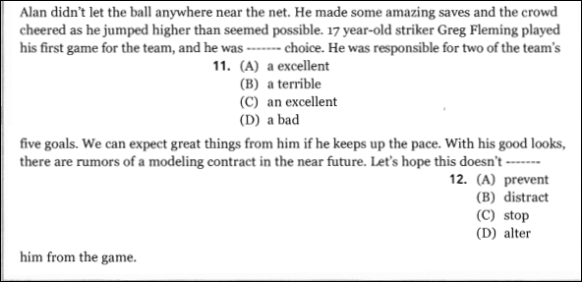
11. C
12. B

Slide 37
PART VII
READING COMPREHENSION

Slide 38
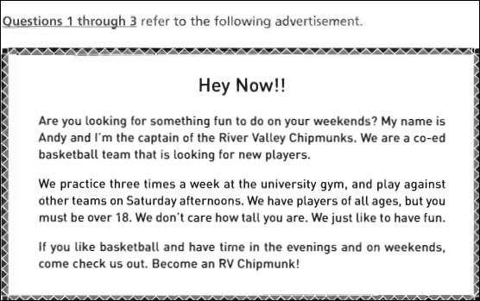

Slide 39
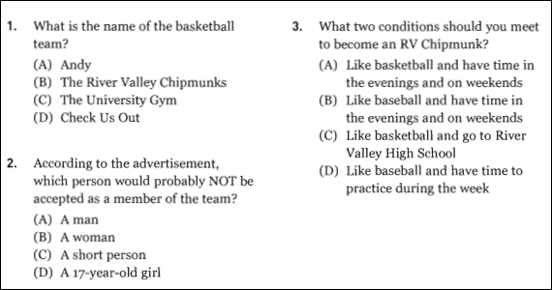
1. B
2. D
3. A

Slide 40
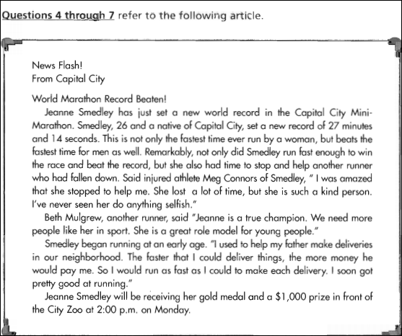

Slide 41
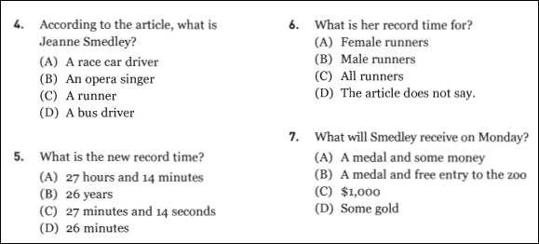
4. C
5. C
6. C
7. A

Slide 44
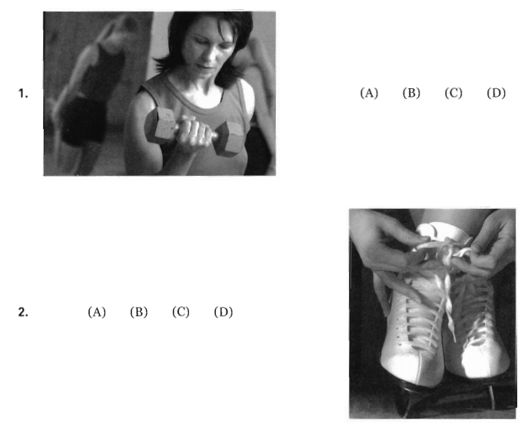
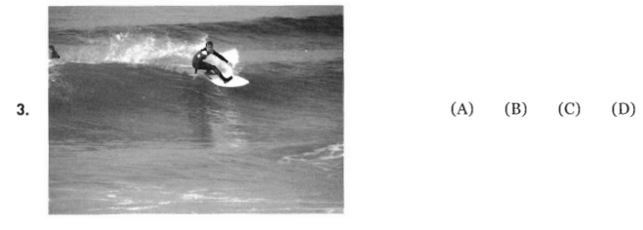
UNIT 9: Modification and Word Order
PART I Picture Description

Slide 45
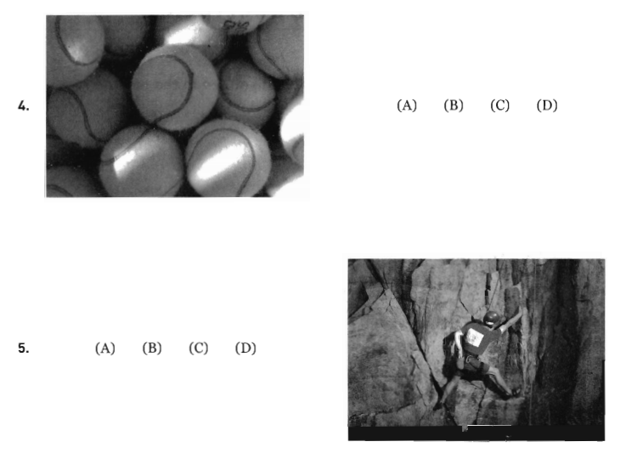
UNIT 9: Modification and Word Order
PART I Picture Description

Slide 46

UNIT 9: Modification and Word Order
PART I Picture Description
New words:
1. weight-lifting

Slide 47
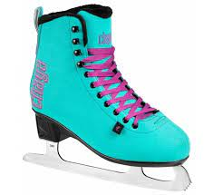
UNIT 9: Modification and Word Order
PART I Picture Description
New words:
2. ice-skates

Slide 48
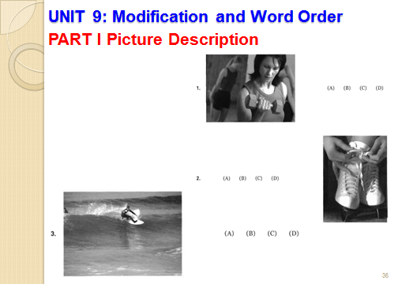


Slide 49
UNIT 9: Modification and Word Order
PART I Picture Description

Slide 50
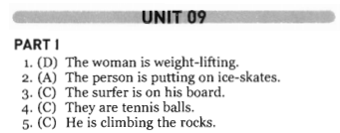
UNIT 9: Modification and Word Order
PART I Picture Description
Answer Key

Slide 51
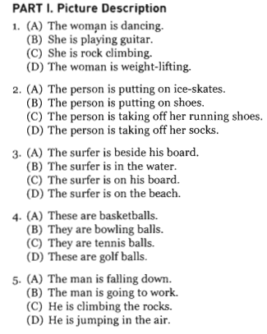
UNIT 9: Modification and Word Order
PART I Picture Description
Transcripts

Slide 52
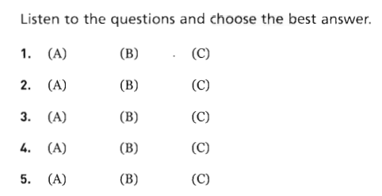
UNIT 9: Modification and Word Order
PART II Questions and Responses

Slide 53

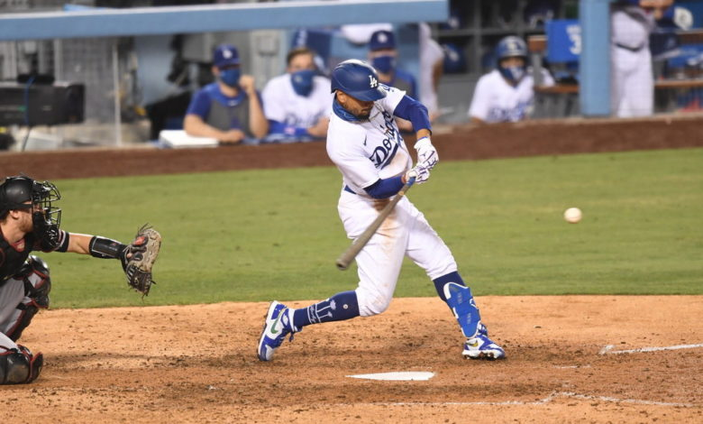
UNIT 9: Modification and Word Order
PART II Questions and Responses
1. baseball game

Slide 54

UNIT 9: Modification and Word Order
PART II Questions and Responses
2. ski

Slide 55
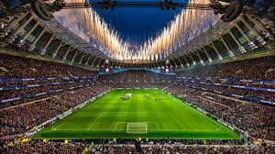
UNIT 9: Modification and Word Order
PART II Questions and Responses
3. stadium

Slide 56
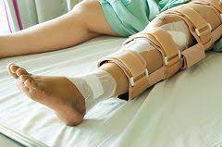
UNIT 9: Modification and Word Order
PART II Questions and Responses
4. injure your leg

Slide 57
UNIT 9: Modification and Word Order
PART II Questions and Responses

Slide 58
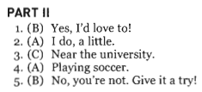
UNIT 9: Modification and Word Order
PART II Questions and Responses
Answer Key

Slide 59
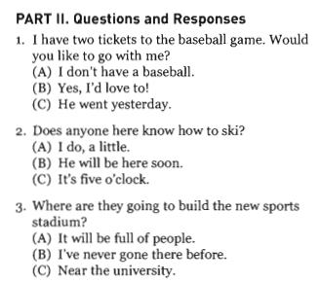
UNIT 9: Modification and Word Order
PART II Questions and Responses
Transcripts

Slide 60
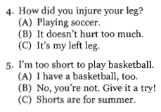
UNIT 9: Modification and Word Order
PART II Questions and Responses
Transcripts

Slide 61
English Discoveries
Intermediate 1 Unit 6 At Work

Slide 62

English Discoveries
Intermediate 1 Unit 6 At Work – Page 78

Slide 63

English Discoveries
Intermediate 1 Unit 6 At Work

Slide 64
English Discoveries
Intermediate 1 Unit 6 At Work
Answer Key a
have had
have been doing
started
was promoted
was given
have had
have made up
haven’t decided

Slide 65

English Discoveries
Intermediate 1 Unit 6 At Work

Slide 66
English Discoveries
Intermediate 1 Unit 6 At Work
Answer Key b
want
have been working / have worked
have gained
have put in
used
told

Slide 67

Thank you very much
for your cooperation.

