Slide 1
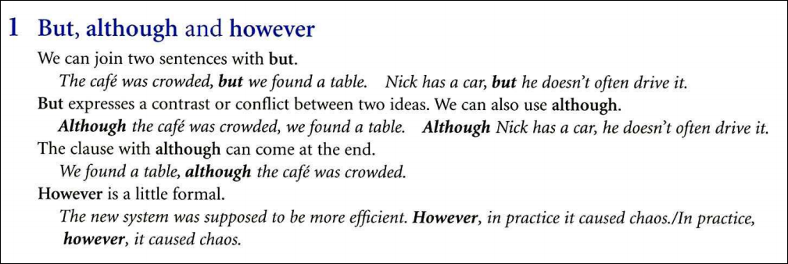

Slide 2
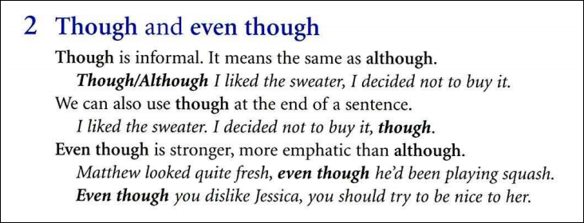

Slide 3


Slide 4


Slide 5


Slide 6


Although
in spite of
Although
in spite of
in spite of

Slide 7

3. though
1. despite
in spite of
in spite of
but
/although
Even though
4. although/ though

Slide 8
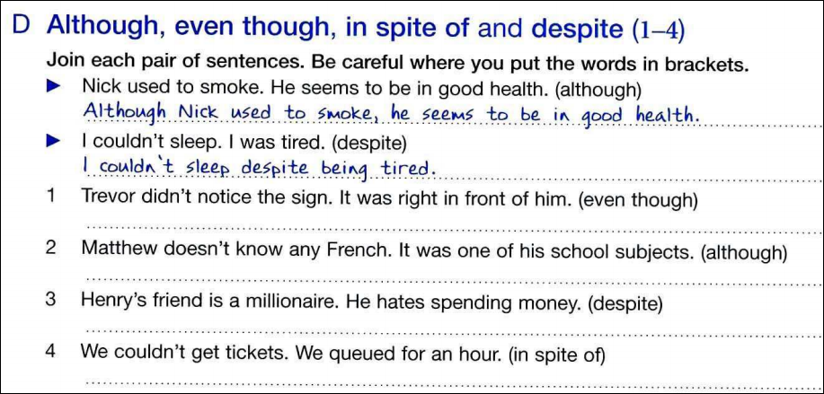





Slide 9


Slide 10

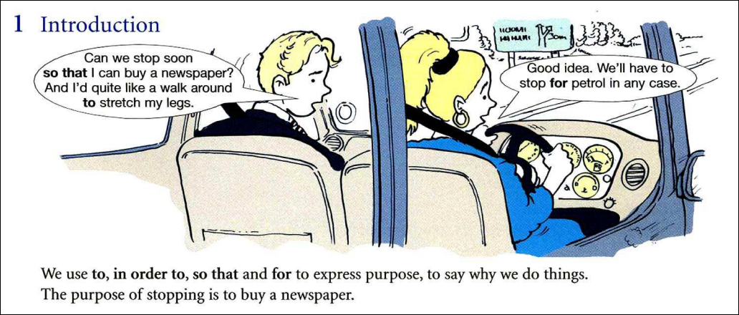

Slide 11
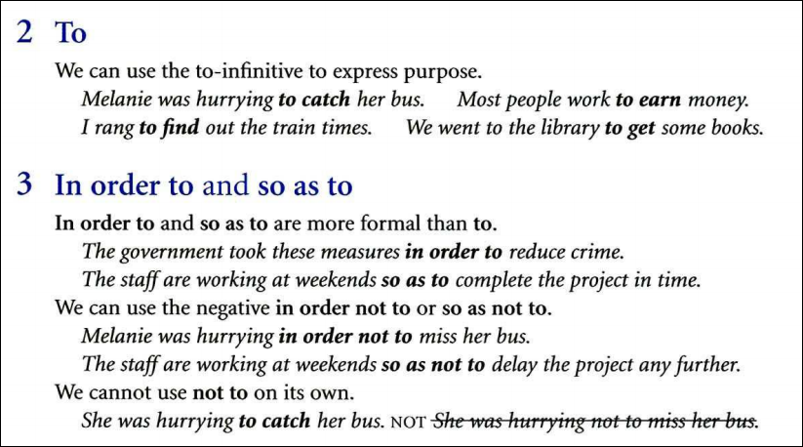

Slide 12
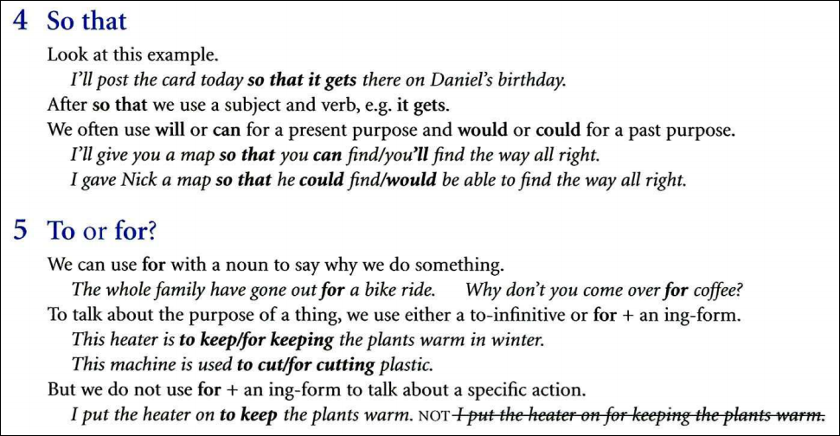

Slide 13



Slide 14
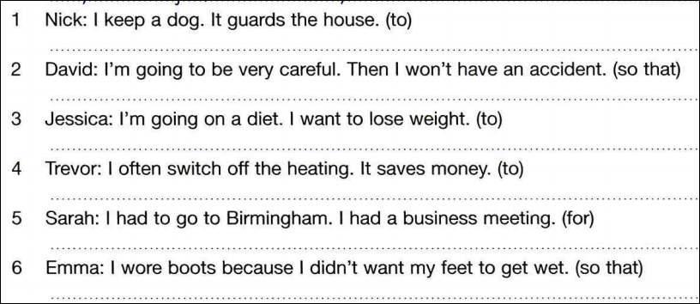






Slide 15

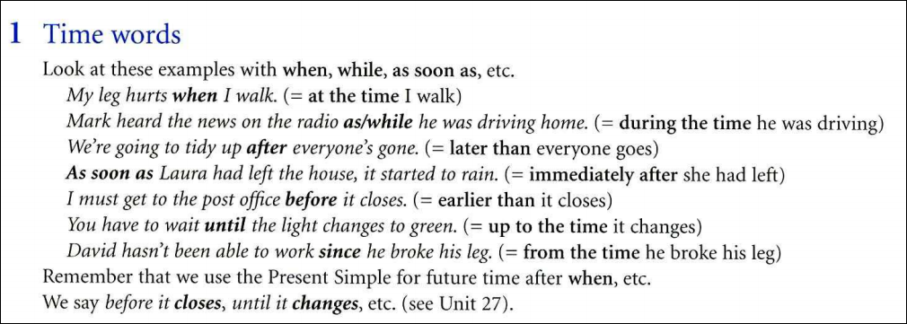

Slide 16
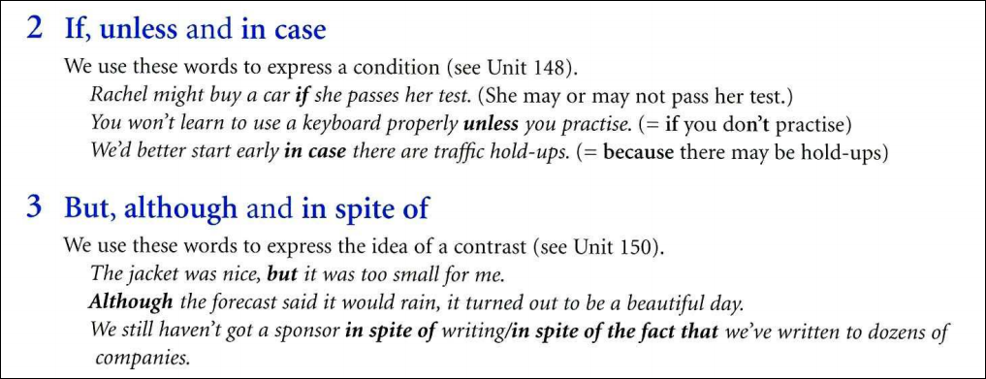

Slide 17


Slide 18


Slide 19
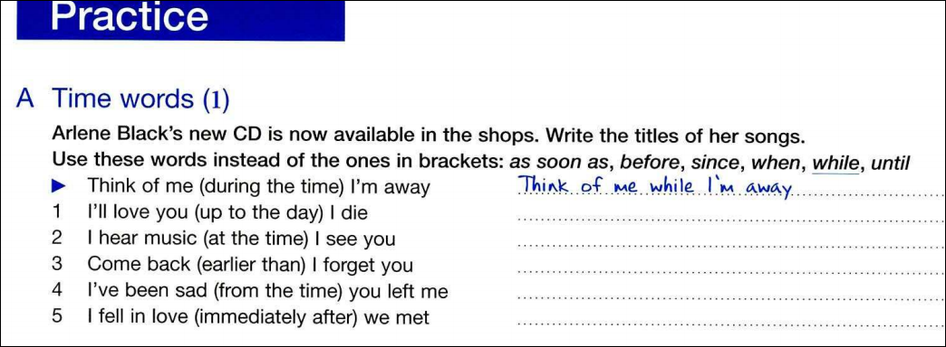






Slide 20

Although
in order to
because
If

Slide 21

but
so
unless
In spite of
in case
because of

Slide 22

1. as soon as
3. since
2. to
4. but
5. so that
6. because

Slide 23

8. since
7. in case
10. although
9. until
11. if
12. so
13. In spite of

Slide 24

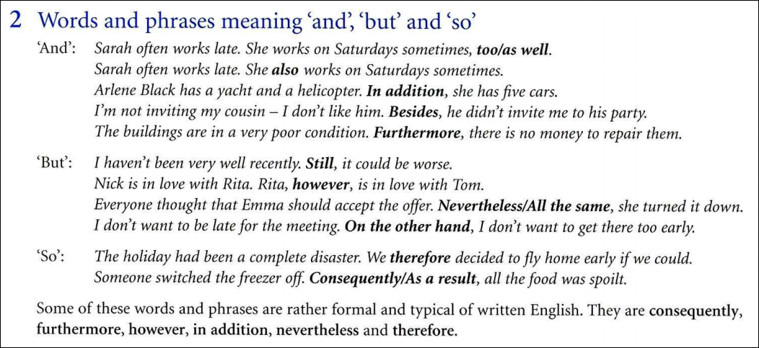

Slide 25
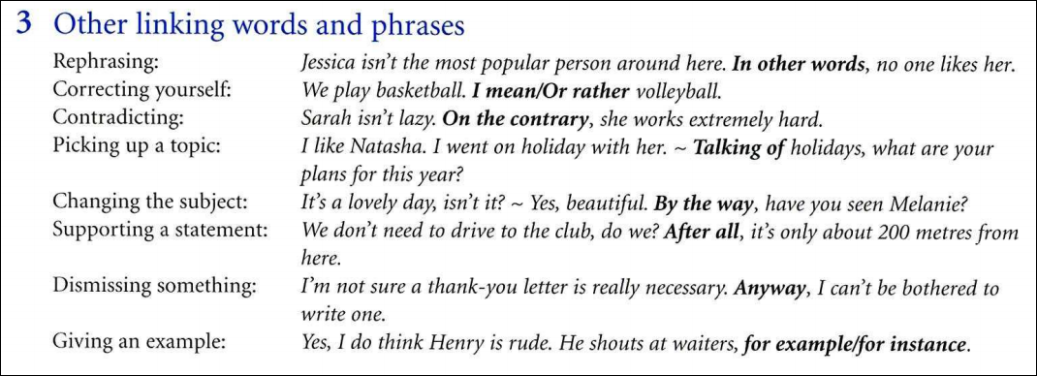

Slide 26
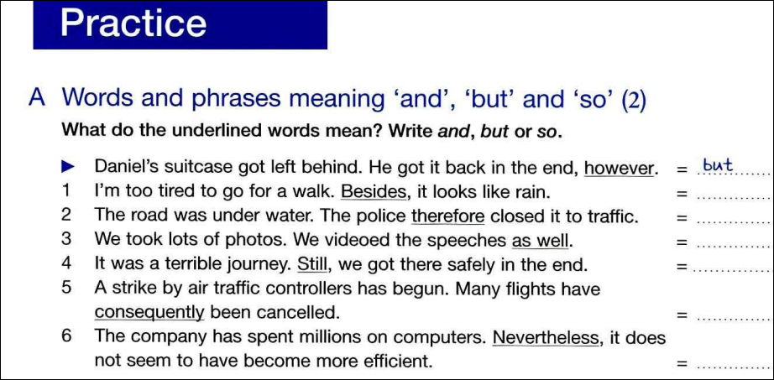
and
so
and
but
so
but

Slide 27
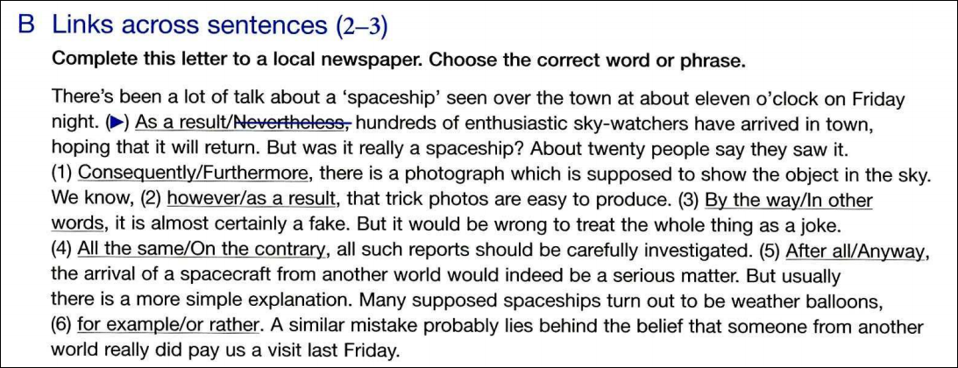
1. Furthermore
2. however
3. In other words
5. After all
4. On the contrary
6. for example

Slide 28



