Slide 1
English Discoveries
Intermediate 1 Unit 6 At Work

Slide 2
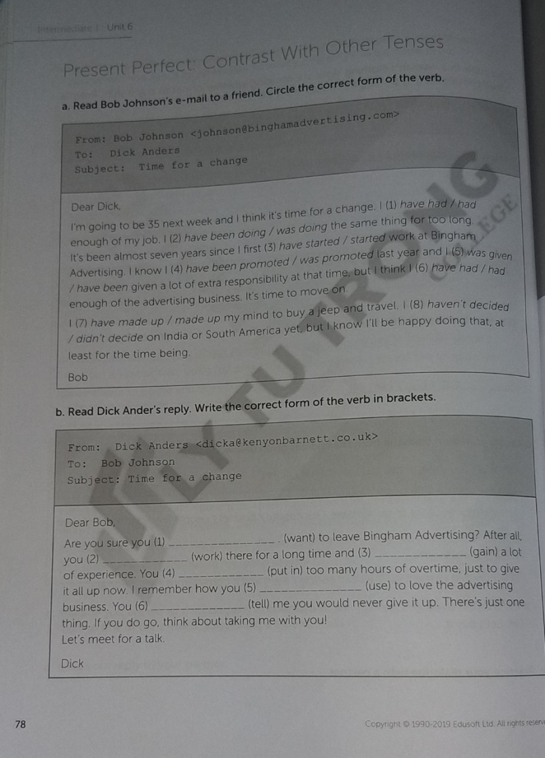

Slide 3
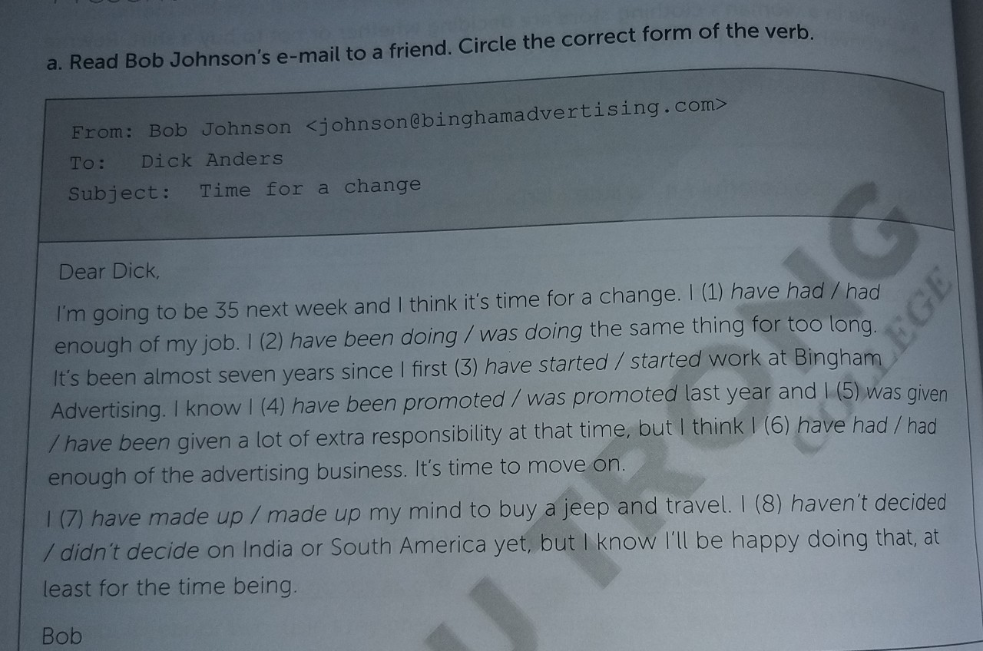
English Discoveries
Intermediate 1 Unit 6 At Work

Slide 4
English Discoveries
Intermediate 1 Unit 6 At Work
Answer Key a
have had
have been doing
started
was promoted
was given
have had
have made up
haven’t decided

Slide 5
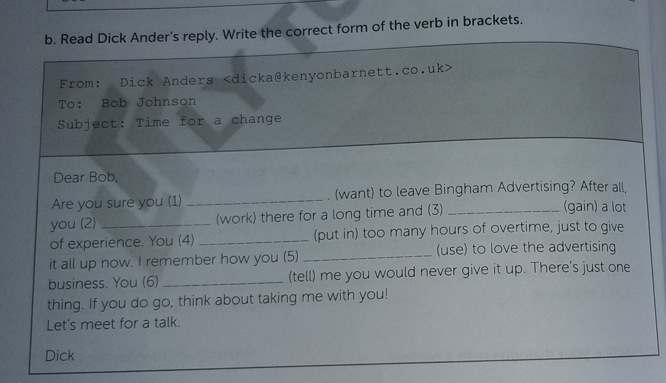
English Discoveries
Intermediate 1 Unit 6 At Work

Slide 6
English Discoveries
Intermediate 1 Unit 6 At Work
Answer Key b
want
have been working / have worked
have gained
have put in
used
told

Slide 7
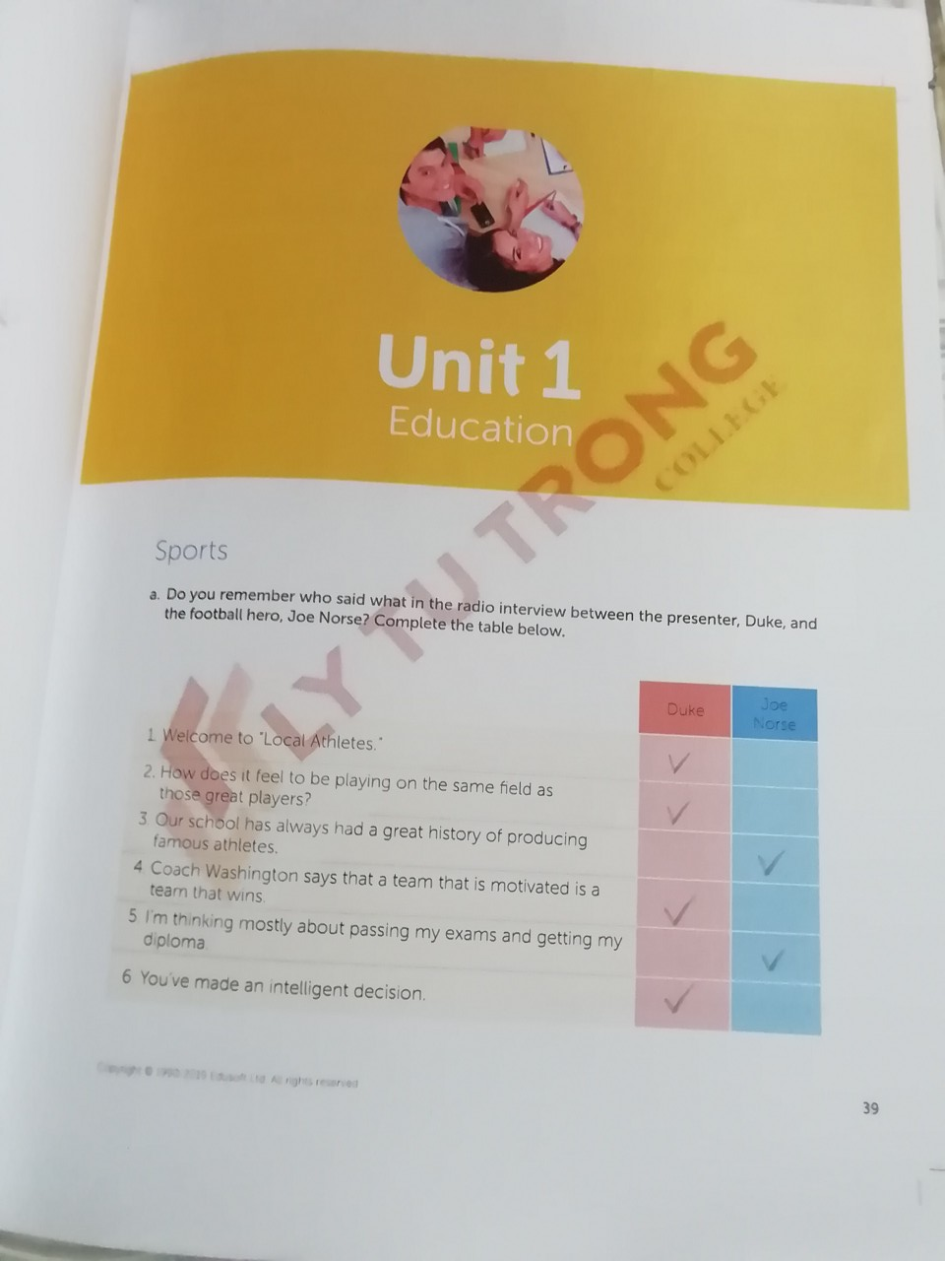
English Discoveries
Intermediate 1 Unit 1 Education
– Page 39

Slide 8
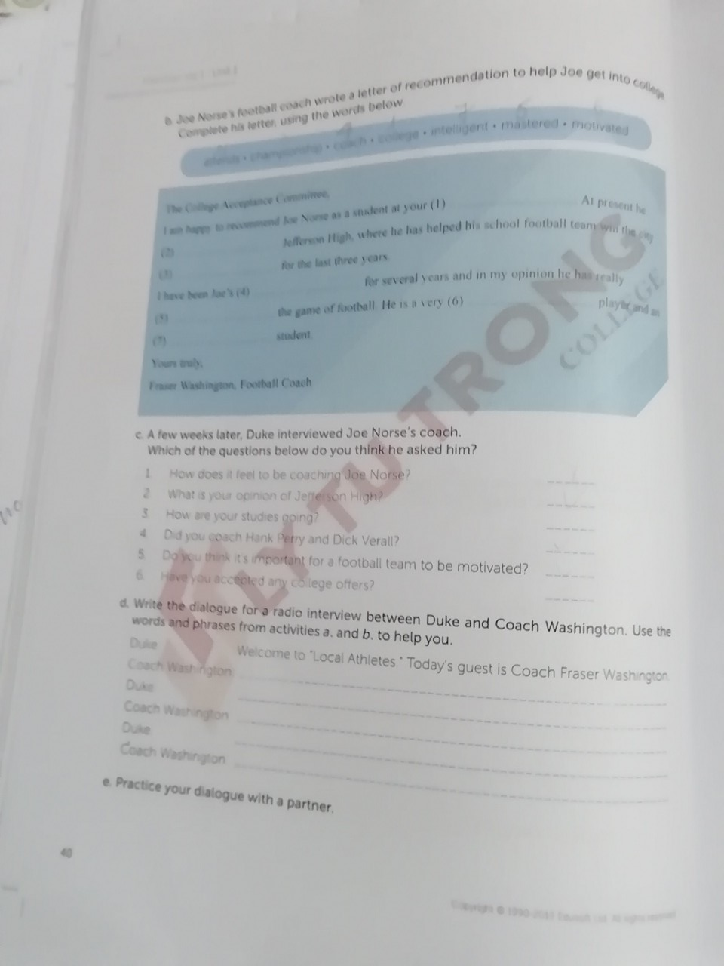
English Discoveries
Unit 1: Education page 40
Answer b:
1. college
2. attends
3. championship
4. coach
5. mastered
6. Motivated
7. Intelligent
Answer c:
1, 2,4,5

Slide 9
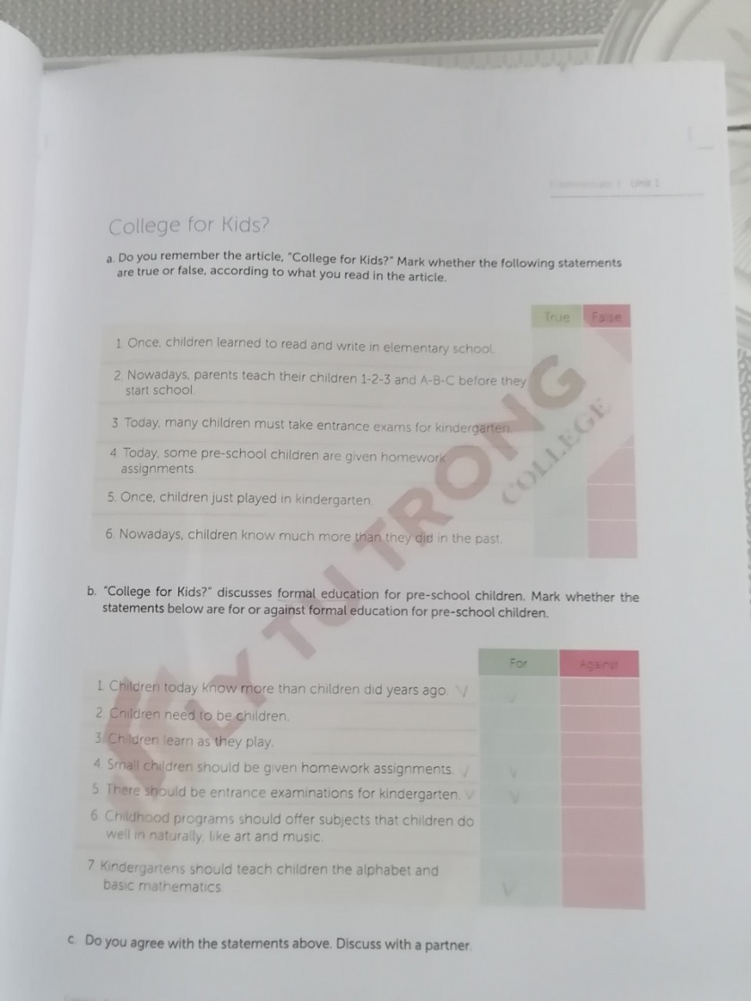
Unit 1: Education page 41
Answer a:
True
True
False
True
True
True
Answer b:
For
Against
Against
For
For
Against
For

Slide 10
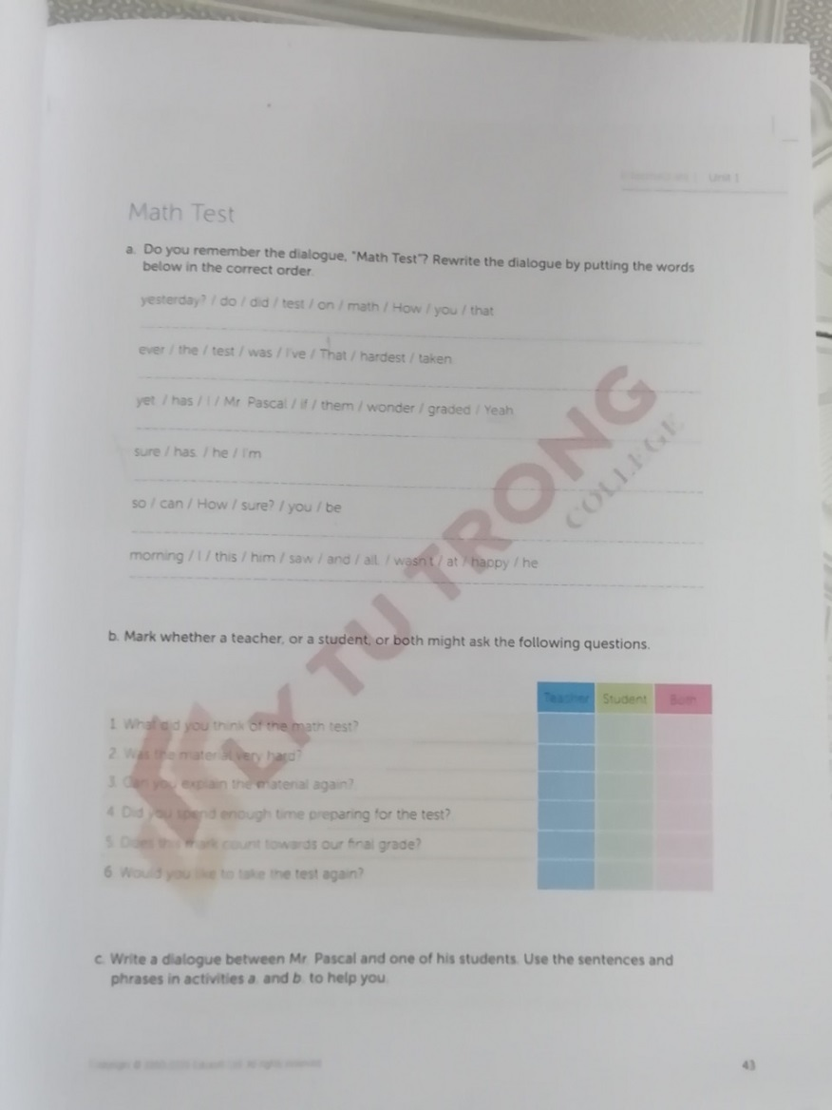
Unit 1: Education page 43
Answer
How did you do on that math test yesterday?
That was the hardest test I’ve ever taken.
Yeah. I wonder if Mr. Pascal has graded them yet.
I’m sure he has.
How can you be sure?
I saw him this morning and he wasn’t happy at all.

Slide 11
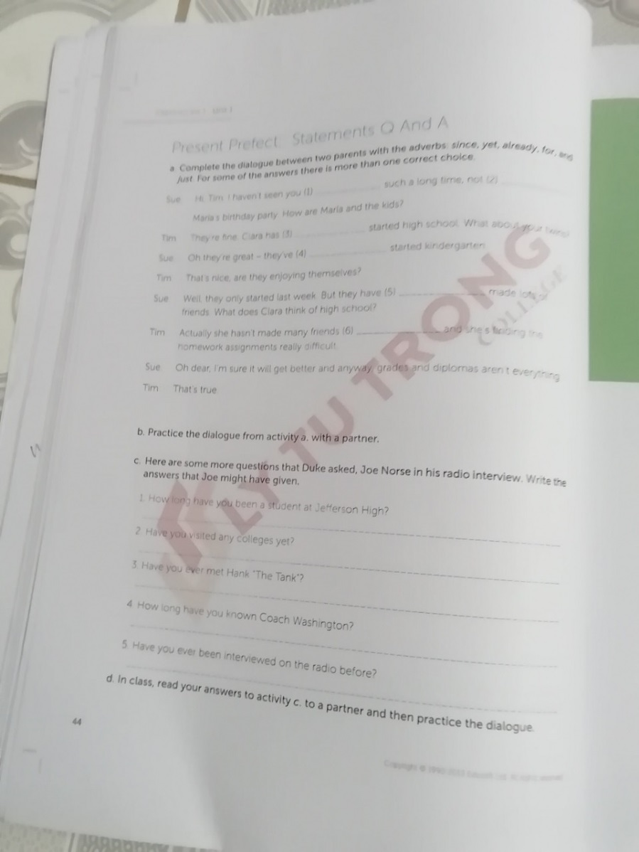
Unit 1: Education page 44
Answer
For
Since
Just/ already
Already/ just
Already
yet

Slide 12
Unit 1: Education page 44
Answer
I have been a student at Jefferson High for three years.
No, I’m concentrating on my exams.
Yes, I met him once at school reunion.
I have known Coach Washington for three years.
No, I have never been interviewed before.

