Slide 1
REVISION
UNIT 9

Slide 2
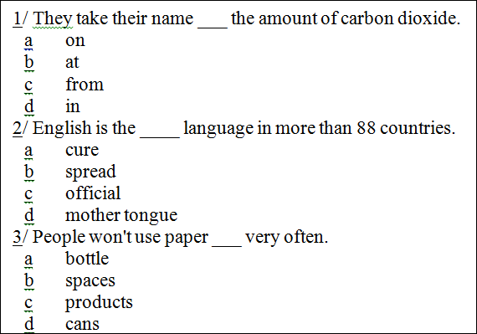
C - FROM
C - OFFICIAL
C - PRODUCTS

Slide 3
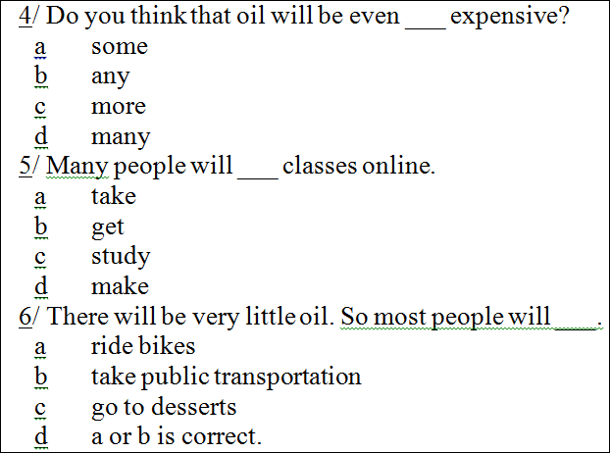
C - MORE
A - TAKE
D – A & B ARE CORRECT

Slide 4
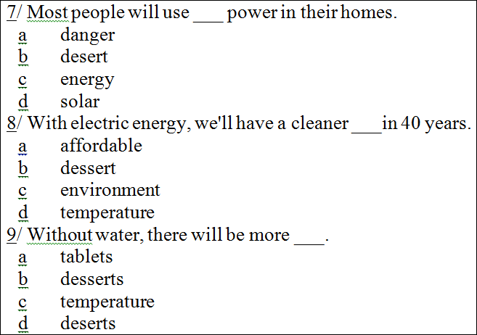
D – SOLAR
C- ENVIRONMENT
D – DESERTS

Slide 5
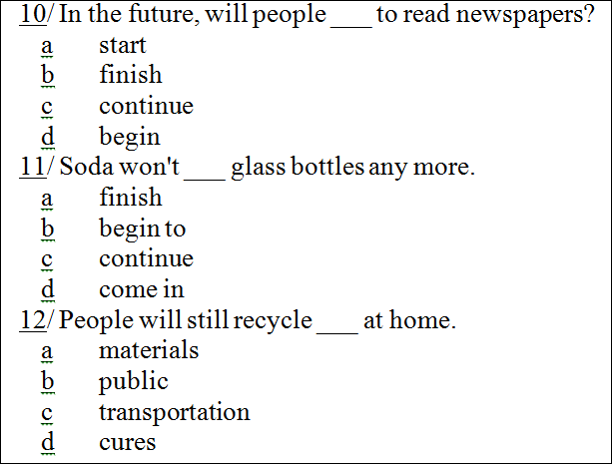
C - CONTINUE
D – COME IN
A - MATERIALS

Slide 6
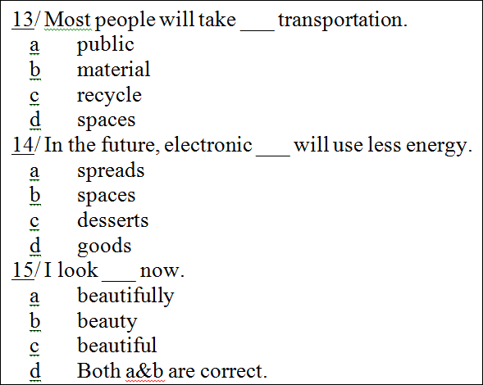
A - PUBLIC
D - GOODS
C - BEAUTIFUL

Slide 7
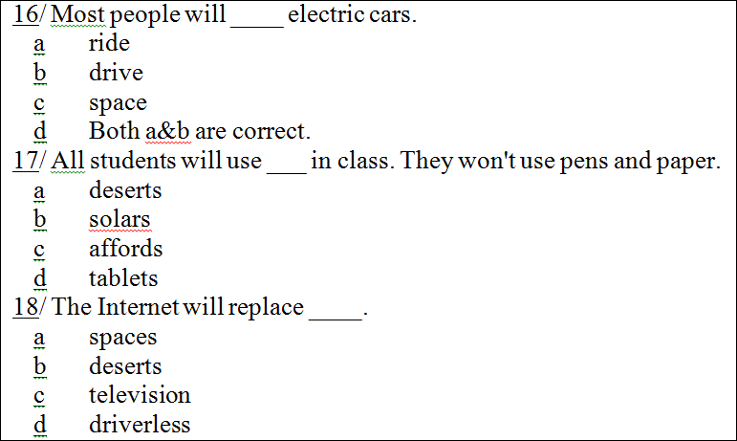
B - DRIVE
D - TABLETS
C - TELEVISION

Slide 8
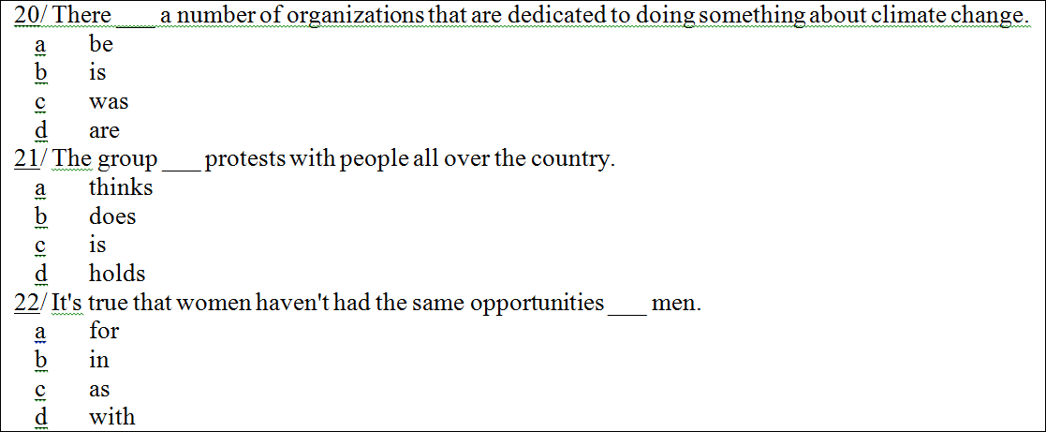
D - WAS
D - HOLDS
C - AS

Slide 9
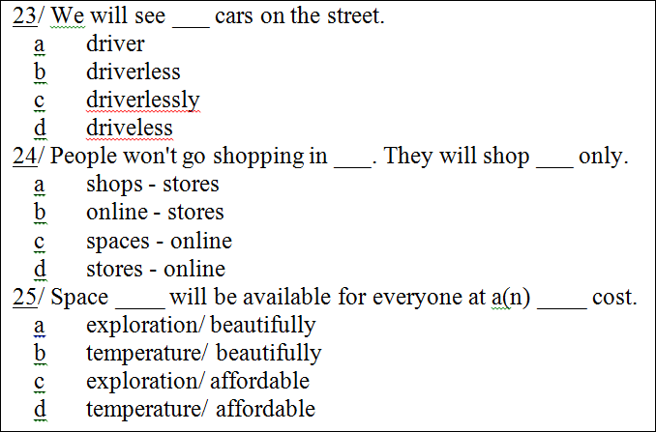
B - DRIVERLESS
D - STORES - ONLINE
C – EXPLORATION/ AFFORDABLE

Slide 10
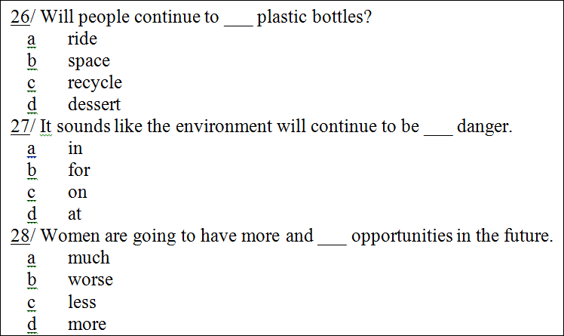
C - RECYCLE
A - IN
D - MORE

Slide 11
UNIT 10

Slide 12
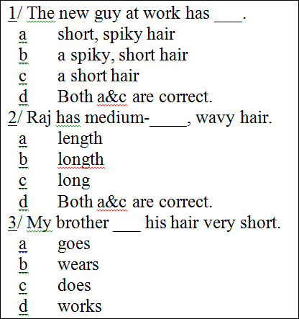
a short, spiky hair
a lenght
b wears

Slide 13
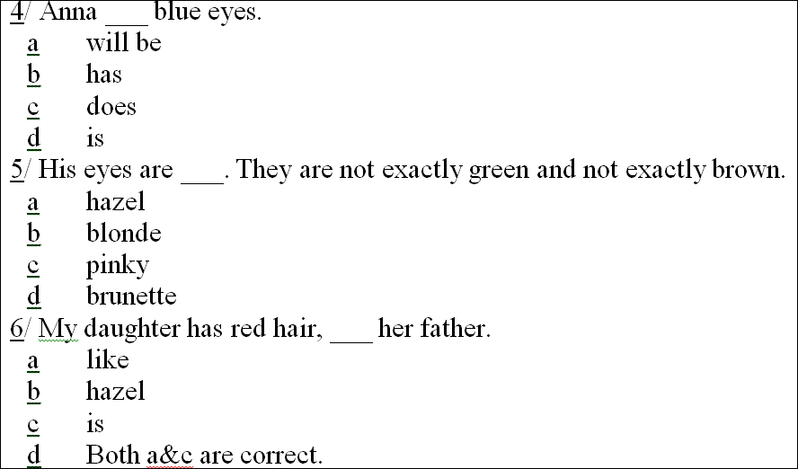
b has
a hazel
a like

Slide 14
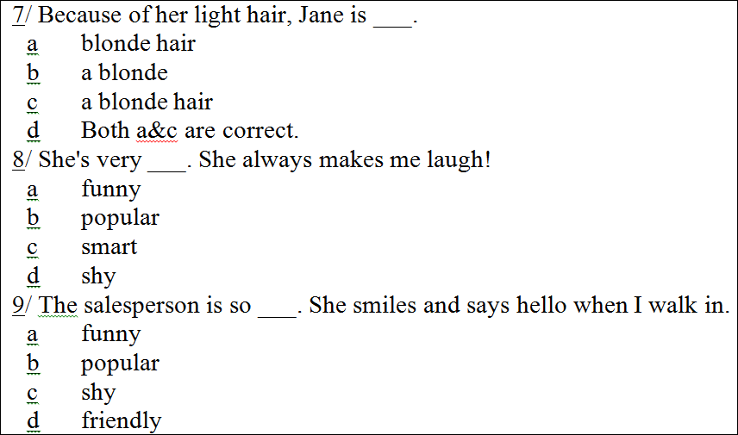
b a blonde hair
a funny
d friendly

Slide 15
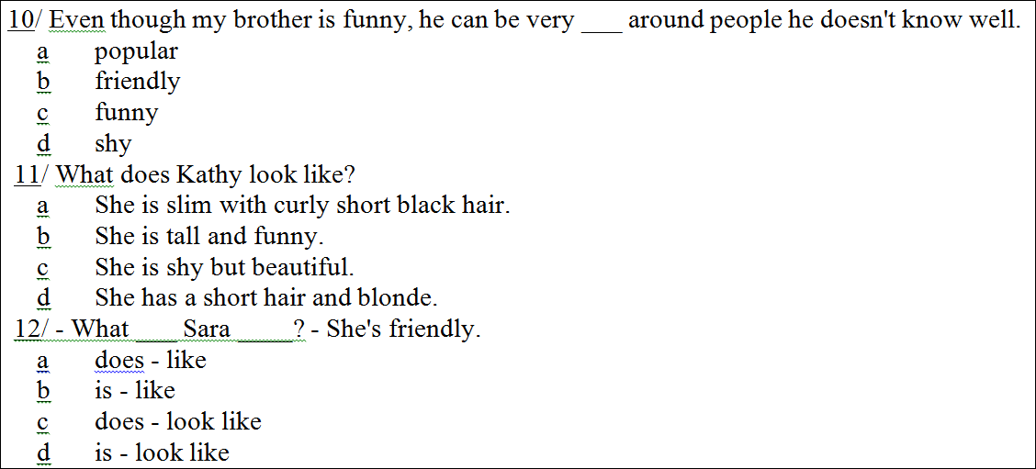
d shy
a She is slim with curly short black hair.
b is – like

Slide 16
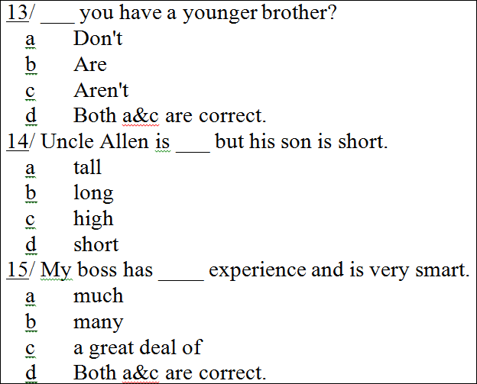
a Don’t
a tall
d A & C are correct.

Slide 17
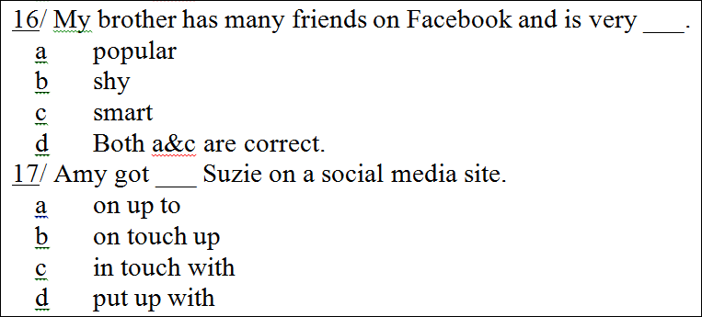
a popular
c in touch with

