Slide 1

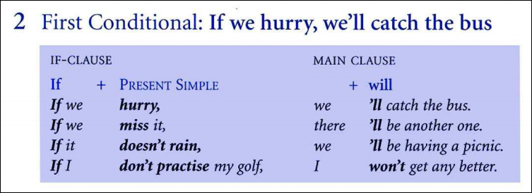

Slide 2
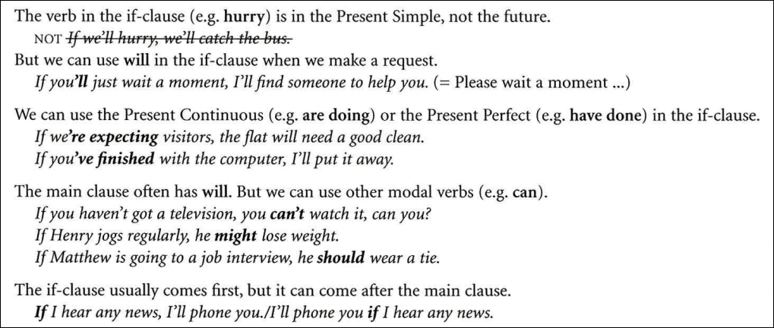

Slide 3



Slide 4

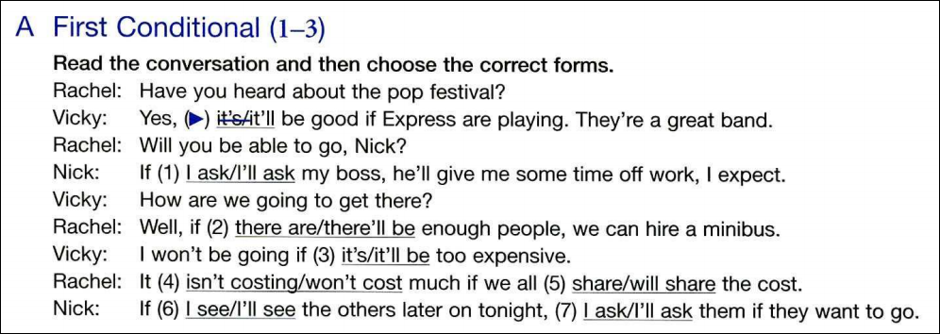
1. I ask
2. there are
3. it’s
4. won’t cost
5. share
6. I see
7. I’ll ask

Slide 5


Slide 6
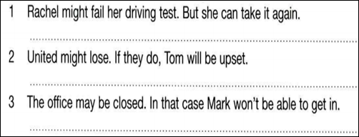



Slide 7
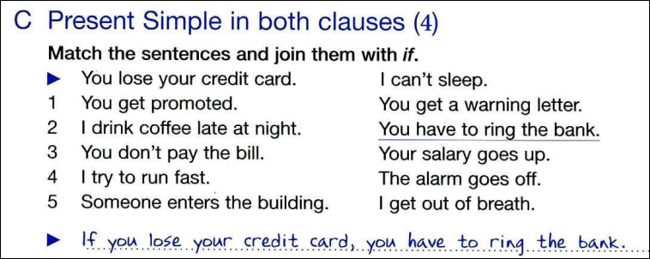

Slide 8



Slide 9


Slide 10


Slide 11
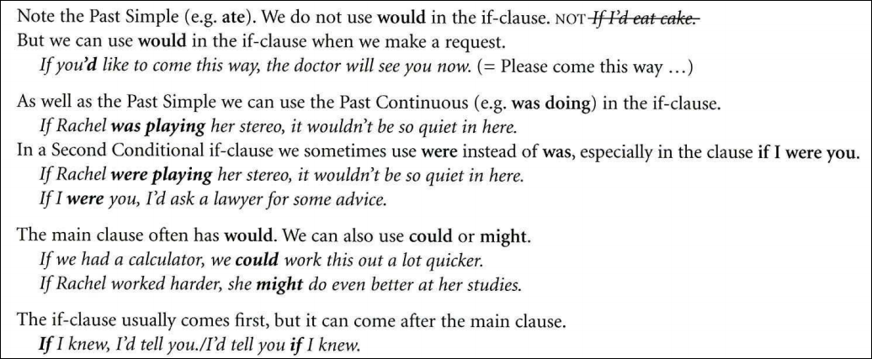

Slide 12
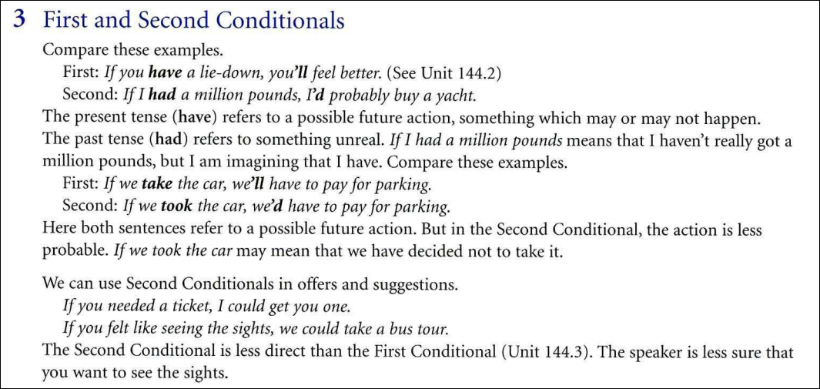

Slide 13



Slide 14




Slide 15





Slide 16




Slide 17








Slide 18



Slide 19






Slide 20

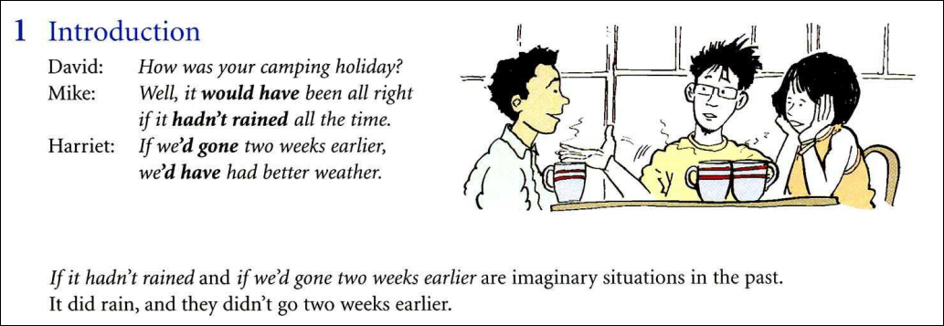

Slide 21
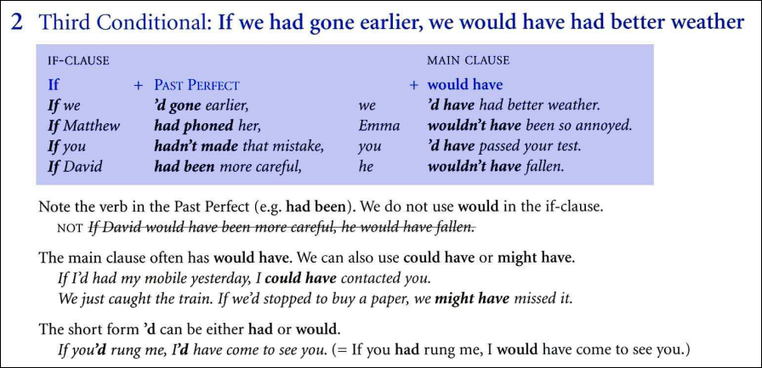

Slide 22



Slide 23
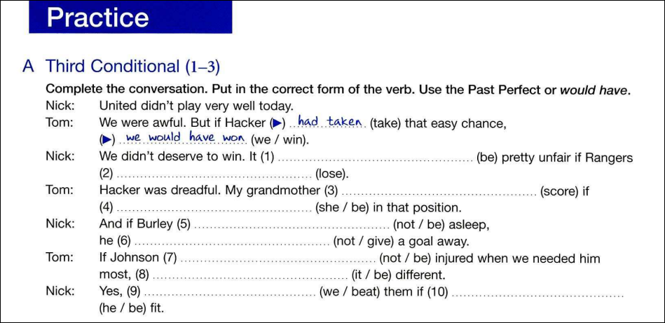










Slide 24
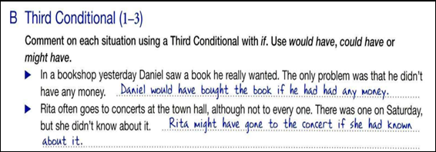




Slide 25





Slide 26
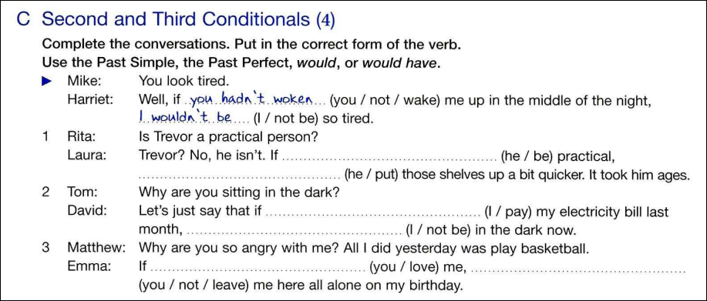







Slide 27

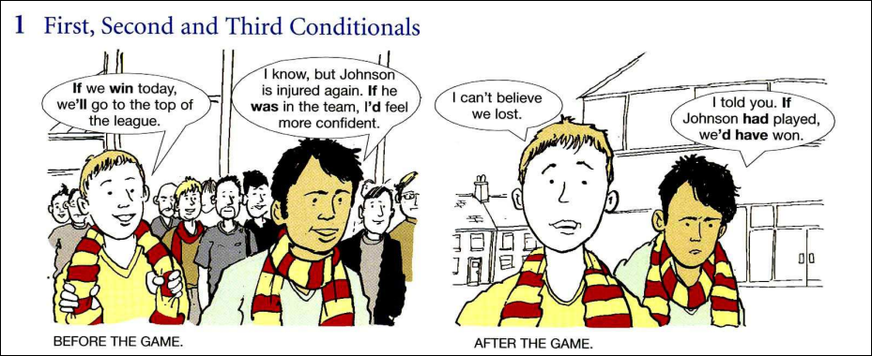

Slide 28
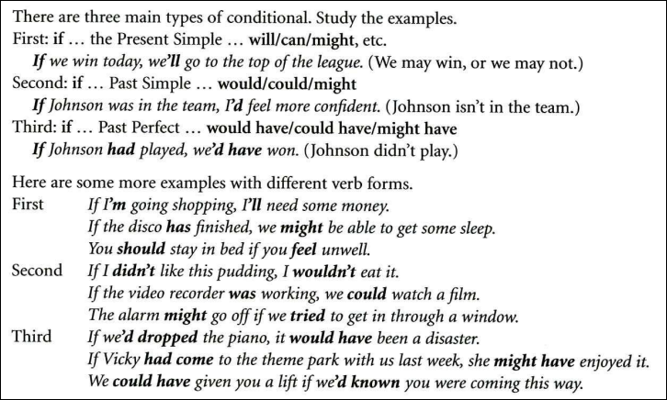

Slide 29
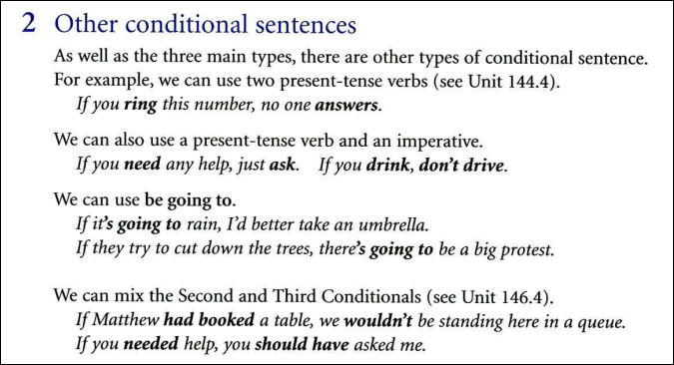

Slide 30
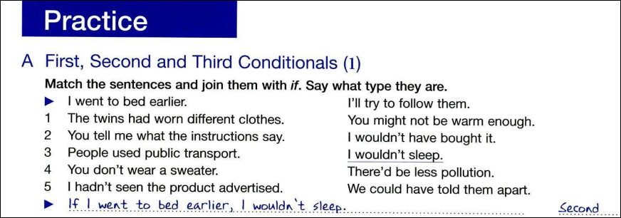

Slide 31






Slide 32
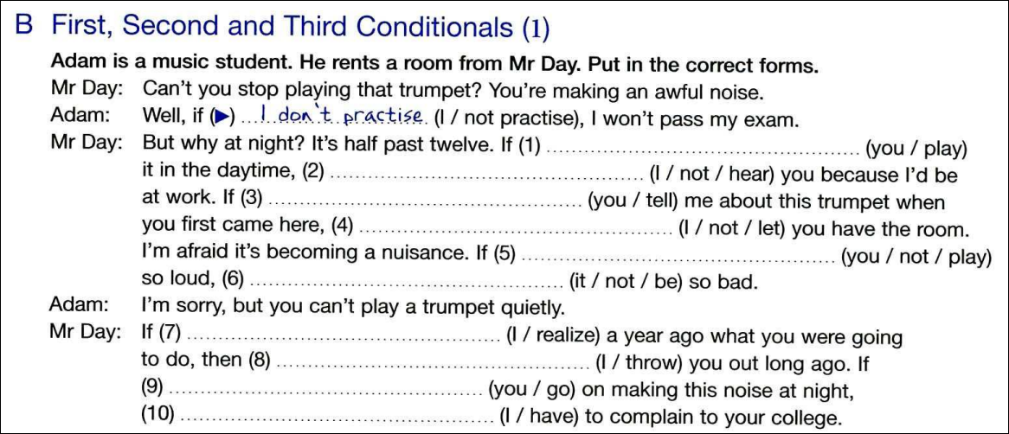












Slide 33
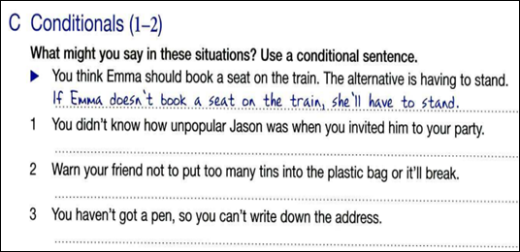



Slide 34



Slide 35


Slide 36
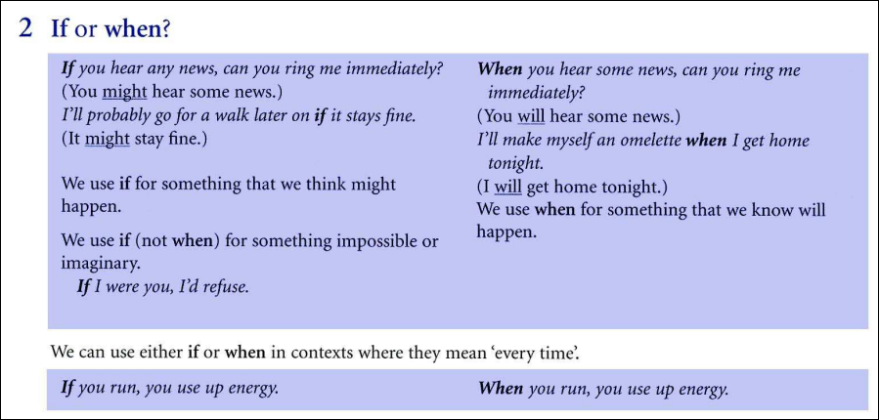

Slide 37

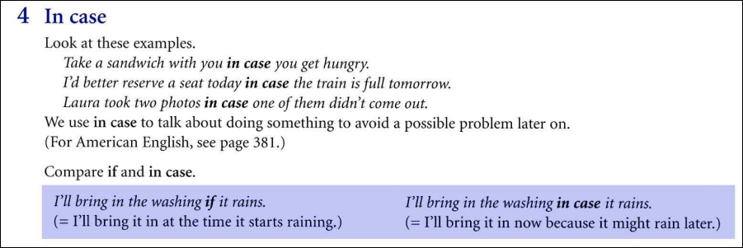

Slide 38






Slide 39





Slide 40
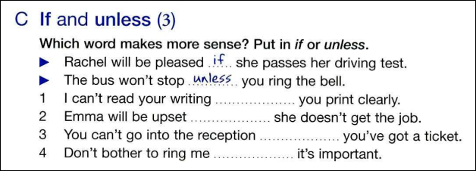



Slide 41
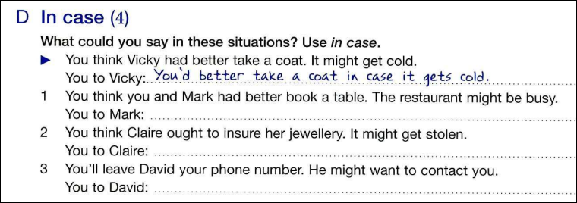




Slide 42




Slide 43
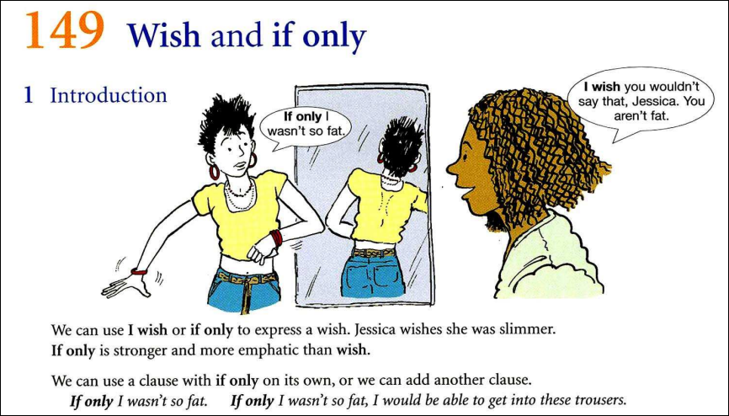

Slide 44


Slide 45
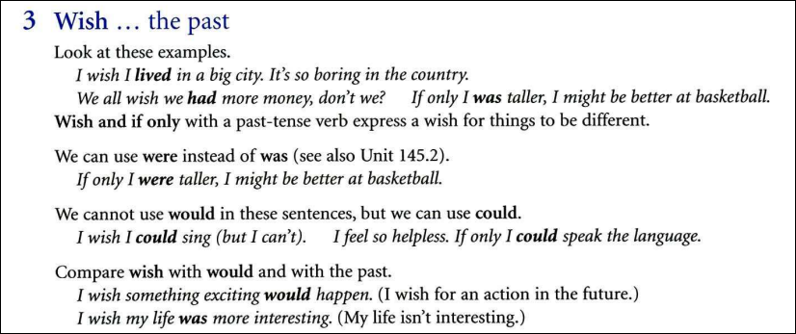

Slide 46
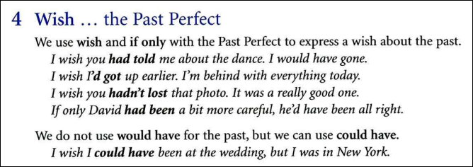

Slide 47
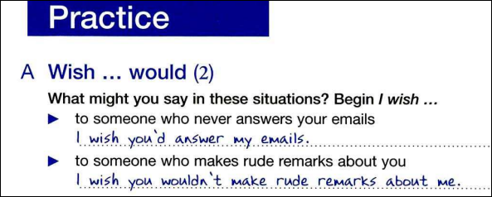

Slide 48
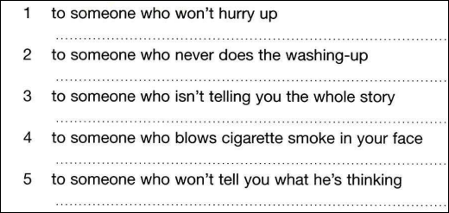




Slide 49
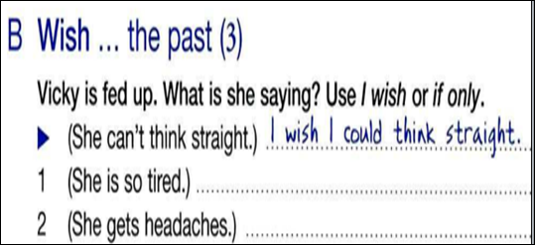

Slide 50


Slide 51








Slide 52







