Slide 1

TRƯỜNG CAO ĐẲNG LÝ TỰ TRỌNG TP. HỒ CHÍ MINH

Slide 2

KHOA KHOA HỌC CƠ BẢN

Slide 3

Good afternoon class.

Slide 4
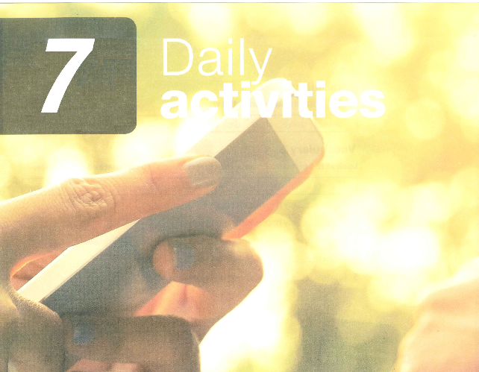
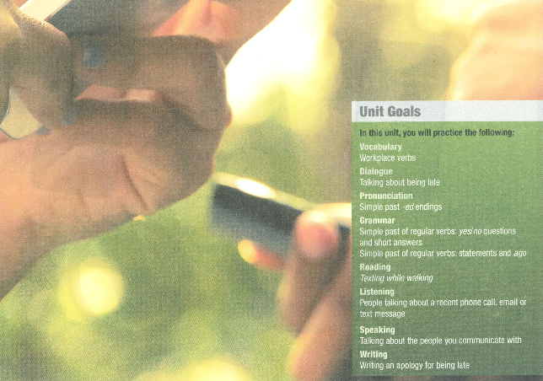

Slide 5


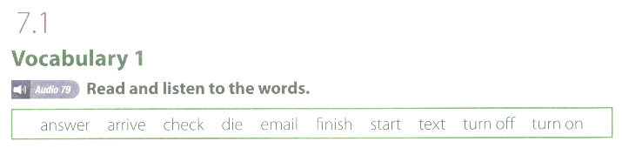

Slide 6
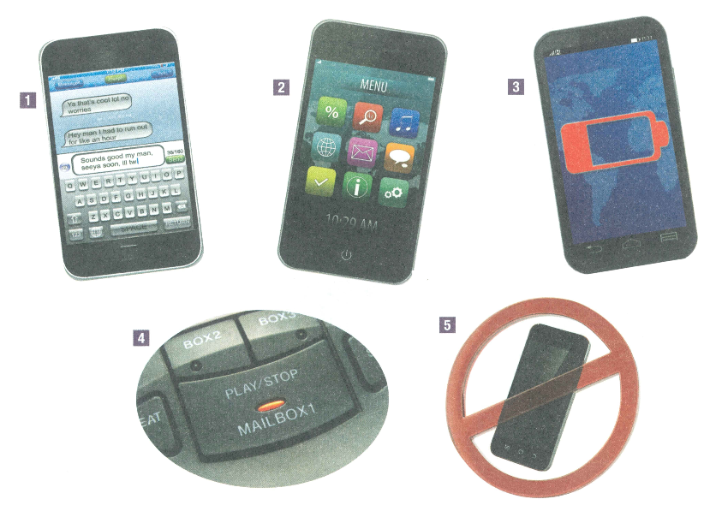
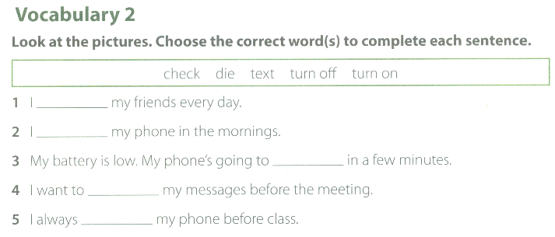
3. die
4. check
1. text
2. turn on
5. turn off

Slide 7
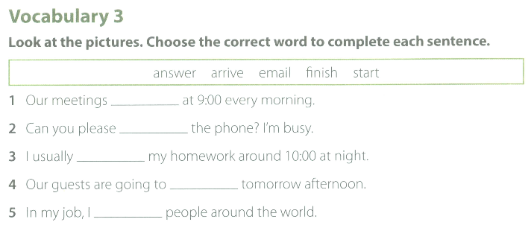
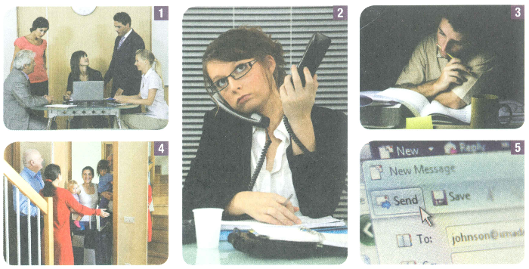
1. start
2. answer
3. finish
4. arrive
5. email

Slide 8
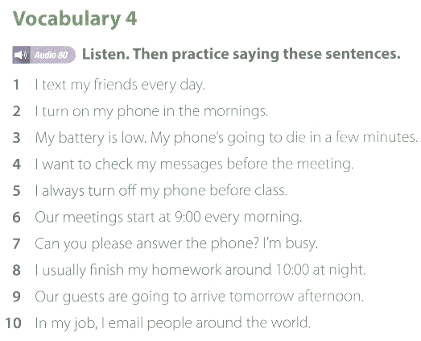

Slide 9
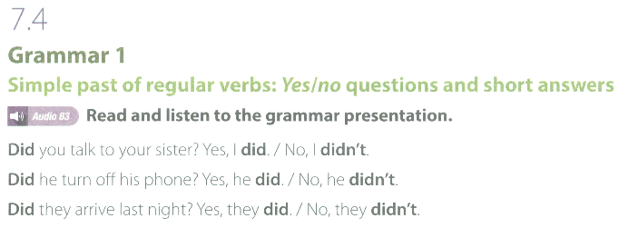
Notes:
PHẦN NÀY FILE NGHE BỊ TRÙNG

Slide 10
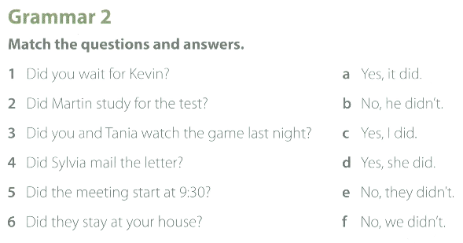
1. c
2. b
3. f
4. d
5. a
6. e
Notes:
PHẦN NÀY FILE NGHE BỊ TRÙNG

Slide 11
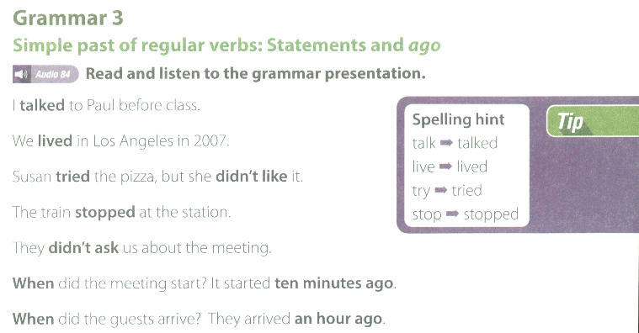

Slide 12
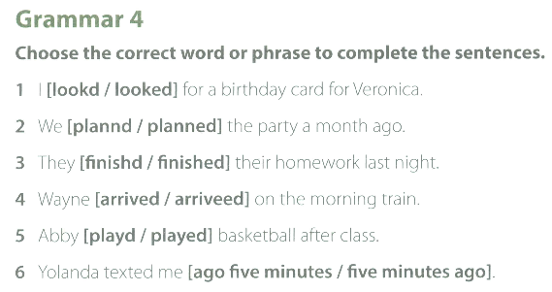

Slide 13
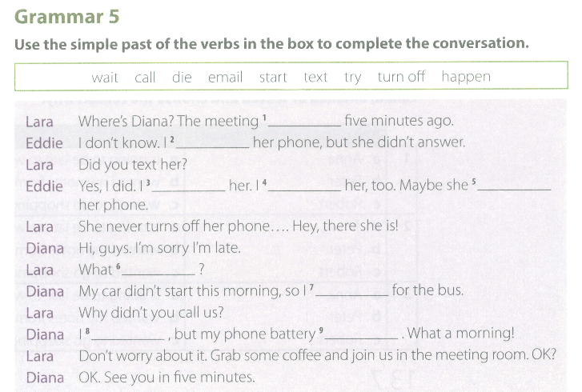
1. started
2. called
4. emailed
5. turned off
3. texted
6. happened
7. waited for
9. died
8. tried

Slide 14
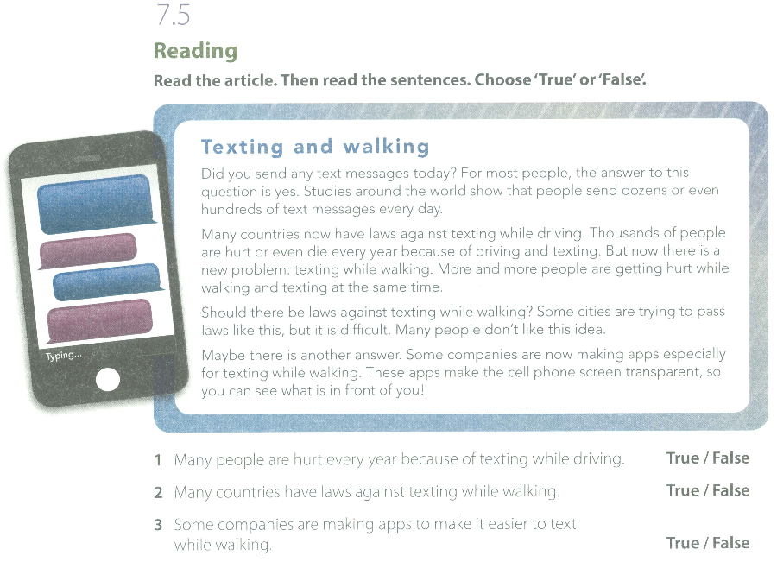

Slide 15


Slide 16
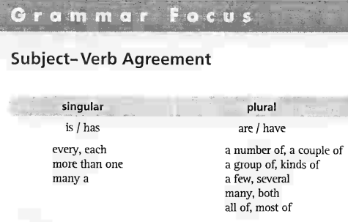

UNIT 4: Subject-Verb Agreement

Slide 17
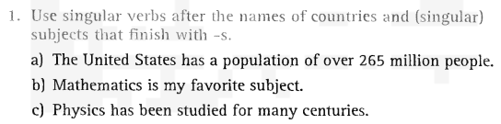

UNIT 4: Subject-Verb Agreement
Grammar Focus

Slide 18
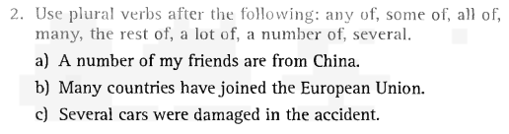

UNIT 4: Subject-Verb Agreement
Grammar Focus

Slide 19
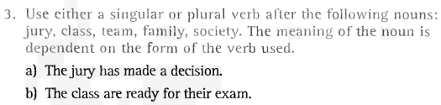

UNIT 4: Subject-Verb Agreement
Grammar Focus

Slide 20
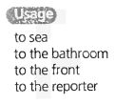

UNIT 4: Subject-Verb Agreement
Preposition: To

Slide 21
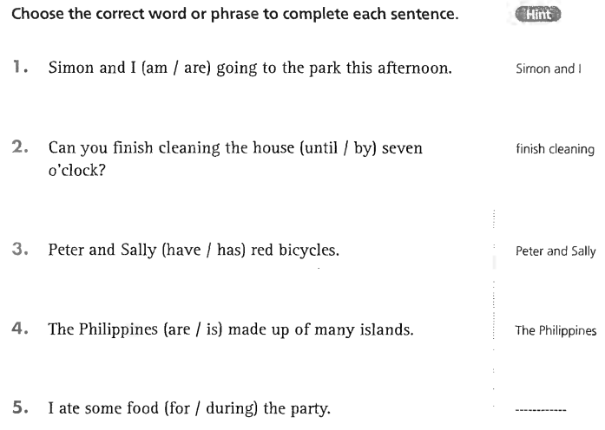
UNIT 4: Subject-Verb Agreement
Grammar Exercises

Slide 22
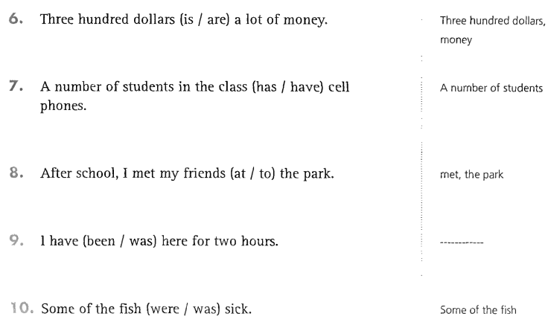
UNIT 4: Subject-Verb Agreement
Grammar Exercises

Slide 23
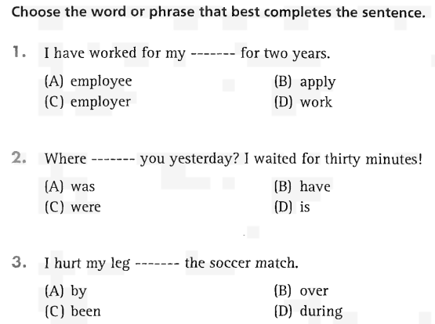
UNIT 4: Subject-Verb Agreement
Part 5 Incomplete Sentences

Slide 24
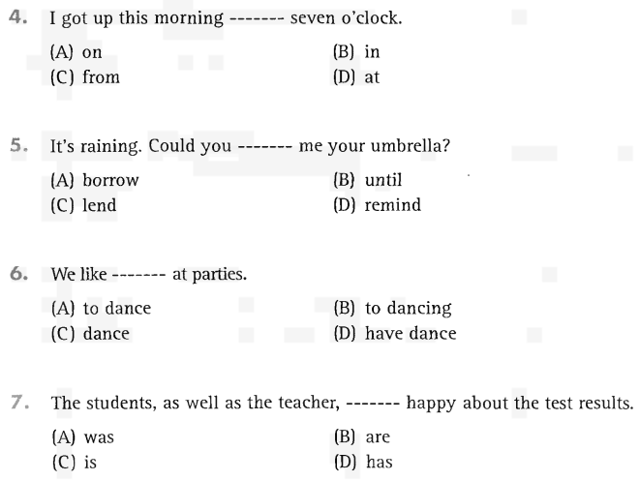
UNIT 4: Subject-Verb Agreement
Part 5 Incomplete Sentences

Slide 25
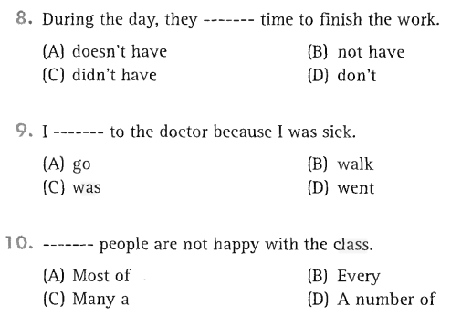
UNIT 4: Subject-Verb Agreement
Part 5 Incomplete Sentences

Slide 26
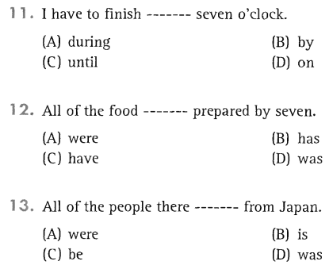
UNIT 4: Subject-Verb Agreement
Part 5 Incomplete Sentences

Slide 27
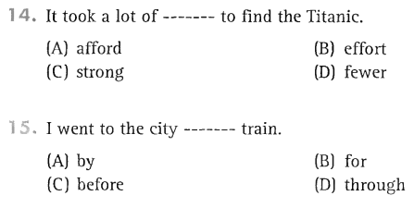
UNIT 4: Subject-Verb Agreement
Part 5 Incomplete Sentences

Slide 28

Thank you very much
for your cooperation.

