Slide 1
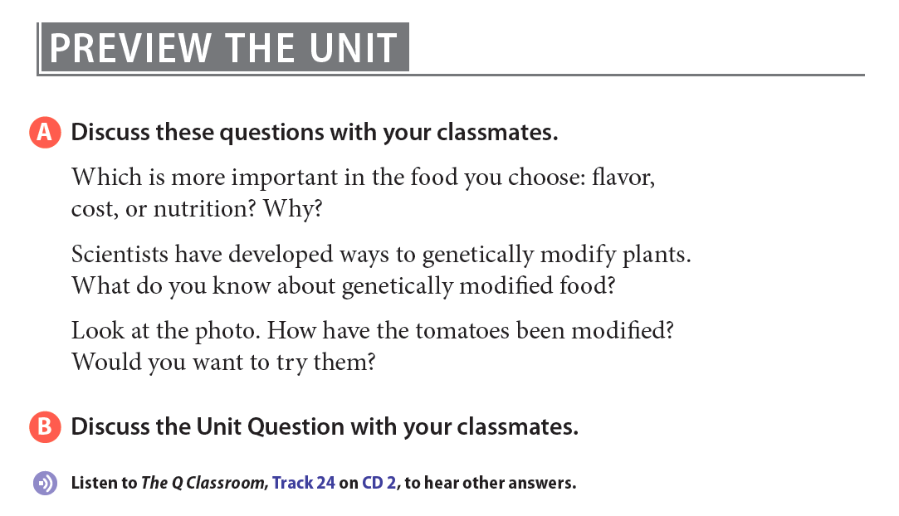
Notes:
In this photo illustration provided by the John Innes Centre UK, purple tomatoes are seen on October 27, 2008 in Norwich, United Kingdom. Scientists from the John Innes Centre, UK have genetically engineered tomatoes to contain very high levels of the cancer-fighting antioxidant anthocyanins, which as a result have turned the usually red fruit into a deep purple. The John Innes Centre does research in plant science and microbiology. Anthocyanins are found in reddish or purple foods such as purple cabbage, beets, blueberries, cherries, raspberries and purple grapes. Anthocyanins are helpful in preventing or treating a variety of health problems including diabetes, vision loss, and age-related neurological problems.

Slide 2




Slide 3

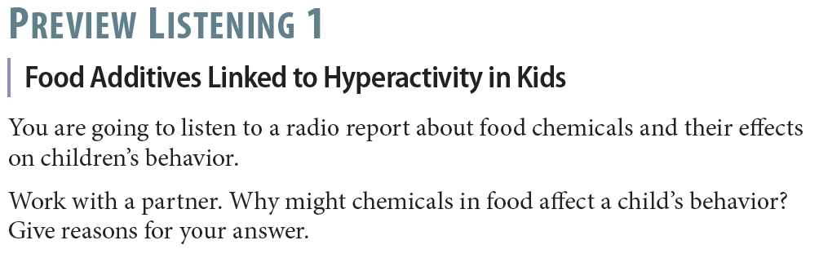


Slide 4
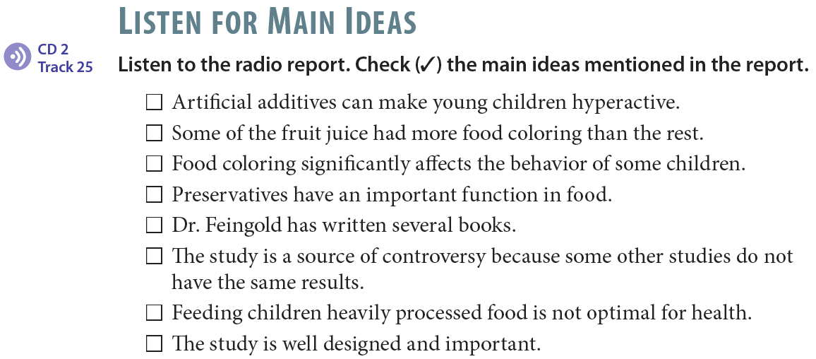
✓
✓
✓
✓

Slide 5
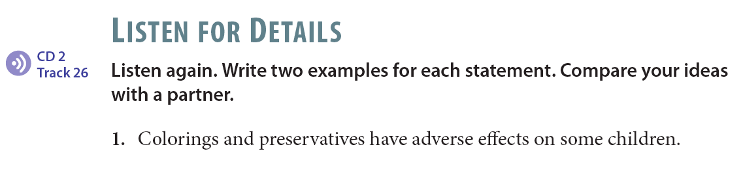
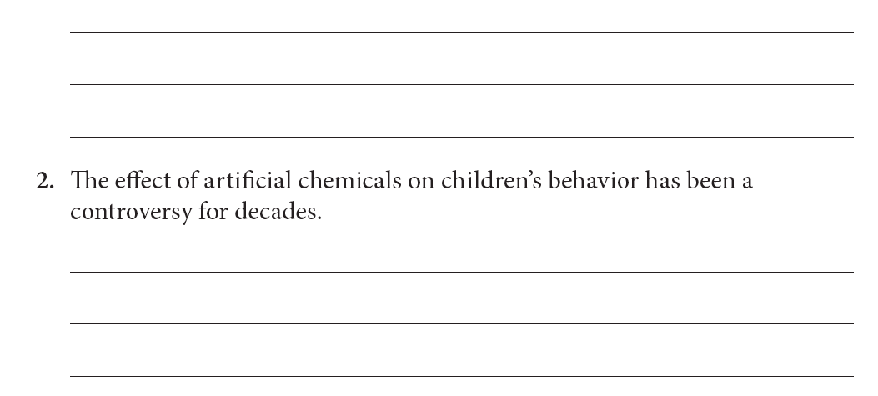

Slide 6
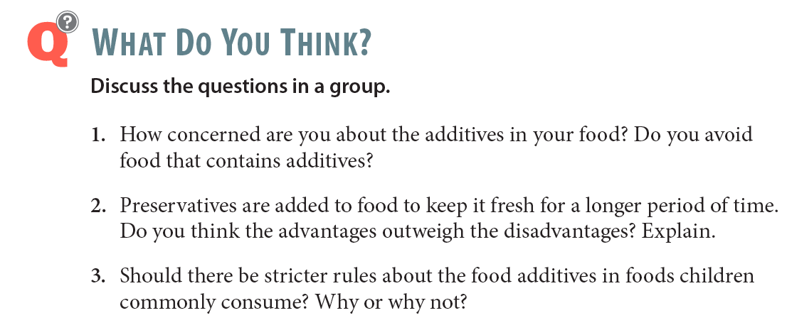

Slide 7
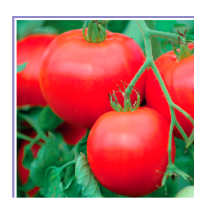
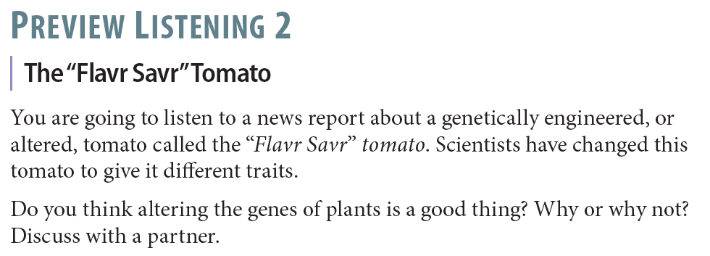

Slide 8
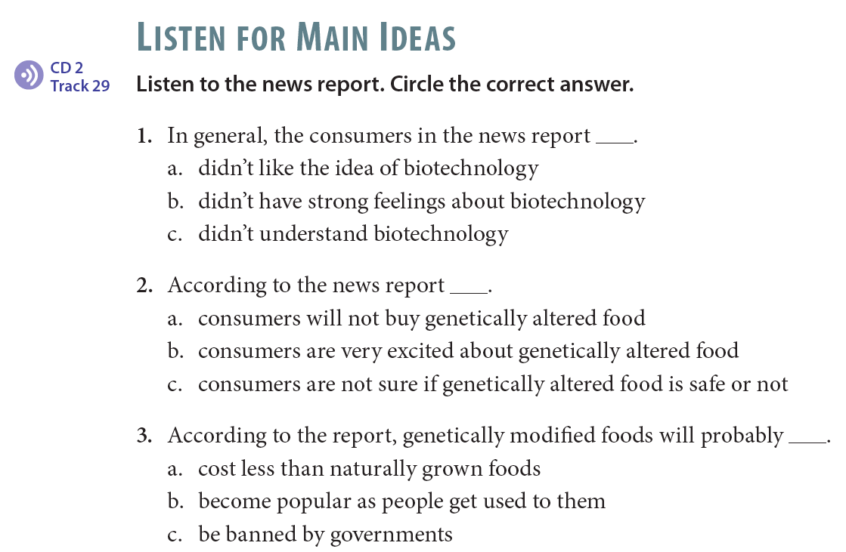

Slide 9
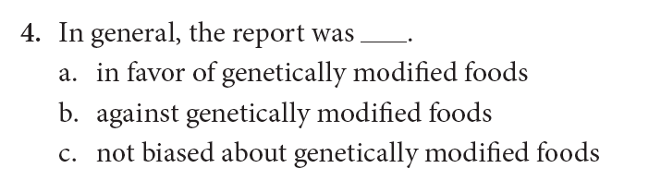

Slide 10
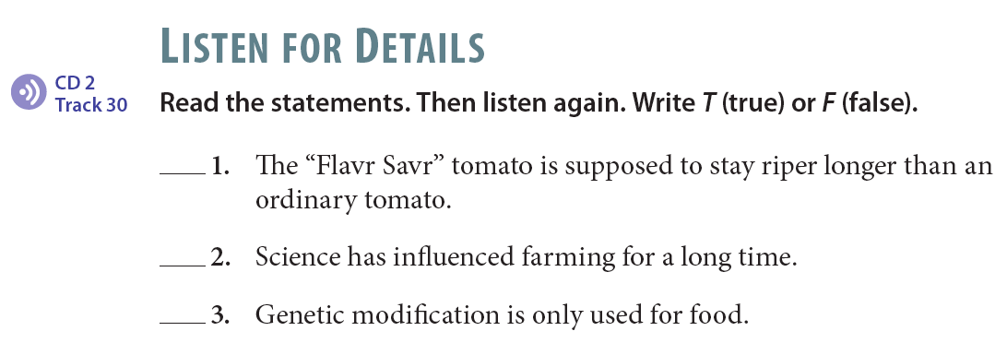
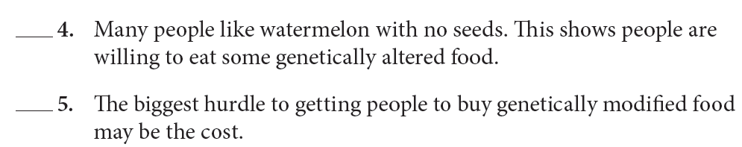
T
F
F
T
T

Slide 11
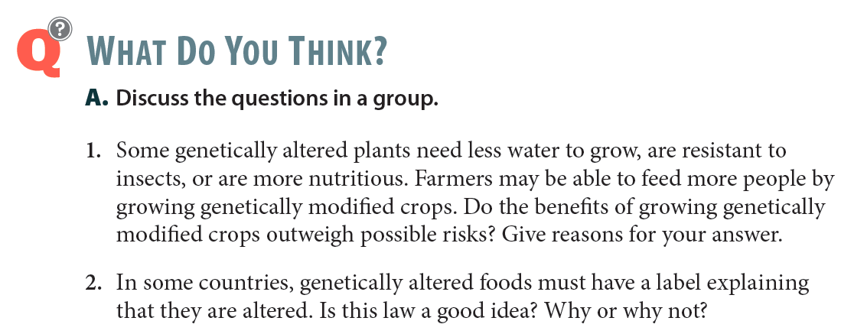

Slide 12


