Slide 1
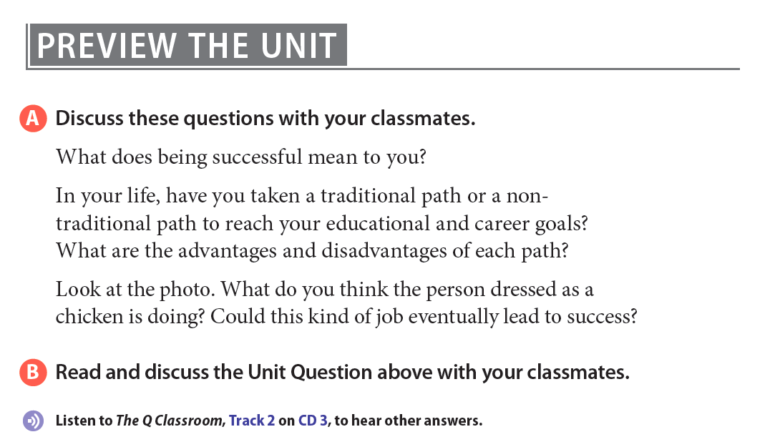
Notes:
One way that people and companies advertise is by handing out flyers on the street, sometimes dressed in costumes in order to get attention.

Slide 2

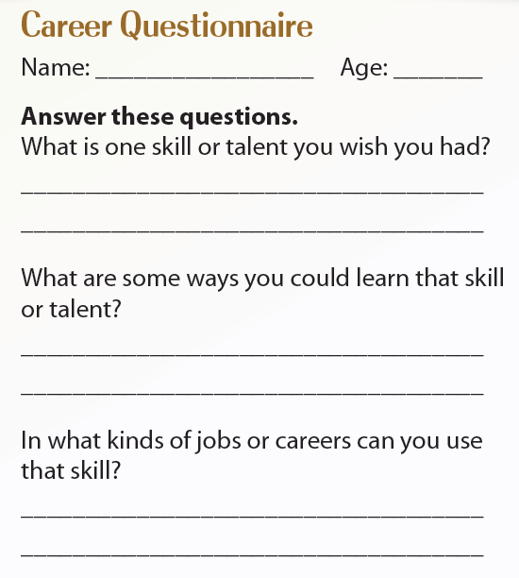


Slide 3


Slide 4

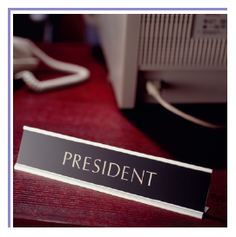

Slide 5
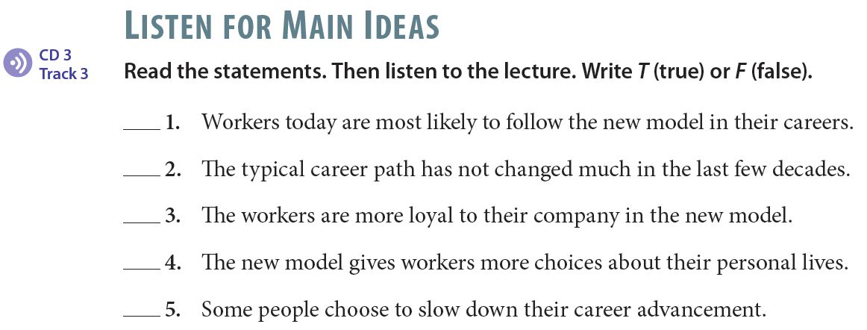
T
F
F
T
T

Slide 6
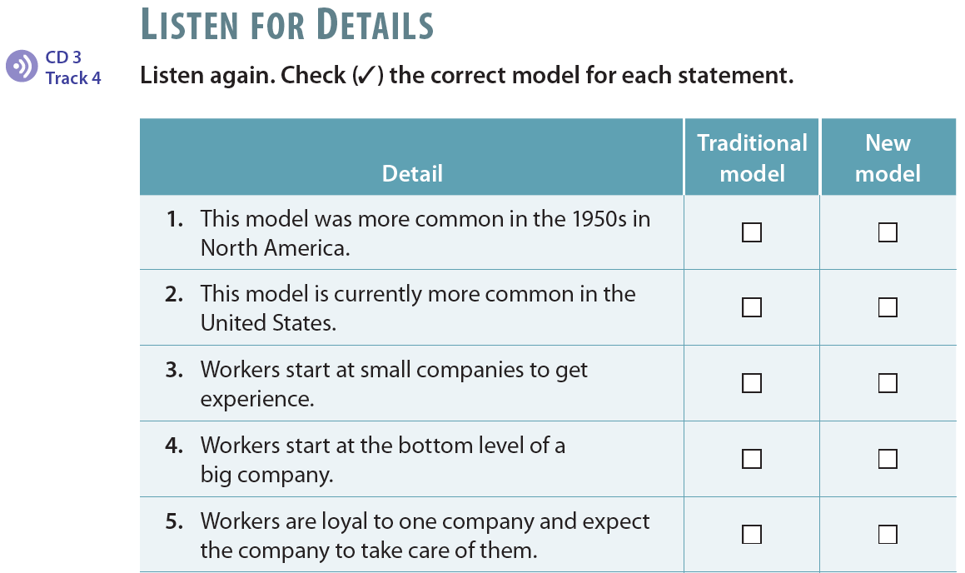
✓
✓
✓
✓
✓

Slide 7

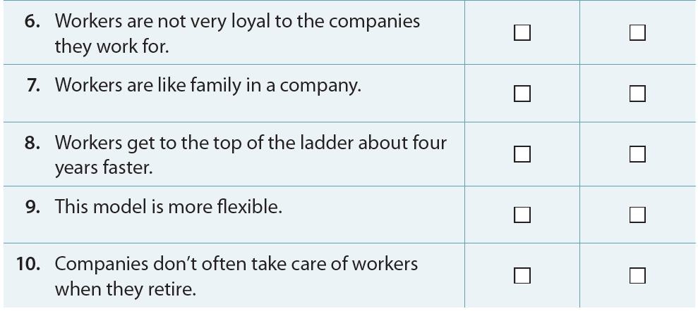
✓
✓
✓
✓
✓

Slide 8
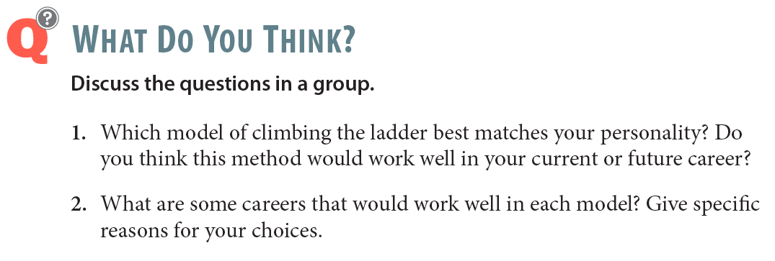

Slide 9
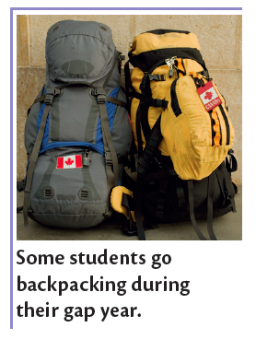
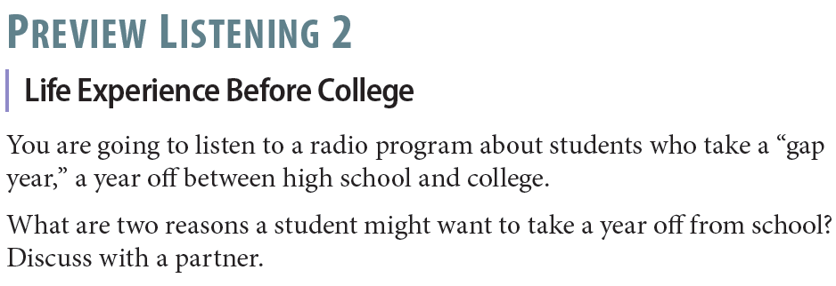


Slide 10
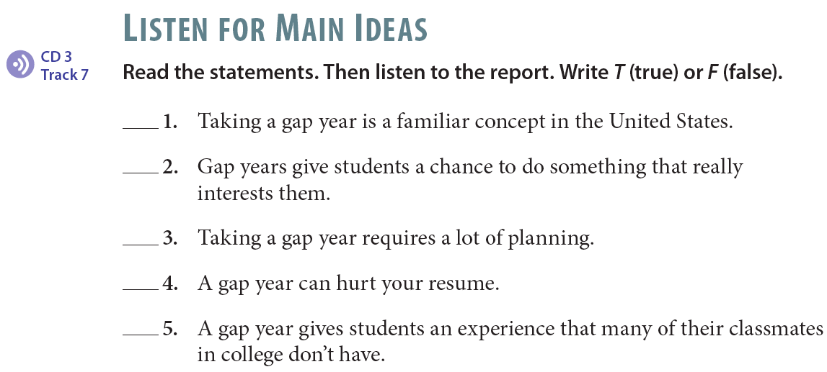
F
T
T
F
T

Slide 11
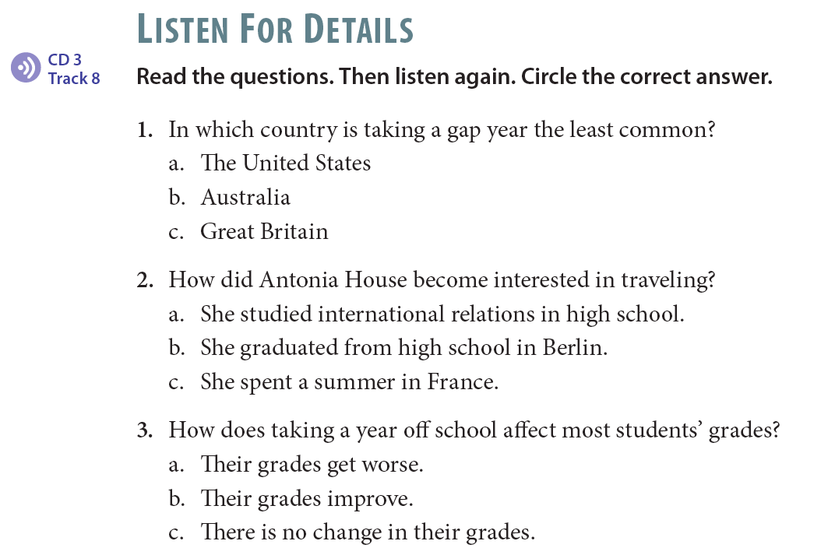

Slide 12
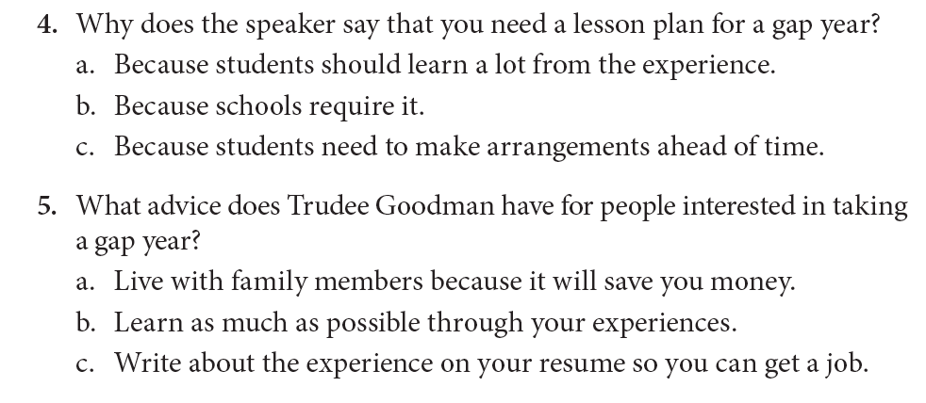

Slide 13
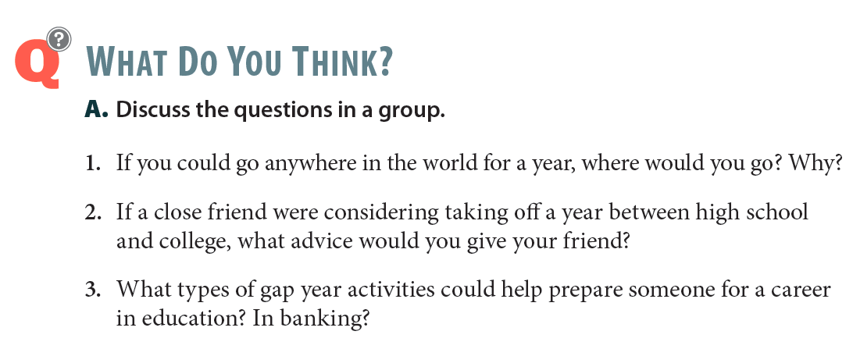

Slide 14


