Slide 1
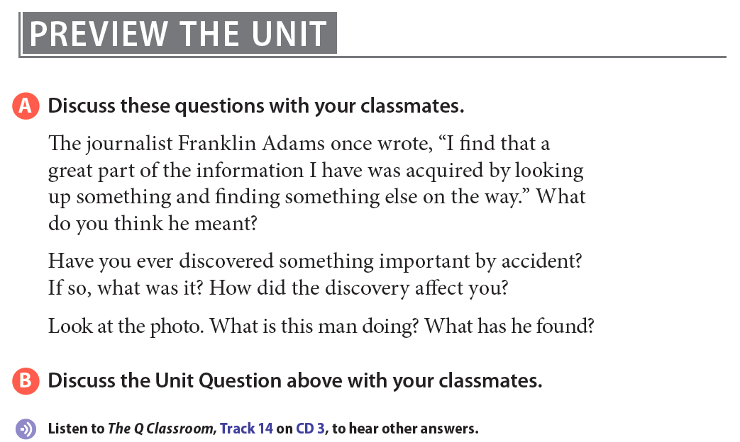
Notes:
A paleontologist is looking at a fossil of a ammonite that he has found among rocks on a sea shore. Fossils appear as rock slowly forms around objects buried in mud. As the rock forms, the shape and anatomy of buried animals and plants can be preserved. Ammonites are one of the most common fossils. They lived in the ocean 240-265 million years ago, and became extinct around the time of the dinosaurs. The discovery of fossils has taught us a lot about life long ago.

Slide 2
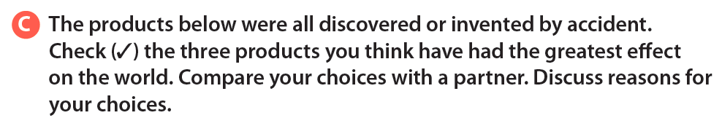
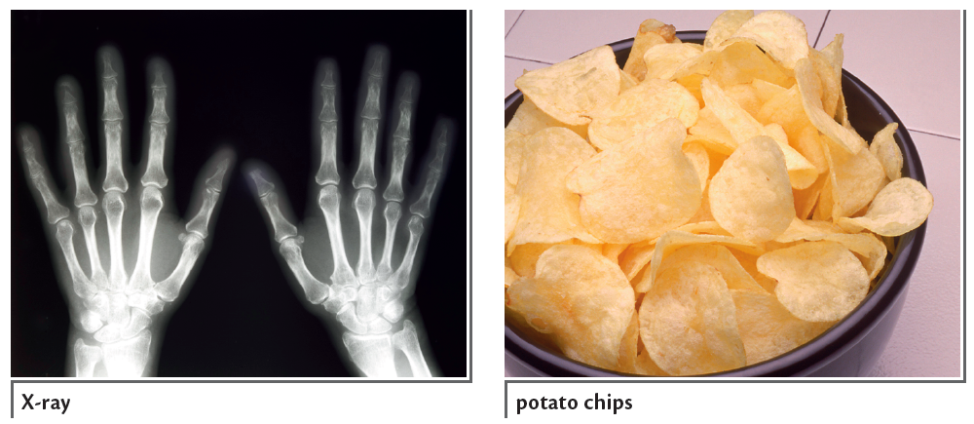
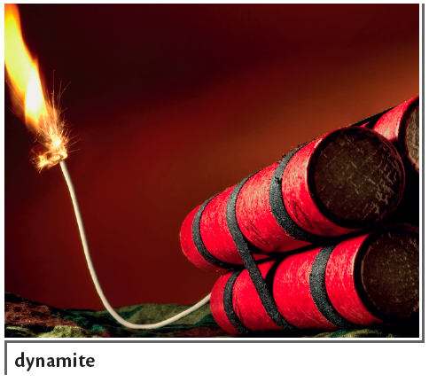



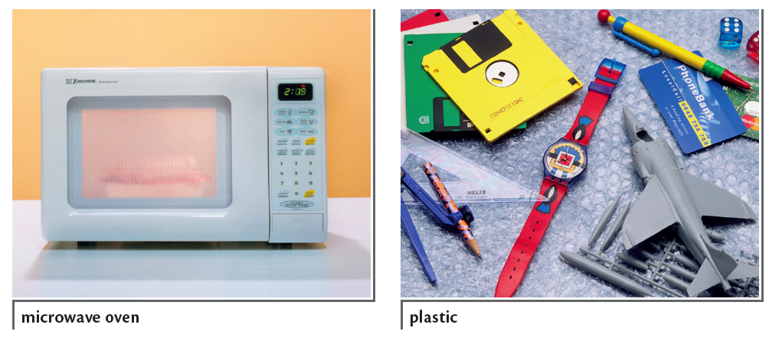





Slide 3
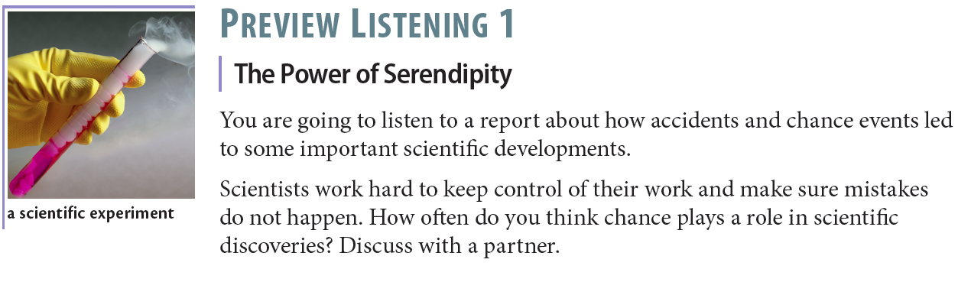

Slide 4
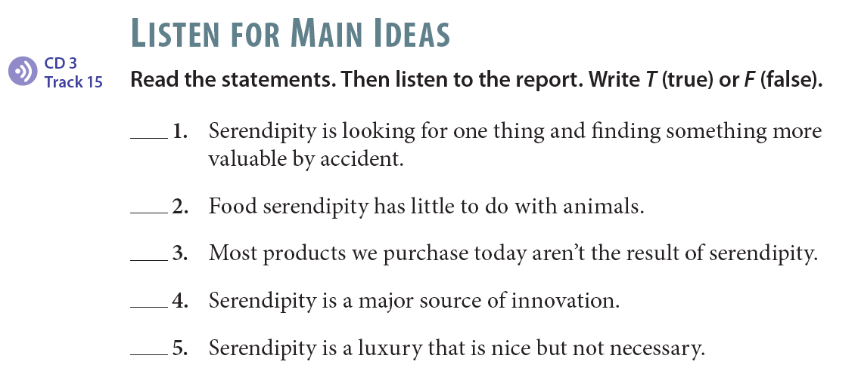
T
F
F
T
F

Slide 5

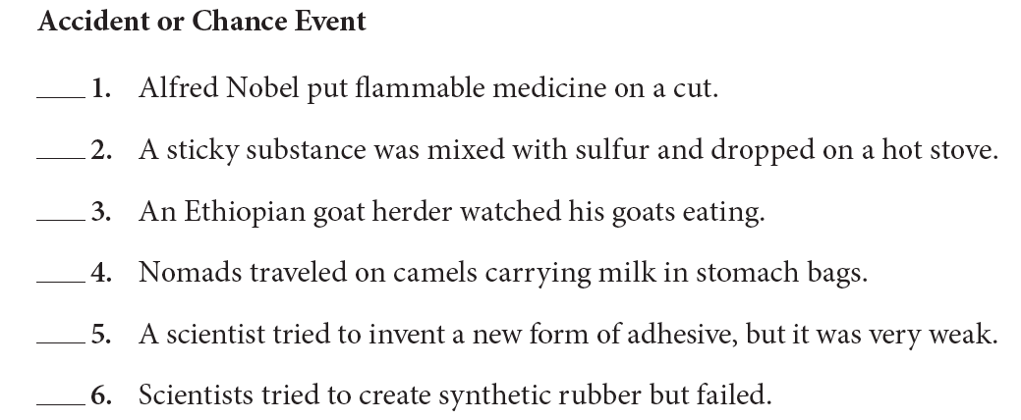
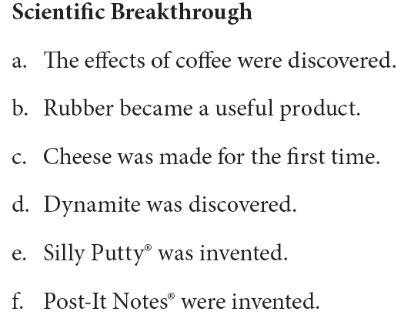
d
b
a
c
f
e

Slide 6
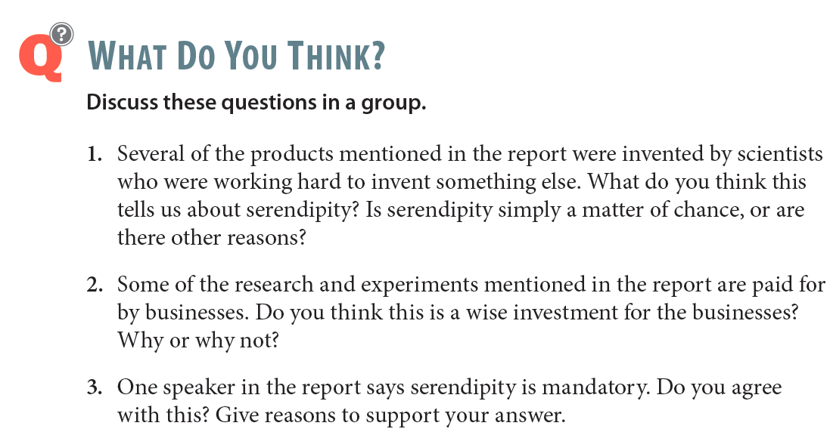

Slide 7
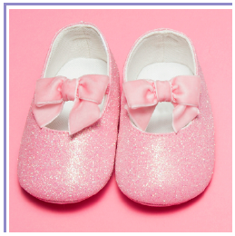
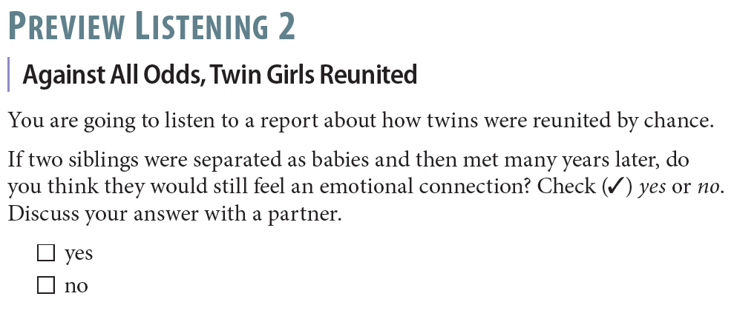

Slide 8
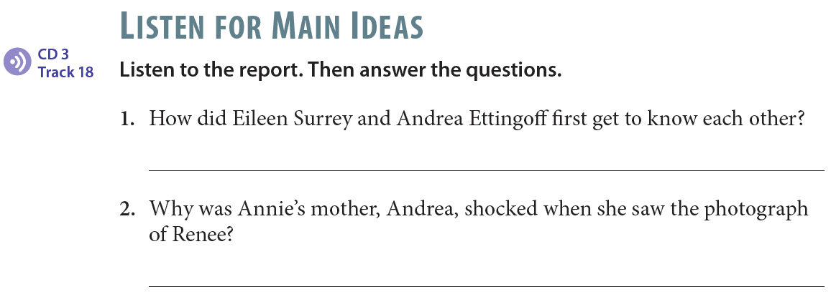
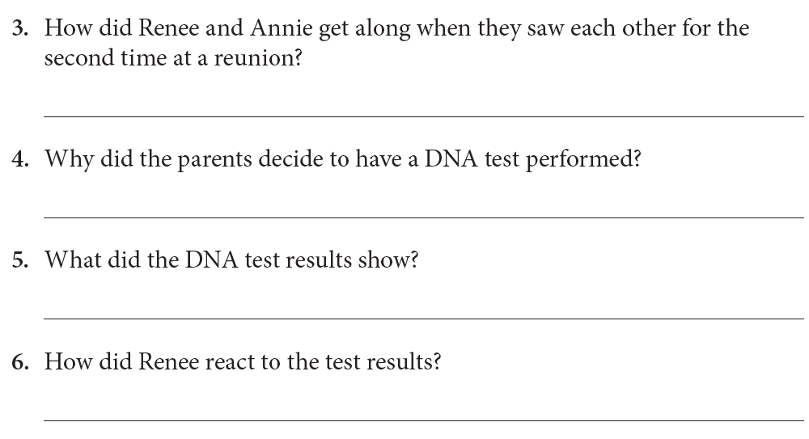
They first got to know each other through an Internet support group.
Renee looked very similar to Annie.
They spent the entire reunion together and became best friends.
The two girls were considering each other as sisters, and Andrea Ettingoff wanted to make sure they weren’t mistaken.

Slide 9
The girls are almost certainly fraternal twins.
She became very excited and happy.

Slide 10
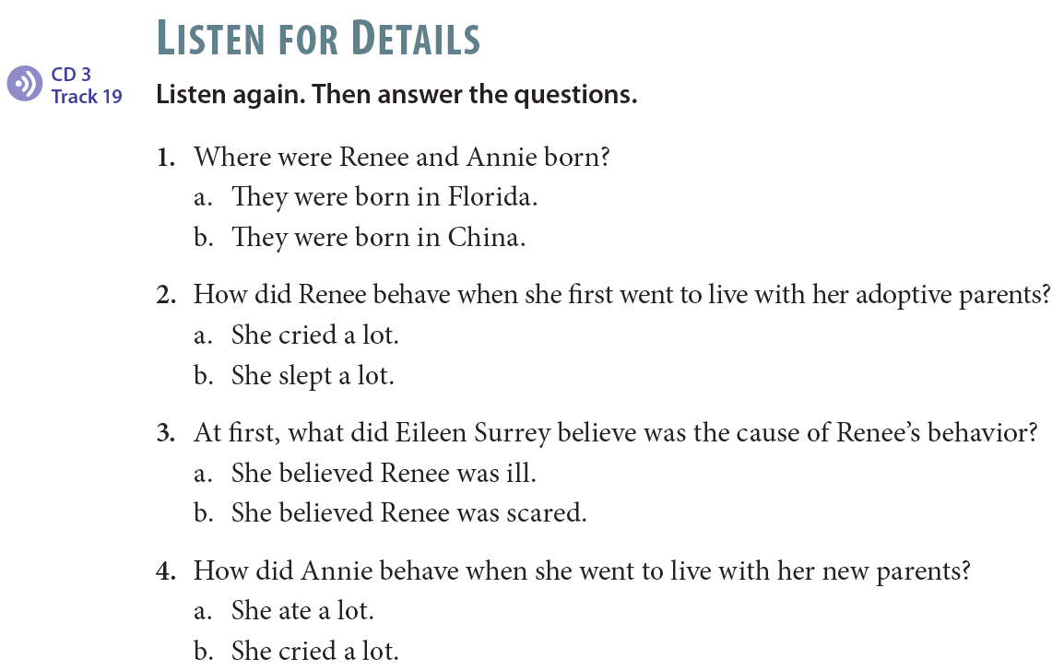

Slide 11
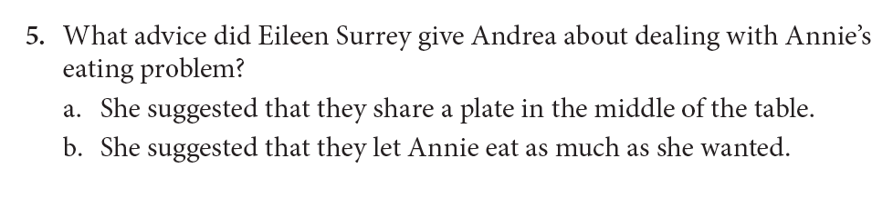
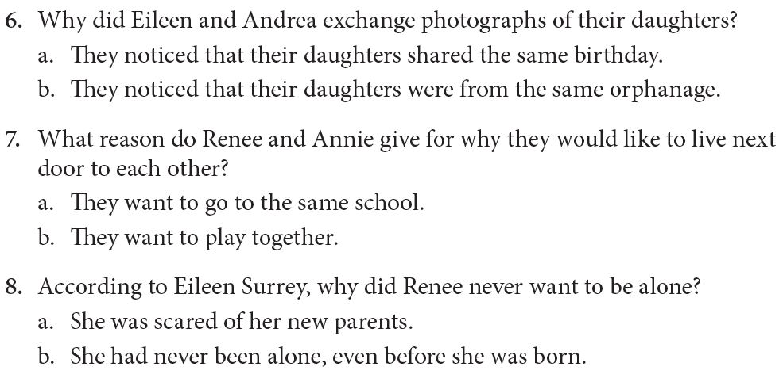

Slide 12
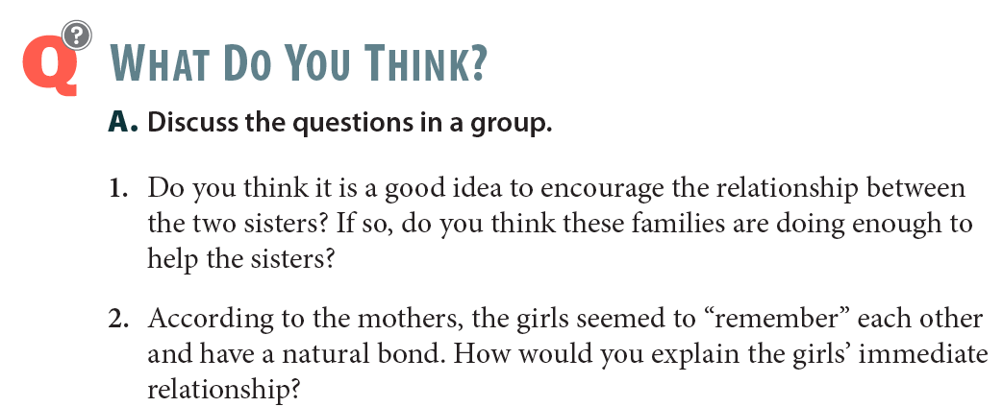

Slide 13


