Slide 1
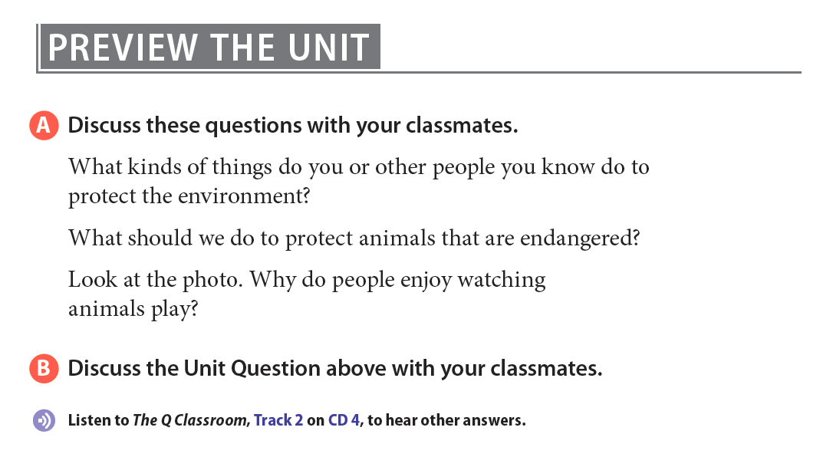
Notes:
A polar bear is playing with a tire. Polar bears are the world’s largest land predators. They live in the Arctic, and are very well adapted to living in cold and snowy conditions. An adult male weighs between 775 and 1500 pounds and a female between 330 and 550 pounds. They feed primarily on seals, waiting near holes in the ice to catch them. With global warming and climate change, the areas of ice and snow become smaller as they melt. Polar bears often have to swim very long distances to find food. Polar bears live in Russia, Canada, Greenland, Norway, and the state of Alaska in the United States. Most populations are declining.

Slide 2
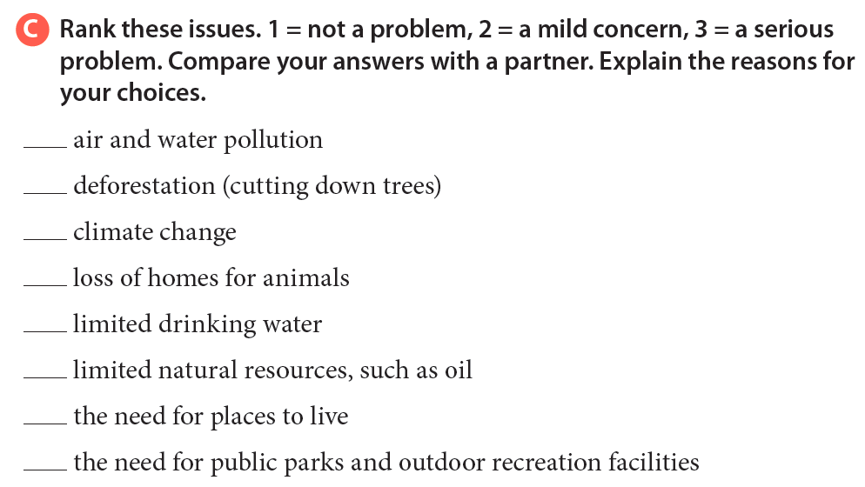

Slide 3


Slide 4



Slide 5
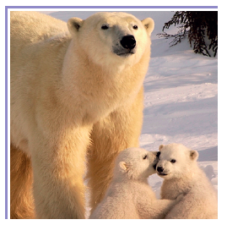
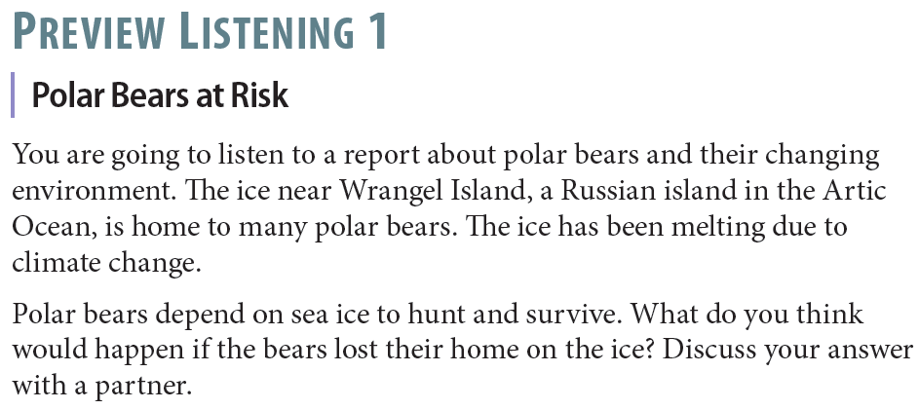

Slide 6

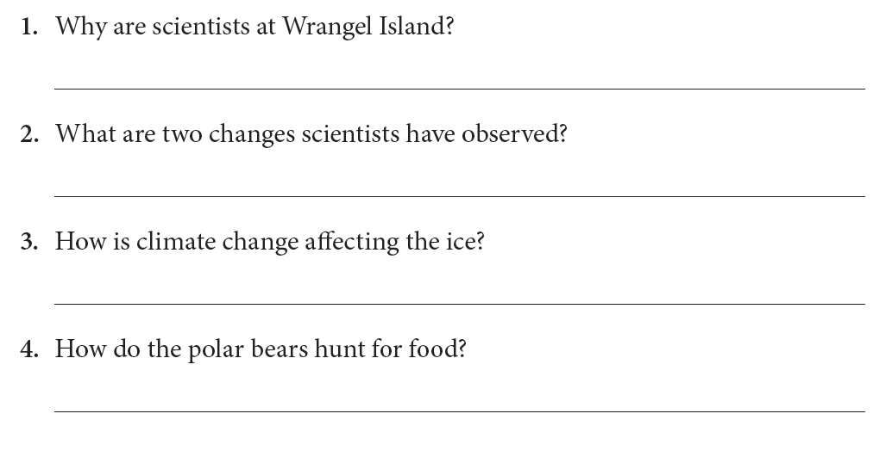
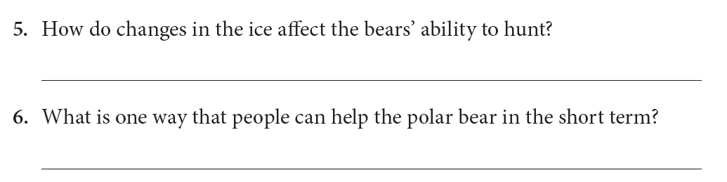
To do research on the polar bears
The polar bear population is smaller; Polar bears are smaller in size; Winter ends earlier.
The ice is melting earlier; The hunting season is shorter.
They stand on the ice to hunt.
Hunting is more difficult; Hunting season is shorter; They have to go farther to find food.
Create refuges

Slide 7
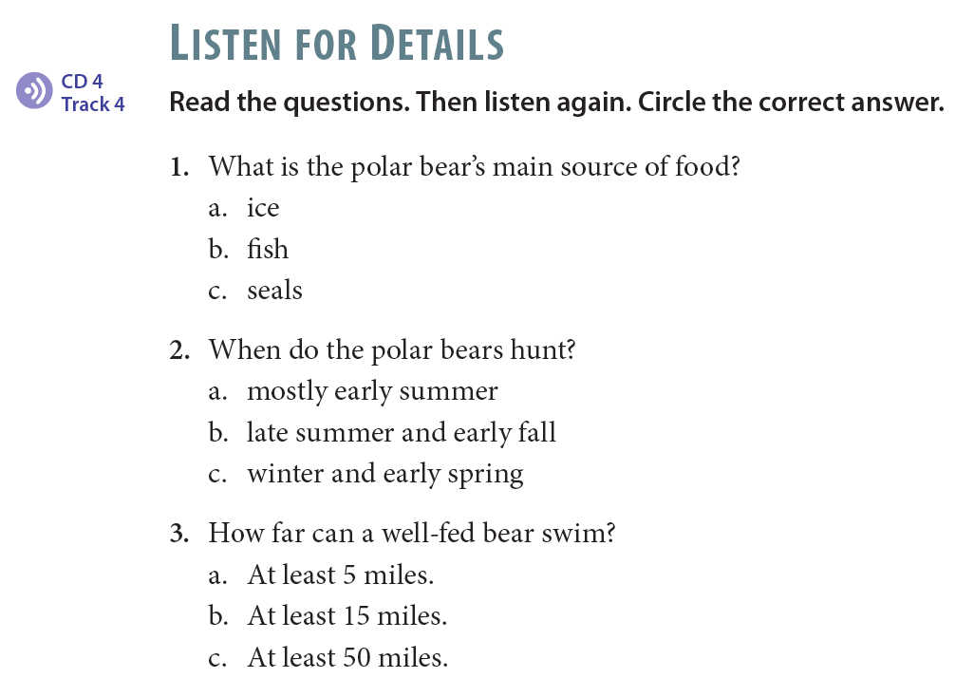

Slide 8
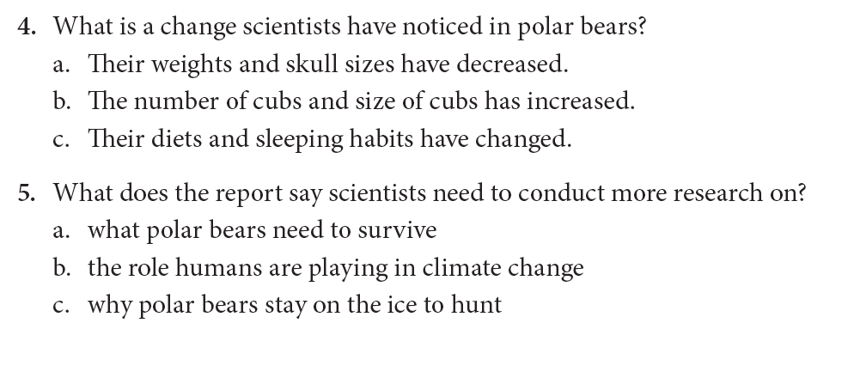

Slide 9
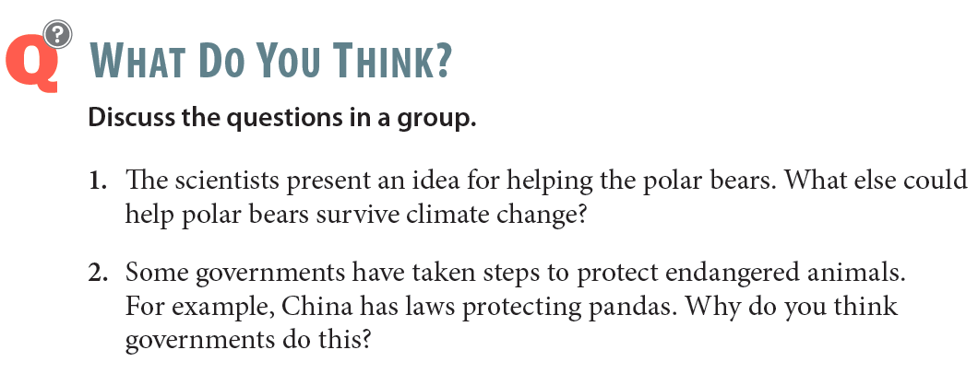

Slide 10

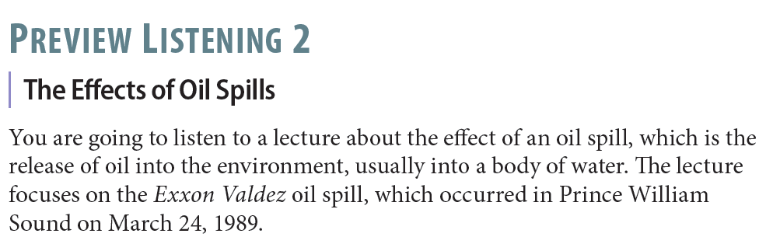
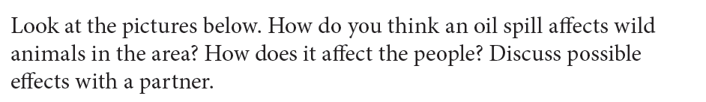
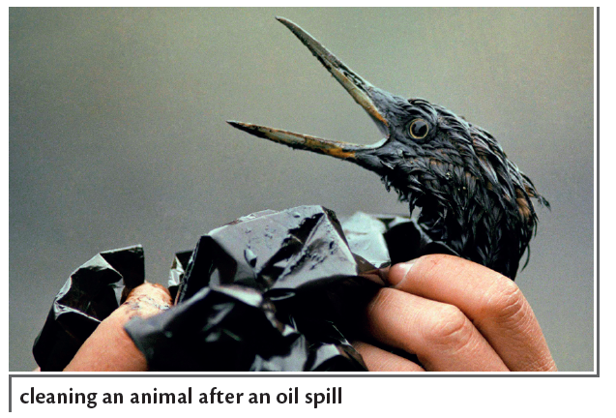

Slide 11
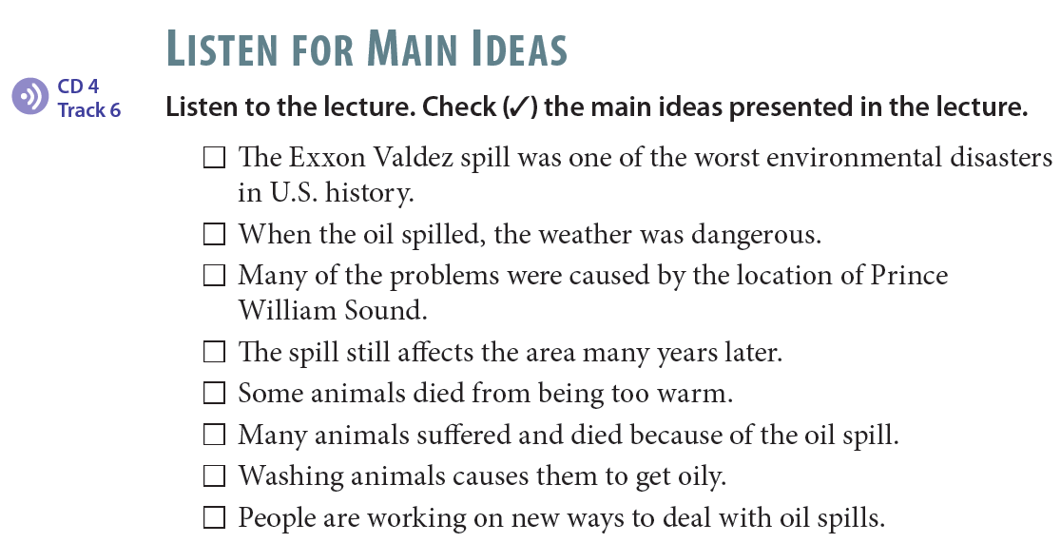
✓
✓
✓
✓
✓

Slide 12
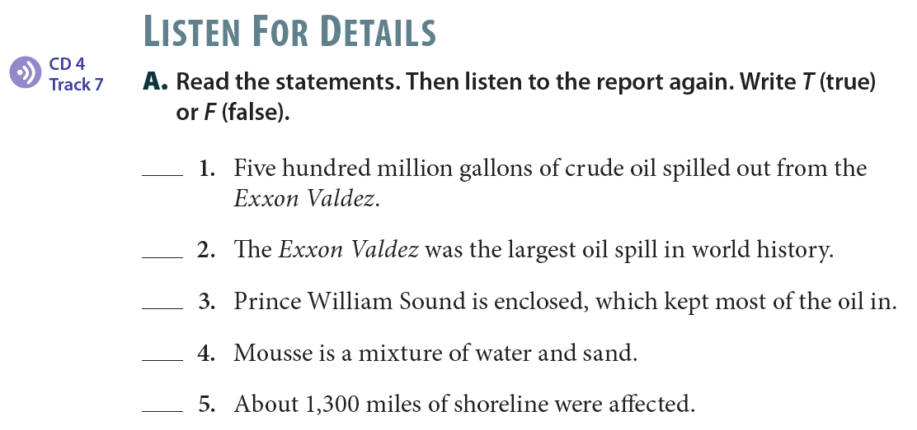
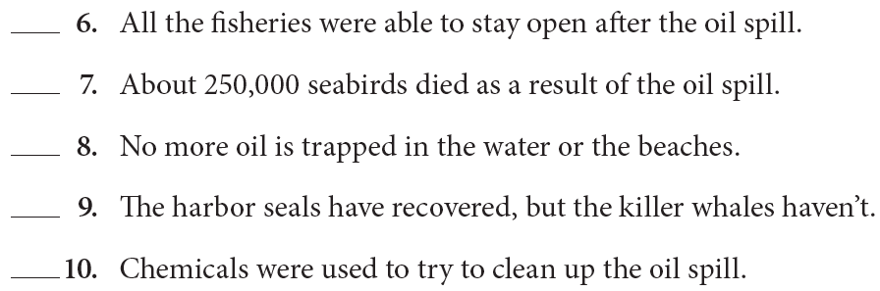
F
F
T
F
T
F
T
F
T
T

Slide 13
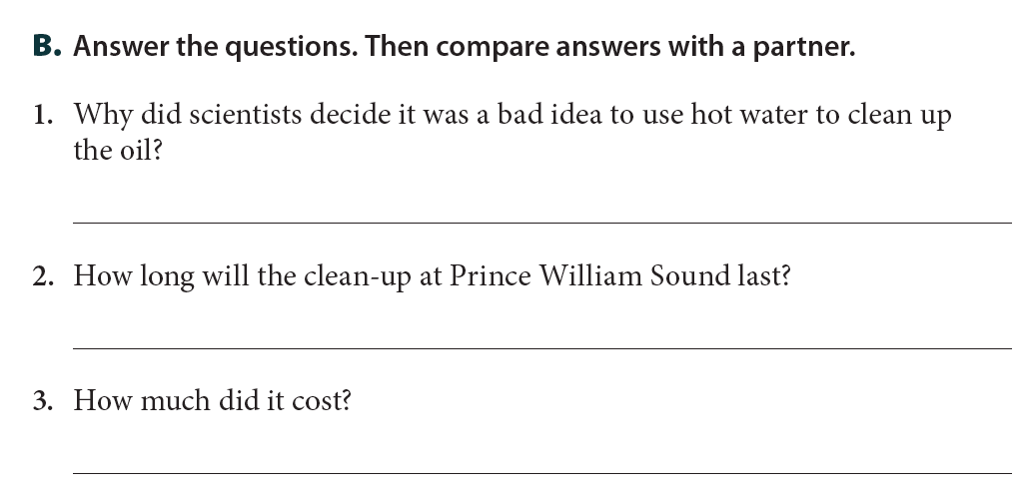
Hot water killed bacteria that help break down oil.
It will last indefinitely.
It has cost $2.1 billion so far.

Slide 14
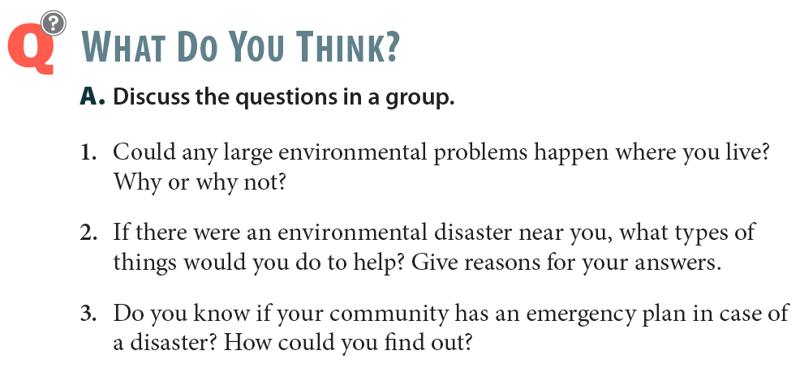

Slide 15


