Slide 1

TRƯỜNG CAO ĐẲNG LÝ TỰ TRỌNG TP. HỒ CHÍ MINH

Slide 2
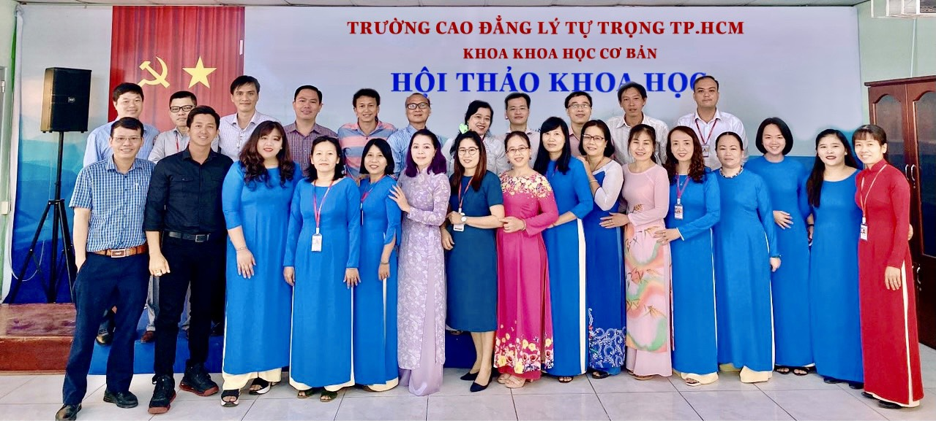
KHOA KHOA HỌC CƠ BẢN

Slide 3

ỦY BAN NHÂN DÂN THÀNH PHỐ HỒ CHÍ MINH
TRƯỜNG CAO ĐẲNG LÝ TỰ TRỌNG TP. HỒ CHÍ MINH
Bậc đào tạo: CAO ĐẲNG CHUYÊN NGHIỆP
Tên giảng viên: TỔ ANH VĂN

Slide 4

Good morning class.

Slide 5
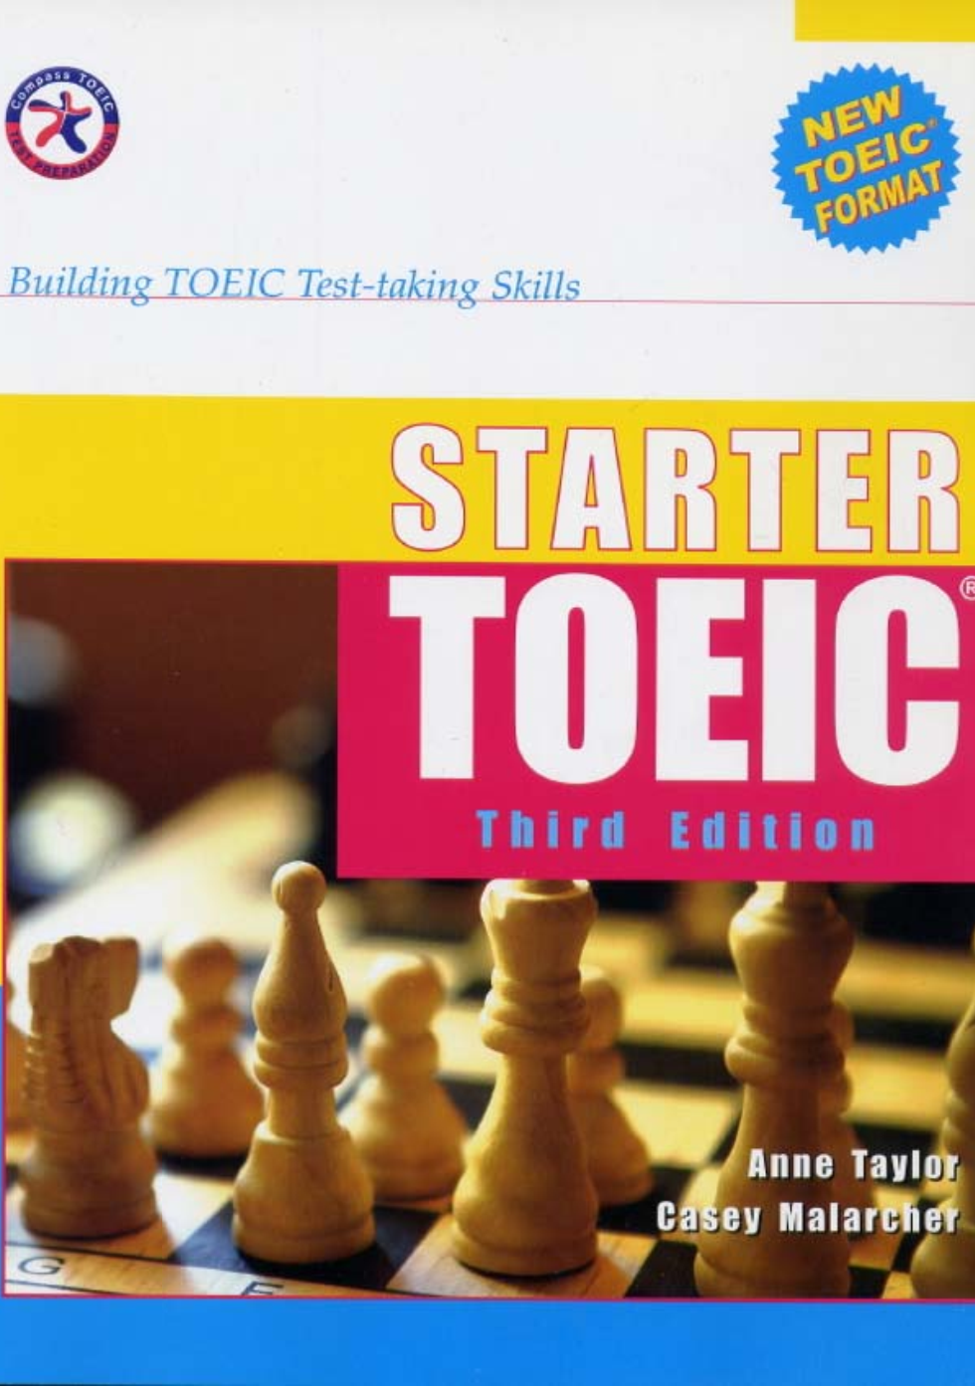

Slide 6
UNIT 9
Modification and Word Order

Slide 7
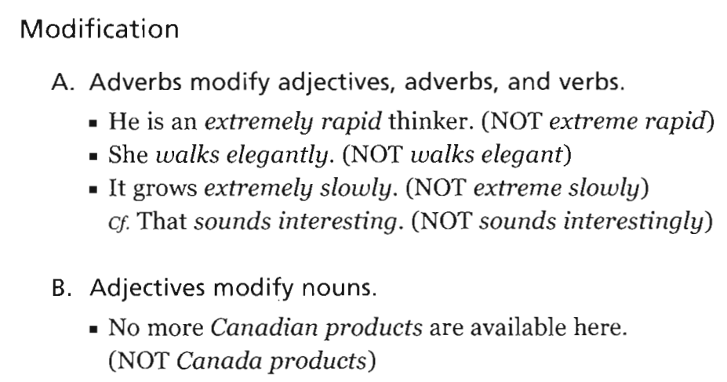
UNIT 9: Modification and Word Order

Slide 8
ADV ADV ADJ N
ADV bổ nghĩa cho động từ thường
ADJ bổ nghĩa cho động từ TOBE
Với những động từ : sound, feel, taste,… theo sau là adj (tính từ)

Slide 9
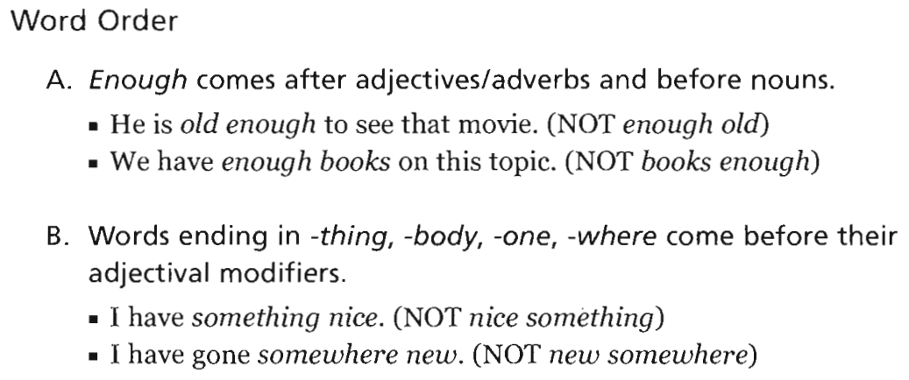
UNIT 9: Modification and Word Order
I have enough money to buy a house
I am old enough to drive car

Slide 10
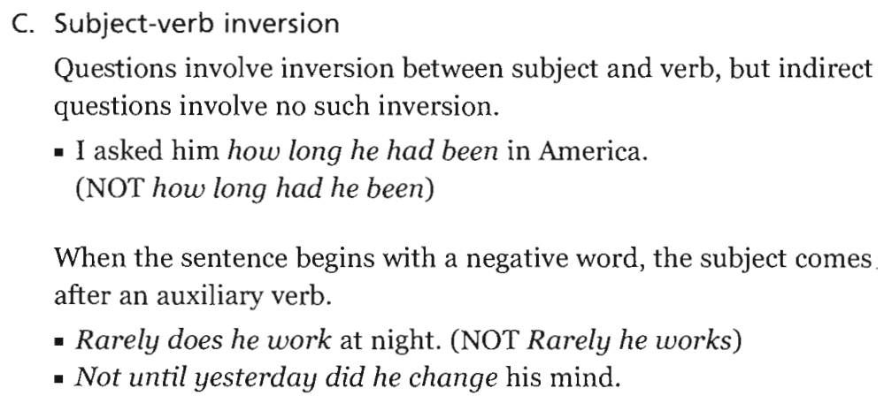
UNIT 9: Modification and Word Order
How long does he stay in HCMC?

Slide 11
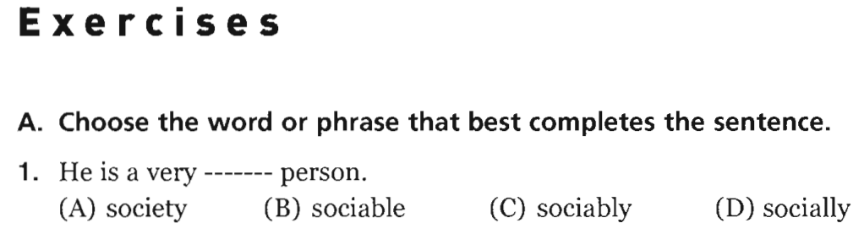
UNIT 9: Modification and Word Order
-> sociable

Slide 12
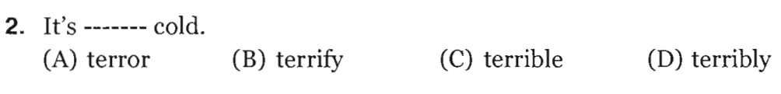
UNIT 9: Modification and Word Order
Exercises
-> terribly

Slide 13
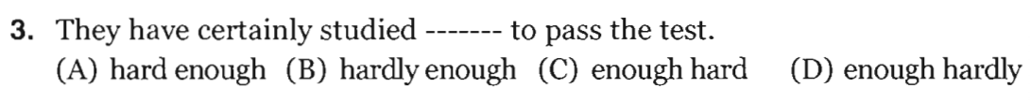
UNIT 9: Modification and Word Order
Exercises
-> hard enough

Slide 14
UNIT 9: Modification and Word Order
Exercises
-> anything new

Slide 15
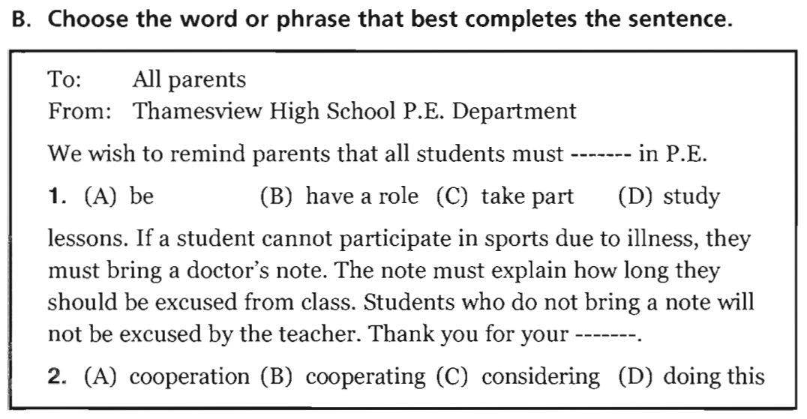
UNIT 9: Modification and Word Order
Exercises

Slide 16
-> 1. take part
-> 2. cooperation

Slide 17
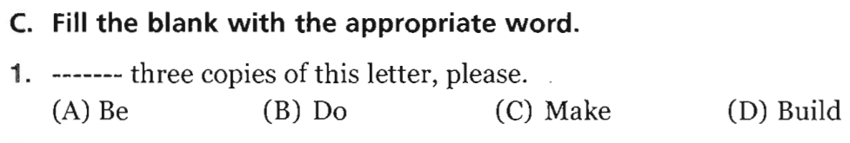
UNIT 9: Modification and Word Order
Exercises
-> Make

Slide 18
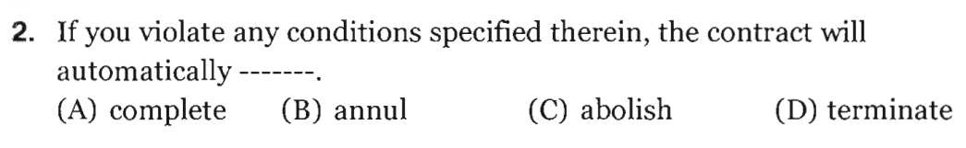
UNIT 9: Modification and Word Order
Exercises
-> terminate

Slide 19
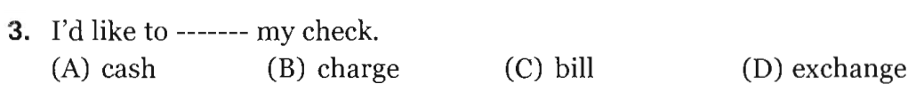
UNIT 9: Modification and Word Order
Exercises
-> cash

Slide 20
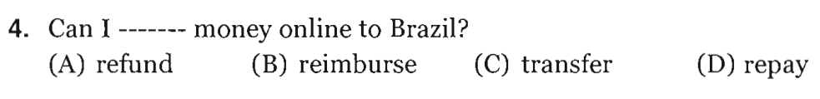
UNIT 9: Modification and Word Order
Exercises
-> transfer

Slide 21
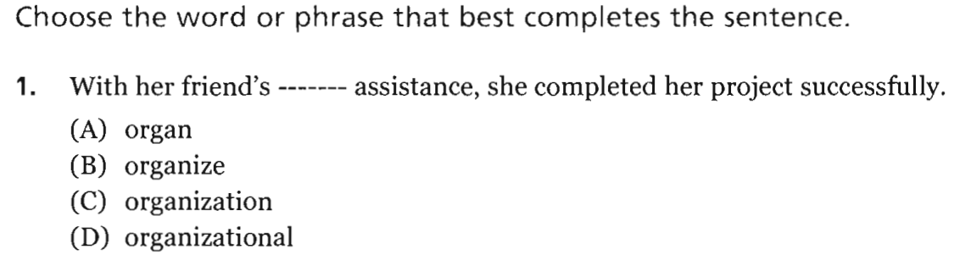
UNIT 9: Modification and Word Order
PART V Incomplete Sentences
-> organizational

Slide 22
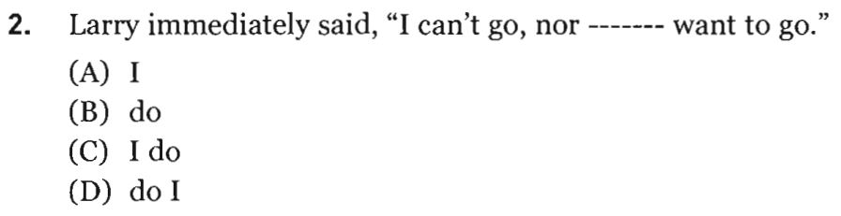
UNIT 9: Modification and Word Order
PART V Incomplete Sentences
-> do I

Slide 23
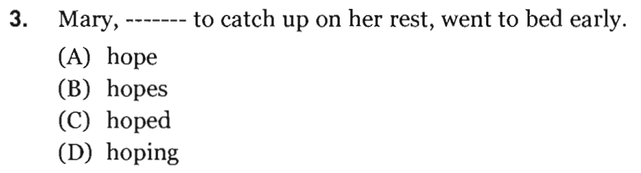
UNIT 9: Modification and Word Order
PART V Incomplete Sentences
-> hoping

Slide 24
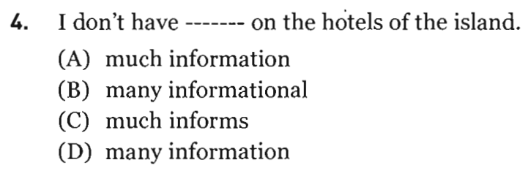
UNIT 9: Modification and Word Order
PART V Incomplete Sentences
-> much information

Slide 25
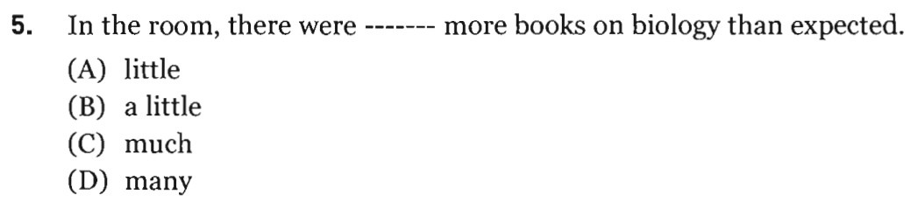
UNIT 9: Modification and Word Order
PART V Incomplete Sentences
-> many

Slide 26
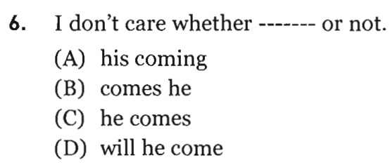
UNIT 9: Modification and Word Order
PART V Incomplete Sentences
-> he comes

Slide 27
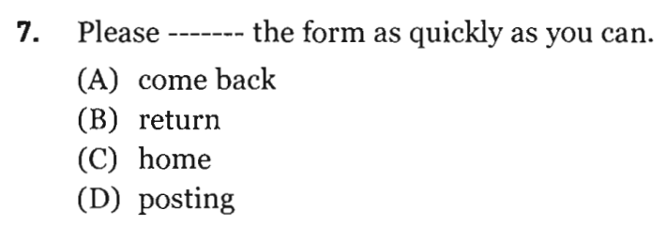
UNIT 9: Modification and Word Order
PART V Incomplete Sentences
-> return

Slide 28
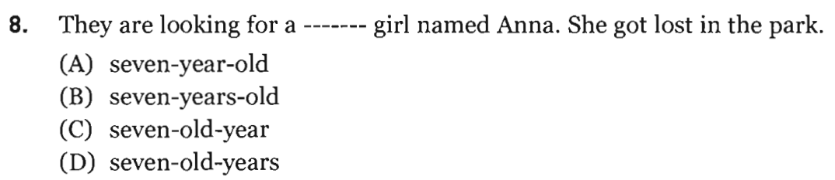
UNIT 9: Modification and Word Order
PART V Incomplete Sentences
-> seven-year-old

Slide 29
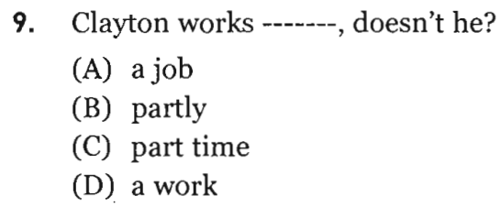
UNIT 9: Modification and Word Order
PART V Incomplete Sentences
-> part time

Slide 30
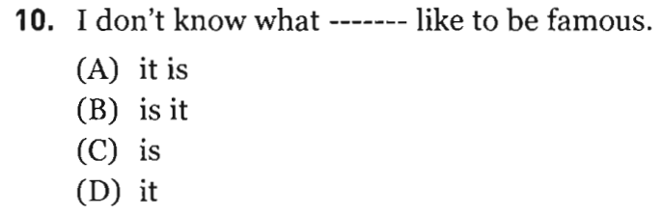
UNIT 9: Modification and Word Order
PART V Incomplete Sentences
-> it is

Slide 31
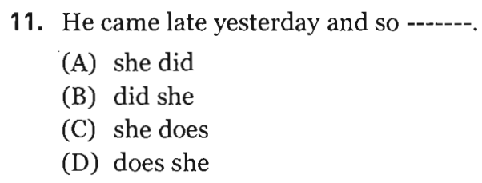
UNIT 9: Modification and Word Order
PART V Incomplete Sentences
-> did she

Slide 32
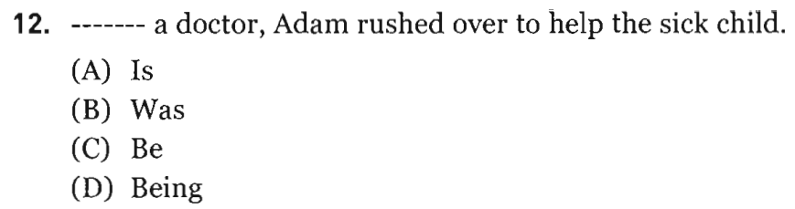
UNIT 9: Modification and Word Order
PART V Incomplete Sentences
-> Being

Slide 33
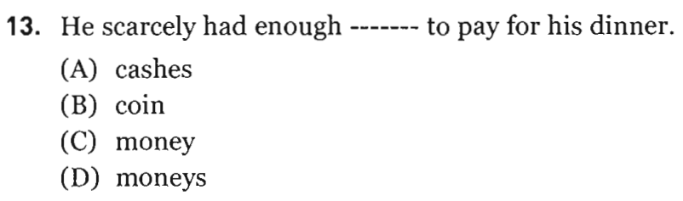
UNIT 9: Modification and Word Order
PART V Incomplete Sentences
-> money

Slide 34
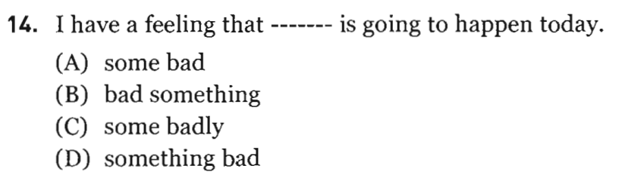
UNIT 9: Modification and Word Order
PART V Incomplete Sentences
-> something bad

Slide 35
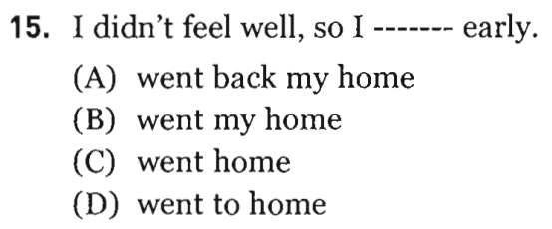
UNIT 9: Modification and Word Order
PART V Incomplete Sentences
-> went home

Slide 36
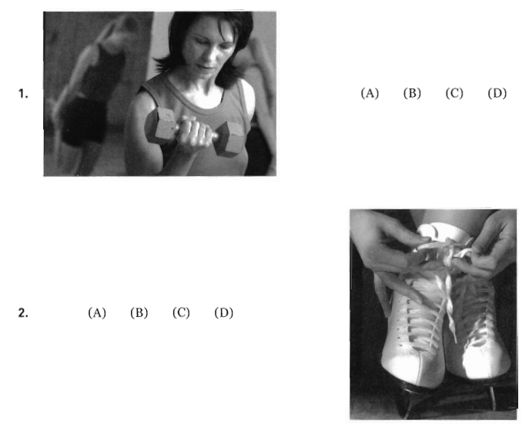
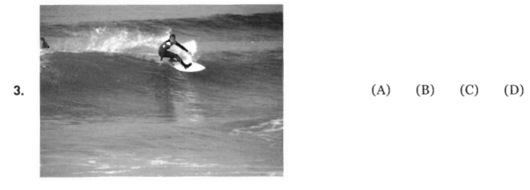
UNIT 9: Modification and Word Order
PART I Picture Description

Slide 37
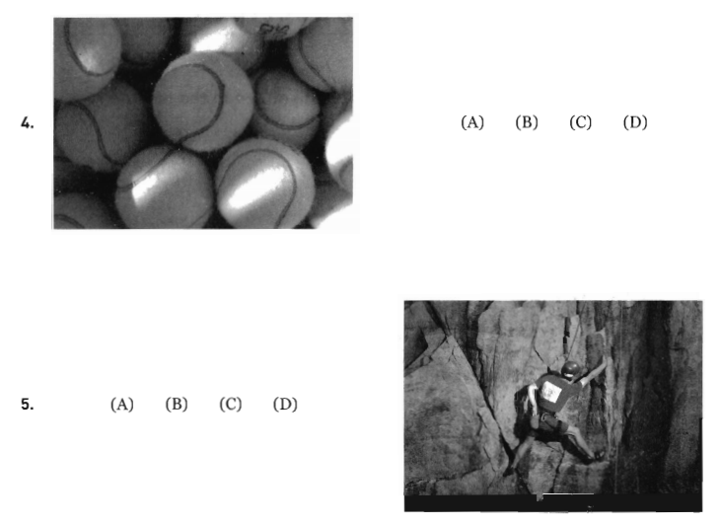
UNIT 9: Modification and Word Order
PART I Picture Description

Slide 38
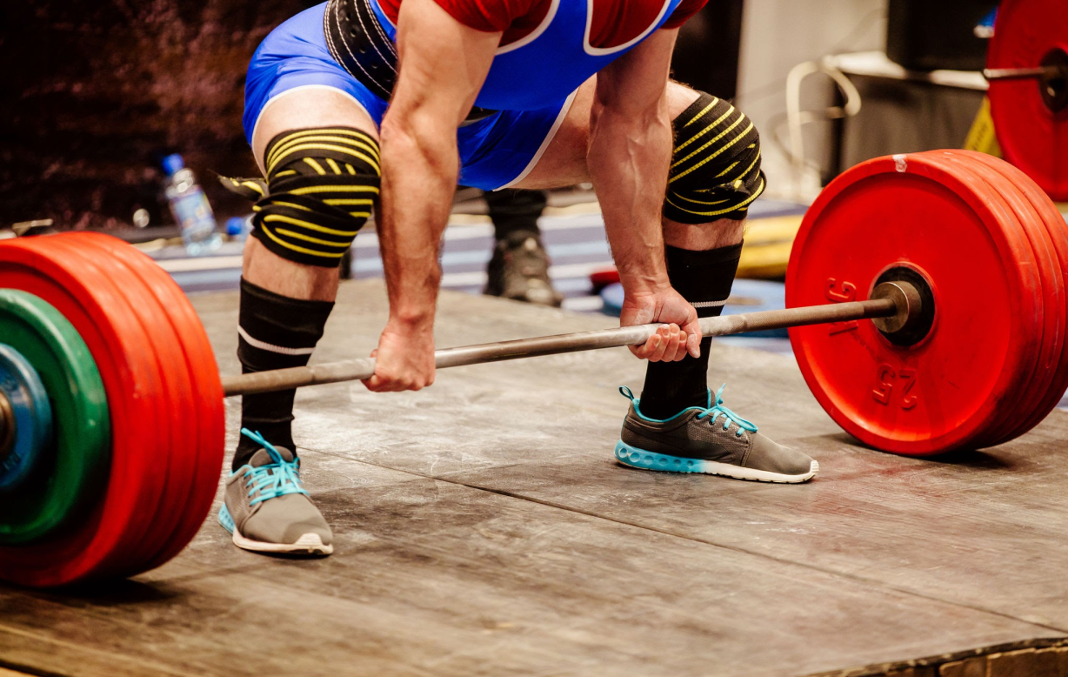
UNIT 9: Modification and Word Order
PART I Picture Description
New words:
1. weight-lifting

Slide 39
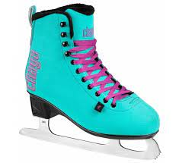
UNIT 9: Modification and Word Order
PART I Picture Description
New words:
2. ice-skates

Slide 40
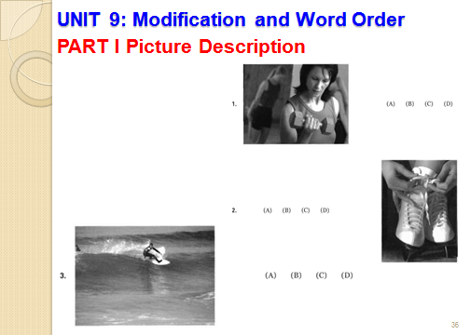


Slide 41
UNIT 9: Modification and Word Order
PART I Picture Description

Slide 42
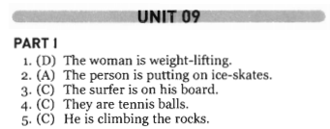
UNIT 9: Modification and Word Order
PART I Picture Description
Answer Key

Slide 43
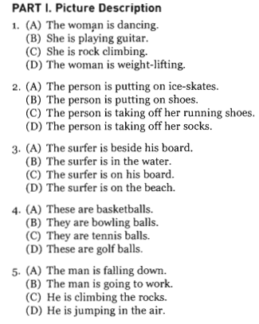
UNIT 9: Modification and Word Order
PART I Picture Description
Transcripts

Slide 44
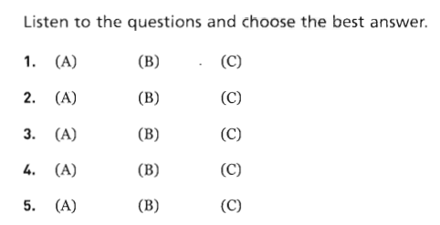
UNIT 9: Modification and Word Order
PART II Questions and Responses

Slide 45

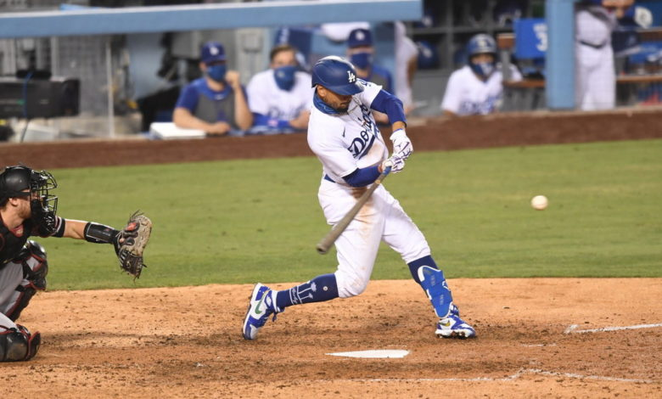
UNIT 9: Modification and Word Order
PART II Questions and Responses
1. baseball game

Slide 46
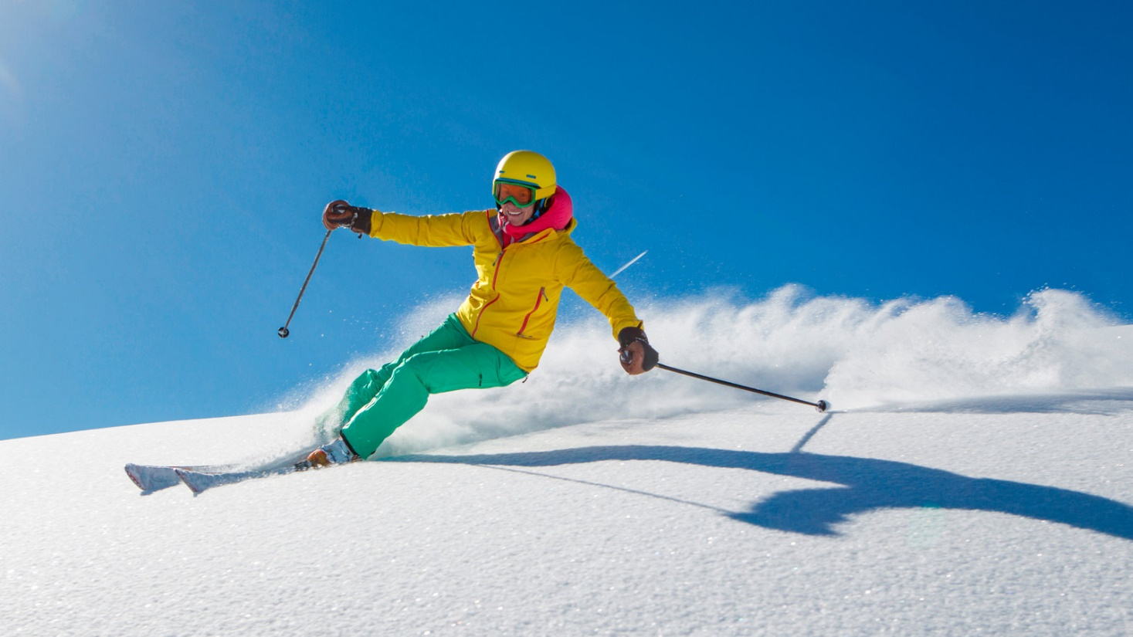
UNIT 9: Modification and Word Order
PART II Questions and Responses
2. ski

Slide 47
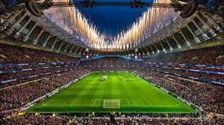
UNIT 9: Modification and Word Order
PART II Questions and Responses
3. stadium

Slide 48
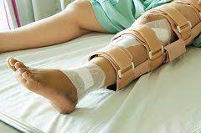
UNIT 9: Modification and Word Order
PART II Questions and Responses
4. injure your leg

Slide 49
UNIT 9: Modification and Word Order
PART II Questions and Responses

Slide 50
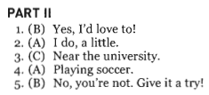
UNIT 9: Modification and Word Order
PART II Questions and Responses
Answer Key

Slide 51
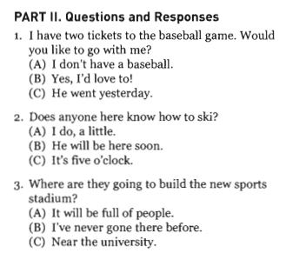
UNIT 9: Modification and Word Order
PART II Questions and Responses
Transcripts

Slide 52
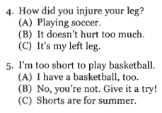
UNIT 9: Modification and Word Order
PART II Questions and Responses
Transcripts

Slide 53
English Discoveries
Intermediate 1 Unit 6 At Work

Slide 54
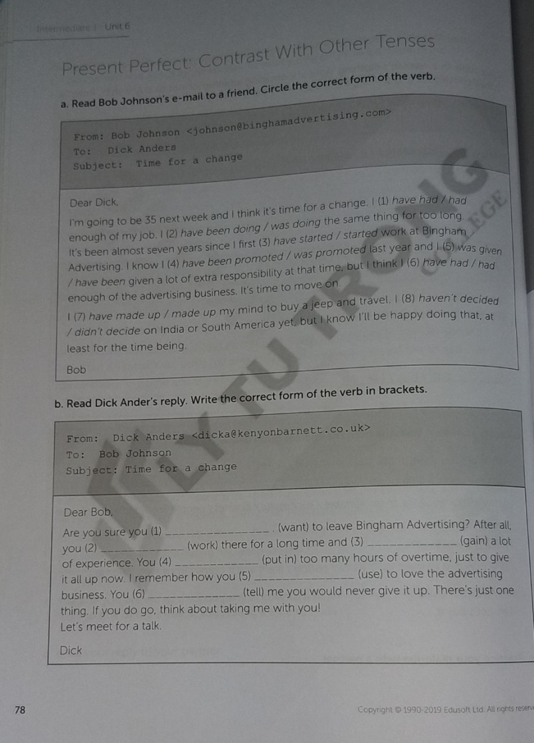
English Discoveries
Intermediate 1 Unit 6 At Work – Page 78

Slide 55
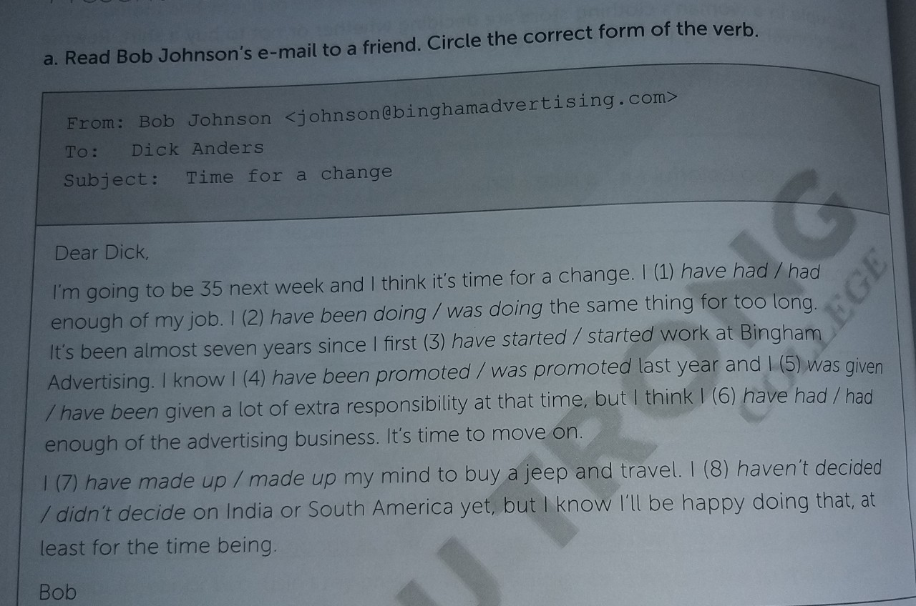
English Discoveries
Intermediate 1 Unit 6 At Work

Slide 56
English Discoveries
Intermediate 1 Unit 6 At Work
Answer Key a
have had
have been doing
started
was promoted
was given
have had
have made up
haven’t decided

Slide 57
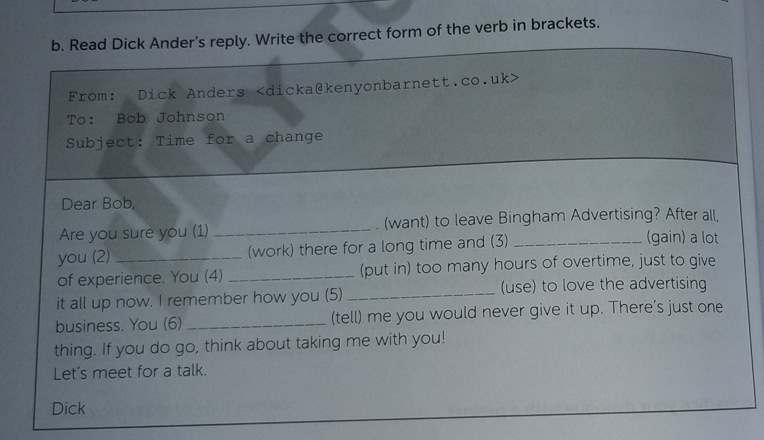
English Discoveries
Intermediate 1 Unit 6 At Work

Slide 58
English Discoveries
Intermediate 1 Unit 6 At Work
Answer Key b
want
have been working / have worked
have gained
have put in
used
told

Slide 59

Thank you very much
for your cooperation.

