Slide 1

TRƯỜNG CAO ĐẲNG LÝ TỰ TRỌNG TP. HỒ CHÍ MINH

Slide 2

ỦY BAN NHÂN DÂN THÀNH PHỐ HỒ CHÍ MINH
TRƯỜNG CAO ĐẲNG LÝ TỰ TRỌNG TP. HỒ CHÍ MINH
Bậc đào tạo: CAO ĐẲNG CHUYÊN NGHIỆP
KHOA NGOẠI NGỮ

Slide 3
Good afternoon everyone

Slide 4


Slide 5
UNIT 4: Participles and Participle Clauses
Page 26

Slide 6
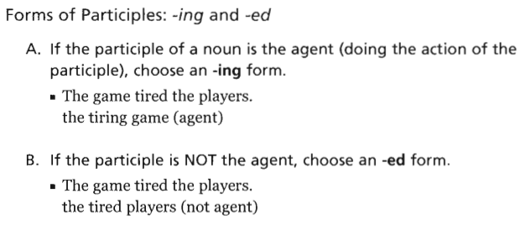
UNIT 4: Participles and Participle Clauses
Page 26
=> Adj + NOUN
Interest => interesting/ interested
Excite => exciting/ excited
Tire ➔ tiring/ tired
Bore => boring/ bored
Know => well-known
NOUN (thing/ event) _:adj (V_ing)
NOUN (people): Adj (V-ed)

Slide 7
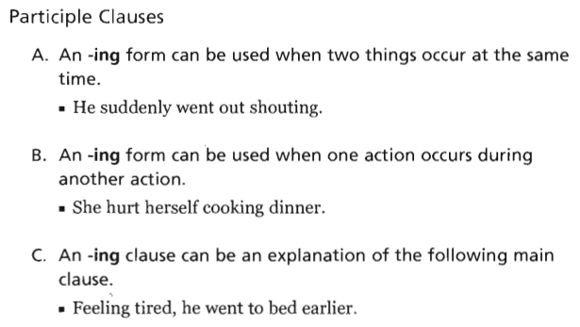
UNIT 4: Participles and Participle Clauses
Page 26
She hurt herself while she was cooking dinner
He felt Feeling tired, he went to bed early.

Slide 8
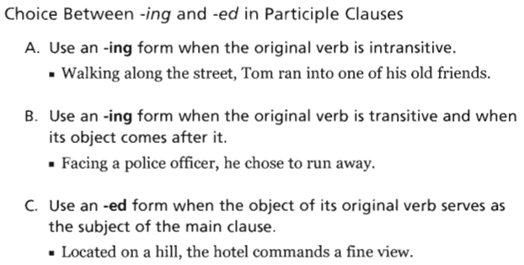
UNIT 4: Participles and Participle Clauses
Page 26
Tom was walking along the street, Tom ran into one of his old friends.
He faced Facing a police officer, he chose to run away
They located the hotel on a hill, the hotel commands a fine view.
The hotel was Located on a hill, the hotel commands a fine view.

Slide 9
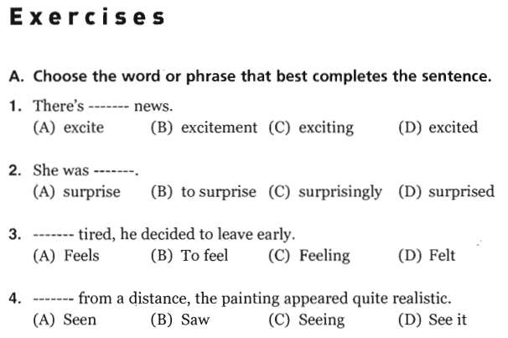
UNIT 4: Participles and Participle Clauses
Page 27
1. C. exciting
2. D. surprised
3. C. Feeling
4. A. Seen

Slide 10
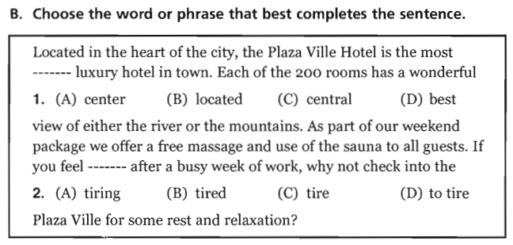
UNIT 4: Participles and Participle Clauses
Page 27
1. C. central
2. B. tired
3. C. Feeling
4. A. Seen

Slide 11
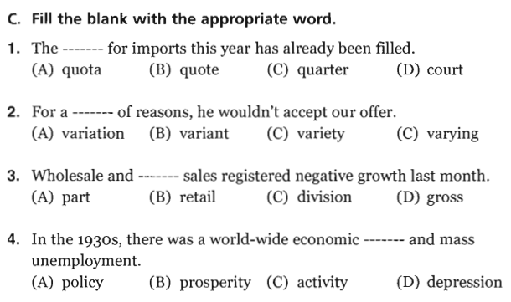
UNIT 4: Participles and Participle Clauses
Page 27
1. A. quota
2. C. variety
3. B. retail
4. D. depression

Slide 12
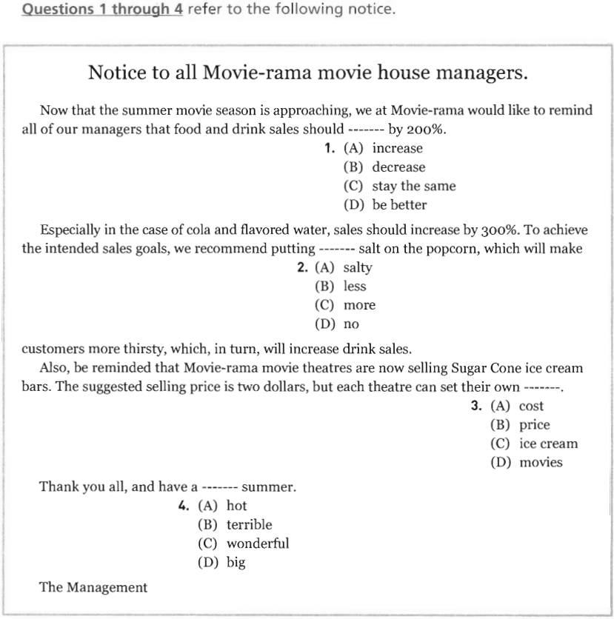
UNIT 4: Participles and Participle Clauses
Part VI - Page 104
1. A. increase
2. C. more
3. B. price
4. C. wonderful

Slide 13
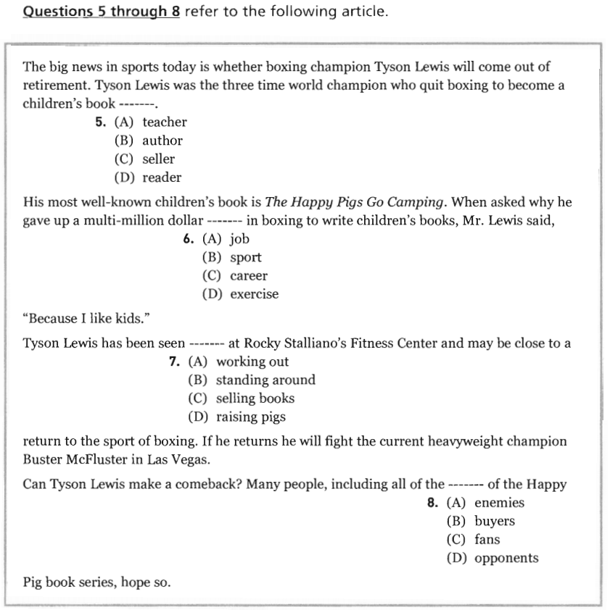
UNIT 4: Participles and Participle Clauses
Part VI - Page 105
5. B. author
1. A. increase
2. C. more
6. C. career
7. A. working out
8. C. fans

Slide 14
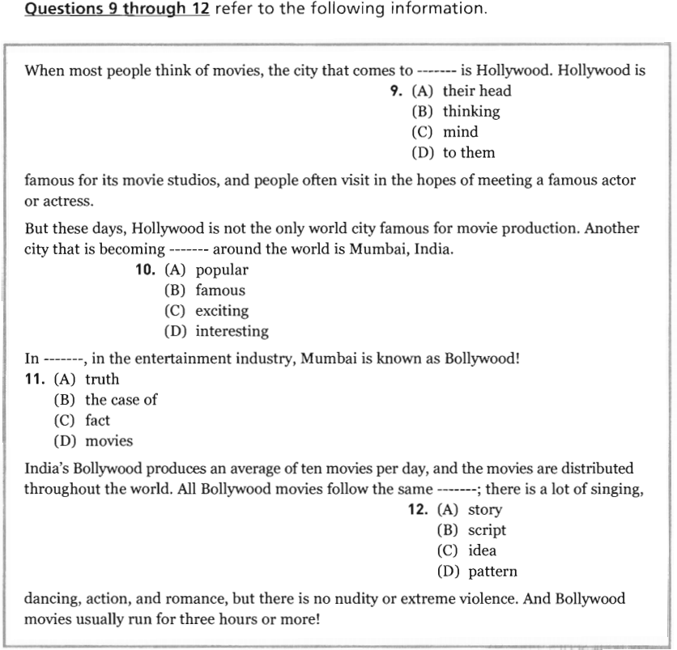
UNIT 4: Participles and Participle Clauses
Part VI - Page 105
9. C. mind
10. B. famous
11. C. fact
12. D. story

Slide 15
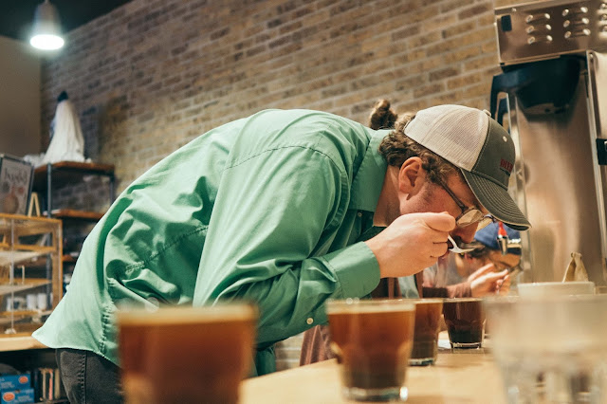
VOCABULARY
1/ To set in (phrasal verb): bắt đầu xảy ra (Khi điều gì đó khó chịu)
Ex: It is normal that in winter, darkness often sets in earlier than in the summer.
2/ To take a look at something (consider a problem or possibility very carefully and without hurrying)
Look at sth. carefully

Slide 16
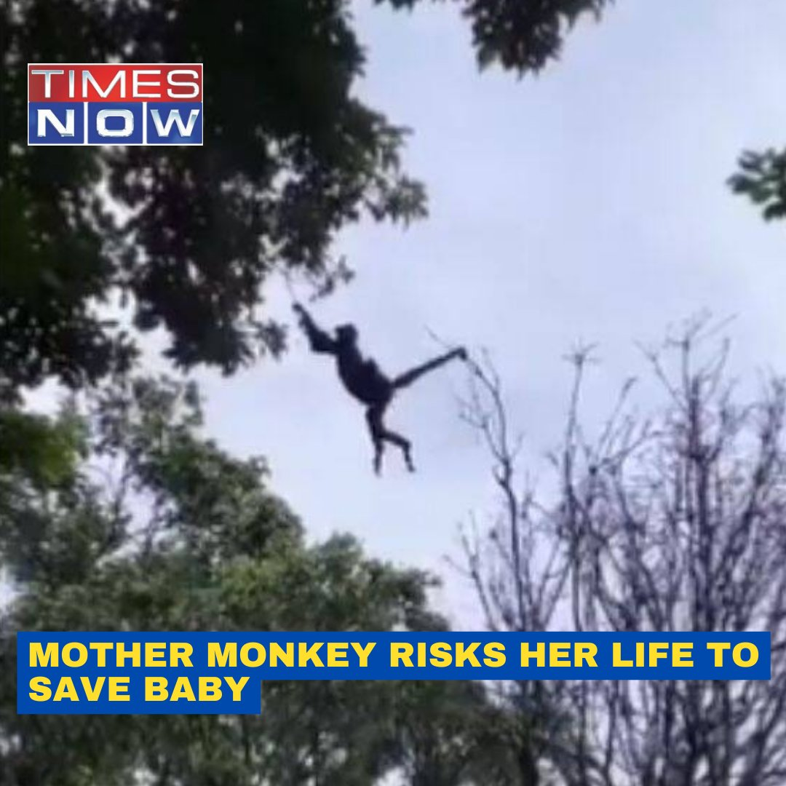
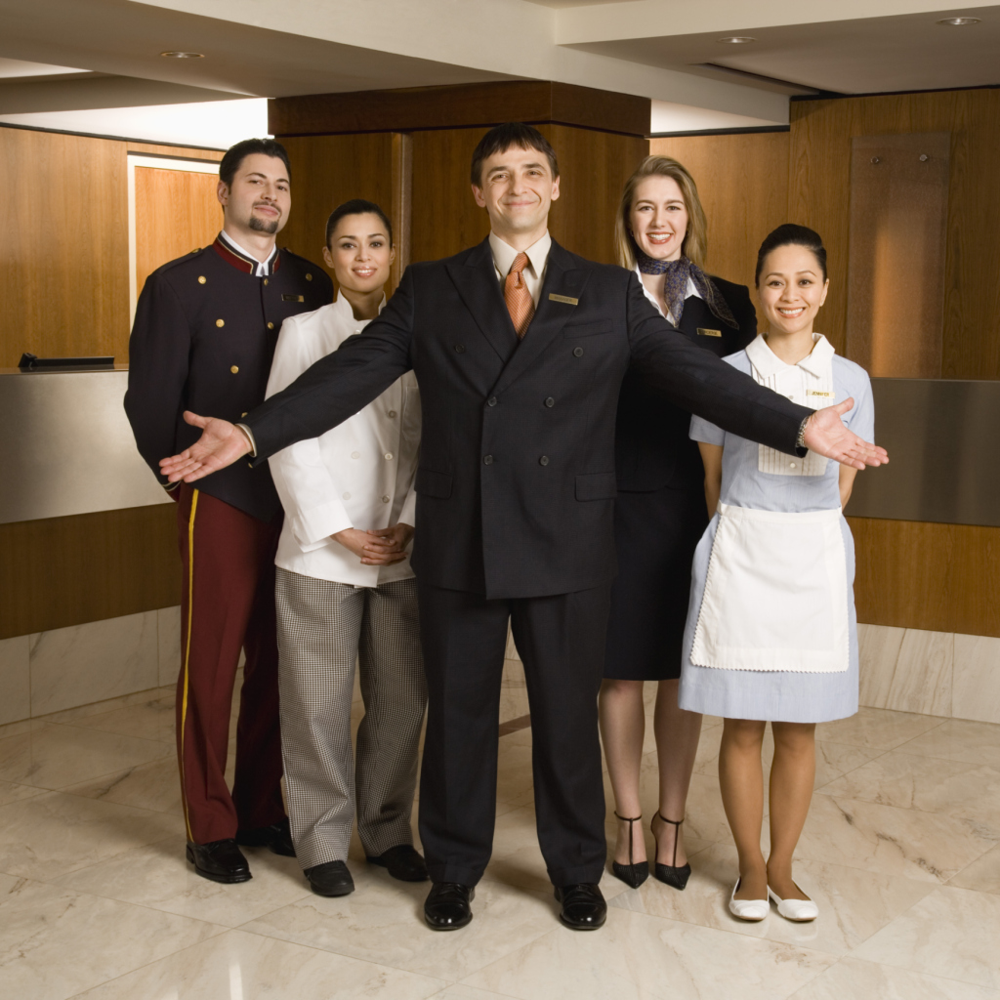
3/To risk one’s lifer to save someone:
Liều mạng cứu ai đó
4/ A hotel manager:

Slide 17
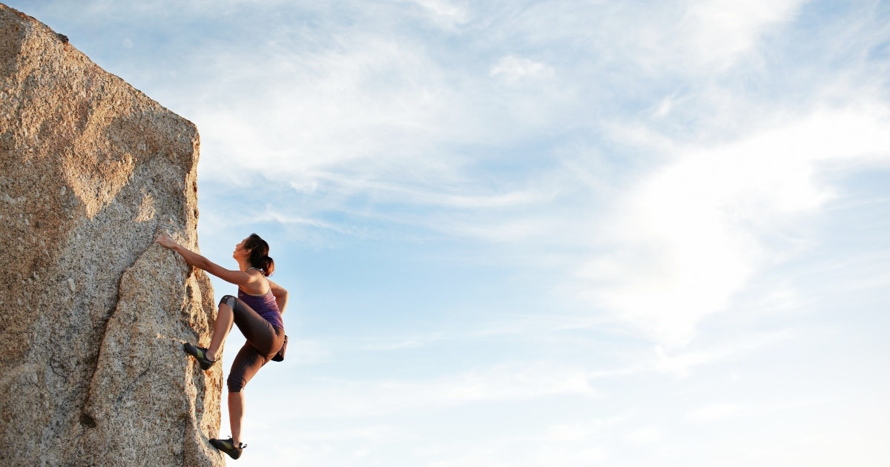

5/Bravery (n)/ˈbreɪvəri/
Brave (adj): gan dạ, dũng cảm
6/ nationwide (adj/adv) /ˌneɪʃnˈwaɪd/
/ˌneɪʃnˈwaɪd/ (​happening or existing in all parts of a particular country)
7/ Academy Award: phần thưởng hàng năm do Hàn lâm viện điện ảnh - nghệ thuật - khoa học Mỹ dành cho những thành tựu về điện ảnh
Ex: The Lion King earned two additional Academy Award nominations for Best Original Song, giving it a total of four Academy Award nominations.
➥ Vua sư tử nhận được hai đề cử giải Oscar nữa cho giải Bài hát gốc hay nhất, tổng cộng là 4 đề cử.
Khắp cả nước

Slide 18
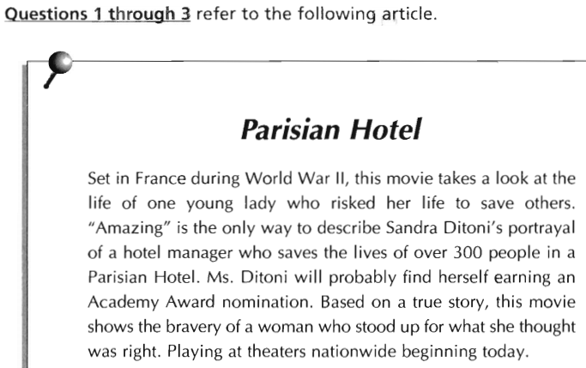
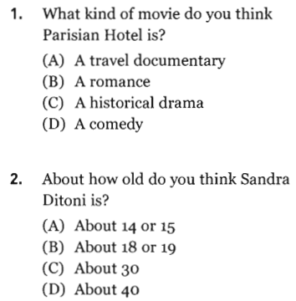
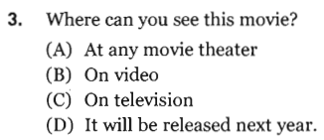
UNIT 4: Participles and Participle Clauses
Part VII - Page 107
1. C. A historical drama
9. C. mind
2. B. About 18 or 19
10. B. famous
3. A. At any movie theater

Slide 19
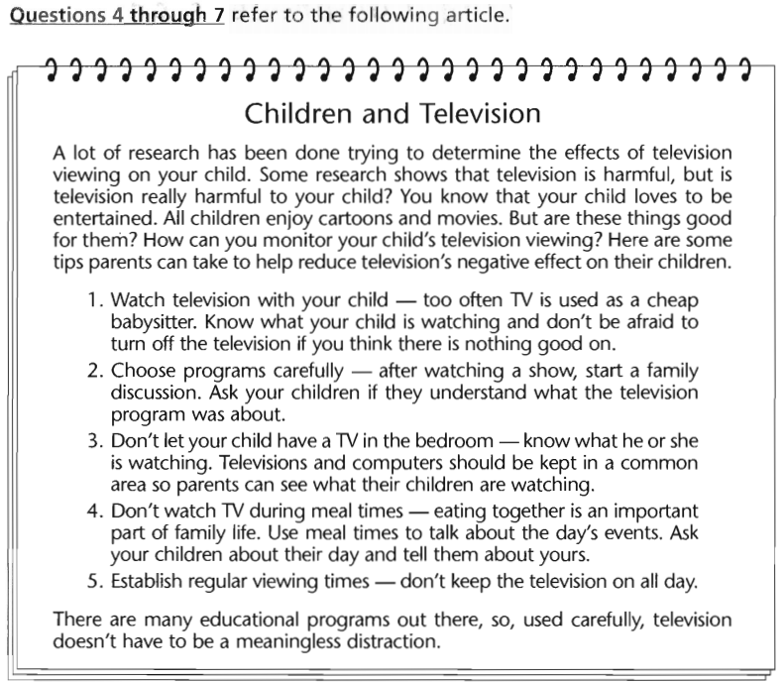
9. C. mind
10. B. famous
3. A. At any movie theater

Slide 20
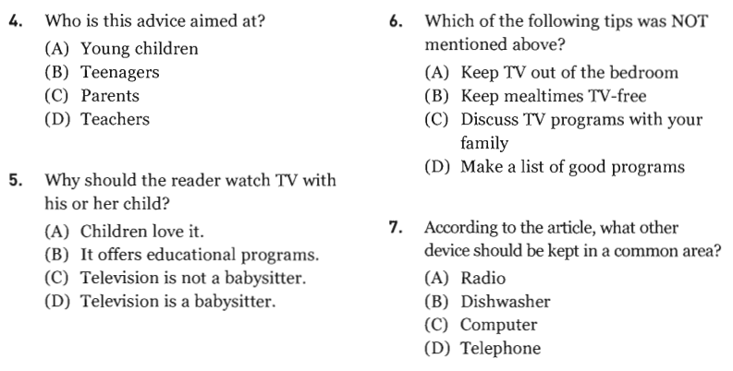
Part VII - Page 108
9. C. mind
10. B. famous
3. A. At any movie theater

Slide 21

Part VII - Page 108
4. C. Parents
5. C. Television is not a babysitter.
6. D. Make a list of good programs
7. C. Computer

Slide 22
Harmful /ˈhɑːmfl/ (adj): có hại
Reduce /rɪˈduːs/ (v): giảm bớt
Effect /ɪˈfekt/ (n): hiệu ứng
establish /ɪˈstæblɪʃ/ (v): thiết lập
Meaningless /ˈmiːnɪŋləs/ (adj): vô nghĩa
Distraction /dɪˈstrækʃn/ (n): trò tiêu khiển, trò giải trí
Câu mệnh lệnh (Imperative Sentences)
Verb + (Object) → positives
Don’t + Vo + (Object) → Negatives
Ex:

Slide 23
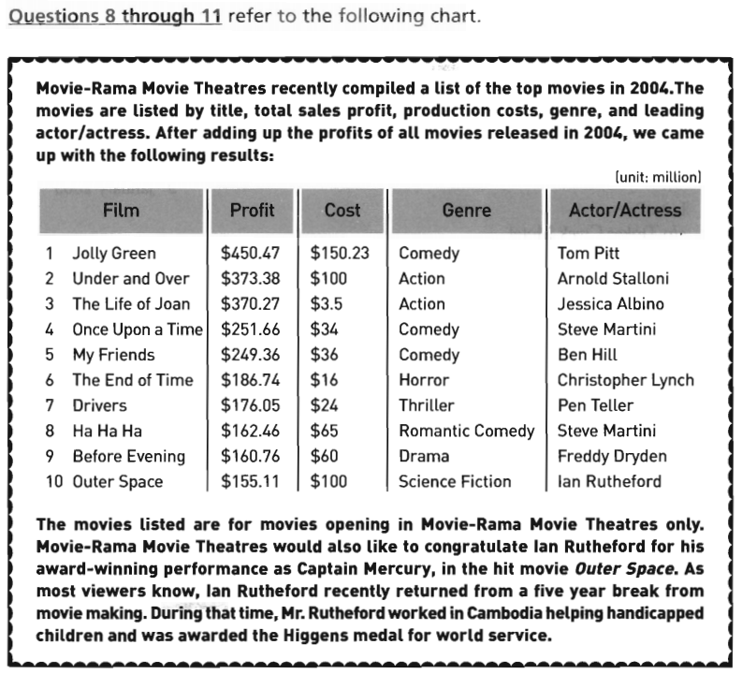
9. C. mind
4. C. Parents
10. B. famous
6. D. Make a list of good programs
3. A. At any movie theater
5. C. Television is not a babysitter.
7. C. Computer

Slide 24
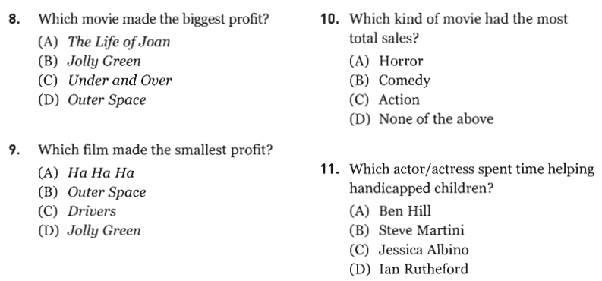
Part VII - Page 109
9. C. mind
4. C. Parents
10. B. famous
6. D. Make a list of good programs
3. A. At any movie theater
5. C. Television is not a babysitter.
7. C. Computer

Slide 25
Part VII - Page 109
9. C. mind
4. C. Parents
8. B. Jolly Green
10. B. famous
6. D. Make a list of good programs
10. B. Comedy
3. A. At any movie theater
11. D. Ian Rutheford
5. C. Television is not a babysitter.
7. C. Computer
9. B. Outer Space

Slide 26
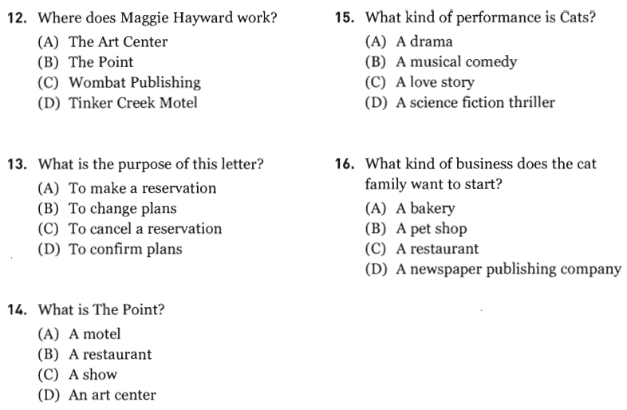
Part VII - Page 111
9. C. mind
4. C. Parents
8. B. Jolly Green
10. B. famous
6. D. Make a list of good programs
10. B. Comedy
3. A. At any movie theater
5. C. Television is not a babysitter.
7. C. Computer
9. B. Outer Space

Slide 27
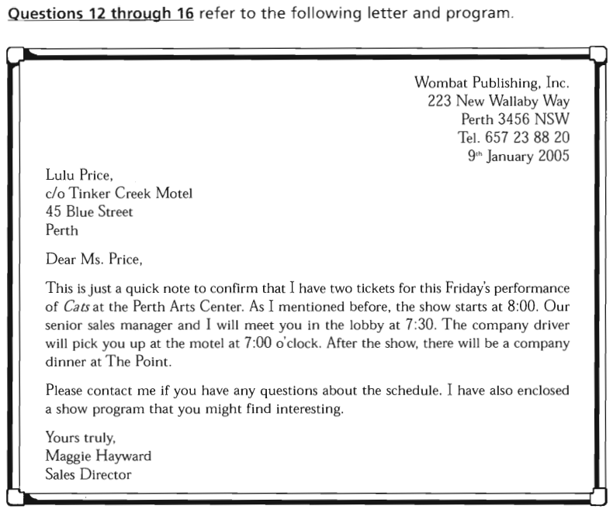
Part VII - Page 110
9. C. mind
4. C. Parents
8. B. Jolly Green
10. B. famous
6. D. Make a list of good programs
10. B. Comedy
3. A. At any movie theater
5. C. Television is not a babysitter.
7. C. Computer
9. B. Outer Space

Slide 28
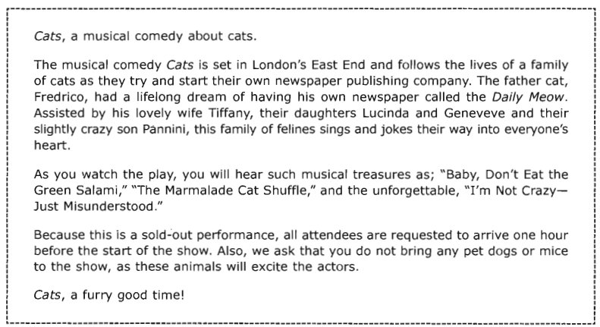
Part VII - Page 110
9. C. mind
4. C. Parents
8. B. Jolly Green
10. B. famous
6. D. Make a list of good programs
10. B. Comedy
3. A. At any movie theater
5. C. Television is not a babysitter.
7. C. Computer
9. B. Outer Space

Slide 29
Part VII - Page 111
9. C. mind
4. C. Parents
12. C. Wombat Publishing
15. B. A musical comedy
8. B. Jolly Green
10. B. famous
6. D. Make a list of good programs
10. B. Comedy
13. D. To confirm plans
3. A. At any movie theater
16. D
5. C. Television is not a babysitter.
14. B. A restaurant
7. C. Computer
9. B. Outer Space

Slide 30
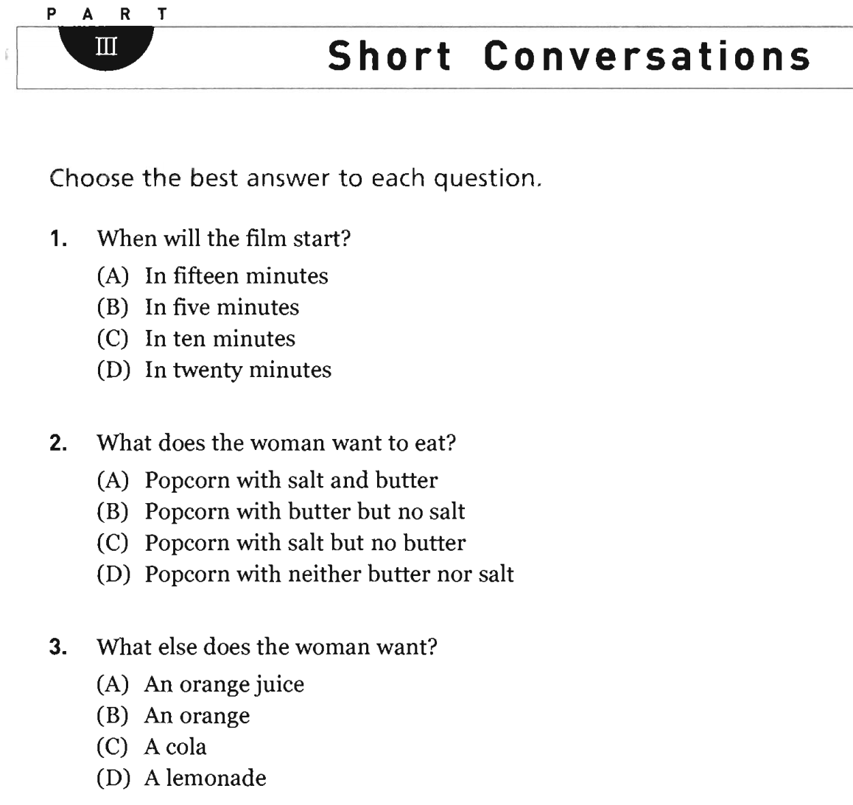

Slide 31


Slide 32
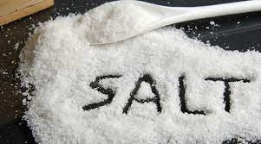
NEW WORDS – PART III (PAGE 99)
1. salt (n):

Slide 33
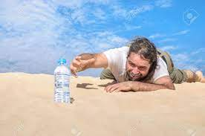
NEW WORDS – PART III (PAGE 99)
2. thirsty (adj):

Slide 34
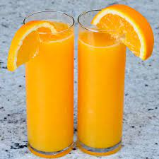
NEW WORDS – PART III (PAGE 99)
3. orange juice (n):

Slide 35
1. C
2. C
3. A

Slide 36

ANSWER KEY – PART III (PAGE 99)

Slide 37
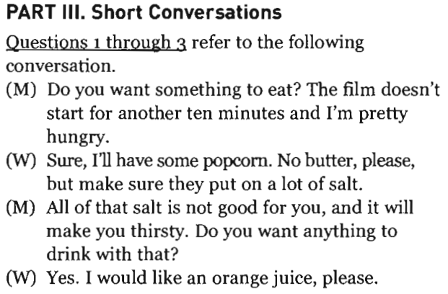
TRANSCRIPTS – PART III (PAGE 99)

Slide 38
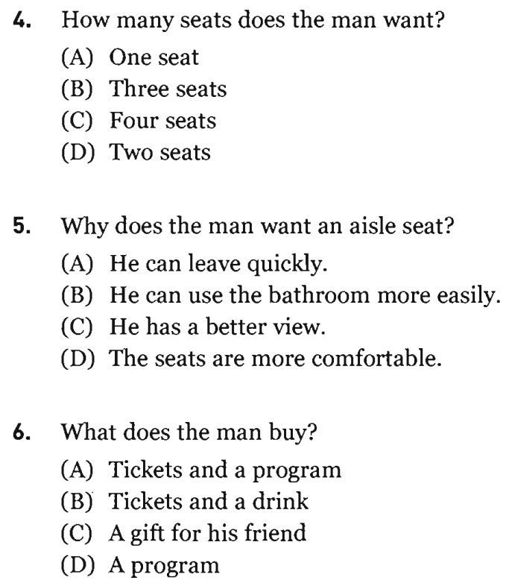
TRANSCRIPTS – PART III (PAGE 99)

Slide 39
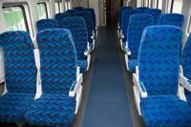
NEW WORDS – PART III (PAGE 99)
1. aisle (n):

Slide 40
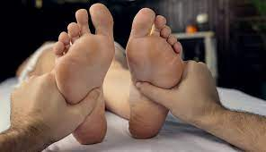
NEW WORDS – PART III (PAGE 99)
2. feet (n):

Slide 41
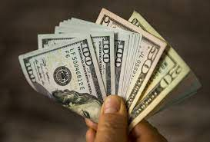
NEW WORDS – PART III (PAGE 99)
3. cash (adj):

Slide 42
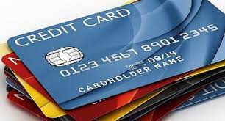
NEW WORDS – PART III (PAGE 99)
4. credit card (n):

Slide 43
TRANSCRIPTS – PART III (PAGE 99)
4. D
5. B
6. A

Slide 44

ANSWER KEY – PART III (PAGE 99)

Slide 45
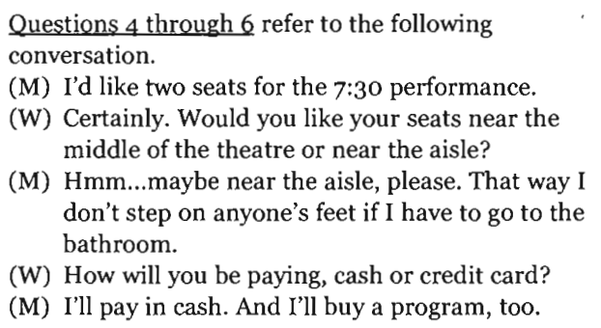
TRANSCRIPTS – PART III (PAGE 99)

Slide 46
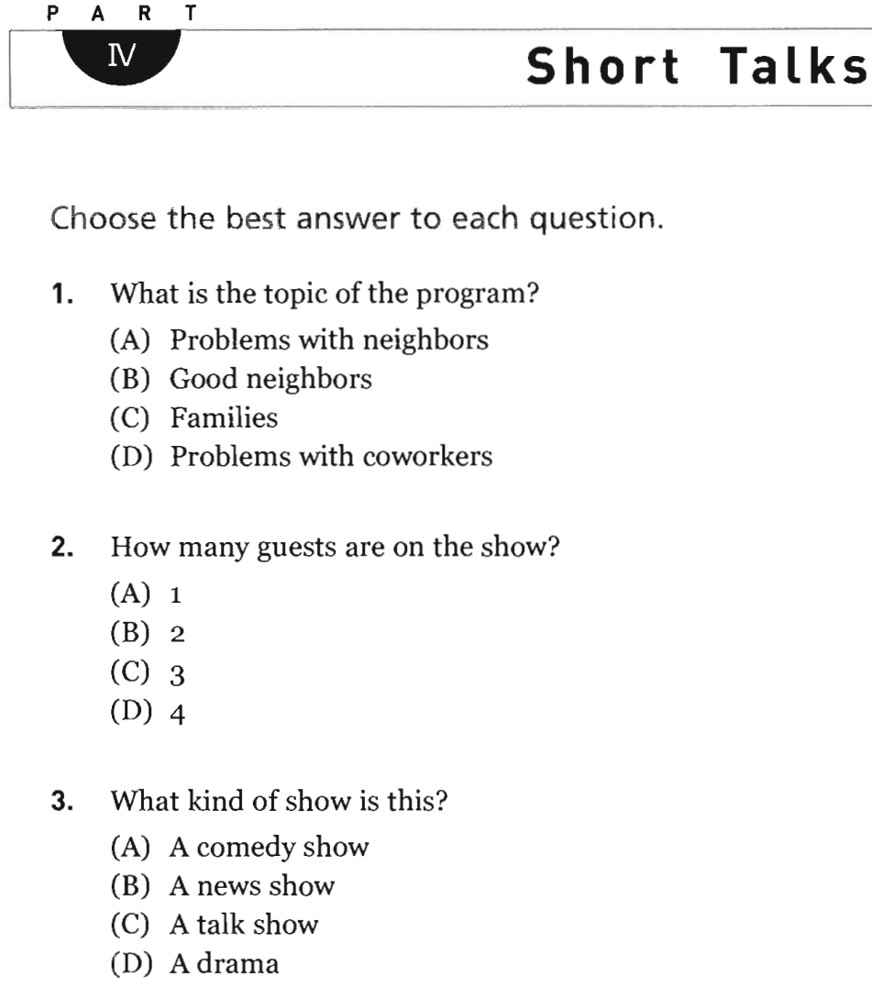
1.C
2
3. A

Slide 47
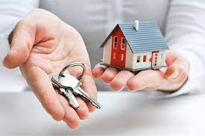
NEW WORDS – PART IV (PAGE 100)
1. homeowner (n):

Slide 48
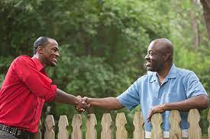
NEW WORDS – PART IV (PAGE 100)
2. neighbor (n):

Slide 49

NEW WORDS – PART IV (PAGE 100)
3. loud (adj):

Slide 50
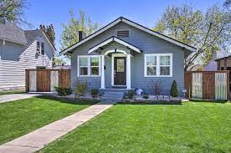
NEW WORDS – PART IV (PAGE 100)
4. yard (n):

Slide 51
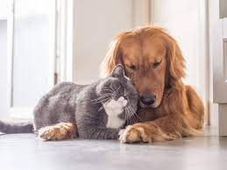
NEW WORDS – PART IV (PAGE 100)
5. get along (v):

Slide 52

NEW WORDS – PART IV (PAGE 100)
6. deal with (v):

Slide 53
1.C
1. A
2. C
2
3. C
3. A

Slide 54

ANSWER KEY – PART IV (PAGE 100)

Slide 55
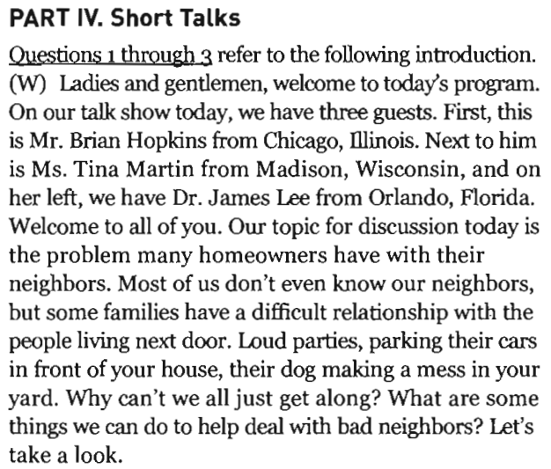
TRANSCRIPTS – PART IV (PAGE 100)

Slide 56
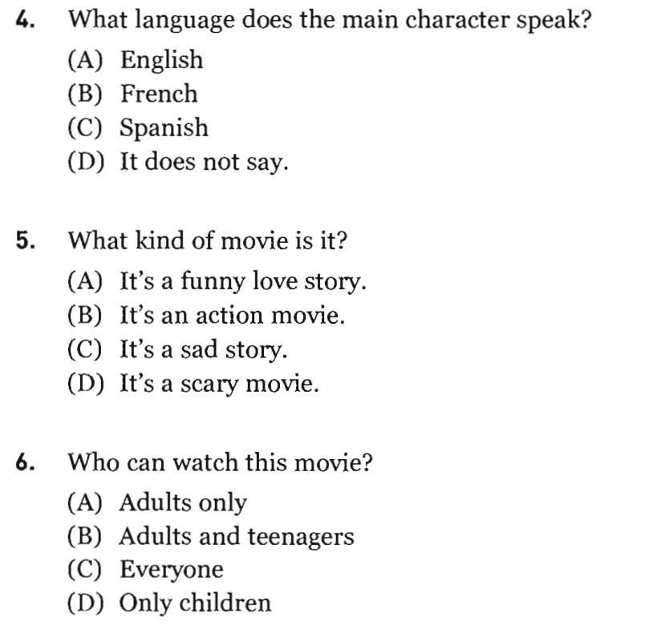

Slide 57

NEW WORDS – PART IV (PAGE 100)
1. comedy (n):

Slide 58
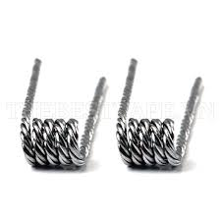
NEW WORDS – PART IV (PAGE 100)
2. twist (n):

Slide 59
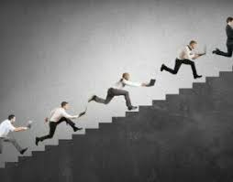
NEW WORDS – PART IV (PAGE 100)
3. constantly (adj):

Slide 60
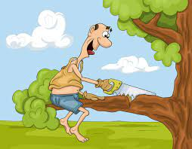
NEW WORDS – PART IV (PAGE 100)
4. foolish (adj):

Slide 61
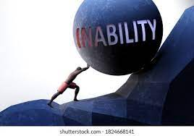
NEW WORDS – PART IV (PAGE 100)
5. inability (n):

Slide 62
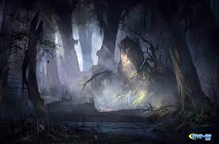
NEW WORDS – PART IV (PAGE 100)
6. mysterious (adj):

Slide 63
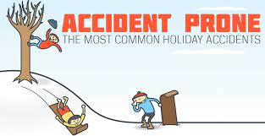
NEW WORDS – PART IV (PAGE 100)
6. accident-prone (adj):

Slide 64
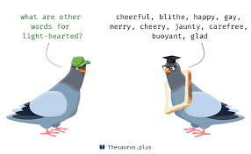
NEW WORDS – PART IV (PAGE 100)
7. light-hearted (adj):

Slide 65
4. D
5. A
6. C

Slide 66

ANSWER KEY – PART IV (PAGE 100)

Slide 67
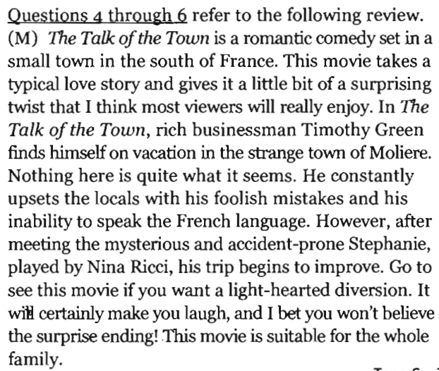
TRANSCRIPTS – PART IV (PAGE 100)

Slide 68

Thank you very much
for your cooperation.

