Slide 1

TRƯỜNG CAO ĐẲNG LÝ TỰ TRỌNG TP. HỒ CHÍ MINH

Slide 2

ỦY BAN NHÂN DÂN THÀNH PHỐ HỒ CHÍ MINH
TRƯỜNG CAO ĐẲNG LÝ TỰ TRỌNG TP. HỒ CHÍ MINH
Bậc đào tạo: TRUNG CẤP CHUYÊN NGHIỆP
KHOA NGOẠI NGỮ

Slide 3

Good morning class.

Slide 4


Slide 5
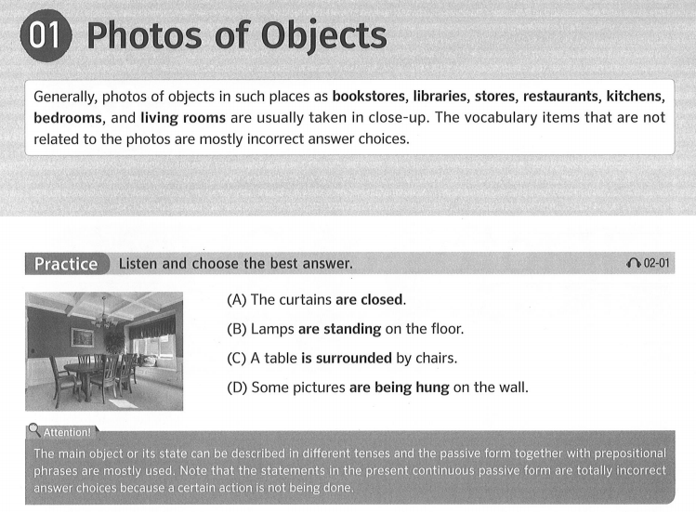

Unit 2: Photos of Objects & Scene – Page 17 – Photo of Objects – Page 18

Slide 6
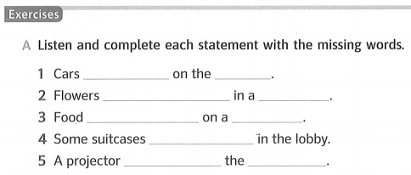
Unit 2: Photos of Objects & Scene – Page 17 – Photo of Objects – Page 18
are parked
road
are being arranged
vase
is being served
plate
are lined up
is attached to
ceiling

Slide 7
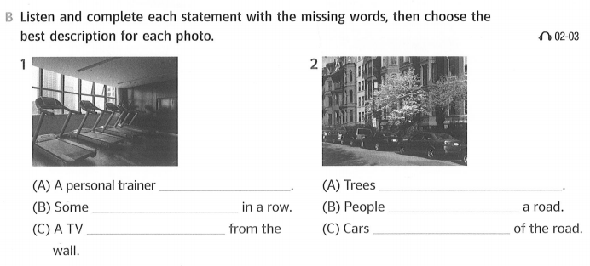
Unit 2: Photos of Objects & Scene – Page 17 – Photo of Objects – Page 18
is standing next to a treadmill
are being trimmed
machines are placed
are crossing
is being taken down
are parked on one side

Slide 8
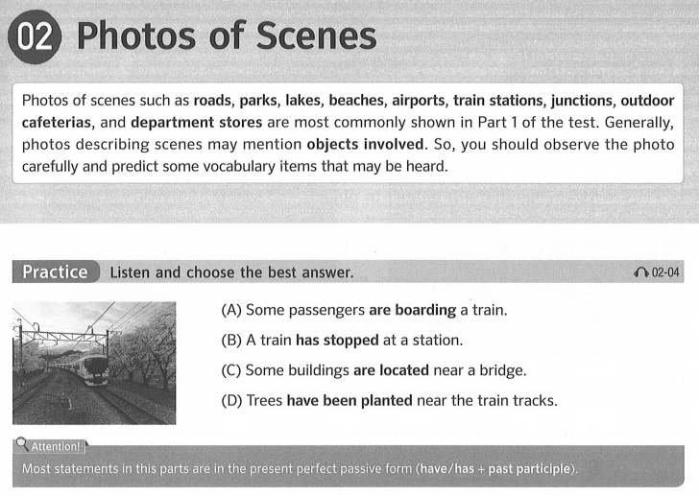
Unit 2: Photos of Objects & Scene – Page 17 – Photo of Objects – Page 19

Slide 9
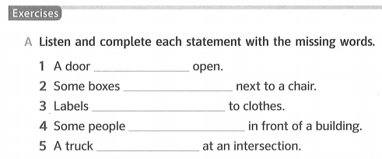
Unit 2: Photos of Objects & Scene – Page 17 – Photo of Objects – Page 19
has been left
have been piled
have been attached
have gathered
has stopped

Slide 10
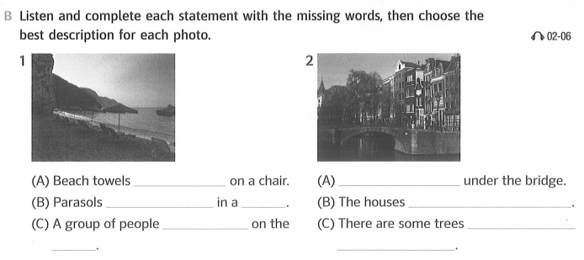
Unit 2: Photos of Objects & Scene – Page 17 – Photo of Objects – Page 19
have been set
A boat is passing
have been arranged
row
have the same height.
has gathered
planted near
beach
the houses

Slide 11
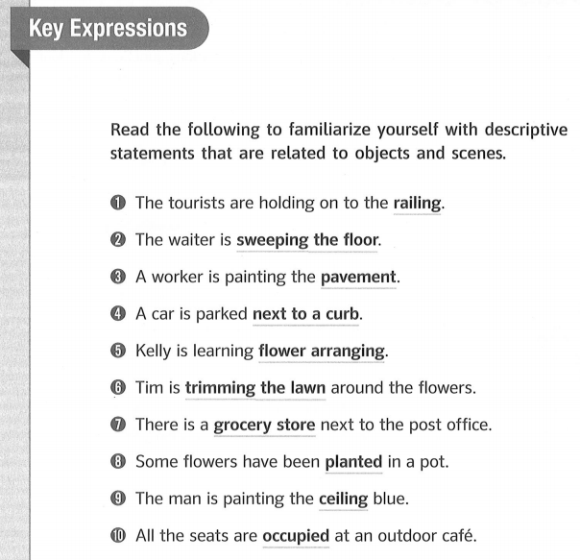
Unit 2: Photos of Objects & Scene – Page 17 – Photo of Objects – Page 20

Slide 12
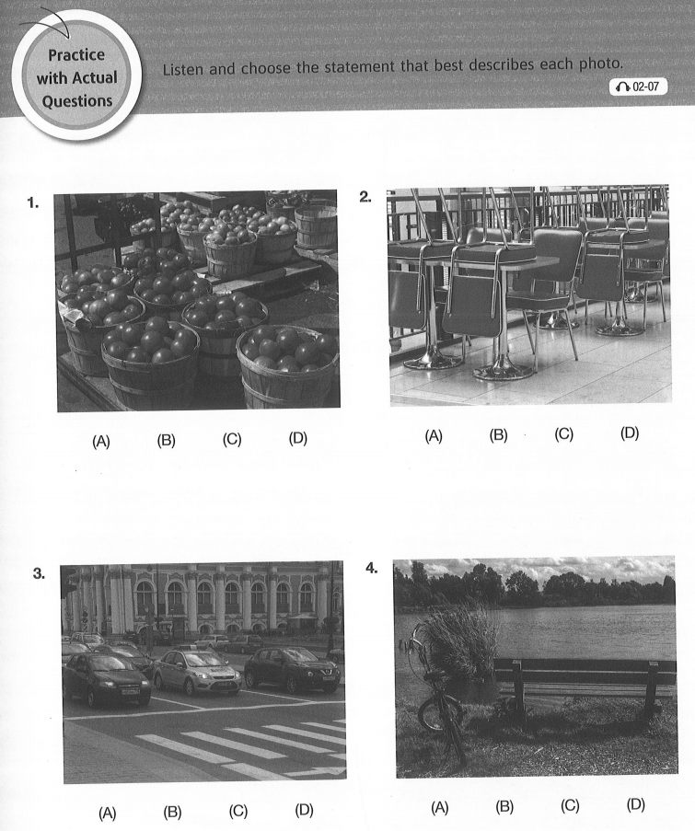
Unit 2: Photos of Objects & Scene – Page 17 – Photo of Objects – Page 21

Slide 13
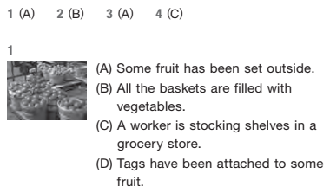
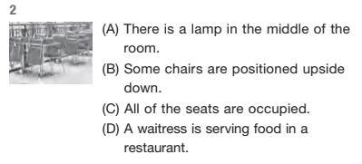
Unit 2: Photos of Objects & Scene – Page 17 – Photo of Objects – Page 21

Slide 14
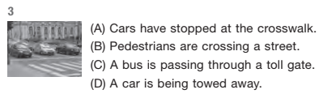
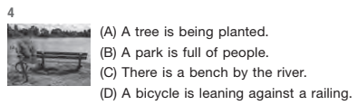
Unit 2: Photos of Objects & Scene – Page 17 – Photo of Objects – Page 21

Slide 15
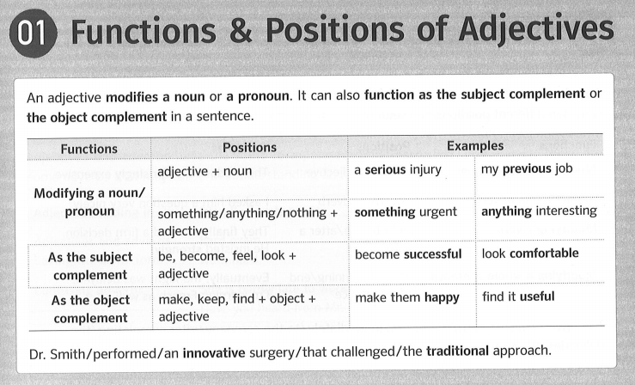
Unit 2: Adjectives & Adverbs – Page 117
01 Functions & Positions of Adjectives – Page 119

Slide 16
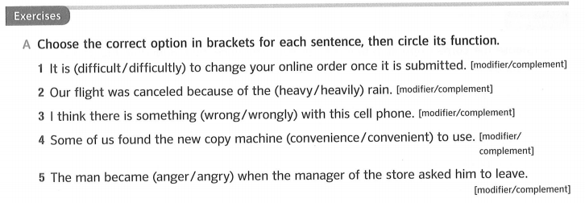
Unit 2: Adjectives & Adverbs – Page 117
01 Functions & Positions of Adjectives – Page 119

Slide 17
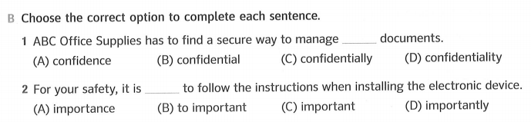
Unit 2: Adjectives & Adverbs – Page 117
01 Functions & Positions of Adjectives – Page 119

Slide 18
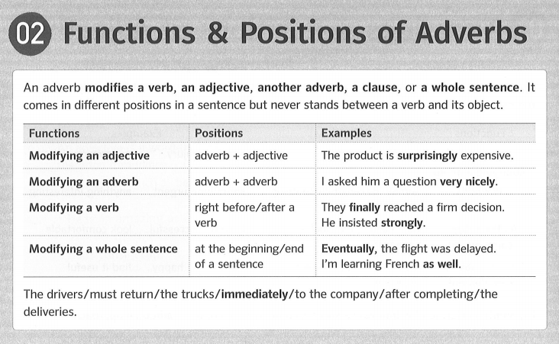
Unit 2: Adjectives & Adverbs – Page 117
02 Functions & Positions of Adverbs – Page 120

Slide 19
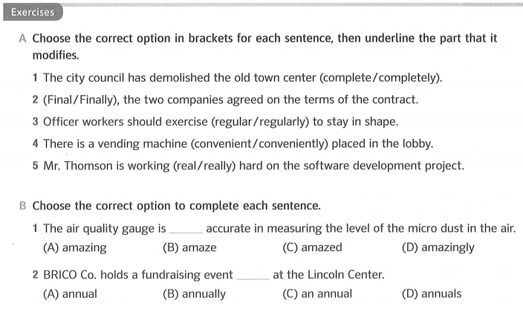
Unit 2: Adjectives & Adverbs – Page 117
02 Functions & Positions of Adverbs – Page 120

Slide 20
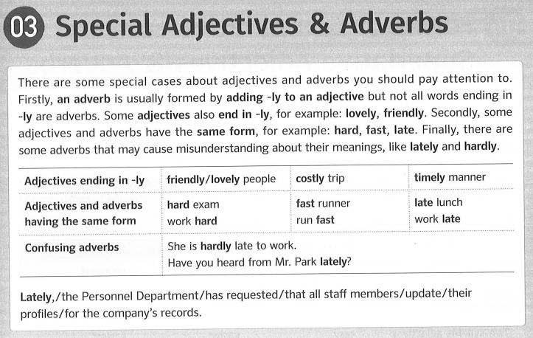
Unit 2: Adjectives & Adverbs – Page 117
03 Special Adjectives & Adverbs – Page 121

Slide 21
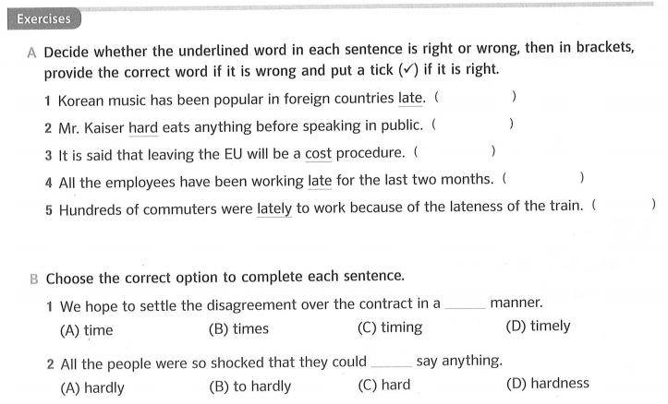
Unit 2: Adjectives & Adverbs – Page 117
03 Special Adjectives & Adverbs – Page 121
lately
hardly
costly

late

Slide 22

Thank you very much
for
your cooperation.

