Slide 1

TRƯỜNG CAO ĐẲNG LÝ TỰ TRỌNG TP. HỒ CHÍ MINH

Slide 2

ỦY BAN NHÂN DÂN THÀNH PHỐ HỒ CHÍ MINH
TRƯỜNG CAO ĐẲNG LÝ TỰ TRỌNG TP. HỒ CHÍ MINH
Bậc đào tạo: TRUNG CẤP CHUYÊN NGHIỆP
KHOA NGOẠI NGỮ

Slide 3

Good morning class.

Slide 4


Slide 5
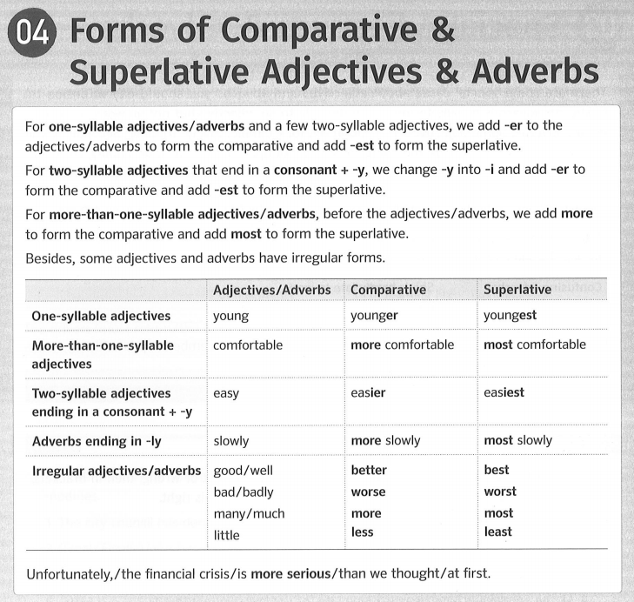
Unit 2: Adjectives & Adverbs – Page 117
04 Forms of Comparative & Superlative Adjectives & Adverbs – Page 122

Slide 6
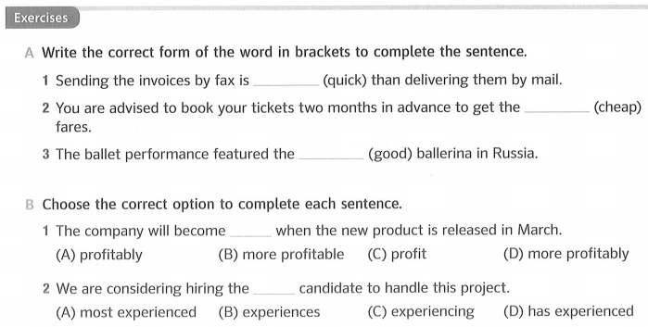
Unit 2: Adjectives & Adverbs – Page 117
04 Forms of Comparative & Superlative Adjectives & Adverbs – Page 122
quicker
cheapest
best

Slide 7
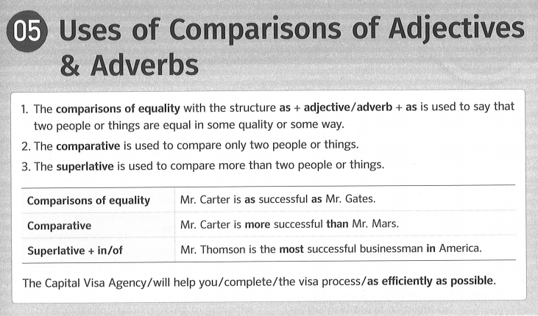
Unit 2: Adjectives & Adverbs – Page 117
05 Uses of Comparisons of Adjectives & Adverbs – Page 123

Slide 8
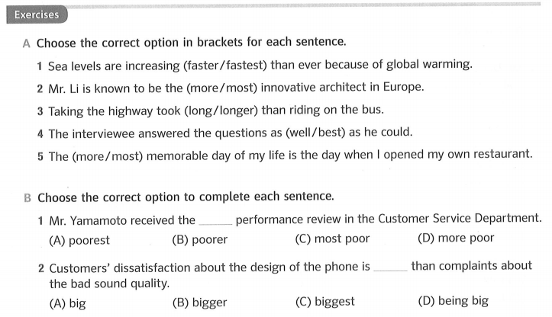
Unit 2: Adjectives & Adverbs – Page 117
05 Uses of Comparisons of Adjectives & Adverbs – Page 123

Slide 9
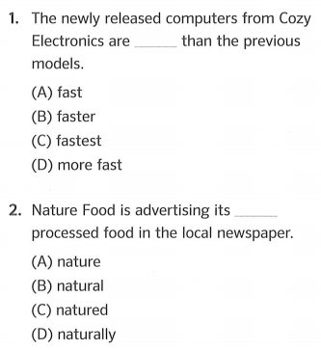
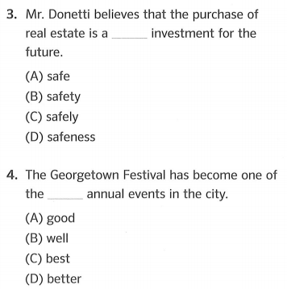
Unit 2: Adjectives & Adverbs – Page 117
Practice with Actual Questions Part 5 – Page 124

Slide 10
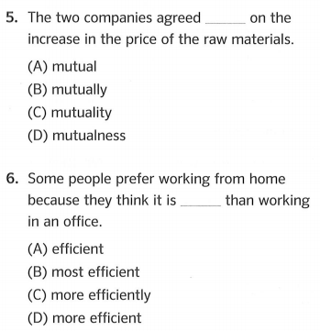
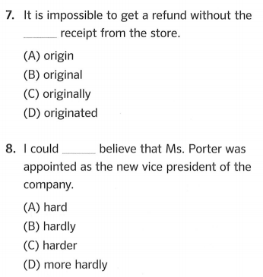
Unit 2: Adjectives & Adverbs – Page 117
Practice with Actual Questions Part 5 – Page 124

Slide 11
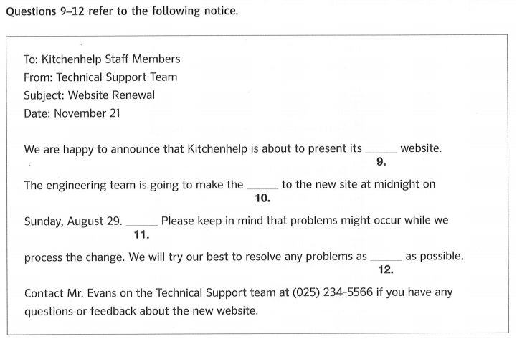
Unit 2: Adjectives & Adverbs – Page 117
Practice with Actual Questions Part 6 – Page 125

Slide 12
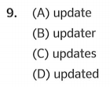
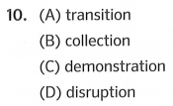
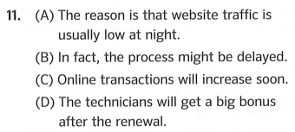
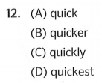
Unit 2: Adjectives & Adverbs – Page 117
Practice with Actual Questions Part 6 – Page 125

Slide 13
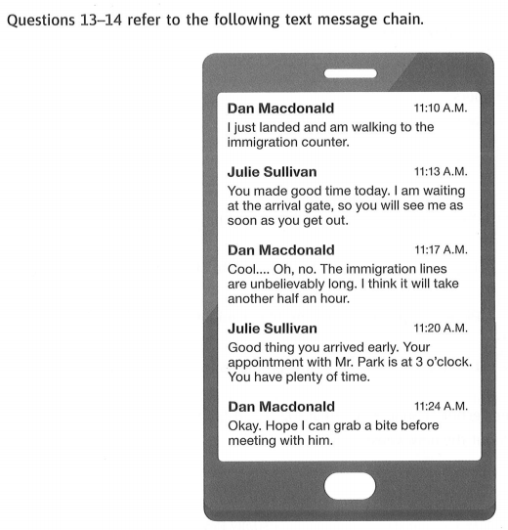
Unit 2: Adjectives & Adverbs – Page 117
Practice with Actual Questions Part 7 – Page 126

Slide 14
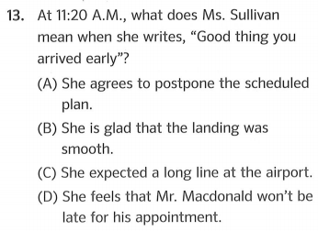
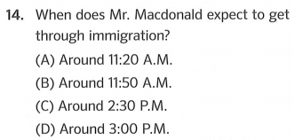
Unit 2: Adjectives & Adverbs – Page 117
Practice with Actual Questions Part 7 – Page 126

Slide 15
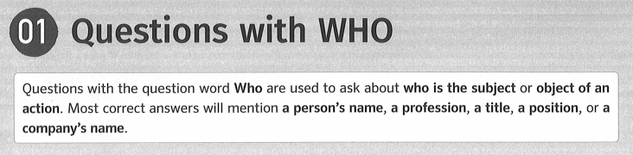
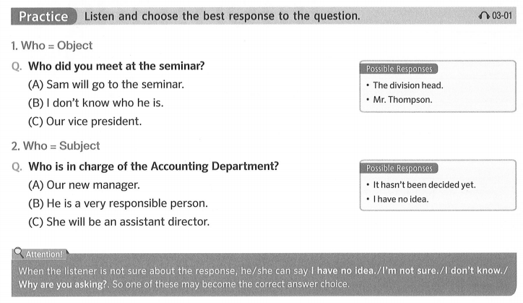

Unit 3: Information Questions (1) – Page 27
01 Questions with WHO – Page 26

Slide 16
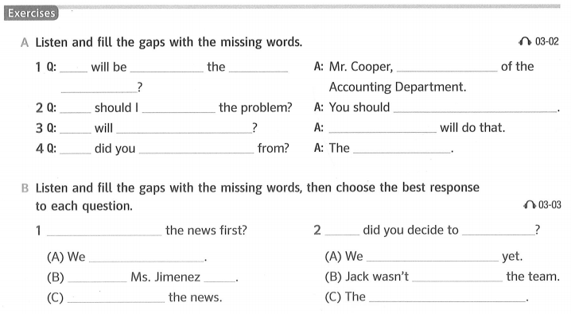
Unit 3: Information Questions (1) – Page 27
01 Questions with WHO – Page 26
Who
responsible for
the manager
new
project
Who
talk to about
go to see the secretary
Who
give us training
The supervisor
Who
get the information
receptionist
Who
Who heard
transfer
haven’t finalized it
delivered it
transferred to
I think
did
Nobody liked
Personnel Department

Slide 17
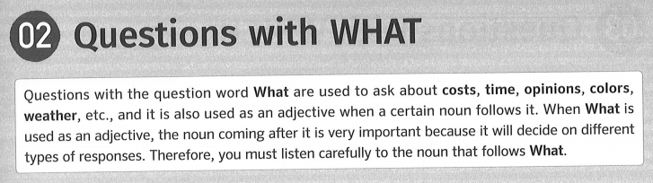
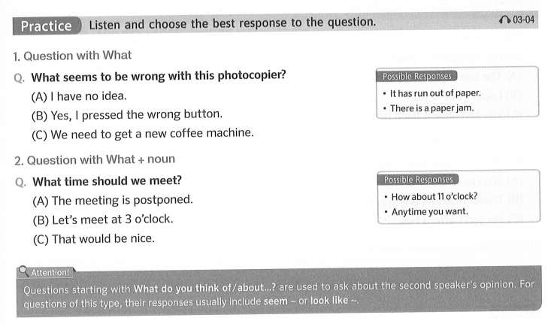
Unit 3: Information Questions (1) – Page 27
02 Questions with WHAT – Page 27

Slide 18
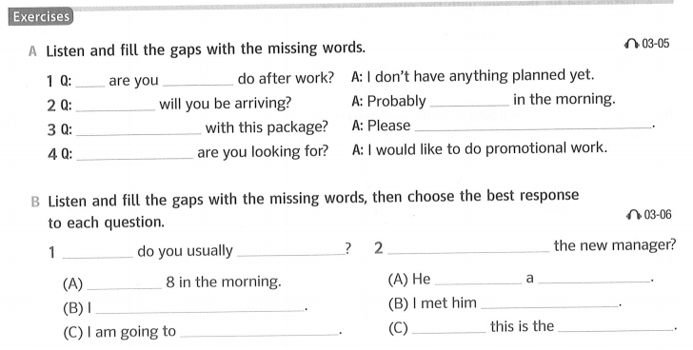
Unit 3: Information Questions (1) – Page 27
02 Questions with WHAT – Page 27
What
planning to
What time
round 7
What should I do
send it to the Marketing Department
What kind of job
What time
leave for work
What do you think about
seems like
Around
nice person
don’t have much time
several times
leave the company
I think
right choice

Slide 19

Thank you very much
for
your cooperation.

