Slide 1

TRƯỜNG CAO ĐẲNG LÝ TỰ TRỌNG TP. HỒ CHÍ MINH

Slide 2

ỦY BAN NHÂN DÂN THÀNH PHỐ HỒ CHÍ MINH
TRƯỜNG CAO ĐẲNG LÝ TỰ TRỌNG TP. HỒ CHÍ MINH
Bậc đào tạo: TRUNG CẤP CHUYÊN NGHIỆP
KHOA NGOẠI NGỮ

Slide 3

Good morning class.

Slide 4


Slide 5
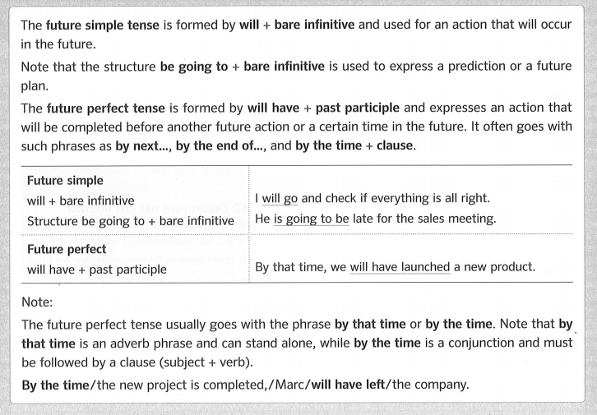
Unit 3: Verb Tenses – Page 127
04 Future Simple & Future Perfect – Page 132

Slide 6
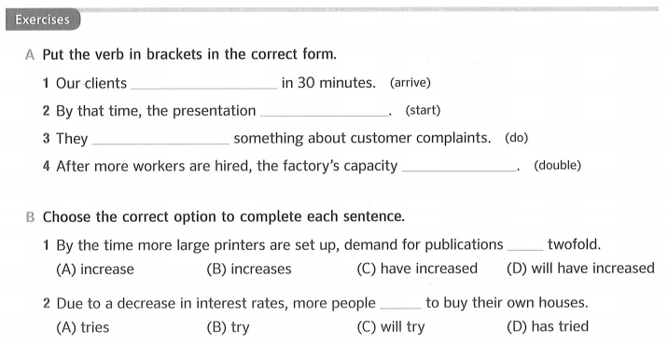
Unit 3: Verb Tenses – Page 127
04 Future Simple & Future Perfect – Page 132
1. are going to arrive
2. will have started
3. are going to do
4. will double

Slide 7
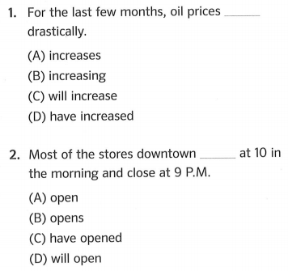
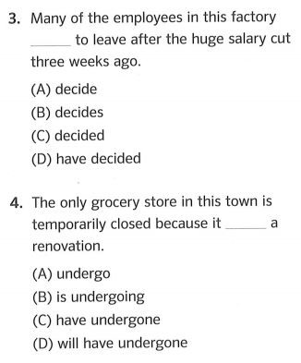
Unit 3: Verb Tenses – Page 127
Practice with Actual Questions Part 5 – Page 133

Slide 8
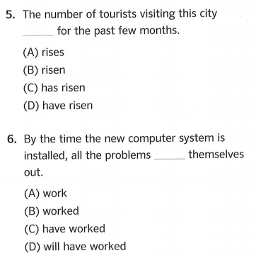
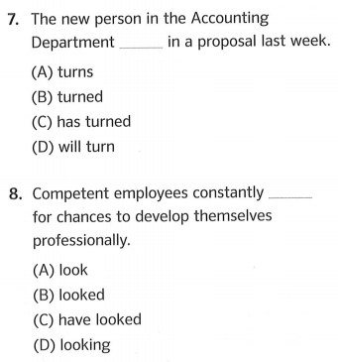
Unit 3: Verb Tenses – Page 127
Practice with Actual Questions Part 5 – Page 133

Slide 9
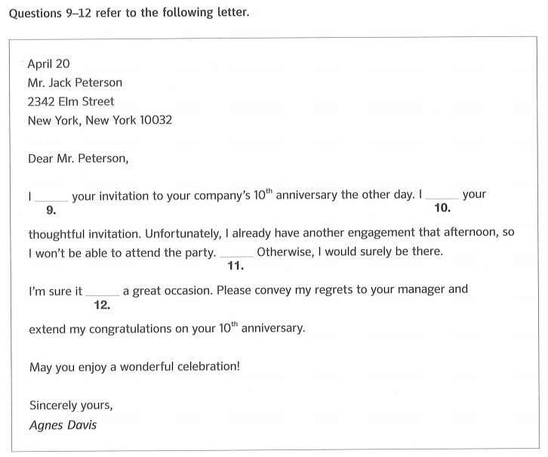
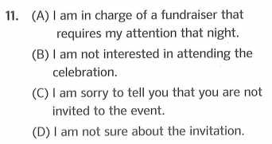
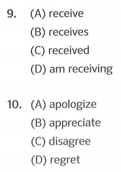
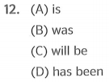
Unit 3: Verb Tenses – Page 127
Practice with Actual Questions Part 6 – Page 134

Slide 10
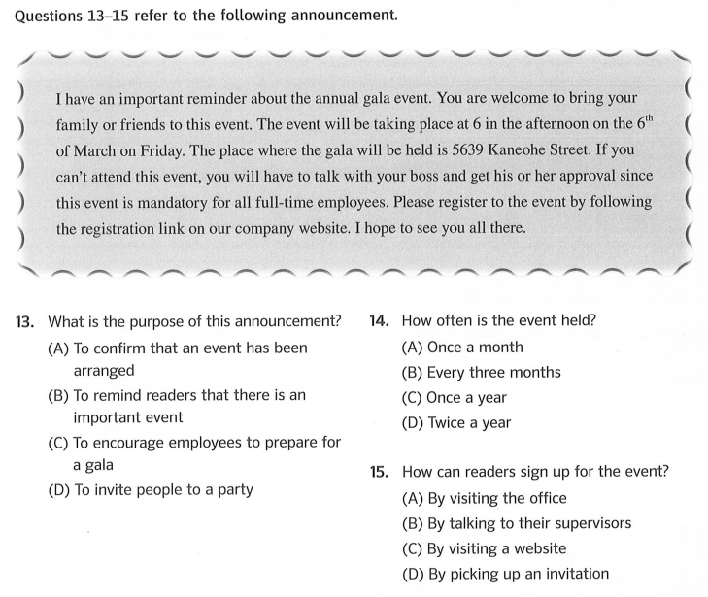
Unit 3: Verb Tenses – Page 127
Practice with Actual Questions Part 7 – Page 135

Slide 11
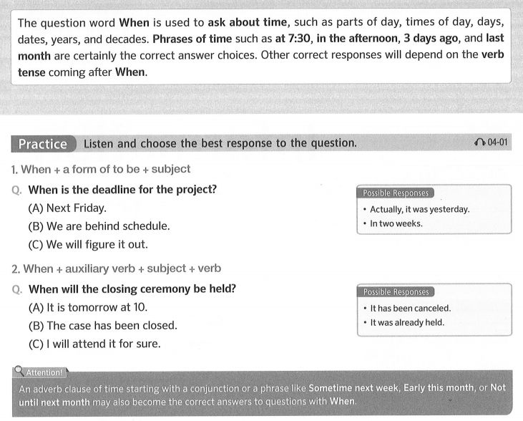

Unit 4: Information Questions (2) – Page 31
01 Questions with WHEN – Page 32

Slide 12
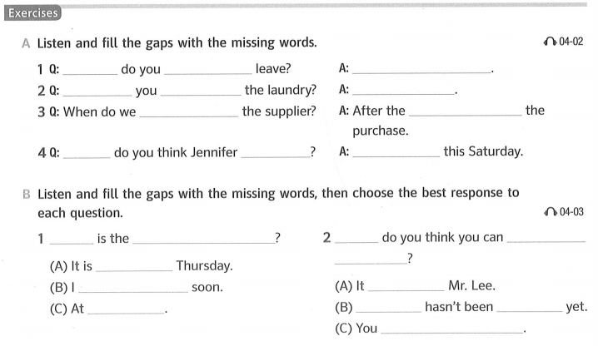
Unit 4: Information Questions (2) – Page 31
01 Questions with WHEN – Page 32
When
plan to
Early next week
When are
going to pick
After work
have to contact
manager approves
will come back
Not until
When
When
retirement party
When
finish
scheduled
the report
will be retiring
depends on
The report
released
the hotel
tried your best

Slide 13
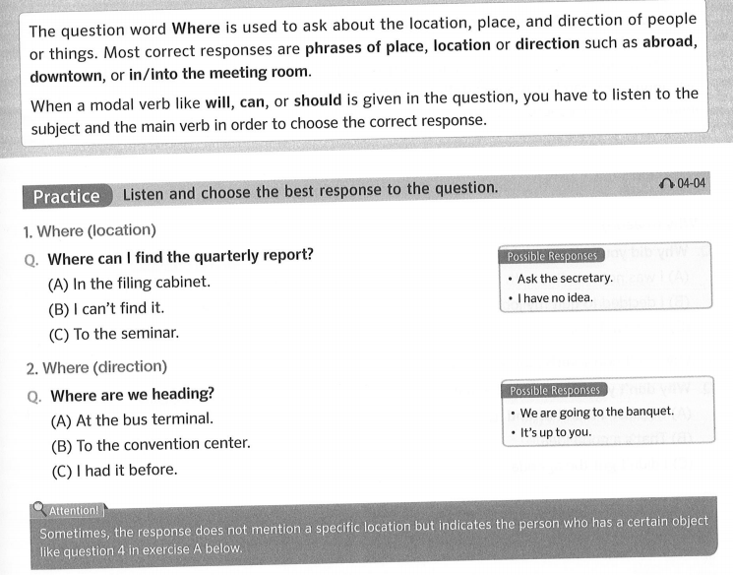
Unit 4: Information Questions (2) – Page 31
02 Questions with WHERE – Page 33

Slide 14
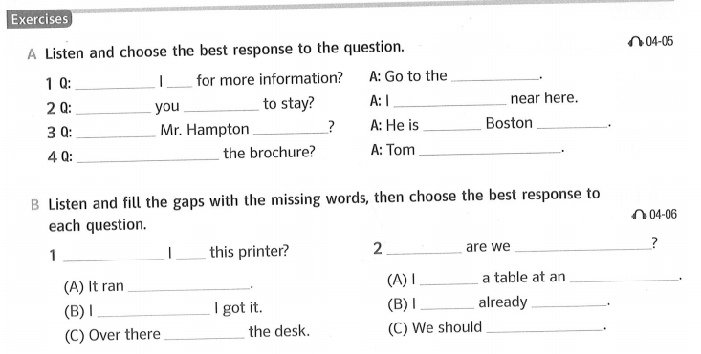
Unit 4: Information Questions (2) – Page 31
02 Questions with WHERE – Page 33
Where should
front desk
go
Where are
booked a hotel
planning
working
at the
branch
Where is
Where did you get
gave me one
Where should
Where
going for dinner
put
reserved
Italian restaurant
out of paper
have
eaten
forgot where
next to
reschedule it

Slide 15
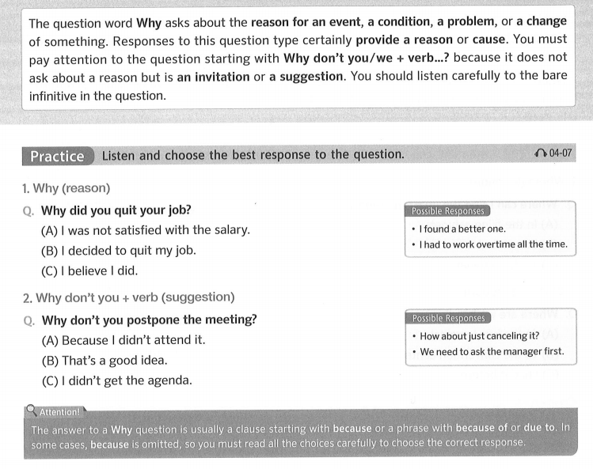
Unit 4: Information Questions (2) – Page 31
03 Questions with WHY – Page 34

Slide 16
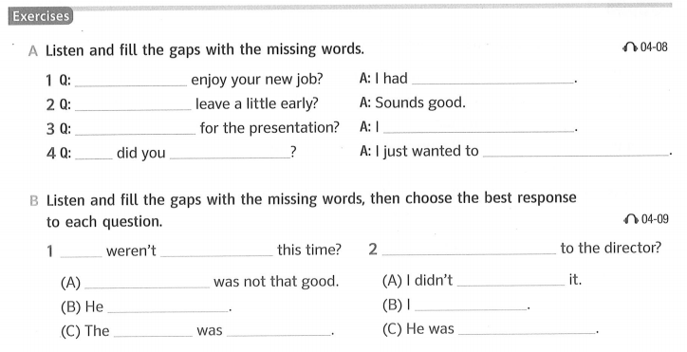
Unit 4: Information Questions (2) – Page 31
03 Questions with WHY – Page 34
Why didn’t you
too much responsibility
Why don’t we
Why were we late
got an important call
Why
call him back
ask for more details
Why
promoted
Why don’t you talk
My evaluation
apply for
lives nearby
already did
campaign
successful
directing traffic

Slide 17

Thank you very much
for
your cooperation.

