Slide 1


Slide 2
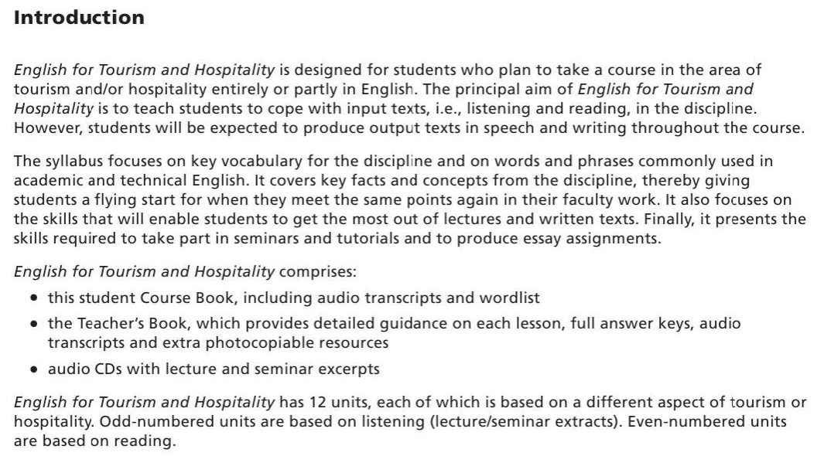

Slide 3


Slide 4


Slide 5
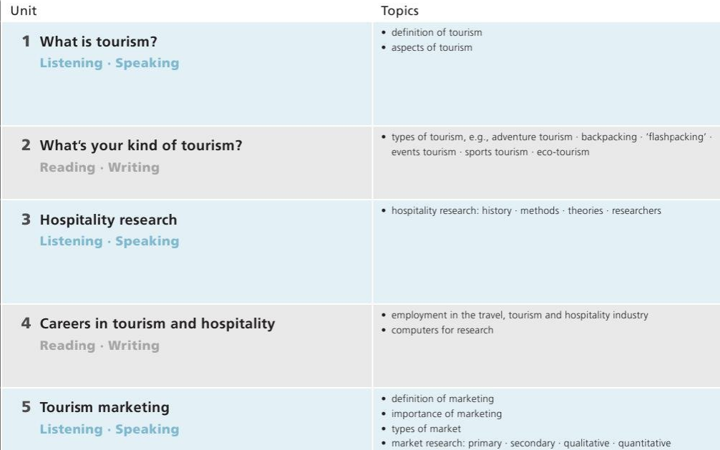

Slide 6
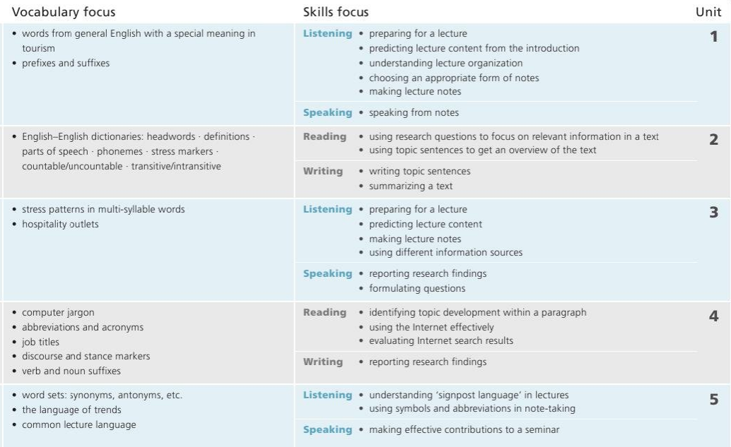

Slide 7


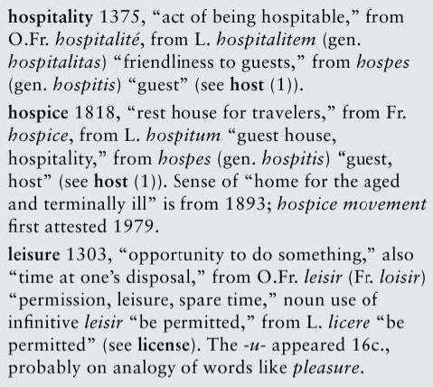
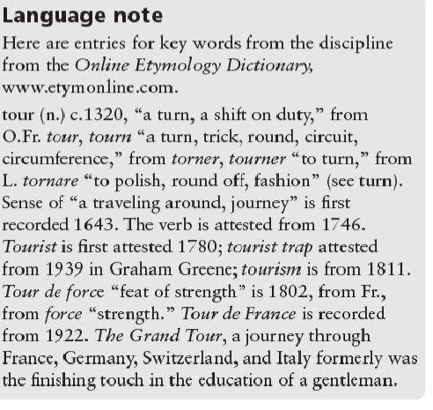
UNIT
tourism, the act and process of spending time away from home in pursuit of recreation, relaxation, and pleasure, while making use of the commercial provision of services. (Britannica)

Slide 8

UNIT

Slide 9

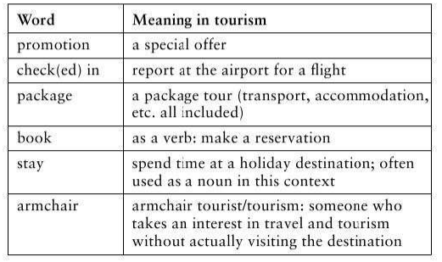

Slide 10

book
promotional
stay
package
armchair
check

Slide 11

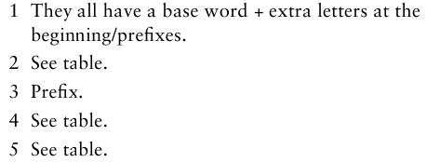
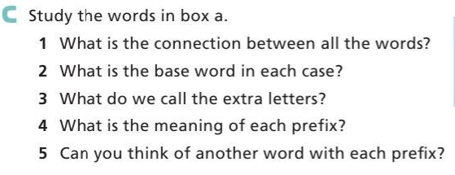

Slide 12
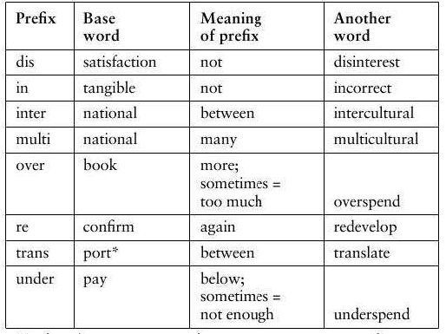

Slide 13
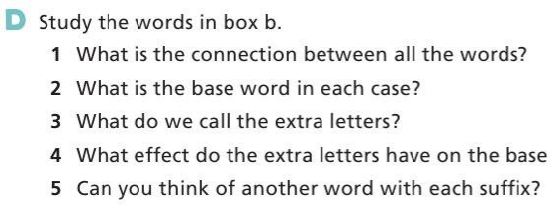
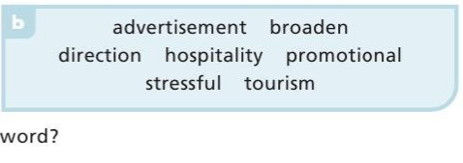

Slide 14
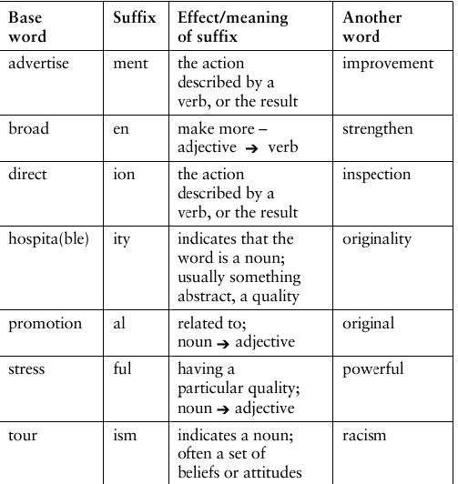


Slide 15
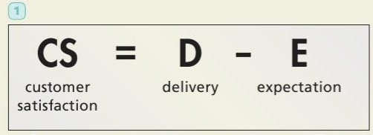
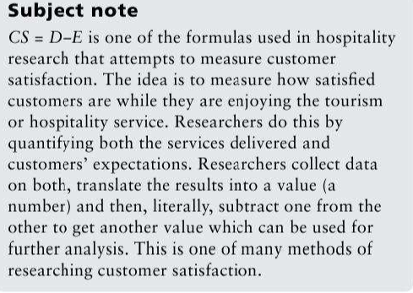
Formula for customer satisfaction

Slide 16

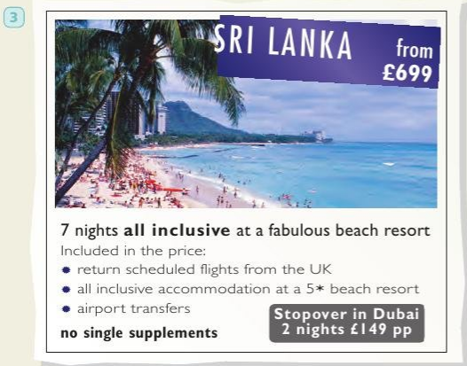
Promotional literature - brochures
An advertisement for a package holiday

Slide 17
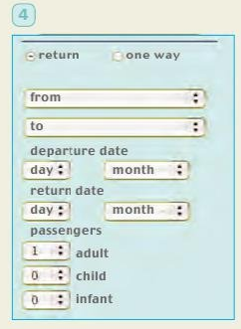
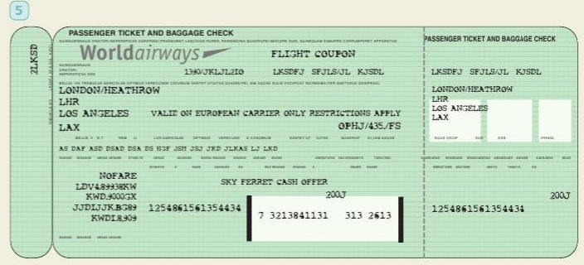
An airline ticket
A website for booking tickets (plane, train, bus)

Slide 18
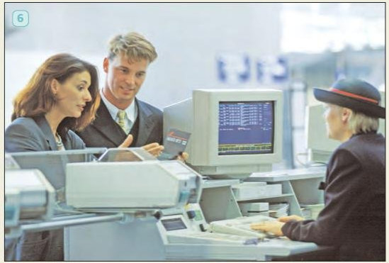
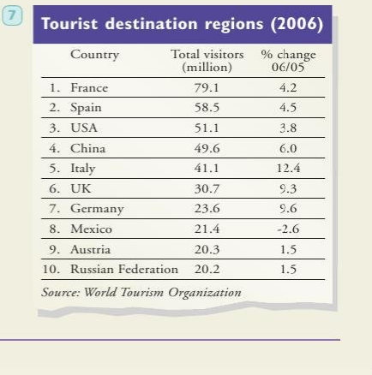
An airline check-in
A table showing top ten destinations for international tourism worldwide

