Slide 1
Unit 1: WHAT IS TOURISM?
1.2 LISTENING
PAGE 08

Slide 2
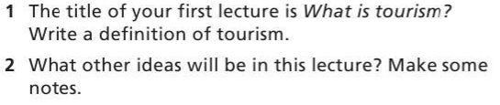
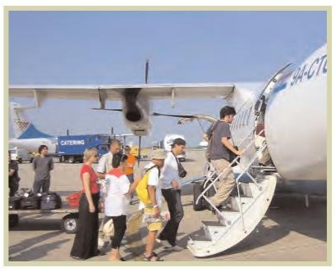
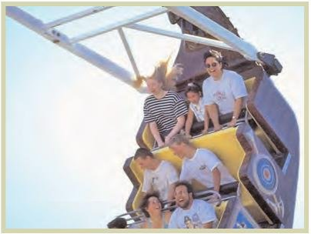
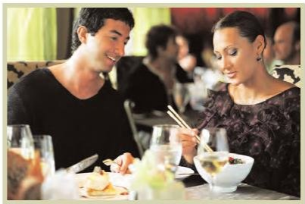
A.

Slide 3
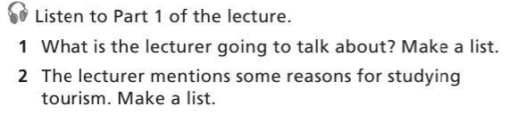

B.

Slide 4
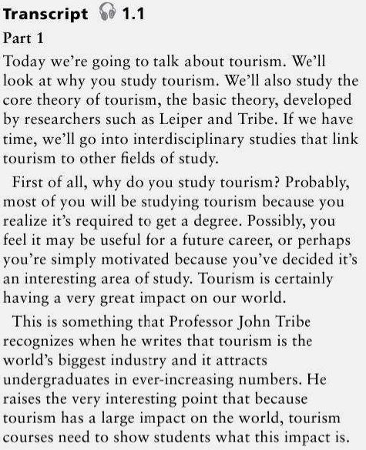


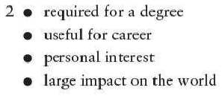
B

Slide 5

C.

Slide 6

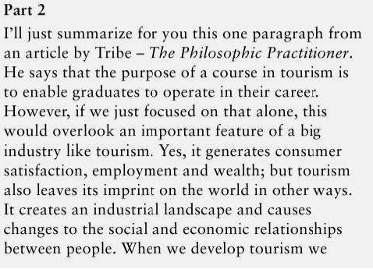
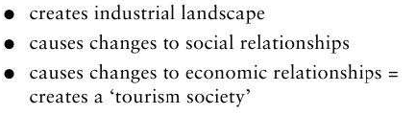

Slide 7
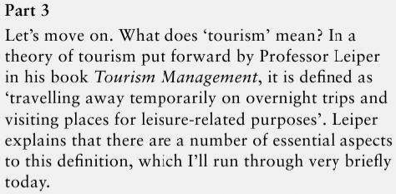
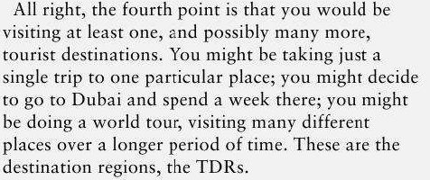
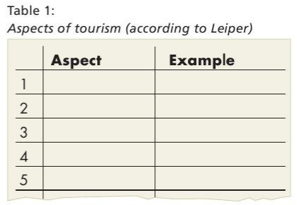
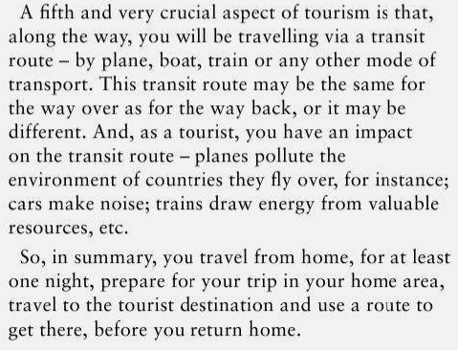
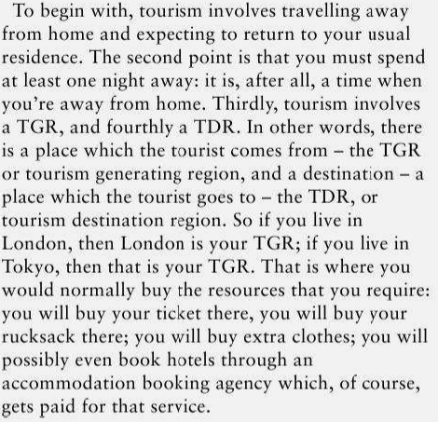
D. In Part 3, the lecturer talks about some aspects of tourism
Listen part 3 of the lecture
Take notes and complete the table 1
Add examples of each aspect from
your own experience

Slide 8
D. In Part 3, the lecturer talks about some aspects of tourism
Listen part 3 of the lecture
Take notes and complete the table 1
Add examples of each aspect from
your own experience
Travel away from home
At least one night away
*TGR= tourism generating region = where tourists come from
*TDR = Tourism destination region = where they go to
There is a TGR
There is TDR
There is a transit route

Slide 9
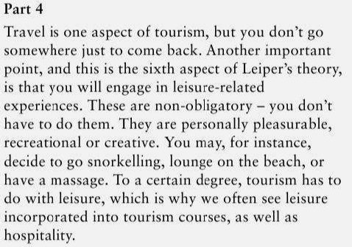
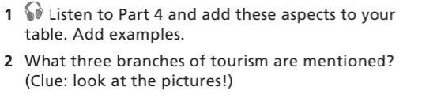
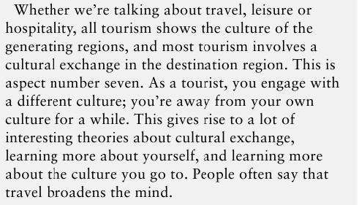
E. In Part 4 of the talk, the lecturer describe two more aspects of tourism
6. Engage in leisure-related experiences
7. Engage with a different culture
Travel, leisure, hospitality

Slide 10
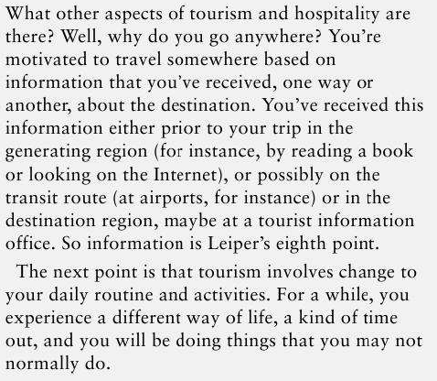
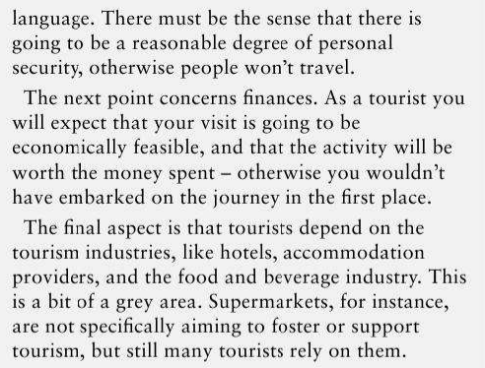
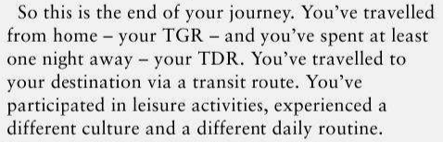
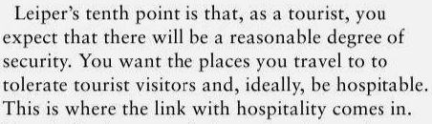
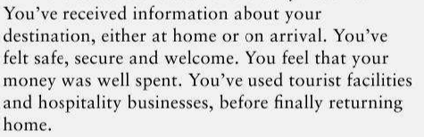
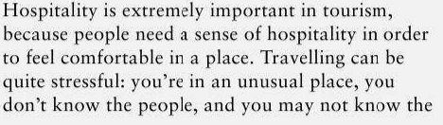
F. In the final Part of the talk, the lecturer discuss five more aspects of tourism.
8. Information
9. Change of routine
10. Security
11. Finances
12. Tourism industries
Add these aspects to your table

Slide 11
G. Rewrite your definition of tourism
Tourism is travel for the purpose of recreation, and the provision of hospitality and leisure services for this

Slide 12
HOMEWORK:
TRANSLATE TRANSCRIPTS INTO VIETNAMESE

