Slide 1
UNIT 4 MONEY AND BUDGETS

Slide 2
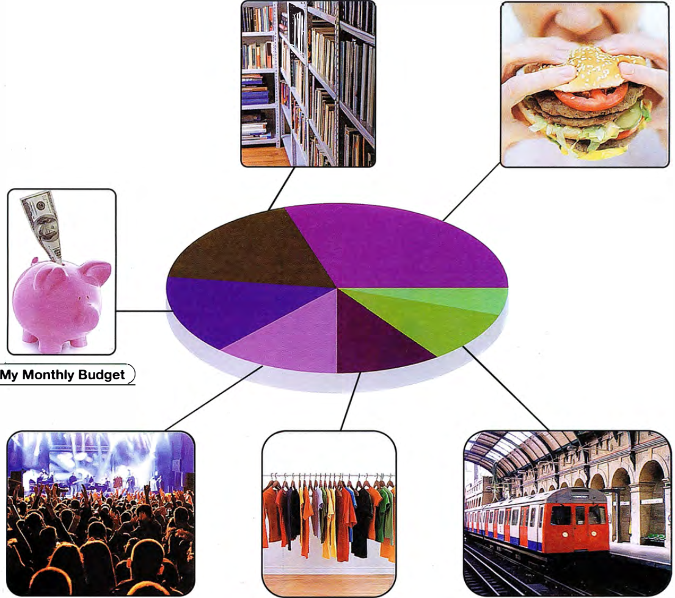

Slide 3
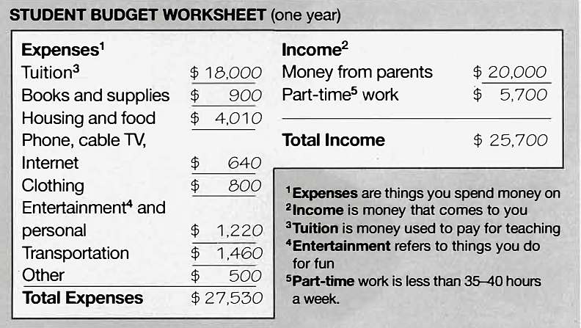

Slide 4
Expenses:
Housing: ……VND
Food: ……VND
Tuition: ……VND
Internet: ……VND
Phone: ……VND
Clothing: ……VND
Entertainment: ……VND
Other: ……VND
Income:
Money from parents: ……VND
From part-time work: ……VND

Slide 5

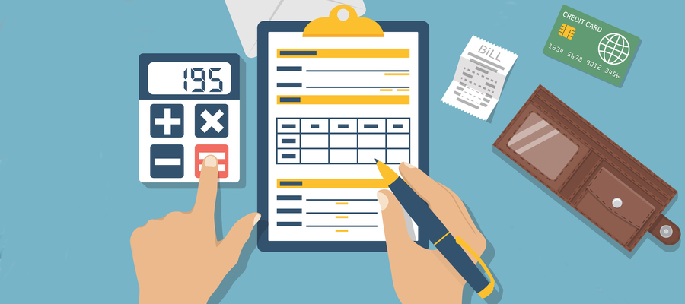
1 budget /ˈbʌdʒ.ɪt/ n/v/adj 1. money 2. plan to use $
The school fee was paid on time and within my budget.

Slide 6
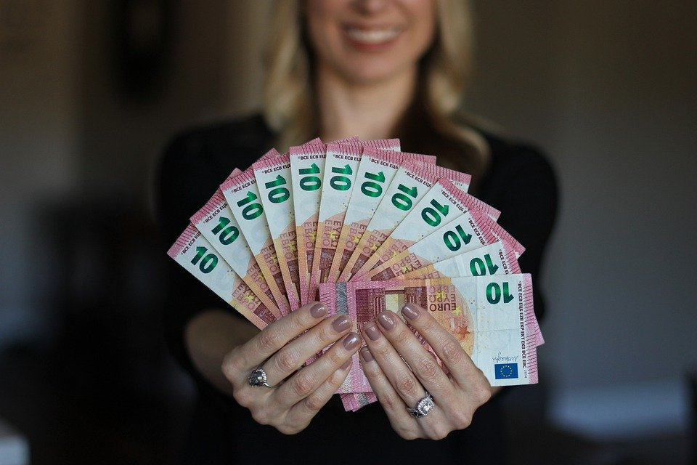
2 income /ˈɪŋ.kʌm/ n money earned from work or other investments.
Average incomes have risen by 4.5 percent over the past year.

Slide 7
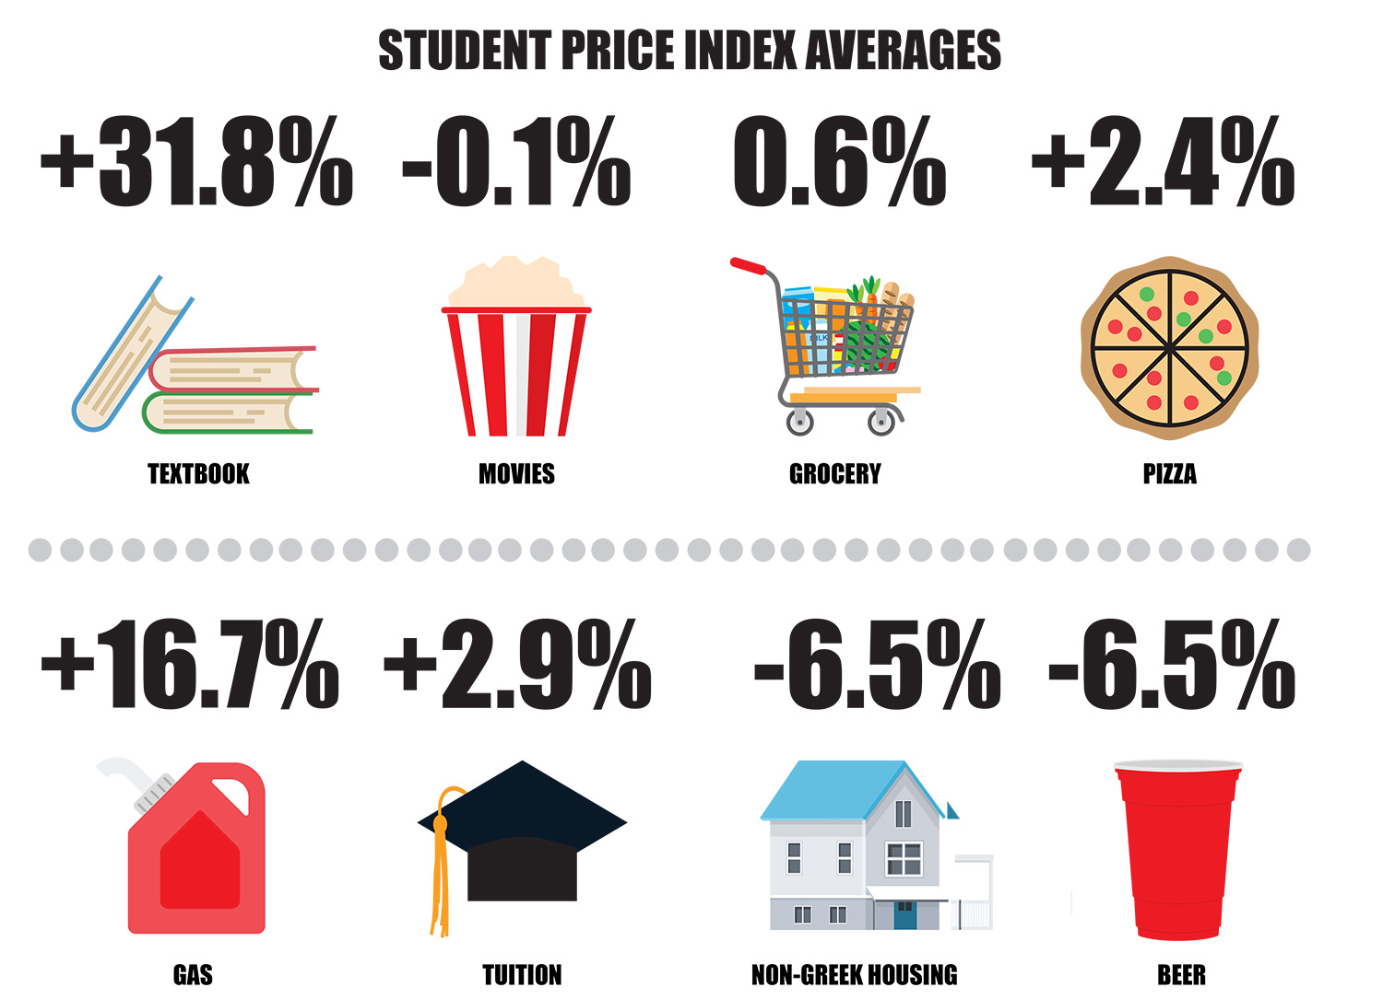
3 personal expenses : the money that you spend on something = costs, spending
It's silly to go to the expense of buying new clothes when you don't really need them.

Slide 8

4 tuition /tʃuːˈɪʃ.ən/ the money paid for being taught by students
tuition fee

Slide 9
Expenses:
Housing: ……VND
Food: ……VND
Tuition: ……VND
Internet: ……VND
Phone: ……VND
Clothing: ……VND
Entertainment: ……VND
Other: ……VND
Income:
Money from parents: ……VND
From part-time work: ……VND

Slide 10
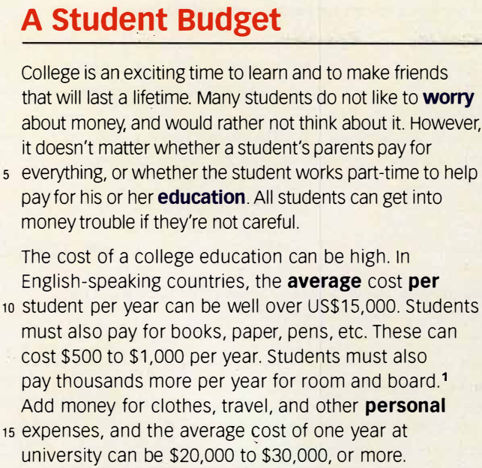

So, students need to spend their money carefully. At most universities, councillors can give students advice on how to budget their money.
This is what they suggest. At the start of a school semester, write down your income-for example, money you will get from your family or from a part-time job. Then, list all of your expenses. Put your expenses into two groups: those that change (food, phone, books, travel), and those that will stay the same (tuition, room and board).
Add together all of your expenses. Are they more than your income? Will you need to borrow from family or friends, or will you need to get more money by doing part-time work? Often, students find it easier to plan out their own budget, and save their own money, rather than trying to borrow from others.
As you can see, there’s more to learn at college than just what’s taught in the classroom!

Slide 11

SKIMMING FOR MAIN IDEAS

Slide 12
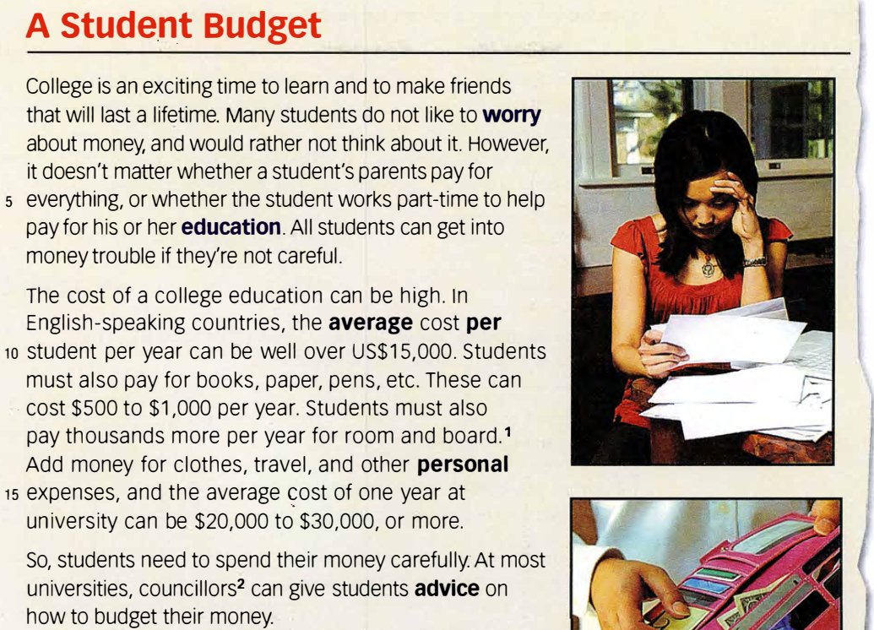
SKIMMING FOR MAIN IDEAS

Slide 13
Skimming for main ideas
What for: to get the main idea of the passage
How:
  (1) preview it: look at the
  (2) quickly look through the text
      read the first line/ last line of each paragraph,
      if it isn’t there, keep looking.
title headings pictures quotes captions a map

Slide 14
SKIMMING FOR MAIN IDEAS
Who would be interested in reading this article?
____________
2. Where would you see this article?
____________

Slide 15

SKIMMING FOR MAIN IDEAS
3. Do you think which is the main idea of this passage?
  A The high cost of a university education
  B How to pay for a university education
  C Living on a student budget

Slide 16
So, students need to spend their money carefully. At most universities, councillors can give students advice on how to budget their money.
This is what they suggest. At the start of a school semester, write down your income-for example, money you will get from your family or from a part-time job. Then, list all of your expenses. Put your expenses into two groups: those that change (food, phone, books, travel), and those that will stay the same (tuition, room and board).
Add together all of your expenses. Are they more than your income? Will you need to borrow from family or friends, or will you need to get more money by doing part-time work? Often, students find it easier to plan out their own budget, and save their own money, rather than trying to borrow from others.
As you can see, there’s more to learn at college than just what’s taught in the classroom!

Slide 17
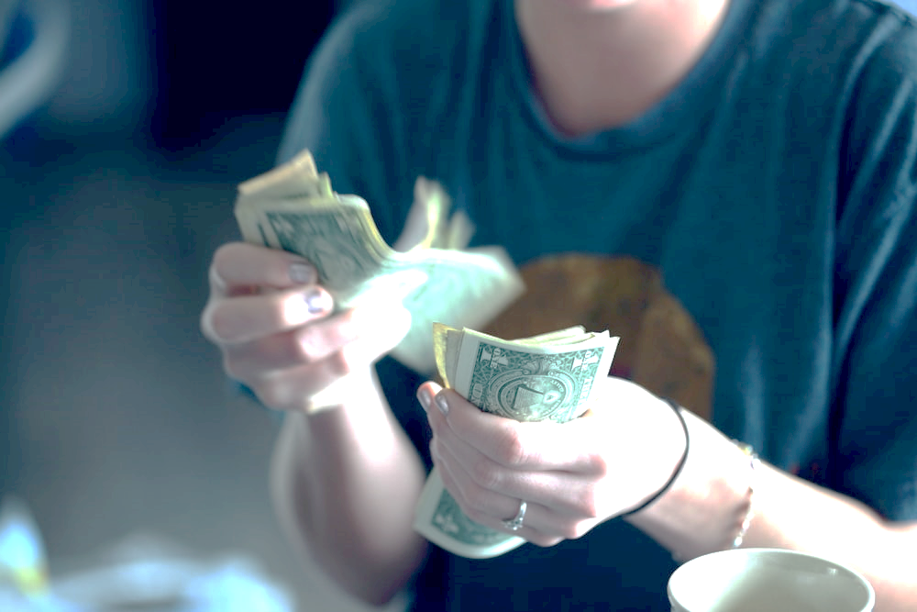
A student budget
College is an exciting time to learn and to make friends that will last a lifetime. Many students do not like to worry about money, and would rather not think about it. However, it doesn't matter whether a student's parents pay for everything, or whether the student works part-time to help pay for his or her education. All students can get into money trouble if they're not careful.

Slide 18
A student budget
The cost of a college education can be high. in English-speaking countries, the average cost per student per year can be well over US$15,000. Students must also pay for books, paper, pens, etc. These can cost $500 to $1,000 per year.
Students must also pay thousands more per year for room and board.' Add money for clothes, travel, and other personal expenses, and the average cost of one year at university can be $20,000 to $30,000, or more.

Slide 19
A student budget
So, students need to spend their money carefully. At most universities, councillors can give students advice on how to budget their money.

Slide 20
A student budget
This is what they suggest. At the start of a school semester, write down your income-for example, money you will get from your family or from a part-time job. Then, list all of your expenses. Put your expenses into two groups: those that change (food, phone, books, travel), and those that will stay the same (tuition, room and board).

Slide 21
A student budget
Add together all of your expenses. Are they more than your income? Will you need to borrow from family or friends, or will you need to get more money by doing part-time work? Often, students find it easier to plan out their own budget, and save their own money, rather than trying to borrow from others.
As you can see, there’s more to learn at college than just what’s taught in the classroom!

Slide 22
Check your understanding > A Choose the correct answers for the following questions.
1 According to the passage, what do many students think very little about?
a studying b parents c money
2 Students pay about ____ for books and other things they will need in class.
a $500 to $1,000 per year b $10,000 per year c $20,000 per year
3 On a list of expenses, advisors say that the cost of food and tuition should be _____.
a grouped together b in different groups c left out
4 The cost of _____ is NOT a personal expense.
a clothes b travel c room and board

Slide 23
Check your understanding > A Choose the correct answers for the following questions.
1 What do many students think very little about?
a studying b parents c money
College is an exciting time to learn and to make friends that will last a lifetime. Many students do not like to worry about money, and would rather not think about it. However, it doesn't matter whether a student's parents pay for everything, or whether the student works part-time to help pay for his or her education. All students can get into money trouble if they're not careful.

Slide 24
Check your understanding > A Choose the correct answers for the following questions.
2 Students pay about ____ for books and other things they will need in class.
a $500 to $1,000 per year b $10,000 per year c $20,000 per year
The cost of a college education can be high. in English-speaking countries, the average cost per student per year can be well over US $ 15,000. Students must also pay for books, paper, pens, etc. These can cost $500 to $1,000 per year.
Students must also pay thousands more per year for room and board.' Add money for clothes, travel, and other personal expenses, and the average cost of one year at university can be $20,000 to $30,000, or more.

Slide 25
Check your understanding > A Choose the correct answers for the following questions.
3 On a list of expenses, advisors say that the cost of food and tuition should be _____.
a grouped together b in different groups c left out
At most universities, councillors can give students advice on how to budget their money.
This is what they suggest. At the start of a school semester, write down your income-for example, money you will get from your family or from a part-time job. Then, list all of your expenses. Put your expenses into two groups: those that change (food, phone, books, travel), and those that will stay the same (tuition, room and board).

Slide 26
Check your understanding > A Choose the correct answers for the following questions.
4 The cost of _____ is NOT a personal expense.
a clothes b travel c room and board
This is what they suggest. At the start of a school semester, write down your income-for example, money you will get from your family or from a part-time job. Then, list all of your expenses. Put your expenses into two groups: those that change (food, phone, books, travel), and those that will stay the same (tuition, room and board).

Slide 27
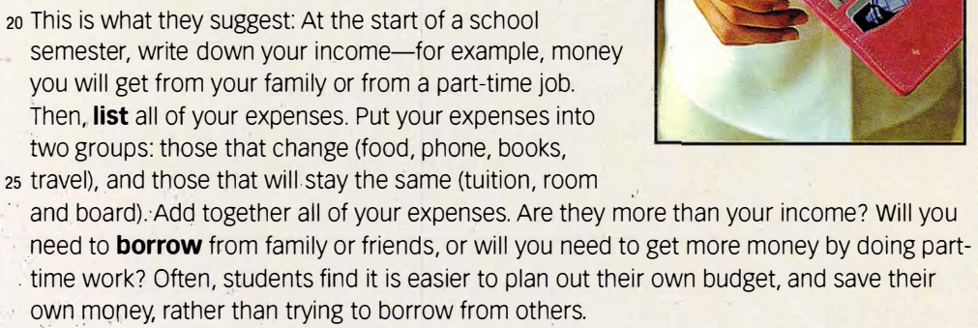
Check your understanding > A Choose the correct answers for the following questions.
4 The cost of _____ is NOT a personal expense.
a clothes b travel c room and board

Slide 28
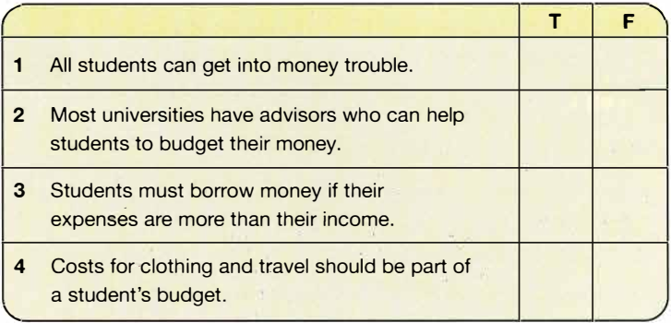
B Read the sentences below. Check true or false. If the sentence is false, change it to make it true.

Slide 29
B Read the sentences below. Check true or false. If the sentence is false, change it to make it true.
 | True | False
1 All students can get into money trouble.
2 Most universities have advisors who can help students to budget their money.
3 Students must borrow money if their expenses are more than their income.
4 Costs for ·clothing and travel should be part of a student's budget.

Slide 30


B Read the sentences below. Check true or false. If the sentence is false, change it to make it true.
 | True | False
1 All students can get into money trouble.
✓

Slide 31
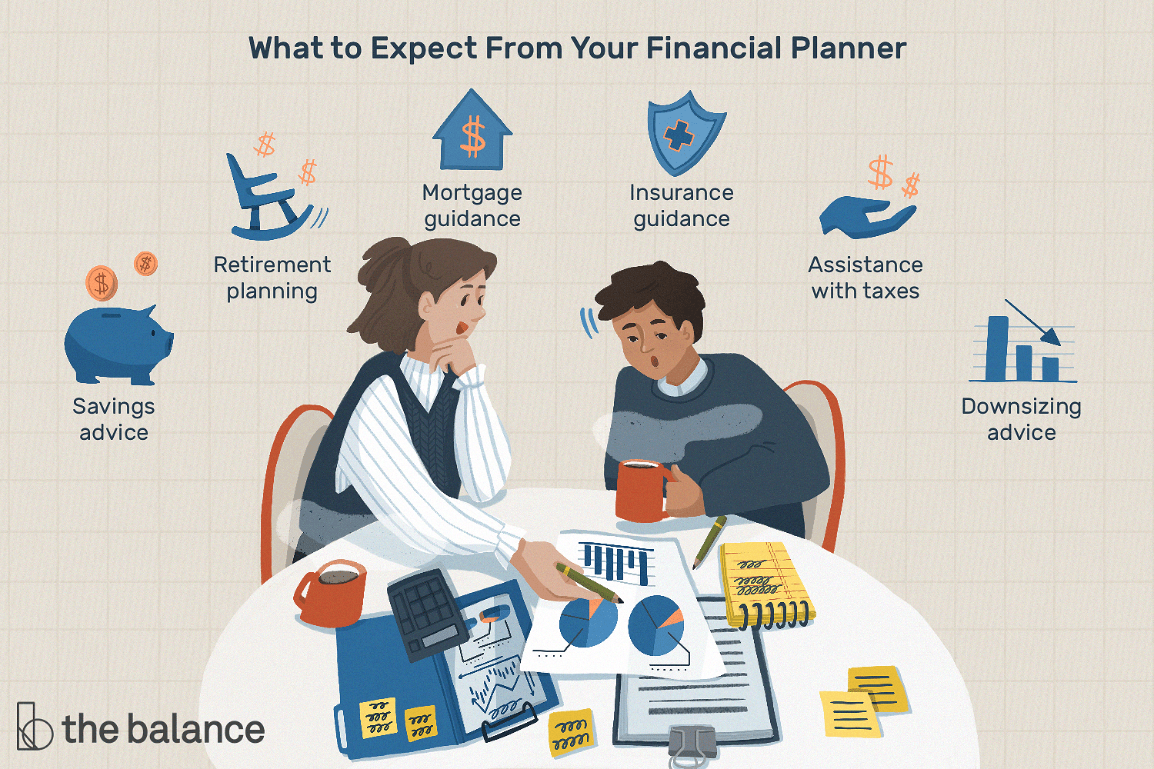
Advise (v) -> advisor

Slide 32

B Read the sentences below. Check true or false. If the sentence is false, change it to make it true.
 | True | False
2 Most universities have advisors who can help students to budget their money.
✓
At most universities, councillors can give students advice on how to budget their money.
This is what they suggest. At the start of a school semester, write down your income-for example, money you will get from your family or from a part-time job. Then, list all of your expenses. Put your expenses into two groups: those that change (food, phone, books, travel), and those that will stay the same (tuition, room and board).

Slide 33

B Read the sentences below. Check true or false. If the sentence is false, change it to make it true.
 | True | False
3 Students must borrow money if their expenses are more than their income.
✓
Add together all of your expenses. Are they more than your income? Will you need to borrow from family or friends, or will you need to get more money by doing part-time work? Often, students find it easier to plan out their own budget, and save their own money, rather than trying to borrow from others.

Slide 34


Slide 35

B Read the sentences below. Check true or false. If the sentence is false, change it to make it true.
 | True | False
4 Costs for clothing and travel should be part of a student's budget.
✓
This is what they suggest. At the start of a school semester, write down your income-for example, money you will get from your family or from a part-time job. Then, list all of your expenses. Put your expenses into two groups: those that change (food, phone, books, travel), and those that will stay the same (tuition, room and board).

Slide 36
B Read the sentences below. Check true or false. If the sentence is false, change it to make it true.
 | True | False
4 Costs for clothing and travel should be part of a student's budget.
✓
Students must also pay thousands more per year for room and board.' Add money for clothes, travel, and other personal expenses, and the average cost of one year at university can be $20,000 to $30,000, or more.

Slide 37
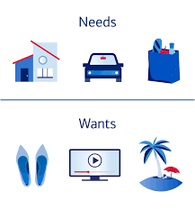
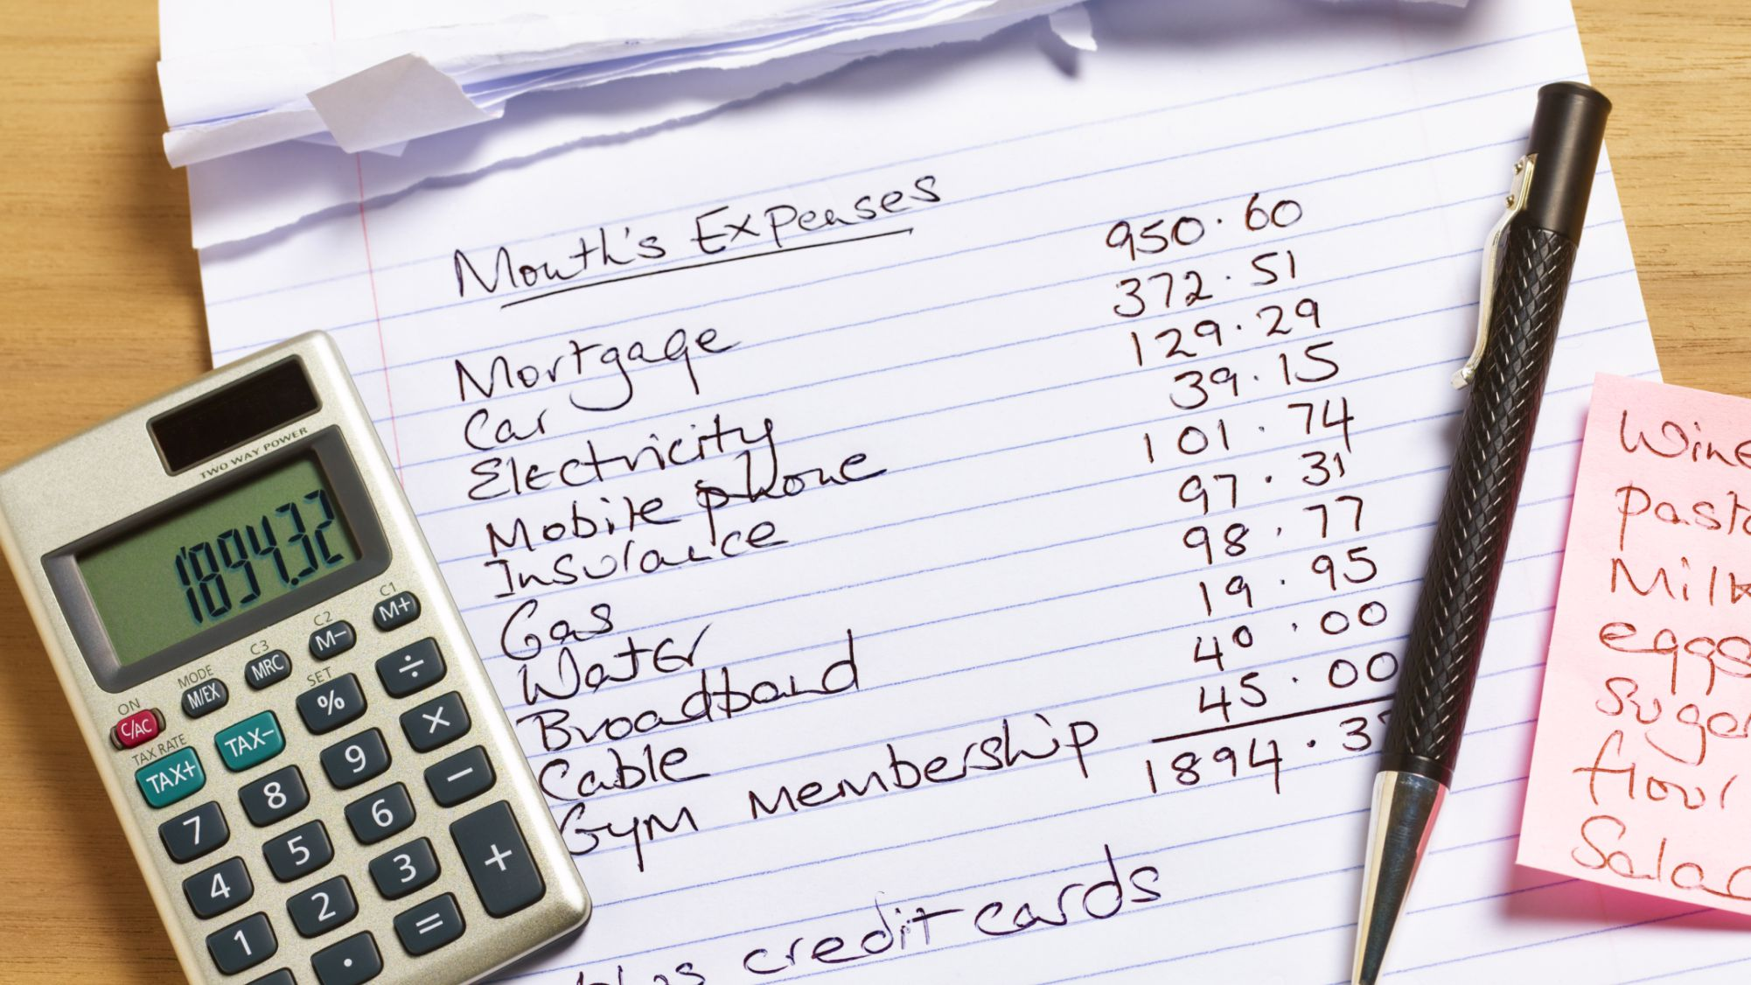
Critical thinking > Discuss the following questions
1 How can student avoid getting into money trouble?

Slide 38




Critical thinking > Discuss the following questions
1 How can student avoid getting into money trouble?
2 Do you think it is hard to have a part-time job while studying? Why, or why not?

Slide 39
Vocabulary comprehension > Definitions
A Match each word with its definitions.
per
education
list
borrow
worry
average
personal
advice
about one person, not everyone
to think about things you are afraid of
helpful ideas you get from someone
usual, normal
to write down a series of items in a column
for each or every
learning
to ask someone to give you something that you will give back later

Slide 40
Vocabulary comprehension > Definitions > A Match each word with its definitions.
per | for each or every
education | learning
list | to write down a series of items in a column
borrow | to ask someone to give you something that you will give back later
worry | to think about things you are afraid of
average | usual, normal
personal | about one person, not everyone
advice | helpful ideas you get from someone

Slide 41
B Complete the following sentences with the correct form of the words from A.
borrowed
My friend ______ $50 from me three weeks ago, but he hasn't returned the money. I'm really starting to _____ that he won't pay me back.
worry

Slide 42
B Complete the following sentences with the correct form of the words from A.
My friend ______ $50 from me three weeks ago, but he hasn't returned the money. I'm really starting to _____ that he won't pay me back.
Sometimes it's easier to get a good job if you got
your _________ at a good university. I went to one that was just _______. It's not the best, but isn't so bad.
education
average

Slide 43
B Complete the following sentences with the correct form of the words from A.
It's important to listen to the ______ that older people give you if you want to improve.
Membership to the club is about $100 ______ year.
advice
per

Slide 44
Prefixes –ex, -in & -im
-ex
out or away
-in, -im
inside or into
expense inhale exclude import introverted inter

Slide 45
external
internal

Slide 46
A Match each word in the box with its opposite.
expense inhale exclude import introverted
import
export _______
exhale _______
income _______
include _______
extroverted _______
inhale
expense
exclude
introverted

Slide 47
B Wrote the words from A next to the correct definition.
______ to bring things into a country
______ to breathe in
______ to leave out
______ money that you make
______ shy, quiet
import
inhale
exclude
income
introverted
expense inhale exclude import introverted income

Slide 48
C Complete the following sentences with the correct form of the words from A.
It is harmful to ________ cigarette smoke.
The lunches to ________ many healthy foods, such as fruits and salads.
Taking a vacation abroad was a very big ________. I could hardly pay for it.
Hailey isn’t shy at all. She’s quite ________, and is always talking.
Many supermarkets sell food that is ________ from all over the world.
expense inhale exclude import extroverted income include

Slide 49
C Complete the following sentences with the correct form of the words from A.
It is harmful to ________ cigarette smoke.
The lunches to ________ many healthy foods, such as fruits and salads.
Taking a vacation abroad was a very big ________. I could hardly pay for it.
Hailey isn’t shy at all. She’s quite ________, and is always talking.
Many supermarkets sell food that is ________ from all over the world.
inhale
include
expense
extroverted
imported
expense inhale exclude import extroverted income include

Slide 50
Summary of the lesson:
Vocabulary
Skimming for the main ideas
Word definitions
Prefixes _in, _im, and _ex.

Slide 51
Homework for today:
Learn the vocabulary, word definitions, words go with prefixes _in, _im, and _ex.
Prepare for chapter 2.

