Slide 1

WELCOME TO DAI KA TEAM

Slide 2

WHAT IS A DREAM JOB ?
A DREAM JOB IS DOING WHAT YOU ABSOLUTELY LOVE TO DO THAT YOU FEEL LIKE YOU DO IT EVERY DAY YOU ARE NOT BORING AT ALL

Slide 3

WHY ARE SO MANY PEOPLE STILL UNABLE TO DETERMINE THEIR DREAM JOBS ?

Slide 4


1.LAZYYYYYYYYYYYYYYYYYYYYYY

Slide 5

2.THE NO PRESSURE ZONE

Slide 6

NO PRESSURE, NO SUCCESS.

Slide 7


3.AFRAID OF FAILURE

Slide 8

DO NOT AFRAID

Slide 9

WHY WE MUST HAVE A DREAM JOB ?

Slide 10

🥺🥺🥺🥺🥺🥺🥺🥺🥺🥺🥺🥺🥺🥺🥺🥺🥺🥺
BLAA…BLAA
18 AND NO DREAM JOBS
YOU ARE LOSER
BLAA...BLAA
BLAA…BLA
ASK MONEY FROM MOM

Slide 11
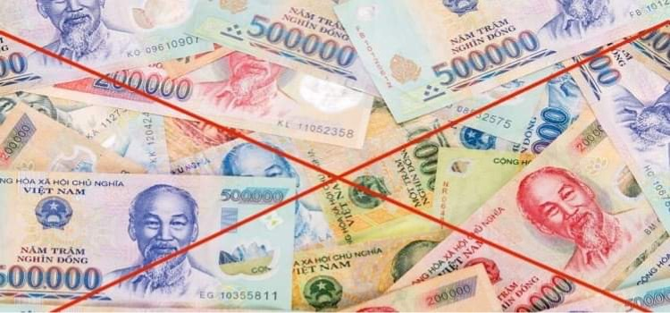
1. MONEY,MONEY,MONEYYYYYYYYY

Slide 12
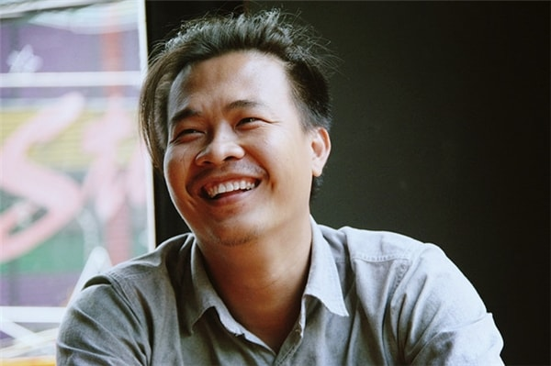

2.THE FEELING, YOU ENJOY INTO YOUR DREAM

Slide 13

3.YOU CAN LIVE INDEPENDENTLY

Slide 14

4.NO MORE LAZYYYY

Slide 15

5.PEAC WITH IN YOURSELF

Slide 16


HOW TO FIND OUR DREAM JOBS ?
1.Make a list of the jobs you hate
2. Make a list of the jobs you love
3.Understand your personality well
4. Take a personality test to find yourself the right job

Slide 17
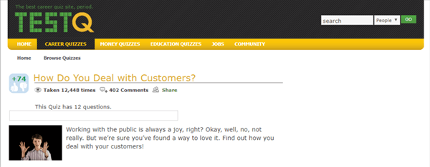
Trusted websites used to test careers through personality
1. Testq.com

Slide 18
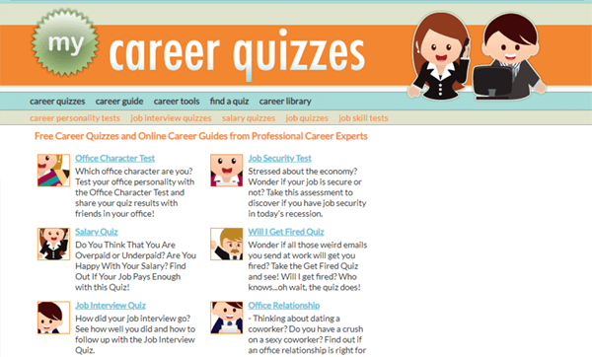
2. Mycareerquizzes.com

Slide 19

3.123test.com

Slide 20
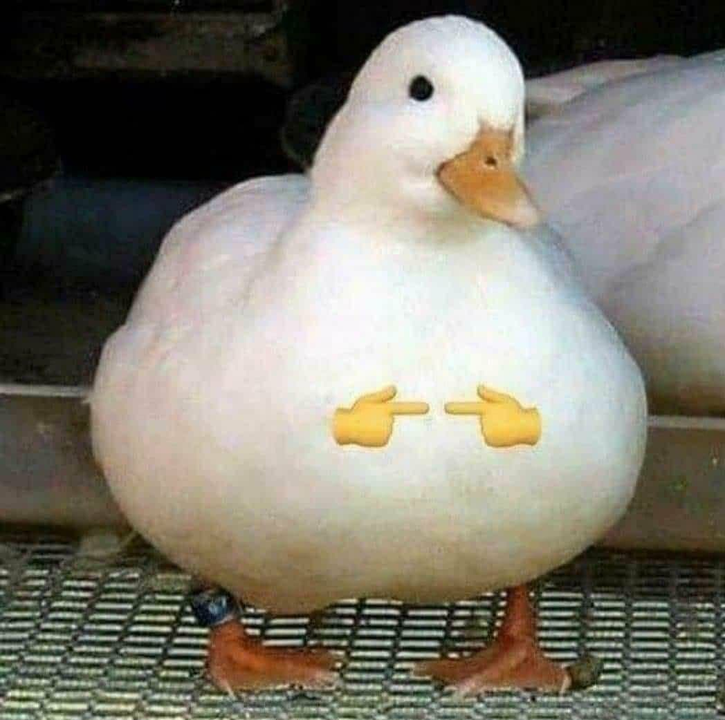
IS IT NORMAL TO NOT HAVE A DREAM JOB ?
MY ADVICE “ YOU SHOULD STOP TRYING TO FIND YOUR DREAM JOB “
1. THE PERFECT JOB WILL NOT MAKE YOU HAPPY
2. JUST BEING YOUR BEST SELF
3. THE CONCEPT OF A DREAM JOB IS AN ILLUSION
*TRY AND REMEMBER THAT NOTHING IS 100% PERFECT

Slide 21


Slide 22


LOVE YOU GUYS ;))))))

