Slide 1

TRƯỜNG CAO ĐẲNG LÝ TỰ TRỌNG TP. HỒ CHÍ MINH

Slide 2

ỦY BAN NHÂN DÂN THÀNH PHỐ HỒ CHÍ MINH
TRƯỜNG CAO ĐẲNG LÝ TỰ TRỌNG TP. HỒ CHÍ MINH
Bậc đào tạo: TRUNG CẤP CHUYÊN NGHIỆP
KHOA NGOẠI NGỮ

Slide 3

Good morning class.

Slide 4


Slide 5

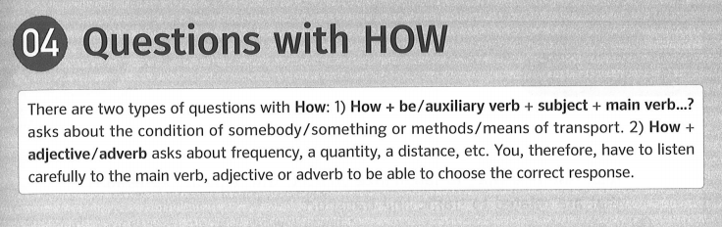
Unit 4: Information Questions (2) – Page 31
04 Questions with HOW – Page 35

Slide 6
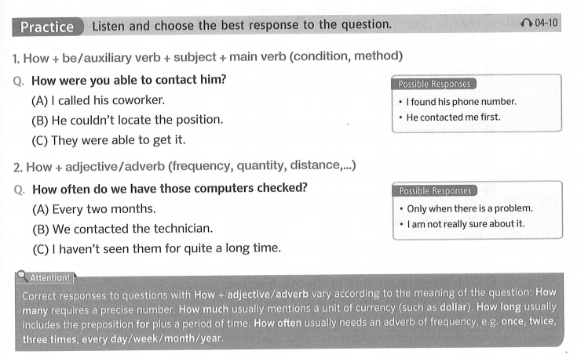
Unit 4: Information Questions (2) – Page 31
04 Questions with HOW – Page 35

Slide 7
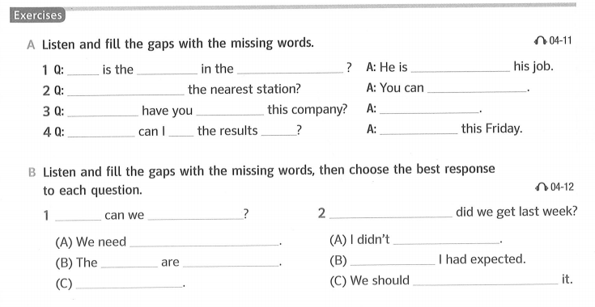
Unit 4: Information Questions (2) – Page 31
04 Questions with HOW – Page 35
new person
Sales Department
How
adjusting to
How can I get to
take a bus
How long
work for
Since 2007
How soon
get
back
Not until
improve sales
How many complaints
How
aggressive marketing
get any replies
items
not for sale
Fewer than
By airplane
do something about

Slide 8
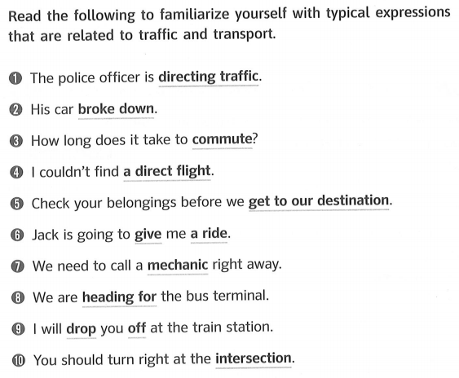
Unit 4: Information Questions (2) – Page 31
Key Expressions – Page 36

Slide 9
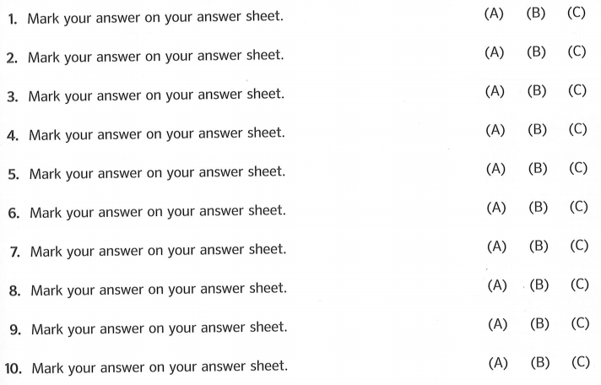
Unit 4: Information Questions (2) – Page 31
Practice with Actual Questions – Page 37

Slide 10
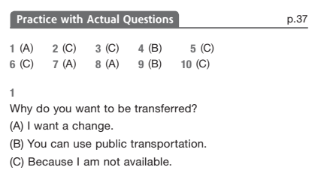
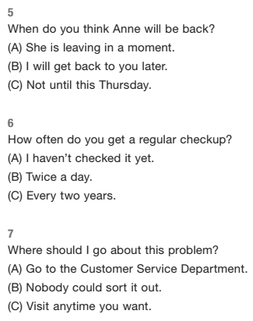
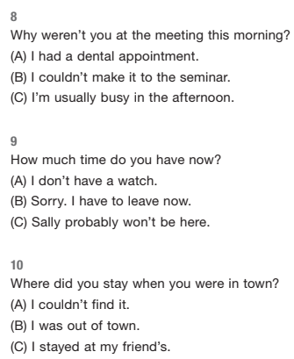
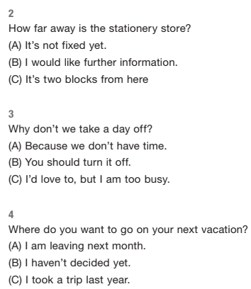
Unit 4: Information Questions (2) – Page 31
Practice with Actual Questions – Page 37

Slide 11
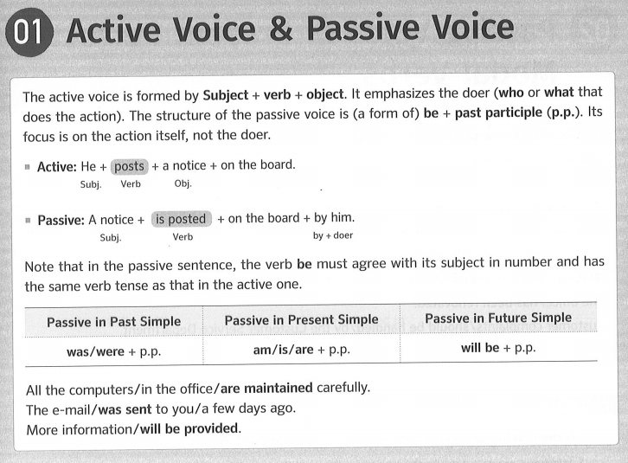
Unit 04: Active Voice & Passive Voice – Page 137
01 Active Voice & Passive Voice – Page 139

Slide 12
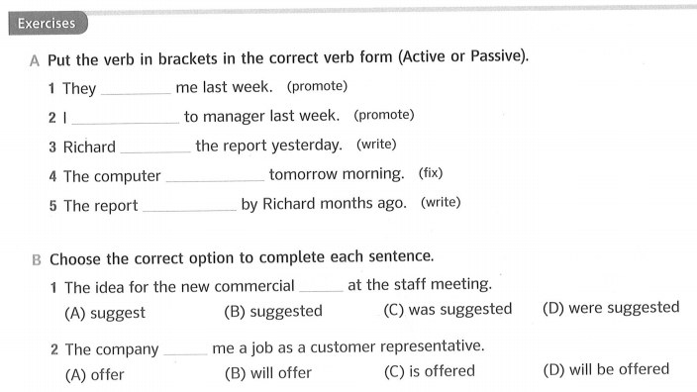
Unit 04: Active Voice & Passive Voice – Page 137
01 Active Voice & Passive Voice – Page 139
promoted
was promoted
wrote
will be fixed
was written

Slide 13
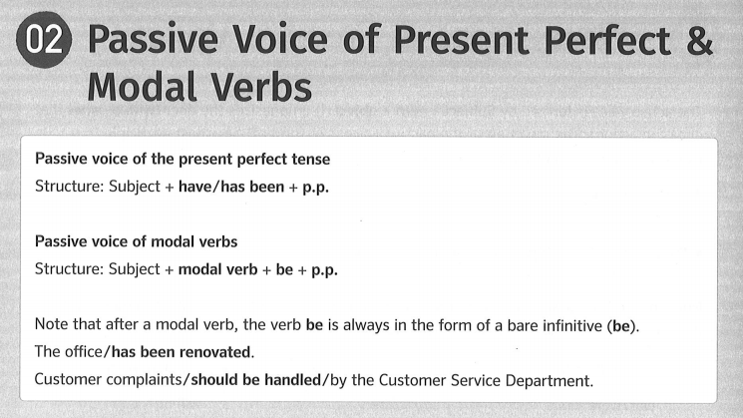
Unit 04: Active Voice & Passive Voice – Page 137
01 Active Voice & Passive Voice – Page 140

Slide 14
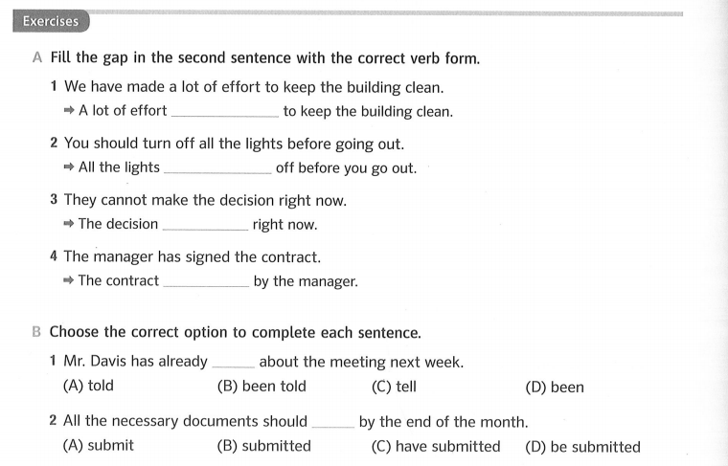
Unit 04: Active Voice & Passive Voice – Page 137
02 Passive Voice of Present Perfect & Modal Verbs – Page 140
1. has been made
2. should be turned
3. cannot be made
4. has been signed

Slide 15
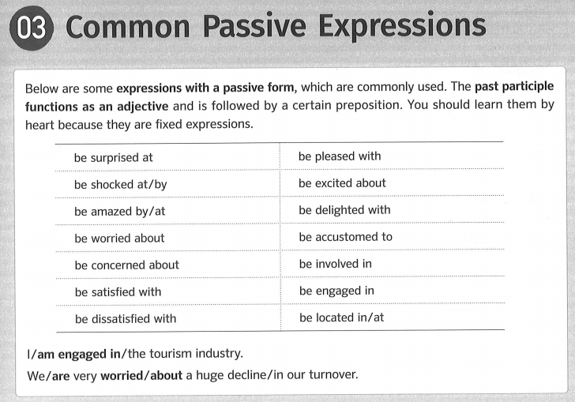
Unit 04: Active Voice & Passive Voice – Page 137
03 Common Passive Expressions – Page 141

Slide 16
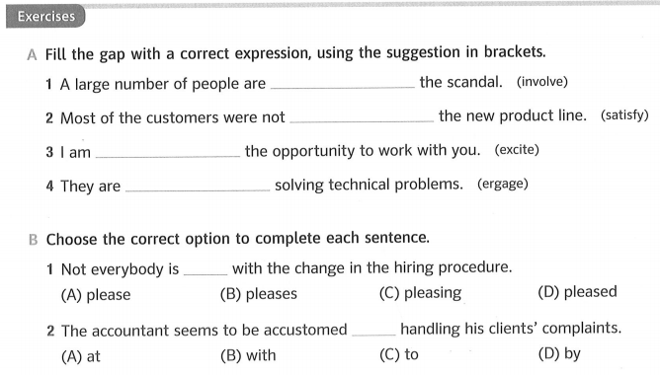
Unit 04: Active Voice & Passive Voice – Page 137
03 Common Passive Expressions – Page 141
involved in
satisfied with
excited about
engaged in

Slide 17
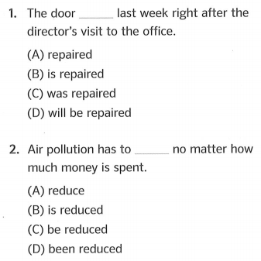
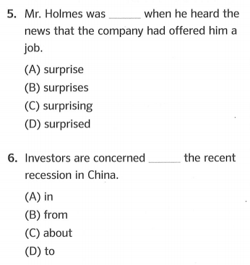
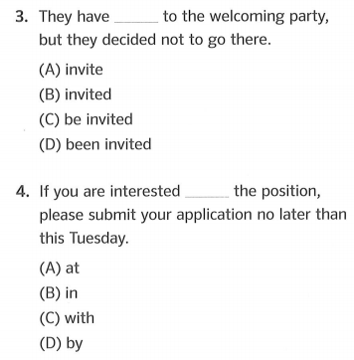
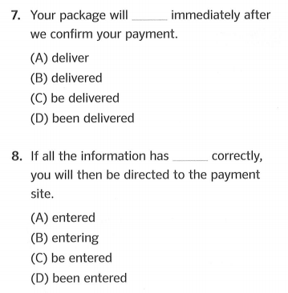
Unit 04: Active Voice & Passive Voice – Page 137
Practice with Actual Questions PART 5 – Page 142
V3/ V -ed
V0
V0
Gói hàng của bạn sẽ được giao ngay sau khi chúng tôi xác nhận khoản thanh toán của bạn.
Nếu tất cả thông tin đã được nhập chính xác, bạn sẽ được chuyển đến trang thanh toán.

Slide 18


Slide 19

ĐƠN XIN VIỆC

Slide 20

Resume (Résumé)
Có nguồn gốc từ tiếng Pháp
Résumé (noun) UK /ˈrez.juː.meɪ / US /ˈrez.ə.meɪ/

Slide 21
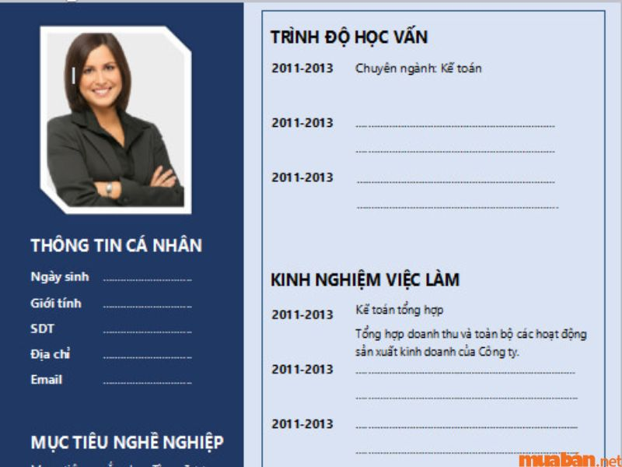

SƠ YẾU LÝ LỊCH

Slide 22


Slide 23


Slide 25
Resume (Résumé)
Có nguồn gốc từ tiếng Pháp
Résumé (noun) UK /ˈrez.juː.meɪ / US /ˈrez.ə.meɪ/

Slide 27
PART 6 – TEXT COMPLETION
( HOÀN THÀNH VÀO ĐOẠN VĂN )
Page 143

Slide 28
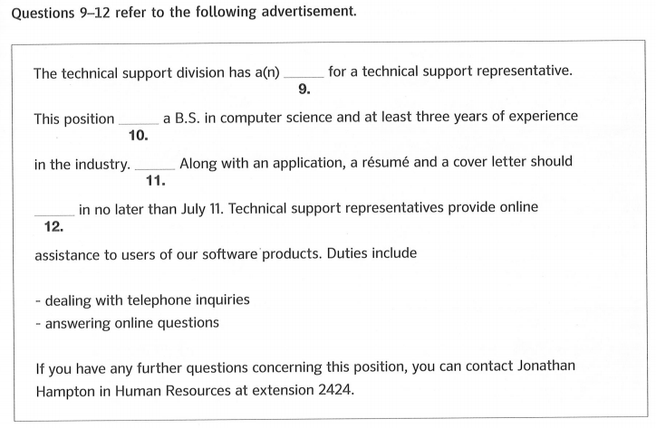
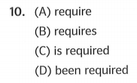
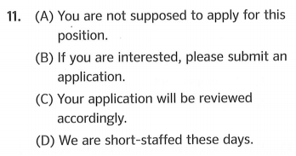
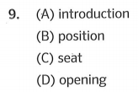
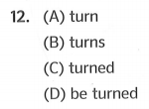
Unit 04: Active Voice & Passive Voice – Page 137
Practice with Actual Questions PART 6 – Page 143
B.S. ( noun ) = Bachelor of Science = Cử nhân khoa học

Slide 29

PART 6 – TEXT COMPLETION
HOÀN THÀNH VÀO ĐOẠN VĂN
Có 2 dạng câu hỏi:
√ Câu hỏi ngữ pháp
√ Câu hỏi từ vựng

Slide 30
PART 6 – TEXT COMPLETION
HOÀN THÀNH VÀO ĐOẠN VĂN
Các chủ điểm ngữ pháp:
√ Từ loại: danh từ, tính từ,
trạng từ . . . (Parts of Speech))
√ Thì của động từ(Tenses)
√ Liên từ và giới từ
(Conjunction and preposition)
√ Mệnh đề (Clauses))

Slide 31


Representative (noun) /ˌrep.rɪˈzen.t̬ə.t̬ɪv/
Người đại diện diện
Position (noun) /pəˈzɪʃ.ən/
Vị trí, chức vụ

Slide 32

Assistance (noun) /əˈsɪs.təns/
Sự giúp đỡ

Slide 33
Task 1: Write the word and its meaning.
No (Number) | Pronunciation | Words | Meaning
1 | /kənˈsɝː.nɪŋ/
2 | /pəˈzɪʃ.ən/
3 | /əˈsɪs.təns/
4 | /ˌrep.rɪˈzen.t̬ə.t̬ɪv/
concerning
liên quan tới

Slide 34
Task 1: Write the word and its meaning.
No (Number) | Pronunciation | Words | Meaning
1 | /kənˈsɝː.nɪŋ/
2 | /pəˈzɪʃ.ən/
3 | /əˈsɪs.təns/
4 | /ˌrep.rɪˈzen.t̬ə.t̬ɪv/
concerning
liên quan tới
position
vị trí, chức vụ
assistance
sự giúp đỡ
representative
người đại diện

Slide 35
Task 1: Write the word and its meaning.
No (Number) | Pronunciation | Words | Meaning
1 | /kənˈsɝː.nɪŋ/
2 | /pəˈzɪʃ.ən/
3 | /əˈsɪs.təns/
4 | /ˌrep.rɪˈzen.t̬ə.t̬ɪv/
concerning
liên quan tới
position
vị trí, chức vụ
assistance
sự giúp đỡ
representative
người đại diện

Slide 36
Unit 04: Active Voice & Passive Voice – Page 137
Practice with Actual Questions PART 6 – Page 143
The technical support division has a(n) opening for a technical support representative.
This position requires a B.S. in computer science and at least three years of experience
in the industry. If you are interested, please submit an application. Along with an application, a résumé and a cover letter should be turned in no later then July 11. Technical support representatives provide online assistance to users of our software products. Duties include:
- dealing with telephone in quiries
- answering online questions
If you are any further questions concerning this position, you can contact Jonathan Hampton in Human Resources at extension 2424.

Slide 37
Unit 04: Active Voice & Passive Voice – Page 137
Practice with Actual Questions PART 6 – Page 143
Task 2:
Fill in the blank with one suitable word in the box
concerning assistance representative position
The technical support division has an opening for a technical support representative.
This position requires a B.S. in computer science and at least three years of experience
in the industry. If you are interested, please submit an application. Along with an application, a résumé and a cover letter should be turned in no later then July 11. Technical support representatives provide online assistance to users of our software products. Duties include:
- dealing with telephone in quiries
- answering online questions
If you are any further questions concerning this position, you can contact Jonathan Hampton in Human Resources at extension 2424.
1.
2.
3.
4.

Slide 38

Retreat (noun) /rɪˈtriːt/ = a private and safe place:
Khu nghỉ dưỡng biệt lập
"Retreat" là một mô hình lưu trú nghỉ dưỡng, là "du lịch chữa lành"

Slide 39

Retreat (noun) /rɪˈtriːt/ = a private and safe place:
Khu nghỉ dưỡng biệt lập
"Retreat" là một mô hình lưu trú nghỉ dưỡng, là "du lịch chữa lành"

Slide 40
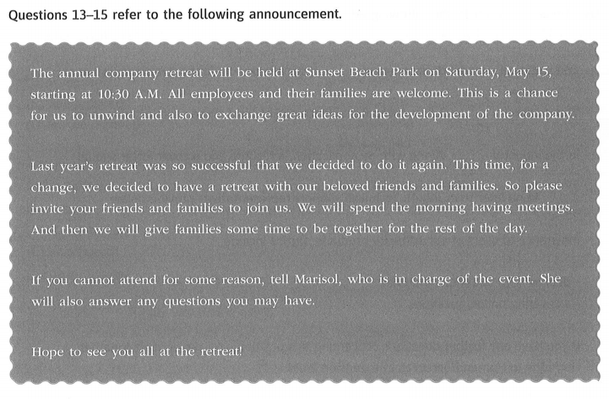
1
P1
P2
P3
10

Slide 41
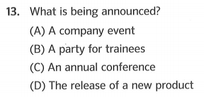
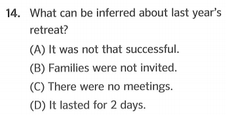
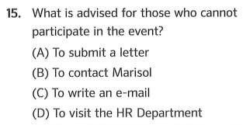
Unit 04: Active Voice & Passive Voice – Page 137
Practice with Actual Questions PART 7 – Page 144
thông báo
announcement (n) = notice

Slide 42
Listen and Repeat
unwind (v) /ʌnˈwaɪnd/
exchange (v) /ɪksˈtʃeɪndʒ/
attend (v) /əˈtend/
be in charge of

Slide 43
Task 1:
Match the words and phrase in column A with their definitions in column B
A | B
1. unwind (v) | a. to go to an event, place, etc.
2. exchange (v) | b. being the person who has control of or is responsible for someone or something
3. attend (v) | c. to relax after a period of work or anxiety
4. be in charge of | d. to give something to someone and receive something from that person

Slide 44
Task 1:
Match the words and phrase in column A with their definitions in column B
A | B
1. unwind (v) | a. to go to an event, place, etc.
2. exchange (v) | b. being the person who has control of or is responsible for someone or something:
3. attend (v) | c. to relax after a period of work or anxiety
4. be in charge of | d. to give something to someone and receive something from that person
________
________
________
_________

Slide 45
Task 1:
Match the words and phrase in column A with their definitions in column B
c
A | B
1. unwind (v) | a. to go to an event, place, etc.
2. exchange (v) | b. being the person who has control of or is responsible for someone or something:
3. attend (v) | c. to relax after a period of work or anxiety
4. be in charge of | d. to give something to someone and receive something from that person
________
________
________
_________
d
a
b

Slide 46
Task 2:
Fill in the blanks with suitable words
unwind exchange attend in charge
attend
1. The meeting is on the fifth and we're hoping everyone will _______.
unwind
2. I’m just going to watch some TV and __________.
in charge
3. Who will be _________ of the department when Sophie leaves?
exchange
4. It's traditional for the two teams to __________ shirts after the game.

Slide 47

Thank you very much
for
your cooperation.

