Slide 1
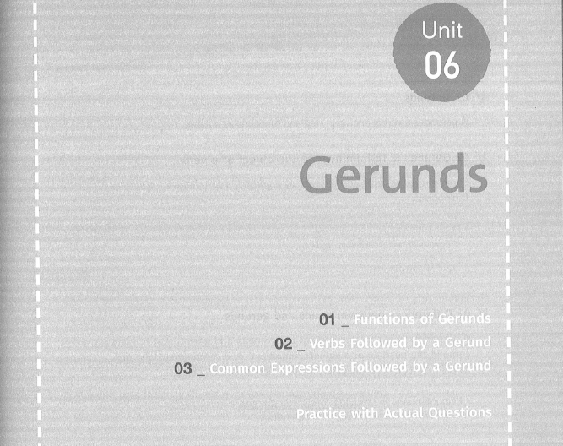

Slide 2
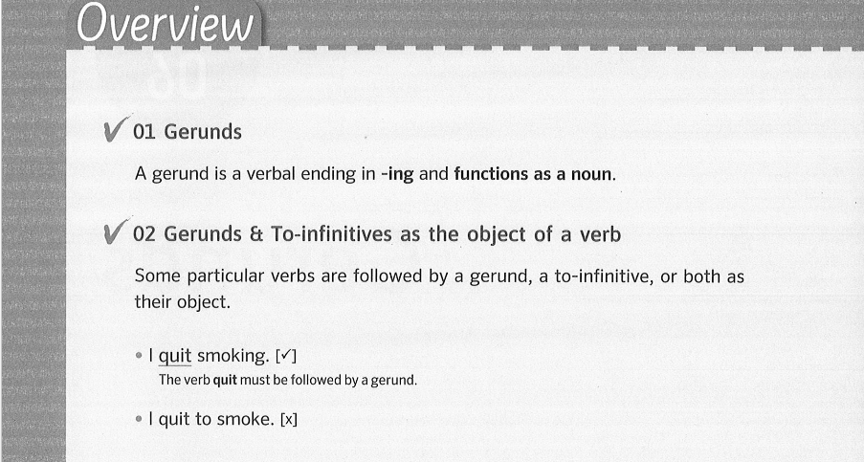

Slide 3
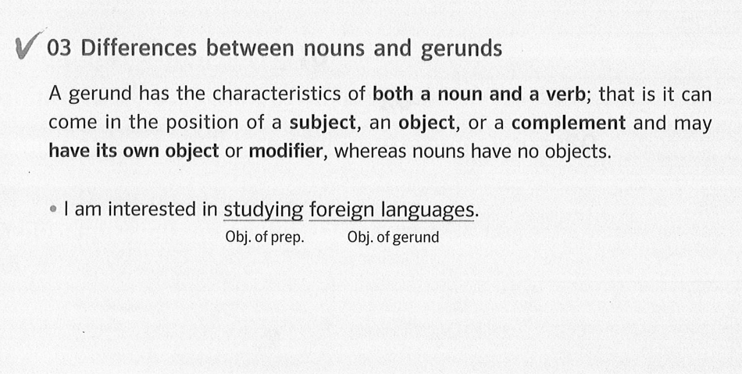

Slide 4
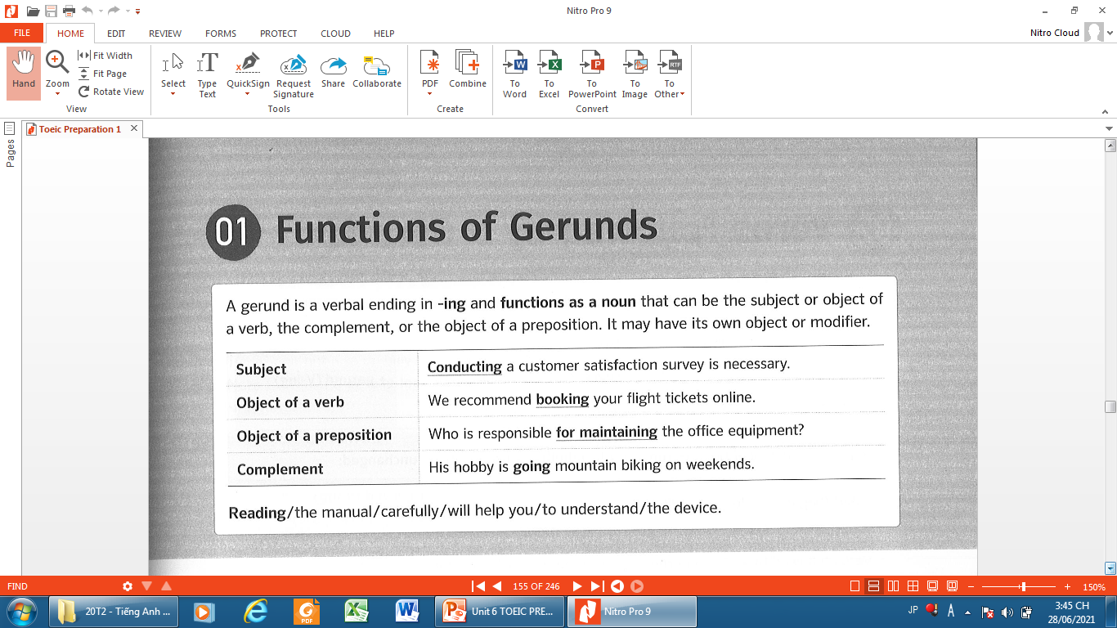

Slide 5
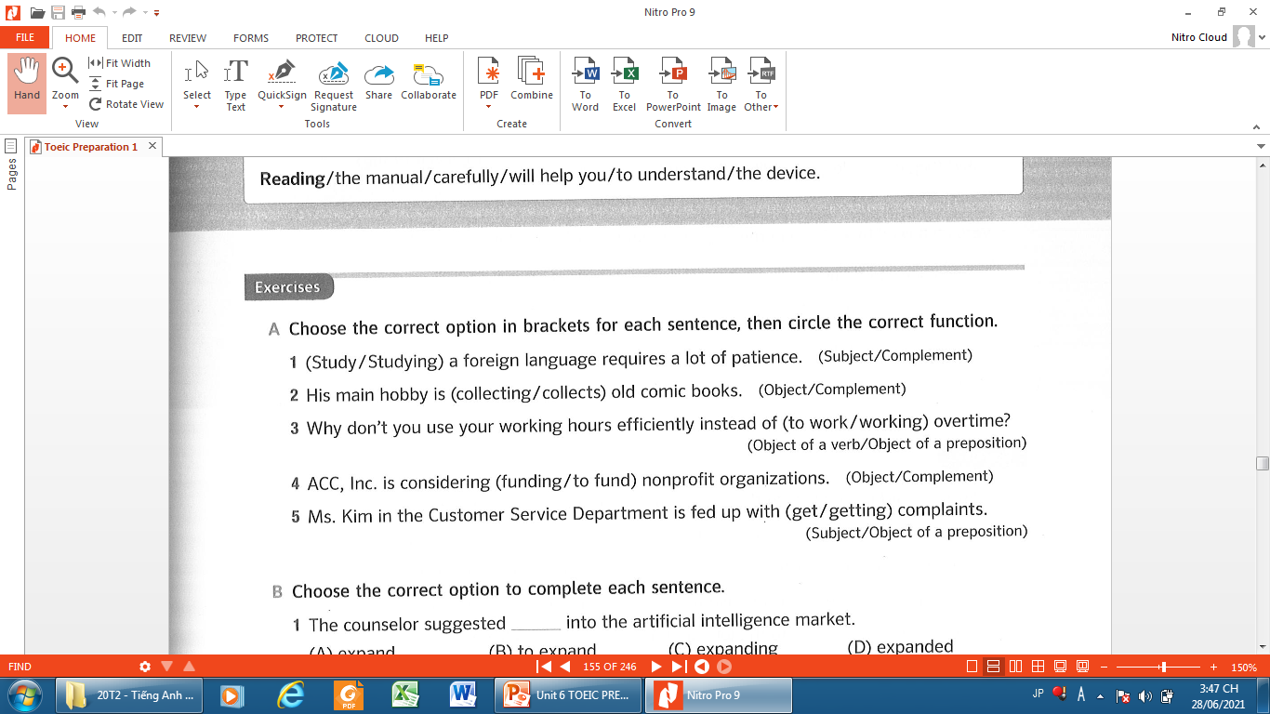
Subject
Complement

Slide 6
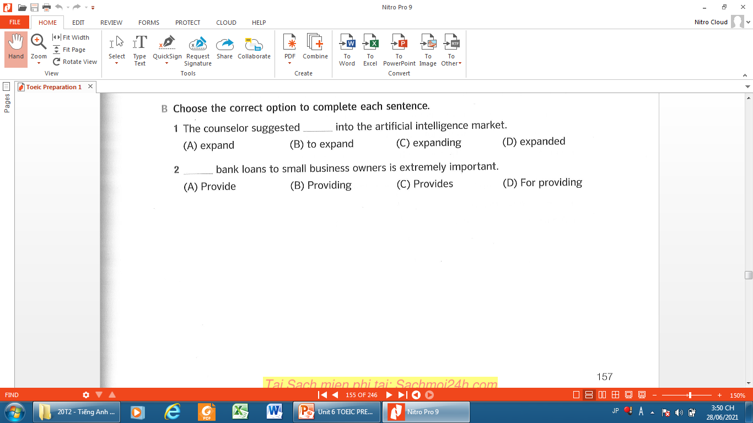

Slide 7
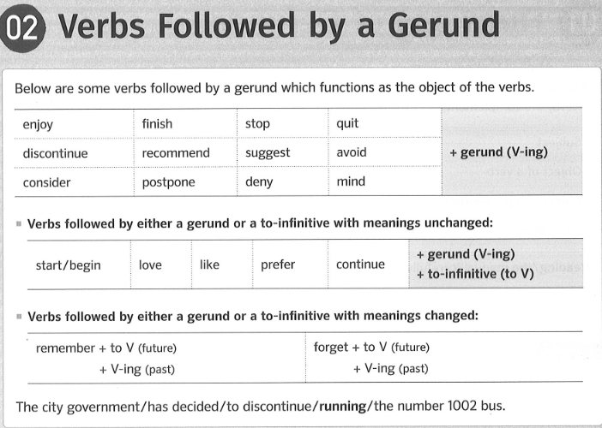

Slide 8
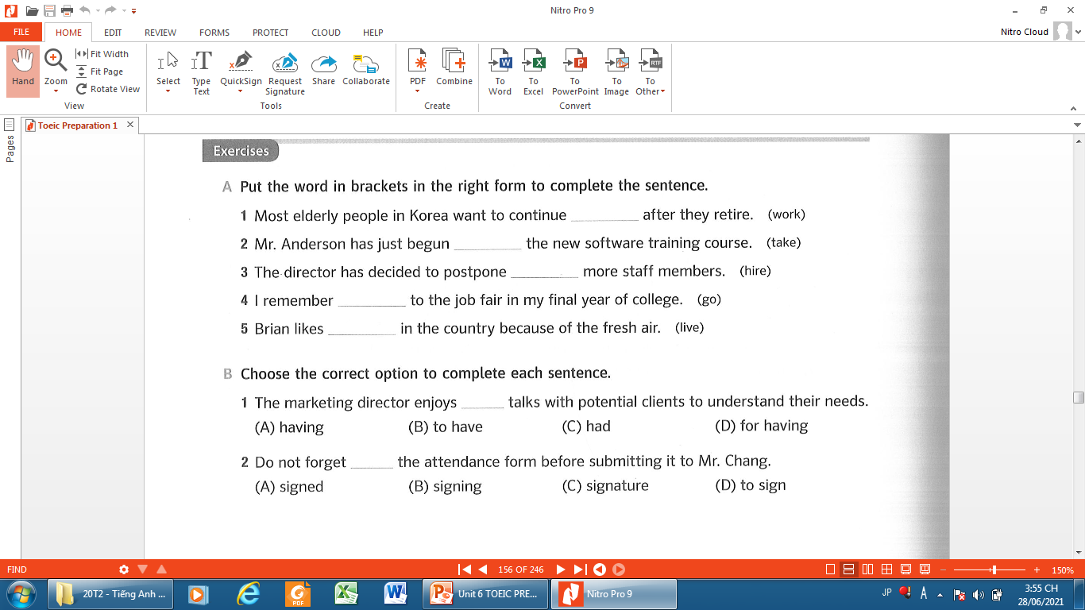
working / to work
taking / to take
hiring
going
to live / living

Slide 9
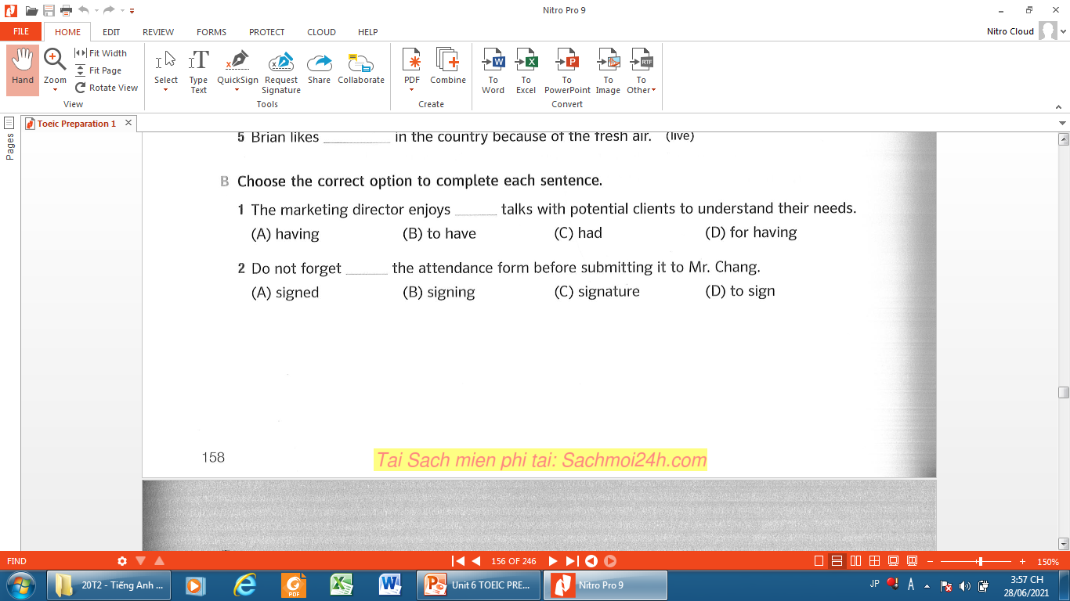

Slide 10
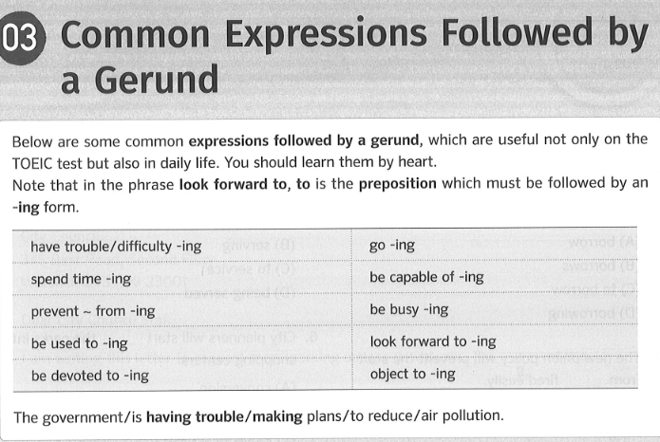

Slide 11
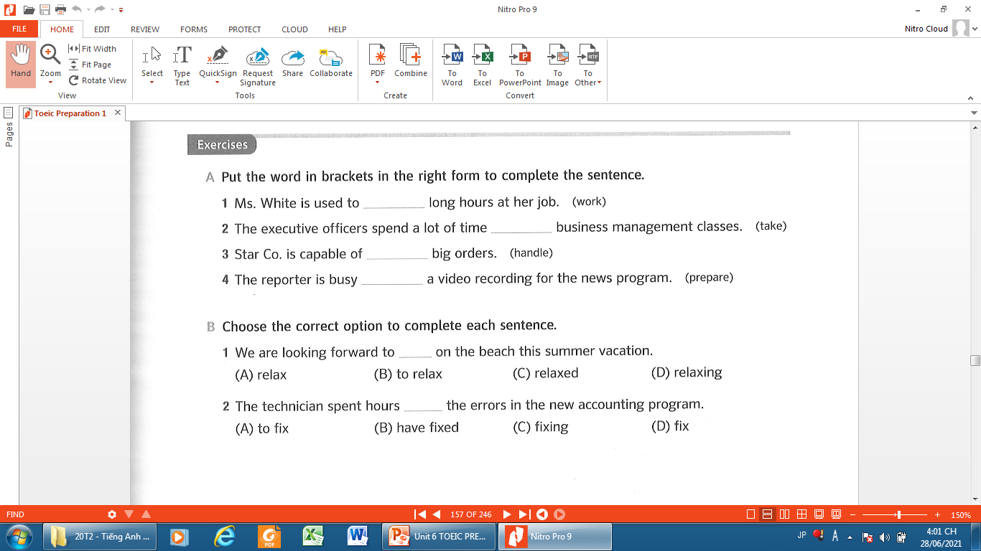
working
taking
handling
preparing

Slide 12


Slide 13
Infinitive | Past Tense | Past Participles
be | was / were | been
go | went | gone
choose | chose | chosen
send | sent | sent
spend | spent | spent
have | had | had

Slide 14


Slide 15
Cấu trúc: S + spend + time / money + V-ing.
Spend dùng để diễn tả việc tiêu tốn vào một việc nào đó.
Anh ấy dành nhiều thời gian để dọn dẹp phòng học của mình.
→ He spends a lot of time cleaning his classroom.
Công ty đã chi hàng ngàn đô la cập nhật các hệ thống máy tính của họ.
→ The company has spent thousands of dollars updating their computer systems.

Slide 16
Khi Spend đi cùng với danh từ
S + spend + time/ money + on + N.
I spend a lot of money on house.
Tôi chi rất nhiều tiền cho nhà cửa.
My wife spend a lot of money on her clothes.
Vợ tôi chi rất nhiều tiền vào quần áo.

Slide 17


Slide 18
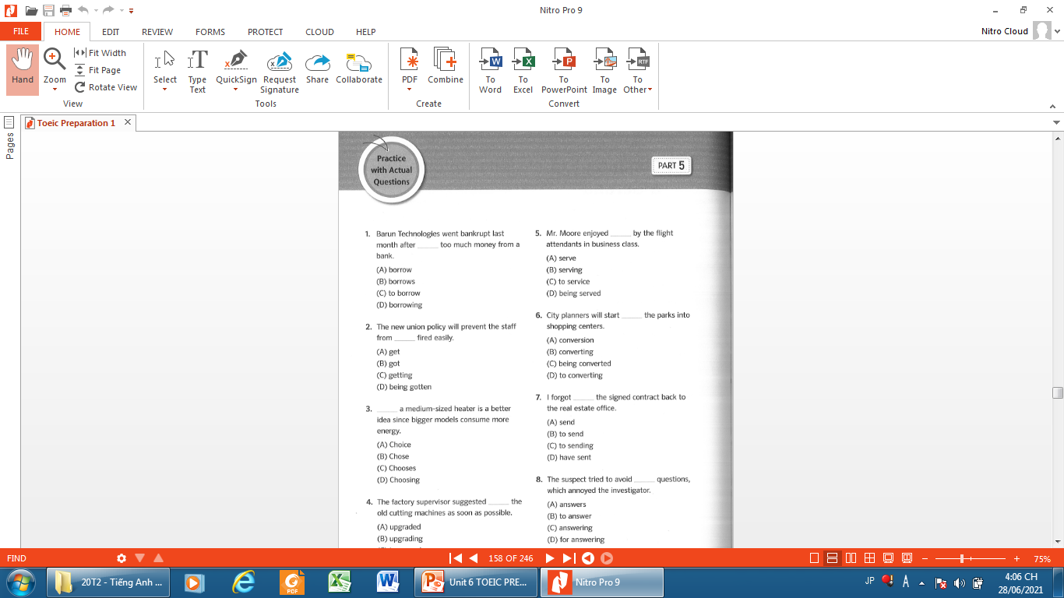
Page 160

Slide 19
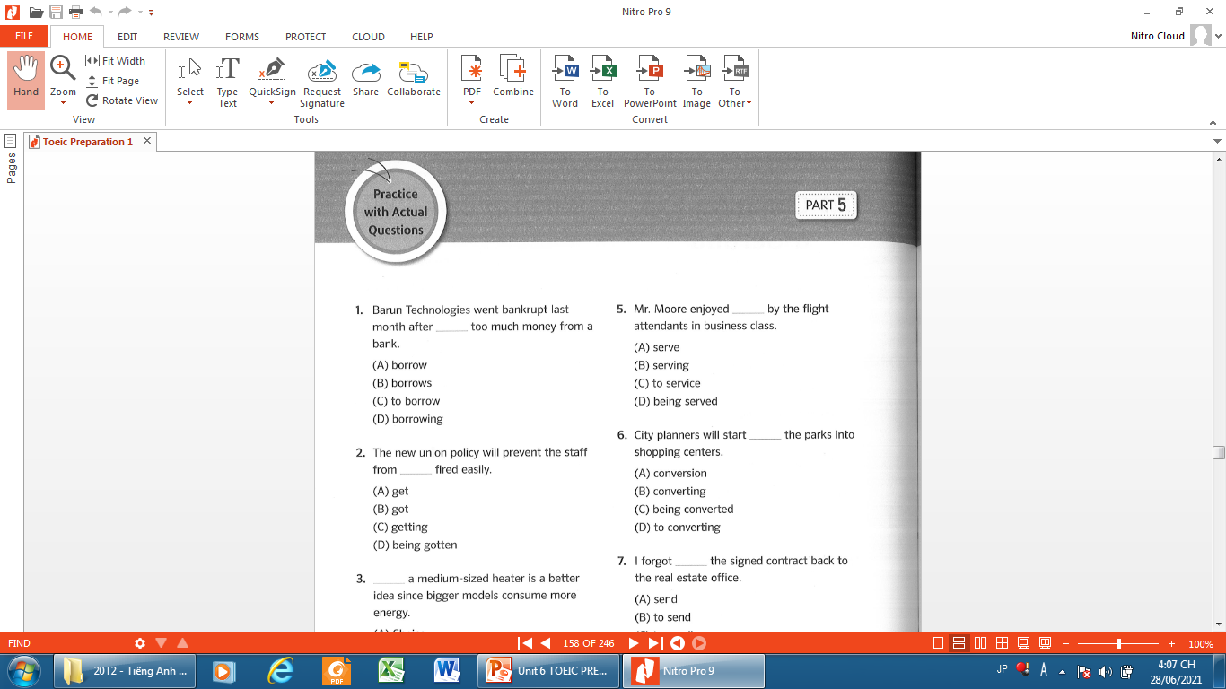
Page 160

Slide 20
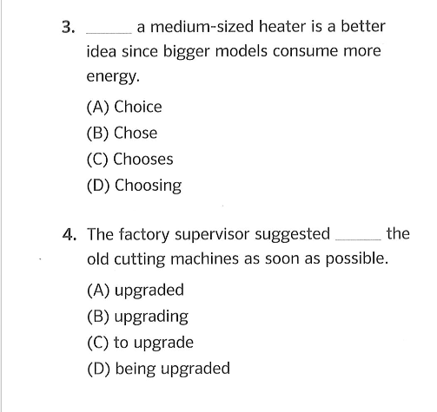

Slide 21
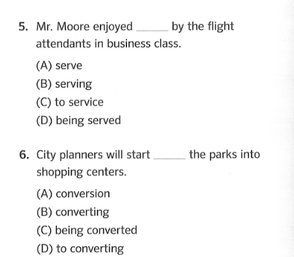

Slide 22


Slide 23


Do you know what it is called ?
Downtown = City center

Slide 24


Do you like to go shopping ?

Slide 25
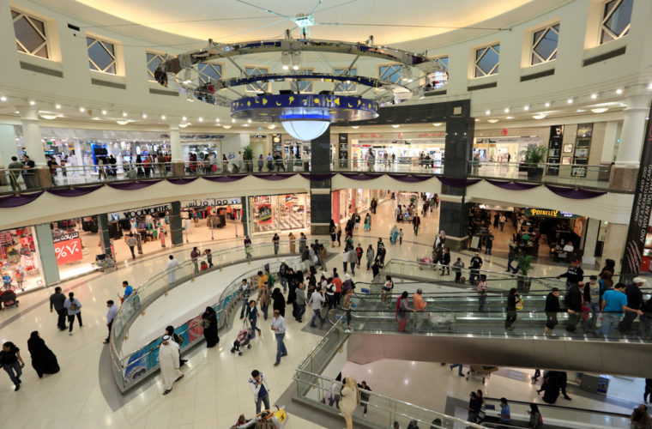
Do you often go to the shopping mall ?

Slide 26
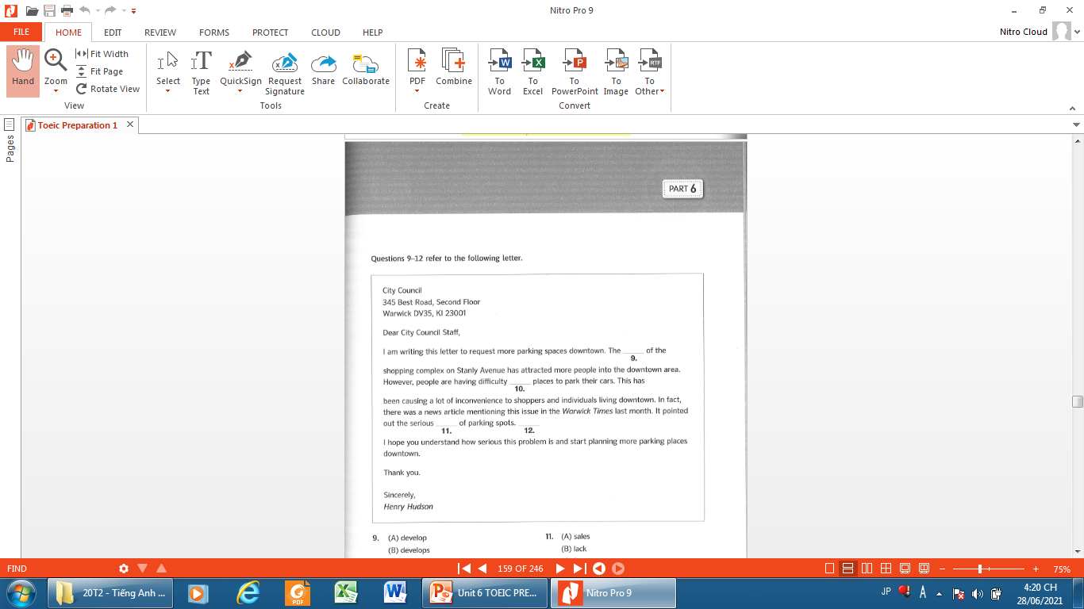
Page 161

Slide 27
Page 161
Parking spaces = parking spots = bãi đậu xe
Convenience >< inconvenience = sự bất tiện

Slide 28
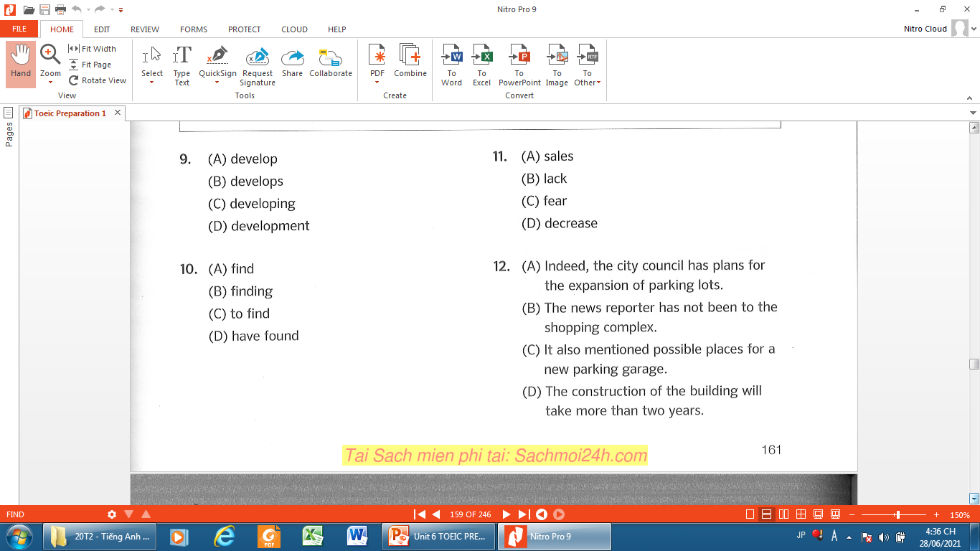
Page 161
Parking spaces = parking spots = bãi đậu xe
Convenience >< inconvenience = sự bất tiện

Slide 29
Page 161
Parking spaces = parking spots = bãi đậu xe
Convenience >< inconvenience = sự bất tiện

Slide 31
Page 161
Parking spaces = parking spots = bãi đậu xe
Convenience >< inconvenience = sự bất tiện

Slide 32
Page 161
Parking spaces = parking spots = bãi đậu xe
Convenience >< inconvenience = sự bất tiện

Slide 34
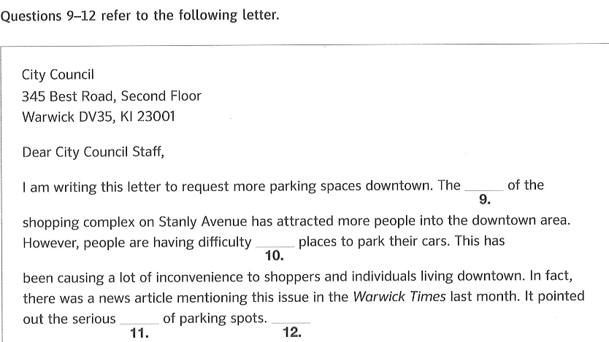
9. (D) development
10. (B) finding
11. (B) lack
12. (c ) It also mentioned possible places for a new parking garage.

Slide 35
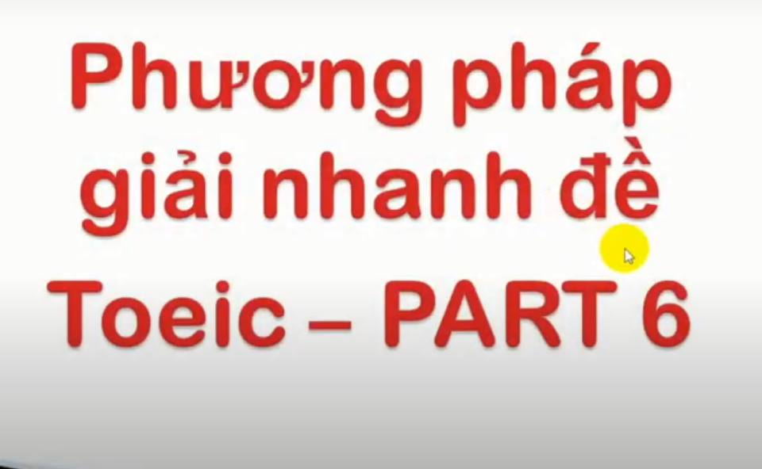

Slide 36
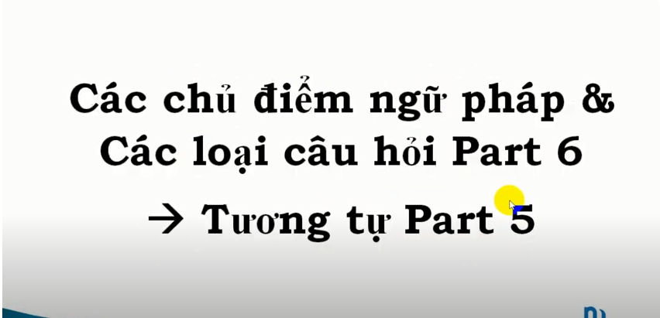

Slide 37
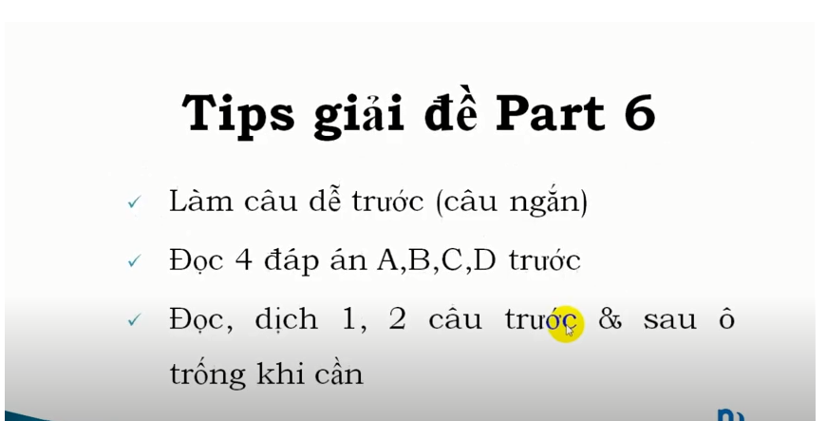

Slide 38
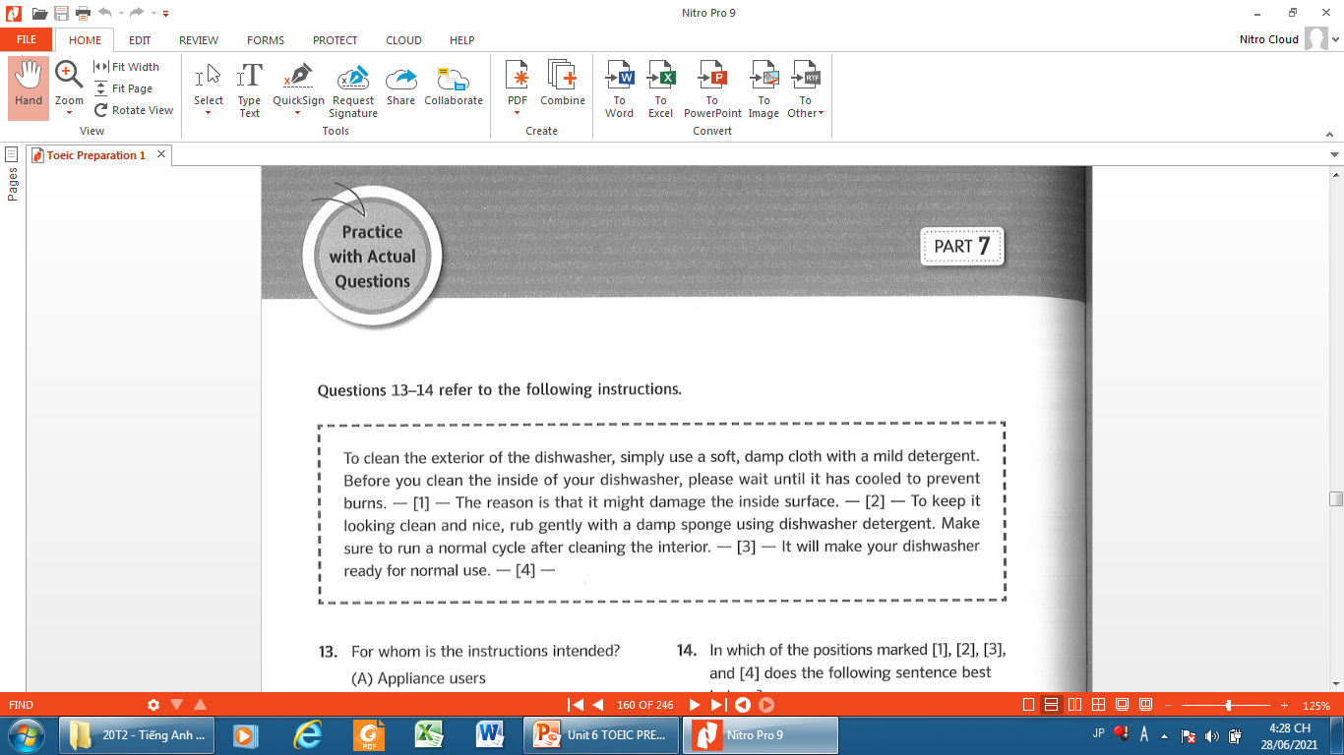
Page 162

Slide 39
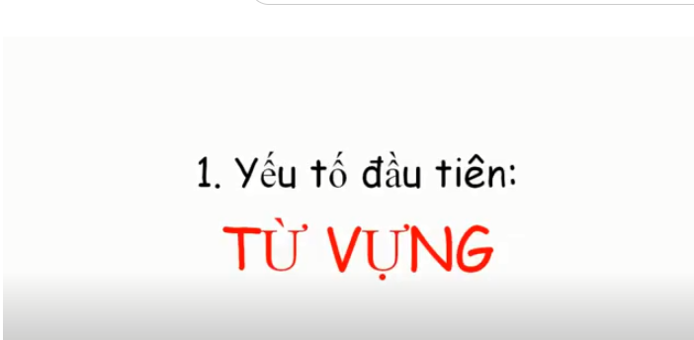

Slide 40
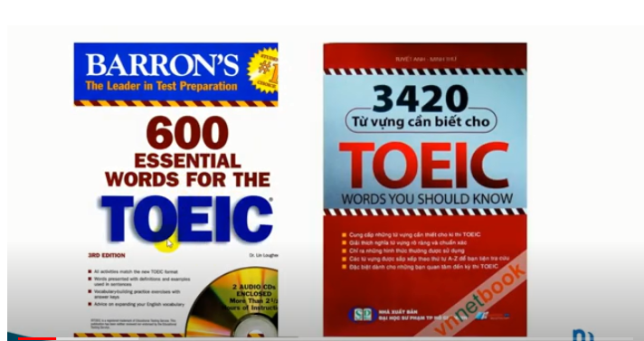

Slide 41
1. Cuốn 600 từ vựng Toeic của NXB Barron: https://drive.google.com/file/d/1mT7O... 2. Cuốn 3420 từ vựng Toeic của NXB TP.Hồ Chí Minh: a. Link Phần 1: https://drive.google.com/file/d/1BBNN... b. Link Phần 2: https://drive.google.com/file/d/1fu9M... c. Link Phần 3: https://drive.google.com/file/d/1fc1U...
Ẩn bớt

Slide 42
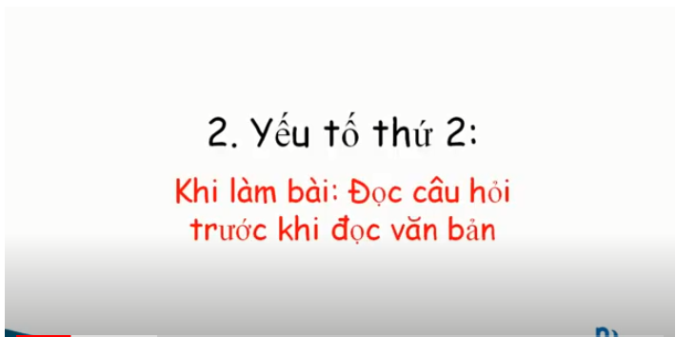

Slide 43
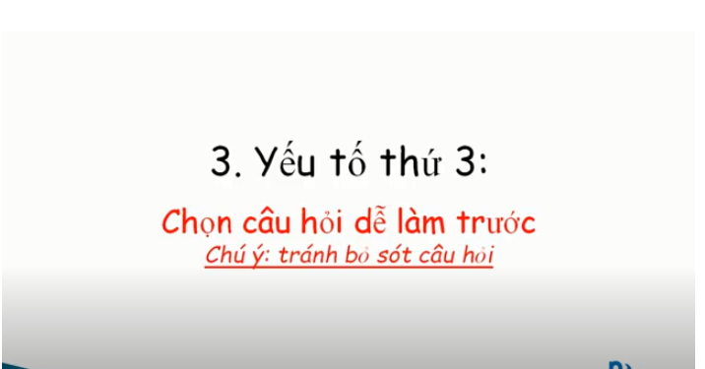

Slide 44
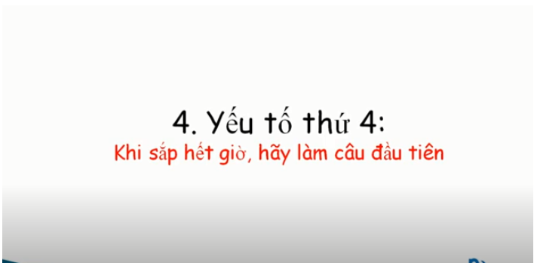

Slide 45

Matching the word with its meaning.
A | B
1. damp | a. bỏng, cháy
2. mild | b. bình thường
3. burn | c. làm nguội, làm mát
4. normal | d. Ẩm ướt
5. cool | e. nhẹ
d
2.
3.
4.
5.
1,
e
a
b
c

Slide 46
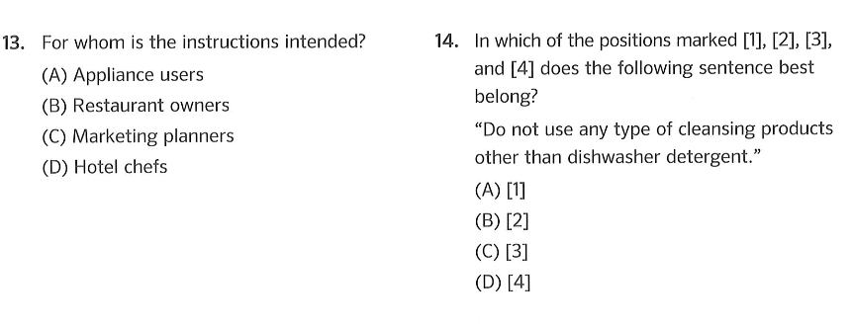

Slide 47
Detergent /dɪˈtɜː.dʒənt/ (n) = a chemical substance in the form of a powder or a liquid for removing dirt from clothes, dishes, etc. chất tẩy
Exterior (n) = outside = bô phận bên ngoài >< interior = inside

Slide 48
Line 1, 2

Slide 49
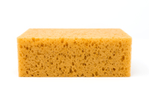
Detergent /dɪˈtɜː.dʒənt/ (n) = a chemical substance in the form of a powder or a liquid for removing dirt from clothes, dishes, etc.
Exterior (n) = outside >< interior = inside
sponge /spʌndʒ/ (n) =
cao su xốp, vật xốp

Slide 50
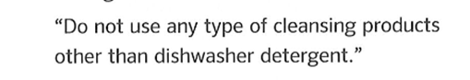
Detergent /dɪˈtɜː.dʒənt/ (n) = a chemical substance in the form of a powder or a liquid for removing dirt from clothes, dishes, etc.
Exterior (n) = outside >< interior = inside
sponge /spʌndʒ/ (n) =
cao su xốp, vật xốp

Slide 52

Exercise:
Fill in the blank using words in the box
products sponge burns mild
1. To clean the exterior of the dishwasher, simply use a soft, damp cloth with a ________ detergent.
mild
2. Before you clean the inside of your dishwasher, please wait until it has cooled to prevent ________.
burns
products
3. Do not use any type of cleansing ________ other than the dishwasher detergent .
4. To keep the dishwasher looking clean and nice, rub gently with a damp _________ using dishwasher detergent.
sponge

Slide 53


Slide 54

Learn new words by heart.
Review exercises from pages 157 - 162
Prepare Unit7 Participles

Slide 55


Slide 56


Slide 57


Slide 58


