Slide 1
Test 15
Tiếng Anh 3

Slide 2
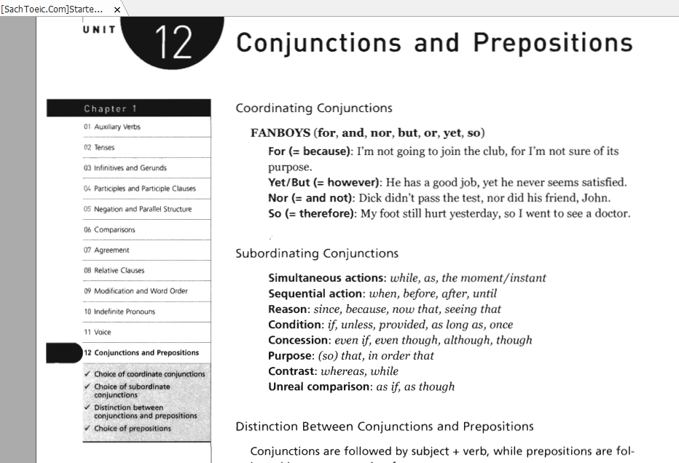

Slide 3
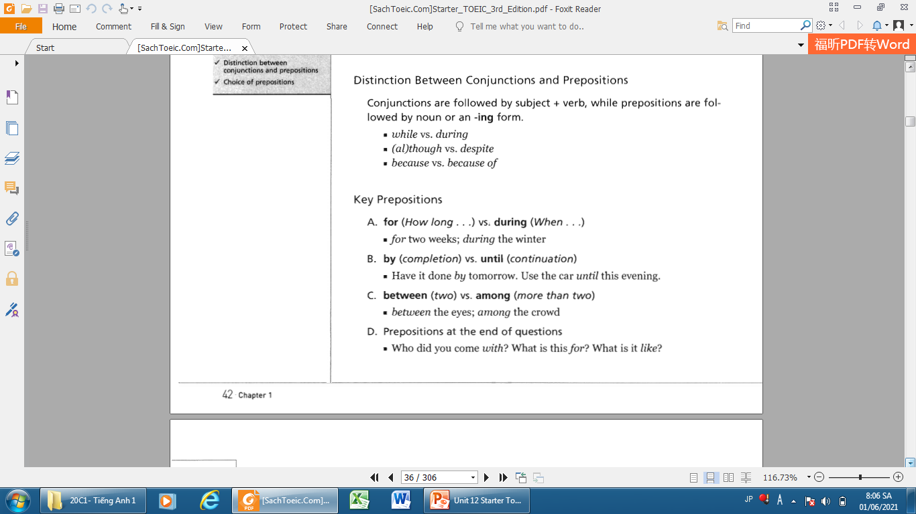

Slide 4
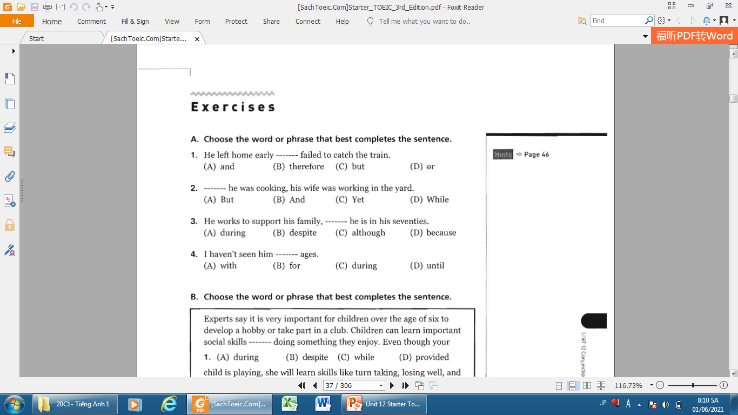
1.C. but
3.C. although
2.D. While
4.B. for

Slide 5
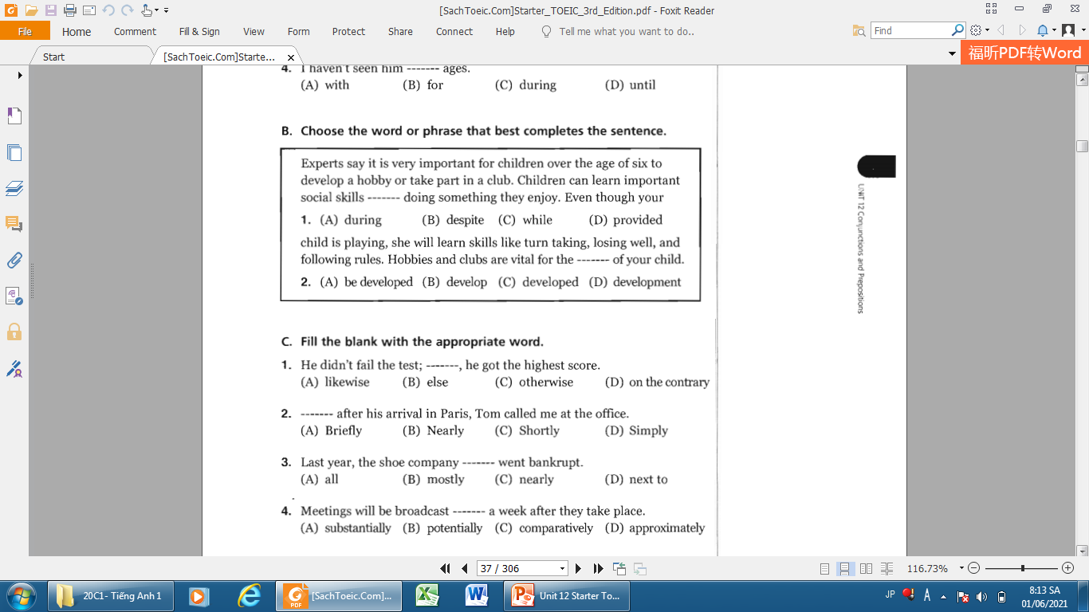
1.C
2.D
1.D
2.C
3.C
4.D

Slide 6
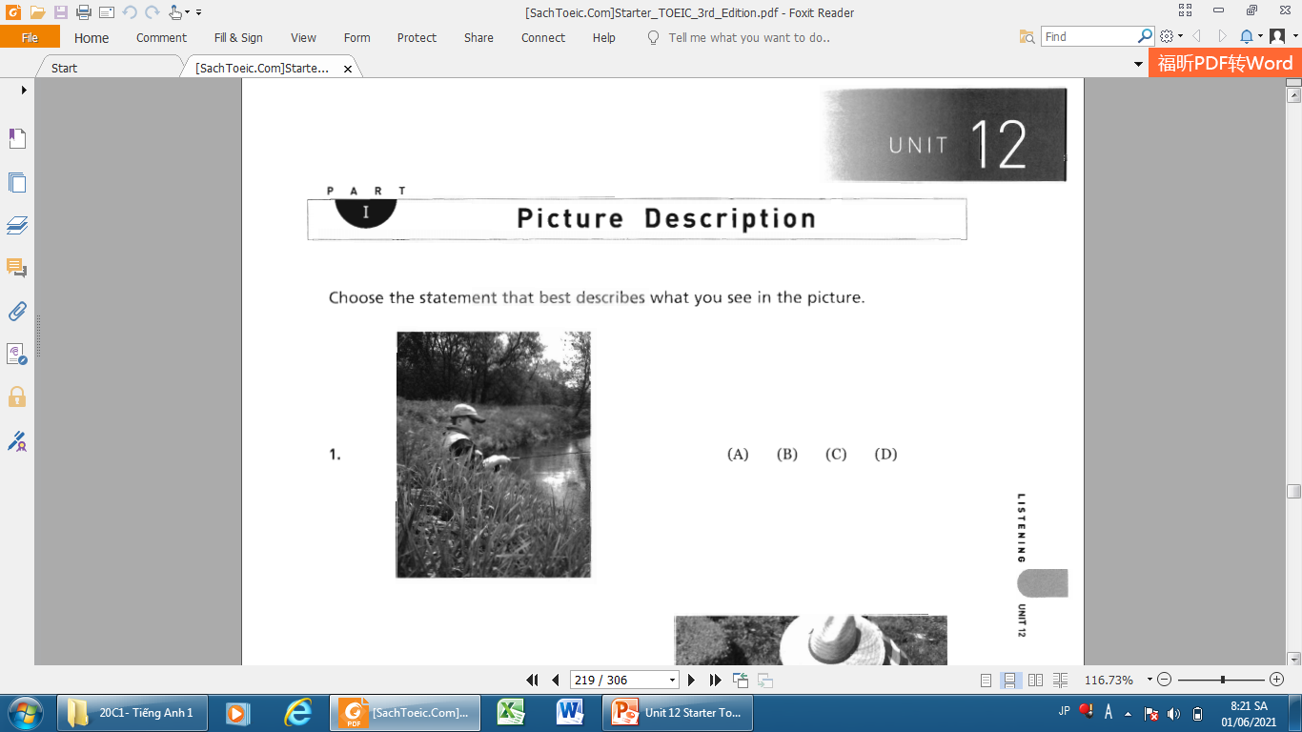

Slide 7
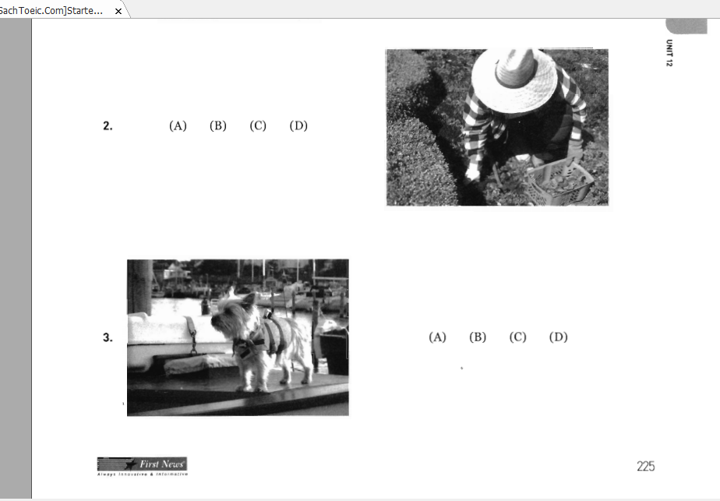

Slide 8
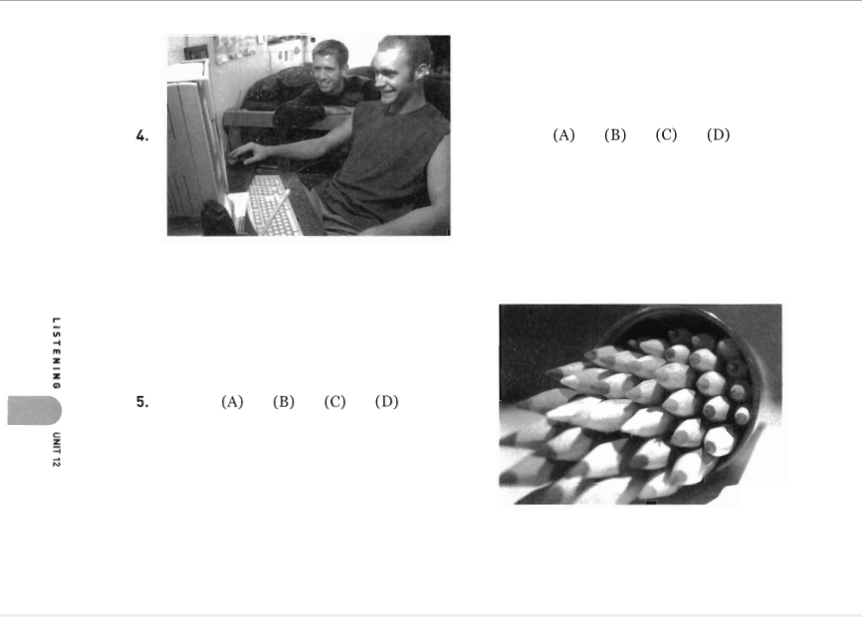

Slide 9
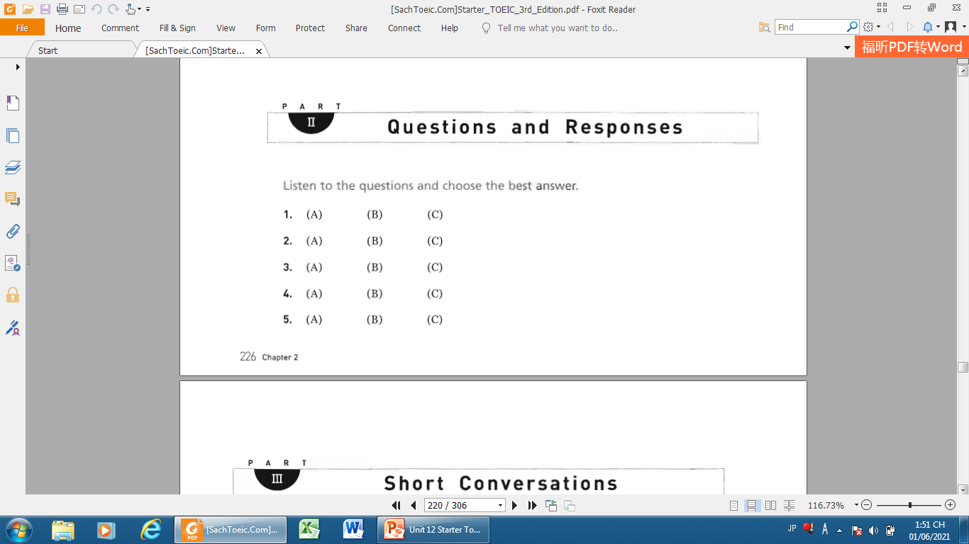

Slide 10
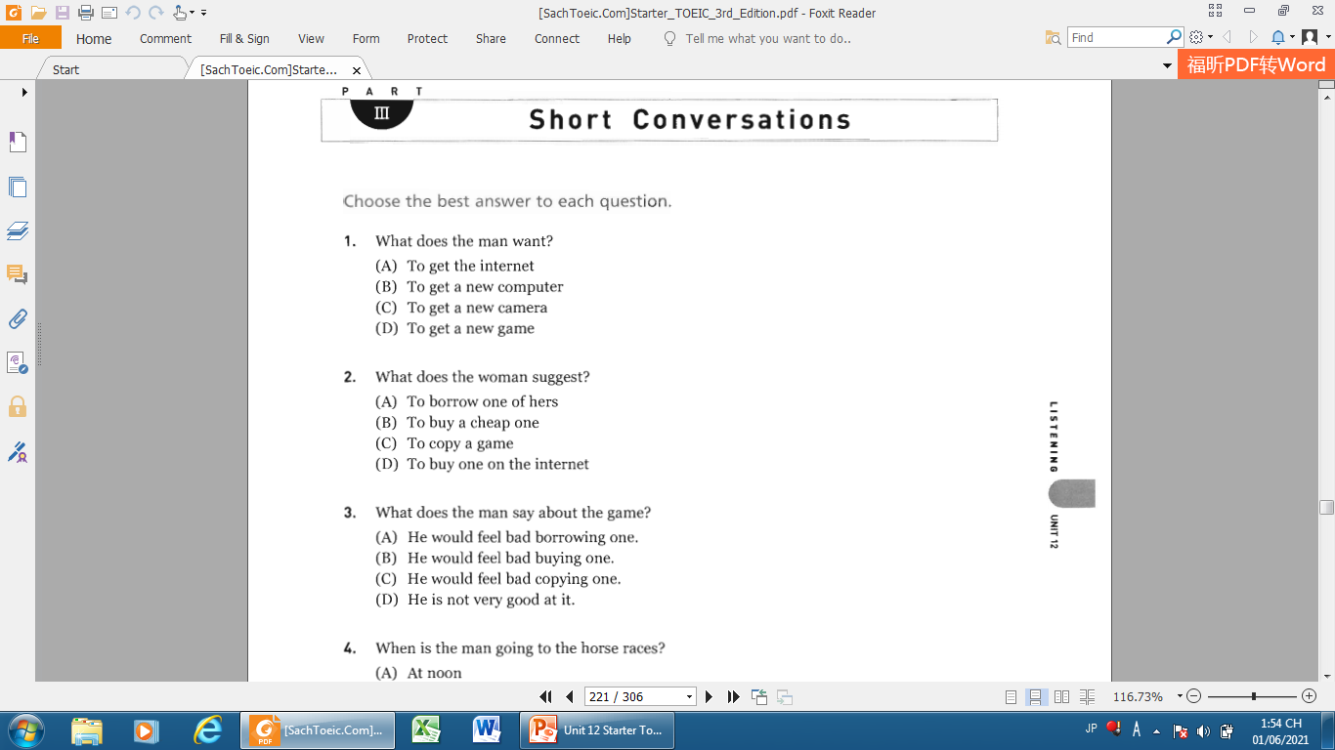

Slide 11
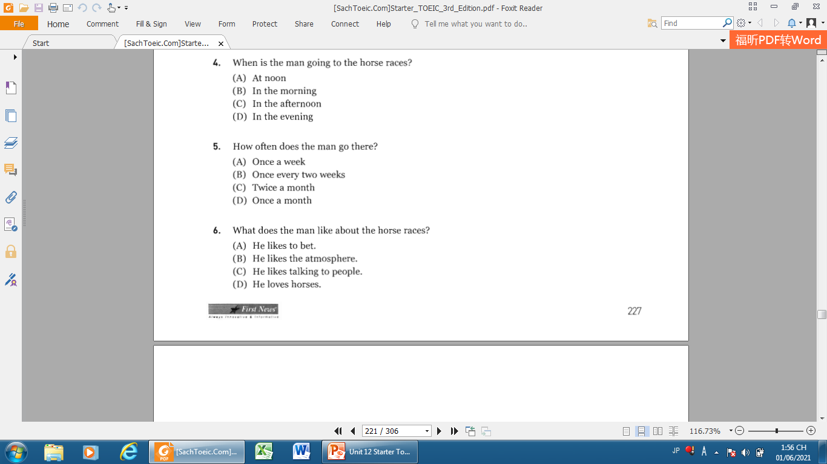

Slide 12
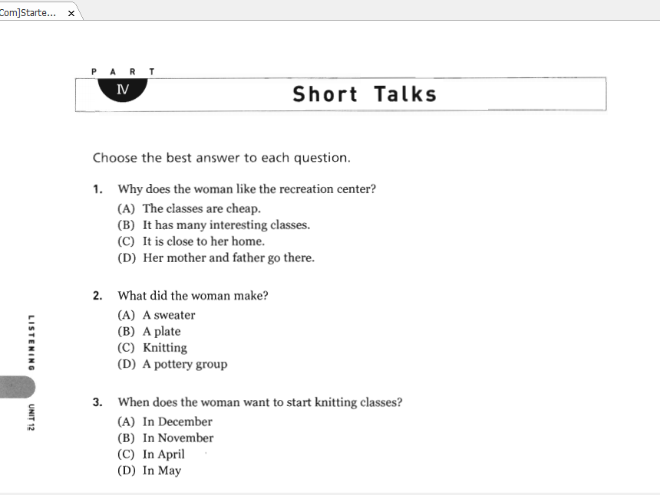

Slide 13
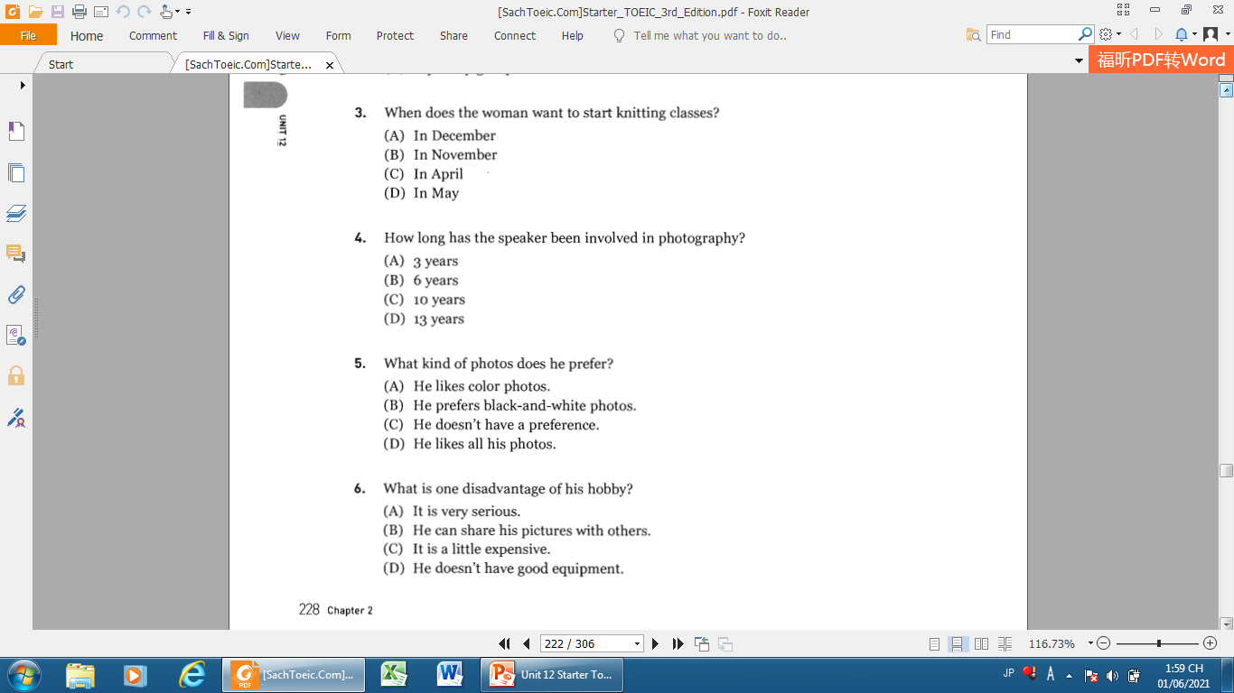

Slide 14
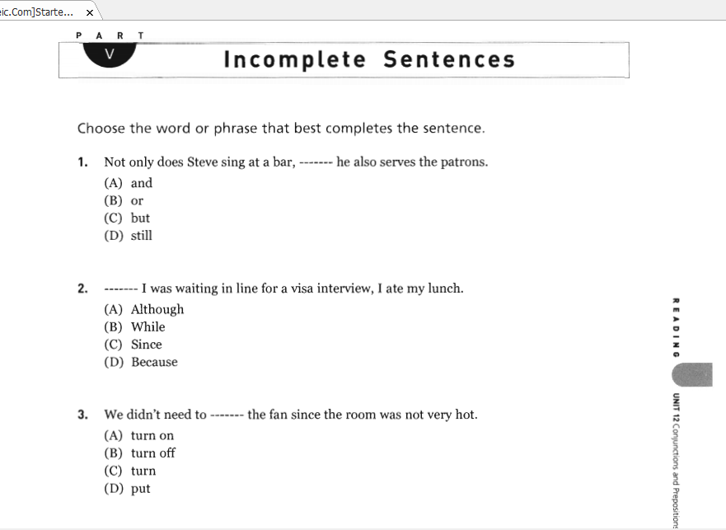
1.(C) but
2.(B) While
3.(A) turn on

Slide 15
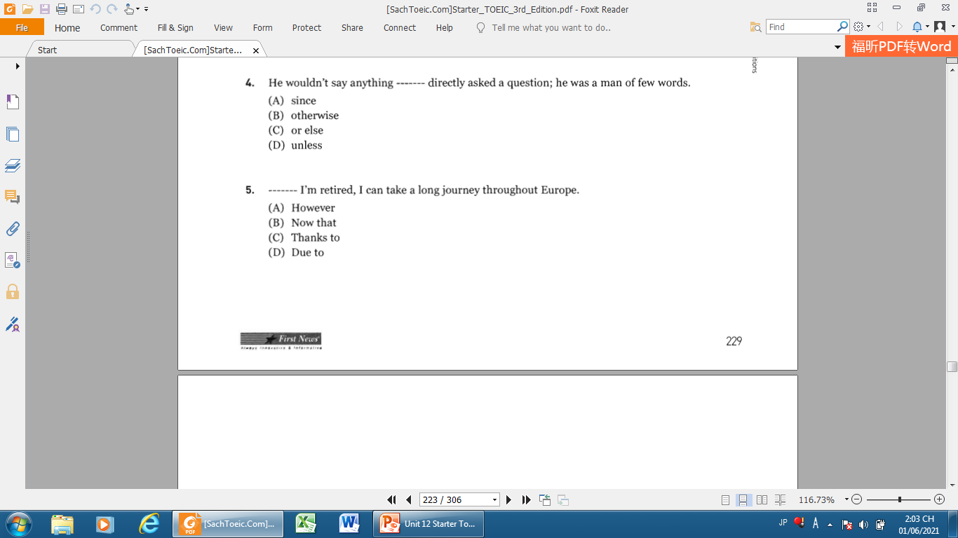
4.(D) unless
5.(B) Now that

Slide 16
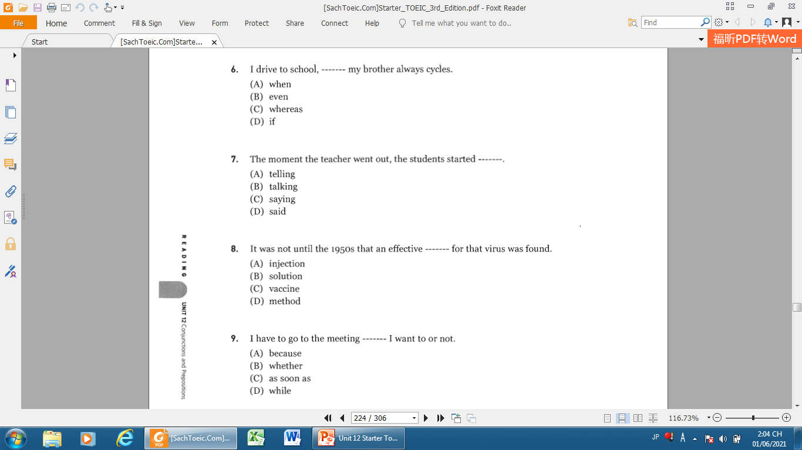
6.(C) whereas
7.(B) talking
8.(C) vaccine
9.(B) whether

Slide 17
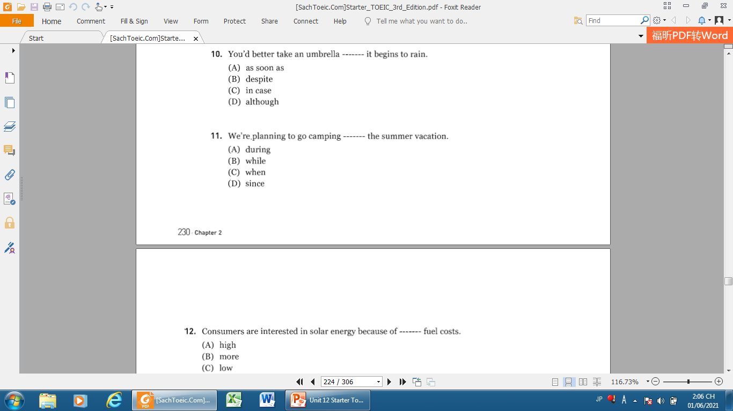
10.(C) in case
11.(A) during

Slide 18
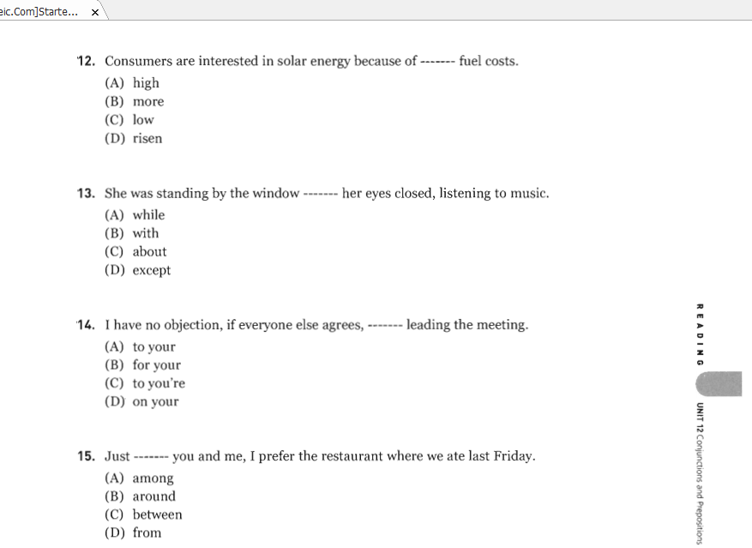
12.(A) high
13.(B) with
14.(A) to your
15.(C) between

Slide 19
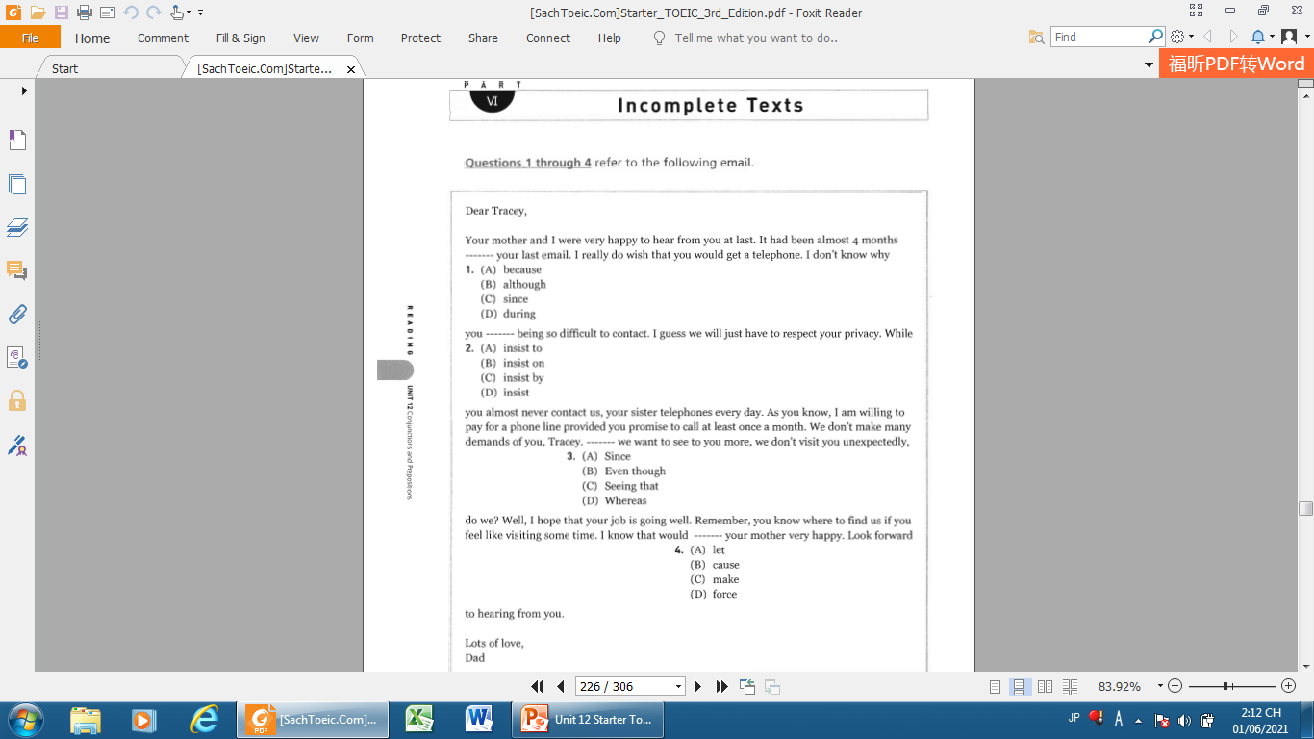
1.(C) since
2.(B) insist on
3.(B) Even though
4.(C) make

Slide 20
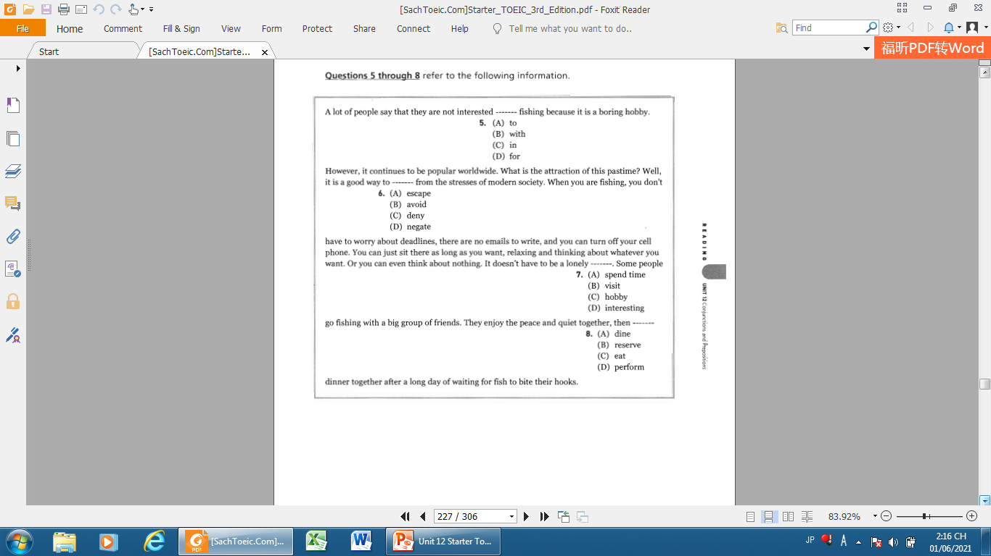
5.(C) in
6.(A) escape
7.(C) hobby
8.(C) eat

Slide 21
5.(C) in
6.(A) escape
7.(C) hobby
8.(C) eat

Slide 22
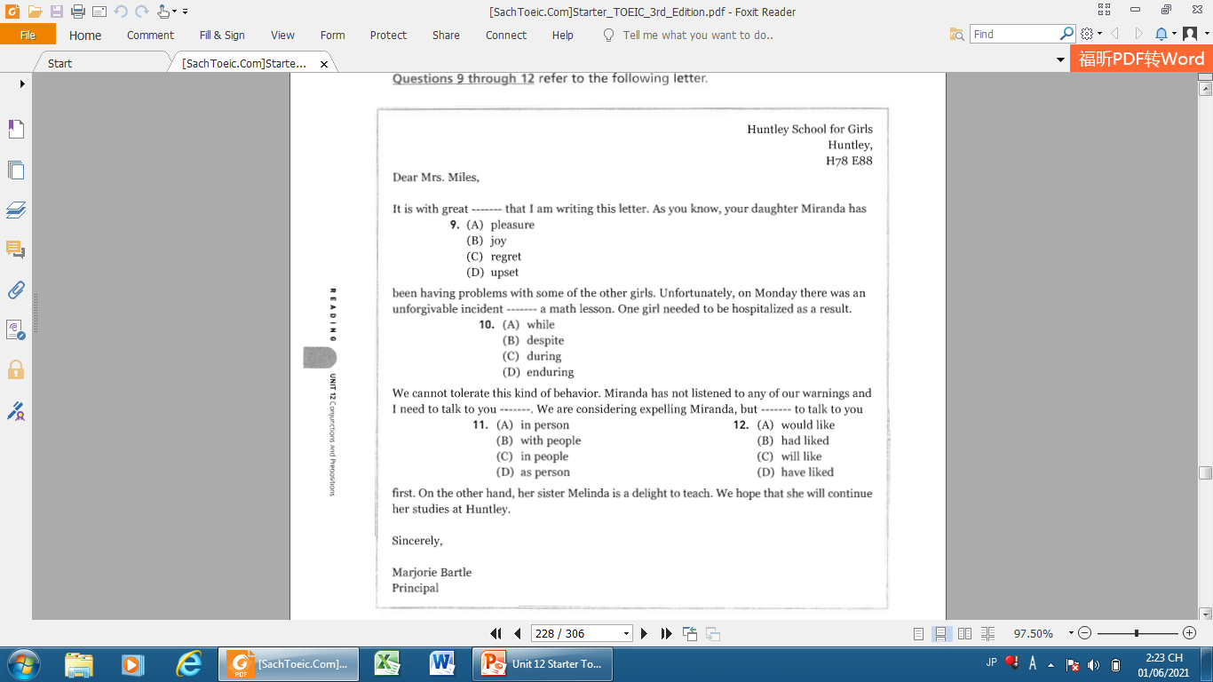
9.(C) regret
10.(C) during
11. in person
12.(A) would like

Slide 23
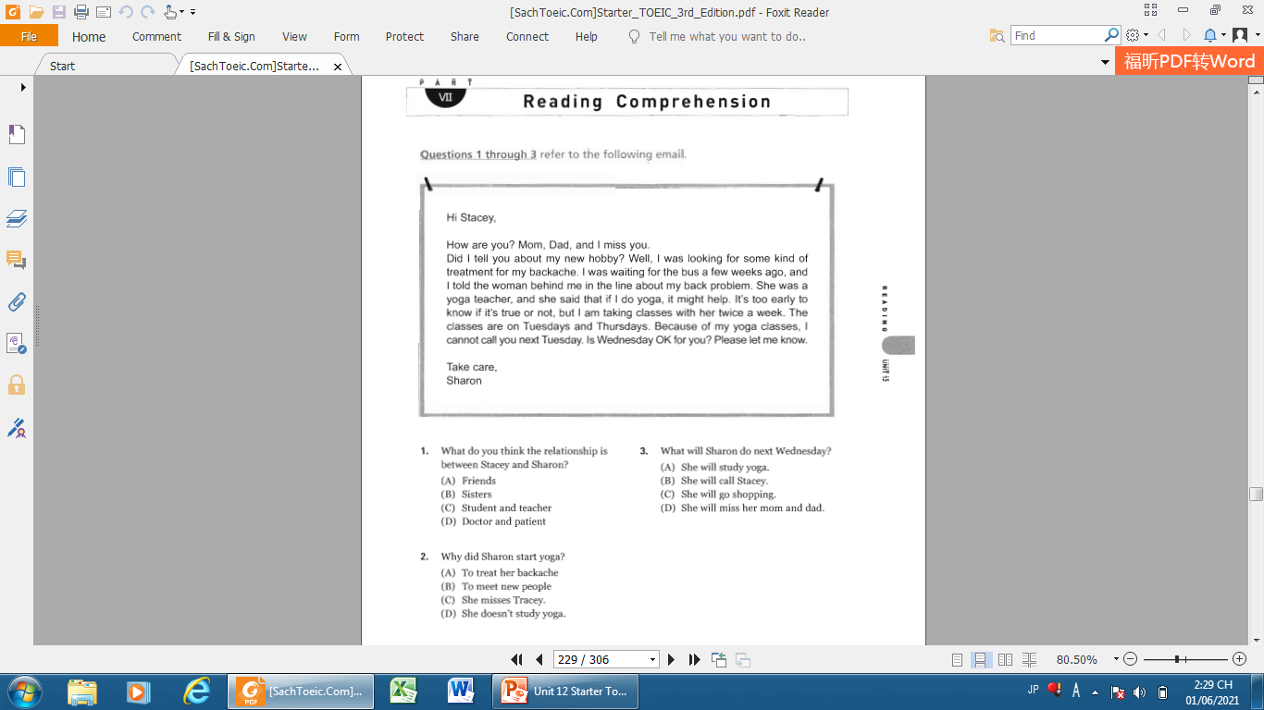
1. B
2. A
3. B

Slide 24
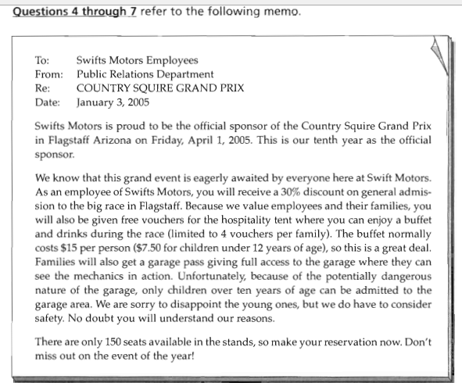

Slide 25
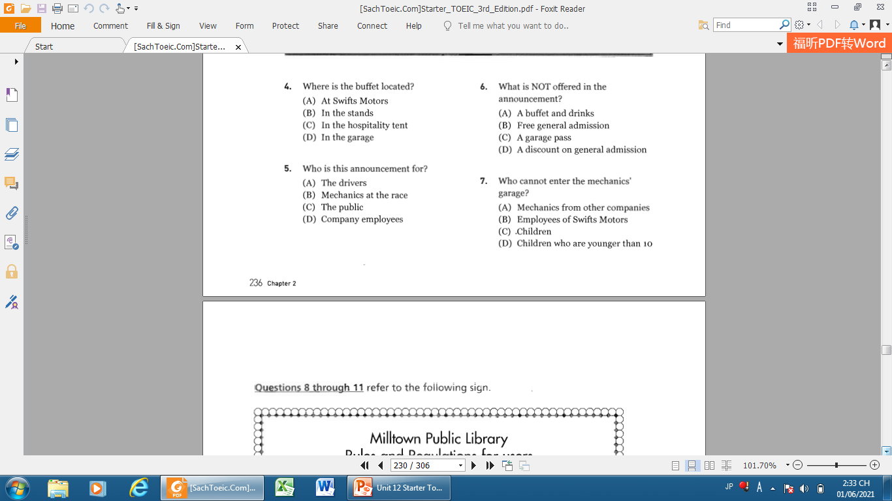
4. C
6. B
5. D
7. D

Slide 26
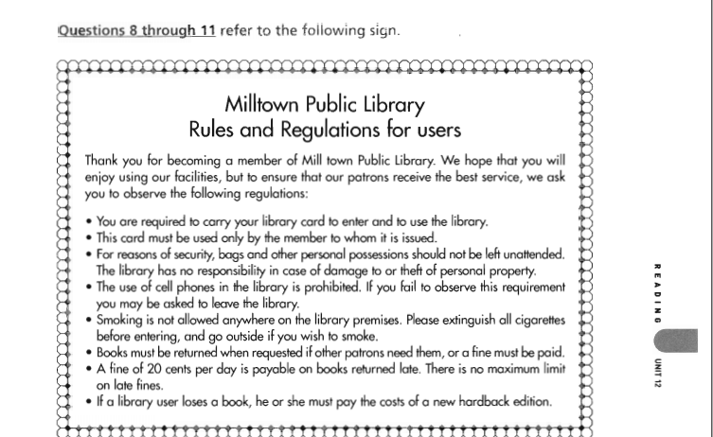

Slide 27
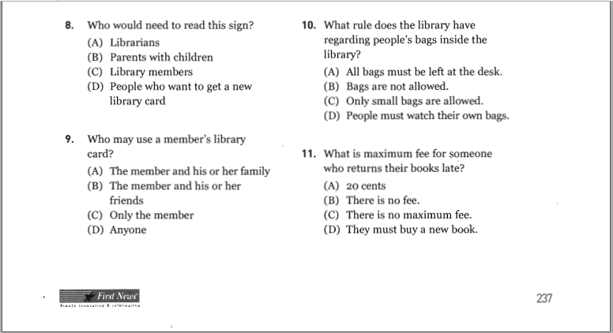
10. D
8. C
9. C
11. C

Slide 28
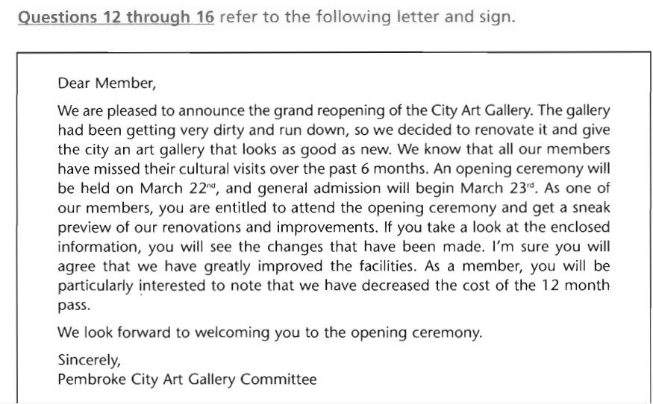

Slide 29
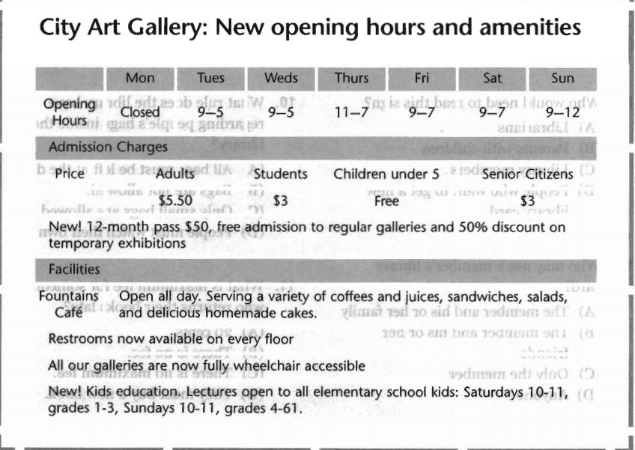

Slide 30
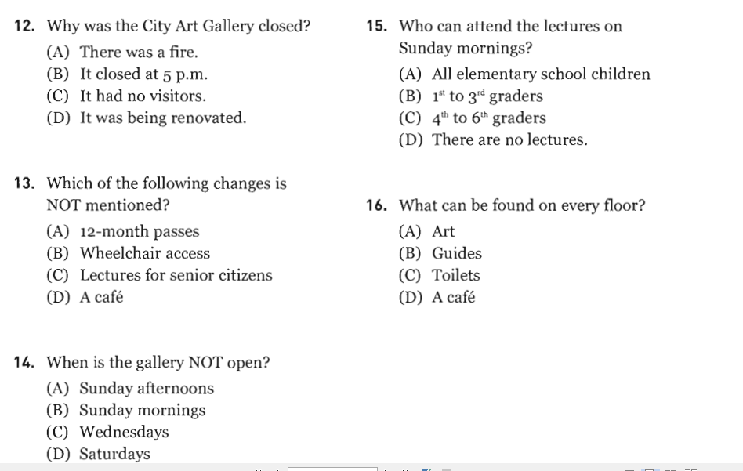
12. D
15. C
13. C
16. C
14. A

Slide 31


Slide 32


