Slide 1

TRƯỜNG CAO ĐẲNG LÝ TỰ TRỌNG
THÀNH PHỐ HỒ CHÍ MINH

Slide 2

KHOA KHOA HỌC CƠ BẢN

Slide 3

ỦY BAN NHÂN DÂN THÀNH PHỐ HỒ CHÍ MINH
TRƯỜNG CAO ĐẲNG LÝ TỰ TRỌNG TP. HỒ CHÍ MINH
Bậc đào tạo: CAO ĐẲNG CHUYÊN NGHIỆP
TỔ NGOẠI NGỮ

Slide 4

Good morning class.

Slide 5


Slide 6
UNIT 11: VOICE
Page 40

Slide 7
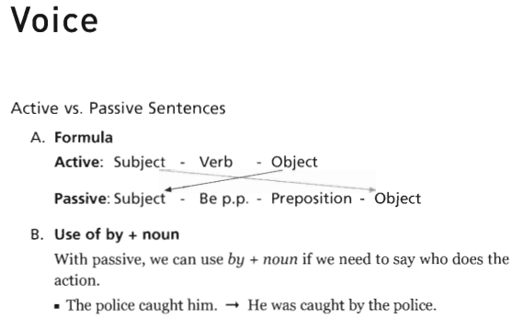
UNIT 11: Voice
Page 40

Slide 8
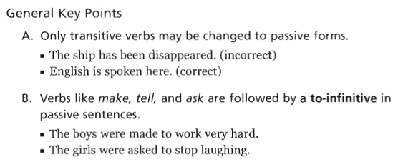
UNIT 11: Voice
Page 40

Slide 9
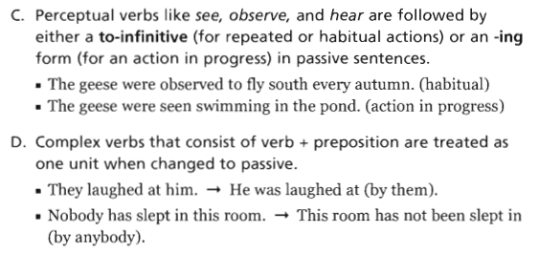
UNIT 11: Voice
Page 40

Slide 10
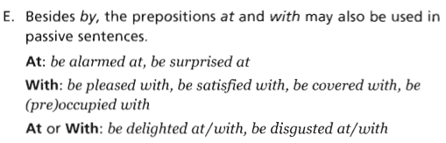
UNIT 11: Voice
Page 40

Slide 11
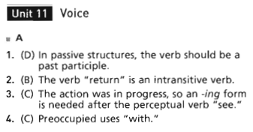
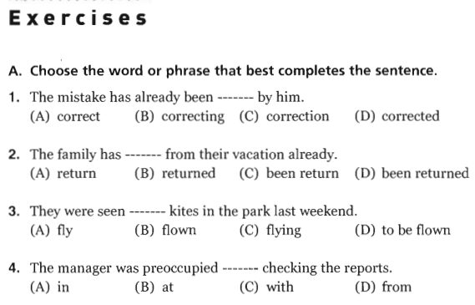
UNIT 11: Voice
Page 41

Slide 12

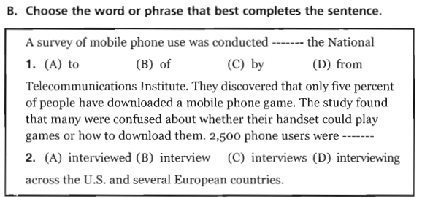

UNIT 11: Voice
Page 41

Slide 13
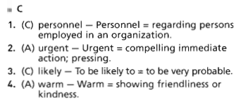
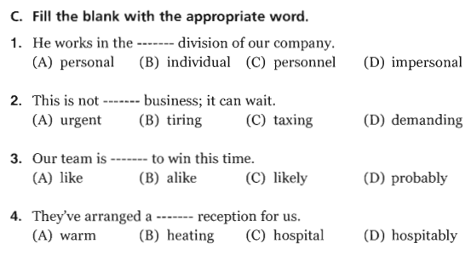
UNIT 11: Voice
Page 41

Slide 14
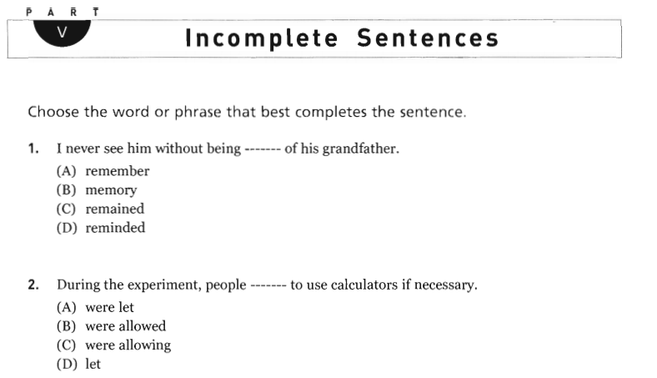
UNIT 11: Voice
Page 213
1. D reminded
2. B were allowed

Slide 15
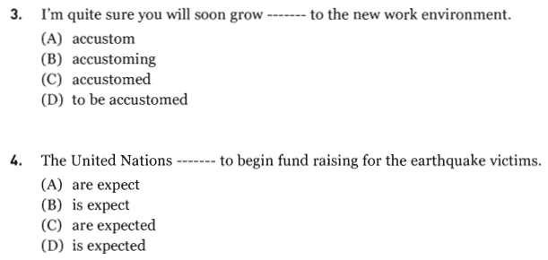
UNIT 11: Voice
3. C accustomed
4. D is expected
Page 213

Slide 16
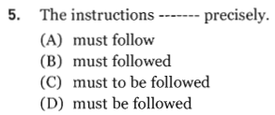
UNIT 11: Voice
Page 213
5. D must be followed

Slide 17
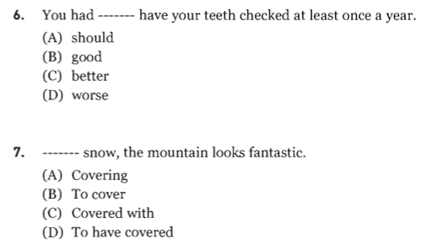
UNIT 11: Voice
6. C better
7. C Covered with
Page 214

Slide 18
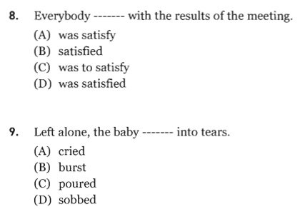
UNIT 11: Voice
8. D was satisfied
9. B burst
Page 214

Slide 19
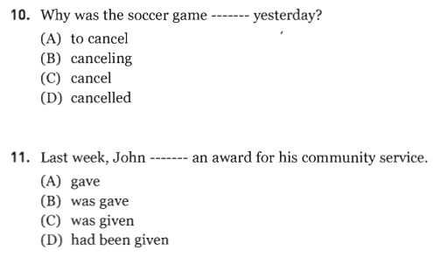
UNIT 11: Voice
10. D cancelled
11. C was given
Page 214

Slide 20
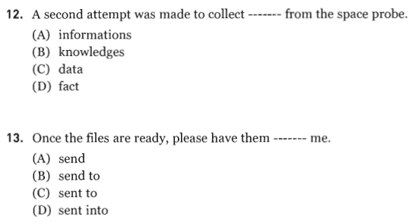
UNIT 11: Voice
12. C data
13. C sent to
Page 215

Slide 21
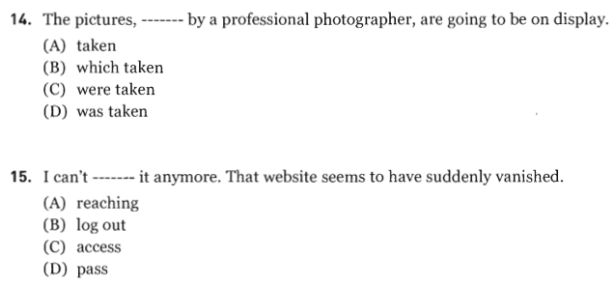
UNIT 11: Voice
14. A taken
15. C access
Page 215

Slide 22
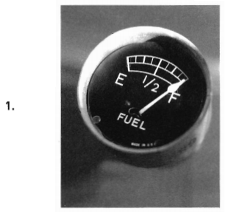
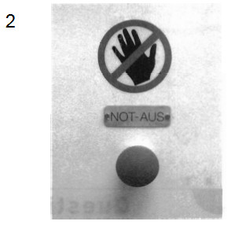
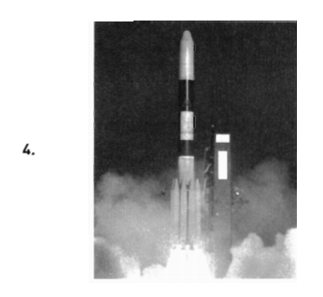
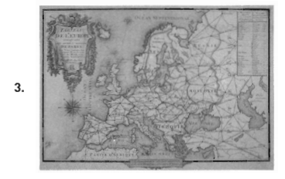
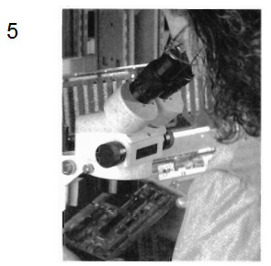
UNIT 11: Voice
PART I Picture Description
Pages 209 and 210

Slide 23

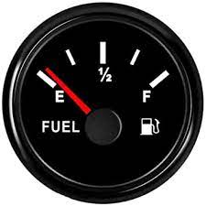
UNIT 11: Voice
PART I Picture Description
Page 209
1. gauge /ɡeɪdʒ/ (n)

Slide 24
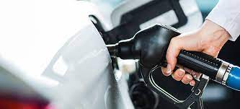
UNIT 11: Voice
PART I Picture Description
Page 209
2. tank (n)

Slide 25
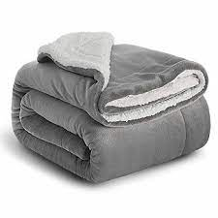
UNIT 11: Voice
PART I Picture Description
Page 209
3. blanket (n)

Slide 26
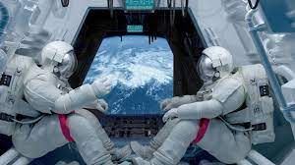
UNIT 11: Voice
PART I Picture Description
Page 209
4. astronaut (n)

Slide 27
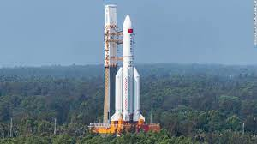
UNIT 11: Voice
PART I Picture Description
Page 209
5. rocket (n)

Slide 28
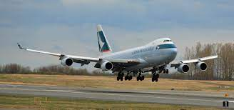
UNIT 11: Voice
PART I Picture Description
Page 209
6. land (v)

Slide 29

UNIT 11: Voice
PART I Picture Description
Pages 209 and 210

Slide 30
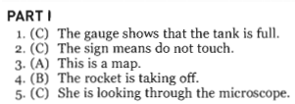
PART I Picture Description – Answer Key

Slide 31
PART I Picture Description – Answer Key

Slide 32
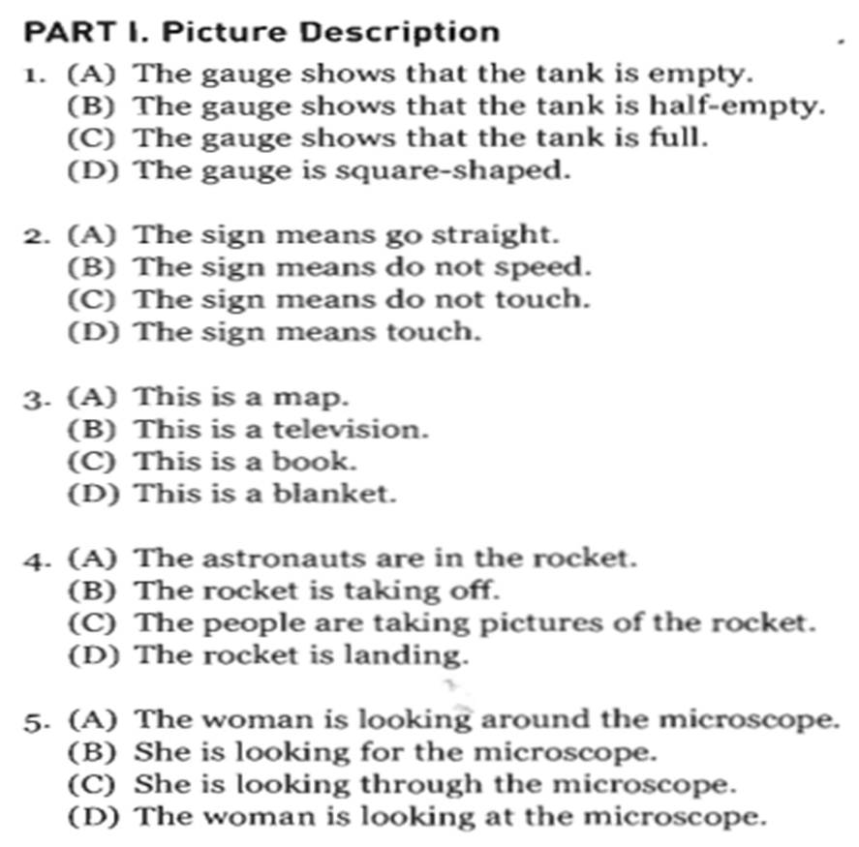
UNIT 11: Voice
PART I Picture Description
Pages 209 and 210

Slide 33
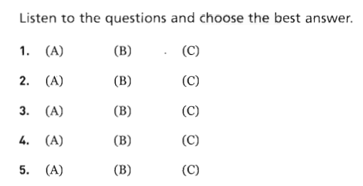
UNIT 11: Voice
PART II Questions and Responses

Slide 34
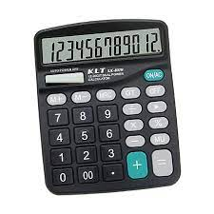
UNIT 11: Voice
PART II Questions and Responses
Page 210
1. calculator (n)

Slide 35

UNIT 11: Voice
PART II Questions and Responses
Page 210
2. puffer fish (n)

Slide 36
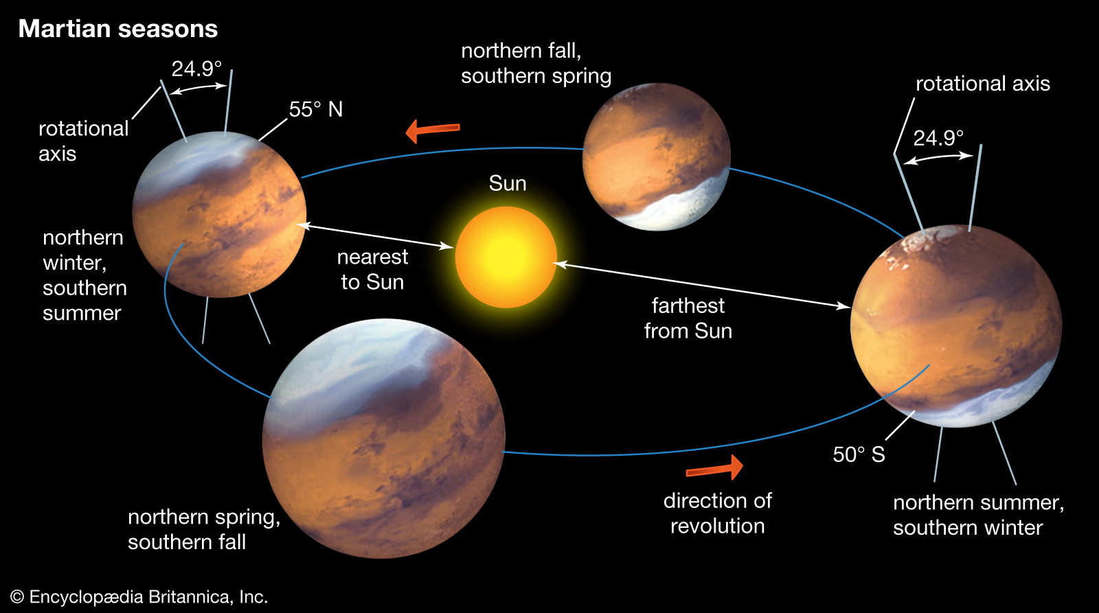
UNIT 11: Voice
PART II Questions and Responses
Page 210
3. Mars (n)

Slide 37
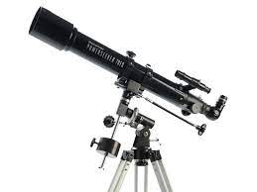
UNIT 11: Voice
PART II Questions and Responses
Page 210
4. telescope (n)

Slide 38
UNIT 11: Voice
PART II Questions and Responses

Slide 39
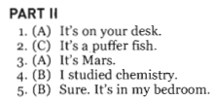
UNIT 11: Voice
PART II Questions and Responses - Key

Slide 40
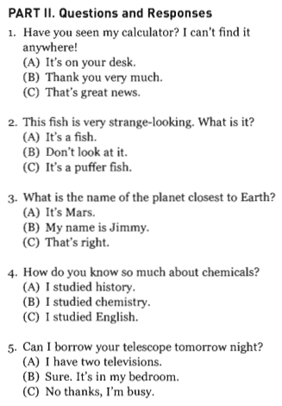
UNIT 11: Voice
Transcripts

Slide 41

Thank you very much
for your cooperation.

