Slide 1
UNIT 1:
AUXILIARY VERBS

Slide 2

A. Auxiliary Verb followed by an –ing or –ed
Continuous Tenses:
to be + V-ing
Passive: to be + Ved / 3
Perfect Tenses: has / have / had + Ved / 3

Slide 3
TENSES
Auxiliaries
NEGATIVE
INTERROGATIVE
do
does
I don’t like
Do you like….. ?
Simple Present
He doesn’t like
Does he like… ?
Simple Past
did
I didn’t like
Did you like…. ?
have
has
I haven’t liked
Have you worked…?
Present Perfect
He hasn’t liked
Has he worked…?
Past Perfect
had
I hadn’t liked
Had you worked…?
am/is/are
was/were
Are you learning…?
Present Continuous
Past Continuous
I am not learning
I was not learning
Were you learning…?
can/could/will/
would/may/might
shall/should/must
can’t / couldn’t /
won’t /
shouldn’t
Can you …?
Modal Verbs
Could you…?
Would you…?
Proposal
would like to
wouldn’t like to
Would you like to…?

Slide 4
What are modal verbs?
They are:
  Can
  Could
  May
  Might
  Must
  Shall
  Should
  Will
  Would
Ought to

Slide 5
Form
Modal verbs do not have infinitives or –ing forms
to can / caning to must /musting
She must study
We should have gone the other way
He could play football in his youth (general ability)
Modal verbs are followed by an infinitive without to

Slide 6
MODAL AUXILIARIES:
Modals | Meanings | Examples
Will | Be willing to, intend to | I will open the door
Shall | Intend to (formal), have decided to | We shall ask the committee
May / can | Be possible to | Fish live in the river
Can / Could / May | Be allowed to | May I have one?
Must | Be necessary, be logically certain | It must be her purse
Must / Have to | Be required to | We must be on time
Should / Ought to / Had Better | Be obliged to | You should call her
Should have / Could have + Ved / 3 | Was not true, didn’t happen | They could have won, but they didn’t
Used to / Would | Habit in the past | We used to talk everyday

Slide 7
Modal | Concept | Examples
Will | Future | Joe will travel to NY next week
Might | Small probability | I might move to Canada some day
Should | Recommendation | You should go to the doctor
Ought to | Formal recommendation | We ought to know about first aids
Had better | Warning | I had better study or I will fail the test

Slide 8
Double Concept Modal
Modal | Concept | Examples
May (1) | Permission | May I come in?
May (2) | Good probability | We may visit Mexico this summer
Must (1) | Responsibility | Everyone must pay taxes
Must (2) | Assumption | She didn’t arrive. She must be sick
Would (1) | Past (used to) | When I was young, I would play soccer
Would (2) | Present unreal | I would buy the car but I can’t afford it

Slide 9
Modal | Concept | Examples
Shall (1) | Educated expression Offer | Excuse me, I shall go now Shall I clean it?
Shall (2) | Contractual obligation | The company shall pay on January 1st
Could (1) | Unreal Ability | I could go if I had time
Could (2) | Past Ability | She could play the piano, not anymore
Can (1) | Present Ability | We can speak English
Can (2) | Permission | Can I have a sweet
Used to Would | Past habit | I used to have long hair.

Slide 10
Modals in Past : Modal + have + past participle / V3
Modal | Concept | Example
Would have | Past unreal action | I would have bought the car, but I didn’t have money
Could have |  | She could have taken the flight
Should have |  | You should have listened to the doctor

Slide 11
Use your imagination
Think about these situations and create a sentence using modals.
We are going to Paris for a weekend. (Make suggestions about things to do)
We start school in September. (Talk about necessity)
Margaret is a very talented sportswoman. (Talk about ability)
You have just won the lottery! (Talk about possibility)
Peter has got a headache and a congested nose. (Give him some advice)
You want to borrow your uncle’s Mercedes Benz. (Ask for permission politely)

Slide 12
1. I would have bought the car, but I didn’t have money.
2. She could have taken the flight.
3. The company shall pay on January 1st
4. When I was young, I would play soccer.
5. We can speak English.
6. I was cleaning the house while my husband was fixing his bike.
7. I have been to Ha Noi 5 times.
8. I am going to become a teacher.
9. I don’t want to see him anymore.
10. I didn’t study hard enough so I fail the exam.

Slide 13
LISTENING
PART 1:
PICTURE DESCRIPTION

Slide 14
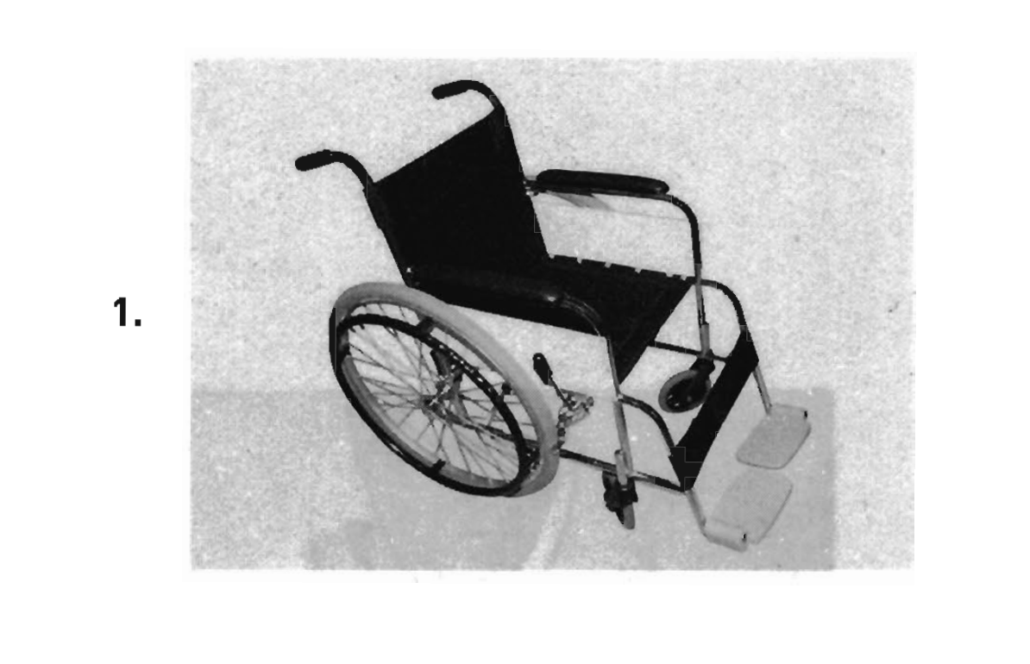
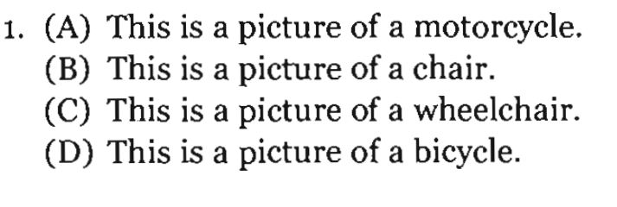

Slide 15
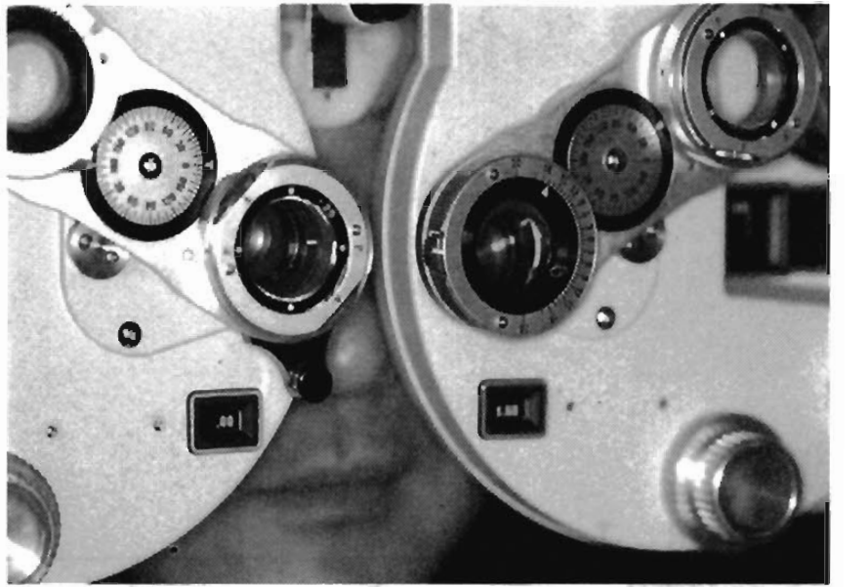
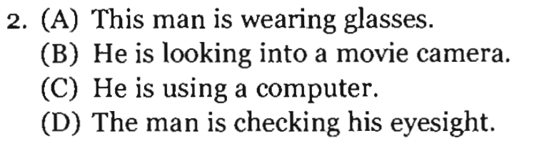

Slide 16
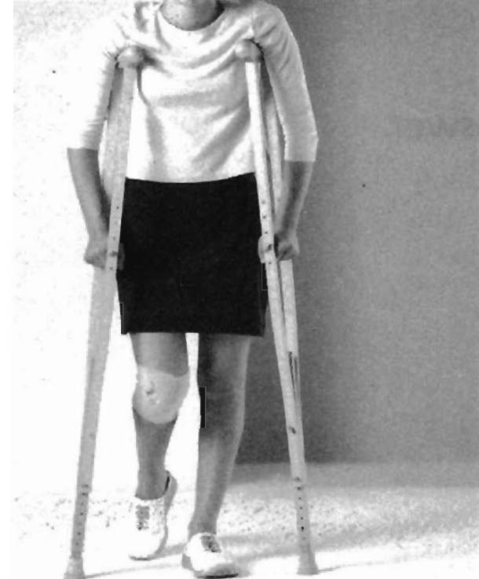
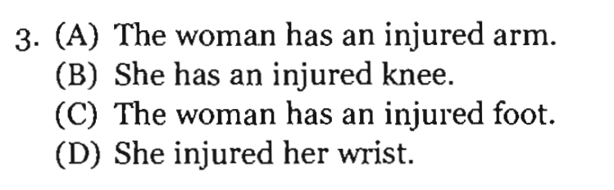

Slide 17
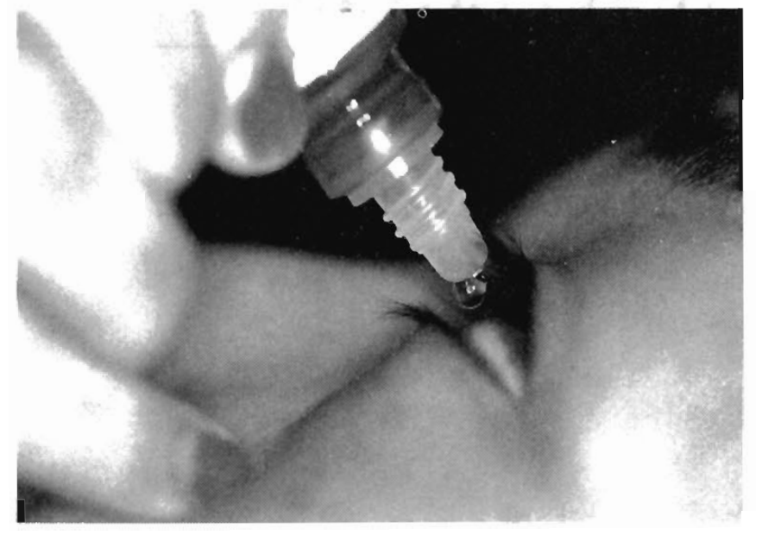
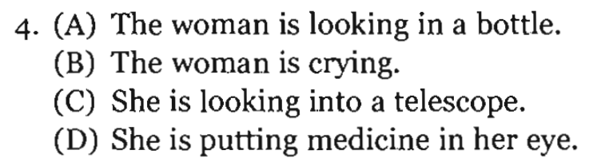

Slide 18
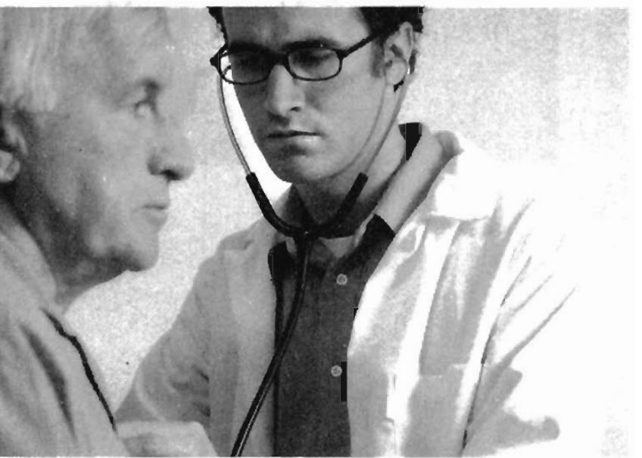
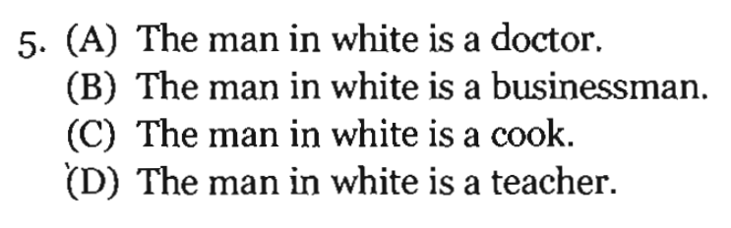

Slide 19
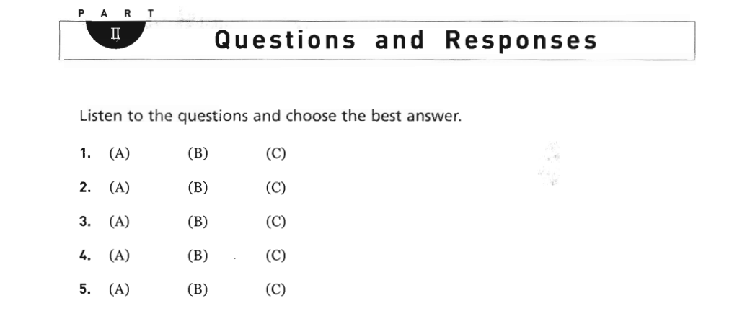

Slide 20
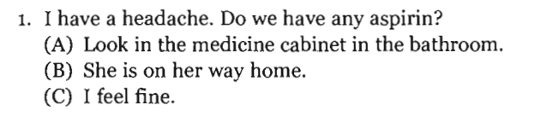
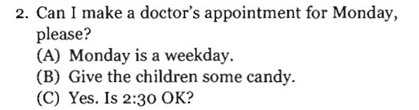
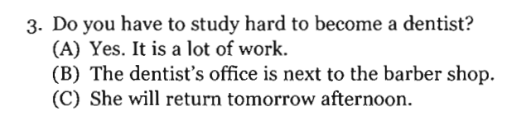
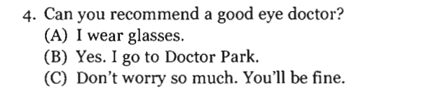
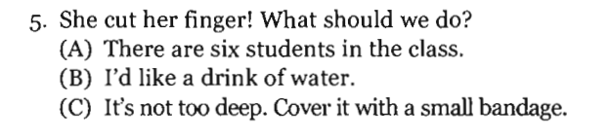

Slide 21
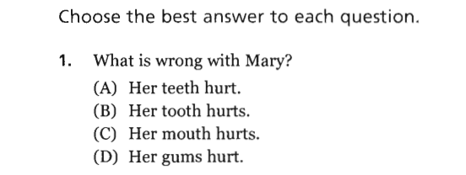
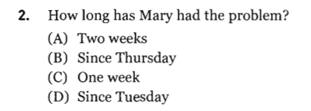
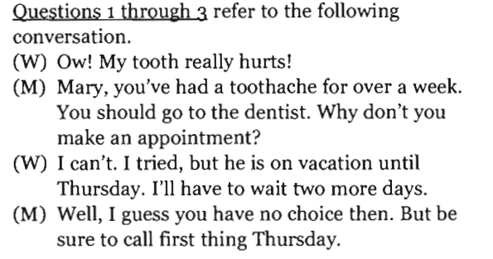
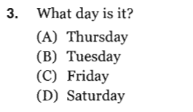

Slide 22
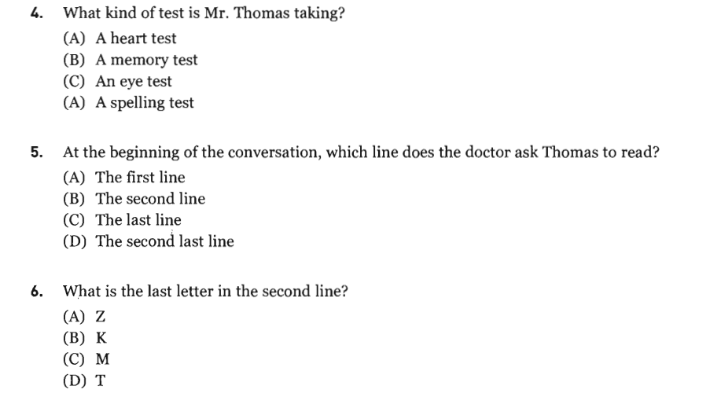
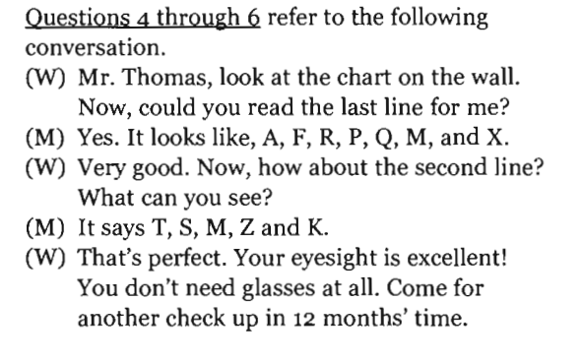

Slide 23

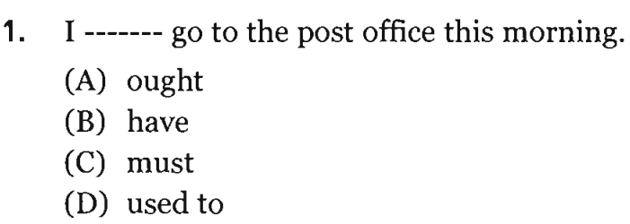
Giải thích:
Ought to: có nghĩa là nên - dùng để khuyên ai nên làm điều tốt nào đó
Have to: có nghĩa là nên – dùng để khuyên ai nên làm một nhiệm vụ nào đó
Must: Có nghĩa là phải - bắt buộc người nào đó phả i làm gì.
Used to: Có nghĩa là đã từng làm 1 việc gì trong quá khứ

Slide 24
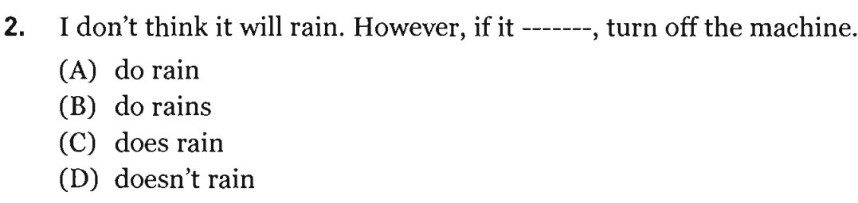
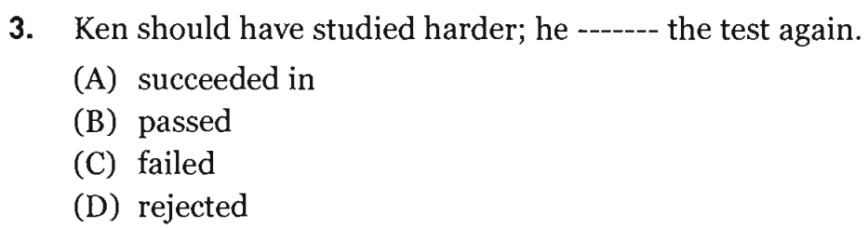
Giải thích:
Should have+V3: lẽ ra nên (1 giả thiết không có thực ở quá khứ)
=> Key C
Từ mới:
pass (v) qua
fail (v) rớt
- reject (v) từ chối

Slide 25
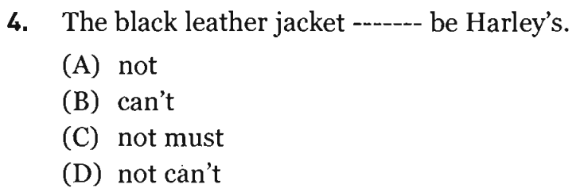
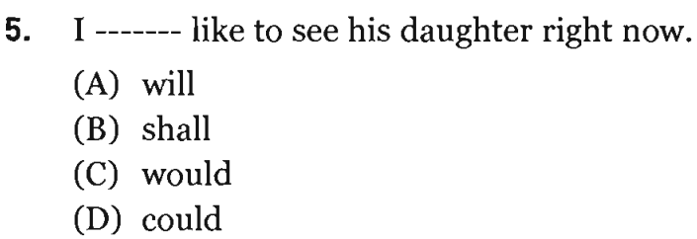
Cannot be + N/ADJ , có nghĩa là chắc chắn không thể nào => Key B
would like to = want to : muốn
=> Key C

Slide 26
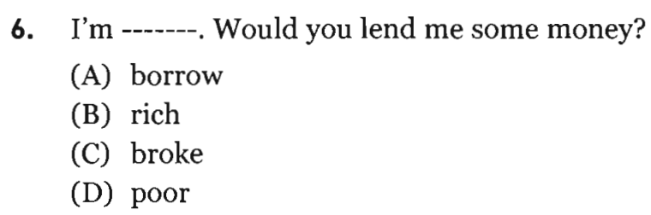
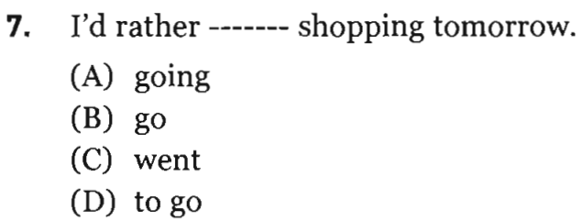
Từ mới:
borrow (v) mượn broke (adj) cháy túi
rich (adj) giàu # poor (adj) nghèo
Would rather + V1: muốn làm gì

Slide 27
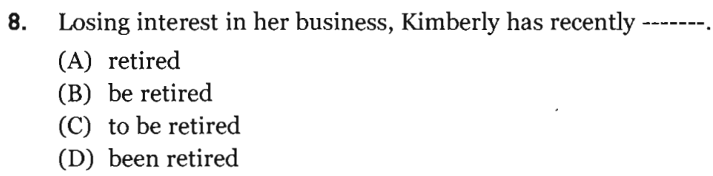
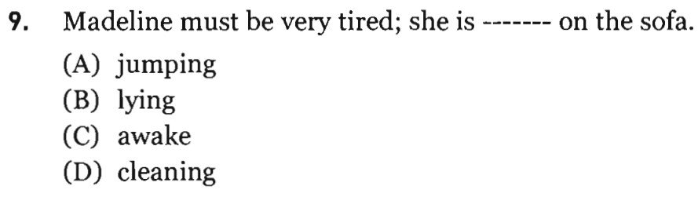
Has recently + V3
Từ mới:
Business: việc, kinh doanh
Retire: về hưu
Từ mới:
Jump: nhảy
Lying: nằm
Wake: tỉnh giấc
Clean: lau chùi, dọn dẹp

Slide 28
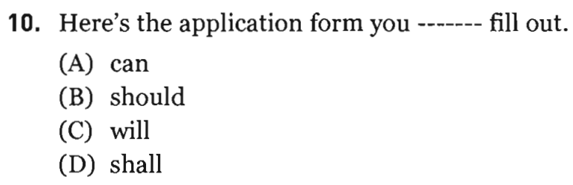
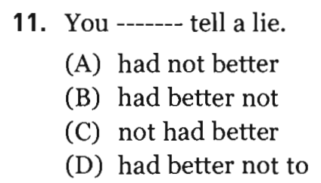
Giải thích:
had better not +V1: không nên làm gì
# had better +V1: Nên làm gì

Slide 29
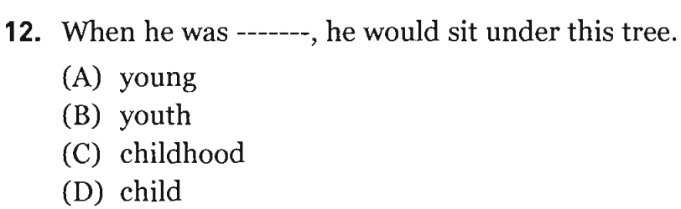
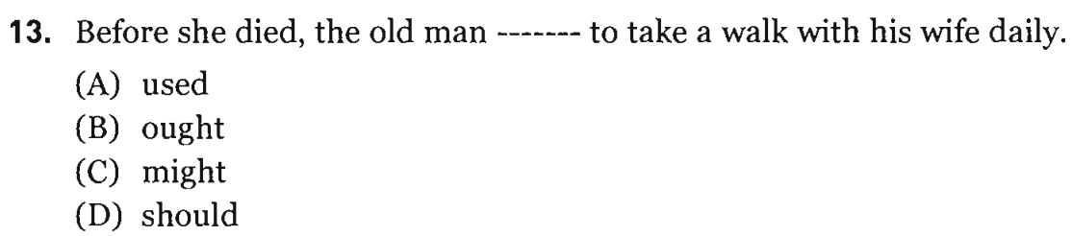
Từ mới:
Young (adj): trẻ
Youth (n) tuổi trẻ
Childhood (n) thời thơ ấu
Child (n) đứa trẻ
Công thức: used to: đã từng (thói quen trong quá khứ)

Slide 30
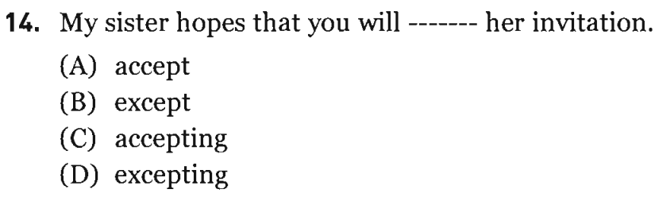
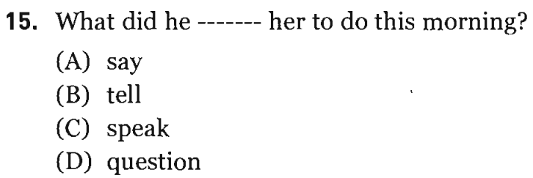
Từ mới:
Accept : Chấp nhận
Except: Ngoại trừ
Tell So to do Sth: Bảo ai làm điều gì
Say to Sth: Nói về điều gì

Slide 31
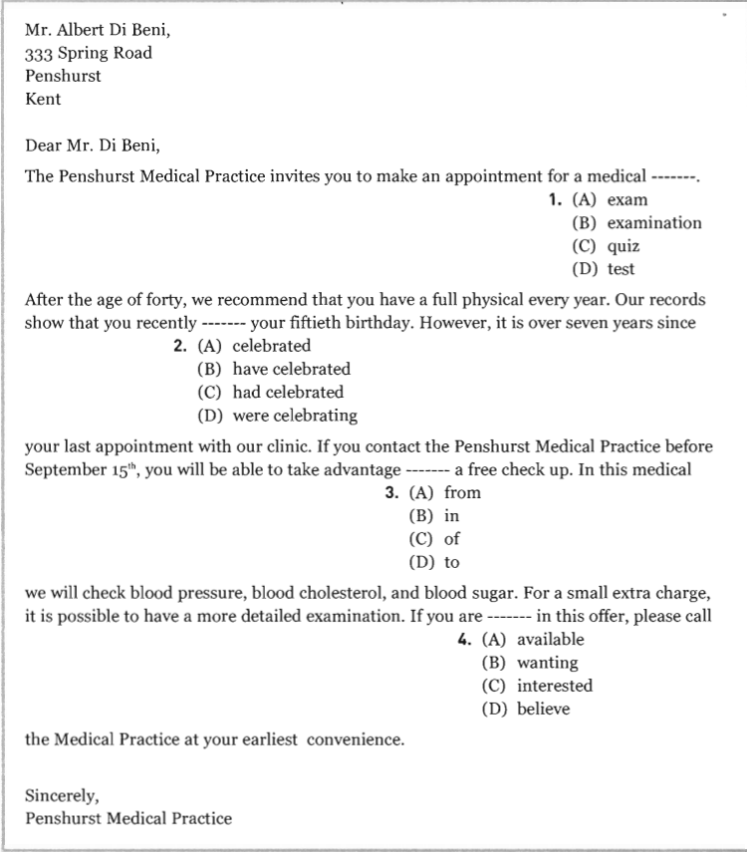
Giải thích Q1:
Exam (n): Bài kiểm tra ở trường
Examination (n) khám sức khỏe tổng quát
Quiz (n) kiểm tra vấn đáp
Test (n) kiểm tra từng phần
Giải thích Q2:
Have/has+ Recently+v3
(thì HT hoàn thành)
Giải thích Q3:
take advantage of : lợi dụng

Slide 32
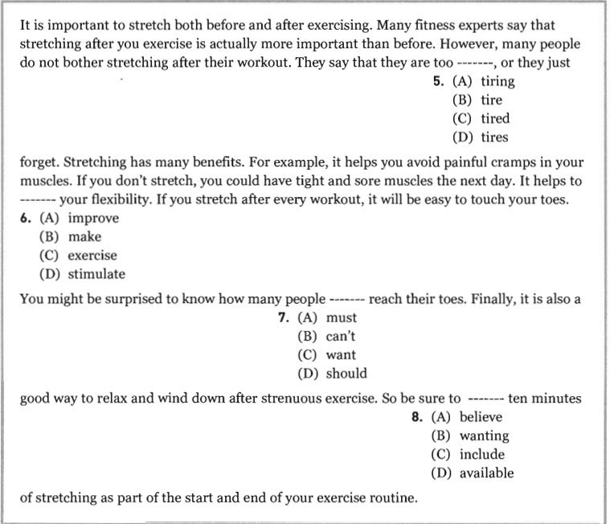
Giải thích Q5: too + ADJ
Giải thích Q6:
Improve: cải thiện
Stimulate: kích thích
Giải thích Q8:
Be sure to + v1
= make sure to+v1
Phải chắc chắn rằng

Slide 33
1
2
3
SPEAKING
4
5
6
FAMILY

Slide 34
QUESTION 1
How many people are there in your family?
Who are they?

Slide 35
QUESTION 2
How do your parents earn a living?
(= what are their jobs)
Talk about it.

Slide 36
QUESTION 3
Pick a family member.
Describe looks (= outside) and character (= inside).

Slide 37
QUESTION 4
What does your family usually do on Sundays?
Talk about it.

Slide 38
QUESTION 5
Are there any rules in your family?
What are they?

Slide 39
QUESTION 6
Would you live with your parents after getting married? Why or why not?

Slide 40


