Slide 1

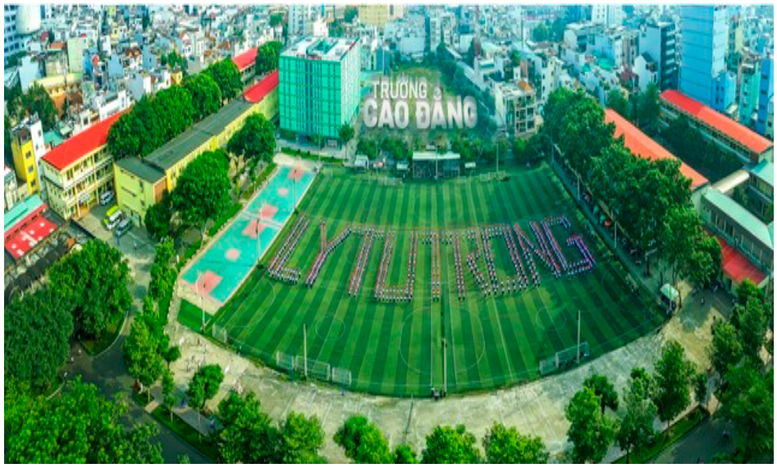
WELCOME TO OUR CLASS
22T4 –KLB2

Slide 2
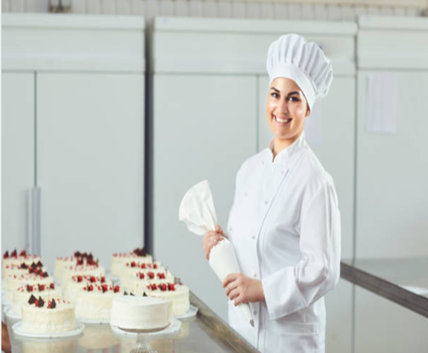
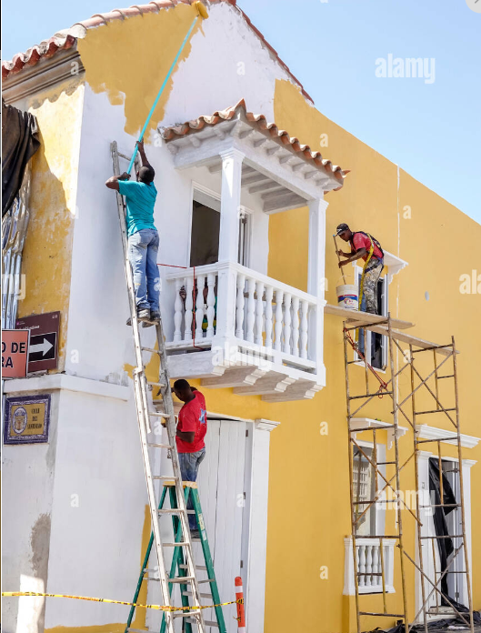
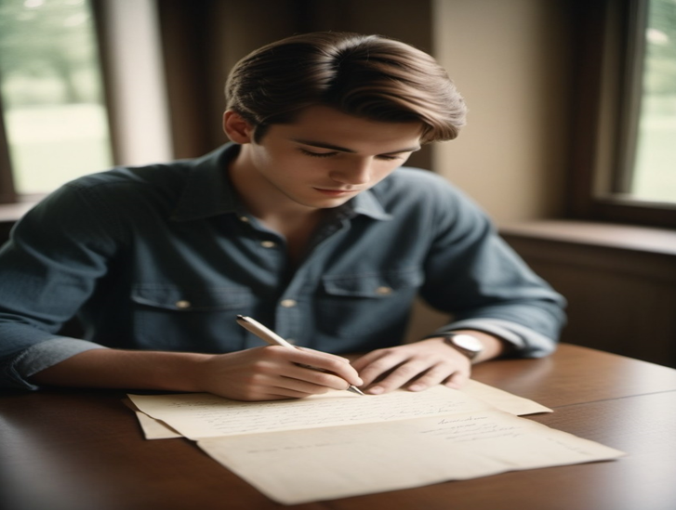
Unit 4: Lead-in Activity
Task 1:
Work in groups and write words to describe the following pictures
Picture 1
Picture 2
Picture 3

Slide 3

Unit 4: Lead-in Activity
Task 2:
Give the correct form of the verbs in brackets
Picture 1
Picture 2
Picture 3
1. She(make)cakes every day.
2. They (paint) the house yesterday.
3. The boy (write) a letter tomorrow.

Slide 4
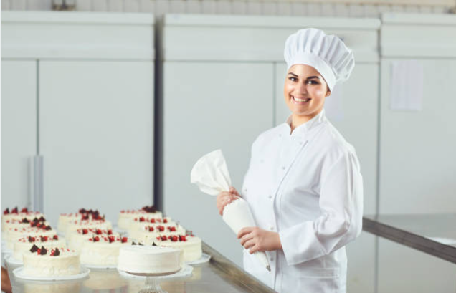
Unit 4: Lead-in Activity – Task 2
Picture 1
Picture 2
Picture 3
1. She (make) cakes everyday.
makes
2. They (paint) the house yesterday.
painted
3. The boy (write) a letter tomorrow.
will write

Slide 5
Unit 4: Active Voice - Introduction
1. She makes cakes every day.
S
V
O
Adv
a person
an action
A person can perform an action
Active voice

Slide 6

Unit 4: Active Voice - Introduction
2. They painted the house yesterday.
S
V
O
Adv
people
an action
People can perform an action
Active voice

Slide 7

Unit 4: Active Voice - Introduction
3. The boy will write a letter tomorrow.
S
V
O
Adv
a person
an action
Active voice

Slide 8
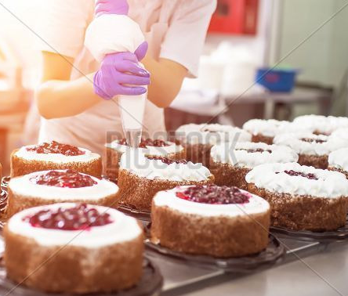
Unit 4: Passive Voice - Introduction
S
+
V
Cakes
(make)
Cakes
be made
everyday.
Cakes
are made
everyday.
Passive voice
S
+ be + V3

Slide 9
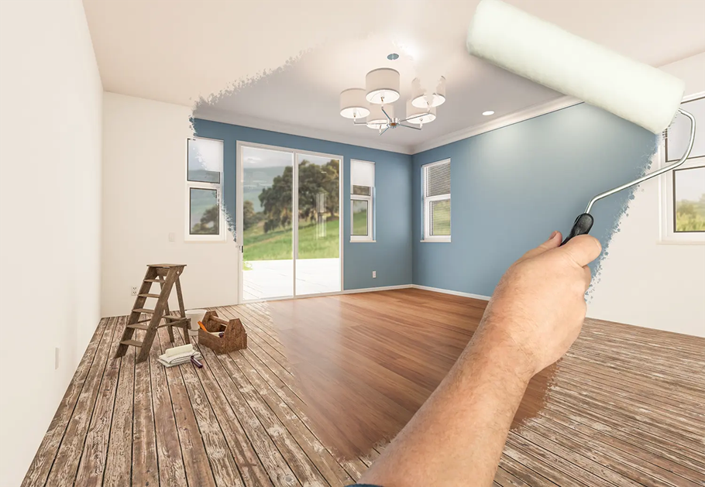
Unit 4: Passive Voice - Introduction
S
+
V
The house
(paint)
The house
be painted
yesterday.
The house
was painted
yesterday.
Passive voice
S
+ be + V-ed

Slide 10
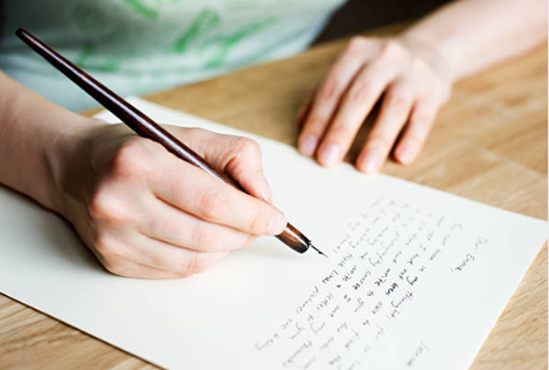
Unit 4: Passive Voice - Introduction
S
+
V
A letter
(write)
be written
tomorrow.
A letter
will be written
by the boy
tomorrow.
Passive voice
S
+ be + V3
+ by O

Slide 11
Unit 4 - Presentation
S + V + O
Active Voice
Subject performs the action of Verb
S
+ be
+ V-ed/ V3
+ by
+ O
Passive Voice
(1)
(2)
(3)
(4)
(5)
Subject receives the action of Verb
based on the tense of main verb

Slide 12
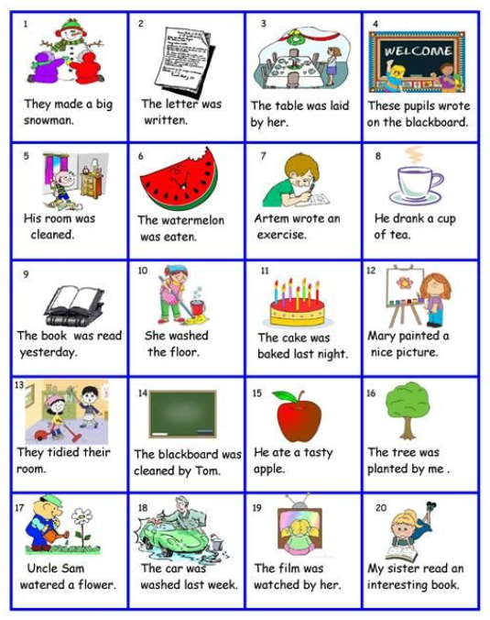
Unit 4 - Practice
Active Voice
Passive Voice
Decide which sentence is active or passive voice
A
P
P
A
P
P
A
A
P
A
P
A
A
P
A
P
A
P
P
A

Slide 13
Unit 4 - Practice
Task 2: Decide if each sentence is either the active or the passive and give the correct forms of the verbs.
That car (wash) ______________ yesterday. (active/passive)
Peter (wash) ______________ yesterday. (active/passive)
Michael (drive) ______________ for Ferrari in 2003. (active/passive)
In the UK, everyone (drive) ______________ on the left. (active/passive)
Inner-city trains (usually/drive) ______________ by men. (active/passive)
The “La Stampa” newspaper (read) ______________ by two million people in Italy. (active/passive)
The Queen (open) ______________ the bridge tomorrow. (active/passive)
The bridge (destroy) ______________ by the storm last night. (active/passive)
I (learn) ______________ Japanese when I was in Tokyo. (active/passive)
I (teach) ______________ by an old Japanese man. (active/passive)
was washed
washed
drove
drives
are usually driven
is read
will open
was destroyed
learned
was taught

