Slide 1
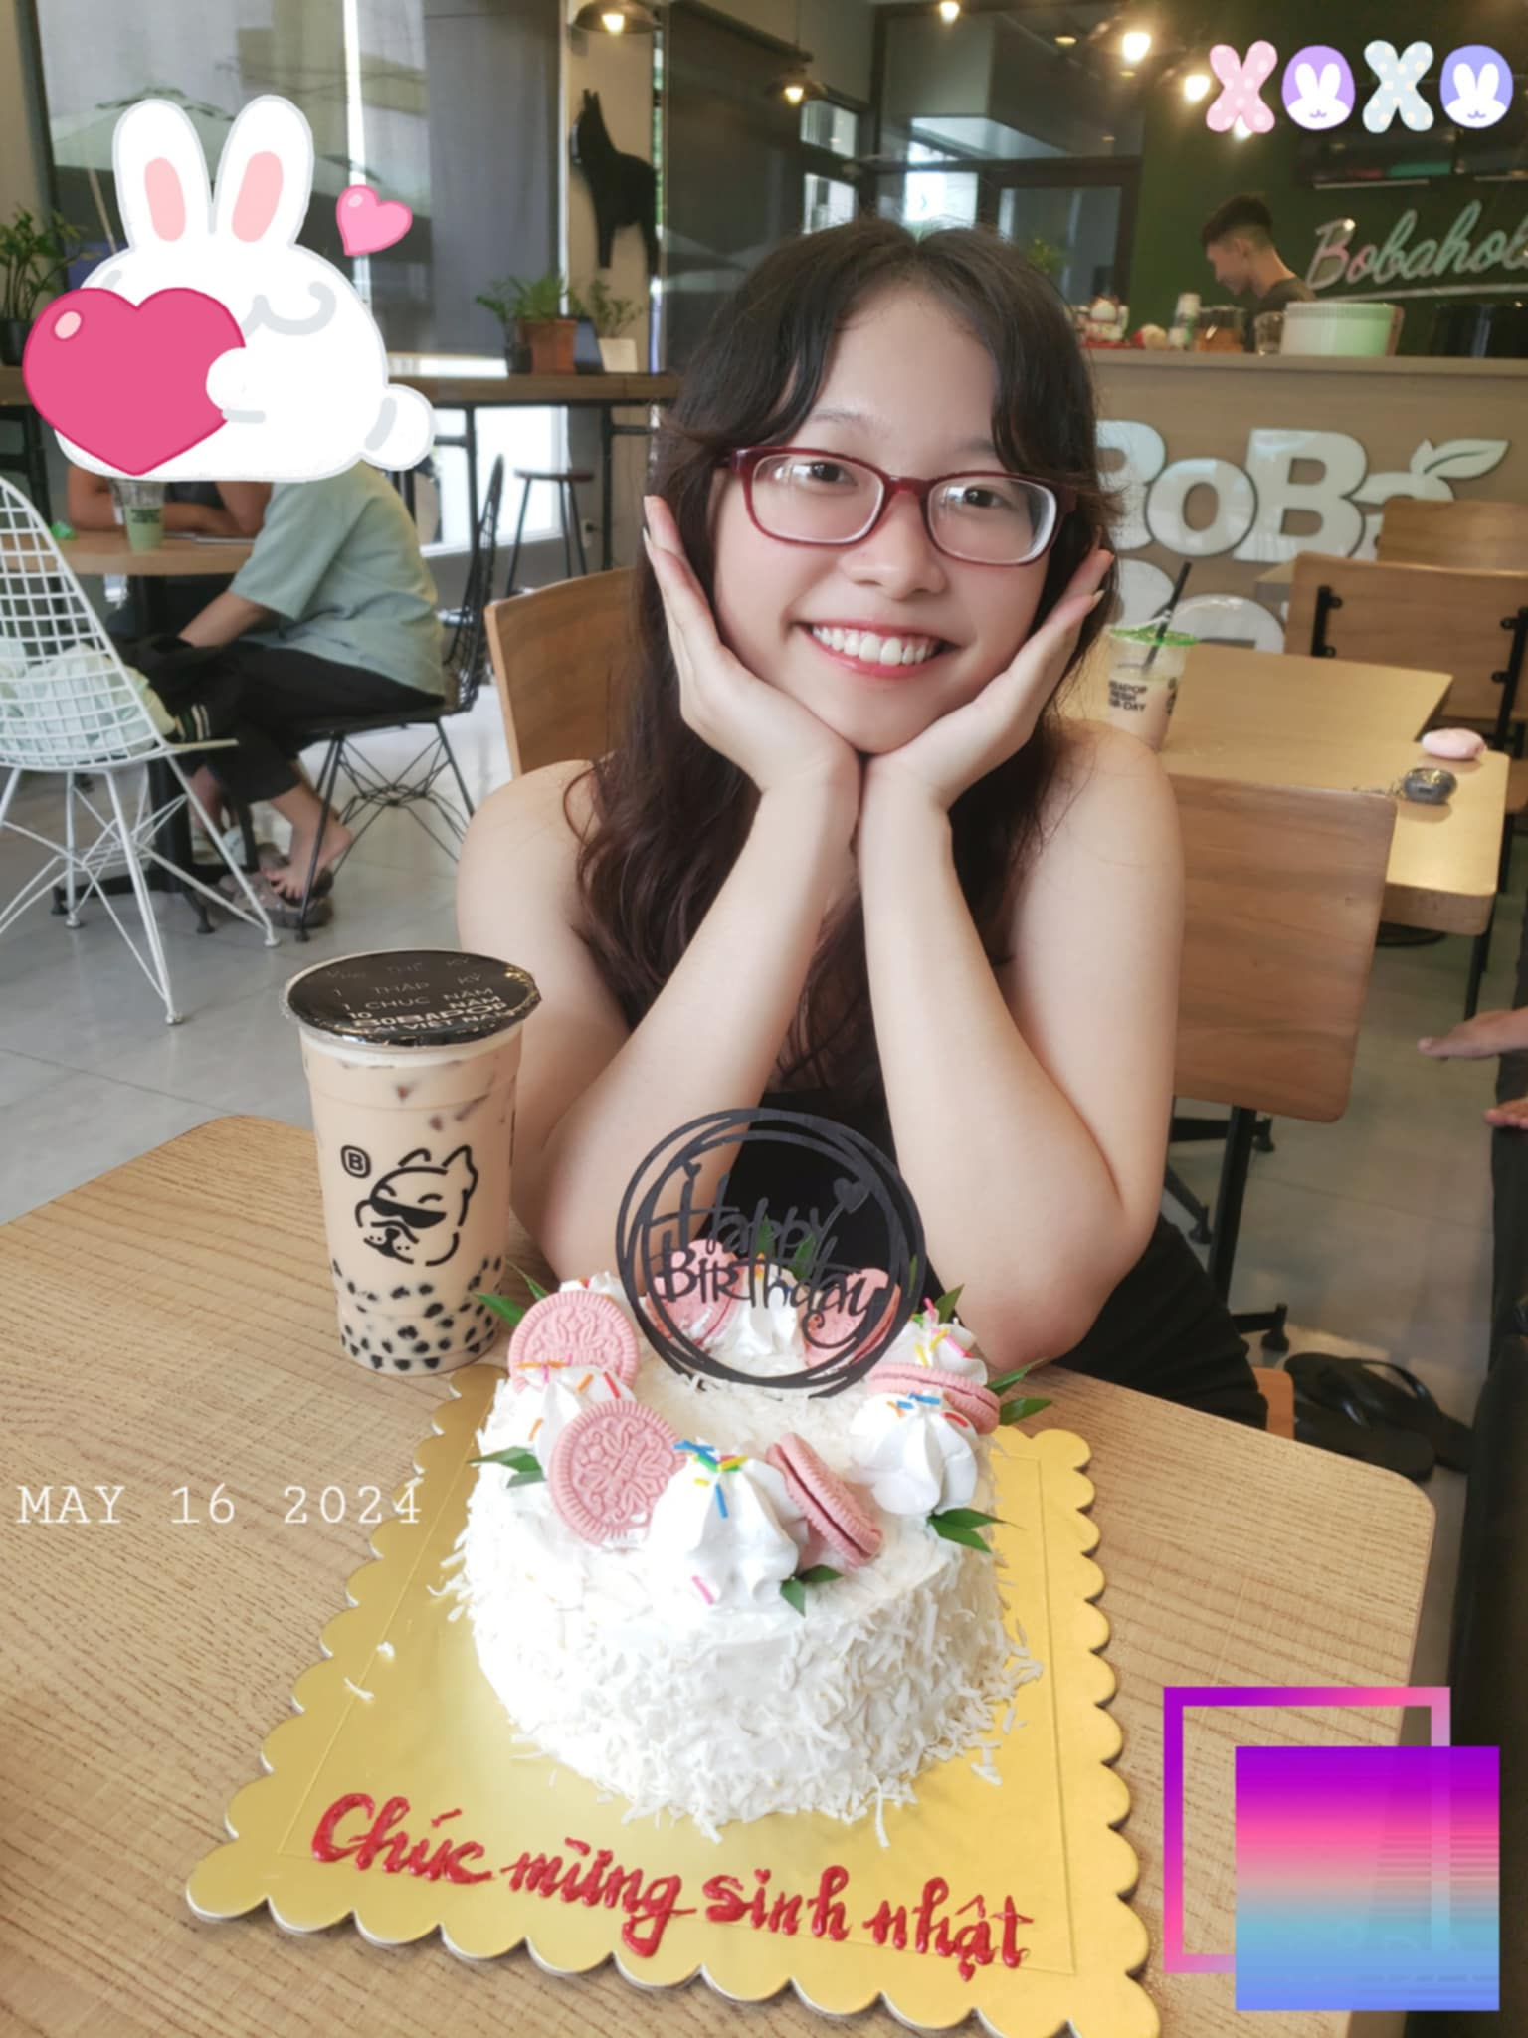
This is meee – Thao Dii
INTRODUCE MYSELF
Name: Phan Thao Vy
Class: 22T4-NNA2
Topic: : "Is Social Media creating unrealistic expectations for travel and lifestyle?"

Slide 2
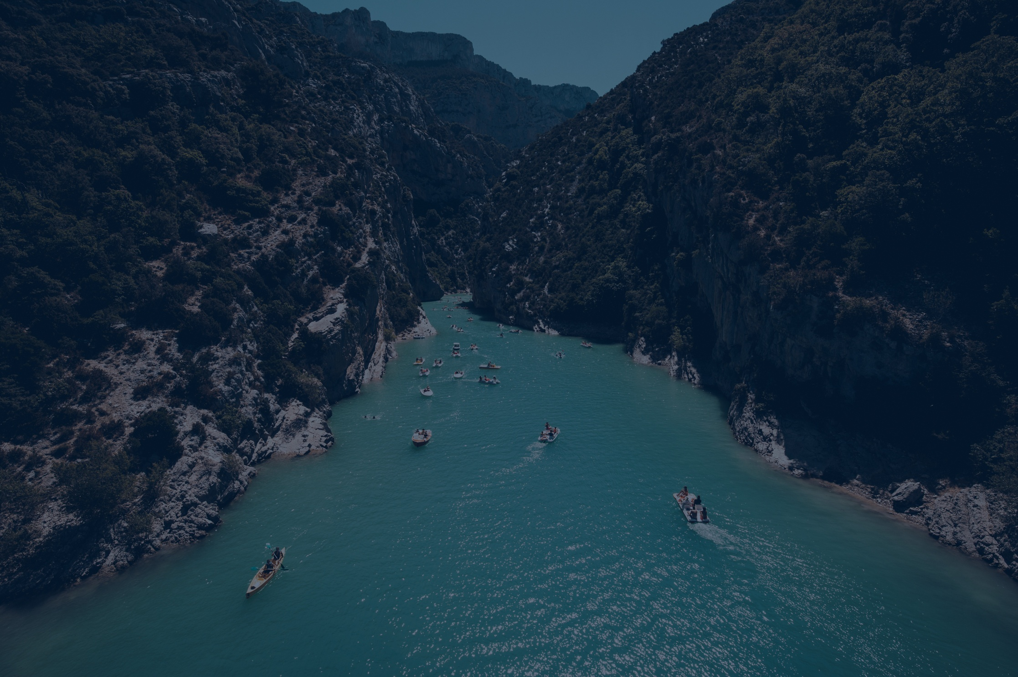



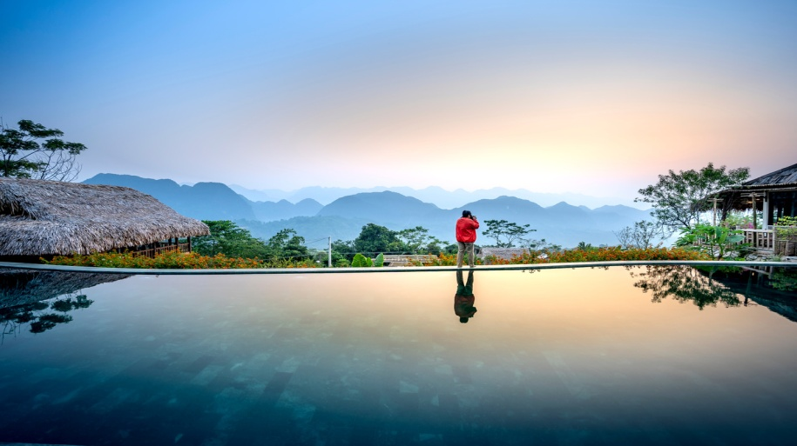
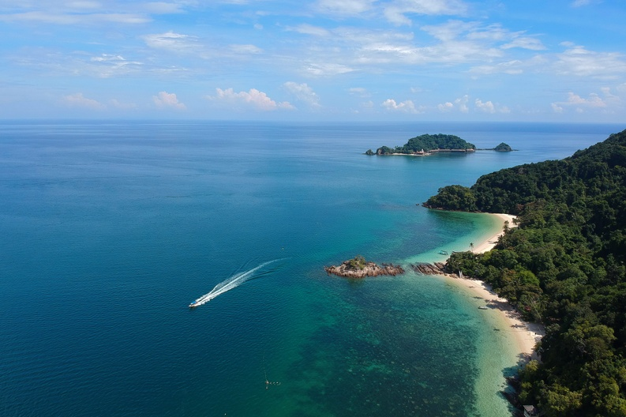
Borcelle
Home
About
Contact
IS SOCIAL MEDIA
Let's reflect on the impact of an online lifestyle managed according to personal expectations!
Start Slide
Learn More
Creating unrealistic expectations for travel and lifestyle?
Vy’s Presentation
2024

Slide 3
01
We’ve organized our presentation into
4 MAIN SECTIONS:
PERSONAL IMPACT ON EACH PERSON
01
02
SO DOES IT CREATE ANY OTHER EFFECTS?
03
INFLUENCE ON SOCIETY AND COMMUNITY
04
THE DISCUSSION ON THIS TOPIC

Slide 4
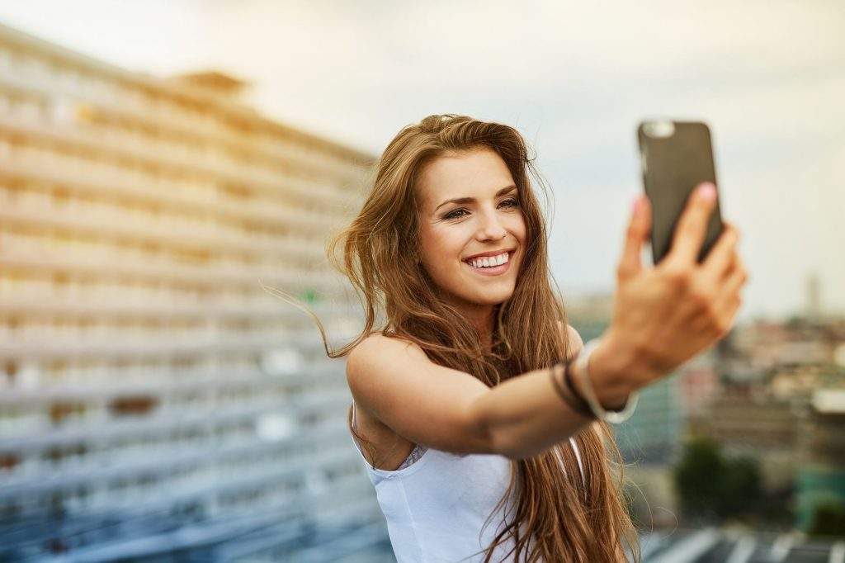
01
PERSONAL IMPACT ON EACH PERSON
THE EDITED PHOTOS
Always post photos that have been edited according to their expectations or the image they want to achieve on social networks.
Often use filters or perfect angles, creating an “idealized” version of the truth

Slide 5


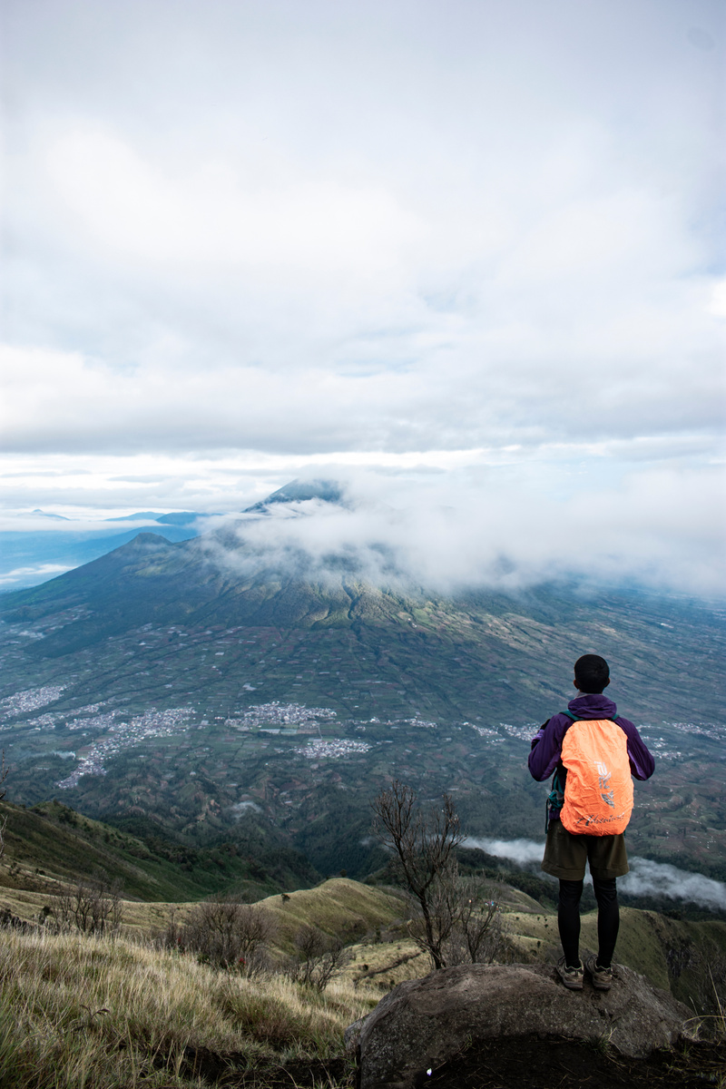
01
PERSONAL IMPACT ON EACH PERSON
Often only post beautiful, successful or interesting moments, ignoring difficulties or failures in their lives
Select Images
They always want to preserve their image and lifestyle beautifully in front of others and society
2024
Borcelle
Home
About
Contact

Slide 6
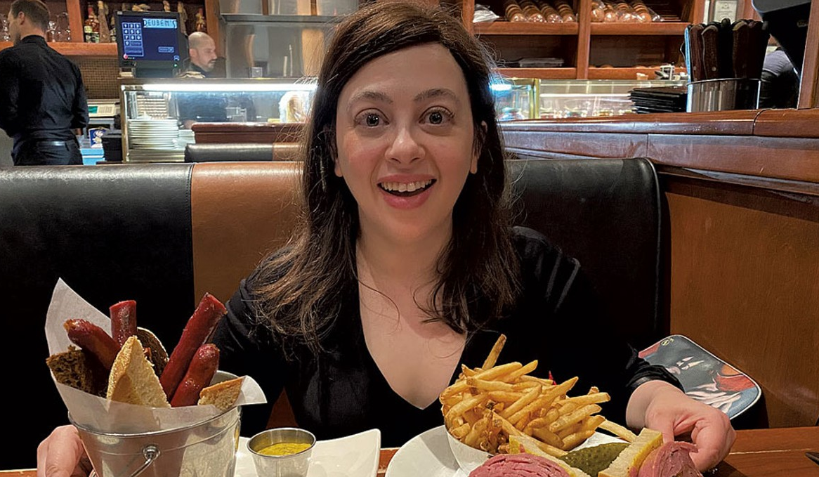
01
PERSONAL IMPACT ON EACH PERSON
KOLs
Or Influencers
Introduce luxurious lifestyles, unrealistic images of travel, experiences, dishes, consumer goods,… because they are paid to advertise
Learn More
2024
Borcelle
Home
About
Contact

Slide 7
02
We’ve organized our presentation into
4 MAIN SECTIONS:
PERSONAL IMPACT ON EACH PERSON
01
02
SO DOES IT CREATE ANY OTHER EFFECTS?
03
INFLUENCE ON SOCIETY AND COMMUNITY
04
THE DISCUSSION ON THIS TOPIC

Slide 8
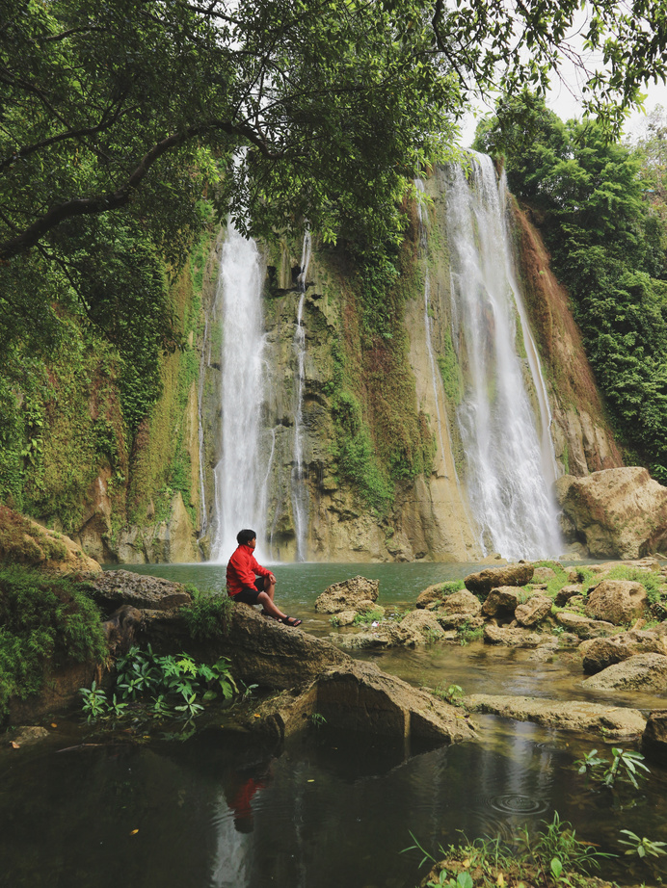
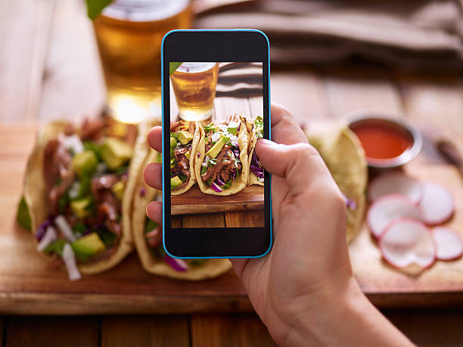
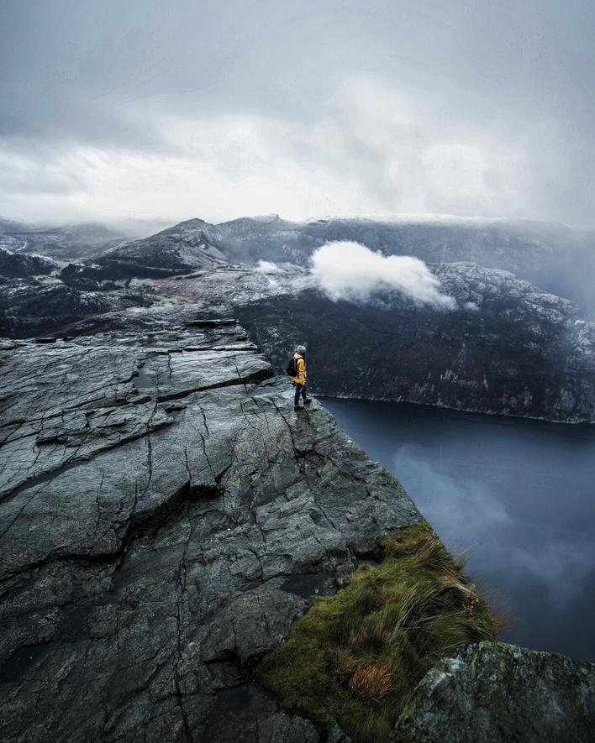
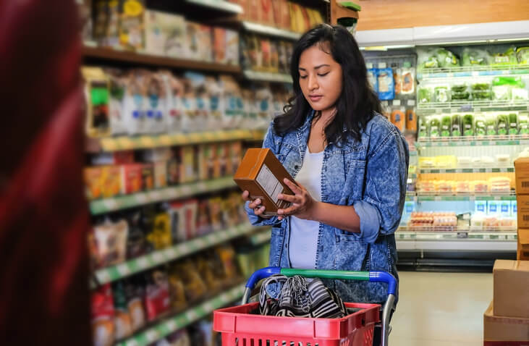
02
INFLUENCE ON SOCIETY AND COMMUNITY
FROM PERSONAL INFLUENCE TO SOCIAL INFLUENCE
When we see many people around us experiencing trips, delicious food, beautiful scenery... but the truth is not necessarily so
=> Create unrealistic expectations, comparison and inferiority
2024
Borcelle
Home
About
Contact

Slide 9
02
INFLUENCE ON SOCIETY AND COMMUNITY
Travel Trips
Images of travel trips shared on social networks often do not fully represent realistic aspects such as costs, travel time, or travel difficulties, leading others to expect that tourists
The schedule must always be “perfect”
2024
Borcelle
Home
About
Contact

Slide 10
02
INFLUENCE ON SOCIETY AND COMMUNITY
Dishes
Dishes are only good when advertised and edited, but when tasted, they are terrible
2024
Borcelle
Home
About
Contact

Slide 11
02
INFLUENCE ON SOCIETY AND COMMUNITY
Beautiful Scenes
Beautiful scenes are only truly beautiful when in favorable weather, with good lighting conditions or when they have been edited and merged
2024
Borcelle
Home
About
Contact

Slide 12
02
INFLUENCE ON SOCIETY AND COMMUNITY
Consumer Products
Consumer products that are unnecessary, purchased because of FOMO or feeling the need to shop and spend more money to achieve an image like what is seen on social networks
2024
Borcelle
Home
About
Contact

Slide 13
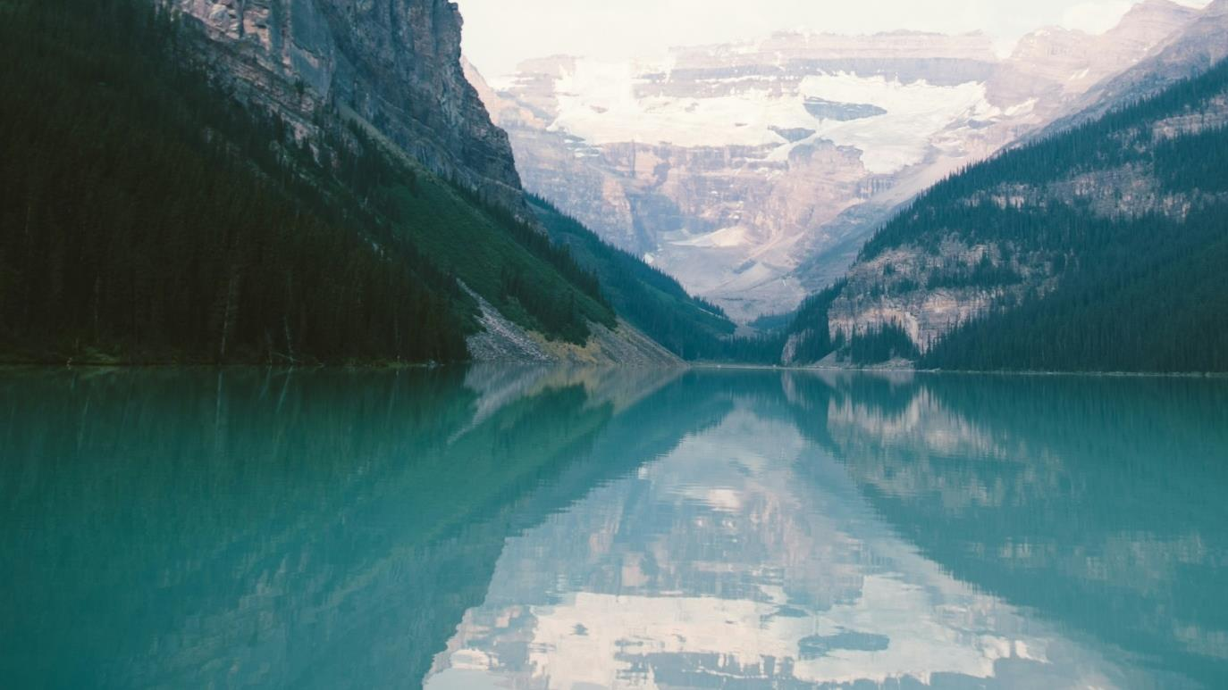
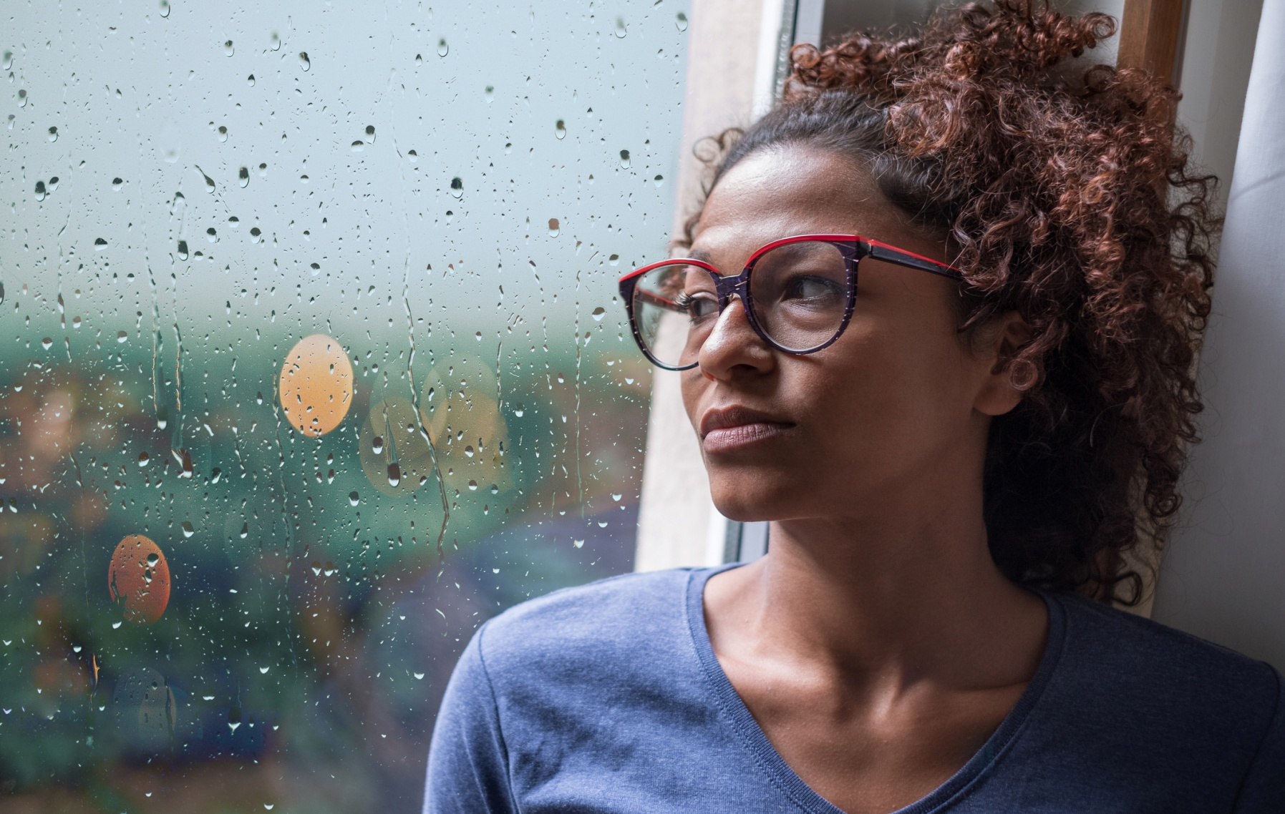
02
INFLUENCE ON SOCIETY AND COMMUNITY
What we get in return is only disappointment, unrealistic expectations due to social networks.

Slide 14
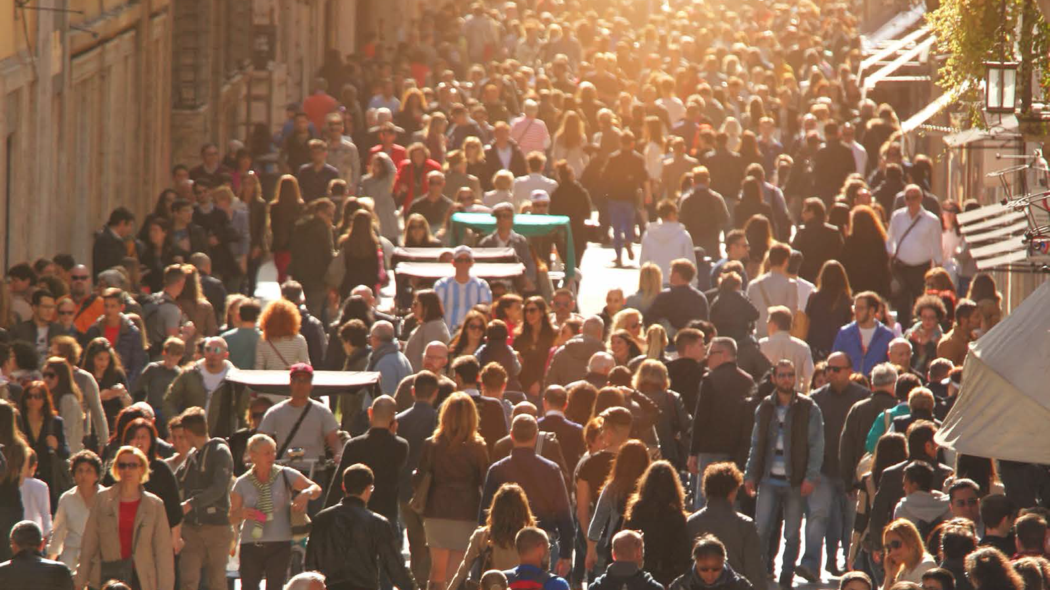

01
+
02
FROM THE ABOVE TWO INFLUENCES
Social networks have really been creating unrealistic expectations about travel and lifestyle in many aspects.
From personal influence leads to social influence
2024
Borcelle
Home
About
Contact

Slide 15
03
We’ve organized our presentation into
4 MAIN SECTIONS:
PERSONAL IMPACT ON EACH PERSON
01
02
SO DOES IT CREATE ANY OTHER EFFECTS?
03
INFLUENCE ON SOCIETY AND COMMUNITY
04
THE DISCUSSION ON THIS TOPIC

Slide 16
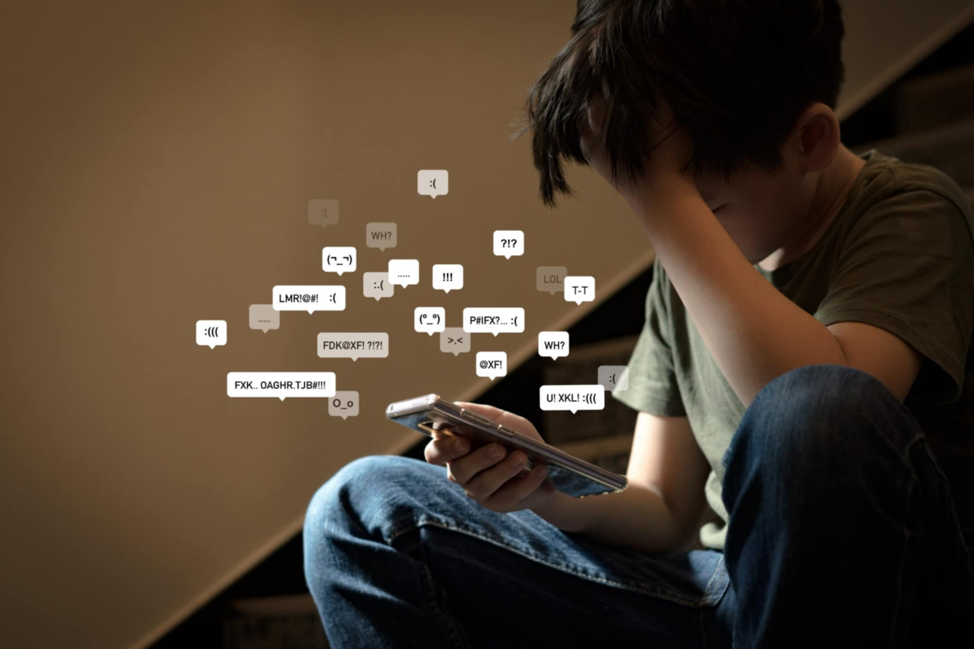

03
SO DOES IT CREATE ANY OTHER EFFECTS?
Next
2024
Borcelle
Home
About
Contact

Slide 17
03
5 OTHER EFFECTS
02
04
Feeling dissatisfied with current life
Cyberbullying and harassment
Stress and Anxiety
Mental health issues
Impact on relationships
01
03
05

Slide 18
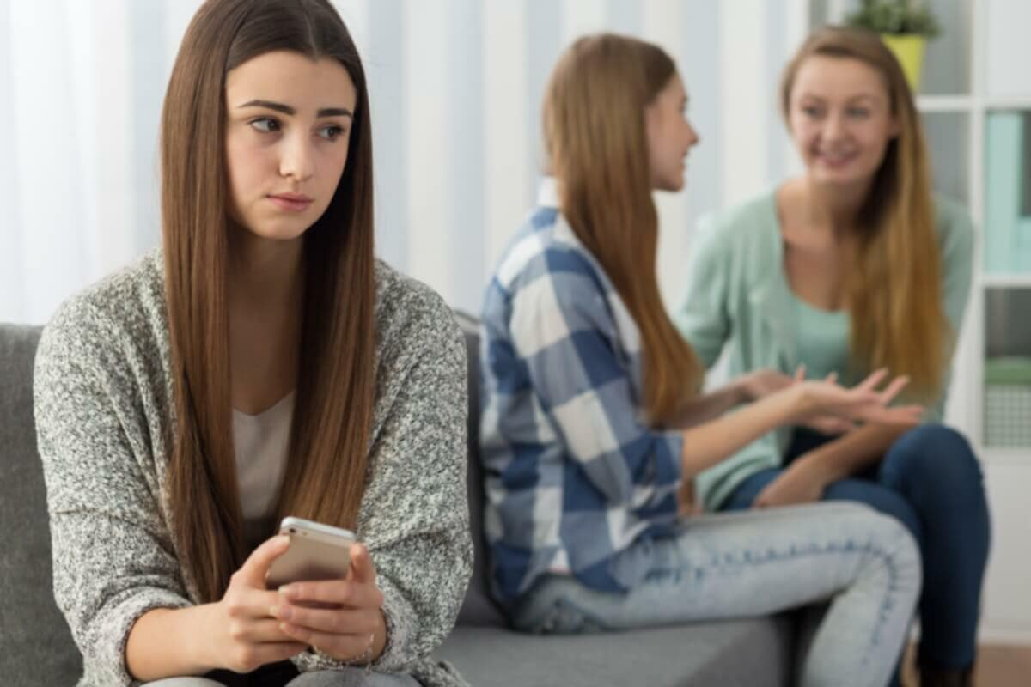
03
5 OTHER EFFECTS
01
Feeling Dissatisfied With Current Life
Social networks can make people lose the ability to appreciate what they have, instead of feeling jealous or dissatisfied, fantasizing about unrealistic things

Slide 19
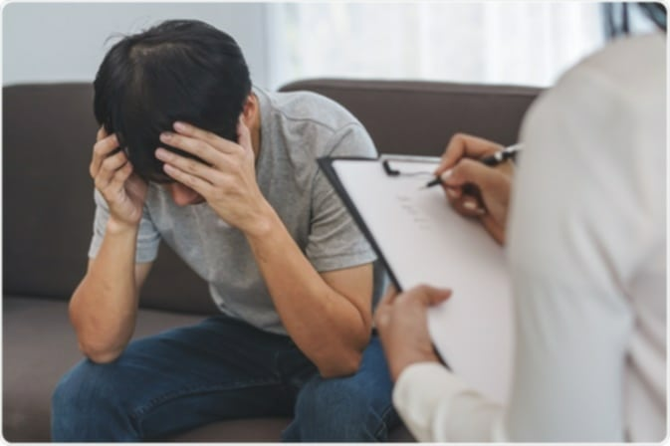
03
5 OTHER EFFECTS
02
Mental Health Issues
One of the most significant consequences is the impact on mental health. Constant comparison to other people's perfect lives can lead to feelings of inadequacy, low self-esteem, depression and anxiety.

Slide 20
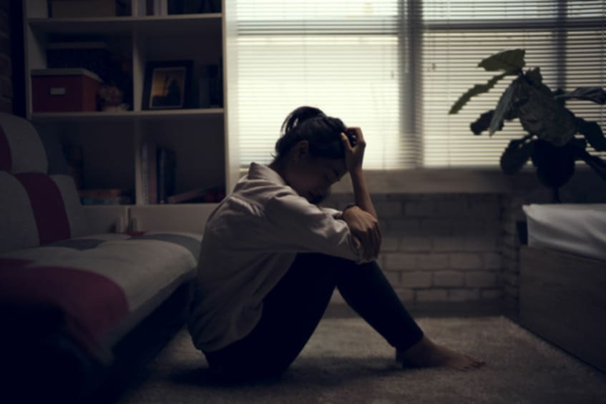
03
5 OTHER EFFECTS
03
Stress And Anxiety
Trying to maintain a "perfect" image on social networks also causes psychological pressure, especially for young people

Slide 21

03
5 OTHER EFFECTS
04
Impact On Relationships
Unrealistic expectations can also strain relationships, as people may feel pressure to appear perfect, leading to dishonesty and superficial interactions. Jealousy and comparison can also create friction between friends or partners

Slide 22
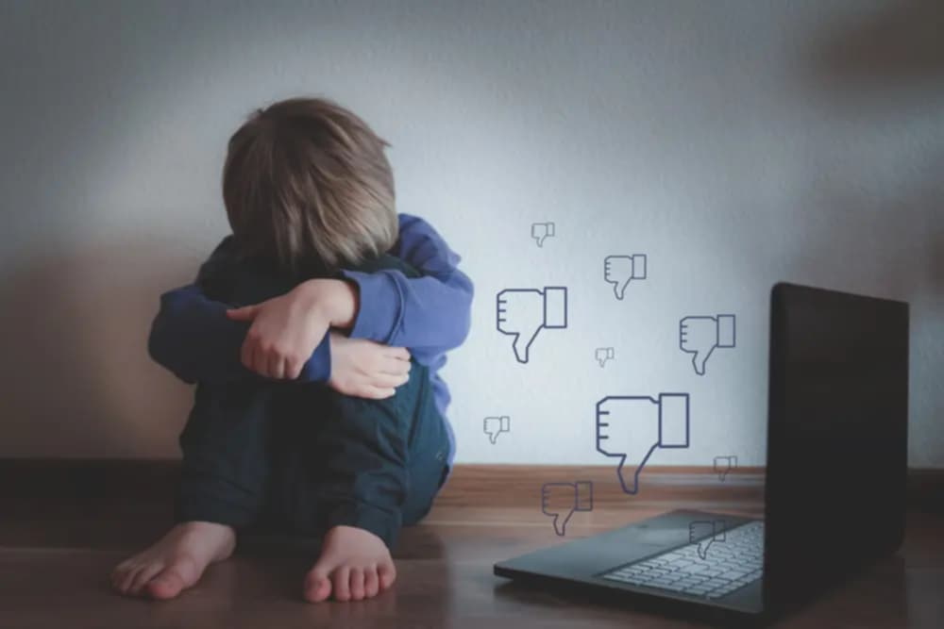
03
5 OTHER EFFECTS
05
Cyberbullying And Harassment
Unrealistic depictions on social media can lead to negative comments, bullying or harassment of those who do not accurately portray these facts, exacerbating mental health concerns for many individuals

Slide 23
04
We’ve organized our presentation into
4 MAIN SECTIONS:
PERSONAL IMPACT ON EACH PERSON
01
02
SO DOES IT CREATE ANY OTHER EFFECTS?
03
INFLUENCE ON SOCIETY AND COMMUNITY
04
THE DISCUSSION ON THIS TOPIC

Slide 24
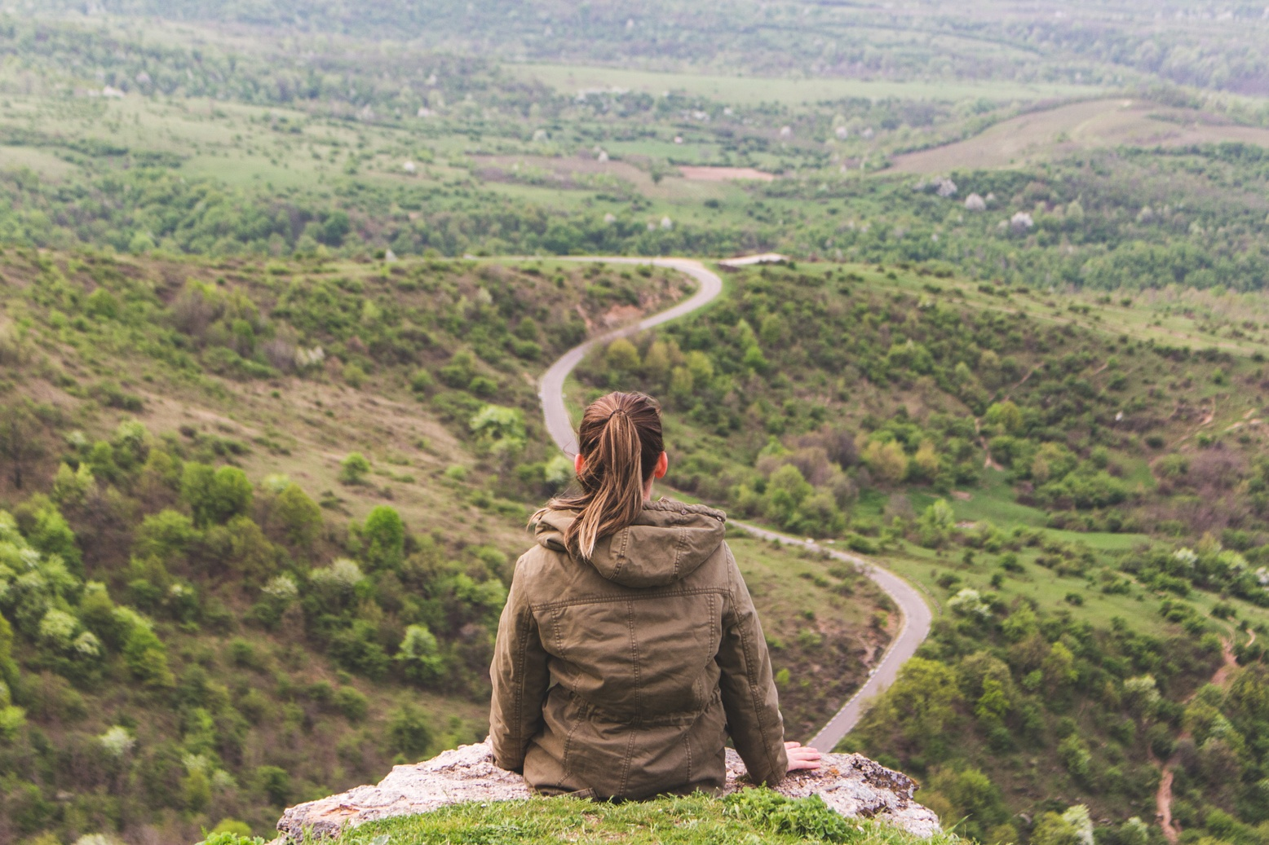
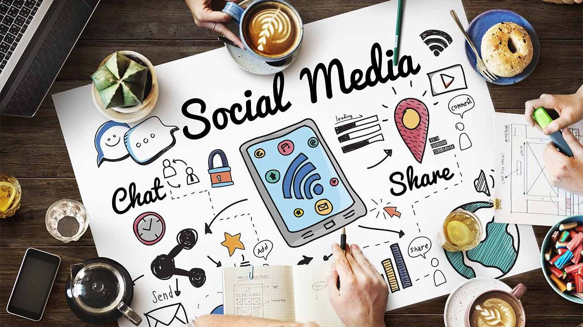
04
Borcelle
Home
About
Contact
Conclude
Media and social networks can provide us with inspiration and glimpses into the beauty of travel and lifestyle. It is important to maintain a perspective base
Always be alert, don't follow the crowd too much to avoid putting pressure on yourself, but appreciate what you have.
Vy’s Presentation
Learn More
2024

Slide 25
Thao Vy 22T4-NNA2
THANK YOU
SO MUCH FOR LISTENING

Slide 26
ổn
Một số chỗ chữ nhỏ.
Ít nhất phải bằng cỡ chữ cô đang đánh.

