Slide 1


Slide 2

ỦY BAN NHÂN DÂN THÀNH PHỐ HỒ CHÍ MINH
TRƯỜNG CAO ĐẲNG LÝ TỰ TRỌNG TP. HỒ CHÍ MINH
Bậc đào tạo: CAO ĐẲNG CHUYÊN NGHIỆP
KHOA NGOẠI NGỮ

Slide 3


Slide 4


Slide 5
UNIT 1
All in a day’s work
Page 6

Slide 6

Unit 1 All in a day’s work – Page 6
Possible advantages:
Meet lots of people
It is interesting.
Lots of different jobs

Slide 7
Unit 1 All in a day’s work – Page 6
Possible disadvantages:
- Hours are long and unsociable.
- Usually work at weekends
- Guests may be difficult.

Slide 8

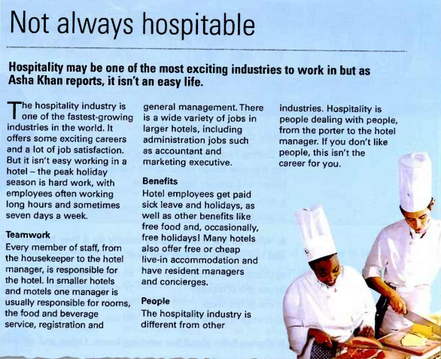
Unit 1 All in a day’s work – Page 6

Slide 9
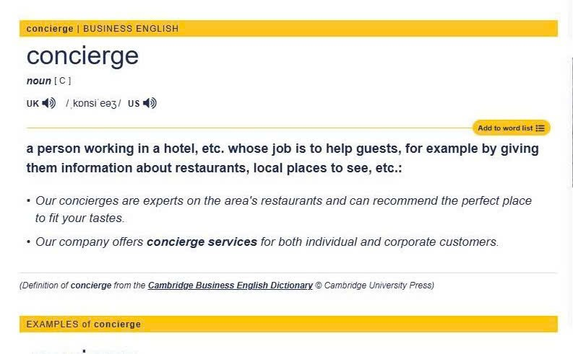
Unit 1 All in a day’s work – Page 6

Slide 10
Unit 1 All in a day’s work – Page 6

Slide 11
Unit 1 All in a day’s work – Page 6
Advantages:
- fast-growing industry
- exciting career
- job satisfaction
- variety of jobs
- paid sick leave and holidays
- free food
- some free – holidays
- free or cheap accommodation

Slide 12
Unit 1 All in a day’s work – Page 6
Disadvantages:
- hard work, especially peak season
- hours are long
- seven-day week

Slide 13
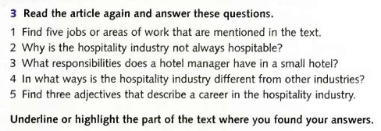
Unit 1 All in a day’s work – Page 6
reading
1
1. housekeeper
2. management
3. administration jobs, e.g. accountant, marketing
4. concierge
5. porter

Slide 14
Unit 1 All in a day’s work – Page 6
reading
2 Because it is not an easy job and the hours can be very long.

Slide 15
Unit 1 All in a day’s work – Page 6
reading
3 They are responsible for the rooms, food and beverage service, registration and general management.

Slide 16
Unit 1 All in a day’s work – Page 6
reading
4 Each job involves dealing with people.

Slide 17
Unit 1 All in a day’s work – Page 6
reading
5 exciting, hard and different

Slide 18
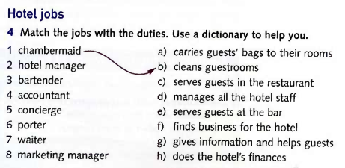
Unit 1 All in a day’s work – Page 7
vocabulary
d
e
h
g
a
c
f

Slide 19

Unit 1 All in a day’s work – Page 7
pronunciation
-> The word which does not have this sound is hours /auəz/, /aurz/.

Slide 20

Unit 1 All in a day’s work – Page 7
speaking

Slide 21

Thank you very much
for
your cooperation.

