Slide 1

TRƯỜNG CAO ĐẲNG LÝ TỰ TRỌNG TP. HỒ CHÍ MINH

Slide 2

KHOA KHOA HỌC CƠ BẢN

Slide 3

ỦY BAN NHÂN DÂN THÀNH PHỐ HỒ CHÍ MINH
TRƯỜNG CAO ĐẲNG LÝ TỰ TRỌNG TP. HỒ CHÍ MINH
Bậc đào tạo: TRUNG CẤP CHUYÊN NGHIỆP
Tên giảng viên: LÊ NGUYỄN MỸ TRÂM

Slide 4

Good afternoon class 19T2.

Slide 5
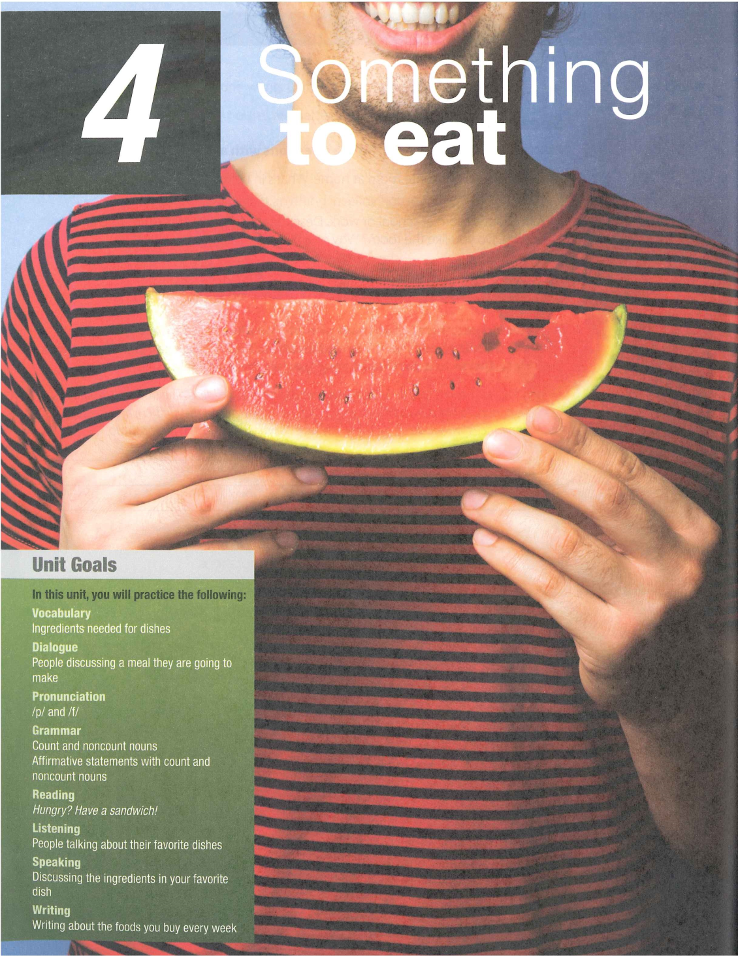

Slide 6

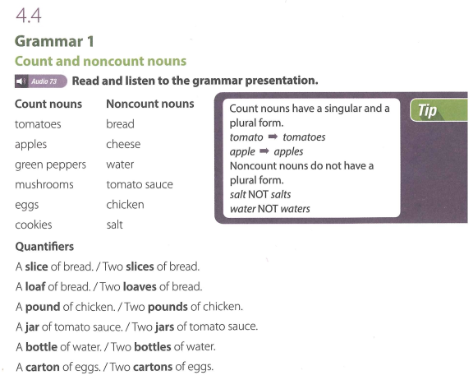

Slide 7
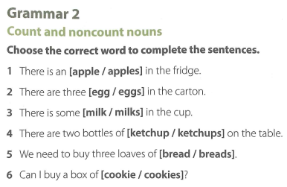

Slide 8
GRAMMAR 2 (KEY)
There is an [apple / apples] in the fridge.
There are three [egg / eggs] in the carton.
There is some [milk / milks] in the cup.
There are two bottles of [ketchup / ketchups] on the table.
We need to buy three loaves of [bread / breads].
Can I buy a box of [cookie / cookies]?

Slide 9
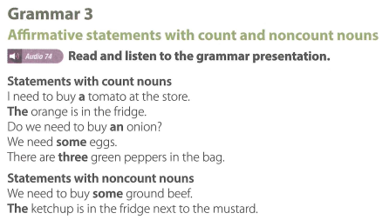

Slide 10
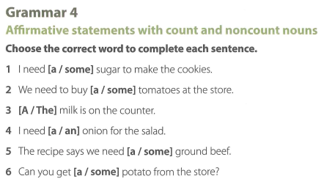

Slide 11
GRAMMAR 4 (KEY)
I need [a / some] sugar to make the cookies.
We need to buy [a / some] tomatoes at the store.
[A / The] milk is on the counter.
I need [a / an] onion for the salad.
The recipe says we need [a / some] ground beef.
Can you get [a / some] potato from the store?

Slide 12
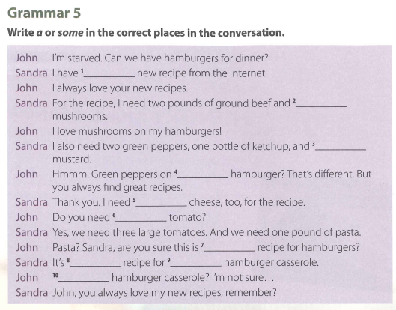

Slide 13
GRAMMAR 5 (KEY)
John: I’m starved. Can we have hamburgers for dinner?
Sandra: I have [1] a new recipe from the Internet.
John: I always love your new recipes.
Sandra: For the recipe, I need two pounds of ground beef and [2] some mushrooms.
John: I love mushrooms on my hamburgers!
Sandra: I also need two green peppers, one bottle of ketchup, and [3] some mustard.
John: Hmmm. Green peppers on [4] a hamburger? That‘s different. But
you always find great recipes.
Sandra: Thank you. I need [5] some cheese, too, for the recipe.
John: Do you need [6] a tomato?
Sandra: Yes, we need three large tomatoes. And we need one pound of pasta.
John: Pasta? Sandra, are you sure this is [7] a recipe for hamburgers?
Sandra: It’s [8] a recipe for [9] a hamburger casserole.
John: [10] A hamburger casserole? I’m not sure...
Sandra: John, you always love my new recipes, remember?

Slide 14
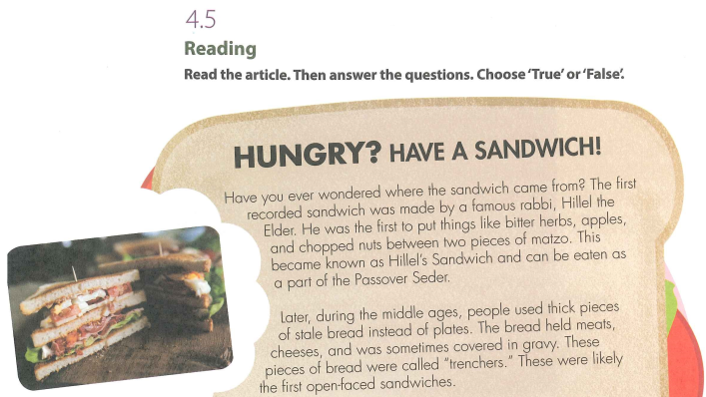

Slide 15
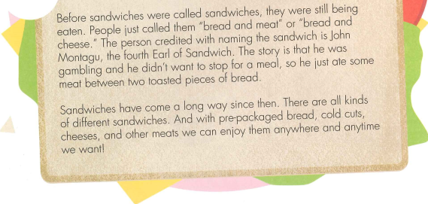

Slide 16
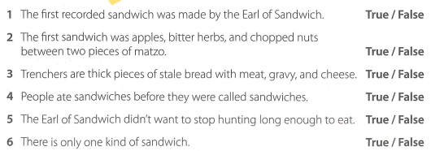

Slide 17
New words:
New words:
1. rabbi (noun) [ C ] UK /ˈræb.aɪ/ US /ˈræb.aɪ/: a religious leader and teacher in the Jewish religion:
Exs:
Rabbi Jonathan Sacks
[as form of address] Good morning, Rabbi.

Slide 18
2. bitter (adjective) UK /ˈbɪt.ər/ US /ˈbɪt̬.ɚ/: angry
Exs:
- Someone who is bitter is angry and unhappy because they cannot forget bad things that happened in the past.
- I feel very bitter about my childhood and all that I went through.

Slide 19
3. herb (noun) [ C ] UK /hɜːb/ US /ɝːb/: a type of plant whose leaves are used in cooking to give flavour to particular dishes or in making medicine:
Exs: - dried/fresh herbs
- Basil, oregano, thyme, and rosemary are all herbs.
- A large range of herbs and spices are used in South Asian cooking.

Slide 20
4. chop (verb) [ T ] UK /tʃɒp/ US /tʃɑːp/: to cut something into pieces with an axe, knife, or other sharp instrument:
Exs: - He was chopping wood in the yard.
- Chop (up) the onions and carrots roughly.

Slide 21
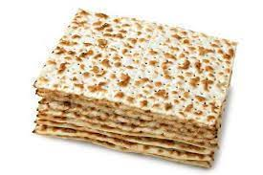
5. matzo

Slide 22
6. Passover Seder (noun):
https://sites.google.com/site/thichdihoc/le-vuot-qua-passover

Slide 23
Lễ Vượt Qua PASSOVER
- Lễ Vượt Qua (tiếng Anh gọi là PASSOVER ) là lễ của người Do Thái nhằm để kỷ niệm ngày giải phóng dân tộc Do Thái thoát khỏi ách nô lệ của đế quốc Ai Cập .
- Lễ Vượt Qua kéo dài một tuần
- Trước ngày lễ vượt qua , ngày đó sẽ kiêng ăn vào buổi sáng (kiêng ăn chỉ dành cho trẻ em khỏe mạnh và trên 14 tuổi, người yếu và già thì được miễn )
- Trong bữa tiệc, người ta ăn thịt chiên với bánh không men và rau đắng,
- Ngoài ra, họ cũng uống với nhau bốn chén rượu đã được vị chủ tọa bữa tiệc chúc lành để kỉ niệm bốn lời hứa của Thiên Chúa với dân Do Thái:
Matzah thường được làm bằng tay hoặc làm bằng máy .

Slide 24
Lễ Vượt Qua PASSOVER
"Ta sẽ đem các ngươi ra từ ách của Ai Cập"
"Ta sẽ giải thoát các ngươi khỏi cảnh làm tôi mọi chúng"
"Ta sẽ giương cánh tay mà chuộc lấy các ngươi"
"Ta sẽ lấy các ngươi làm dân Ta, và Ta sẽ là Thiên Chúa các ngươi"
Các thức ăn được dùng trong lễ Vượt Qua
Matzah là bánh không men, khi nấu tính đủ thời gian là 18 phút .
Nếu quá thời gian 18 phút thì bánh sẽ lên men, và sẽ không được sử dụng.

Slide 25
7. stale (adjective) UK /steɪl/ US /steɪl/: no longer new or fresh, usually as a result of being kept for too long:
Exs: - The bread/biscuits/cake had gone stale.
- The morning after the party, their apartment smelled of stale cigarette smoke.

Slide 26
8. cover (verb) UK /ˈkʌv.ər/ US /ˈkʌv.ɚ/: to put or spread something over something, or to lie on the surface of something:
Exs: - The light was so bright that I had to cover my eyes.
- Snow covered the hillsides.
- Cover the meat with a layer of cheese.

Slide 27
9. gravy (noun) [ U ] UK /ˈɡreɪ.vi/ US /ˈɡreɪ.vi/:
a sauce made with meat juices and flour, served with meat and vegetables

Slide 28
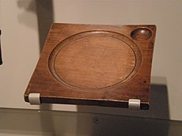
10. trencher (noun) [ C ] UK /ˈtren.tʃər/ US /ˈtren.tʃɚ/: in the past, a flat, wooden dish used to serve food

Slide 29
11. credit (verb) /ˈkredɪt/ /ˈkredɪt/ [usually passive]: to believe or say that somebody is responsible for doing something, especially something good
* be credited with doing something:
- The group has been widely credited with creating the sound of heavy metal.
- The company is credited with inventing the industrial robot.

Slide 30
12. earl (noun) [ C ] UK /ɜːl/ US /ɝːl/:
(the title of) a British man of high social rank, between a marquis and a viscount (một người đàn ông Anh có địa vị xã hội cao, giữa một hầu tước và một tử tước):
Ex: the Earl of Northumberland

Slide 31
13. toast (verb) /təʊst/ /təʊst/ [transitive, intransitive]: toast (something): to make something, especially bread, turn brown by heating it in a toaster or close to heat; to turn brown in this way
Exs:
- Toast the bread lightly on both sides.
- a toasted sandwich
- Place under a hot grill until the nuts have toasted.

Slide 32
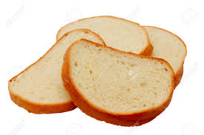
14. pieces of bread (noun):

Slide 33
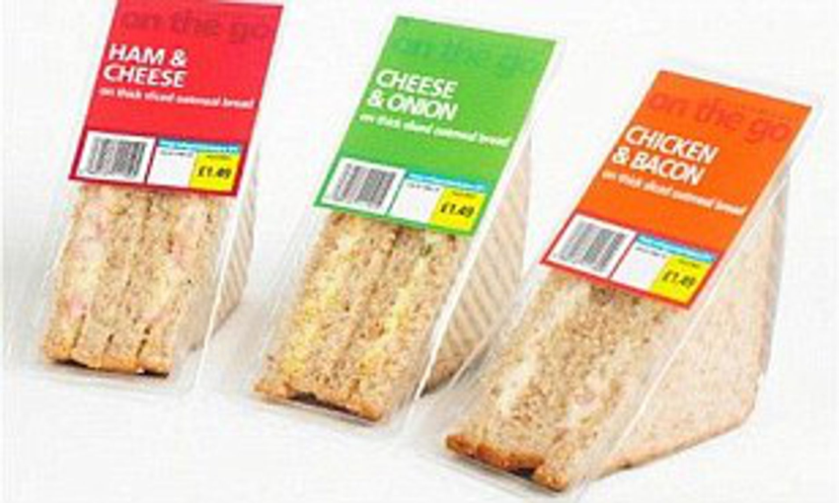
15. pre-packaged (adjective) (also prepackaged) UK US (also pre-packed): already wrapped or in a container:
Ex: Britons spend more than £3 billion a year on pre-packed sandwiches.

Slide 34
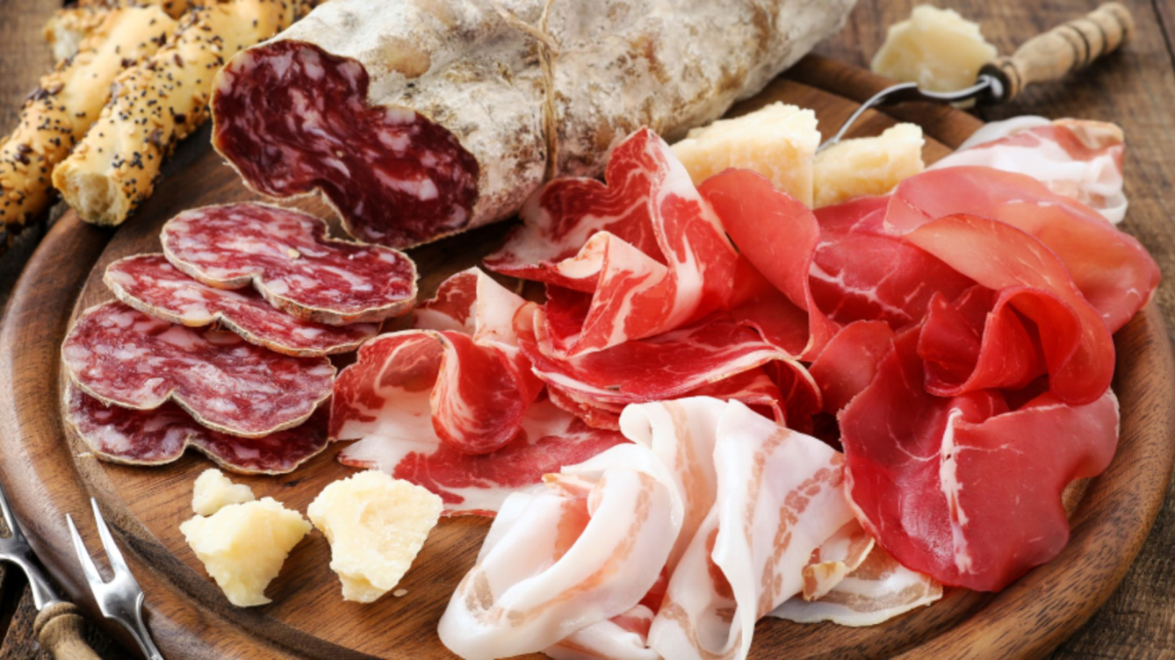
16. cold cuts (noun) [ plural ] mainly US UK /ˈkəʊld ˌkʌts/ US /ˈkoʊld ˌkʌts/: thin, flat slices of cold cooked meat

Slide 38
4.5 Reading (Key)
The first recorded sandwich was made by the Earl of Sandwich. (True / False)
The first sandwich was apples, bitter herbs, and chopped nuts pieces of matzo. (True / False)
Trenchers are thick pieces of stale bread with meat, gravy, and cheese. (True / False)
People ate sandwiches before they were called sandwiches. (True / False)
The Earl of Sandwich didn't want to stop hunting long enough to eat. (True / False)
There is only one kind of sandwich. (True / False)

Slide 39
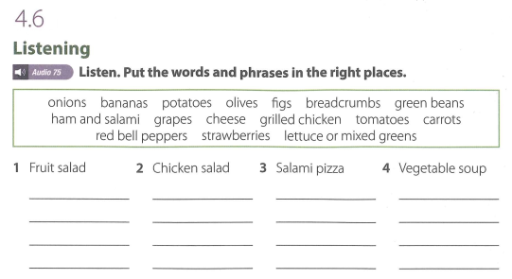

Slide 40
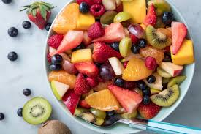
New words:
1. fruit salad (noun):

Slide 41
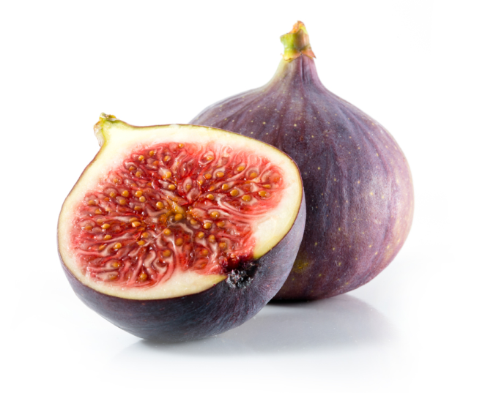
2. fig (noun) [ C ] UK /fɪɡ/ US /fɪɡ/: a sweet, soft, purple, or green fruit with many seeds, or a tree on which these grow

Slide 42
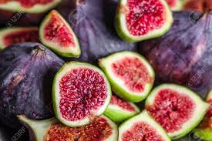
3. fig slices (noun):

Slide 43
4. refreshing (adjective) UK /rɪˈfreʃ.ɪŋ/ US /rɪˈfreʃ.ɪŋ/: making you feel less hot or tired: sảng khoái
Ex:
There's nothing more refreshing on a hot day than a cold beer.

Slide 44
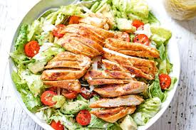
5. chicken salad (noun):

Slide 45
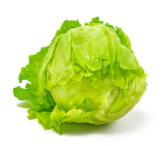
6. lettuce (noun) [ C or U ] UK /ˈlet.ɪs/ US /ˈlet̬.ɪs/: a plant with large, green leaves, eaten uncooked in salads
Exs:
- One sandwich and a lettuce leaf - I don't call that a meal!
- Shred (Cắt nhỏ) the heart of a lettuce and put it in a large bowl.

Slide 46
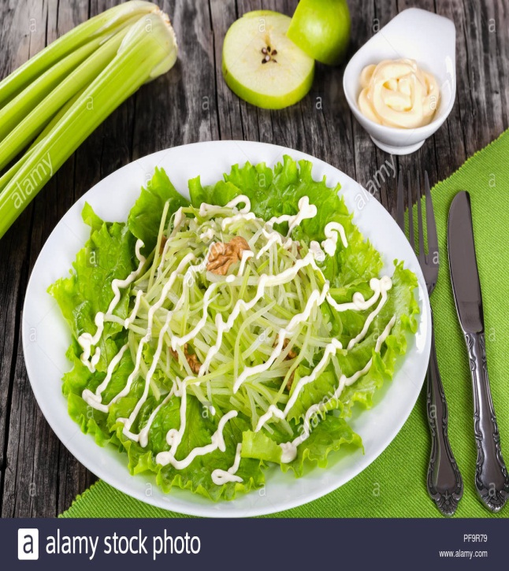
7. a bed of lettuce:

Slide 47
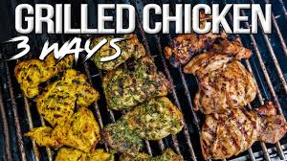
8. grilled chicken:

Slide 48
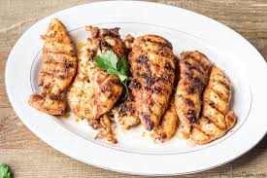
9. strips of grilled chicken:

Slide 49
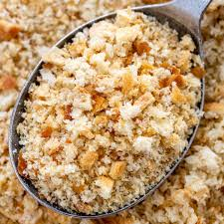
10. breadcrumbs:

Slide 50
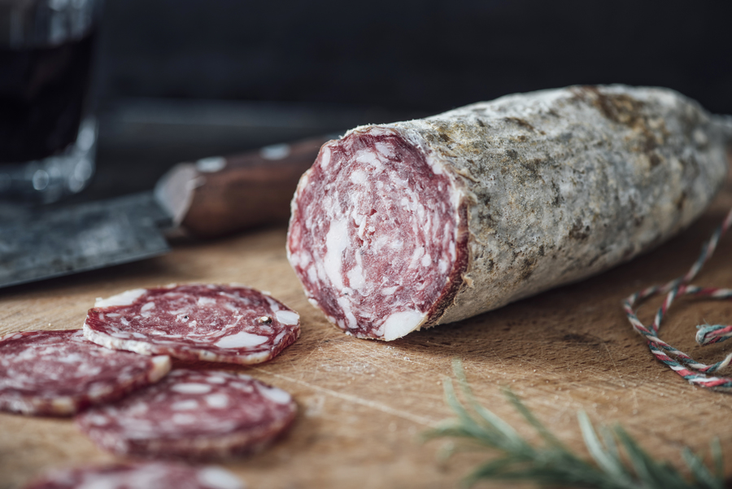
11. salami (noun) [ U ] UK /səˈlɑː.mi/ US /səˈlɑː.mi/: a large sausage made from meat and spices that has a strong taste and is usually eaten cold in slices

Slide 51
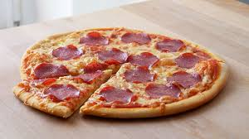
12. salami pizza:

Slide 52
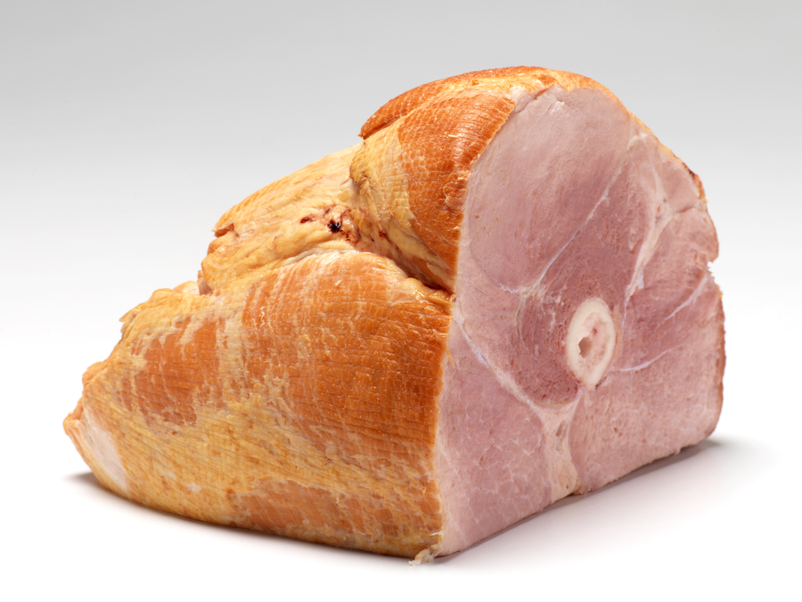
13. ham (noun) UK /hæm/ US /hæm/ [ C or U ]: pig's meat from the leg or shoulder, preserved with salt or smoke
Exs: - I'd like a ham sandwich on rye, hold the lettuce.
- Would you like another slice of ham?

Slide 53
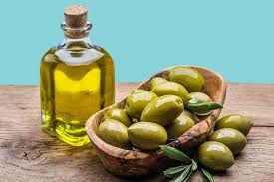
14. olive (noun)

Slide 54
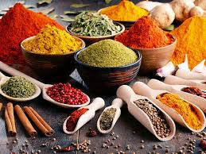
15. spices (noun)

Slide 56
4.6 Listening (Key)
1. Fruit salad
1. figs
2. bananas
3. strawberries
4. grapes

Slide 57
4.6 Listening (Key)
2. Chicken salad
1. tomatoes
2. grilled chicken
3. lettuce or mixed greens
4. breadcrumbs

Slide 58
4.6 Listening (Key)
3. Salami and pizza
1. ham and salami
2. cheese
3. onions
4. olives

Slide 59
4.6 Listening (Key)
4. Vegetable soup
1. green beans
2. potatoes
3. carrots
4. red bell peppers

Slide 60
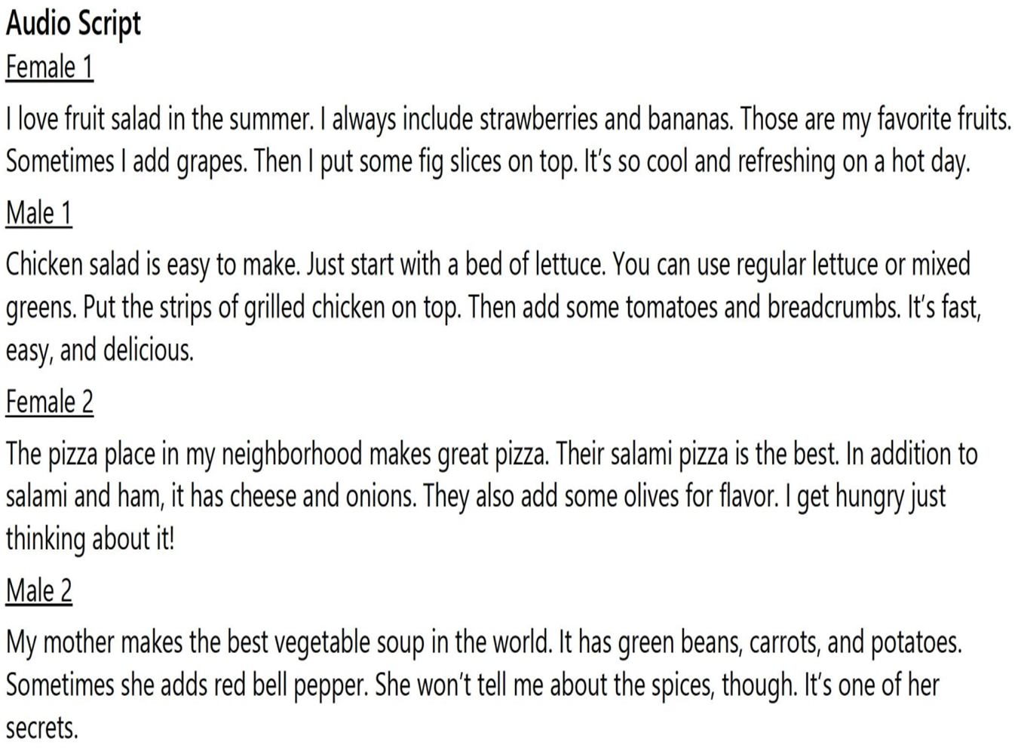

Slide 61
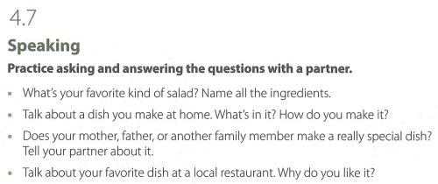

Slide 74

Thank you very much
for your cooperation.

