Slide 1
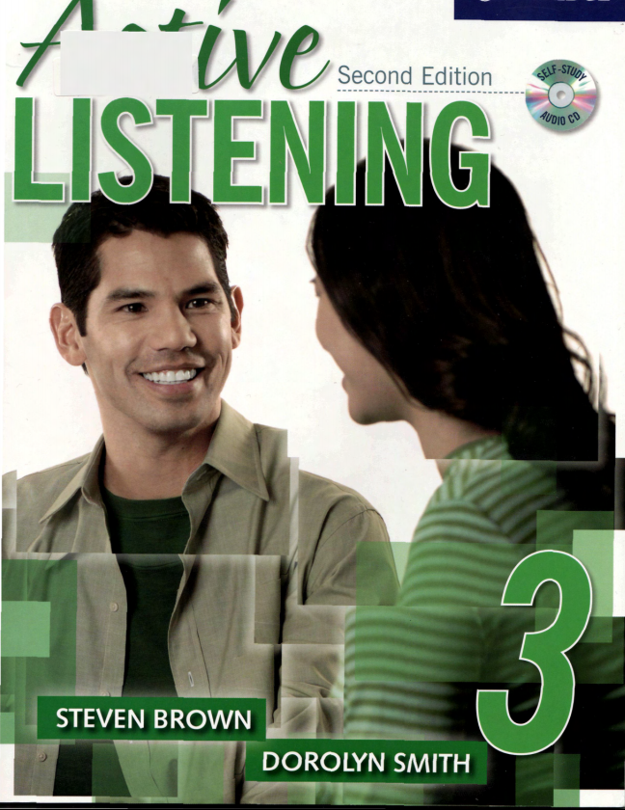
UNIT 3:
Communication
&
Culture
Teacher’s name:
Vuong Thanh Thuy

Slide 2
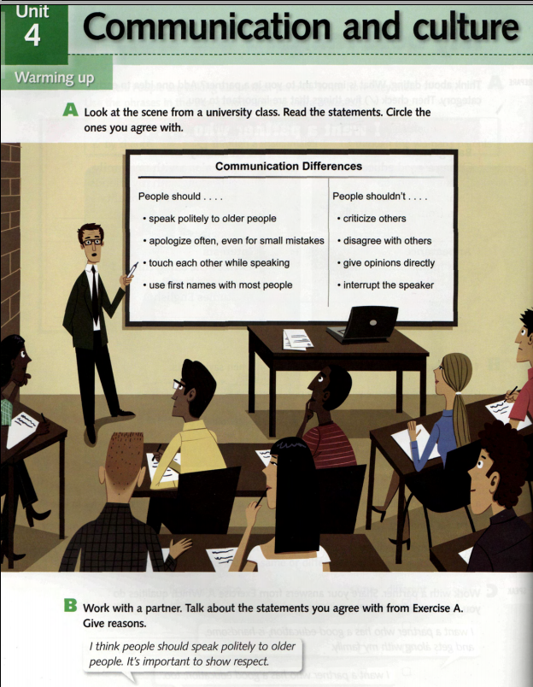

Slide 3
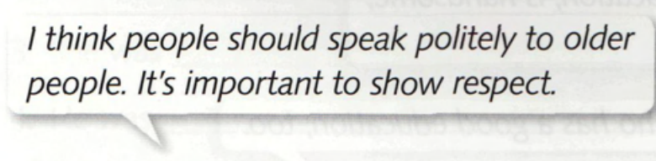
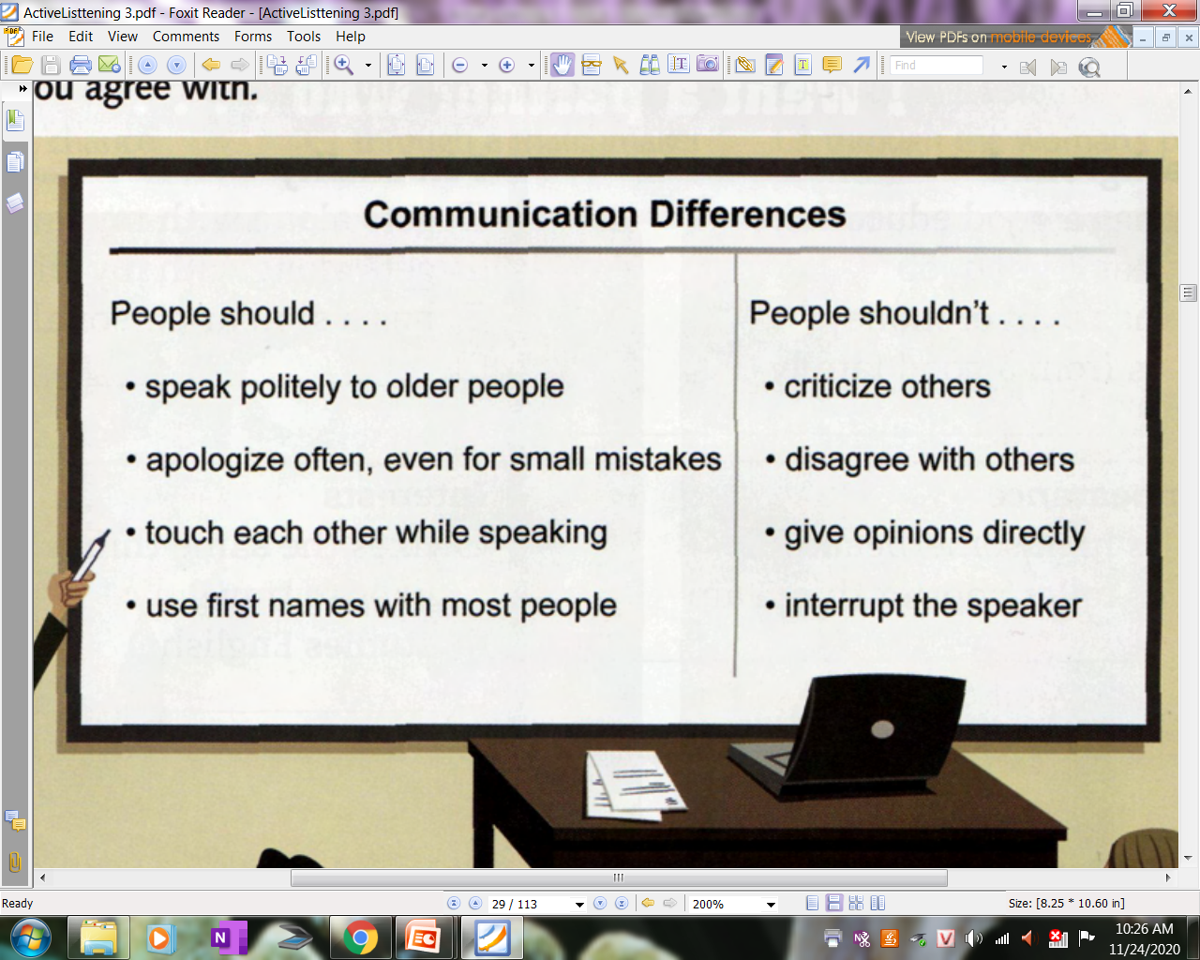

Slide 4
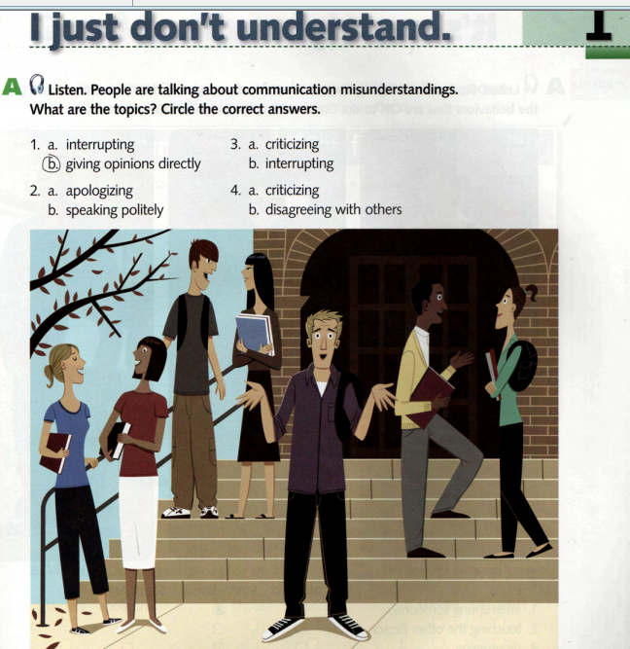

Slide 5
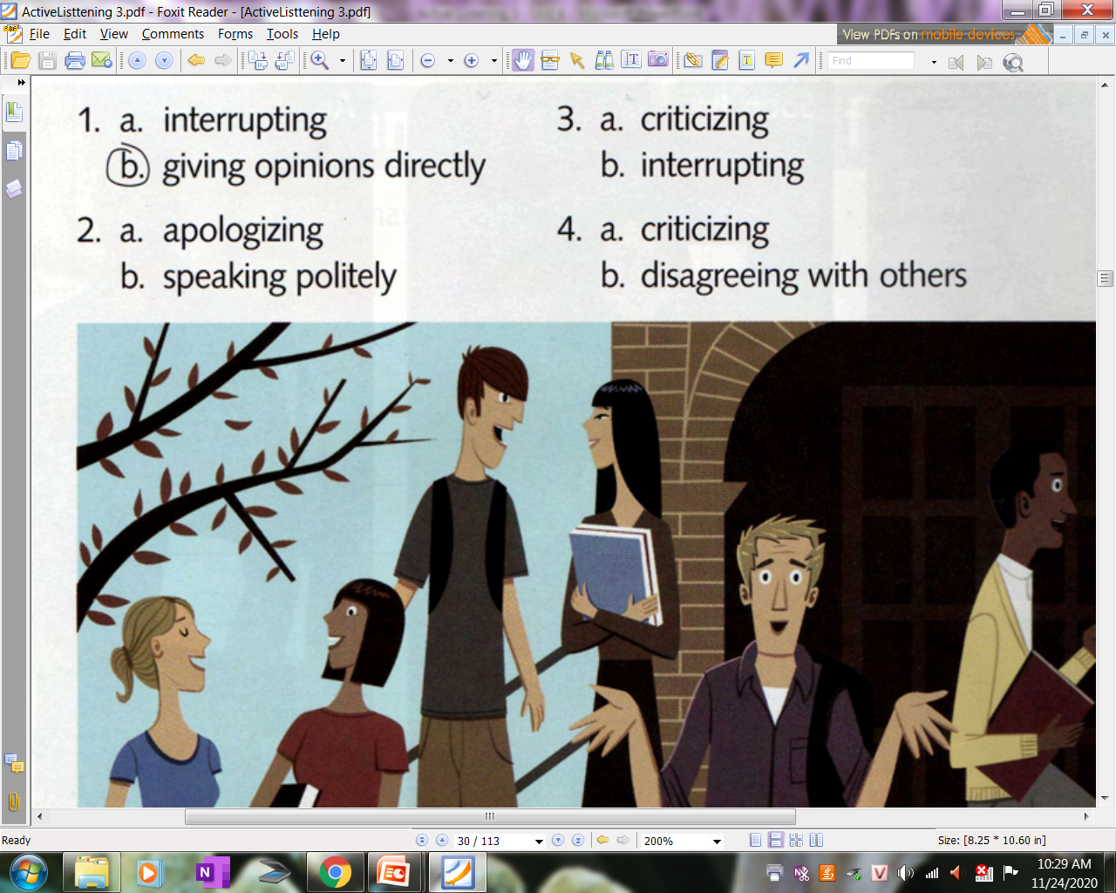
1.17

Slide 6
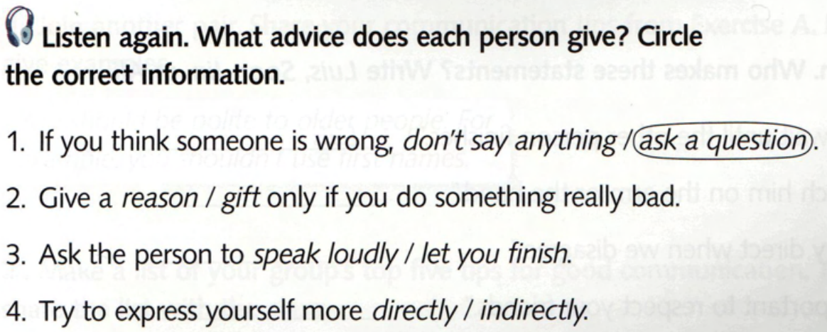
1.17

Slide 7
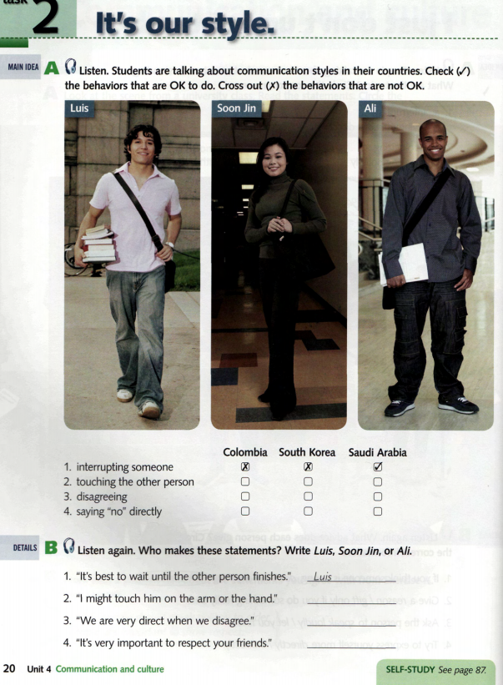
1.18

Slide 8
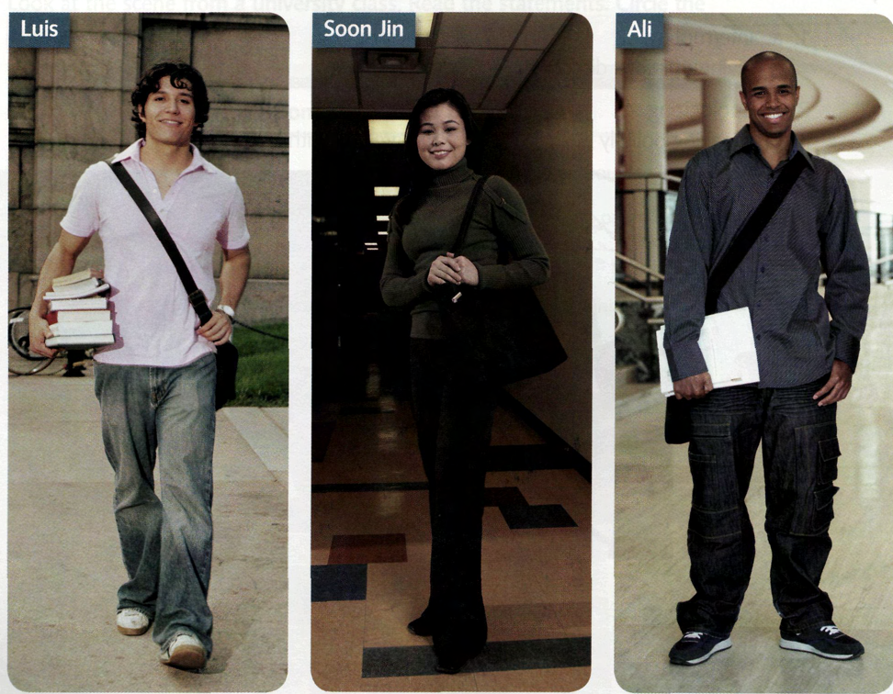
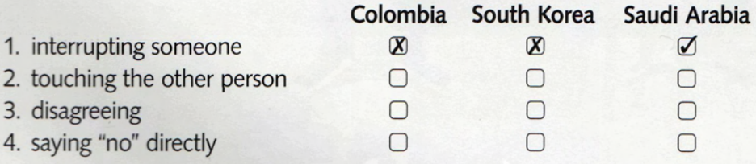
1.18
√
√
√
√
x
√
x
x
x

Slide 9
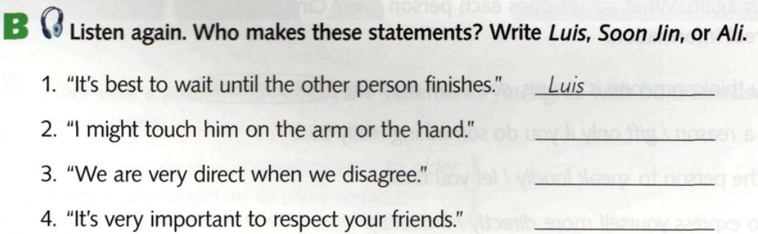
1.18

Slide 10
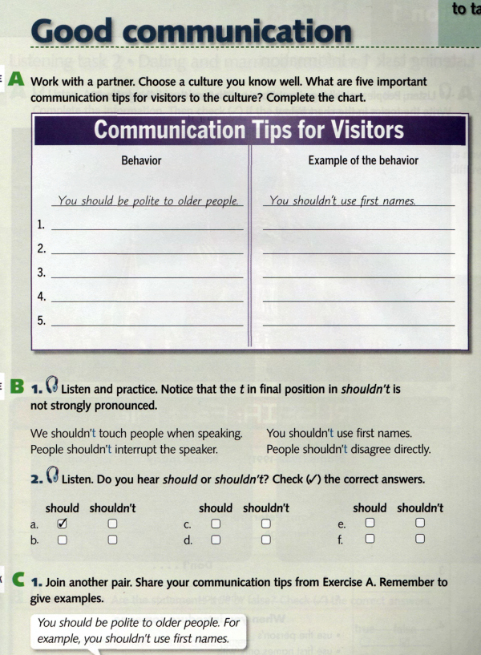
1.19
20

Slide 11
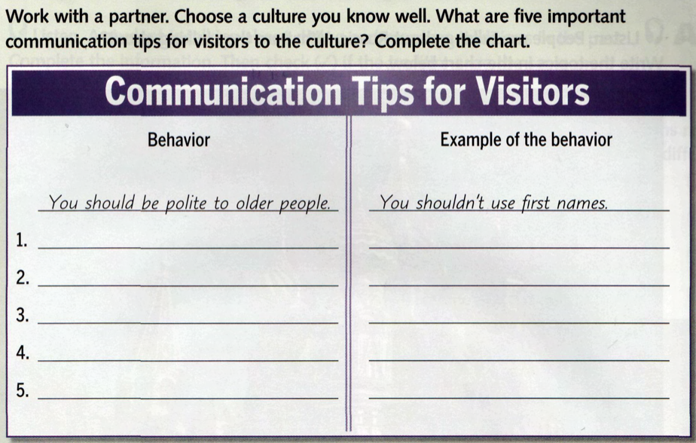

Slide 12
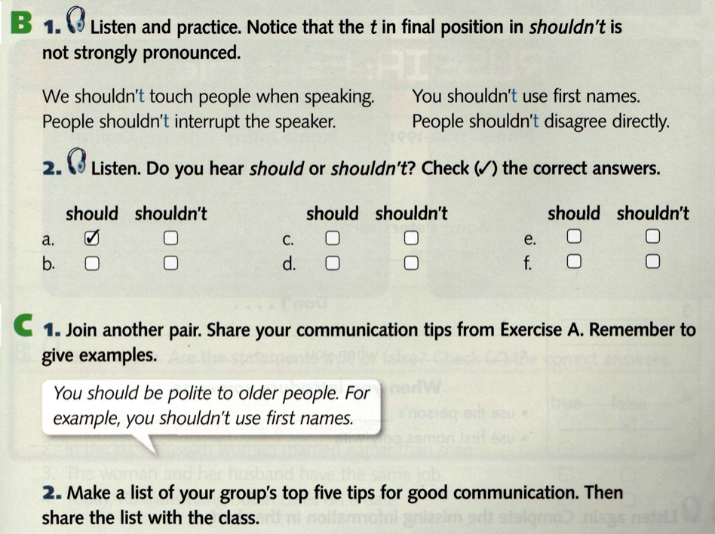
1.19
1.20

Slide 14
DICTATION
I just met my perfect match! He has a good job, good education, and a lot of money.
My sister’s new boyfriend speaks Spanish, French and English.
My ideal man would be tall, dark, and handsome.
My parents’ story is really romantic. They met by chance, fell in love, and got married.
1.16

Slide 16
4
____1____
√
1.08
planning to do
1.16

