Slide 1
Implementing OSPF

Slide 2
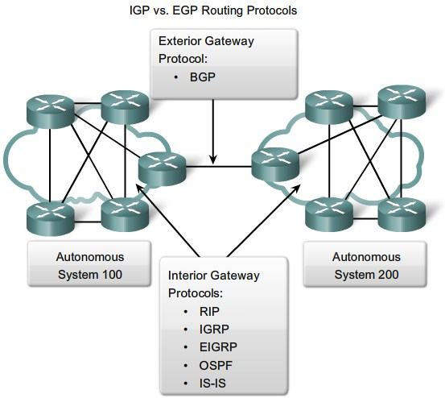
OSPF: IGP vs EGP

Slide 3
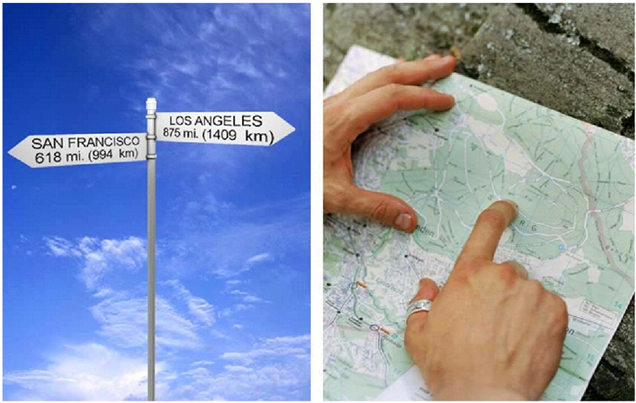
OSPF: Distance Vector vs Link State

Slide 4
Implementing OSPF
Configuring OSPF
OSPF Metric
  Load Balancing
  Redundancy
Neighbor Adjacencies
  Router-id
  OSPF Neighbor Timer
  OSPF Neighbor Condition
  OSPF Network-Type
    Point-to-Point
    Broadcast MutiAccess

Slide 5

OSPF: Administrative Distance
OSPF
AD 110
OSPF
EIGRP
10.0.0.0/8
AD 90
EIGRP

Slide 6
OSPF: Configure
172.16.1.1/24
192.168.12.0/24
.1
.2
172.16.2.1/24
R1
R2
f0/0
interface f0/0
ip ospf 1 area 0
172.16.3.1/24
R1(config)# router ospf 1
R1(config-router)# network 172.16.0.0 0.0.255.255 area 0
R1(config-router)# network 172.16.1.0 0.0.0.255 area 0
R1(config-router)# network 172.16.2.0 0.0.0.255 area 0
R1(config-router)# network 172.16.3.0 0.0.0.255 area 0
R1# show ip ospf interface brief
Interface PID Area IP Address/Mask Cost State Nbrs
F0/0 1 0 192.168.12.1/24 1 P2P 1/1
F0/1 1 0 172.16.1.1/24 1 P2P 0/0
F0/2 1 0 172.16.2.1/24 1 P2P 0/0
F0/3 1 0 172.16.3.1/24 1 P2P 0/0

Slide 7
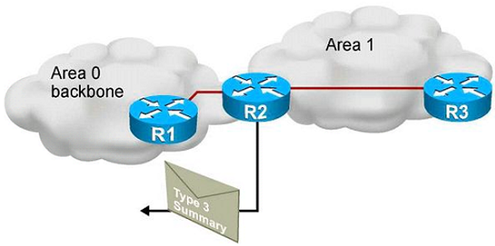
Link-State Routing Protocols
Topology
Area 0
Topology
Area 0 & 1
Topology
Area 1
Dijkstra
Short Path First

Slide 8

Advertise Default Route OSPF
R2(config)# ip route 0.0.0.0 0.0.0.0 f0/0
R2(config)# router ospf 1
R2(config-router)# default-information originate
DS1
0.0.0.0/0 via Core
0.0.0.0/0 via NAT
Core
NAT
ISP
f0/0
DS2
0.0.0.0/0 via Core
Notes:
Purpose: This figure presents the IGRP metric with its five possible components.
Emphasize : Bandwidth and delay are the two metrics that are most commonly used. They also comprise the default metric.
Note: Changing IGRP metrics can have great impact on network performance.
Describe the IGRP 24-bit metric field, as follows:
Bandwidth—Minimum bandwidth on the route, in kilobits per second.
Delay—Route delay, in tens of microseconds.
Reliability—Likelihood of successful packet transmission, expressed as an integer from 0 to 255.
Loading—Effective bandwidth of path.
MTU—Minimum MTU in path, expressed in bytes.
The following equation calculates the metric. It is presented for instructors and is not required to be taught:
metric = [k1 x bandwidth + (k2 x bandwidth) / (256 - load) + k3 x delay]
If k5 does not equal 0, an additional operation is done:
metric = metric x (k5/(reliability + k4))
The default constant values are k1 = k3 = 1 and k2 = k4 = k5 = 0.
Again, if default values are set, metric = bandwidth + delay.
The constants (k1, k2, k3) can be changed using the metric weights command. Changes to the IGRP constant values should be made with great care.

Slide 9
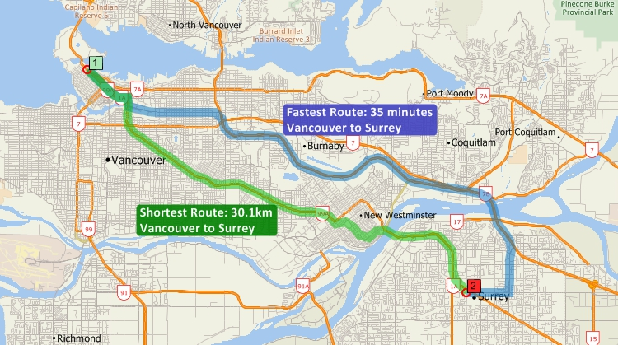
OSPF Metric

Slide 10
OSPF Metric: Load Balancing
R2
Metric
3
LAN
R3
R1
172.16.0.0/16
Metric
65

Slide 11
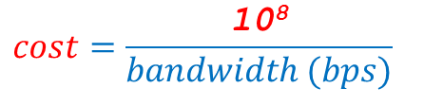
OSPF Metric: Load Balancing
R2# show ip ospf int f0/0
FastEthernet 0 is up, line protocol is up
Internet Address 10.0.1.1, Mask 255.255.255.0, Area 0.0.0.0
AS 1, Router ID 10.0.1.1, Network Type BROADCAST, Cost: 10
R2
R2(config)# interface f0/0
R2(config-if)# ip ospf cost 10
Cost 1
$$cost=\frac{\text{10}\text{8}}{bandwidth (bps)}$$
Metric
3
Cost 1
Cost 1
LAN
R3
R1
172.16.0.0/16
R3# show ip route
0 [110/3] 172.16.0.0/16 via 192.168.12.2 00:01:25 f0/0

Slide 12
OSPF: Router-ID
R(config)# router ospf 1
R(config-router)# router-id 0.0.0.2
R# clear ip ospf process
Router-ID 0.0.0.2
R2
172.16.0.0/16
Router-ID 0.0.0.1
172.16.0.0/16
Router-ID 0.0.0.1
R3
R1
172.16.0.0/16
Router-ID 0.0.0.3
172.16.0.0/16
Router-ID 0.0.0.1
Router-ID 0.0.0.1

Slide 13
Router-ID
Loopback2 172.16.0.2/32
Loopback1 172.16.0.1/32
f0/0
192.168.1.1/24
f0/1
192.168.2.1/24
RouterX# show ip ospf
Routing Process "ospf 50" with ID 10.64.0.2
<output omitted>

Slide 14

OSPF: LSU (Link State Update)
LSU 224.0.0.5
OSPF
Hello 10s
172.16.0.0/16
R1
R2
OSPF
224.0.0.5

Slide 15
OSPF: LSU (Link State Update)
OSPF
172.16.0.0/16
R1
192.168.12.1
R2
OSPF
Hello 10s
interface f0/0
ip ospf hello-interval 10
ip ospf dead-interval 40
R2# show ip route ospf
0 [110/2] 172.16.0.0/16 via 192.168.12.1 00:01:25 f0/0

Slide 16
OSPF: Neighbor Condition
router ospf 1
network 10.0.0.1 0.0.0.0 area 0
172.16.0.0/16
MTU
1500
10.0.0.1
/24
Optical
Converter
MTU
9000
10.0.0.2
/25
router ospf 1
network 10.0.0.2 0.0.0.0 area 1
Area
Subnet & Prefix-Length
Hello & Dead Timer
Authentication
MTU (Maxminum Transmition Unit)
Stub area flag
R# show ip ospf neighbor detail
ID Pri State Dead Time Address Interface
0.0.0.2 1 FULL/DR 0:00:31 10.0.0.2 F0/1

Slide 17

OSPF: Neighbor Condition (Authentication)
10 route + Password
R1
R2
172.16.0.0/16
MTU
1500
10.0.0.1
/24
MTU
9000
10.0.0.2
/25
100.000 route
PC1
Cain & Abel

Slide 18
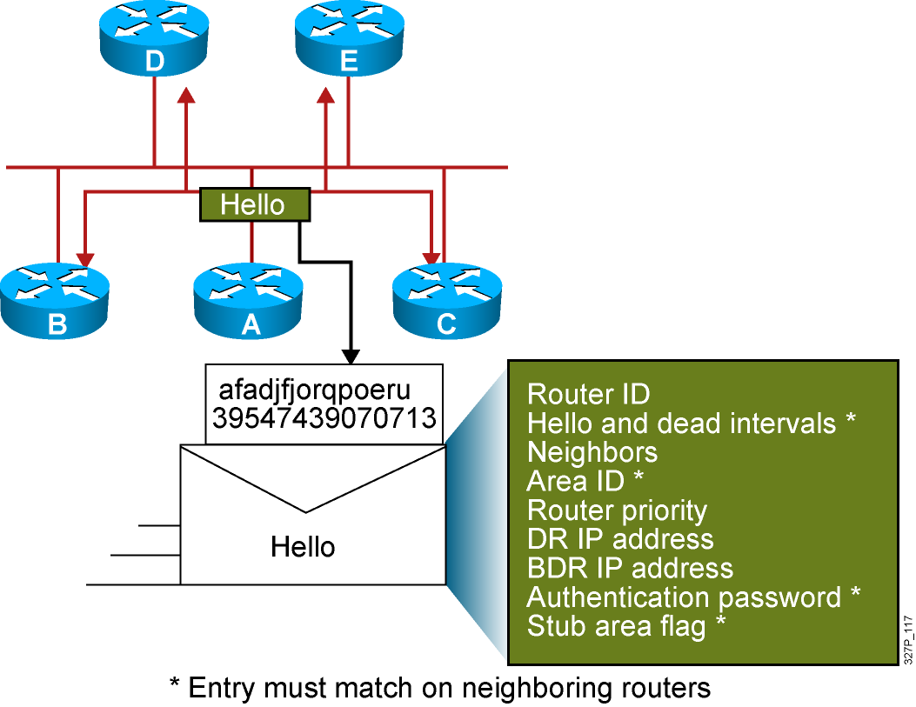
Neighbor Adjacencies: The Hello Packet

Slide 19
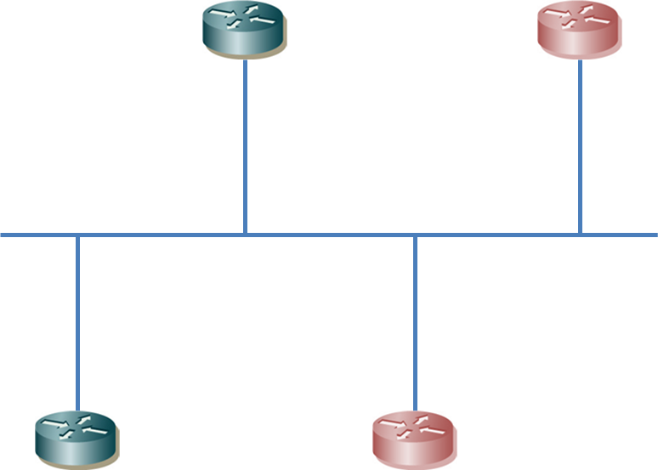

OSPF: Network Type (Point-to-Point vs Broadcast)
224.0.0.5
DROther
DROther
DR
DR
PPP/HDLC
Ethernet
Lease Line
224.0.0.6
224.0.0.5
DROther
DROther
BDR
LSU
Neighbor
DR& BDR Selection
Update LSDB
Neighbor
DR& BDR Selection
Update LSDB

Slide 20
OSPF: Network Type (Point-to-Point vs Broadcast)
DROther
DR
DR
PPP/HDLC
224.0.0.5
Lease Line
DROther
DROther
BDR
BDR
Neighbor
DR& BDR Selection
Update LSDB
Neighbor
DR& BDR Selection
Update LSDB

Slide 21
OSPF: Network Type (Point-to-Point vs Broadcast)
R1# show ip ospf interface f0/0
FastEthernet0/0 is up, line protocol is up
Internet Address 10.0.13.1/24, Area 0
Process ID 1, Router ID 0.0.0.1, Network Type BROADCAST, Cost: 1
Transmit Delay is 1 sec, State DR, Priority 100
Designated Router (ID) 0.0.0.1, Interface address 10.0.13.1
No backup designated router on this network
Timer intervals configured, Hello 10, Dead 40, Wait 40, Retransmit 5
…
R1#
R1# show ip ospf interface s1/0
Serial1/0 is up, line protocol is up
Internet Address 10.0.13.1/24, Area 0
Process ID 1, Router ID 0.0.0.1, Network Type POINT_TO_POINT, Cost: 64
Transmit Delay is 1 sec, State POINT_TO_POINT
Timer intervals configured, Hello 10, Dead 40, Wait 40, Retransmit 5
…
R1#

Slide 22
OSPF: Designated Router vs Backup DR
Router-ID
0.0.0.3
R3
DR
DROther
30
interface f0/0
ip ospf priority 10
BDR
F0/0
20
R1
R2
Router-ID
0.0.0.1
Router-ID
0.0.0.2
Priority 0, Router is always DROther

Slide 23
OSPF: Designated Router vs Backup DR
DR
Router-ID
0.0.0.3
R3
1
interface f0/0
ip ospf priority 1
F0/0
1
R1
R2
BDR
DROther
Router-ID
0.0.0.1
Router-ID
0.0.0.2
Priority 0, Router is always DROther

Slide 24
OSPF: Designated Router vs Backup DR
DR
Router-ID
0.0.0.3
R3
1
interface f0/0
ip ospf priority 1
BDR
DR
F0/0
1
R1
R2
BDR
DROther
Router-ID
0.0.0.1
Router-ID
0.0.0.2
Priority 0, Router is always DROther

Slide 25
OSPF: Designated Router vs Backup DR
DR
DROther
Router-ID
0.0.0.3
R3
30
interface f0/0
ip ospf priority 1
BDR
DR
F0/0
1
R1
R2
BDR
DROther
Router-ID
0.0.0.1
Router-ID
0.0.0.2
Router# clear ip ospf process
Router# clear ip ospf process
Priority 0, Router is always DROther

Slide 26
OSPF: Designated Router vs Backup DR
Router-ID
0.0.0.3
DR
R3
DROther
30
interface f0/0
ip ospf priority 0
BDR
F0/0
20
R1
R2
Router-ID
0.0.0.1
Router-ID
0.0.0.2
Priority 0, Router is always DROther

Slide 27
OSPF: Point-to-Point vs Broadcast
interface f0/0
ip ospf network-type point-to-point
172.16.0.0/16
10.0.0.0/16
BDR
Priority 200
DR
Priority 1
BDR
DR
f0/0
R1# show ip ospf interface f0/0
FastEthernet0/0 is up, line protocol is up
Internet Address 10.0.13.1/24, Area 0
Process ID 1, Router ID 0.0.0.1, Network Type BROADCAST, Cost: 1
Transmit Delay is 1 sec, State DR, Priority 100
…
R1#

Slide 28

OSPF: Verifying the OSPF Configuration
Router-id 0.0.0.4
DR
Full/DR
Full/BDR
DRother
f0/1
BDR
Router-id 0.0.0.3
2-Way/DROther
DRother
Router-id 0.0.0.2
DRother# show ip ospf neighbor
ID Pri State Dead Time Address Interface
0.0.0.4 200 FULL/DR 0:00:31 10.0.0.4 F0/1
0.0.0.3 100 FULL/BDR 0:00:33 10.0.0.3 F0/1
0.0.0.2 1 2-Way/DROTHER 0:00:33 10.0.0.2 F0/1

